Slide 1
UNIT-2: The Data Link Layer

Slide 2
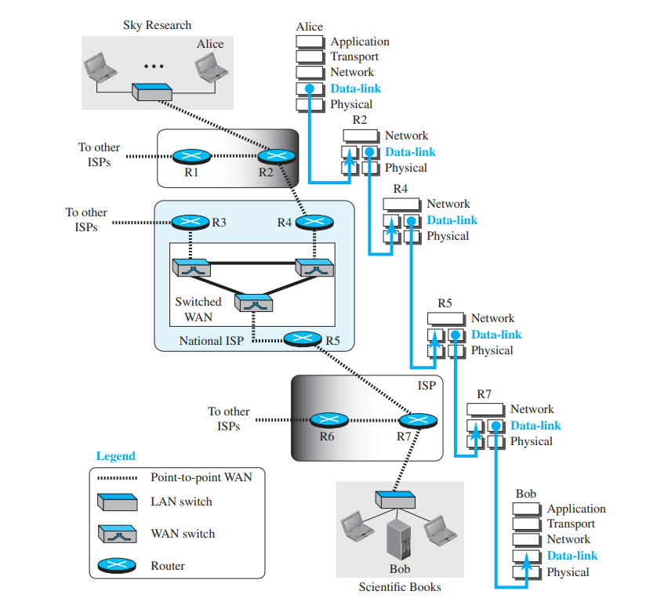
Communication at the data link layer

Slide 3
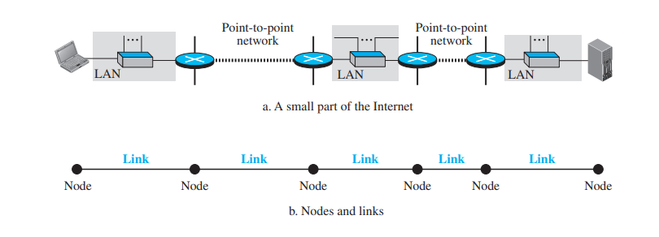
Nodes and Links

Slide 4
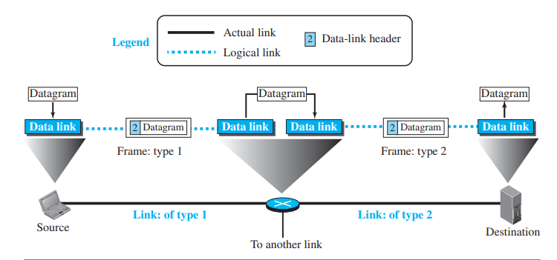
Services provided

Slide 5
Framing
Flow Control
Error Control
Congestion Control

Slide 6
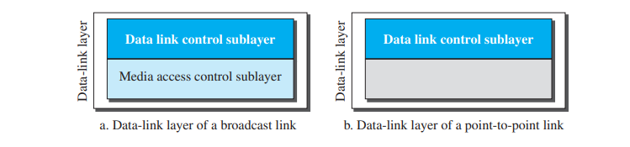
Two sub-layers
Data Link Control (DLC)
Medium Access Control (MAC)

Slide 7
Link Layer Addressing
IP addresses: They are network layer addresses that define the source and the destination in the network. But they cannot determine which links the packets have to travel to reach its destination.
Link Layer address (MAC address or physical address):When a datagram passes from the network layer to the data-link layer, the datagram will be encapsulated in a frame and two data-link addresses are added to the frame header. These two addresses are changed every time the frame moves from one link to another.

Slide 8
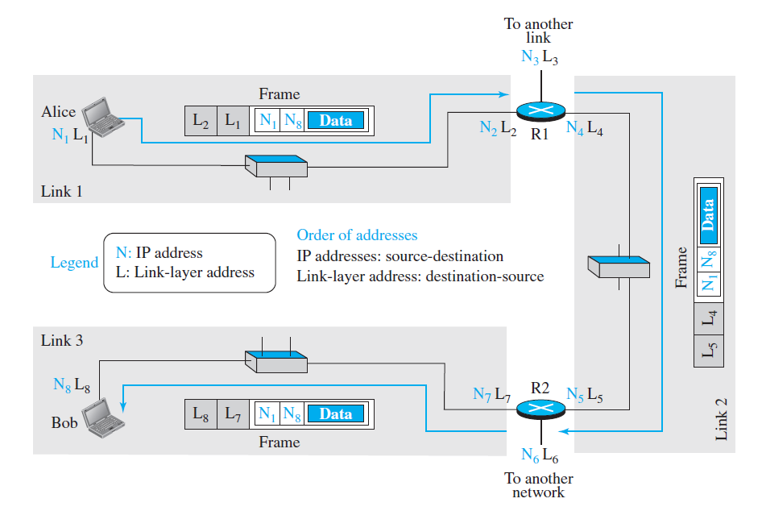

Slide 9
Three types of addresses
1. Unicast Address: Each host or each interface of a router is assigned a unicast address. Unicasting means one-to-one communication. A frame with a unicast address destination is destined only for one entity in the link.
The unicast link-layer addresses in the most common LAN, Ethernet, are 48 bits (six bytes) that are presented as 12 hexadecimal digits separated by colons. Ex:
A3:34:45:11:92:F1

Slide 10
2. Multicast Addresses: Multicasting means one-to-many
communication.
The multicast link-layer addresses in the most common LAN, Ethernet, are 48 bits (six bytes) that are presented as 12 hexadecimal digits separated by colons.
The second digit, however, needs to be an even number in hexadecimal.
Ex: A2:34:45:11:92:F1

Slide 11
3. Broadcast address: Broadcasting means one-to-all
communication. A frame with a destination broadcast address is sent to all entities in
the link.
The link layer broadcast address is all 1’s
FF:FF:FF:FF:FF:FF

Slide 12
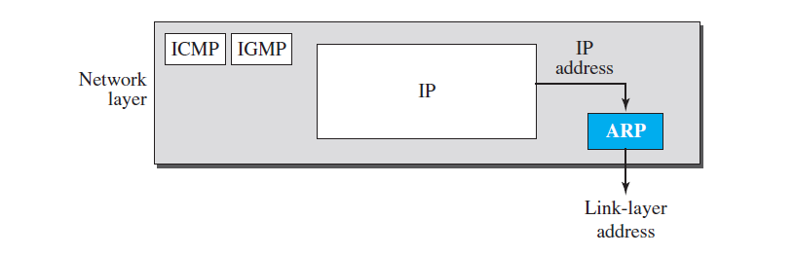
Address Resolution Protocol (ARP)
The source host knows the IP address and link layer address of itself. It also knows the IP address of the destination. But it does not know the link layer address of the receiver.
The ARP is used to find out the link layer address of a host, given its IP address.

Slide 13
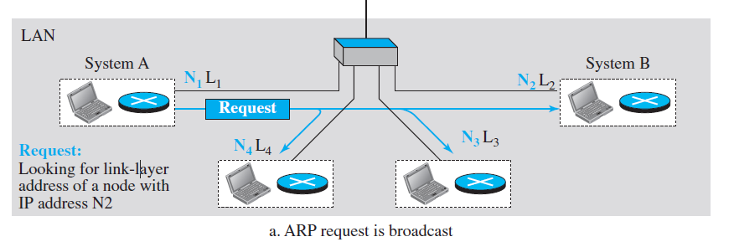
ARP Operation: Request

Slide 14
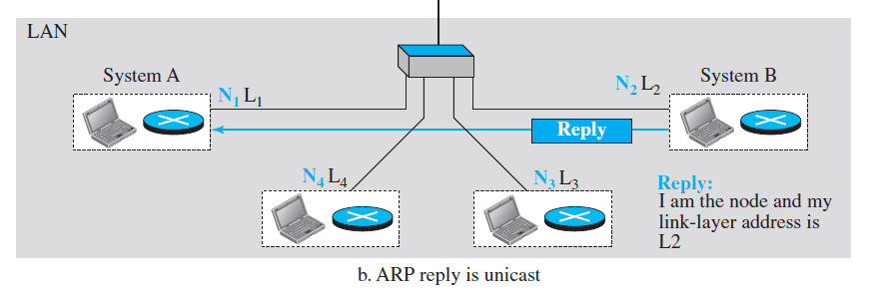
Response- Unicast

Slide 15
Caching

Slide 16
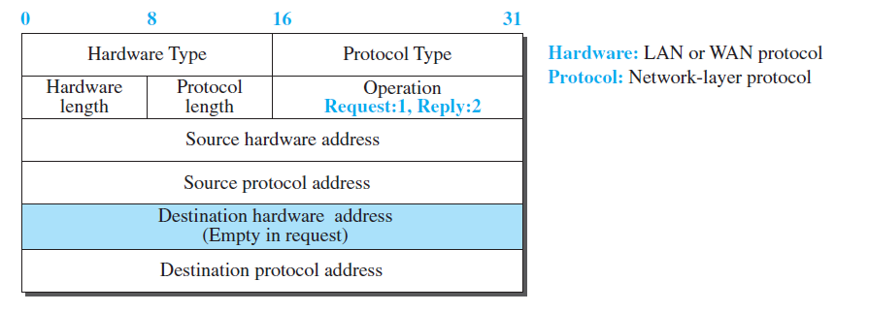
Packet Format

Slide 17
Hardware type − This field specifies the type of hardware used on the network, such as Ethernet.
Protocol type − This field specifies the type of protocol used on the network, such as IPv4.
Hardware address length − This field specifies the length of the hardware address, in bytes.
Protocol address length − This field specifies the length of the protocol address, in bytes.
Operation − This field specifies the type of ARP operation being performed, such as request or reply.
Sender hardware address − This field contains the hardware address of the sender of the packet.
Sender protocol address − This field contains the protocol address of the sender of the packet.
Target hardware address − This field contains the hardware address of the target of the packet.
Target protocol address − This field contains the protocol address of the target of the packet.

Slide 18
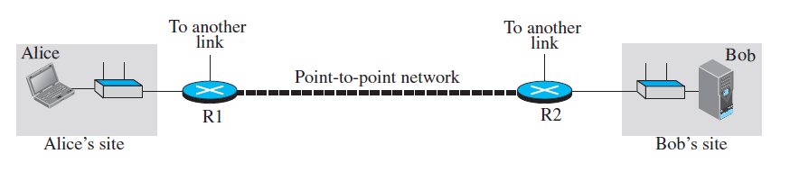
An Example of Communication

Slide 19
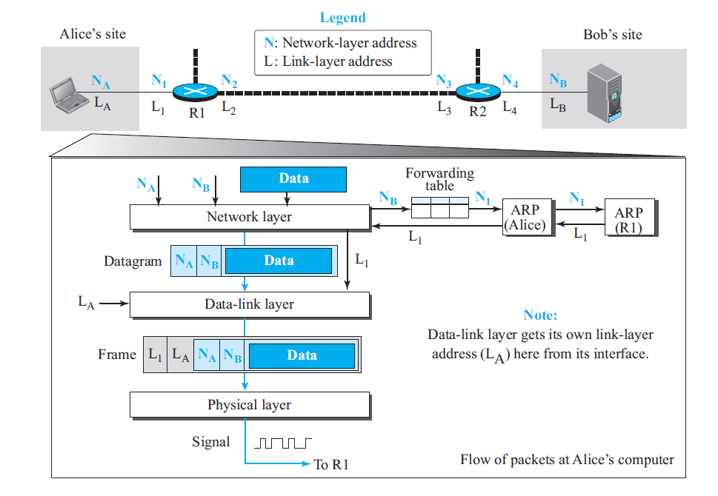
Activities at Alice’s Site

Slide 20
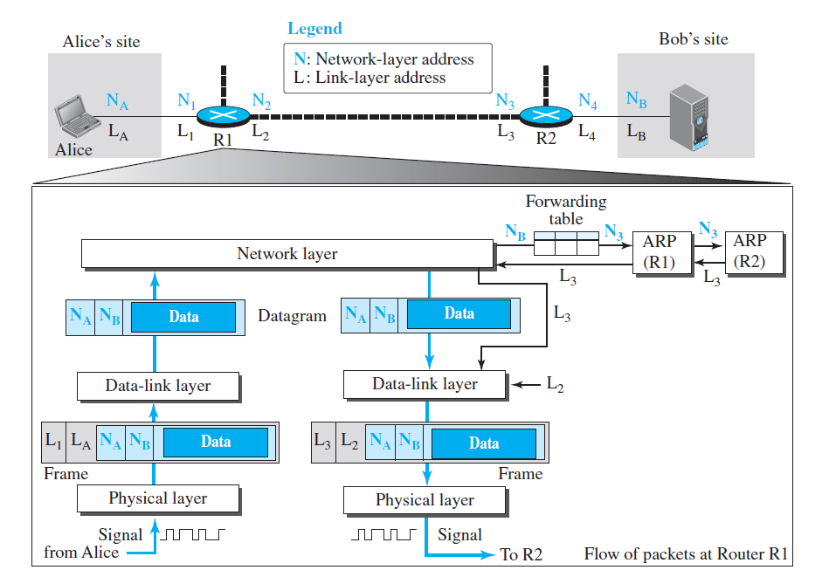
Activities at Router R1

Slide 21
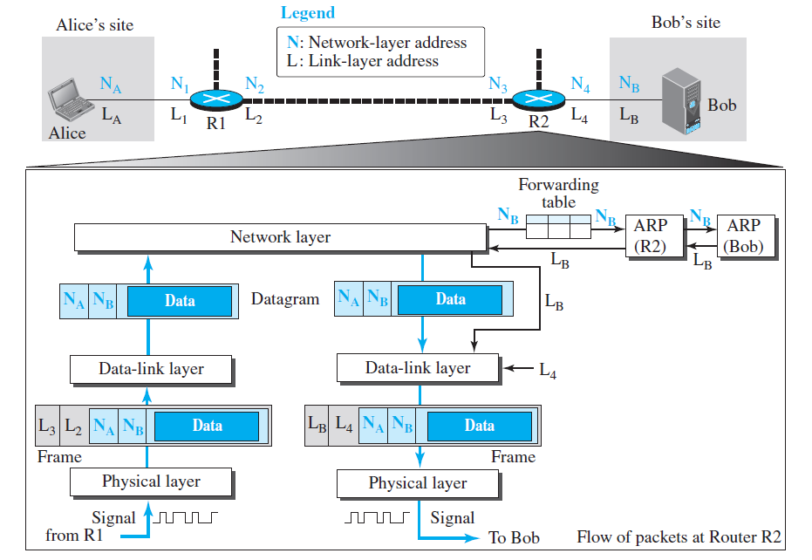
Activities at Router R2

Slide 22
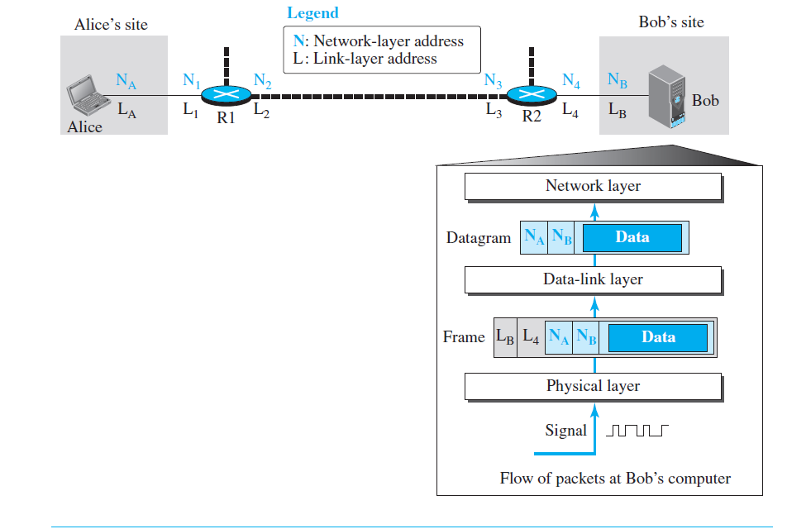

Slide 23

Chapter 10
Error Detection and Correction
Copyright © The McGraw-Hill Companies, Inc. Permission required for reproduction or display.

Slide 24

Note
Data can be corrupted during transmission.
Some applications require that errors be detected and corrected.

Slide 25
10-1 INTRODUCTION
Let us first discuss some issues related, directly or indirectly, to error detection and correction.
Topics discussed in this section:
Types of Errors Redundancy Detection Versus Correction Forward Error Correction Versus Retransmission Coding
Modular Arithmetic

Slide 26
Note
In a single-bit error, only 1 bit in the data unit has changed.

Slide 27
Types of Errors
Single Bit
Burst Error

Slide 28
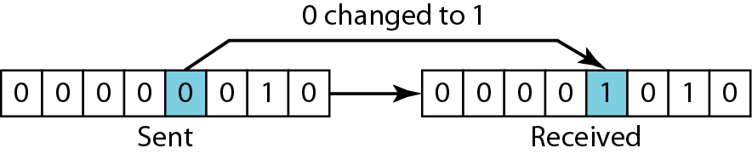
Figure 10.1 Single-bit error

Slide 29
Note
A burst error means that 2 or more bits in the data unit have changed.

Slide 30
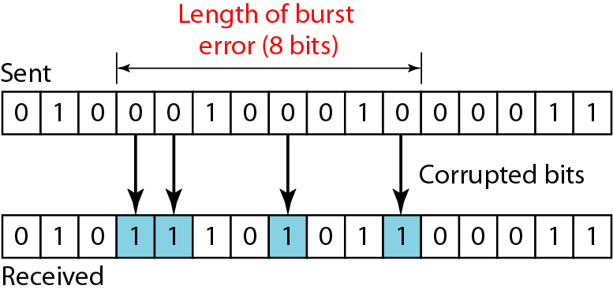
Figure 10.2 Burst error of length 8

Slide 31
Note
To detect or correct errors, we need to send extra (redundant) bits with data.
This is called Redundant Bit.

Slide 32
Detection versus Correction
The correction of errors is more difficult than the detection.
In detection, only check is made if error is present? Answer is simple, yes or no.
In correction, once the check is made and error is detected, it also locates the error. Answer is additional information of location of error to perform correction.

Slide 33
Coding
Redundancy is achieved through various coding schemes.
We can divide coding schemes into two broad categories: block coding and convolution coding.
The receiver can detect error/ a change in the original codeword, if it follows these two conditions: 1. The receiver has (or can find) a list of valid codewords. 2. The original codeword has changed to an invalid one

Slide 34
10-2 BLOCK CODING
In block coding, we divide our message into blocks, each of k bits, called datawords. We add r redundant bits to each block to make the length n = k + r. The resulting n-bit blocks are called codewords.
Topics discussed in this section:
Error Detection Error Correction Hamming Distance
Minimum Hamming Distance

Slide 35
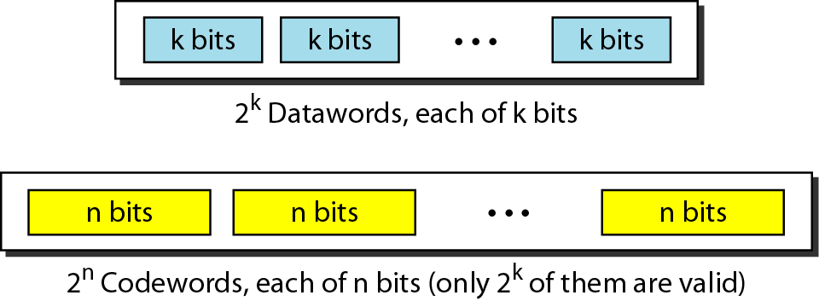
Figure 10.5 Datawords and codewords in block coding

Slide 36
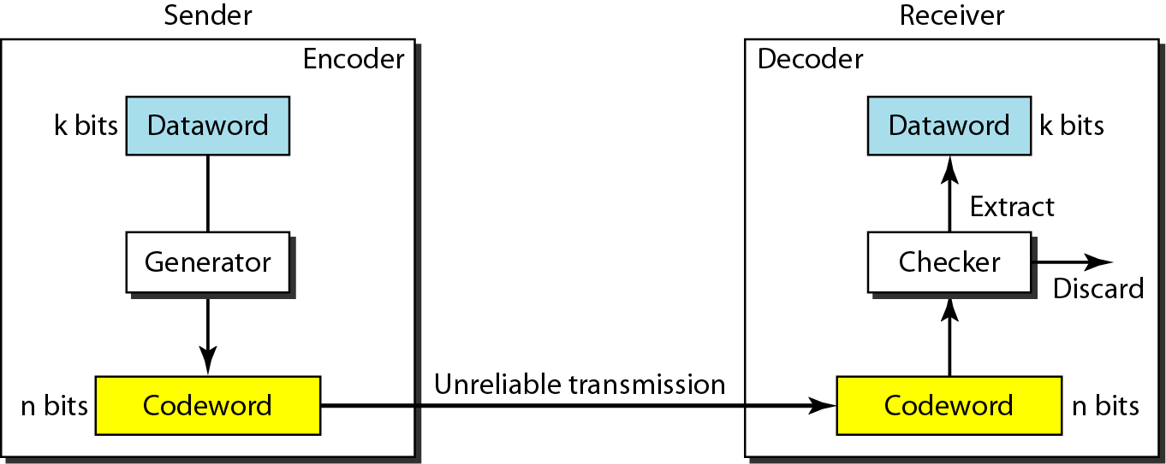
Figure 10.6 Process of error detection in block coding

Slide 37
Example 10.2
Let us assume that k = 2 and n = 3. Table 10.1 shows the list of datawords and codewords. Later, we will see how to derive a codeword from a dataword.
Assume the sender encodes the dataword 01 as 011 and
sends it to the receiver. Consider the following cases:
1. The receiver receives 011. It is a valid codeword. The receiver extracts the dataword 01 from it.

Slide 38
Example 10.2 (continued)
2. The codeword is corrupted during transmission, and 111 is received. This is not a valid codeword and is discarded.
3. The codeword is corrupted during transmission, and 000 is received. This is a valid codeword. The receiver incorrectly extracts the dataword 00. Two corrupted bits have made the error undetectable.

Slide 39
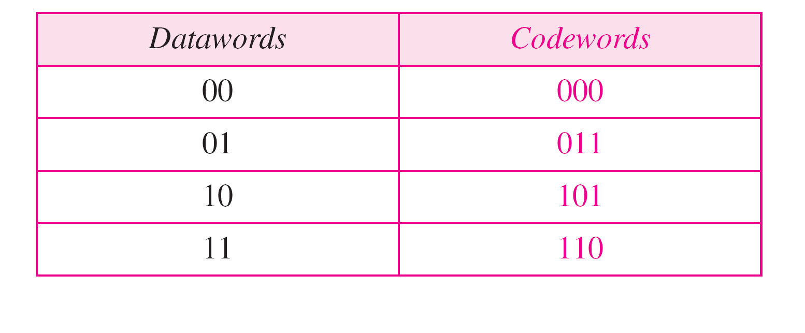
Table 10.1 A code for error detection (Example 10.2)

Slide 40
Note
An error-detecting code can detect only the types of errors for which it is designed; other types of errors may remain undetected.

Slide 41
Hamming distance
Note
The Hamming distance between two words is the number of differences between corresponding bits.

Slide 42

Example 10.4
Let us find the Hamming distance between two pairs of words.
1. The Hamming distance d(000, 011) is 2 because
2. The Hamming distance d(10101, 11110) is 3 because

Slide 43
Note
The minimum Hamming distance is the smallest Hamming distance between all possible pairs in a set of words.

Slide 44
Example 10.5
Find the minimum Hamming distance of the coding scheme in Table 10.1.
Solution
We first find all Hamming distances.
The d_{min} in this case is 2.

Slide 45
Note
To guarantee the detection of up to s errors in all cases, the minimum
Hamming distance in a block code must be d_{min} = s + 1.

Slide 46
10-3 LINEAR BLOCK CODES
Almost all block codes used today belong to a subset called linear block codes. A linear block code is a code in which the exclusive OR (addition modulo-2) of two valid codewords creates another valid codeword.
Topics discussed in this section:
Minimum Distance for Linear Block Codes Some Linear Block Codes

Slide 47
Note
In a linear block code, the exclusive OR (XOR) of any two valid codewords creates another valid codeword.
The minimum hamming distance for linear block code is the number of 1’s in a non-zero valid codeword with smallest number of 1’s.

Slide 48
Parity Check Code
It is a linear block code where a k-bit dataword is changed to n=k+1 bit codeword.
There is a single redundant bit called parity bit.
A parity bit is added to make sure that the codeword has even number of 1’s.
Also called as even parity.
This code can only detect single bit errors.

Slide 49
Note
A simple parity-check code is a single-bit error-detecting code in which n = k + 1 with d_{min} = 2.

Slide 50
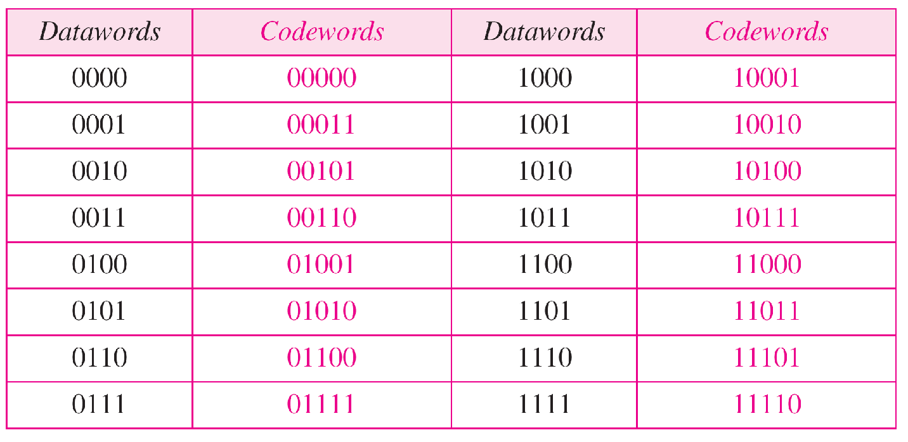
Table 10.3 Simple parity-check code C(5, 4)

Slide 51
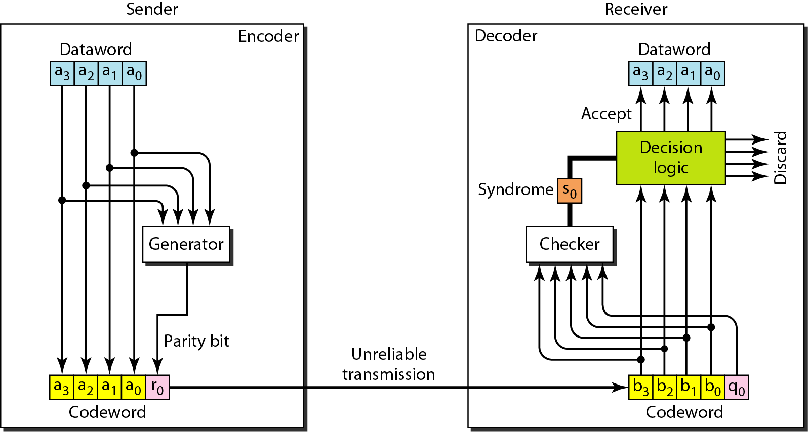
Figure 10.10 Encoder and decoder for simple parity-check code

Slide 52
The parity bit is generated using the modulo-2 arithmetic
r= a0+a1+a2+a3 (modulo-2)
If the number of 1’s is even, the result is 0 and if odd, the result is 1.
The receiver does the same calculation.
s0= a0+a1+a2+a3+r0 (modulo-2)
s0 is called the syndrome bit.
The syndrome is passed to the decision logic.
If syndrome is 0, there is no error. Otherwise, there is an error.

Slide 53
Example 10.12
Let us look at some transmission scenarios. Assume the sender sends the dataword 1011. The codeword created from this dataword is 10111, which is sent to the receiver. We examine five cases:
1. No error occurs; the received codeword is 10111. The syndrome is 0. The dataword 1011 is created.
2. One single-bit error changes a₁ . The received codeword is 10011. The syndrome is 1. No dataword is created.
3. One single-bit error changes r₀ . The received codeword is 10110. The syndrome is 1. No dataword is created.

Slide 54
Example 10.12 (continued)
4. An error changes r₀ and a second error changes a₃ .
The received codeword is 00110. The syndrome is 0. The dataword 0011 is created at the receiver. Note that
here the dataword is wrongly created due to the
syndrome value.
5. Three bits—a₃, a₂, and a₁—are changed by errors. The received codeword is 01011. The syndrome is 1. The dataword is not created. This shows that the simple parity check, guaranteed to detect one single error, can also find any odd number of errors.

Slide 55
Note
A simple parity-check code can detect an odd number of errors.

Slide 56
10-5 CHECKSUM
The checksum is used in the Internet by several protocols although not at the data link layer.
It is an error detecting technique that can be applied to a message of any length.
Topics discussed in this section:
Idea One’s Complement Internet Checksum

Slide 57
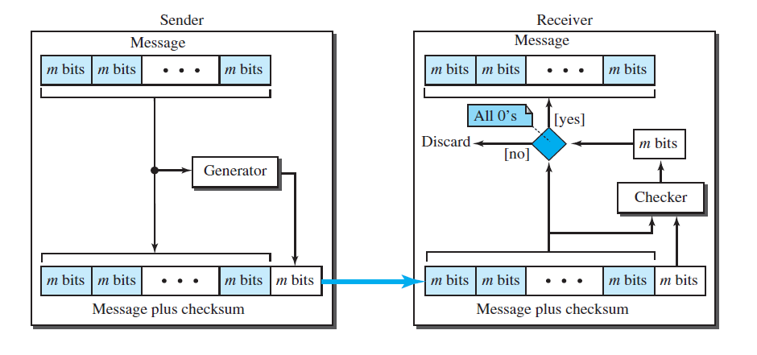
How Checksum works?

Slide 58
Example 10.18
Suppose our data is a list of five 4-bit numbers that we want to send to a destination. In addition to sending these numbers, we send the sum of the numbers. For example, if the set of numbers is (7, 11, 12, 0, 6), we send (7, 11, 12, 0, 6, 36), where 36 is the sum of the original numbers. The receiver adds the five numbers and compares the result with the sum. If the two are the same, the receiver assumes no error, accepts the five numbers, and discards the sum. Otherwise, there is an error somewhere and the data are not accepted.

Slide 59
Example 10.19
We can make the job of the receiver easier if we send the negative (complement) of the sum, called the checksum. In this case, we send (7, 11, 12, 0, 6, −36). The receiver can add all the numbers received (including the checksum). If the result is 0, it assumes no error; otherwise, there is an error.

Slide 60
Internet Checksum
Note
Sender site:
1. The message is divided into 16-bit words.
2. The value of the checksum word is set to 0.
3. All words including the checksum are added using one’s complement addition.
4. The sum is complemented and becomes the checksum.
5. The checksum is sent with the data.

Slide 61
Note
Receiver site:
1. The message (including checksum) is divided into 16-bit words.
2. All words are added using one’s complement addition.
3. The sum is complemented and becomes the new checksum.
4. If the value of checksum is 0, the message is accepted; otherwise, it is rejected.

Slide 62
Example 10.23
Let us calculate the checksum for a text of 8 characters (“Forouzan”). The text needs to be divided into 2-byte (16-bit) words. We use ASCII (see Appendix A) to change each byte to a 2-digit hexadecimal number. For example, F is represented as 0x46 and o is represented as 0x6F. Figure 10.25 shows how the checksum is calculated at the sender and receiver sites. In part a of the figure, the value of partial sum for the first column is 0x36. We keep the rightmost digit (6) and insert the leftmost digit (3) as the carry in the second column. The process is repeated for each column. Note that if there is any corruption, the checksum recalculated by the receiver is not all 0s. We leave this an exercise.
10.

Slide 63
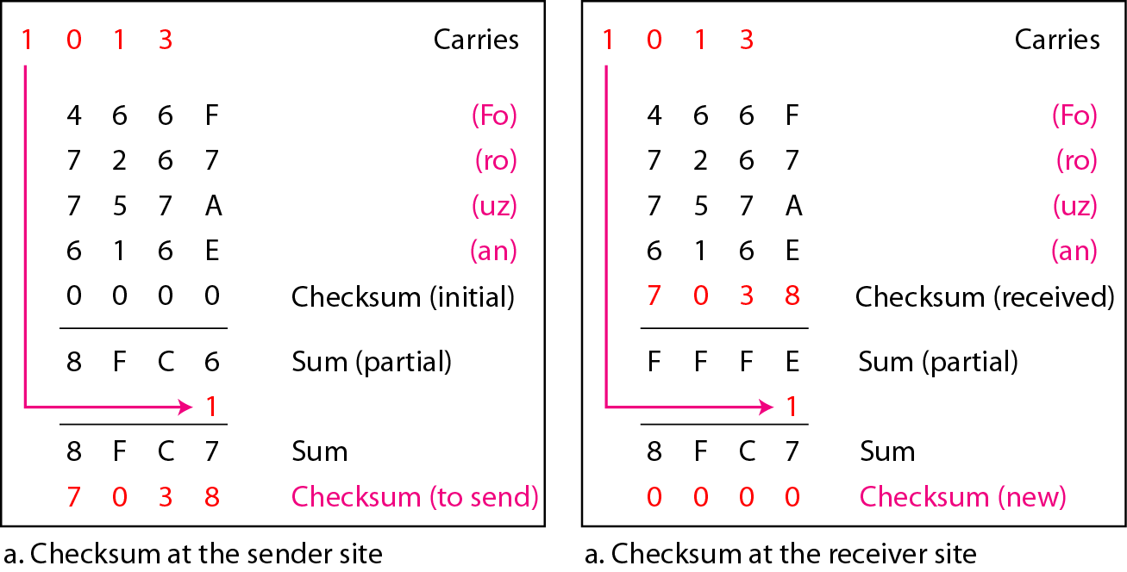
Figure 10.25 Example 10.23
F
F
Note : F + F + A + E + 0 -> 15+15+10+14=54 54/16 Quo-> 3 (carry), Re-6

Slide 64
