Slide 1
§
MACHINE LEARNING MINI-PROJECT 5 · UE24CS352A
Classification of
Legal Text
Predicting the issue area of US Supreme Court opinions
Team C-26 · Section AIML-C
Kshitij Satish Shetty (PES1UG24AM143) | Kushal G (PES1UG24AM145)
Notes:
TALK TRACK: Introduce the team and the one-line problem: automatically labeling the legal topic of Supreme Court opinions. Likely questions: Why this task? Because hand cataloguing is slow and a reliable classifier helps legal search.

Slide 2
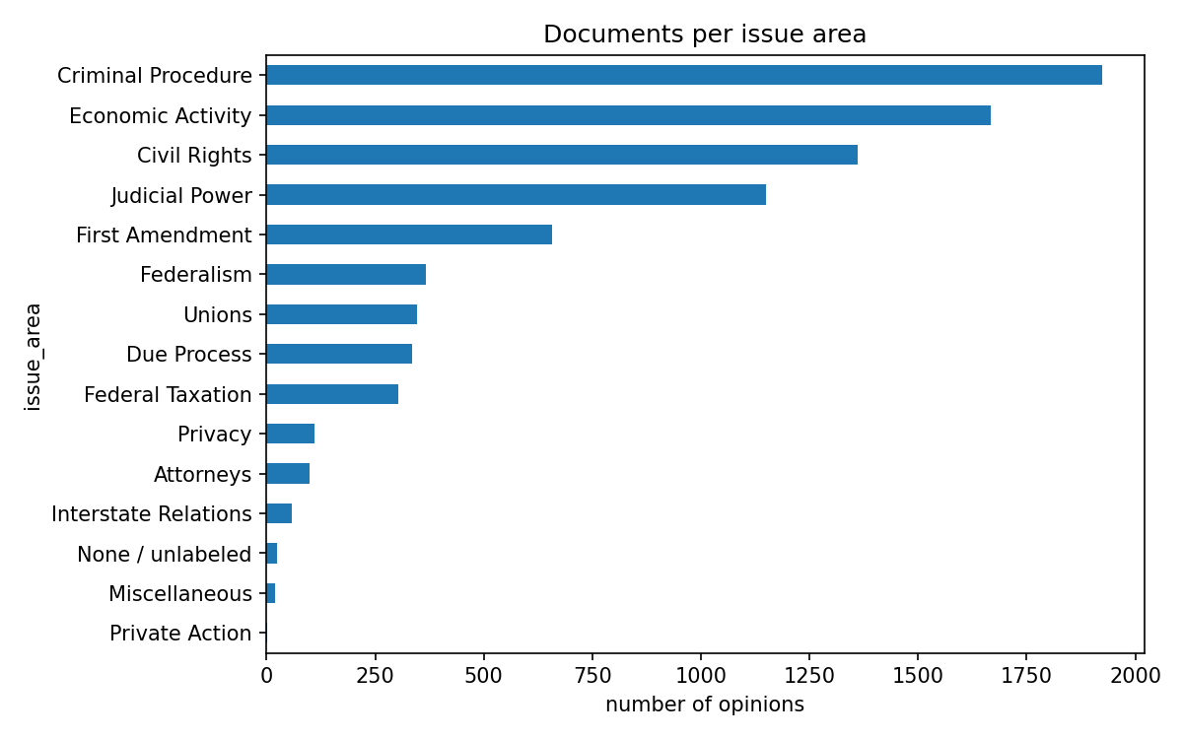
§ 01
THE PROBLEM
A long, imbalanced legal text problem
Given an opinion's text, predict its legal topic (e.g. Criminal Procedure, Civil Rights, Federal Taxation).
8,328
documents, 13 classes · after cleaning 8,419 opinions (1946–2016)
~5,550
words, median length · first 30,000 characters used
5,829 / 1,249 / 1,250
train / val / test · stratified split
Documents per issue area, before cleaning. Criminal Procedure 1,924; Miscellaneous 19.
Task: predict the issue area (legal topic) of an opinion from its text. Data: Supreme Court Database via textacy, expert labels.
Notes:
TALK TRACK: We predict the legal topic of a Supreme Court opinion from its text. Two things make it hard: opinions are very long and the classes are very uneven (1,924 Criminal Procedure vs 19 Miscellaneous). Cleaning removed 91 rows (short, unlabeled, duplicate, and the one-document class Private Action). | : the documents are long, and the classes are imbalanced, so we select models on macro-F1 and use balanced class weights. Private Action had one document and was dropped.

Slide 3
§ 02
CONTEXT
What the paper did, and what we added
We re-ran the paper's two models on a fair split, then added stronger models and extra checks.
Iyer, CS229 2020
Our project
THE REFERENCE PAPER
WHAT WE ADDED
1
LDA topics + Logistic Regression (baseline)
1
Both paper models, re-run on a leak-free split
2
Doc2Vec + Logistic Regression (best)
2
TF-IDF + linear models, chosen on validation
3
BERT: ran out of memory
3
Cross-validation, error analysis, fine-grained task
4
Doc2Vec similarity search (Roe v. Wade)
4
Streamlit demo with word-level explanations
The paper reports accuracy on 15 issue areas (about 0.47 for LDA, 0.63 for Doc2Vec); we use 13 after cleaning, so comparisons are indicative only. Its ordering, Doc2Vec above LDA, is reproduced.
Notes:
TALK TRACK: The reference is Iyer, CS229 2020. We re-ran its two models and added a stronger baseline, validation-based selection, cross-validation, error analysis and a demo. | : the paper uses 15 classes and a different split, so we compare trends, not exact numbers. The paper Table 1 column headings are swapped, so we read the figures from its text: about 0.47 for LDA+LR and 0.63 for Doc2Vec+LR on 15 issue areas.

Slide 4
§ 03
METHOD
Approach: split first, then fit anything
A leak-proof pipeline: nothing learns from validation or test data before the final check.
1
2
3
4
5
Clean
Split
Features
Models
Evaluate
Drop short, unlabeled, duplicate texts
70 / 15 / 15, stratified, seed 42
TF-IDF, LDA topics, Doc2Vec; fit on train only
Majority, LogReg, Linear SVM, NB, paper models
Pick on validation macro-F1; test used once
LEAKAGE CHECKS
0
0.167
1×
identical texts shared by two splits
validation accuracy with shuffled labels, below the 0.231 majority rate
test set used, after the model was chosen
Notes:
TALK TRACK: Split first, then fit. Three checks: no identical text in two splits, a shuffled-label test scores 0.167 (below the 0.231 majority rate), and the test set is used once. | : the vectorizer, LDA and Doc2Vec are all fitted on the training split only. The shuffled-label test scored below the majority-class rate, so the features alone do not reveal the label.

Slide 5
§ 04
RESULTS
A simple supervised model wins
Simple word-weight features with a Linear SVM beat the topic and embedding models.
0.82
test accuracy of TF-IDF + Linear SVM (C=0.5)
0.77
macro-F1 (every class counts equally), against 0.03 for the majority baseline
Notes:
TALK TRACK: Read the chart left to right: majority baseline, then the paper models, then ours. Macro-F1 averages the score over all 13 classes so small classes matter as much as big ones. | macro-F1 (Linear SVM C=0.5: validation accuracy 0.7958, macro-F1 0.7322). Other validation results: Logistic Regression C=10 0.7846 / 0.7107, best Complement NB 0.7222 / 0.5725. LDA and Doc2Vec lose label-specific information that supervised word weights keep.

Slide 6
§ 05
ROBUSTNESS
The result holds up under extra checks
Three extra checks agree: the 0.82 result is not a lucky split.
5-FOLD CROSS-VALIDATION
FINE-GRAINED TASK
SINGLE SPLIT VS SPREAD
0.808 ± 0.020
0.707
0.818
accuracy
accuracy on 141 issue codes
test accuracy, one split
macro-F1 0.746 ± 0.027; TF-IDF re-fitted inside each fold
macro-F1 0.656; top-5 accuracy 0.931 (right code in top 5 guesses); majority code only 0.032
inside the cross-validation range, so not a lucky split
Notes:
TALK TRACK: Cross-validation 0.808 ± 0.020 brackets our single test score of 0.818. The fine-grained task has 141 issue codes, so 0.707 is strong, and top-5 accuracy is 0.931. | : only issue codes with at least 15 opinions are kept (141 codes, 7,434 opinions, 80/20 split), so it is not the same as the paper's 279-code experiment. Cross-validation uses train + validation only; the test set is untouched.

Slide 7
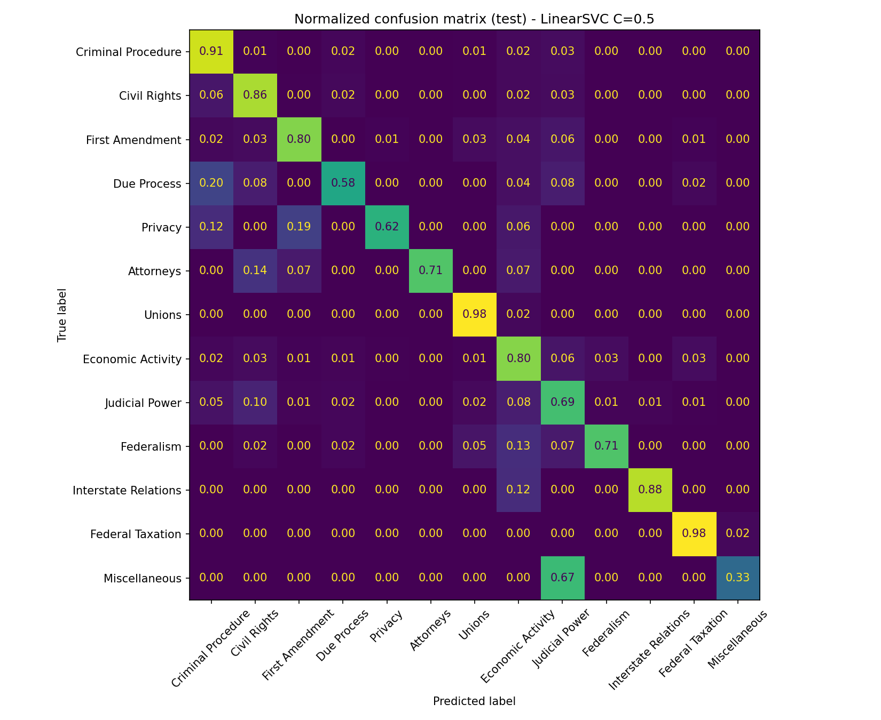
§ 06
ERROR ANALYSIS
Errors fall between neighbouring legal areas
Most of the 228 mistakes (out of 1,250 test opinions) are between legally adjacent areas.
Strongest
Criminal Procedure F1 0.89, Federal Taxation 0.88, Unions 0.86, Civil Rights and First Amendment 0.84
Weakest
Miscellaneous 0.40 (3 test documents), Due Process 0.61, Judicial Power 0.70, Privacy 0.71
Errors
228 of 1,250 test opinions; Judicial Power to Civil Rights (16), Economic Activity and Judicial Power (14 each way)
Caveat
some top words are case names (bruton, garmon, chadha), so the model partly leans on case-specific vocabulary
Normalized confusion matrix, test set
Notes:
TALK TRACK: Point at the diagonal of the matrix: bright cells are correct. Off-diagonal errors sit between neighbours such as Judicial Power and Civil Rights. Small classes make per-class scores noisy. | areas that legally overlap. Small classes (3 to 16 test documents) make per-class scores noisy.

Slide 8
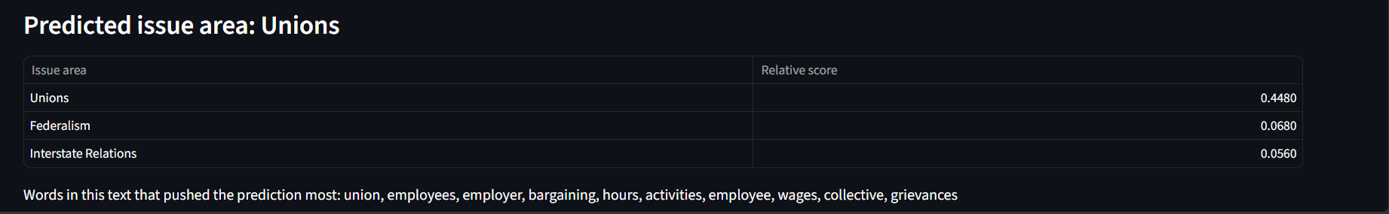
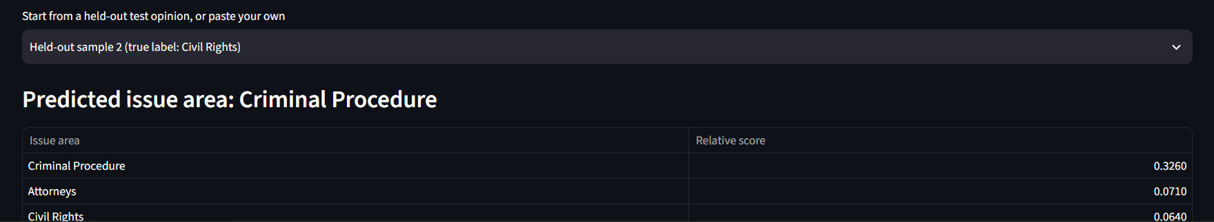
§ 07
LIVE DEMO
Streamlit demo: one hit, one miss
Paste an opinion, get the top 3 issue areas and the words that drove the prediction.
HIT
Why the miss
It is a right-to-counsel trial: its vocabulary (trial, jury, counsel) points to Criminal Procedure
Labor-contract clause: predicted Unions (score 0.448, runner-up 0.068).
Why it explains itself
A linear model gives every word a weight per class, so the app can list the words that drove a prediction
MISS
Read scores with care
Scores are a softmax of SVM margins: they rank classes, they are not calibrated probabilities
Held-out sample 2 (true label Civil Rights): predicted Criminal Procedure (0.326, runner-up Attorneys 0.071).
Notes:
TALK TRACK: Hit first (labor clause, Unions), then the miss (sample 2, true label Civil Rights, predicted Criminal Procedure because of words like trial, jury, counsel). Scores rank classes; they are not probabilities. | from the laptop: python -m streamlit run app.py. Show a held-out sample that is correct and then sample 2, which is a known error, and explain it as an adjacent-area confusion (see the error-analysis slide).

Slide 9
§ 08
SIMILARITY SEARCH
Finding related opinions: Roe v. Wade (1973)
Which past opinions read most like Roe v. Wade? A higher score means more alike (max 1).
TF-IDF cosine similarity
Doc2Vec cosine similarity
Opinion | Year | Issue area | Sim.
Doe v. Bolton | 1973 | Privacy | 0.404
Planned Parenthood v. Danforth | 1976 | Privacy | 0.338
Connecticut v. Menillo | 1975 | Privacy | 0.302
City of Akron v. Akron Center | 1983 | Privacy | 0.285
Singleton v. (Bureau of Medical Services) | 1976 | Judicial Power | 0.284
Opinion | Year | Issue area | Sim.
Doe v. Bolton | 1973 | Privacy | 0.718
Poe v. Ullman | 1961 | Judicial Power | 0.643
Planned Parenthood v. Danforth | 1976 | Privacy | 0.627
Bowers v. Hardwick | 1986 | Privacy | 0.601
H. L. v. Matheson | 1981 | Privacy | 0.593
Roe v. Wade is labeled Privacy. Doe v. Bolton and Planned Parenthood v. Danforth appear in both lists, as in the reference report's similarity search.
Notes:
TALK TRACK: Roe v. Wade is labeled Privacy, and most neighbours are Privacy cases. Doe v. Bolton and Planned Parenthood v. Danforth appear in both lists. Doc2Vec shows no-label similarity, TF-IDF shows shared wording. | on training data only and are used here just to transform the opinions. This reproduces the paper's Roe v. Wade search idea with our own pipeline. Case names are shortened from the dataset titles.

Slide 10
§
Conclusions and next steps
WHAT WE FOUND
LIMITATIONS AND NEXT STEPS
1
TF-IDF + Linear SVM: 0.82 test accuracy, 0.77 macro-F1, trained in about 3 seconds on CPU
1
Tiny classes (3 to 16 test documents) make per-class scores noisy
2
It beats the paper's two model types (LDA 0.58, Doc2Vec 0.67 on our split)
2
First 30,000 characters and single words only; some case-name words
3
Cross-validation (0.808 ± 0.020) confirms the result
3
Next: word pairs, a time-based split, Longformer or Legal-BERT on a GPU
github.com/KshitijShetty27/Legal-Text-Classification_ML_Mini_Project
Notes:
TALK TRACK: Finding: a simple supervised model wins at 0.82 accuracy and 0.77 macro-F1, trains in about 3 seconds on CPU and is explainable. Unsupervised features lose label information. Be honest about limits: single test split, tiny classes, single words only, case names. Next: word pairs, time-based split, Longformer or Legal-BERT.

Slide 11
§ A
BACKUP
Quick glossary
If a term comes up in questions, here is the plain-English version.
Issue area
TF-IDF
Linear SVM
The legal topic label given by expert coders in the Supreme Court Database. We predict one of 13.
Scores each word by how often it appears in an opinion and how rare it is across all opinions.
A classifier that gives every word a weight per class, so predictions can be explained by words.
Macro-F1
Data leakage
LDA / Doc2Vec
F1 score averaged over classes, so small classes count as much as large ones.
Information from validation or test data sneaking into training. We split first and fit only on training data.
Unsupervised ways to summarise a document: 25 topic proportions (LDA) or a 100-number vector (Doc2Vec). Used in the paper.
Notes:
BACKUP SLIDE: not for the main talk. Possible questions. Why macro-F1? Classes are imbalanced. Why not BERT? The paper's BERT ran out of memory and we trained on CPU only; Longformer or Legal-BERT on a GPU is a next step. Is 0.82 reliable? Cross-validation gives 0.808 ± 0.020. Why do case names appear as top words? Some names repeat within a topic, so the model partly leans on case-specific vocabulary, listed as a limitation.

