Slide 1
Image To Pixel Art Converter
Using Linear Algebra Concepts
Presented by : Kshitij Satish Shetty - PES1UG24AM143
: Mallikarjuna Rao RV - PES1UG24AM155
: Mounik Manohar - PES1UG24AM168

Slide 2

Objective
Convert a high-resolution image into a pixel-art style image
Reduce image complexity by lowering resolution and number of colors
Represent image data using matrices and vectors
Demonstrate practical application of Linear Algebra in image processing

Slide 3
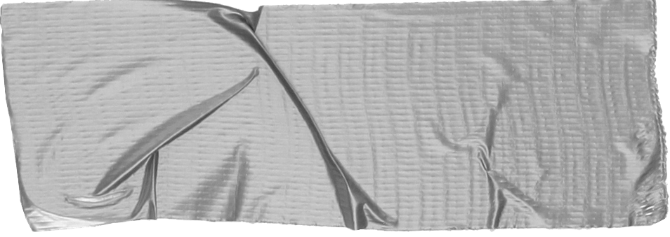

Methodology
LAA Concepts Used
Image represented as matrix (m x n x 3)
Each pixel treated as RGB vector [R,G,B]
Downsample image (e.g., 64×64) to reduce detail
Apply K-means to cluster similar colors
Replace pixels with cluster centroids
Upscale using nearest-neighbor for pixel effect
Matrix & vector representation
Euclidean distance
Vector clustering (K-means)
Matrix transformation & reconstruction

Slide 4
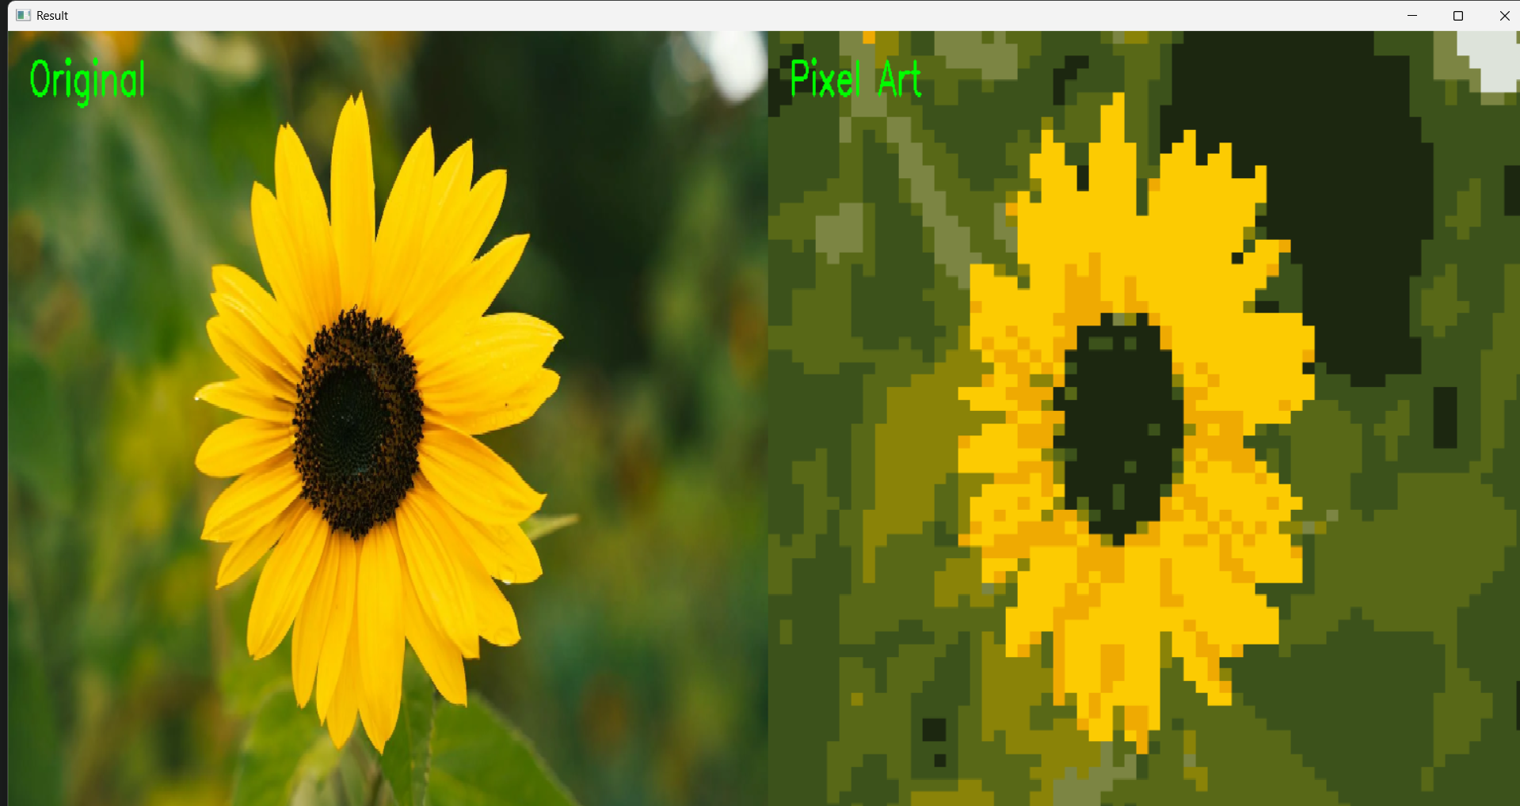
Output
Results & Observations
Original and processed images displayed side-by-side
Number of colors reduced significantly (e.g., from thousands to 8)
Output image appears blocky, resembling pixel art
Higher K → more detail retained
Lower K → stronger pixel-art effect
Downsampling + color reduction creates stylized output
Applications
Game design and retro graphics
Image compression
Digital art and stylization

