Slide 1
Electricity Demand Forecasting for Ontario
Problem & Research Question -Kshitij
Problem
Electricity demand varies over time due to factors such as weather, population, and seasonal patterns.
Accurate demand forecasting can support electricity planning and resource management.
Objective
Develop machine-learning models to forecast Ontario electricity demand.
Compare the predictive performance of different machine-learning algorithms.
Research Question:
Can Random Forest Regression provide more accurate one-hour-ahead Ontario electricity-demand forecasts than Linear Regression using previous hour's electricity demand, temperature, and population?

Slide 2
How the data grid works in Ontario
Ontario Electricity Context -Kshitij

Slide 3
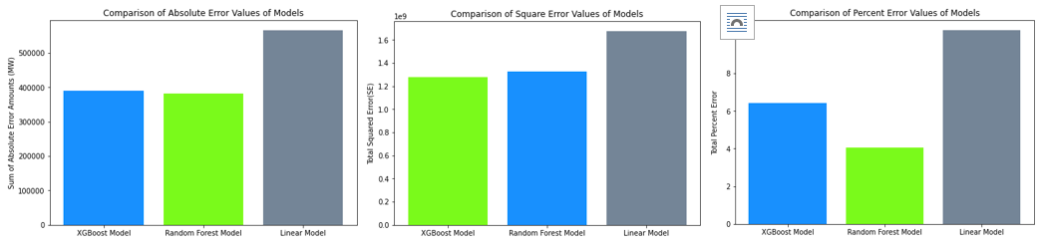
State of the Art — Gökçe & Duman (2022) -VIctor
Objective
Forecast short-term(hourly) electricity demand and compare different machine-learning algorithms. [1]
Data
Electricity-consumption data from Turkey (2018–2021). Hourly demand.
Meteorological factors and public holidays were included.
Algorithms: Linear Regression, Random Forest, Extreme Gradient Boosting (XGBoost)
Method:
They used hourly Turkish electricity-consumption data, hourly temperature data, and included electricity consumption from 24 hours earlier as a lagged feature. STLF = Few hours to 24h.
Key Finding:
Random Forest and XGBoost generally performed better than Linear Regression.
And random forest had the lowest percent error and absolute error.

Slide 4
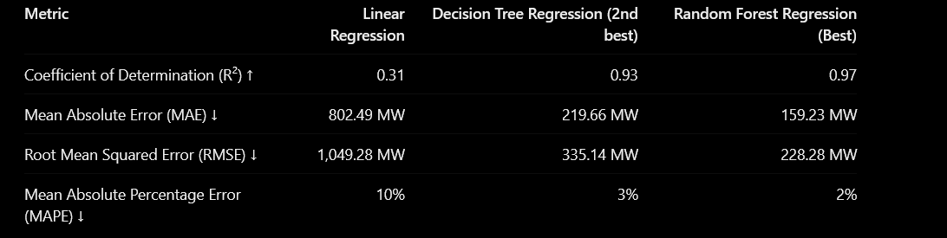
State of the Art — Rawal & Ahmad (2022) -Victor
Objective
Compare supervised machine-learning algorithms for medium-term electricity-demand forecasting.[2]
Data
Electricity-demand data from New South Wales, Australia (2020). 30-minute-resolution data from january-december 2020.
Algorithms
Multiple were used, notably Linear regression and random forest.
Key Finding
Non-parametric algorithms generally performed better than parametric approaches.
Random Forest was the best-performing algorithm in the study.

Slide 5
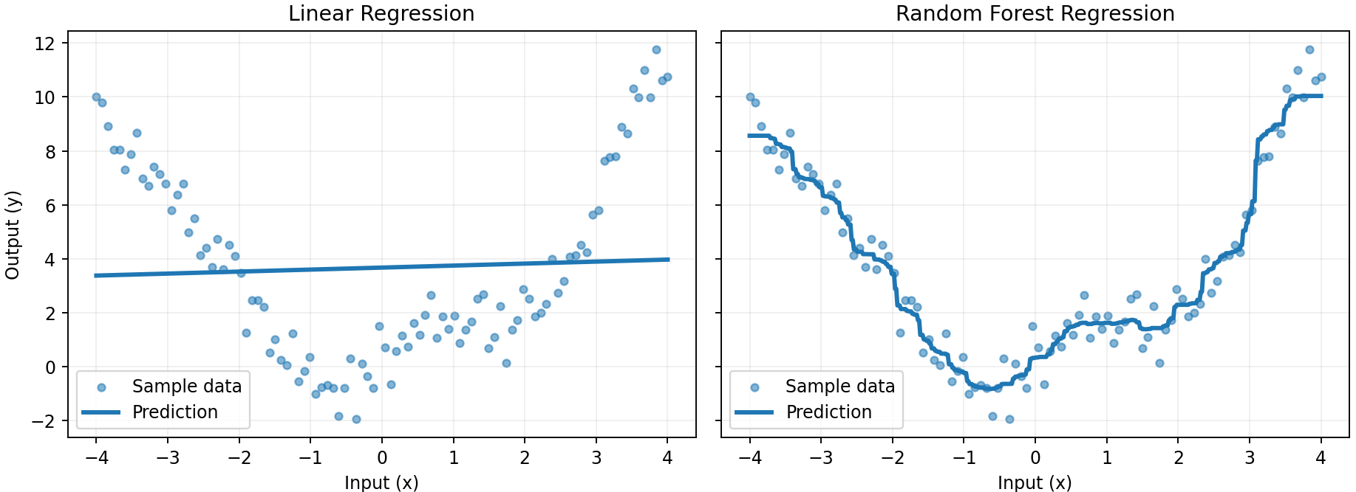
Methodology: Proposed ML Solution -Victor
Goal
Forecast Ontario electricity demand using historical and contextual data.
Input Variables
Previous hour's (t) electricity demand (lagged demand) = Dt
Population-weighted or unweighted Ontario temperature at t = Tt
Ontario Population at t = Pt
Month / time information = Calendar Variables
Geographic scope: Ontario-wide
Time scope: from 2020-2025
Function:
Dt+1 = F(Dt, Tt, Pt, calendar variables)
Machine Learning Algorithms / Model Development
Linear Regression
Used as a simple baseline model.
Models the relationship between the input variables and electricity demand.
Random Forest Regression
Combines predictions from multiple decision trees.
Can model more complex and nonlinear relationships between the variables.
Proposed Workflow: Data Collection → Data Preprocessing → Model Training → Demand Prediction → Model Comparison
LR and RF Examples

Slide 6
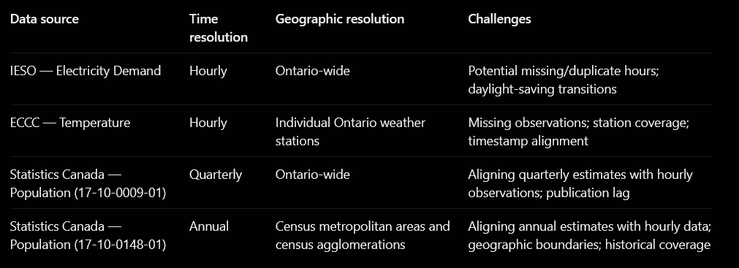
Methodology: Data Sources [3-6] -Victor

Slide 7
Methodology: Data Preprocessing and Alignment -Victor
Data Preprocessing:
1. Download the datasets in CSV or Excel format.
2. Load the datasets into Python data frames.
3. Clean the data, including handling missing or inconsistent values.
4. Align all datasets to a common hourly timeframe, where one row = one observation = one hour.
5. Apply One-Hot Encoding to categorical calendar variables (day of week and month).
6. Create lagged features and shift the target variable by one hour to predict next-hour electricity demand.
Data alignment by location (experimental) :
step 1: Collect temperature data from several representative Ontario weather stations.
step 2: Calculate and align temperature observations by hour.
step 3: Obtain annual population estimates for the corresponding metropolitan areas from Statistics Canada and associate them with each hour's observations.
step 4: Weight each area's temperature by population to calculate a population-weighted hourly Ontario temperature
Note : this is experimental, and we will see if just having average ontario temp is more acurate.

Slide 8
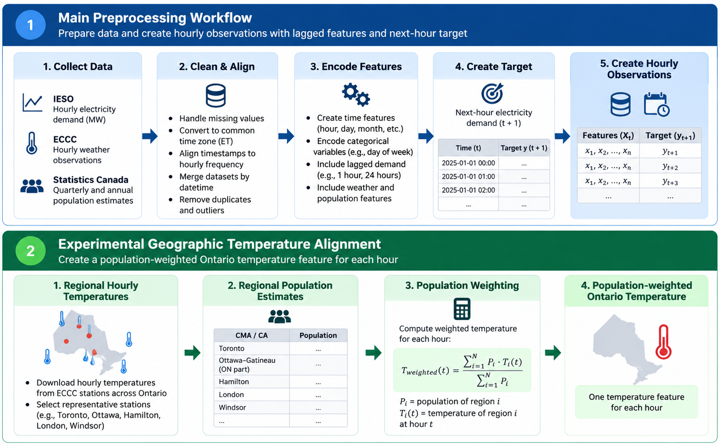
Methodology: Data Preprocessing and Alignment -Victor
Alternative experiment: Unweighted average Ontario temperature.

Slide 9
Implementation proposals and feasibility - Kshitij
Kshitij make a note about feasability please

Slide 10
Methodology: Training, Forecasting & Evaluation -Victor
Model Training & Evaluation
Split the data chronologically to preserve the time-series structure.
Training set: earlier observations years from 2020-2023
Validation set: 2024
Test set: later, unseen observations : 2025
Train Linear Regression and Random Forest Regression using the same training data.
Compare predicted demand with actual demand on the test set.
Forecast Horizon
One-hour-ahead forecasting
Predict next hour's electricity demand using information available from previous hours.
Performance Metrics
MAE — average absolute prediction error.
RMSE — prediction error with greater penalty for large errors.
R² — proportion of variation in electricity demand explained by the model.
Dataset Resolution
Geographic scope: Ontario-wide
Time resolution: Hourly
Observation: One row represents one hour

Slide 11
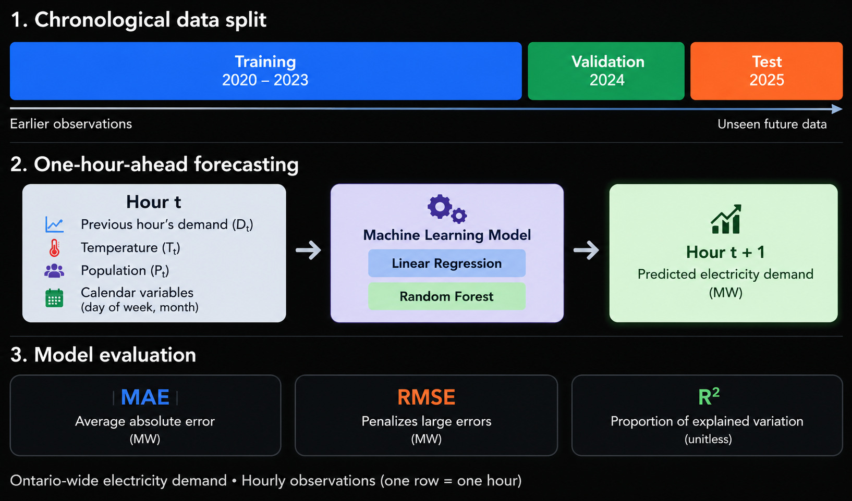
Methodology: Training, Forecasting & Evaluation -Victor

Slide 12
Methodology:Next Steps -Kshitij
Next Steps
Collect electricity-demand, temperature, and population data.
Clean and combine the datasets.
Train and test both models.
Compare results and identify the better-performing approach.

Slide 13
Q and A

Slide 14
References
[1] Gökçe and Duman, “Performance Comparison of Simple Regression, Random Forest and XGBoost Algorithms for Forecasting Electricity Demand,” 2022. doi: 10.1109/IISEC56263.2022.9998213.
[2] Rawal and Ahmad, “A Comparative Analysis of Supervised Machine Learning Algorithms for Electricity Demand Forecasting,” 2022. doi: 10.1109/ICPC2T53885.2022.9776960.
[3] Independent Electricity System Operator (IESO), “Ontario Electricity Demand Reports.” [Online]. Available: https://reports-public.ieso.ca/public/Demand/
[4] Environment and Climate Change Canada, “Historical Climate Data.” [Online]. Available: https://climate.weather.gc.ca/
[5] Statistics Canada, “Population estimates, quarterly,” Table 17-10-0009-01. [Online]. Available: https://doi.org/10.25318/1710000901-eng
[6] Statistics Canada, “Population estimates, July 1, by census metropolitan area and census agglomeration, 2021 boundaries,” Table 17-10-0148-01. [Online]. Available: https://doi.org/10.25318/1710014801-eng

Slide 15
AI disclosure
Tool: ChatGPT (OpenAI)
Purpose: Used to assist with creating summary tables, generating illustrative diagrams.
Verification: Numerical results were checked against the cited research papers.

