Slide 1


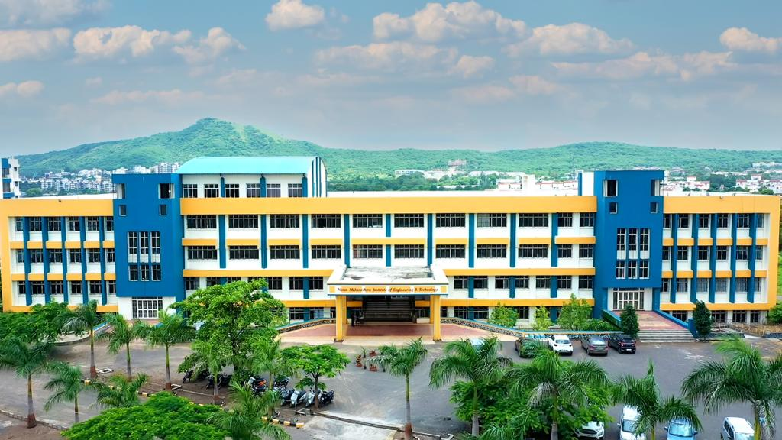
NUTAN MAHARASHTRA INSTITUTE OF ENGINEERING & TECHNOLOGY, PUNE
Nutan Maharashtra Vidya Prasarak Mandal's
Department of Information Technology

Slide 2

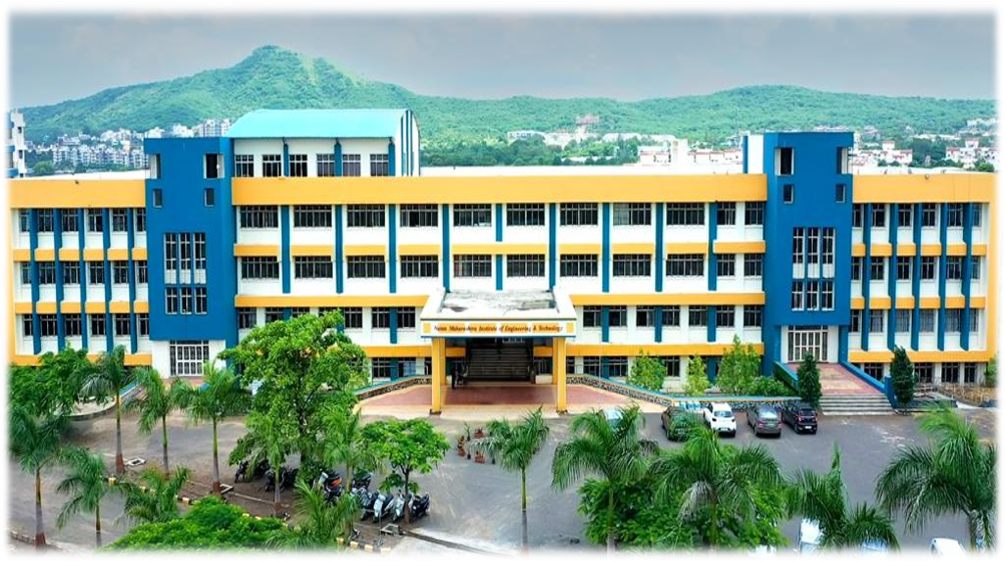
Nutan Maharashtra Vidya Prasarak Mandal's
NUTAN MAHARASHTRA INSTITUTE OF ENGINEERING & TECHNOLOGY, PUNE
Project Title
FinTrace : AI-Based Financial Transaction Monitoring for Anti-Money Laundering Detection
Domain
Artificial Intelligence & Machine Learning (Anomaly Detection, Graph Analytics, Explainable AI) — applied to FinTech / Anti-Money Laundering (AML) Compliance
Department of Information Technology
https://www.nmiet.edu.in

Slide 3
Nutan Maharashtra Vidya Prasarak Mandal's
NUTAN MAHARASHTRA INSTITUTE OF ENGINEERING & TECHNOLOGY, PUNE
Problem Statement
Banks and payment platforms process millions of transactions every day, and launderers hide illicit money through structuring, layering, and networks of mule accounts. Traditional rule-based AML systems raise a very high share of false alarms and miss complex multi-account patterns, overloading compliance analysts.
This creates a need for an AI-powered system that detects suspicious transactions accurately and explains every alert.
Department of Information Technology
https://www.nmiet.edu.in

Slide 4
Nutan Maharashtra Vidya Prasarak Mandal's
NUTAN MAHARASHTRA INSTITUTE OF ENGINEERING & TECHNOLOGY, PUNE
Objectives
Real-Time Transaction Monitoring - Ingest and score financial transactions as they occur to flag suspicious activity instantly.
Anomaly Detection - Use ML models (Isolation Forest, XGBoost) to detect structuring, smurfing, and unusual customer behaviour.
Graph-Based Network Analysis - Model accounts as a graph to uncover layering chains, circular flows, and mule networks.
Risk Scoring & Alert Prioritisation - Assign a risk score to each transaction to cut false positives and rank alerts.
Explainable Alerts & Reporting - Show SHAP-based reasons and let analysts generate Suspicious Transaction Reports (STR) faster.
Department of Information Technology
https://www.nmiet.edu.in

Slide 5
Nutan Maharashtra Vidya Prasarak Mandal's
NUTAN MAHARASHTRA INSTITUTE OF ENGINEERING & TECHNOLOGY, PUNE
Literature Review
Weber et al. (2019): Graph Convolutional Networks on the Elliptic Bitcoin graph beat standard ML baselines – built for crypto data, not bank account transfers, and gives no explanations
Altman et al. (2023): IBM synthetic AML benchmark with labelled laundering patterns – provides data and baselines, but not a deployable monitoring pipeline
Liu et al. (2008): Isolation Forest – fast unsupervised anomaly detection on tabular data – ignores relationships between accounts
Chen & Guestrin (2016): XGBoost – strong supervised classifier for tabular data – needs careful tuning under extreme class imbalance (very few laundering cases)
Lundberg & Lee (2017): SHAP – model-agnostic explanations of predictions – must be integrated into an analyst workflow to be useful for AML alerts
Department of Information Technology
https://www.nmiet.edu.in

Slide 6
Nutan Maharashtra Vidya Prasarak Mandal's
NUTAN MAHARASHTRA INSTITUTE OF ENGINEERING & TECHNOLOGY, PUNE
Proposed Methodology
Data Collection & Ingestion - Use public AML datasets (IBM AML synthetic, Elliptic) plus a simulated live transaction stream.
Preprocessing & Feature Engineering - Clean data and build features such as transaction velocity, amount deviation, and counterparty diversity.
Hybrid Detection Models - Combine Isolation Forest (unsupervised) with XGBoost (supervised); handle class imbalance using SMOTE.
Graph Analytics - Build a transaction graph and detect cycles, fan-in / fan-out, and mule clusters using NetworkX.
Risk Scoring & Explainability - Fuse model outputs into a 0–100 risk score and show SHAP reasons for each alert.
Alert Dashboard & Reporting - Analysts review, filter, and close alerts, and export STR reports.
Department of Information Technology
https://www.nmiet.edu.in

Slide 7
Nutan Maharashtra Vidya Prasarak Mandal's
NUTAN MAHARASHTRA INSTITUTE OF ENGINEERING & TECHNOLOGY, PUNE
System Architecture
Analyst
Dashboard (Login / Alerts / Reports)
Backend Server
Authentication
&
Authorization
Transaction
Ingestion
AI Detection
Engine
MySQL
Database
Data Feed
ML Models
Graph Engine
Department of Information Technology
https://www.nmiet.edu.in

Slide 8
Nutan Maharashtra Vidya Prasarak Mandal's
NUTAN MAHARASHTRA INSTITUTE OF ENGINEERING & TECHNOLOGY, PUNE
Technology Stack
Backend: Python + FastAPI – async REST APIs, and the natural fit since ML and graph libraries are Python-first
Frontend: React.js – component-based analyst dashboard for alert queue, risk scores, and network view
Database: MySQL for transactions, customers, and alerts + Redis cache for low-latency real-time scoring
ML Models: scikit-learn (Isolation Forest), XGBoost, and imbalanced-learn (SMOTE) for imbalanced AML data
Graph & Explainability: NetworkX for laundering-pattern detection and SHAP for transparent, auditable alerts
Department of Information Technology
https://www.nmiet.edu.in

Slide 9
Nutan Maharashtra Vidya Prasarak Mandal's
NUTAN MAHARASHTRA INSTITUTE OF ENGINEERING & TECHNOLOGY, PUNE
Implementation Plan
Phase 1 (Weeks 1–2) : Project setup – dataset collection, MySQL schema, FastAPI skeleton, React dashboard shell
Phase 2 (Weeks 3–4) : Preprocessing & feature engineering – cleaning, velocity/amount features, SMOTE balancing
Phase 3 (Weeks 5–7) : Model development – Isolation Forest + XGBoost training, tuning, and evaluation
Phase 4 (Weeks 8–10) : Graph analytics & risk scoring – cycle/mule detection, SHAP explanations
Phase 5 (Weeks 11–13) : Dashboard integration, end-to-end testing, and documentation
Department of Information Technology
https://www.nmiet.edu.in

Slide 10
Nutan Maharashtra Vidya Prasarak Mandal's
NUTAN MAHARASHTRA INSTITUTE OF ENGINEERING & TECHNOLOGY, PUNE
Expected Outcome
A working prototype that scores transactions in real time and flags suspicious activity
Target detection performance of ≥ 90% recall and ≥ 0.90 AUC-ROC on benchmark AML data
Target of about 40% fewer false positives compared with a rule-based baseline
A network view that exposes layering chains, circular flows, and mule-account clusters
Explainable alerts – top SHAP reasons shown for every flagged transaction
Analyst dashboard with an alert queue, case status tracking, and one-click STR export
Department of Information Technology
https://www.nmiet.edu.in

Slide 11
Nutan Maharashtra Vidya Prasarak Mandal's
NUTAN MAHARASHTRA INSTITUTE OF ENGINEERING & TECHNOLOGY, PUNE
References
Weber, M. et al.: Anti-Money Laundering in Bitcoin: Experimenting with Graph Convolutional Networks for Financial Forensics, arXiv:1908.02591, 2019
Altman, E. et al.: Realistic Synthetic Financial Transactions for Anti-Money Laundering Models, NeurIPS Datasets & Benchmarks, 2023
Liu, F. T., Ting, K. M., Zhou, Z.-H.: Isolation Forest, IEEE International Conference on Data Mining (ICDM), 2008
Chen, T. & Guestrin, C.: XGBoost: A Scalable Tree Boosting System, ACM SIGKDD, 2016
Lundberg, S. & Lee, S.-I.: A Unified Approach to Interpreting Model Predictions, NeurIPS, 2017
Department of Information Technology
https://www.nmiet.edu.in

