Slide 1


Swami Keshvanand Institute of Technology, Management & Gramothan, Jaipur
(An Autonomous Institute Affiliated to Rajasthan Technical University, Kota)
Industrial Training
Presentation
TOPIC:ClassBoard
Submitted To:
Name:- Dr. Meenakshi Nawal
Associate Professor
Submitted By:
Name:-Leelakshi Choudhary
Roll No.:- 24ESKCS192

Slide 2
Index
Introduction
Objectives
Technology Used
Key Features
Project Overview
Working Project
Future Scope
Q&A
SKIT, JAIPUR www.skit.ac.in

Slide 3
Company Overview
InternPe, is a fast-growing platform dedicated to providing job opportunities, internships, and placement support to college and university students across India. With its office located at New Sanganer Road, Sanganer, Maruti Nagar, Jaipur, Rajasthan – 302029, InternPe focuses on bridging the gap between academic learning and industry requirements. The platform empowers students with real-world exposure, practical experience, and career-ready skills. Registered under MSME (UDYAM-RJ-17-0195598), InternPe is owned and managed by Latesh Bansal, who leads the organization with a vision to make quality career opportunities accessible to students across India. At InternPe, the focus is on shaping students' careers by connecting young talent with the right opportunities and professional growth.
SKIT, JAIPUR www.skit.ac.in

Slide 4
Objectives
To design and build a role-based full-stack platform for Admin, Teacher, and Student users using the MERN stack (MongoDB, Express.js, React.js, Node.js).
To implement secure authentication and authorization using JWT and bcrypt.js, with protected routes for each role.
To build core academic modules — departments, courses, timetables, attendance, assignments, study materials, and grades.
To design a clean, responsive UI with Tailwind CSS and REST APIs connecting the frontend and backend cleanly.
To gain hands-on experience with real-world software practices — Git version control, API testing, and deployment workflows.
SKIT, JAIPUR www.skit.ac.in

Slide 5









Technology Stack Used
SKIT, JAIPUR www.skit.ac.in

Slide 6
Key Features
Role-based dashboards — separate, tailored views for Admin, Teacher, and Student.
Academic management — departments, courses, subjects, academic years, semesters, sections, and classes.
Timetable & attendance — weekly class schedules and attendance tracking per section.
Assignments & study materials — teachers upload materials and assignments; students submit and get graded.
Announcements & reports — role-targeted announcements and exportable attendance/grade reports.
Secure authentication — JWT-based login/signup with bcrypt password hashing and protected routes.
SKIT, JAIPUR www.skit.ac.in

Slide 7
ClassBoard Overview
ClassBoard is a role-based college management platform covering the full academic workflow — from department setup to attendance and grading.
Admins manage departments, courses, subjects, sections, teachers, students, and the weekly timetable — all from one dashboard.
Teachers manage their classes, upload study materials and assignments, grade submissions, and mark attendance.
Students view their timetable, download study materials, submit assignments, track attendance, and check grades.
Built with the MERN stack, the platform uses JWT + bcrypt.js for secure authentication and a clean, responsive Tailwind CSS interface.
SKIT, JAIPUR www.skit.ac.in

Slide 8
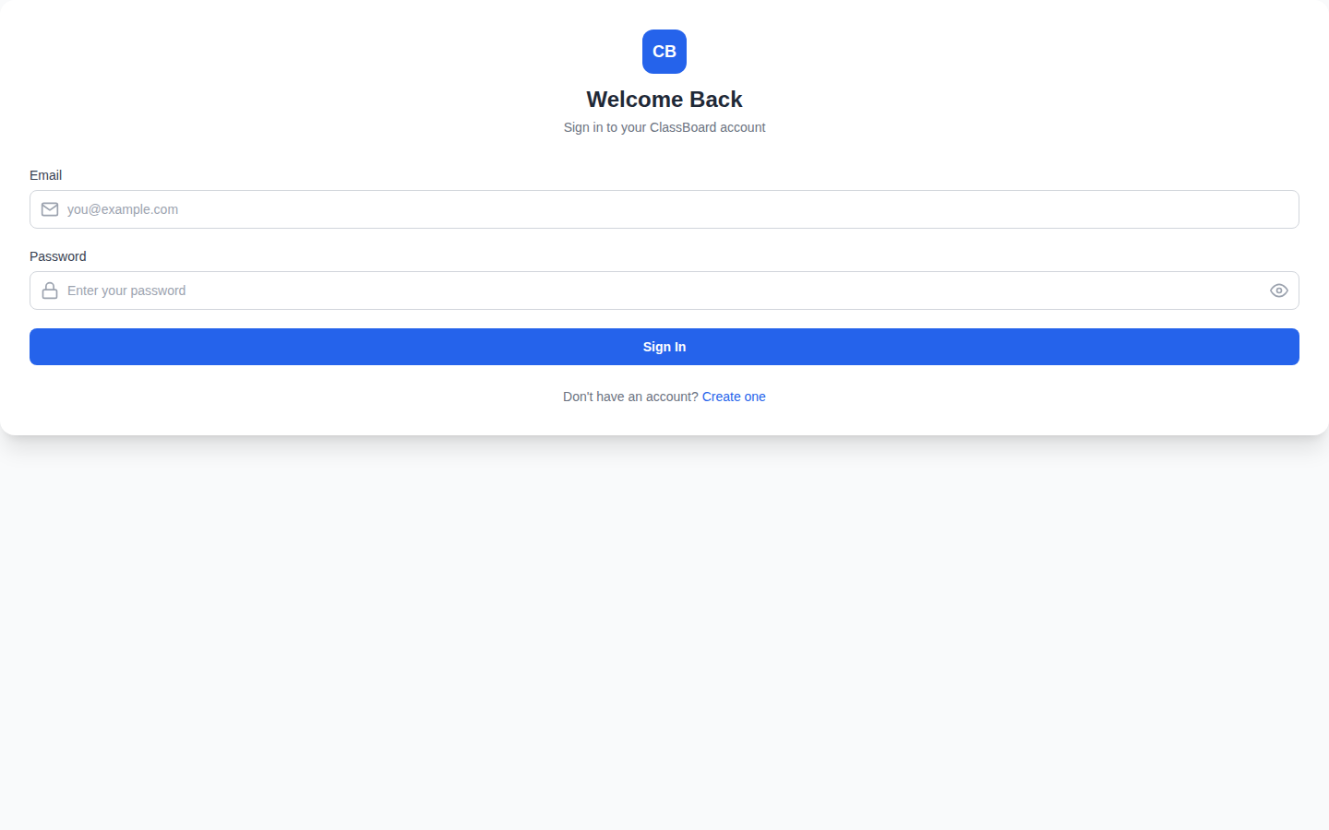
Login Page

Slide 9
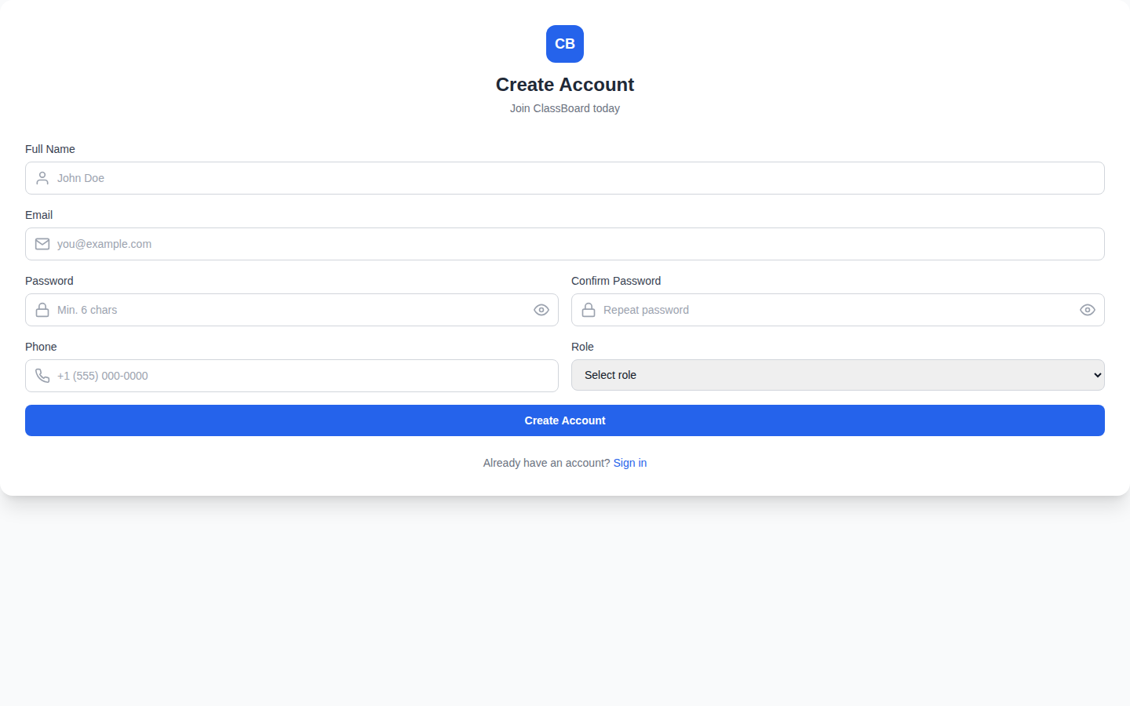
Register Page

Slide 10
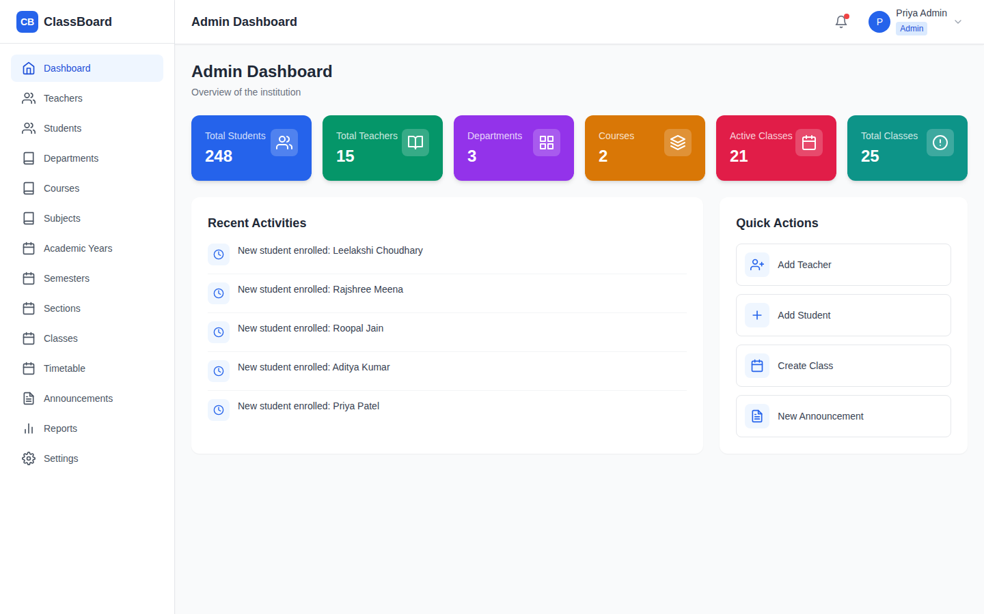
Admin Dashboard

Slide 11
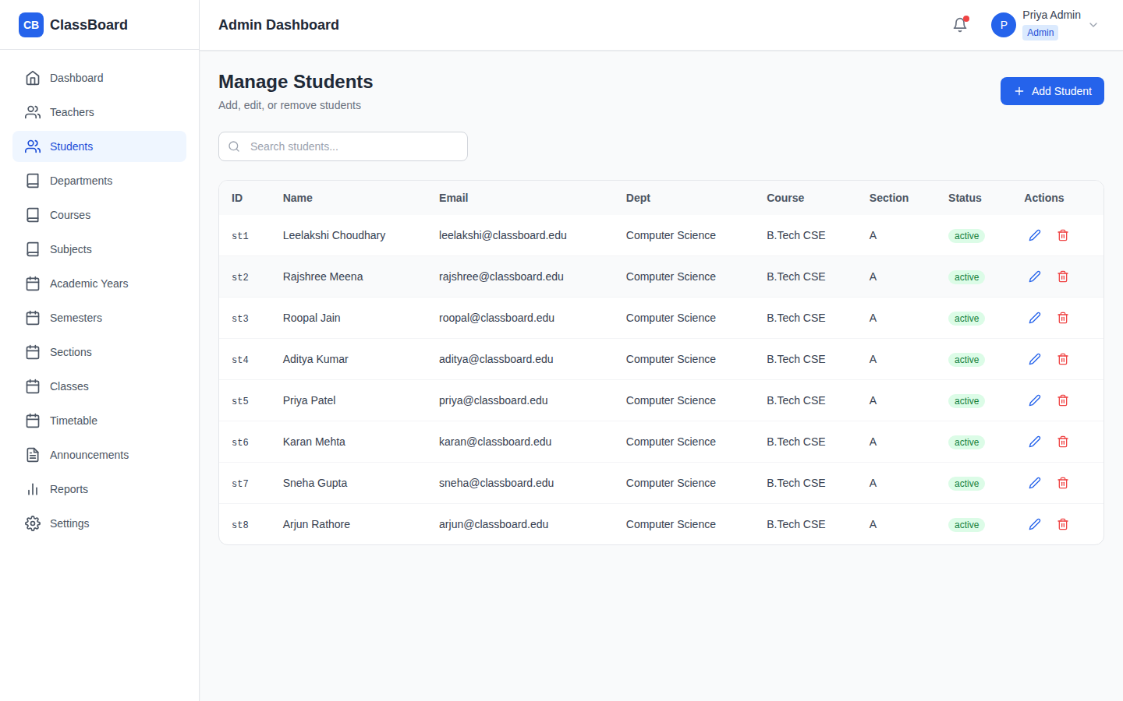
Manage Students

Slide 12
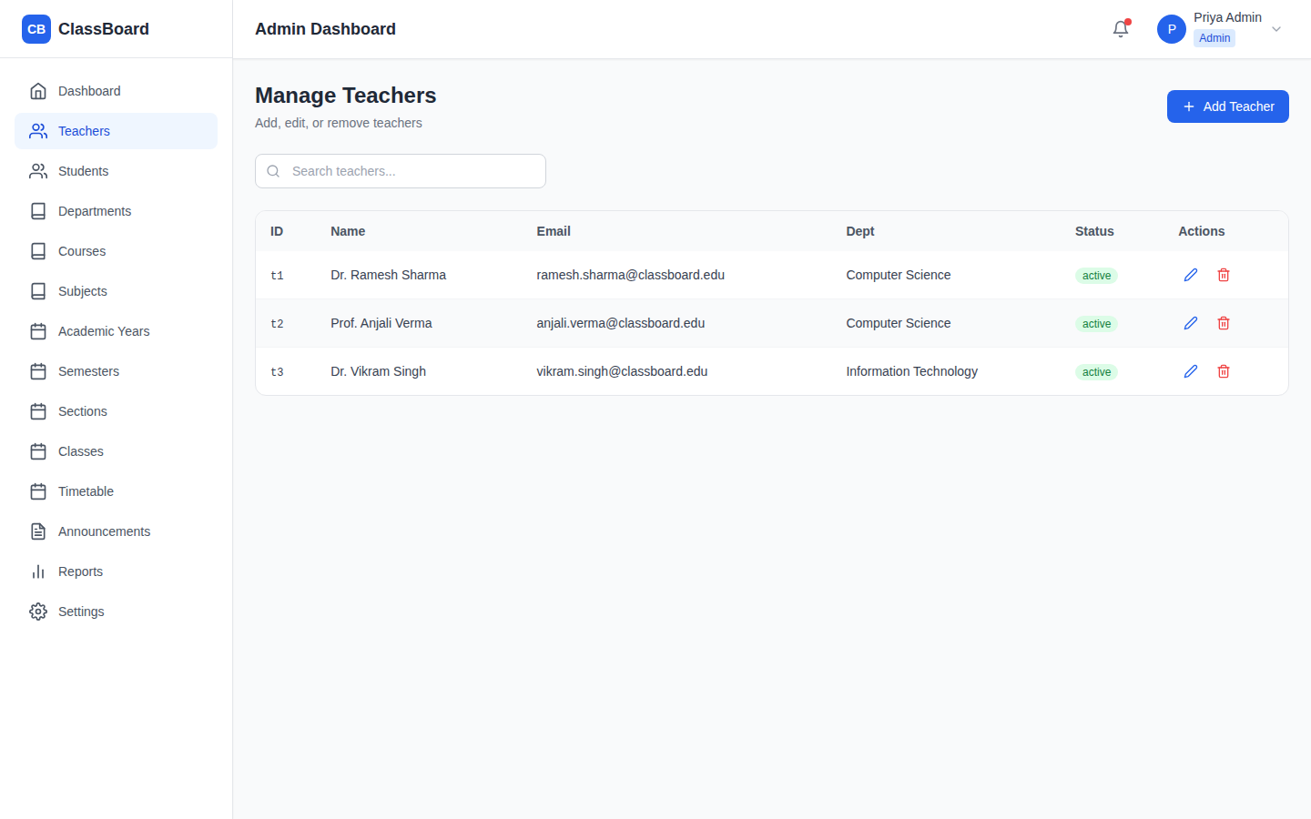
Manage Teachers

Slide 13
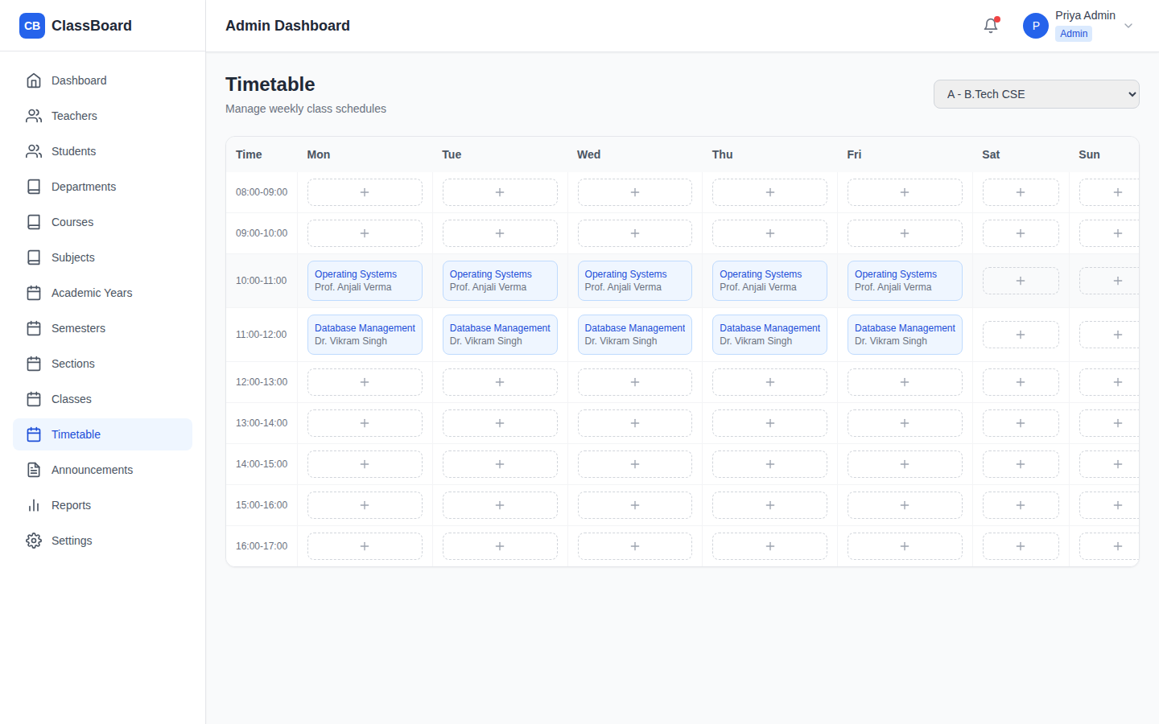
Timetable

Slide 14
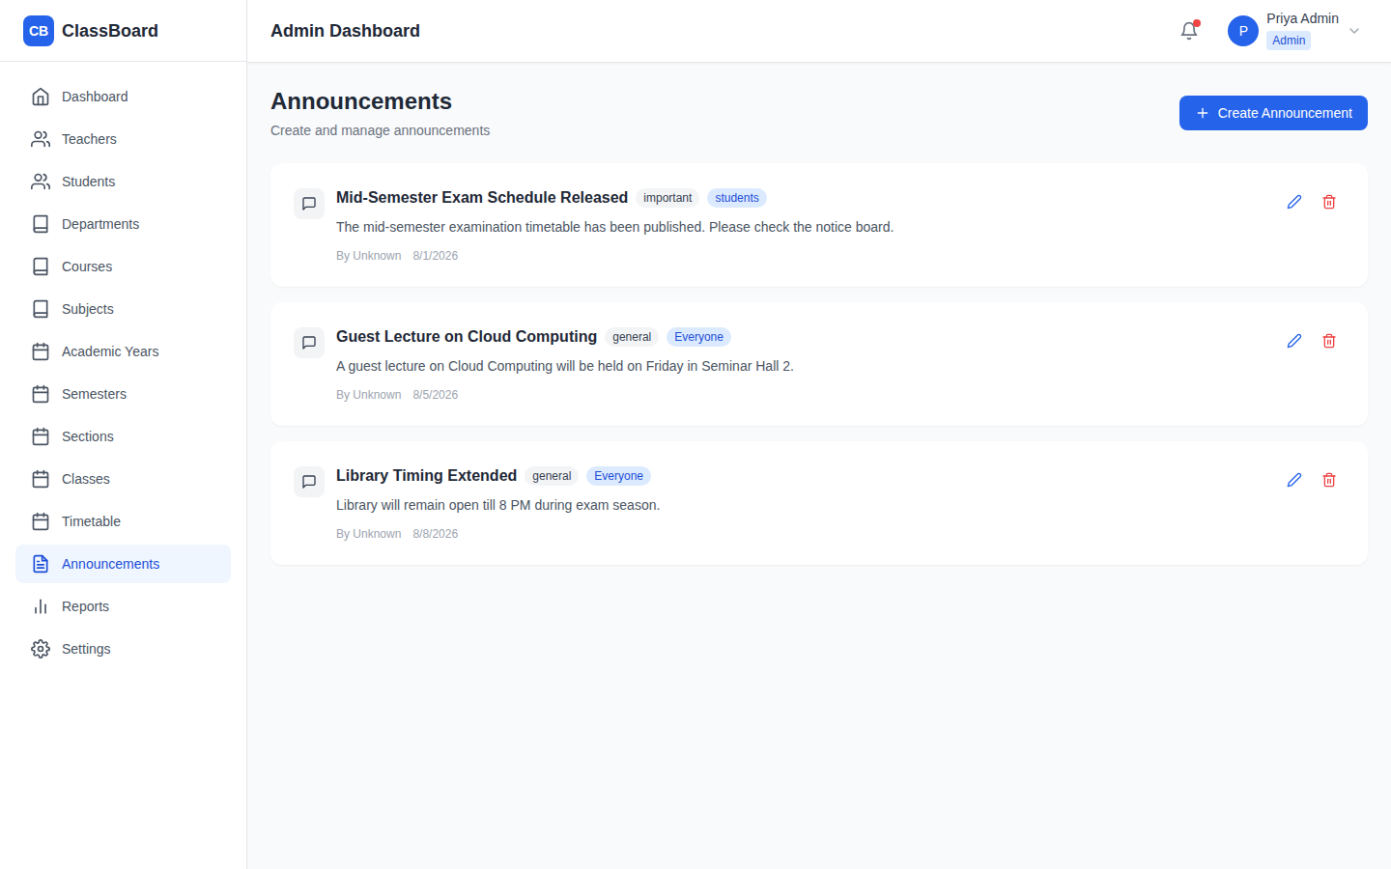
Announcements

Slide 15
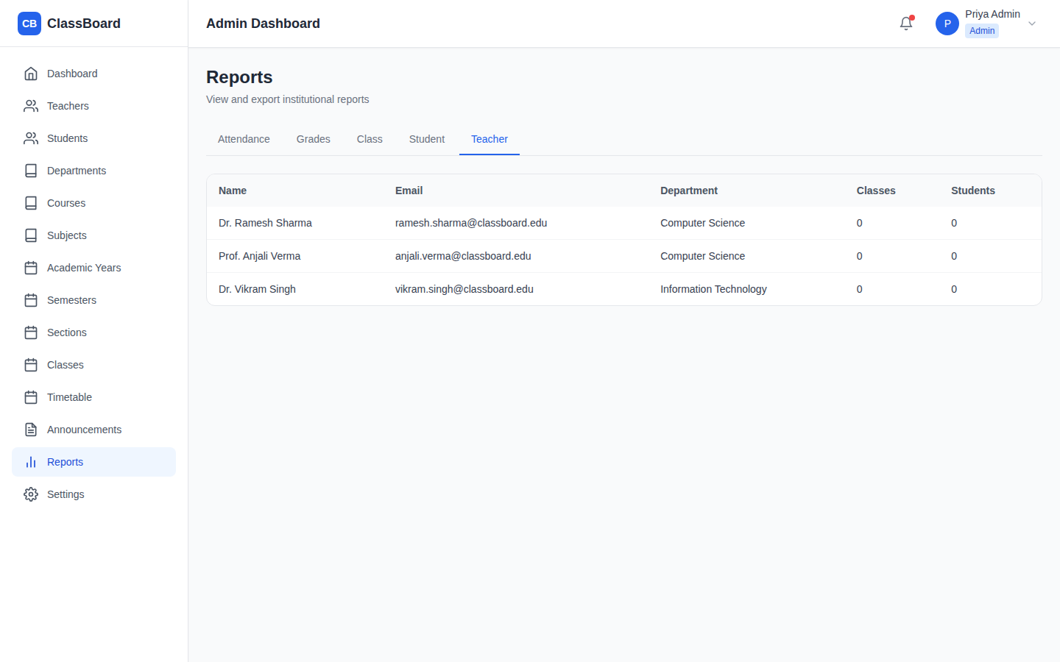
Reports

Slide 16
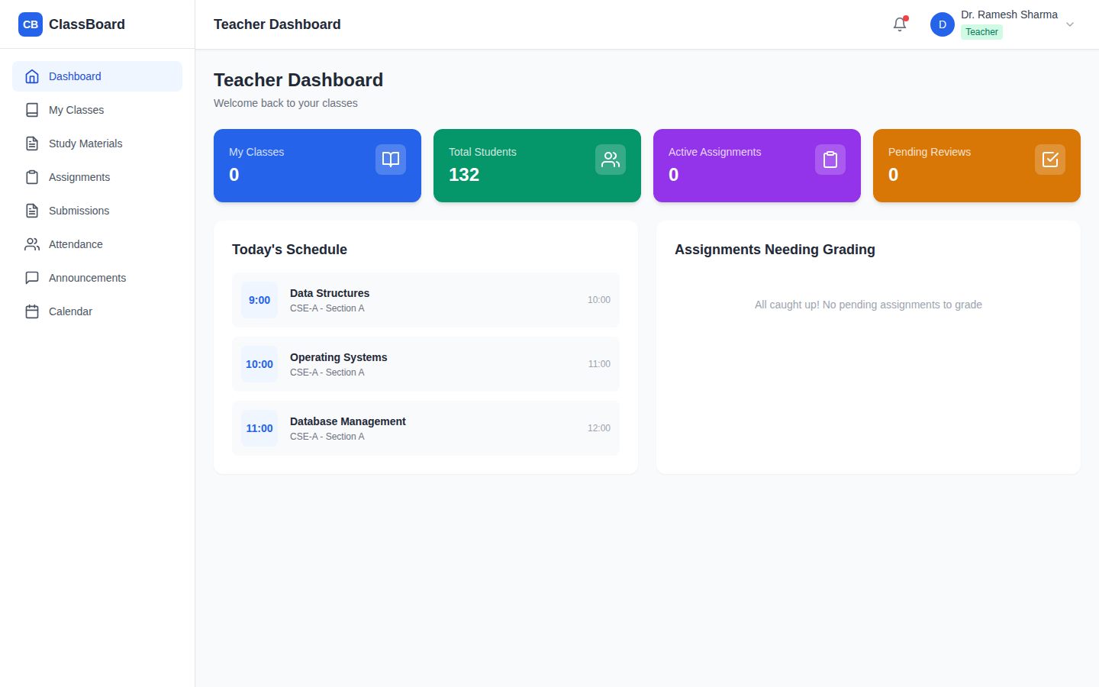
Teacher Dashboard

Slide 17
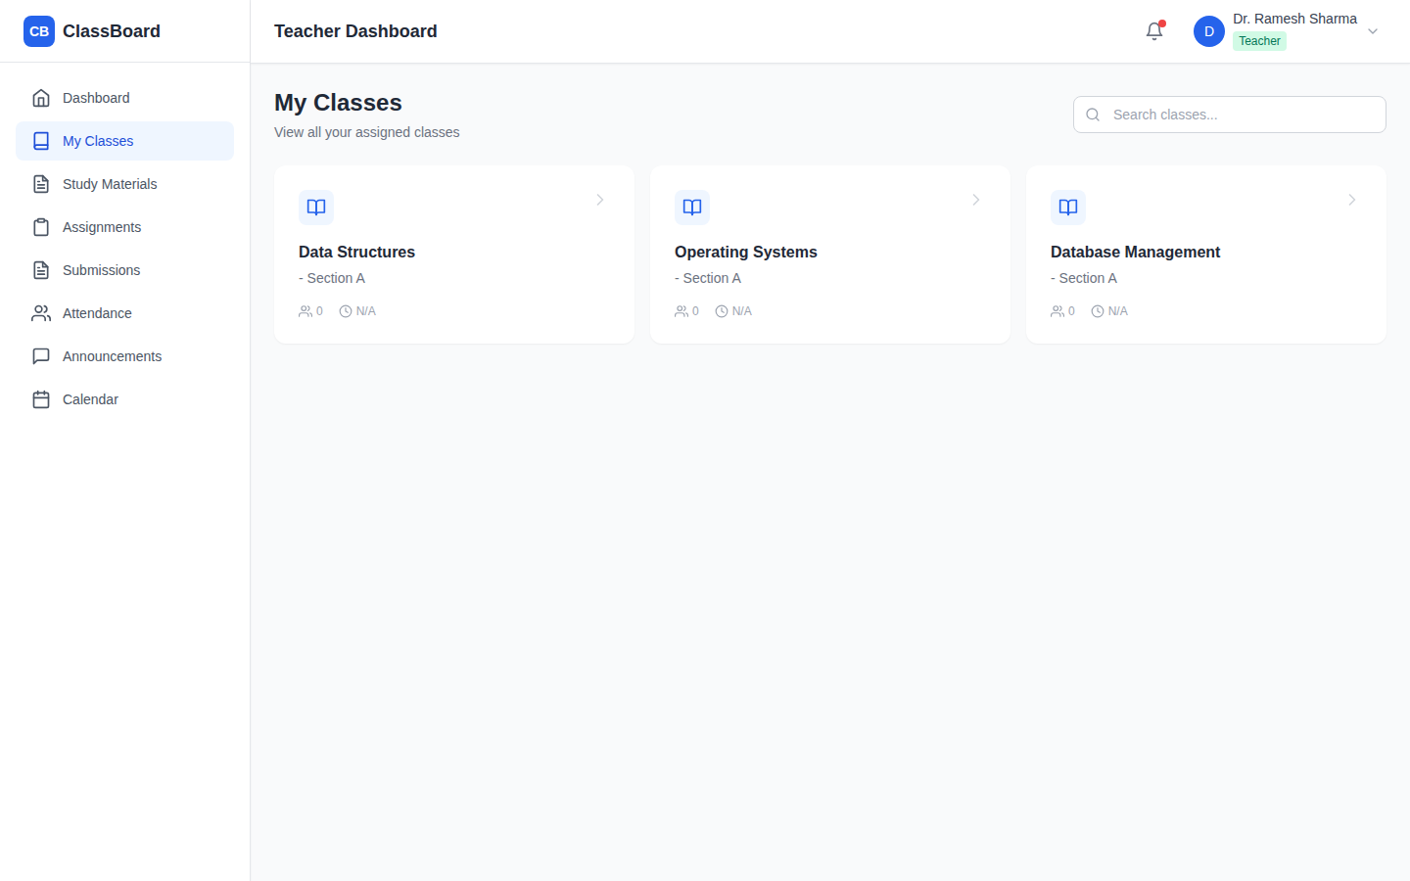
My Classes

Slide 18
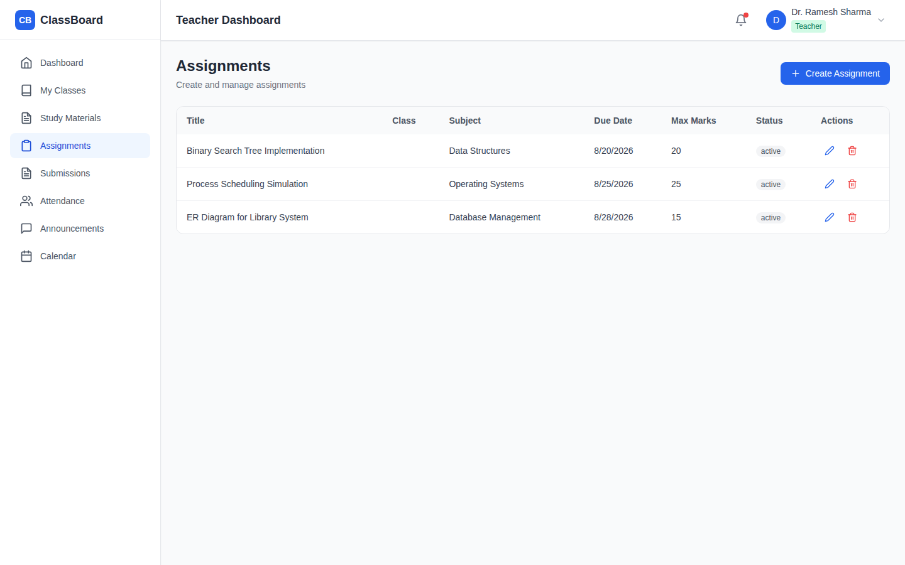
Assignments

Slide 19
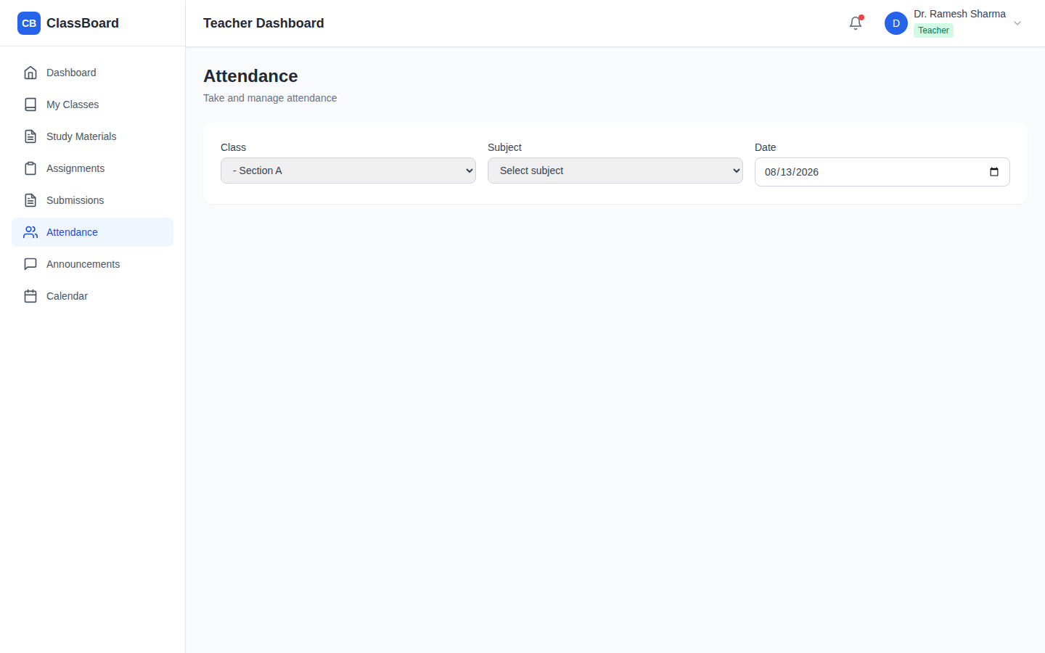
Attendance

Slide 20
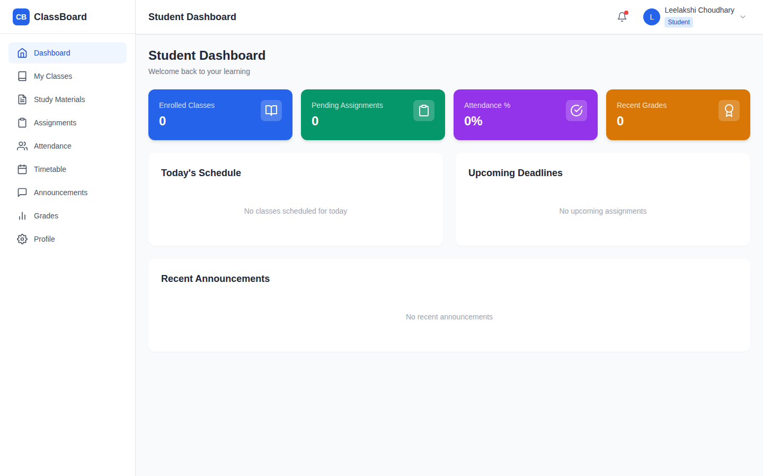
Student Dashboard

Slide 21
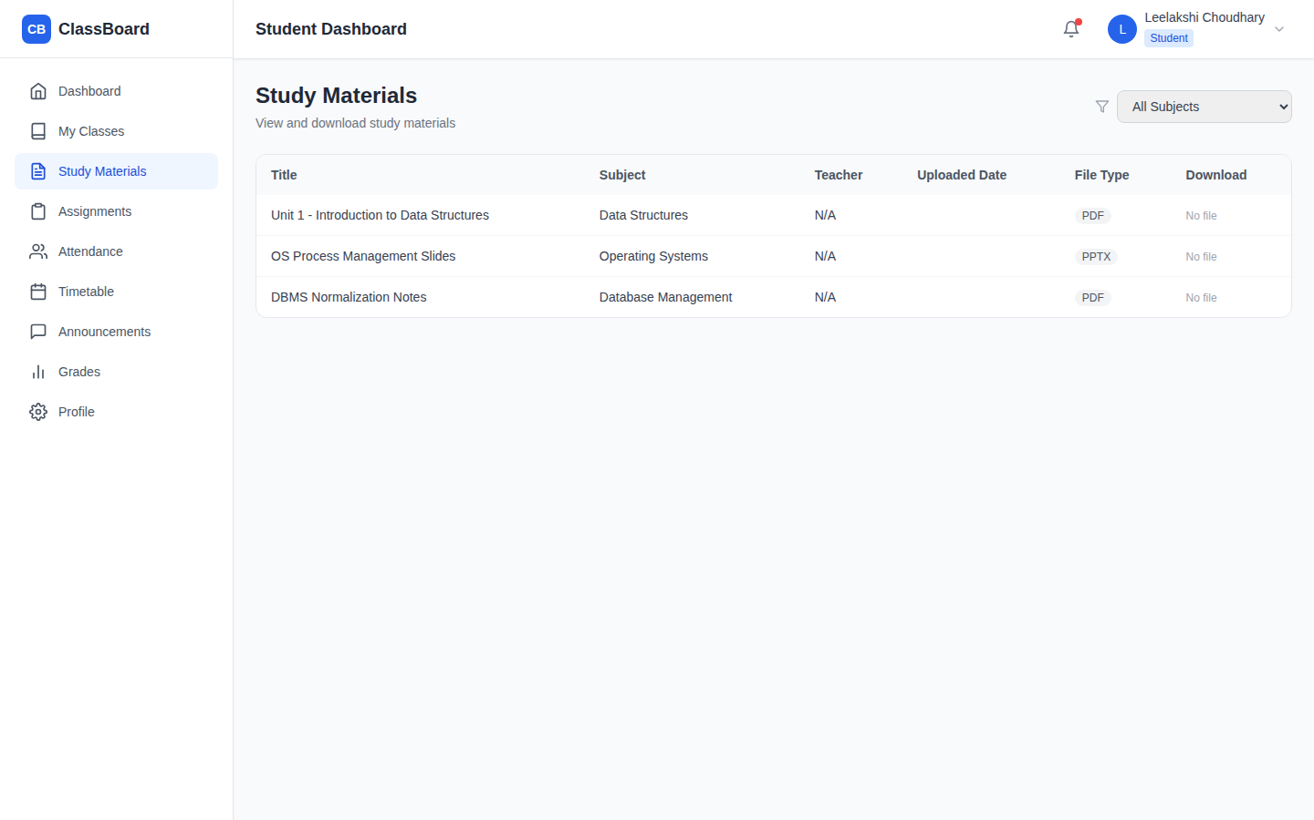
Study Materials

Slide 22
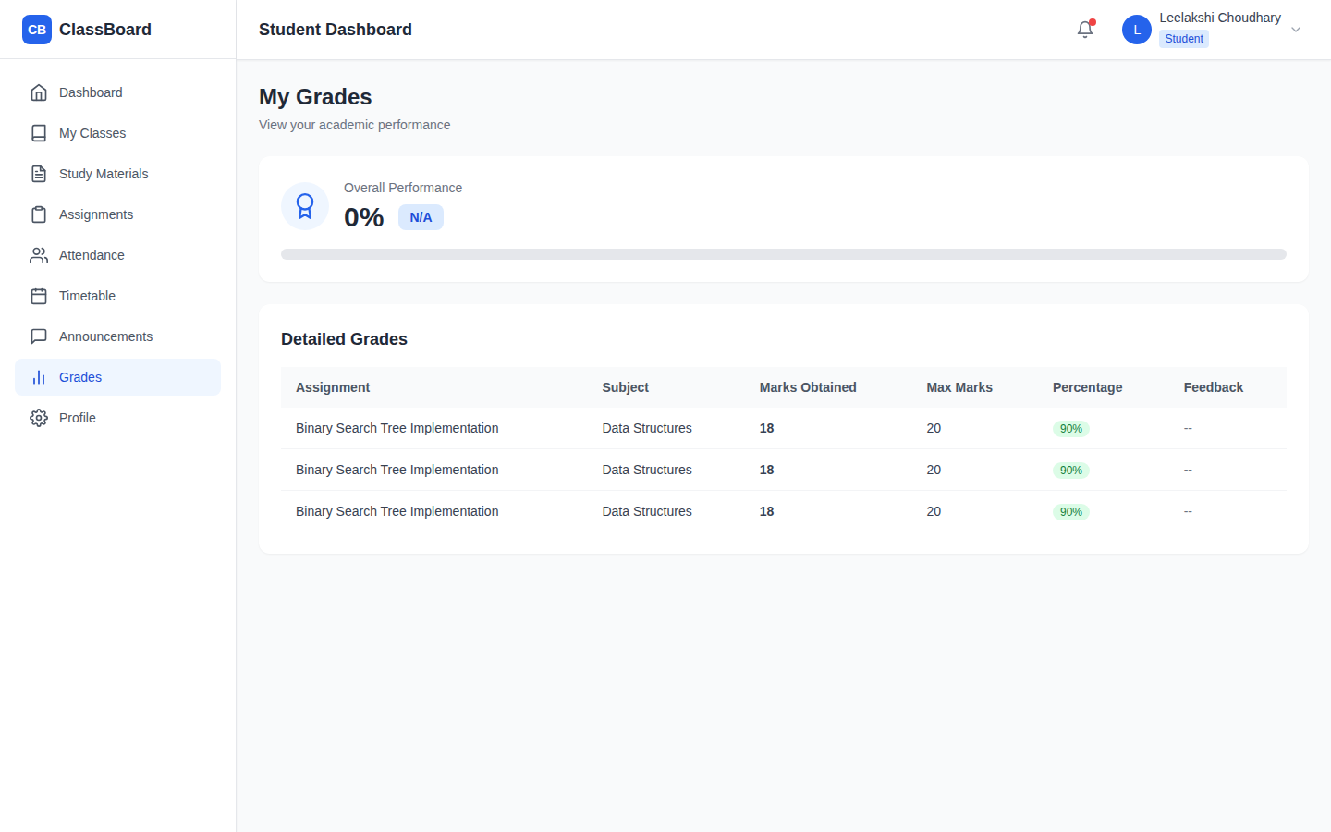
Grades

Slide 23
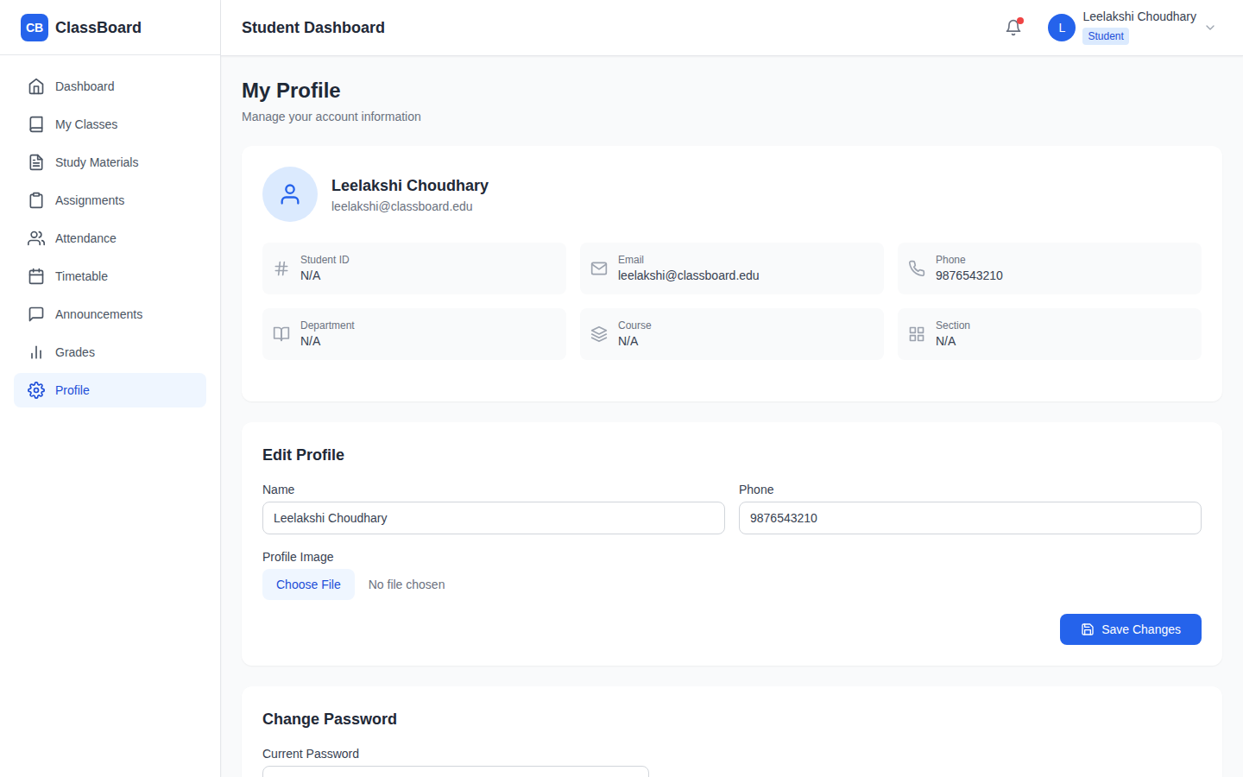
Profile

Slide 24
Future Scope
1. Real-time notifications and chat between teachers and students.
2. Mobile app version using React Native for on-the-go access.
3. Online exam and quiz module with auto-grading.
4. Fee management and payment gateway integration.
5. Analytics dashboard for performance and attendance trends.
SKIT, JAIPUR www.skit.ac.in

Slide 25
Q & A
SKIT, JAIPUR www.skit.ac.in

Slide 26
Thank You
SKIT, JAIPUR www.skit.ac.in

