Slide 1
Swami Keshvanand Institute of Technology, Management & Gramothan, Jaipur
(An Autonomous Institute Affiliated to Rajasthan Technical University, Kota)
Industrial Training
Presentation
TOPIC: FocusTube
A Distraction-Free Educational Video Portal
Submitted To:
Dr. Meenakshi Nawal
Associate Professor
Submitted By:
Kushagra Rathore
Roll No.: 24ESKCS187
SKIT, JAIPUR FocusTube | 1

Slide 2
FT
Index
Introduction
Objectives
Technology Stack Used
Key Features
Project Overview
Working Project / Interface
Future Scope
Q&A
SKIT, JAIPUR FocusTube | 2

Slide 3
FT
Company Overview
Enexa IT Solutions Private Limited
According to the internship certificate, Enexa IT Solutions Private Limited conducted a 45-day internship programme in Software Development for Kushagra Rathore.
Internship Period: 15 May – 30 June 2026
Certificate Issue Date: 30 June 2026
Internship Domain: Software Development
Certificate signed by Lov Prakash, Director
SKIT, JAIPUR FocusTube | Company Overview

Slide 4
FT
Introduction
FocusTube is an educational video portal designed for engineering students.
It helps students search for engineering lectures and curated YouTube playlists.
The interface aims to reduce distractions by keeping learning tools in one place.
The platform includes a Focus Player, study timer, playlists, and lecture notes.
It is designed around focused, structured, and self-paced learning.
SKIT, JAIPUR FocusTube | 3

Slide 5
FT
Objectives
Build a full-stack educational portal using the MERN stack.
Make it easier to find engineering lectures by topic and discipline.
Provide a focused video-watching interface for study sessions.
Support study planning through a Pomodoro timer and lecture notes.
Allow students to organize useful videos and revisit saved learning material.
SKIT, JAIPUR FocusTube | 4

Slide 6
FT
Technology Stack Used
MongoDB
Express.js
React.js
Database for storing application data
Backend web framework
Interactive user interface
Node.js
YouTube Data API v3
HTML / CSS / JavaScript
JavaScript runtime for the server
Search and video discovery integration
Web structure, styling, and behavior
SKIT, JAIPUR FocusTube | 5

Slide 7
FT
Key Features
Educational video search with discipline and subject quick-filters.
Playlist search mode for discovering longer learning resources.
Focus Player page with a dedicated study interface.
Pomodoro timer with Study and Break modes.
Lecture notes with timestamps and a way to save key concepts.
Study notes page with keyword search, editing, deletion, and text export options.
Recently watched lectures and a distraction-free learning layout.
SKIT, JAIPUR FocusTube | 6

Slide 8
FT
Project Overview
FocusTube brings lecture discovery and study productivity together in a single web application.
Home page: search lectures, filter by engineering discipline, and explore popular lecture channels.
Focus Player: watch a selected lecture alongside study tools.
Notes: capture concepts, formulas, exam points, and video timestamps.
Playlists: discover and organize learning videos for later study.
The interface is intended to support focused study without the usual video-platform distractions.
SKIT, JAIPUR FocusTube | 7

Slide 9
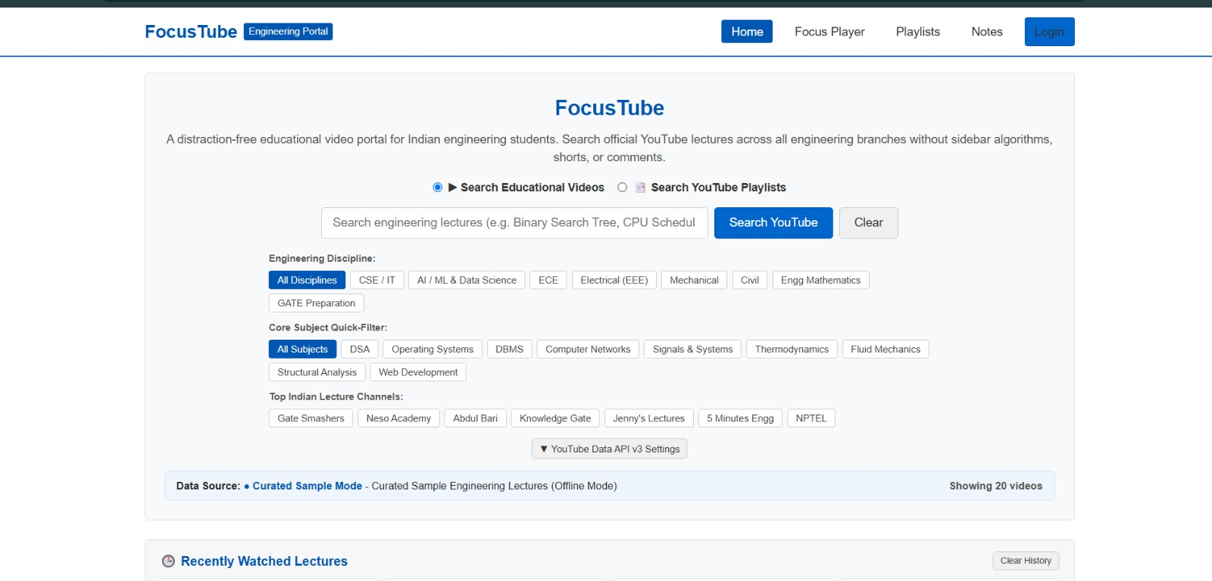
FT
Home Page – Search Educational Videos
SKIT, JAIPUR FocusTube | 8

Slide 10
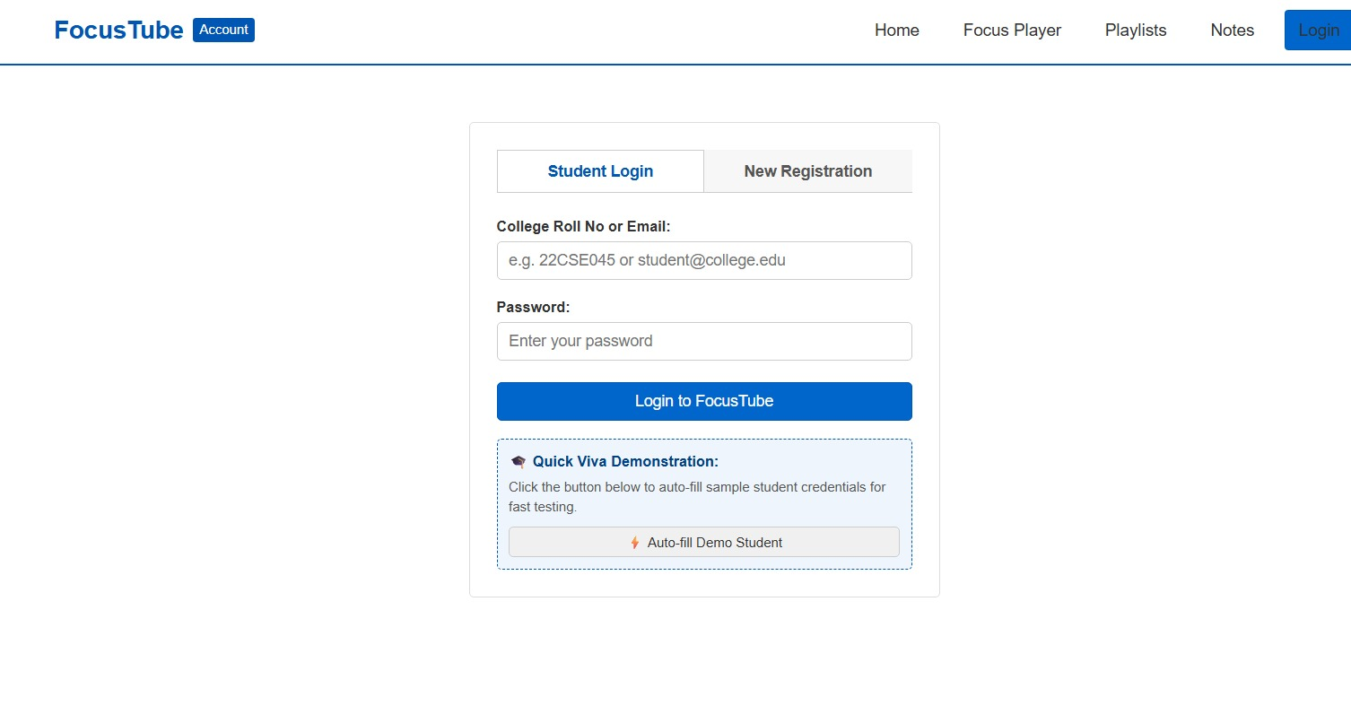
FT
Student Login & Registration
The screen provides student login and new-registration tabs, with a demo autofill option for testing.
SKIT, JAIPUR FocusTube | 9

Slide 11
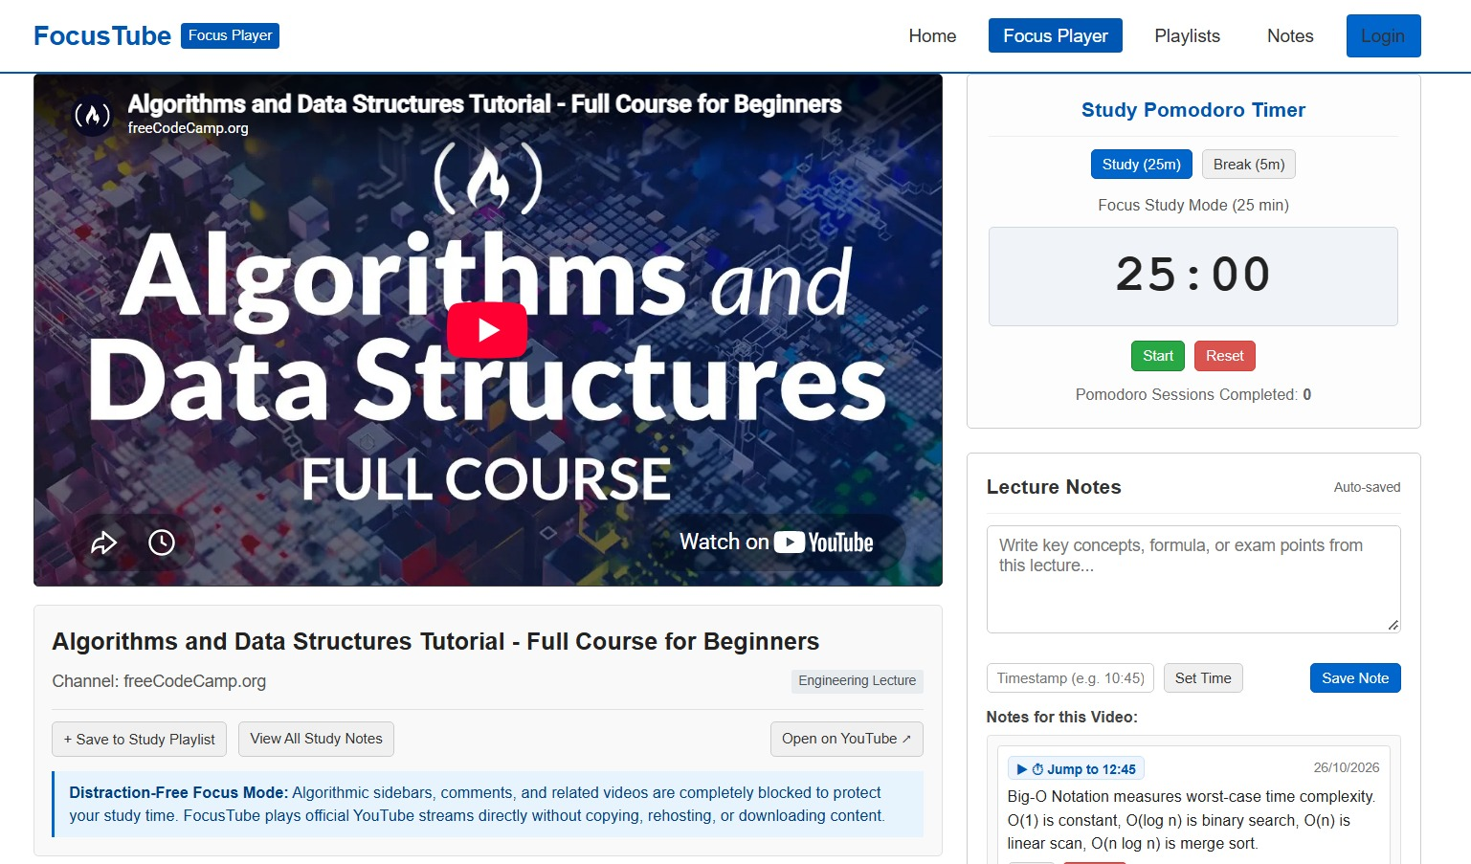
FT
Focus Player & Pomodoro Timer
SKIT, JAIPUR FocusTube | 10

Slide 12
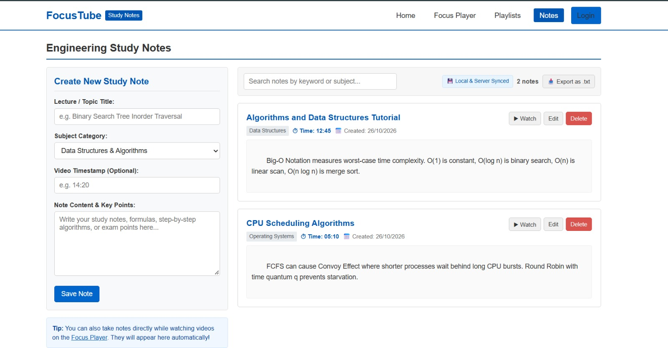
FT
Engineering Study Notes
SKIT, JAIPUR FocusTube | 11

Slide 13
FT
How FocusTube Works
01
Search
Enter a topic or choose a discipline / subject filter.
02
Select
Choose a lecture or playlist relevant to the topic.
03
Focus
Open the Focus Player and start a study session.
04
Record
Write notes and add timestamps for important moments.
05
Review
Return to saved notes and recently watched lectures.
SKIT, JAIPUR FocusTube | 12

Slide 14
FT
Benefits of FocusTube
Keeps lecture discovery and study utilities together.
Provides quick access to engineering topics and popular educational channels.
Encourages structured study using Pomodoro sessions.
Makes it easier to save and revisit key lecture points.
Supports revision through searchable and exportable notes.
Offers a cleaner learning experience focused on educational content.
SKIT, JAIPUR FocusTube | 13

Slide 15
FT
Future Scope
Add personalized recommendations based on subjects and learning goals.
Improve playlist management with folders, tags, and progress tracking.
Introduce cloud synchronization for notes across devices.
Add reminders, study streaks, and weekly productivity reports.
Improve accessibility and mobile responsiveness.
Expand testing, deployment monitoring, and user feedback features.
SKIT, JAIPUR FocusTube | 14

Slide 16
FT
Conclusion
FocusTube combines educational video discovery with practical study tools to help engineering students learn with fewer distractions.
MERN-based full-stack project concept.
Lecture search, Focus Player, Pomodoro timer, and study notes.
A foundation that can be extended with personalization and progress tracking.
SKIT, JAIPUR FocusTube | 15

Slide 17
Questions & Answers
Thank You!
FocusTube – Industrial Training Presentation
Presented by Kushagra Rathore | Roll No. 24ESKCS187
SKIT, JAIPUR FocusTube | 16

