Slide 1


Swami Keshvanand Institute of Technology, Management & Gramothan, Jaipur
(An Autonomous Institute Affiliated to Rajasthan Technical University, Kota)
Industrial Training
Presentation
TOPIC: Sentra
A Unified Uptime & Reliability Monitoring Platform
Submitted To:
Dr. Meenakshi Nawal
Associate Professor
Submitted By:
Kshitij Kumar
Roll No.: 24ESKCS185
SKIT, JAIPUR Sentra | 1
Notes:
Introduce yourself and the project: Sentra, a monitoring platform that tells you the moment a website, server, certificate or scheduled job stops working.

Slide 2
Index
Introduction
Objectives
Technology Stack Used
Key Features
Project Overview
Working Project / Interface
How Sentra Works
Future Scope
Q&A
SKIT, JAIPUR Sentra | 2

Slide 3
Company Overview
Enexa IT Solutions Private Limited
As per the internship certificate, Enexa IT Solutions Private Limited offered a 45-day Software Development internship to [Your Name].
Internship Period: 15 May – 30 June 2026
Certificate Issue Date: 30 June 2026
Internship Domain: Software Development
Certificate signed by Lov Prakash, Director
SKIT, JAIPUR Sentra | Company Overview

Slide 4
Introduction
Sentra is a web platform that watches websites, servers and scheduled jobs.
It brings uptime, SSL, domain and cron job monitoring into one dashboard.
Every check runs on its own schedule, and every result is saved as history.
A confirmed failure opens an incident and sends an alert to a webhook.
It supports many users; each user sees and manages only their own checks.
SKIT, JAIPUR Sentra | 3
Notes:
Most outages are first noticed by users. Sentra's goal is to notice them first, from one place.

Slide 5
Objectives
Build an engine that runs every check on time and never runs one twice.
Support five check types: HTTP, TCP, TLS, domain expiry and cron job.
Confirm a failure several times before opening an incident.
Send each alert exactly once, even when tasks run in parallel.
Keep each user's data private and block requests to internal addresses.
Offer a clear dashboard to add checks and see their health at a glance.
SKIT, JAIPUR Sentra | 4

Slide 6
Technology Stack Used
Java + Spring Boot
PostgreSQL 16
React + Vite
REST API, scheduler and monitoring engine
Stores checks, run history and incidents
Login, dashboard and check detail screens
Spring Security
Flyway
Docker
JWT login with BCrypt-hashed passwords
Versioned database schema migrations
Runs the database the same way on any PC
SKIT, JAIPUR Sentra | 5

Slide 7
Key Features
Five check types: website (HTTP), open port (TCP), SSL certificate, domain expiry and cron job.
A scheduler that runs each check automatically at its own interval.
Incident tracking with thresholds: 3 failures open an incident, 2 successes close it.
Webhook alerts on outage and recovery, with reminders while an incident stays open.
Early warning before an SSL certificate or a domain registration expires.
Secure sign-up and login, with every user's checks kept private.
A live dashboard whose “run tape” shows the speed and result of recent runs.
SKIT, JAIPUR Sentra | 6

Slide 8
Project Overview
Two parts: a background monitoring engine and a web dashboard.
Scheduler: finds the checks that are due and hands them to a pool of worker threads.
Probes: one probe per check type runs the actual test and measures the response time.
Evaluation: marks a check healthy or down, and opens or closes incidents.
Alerting: sends a webhook when an incident opens or closes, never twice for one event.
Dashboard: React screens for login, the list of checks and each check's full history.
SKIT, JAIPUR Sentra | 7

Slide 9
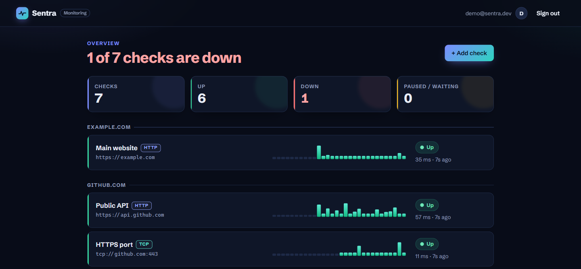
Dashboard – All Checks at a Glance
SKIT, JAIPUR Sentra | 8
Notes:
The headline counts how many checks are down. Each row shows the check type, target, latest response time and a run tape: one bar per run, taller means slower, red means failed.

Slide 10
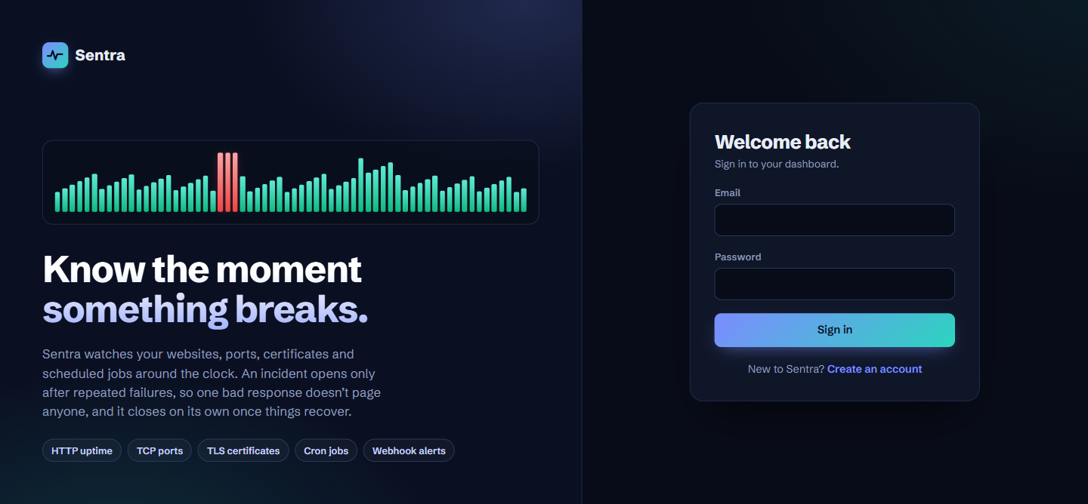
Login & Registration
Users sign in or create an account; after login, every API request carries a JWT token.
SKIT, JAIPUR Sentra | 9

Slide 11
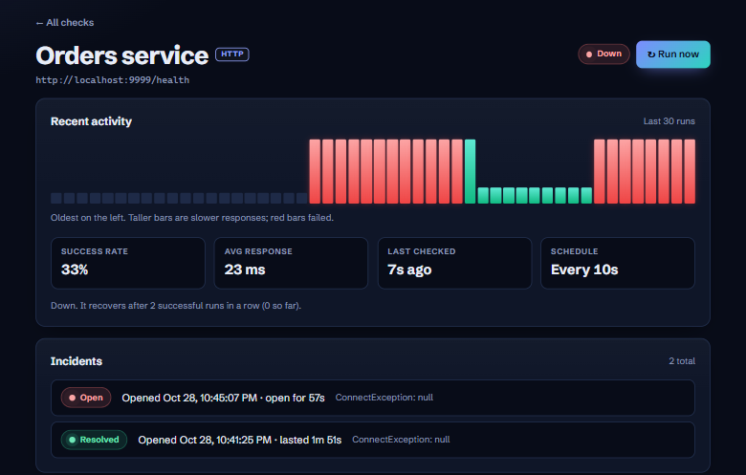
Check Detail – Run History & Incidents
SKIT, JAIPUR Sentra | 10
Notes:
This check was broken on purpose. After 3 failed runs Sentra opened an incident; after 2 successful runs it closed it and recorded how long the outage lasted.

Slide 12
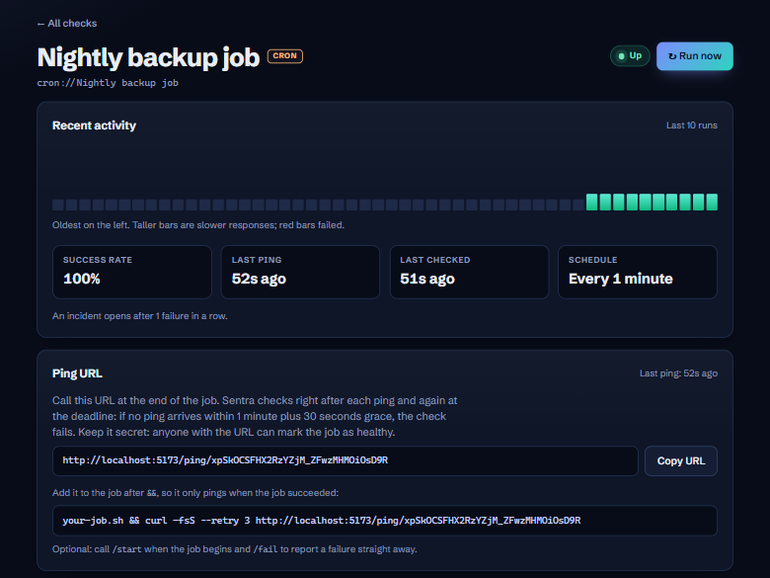
Cron Job Monitoring – Heartbeat Pings
SKIT, JAIPUR Sentra | 11
Notes:
A cron job cannot be checked from outside, so the job calls a secret ping URL after each run. If the ping is late or reports failure, Sentra marks the job down.

Slide 13
How Sentra Works
01
Add
Create a check: a URL, a host and port, a domain or a cron job.
02
Schedule
The scheduler claims checks that are due, so none runs twice.
03
Probe
A probe tests the target and records the result and timing.
04
Evaluate
Repeated failures open an incident; repeated successes close it.
05
Alert
A webhook tells the team once when an outage starts and ends.
SKIT, JAIPUR Sentra | 12

Slide 14
Benefits of Sentra
One place to monitor websites, ports, certificates, domains and scheduled jobs.
Problems are spotted within seconds, often before users report them.
Fewer false alarms, because a failure must repeat before an incident opens.
Expiring certificates and domains are flagged weeks in advance.
Cron jobs that silently stop running are caught through missed pings.
Incident history shows how often, and for how long, each service was down.
SKIT, JAIPUR Sentra | 13

Slide 15
Future Scope
Email, Slack and SMS alerts alongside webhooks.
A public status page that customers can open during an outage.
Weekly and monthly uptime percentage reports with charts.
Database health checks that log in and run a test query.
Probes from several regions, to confirm an outage from more than one place.
Cloud deployment with team accounts and role-based access.
SKIT, JAIPUR Sentra | 14

Slide 16
Conclusion
Sentra shows that a single, well-designed engine can monitor many kinds of services, alert only when a problem is real, and keep each user's data private.
Full-stack project built with Spring Boot, PostgreSQL and React.
Five check types, incidents, webhook alerts and a live dashboard.
Secure by design: JWT login, data isolation and SSRF protection.
SKIT, JAIPUR Sentra | 15

Slide 17
Questions & Answers
Thank You!
SKIT, JAIPUR Sentra | 16

