Slide 2
What and Why Machine Learning?
According to a recent study, machine learning algorithms are expected to replace 25% of the jobs across the world, in the next 10 years.
With the rapid growth of big data and availability of programming tools like Python and R – machine learning is gaining mainstream presence for data scientists.
Machine learning applications are highly automated and self-modifying which continue to improve over time with minimal human intervention as they learn with more data.

Slide 3
Types of Machine Learning Algorithm
Machine Learning algorithms are classified as –
Supervised Machine Learning Algorithms
Unsupervised Machine Learning Algorithms
Reinforcement Machine Learning Algorithms

Slide 4
Supervised Machine Learning Algorithms
Machine learning algorithms that make predictions on given set of samples. Supervised machine le
arning algorithm searches for similar classification groups within the value labels assigned to data points.
I/P & O/P mapping.
Labelled dataset
For classification and regression problems

Slide 5
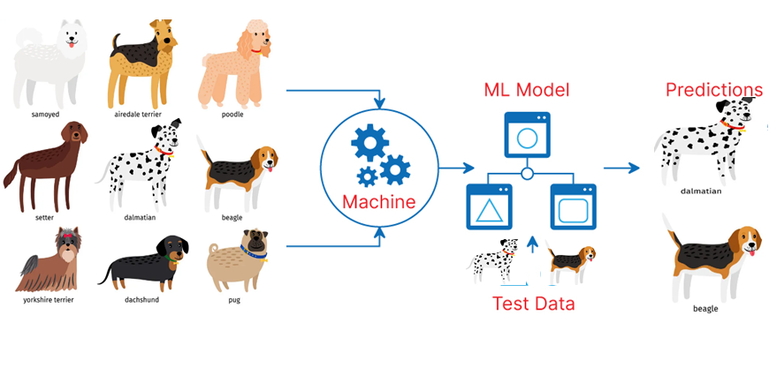

Slide 6
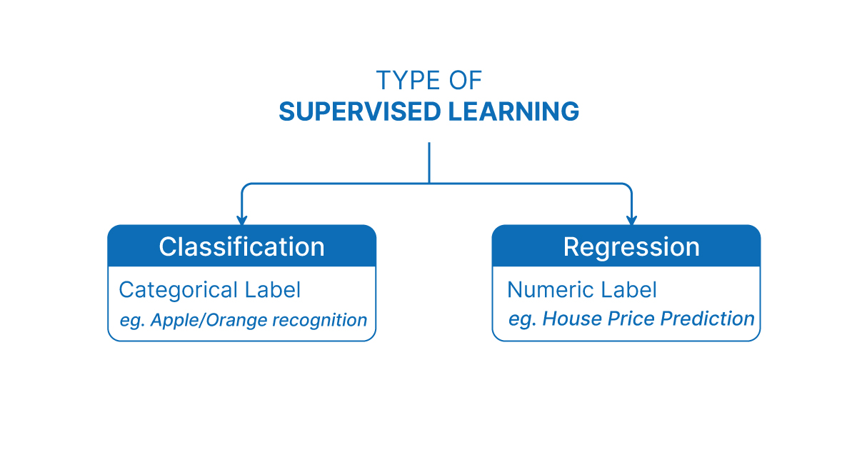

Slide 7
Supervised learning types
classification
regression
Classification algorithms are used when the output variable is categorical. This means there are two classes: yes-no, male-female
Regression is a type of machine learning task that is used to predict a continuous value, such as a numerical or a probability. It is a supervised learning task, which means that the model is trained on a dataset of labeled examples, where the input data is paired with the correct output labels

Slide 8
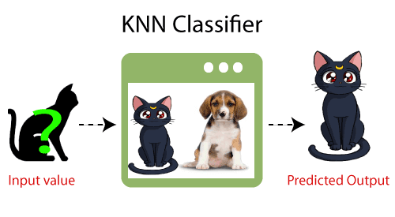
K nearest neighbor(KNN)
K-Nearest Neighbor is one of the simplest Machine Learning algorithms based on Supervised Learning technique.
K-NN algorithm assumes the similarity between the new case/data and available cases and put the new case into the category that is most similar to the available categories.
K-NN algorithm stores all the available data and classifies a new data point based on the similarity. This means when new data appears then it can be easily classified into a well suite category by using K- NN algorithm

Slide 9
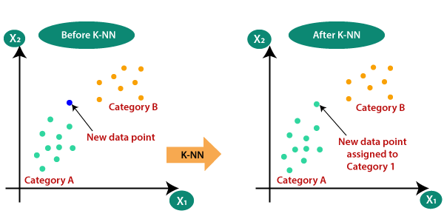

Slide 10
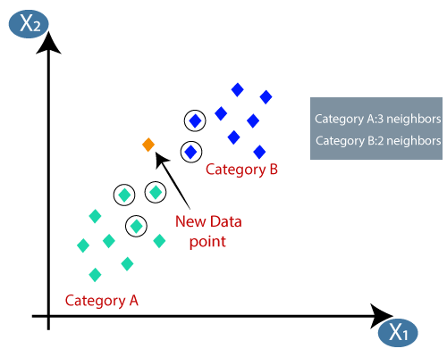
After assigning a value to k, lets say k=5.
By calculating the Euclidian distance we
Identify the new data point class or group.

Slide 11
Support Vector Machines(SVMs)
Support Vector Machine or SVM is one of the most popular Supervised Learning algorithms, which is used for Classification as well as Regression problems. However, primarily, it is used for Classification problems in Machine Learning.
The goal of the SVM algorithm is to create the best line or decision boundary that can segregate n-dimensional space into classes so that we can easily put the new data point in the correct category in the future. This best decision boundary is called a hyperplane.

Slide 12


Slide 13
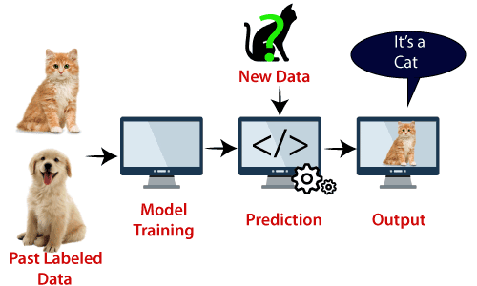
.
SVM algorithm can be used for Face detection, image classification, text categorization, etc.

Slide 14
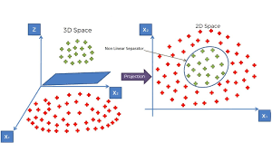
In Case of non linear data we will perform kernal function on the dataset to increase the dimensions of the data
To separate the data with hyperplane.

Slide 15
Decision tree
Decision Tree is a Supervised learning technique that can be used for both classification and Regression problems, but mostly it is preferred for solving Classification problems. It is a tree-structured classifier, where internal nodes represent the features of a dataset, branches represent the decision rules and each leaf node represents the outcome.
In a Decision tree, there are two nodes, which are the Decision Node and Leaf Node. Decision nodes are used to make any decision and have multiple branches, whereas Leaf nodes are the output of those decisions and do not contain any further branches.

Slide 16


