Slide 1
Code Mix Sentiment Analysis
Kshitij Kumar Singh 2018124
Suyash Khare 2018257
Karan Tiwari 2018114

Slide 2
INTRODUCTION
Sentiment Analysis is the interpretation and classification of emotions (positive, negative and neutral) within text data using text analysis and AI techniques.
Our project takes care of the issue of code-mixed text written in Hinglish(i.e Romanagri script) which is combination of both hindi and english written in Roman Alphabet, with the help of google translation.

Slide 3
LITERATURE SURVEY
The process of sentiment analysis can be said to be a form of application that combines and applies the concept of text analytics, computational linguistics as well as natural language processing.
The current study is based on machine learning based approach; therefore we carried literature survey on machine learning and hybrid based approaches.
Research done in this field includes :
The previous research work introduces the Sub-Word Long Short Term Memory model to learn sentiments in a noisy Hindi-English Code Mixed dataset.
In other paper a mechanism was proposed for machine translation of Hinglish to pure (standard) Hindi and pure English form is presented.

Slide 4
DATASET
The dataset which is used was obtained from ‘Kaggle’ called as ‘Sentiment140’ dataset.
It contains 1.6 Million tweets extracted using the twitter API and tweets have been annotated (0 = negative, 2 = neutral, 4 = positive) and they can be used to detect sentiment.
Only 100000 rows were randomly selected from this dataset, with almost equal distribution of positive and negative tweets.
It’s columns are Label,Id,Date,NO_QUERY,Name,Tweet. Only Label and Tweet were used rest were dropped.

Slide 5
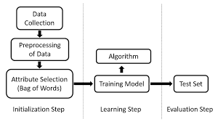
DATASET PREPROCESSING
Various data preprocessing methods can be used to reduce the noise.
We have applied an extensive number of pre-processing steps to standardize the dataset and reduce its size.
Img source: https://www.researchgate.net/figure/Steps-for-training-a-classifier-for-sentiment-analysis-Firstly-data-have-to-be-prepared_fig1_311615347

Slide 6
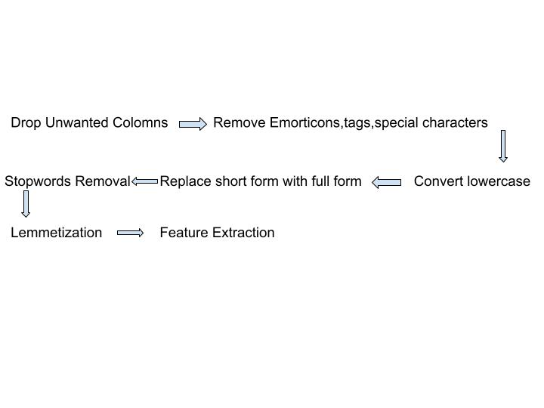
Preprocessing...
Img source: Gallery

Slide 7
MODELS USED
Naïve Bayes’ Classifier : Naive Bayes methods are a set of supervised learning algorithms based on applying Bayes’ theorem with the “naive” assumption of conditional independence between every pair of features given the value of the class variable.
Bernoulli Naïve Bayes’ Classifier : implements the naive Bayes training and classification algorithms for data that is distributed according to multivariate Bernoulli distributions; i.e., there may be multiple features but each one is assumed to be a binary-valued (Bernoulli, boolean) variable. Therefore, this class requires samples to be represented as binary-valued feature vectors

Slide 8
MODELS USED
Logistic Regression : Logistic Regression is a statistical method for analysing a dataset in which there are one or more independent variables that determine an outcome . The outcome is measured with a dichotomous variable (in which there are only two outcomes).
Stochastic Gradient Descent Classifier : Stochastic Gradient Descent (SGD) is a simple yet very efficient approach to discriminative learning of linear classifiers under convex loss functions such as (linear) Support Vector Machines and Logistic Regression. Stochastic gradient descent refers to calculating the derivative from each training data instance and calculating the update immediately. It is particularly useful when the sample data is in a larger number. It supports different loss functions and penalties for classification

Slide 9
MODELS USED
Support Vector Classifier: Generally, Support Vector Classifier(SVC) is considered to be a classification approach, but it can be employed in both classification and regression problems . It can easily handle multiple continuous and categorical variables .
Maximum Entropy Classifier : The Maximum Entropy (MaxEnt) classifier is a probabilistic classifier which belongs to the class of exponential models . It does not assume that the features are conditionally independent of each other. The MaxEnt is based on the Principle of Maximum Entropy and from all the models that fit our training data, selects the one which has the largest entropy

Slide 10
Model Results Table
Classifiers Vs Accuracy
Models | Accuracy
Naïve Bayes’ Classifier | 71.58
Bernoulli Naïve Bayes’ Classifier | 72.61
Logistic Regression | 75.82
Stochastic Gradient Descent Classifier | 76.64
Support Vector Classifier | 76.56
Maximum Entropy Classifier | 77.48

Slide 11
Comparison
Accuracy | Benefits | Drawbacks
69.7% | Sub-Word LSTM interprets sentiment based on morpheme-like structures and the results thus produced are signiﬁcantly better than baselines. | The lexicon lookup approach didn’t perform well owing to the heavily misspelt words in the text, which led to incorrect transliterations.

Slide 12
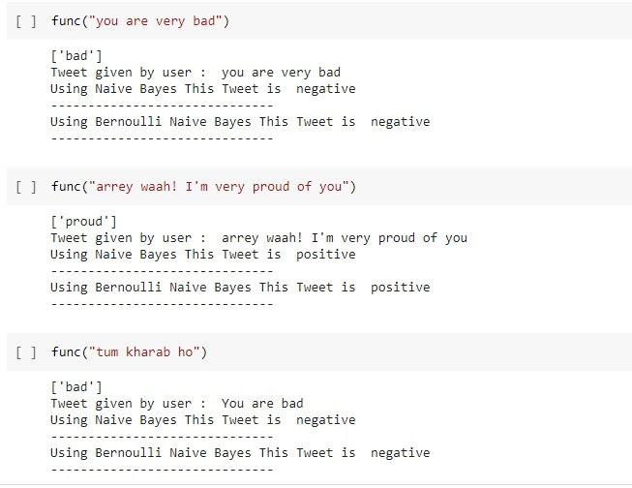
Output
1.Naive Bayes
2.Bernoulli Naive Bayes

Slide 13
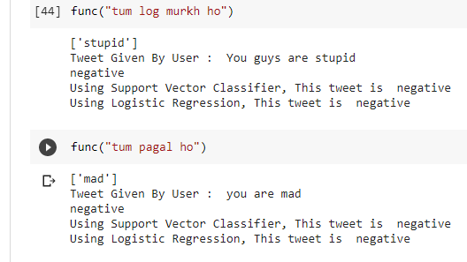
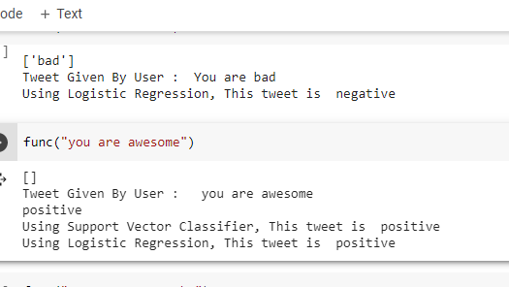
Output
Logistic Regression And Support Vector Classifier

Slide 14
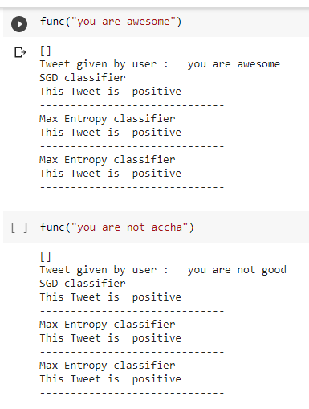
Output
1. SGD Classifier
2. Max Entropy Classifier

Slide 15
Work distribution
Kshtij Kumar Singh: Pre processing , SGD , Max Entropy Model
Karan Tiwari : Pre-Processing, SVC, Logistic Regression
Suyash Khare : Pre processing , Naive Bayes , Bernoulli Naive Bayes

Slide 16
Challenges
Accuracy for the testing of the models was around 77%, even after several
efforts to increase it.
Instead of Google translation better approach which includes integration of
deep learning techniques like Bert and LSTM can be used.
Good Hinglish dataset were not available readily and there is no standard
way to write hinglish sentences so its analysis and classification is very
difficult through ML

Slide 17
Thank You

