Slide 1
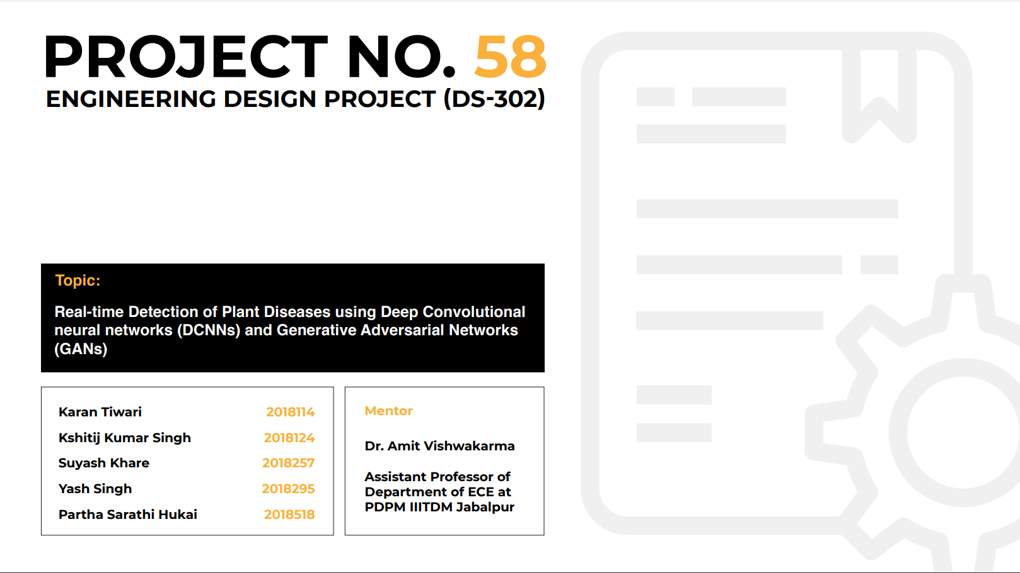
Group Number 42

Slide 2
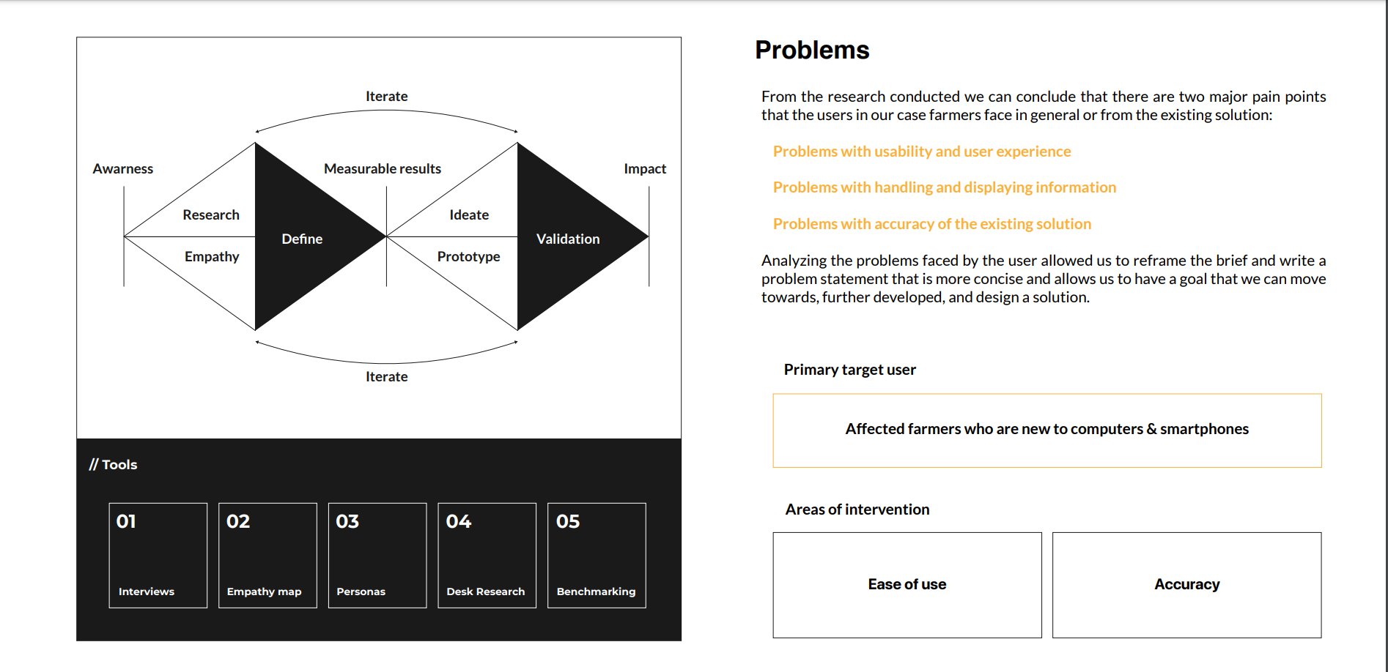
Problem Identification & Objectives

Slide 3
Problem Identification and Objectives
Plant disease has been a major factor influencing food production and human societal development over many years. Modern technologies like AI, Machine learning, etc. can help us with the age-old problem, society has been facing.
In this artificial intelligence-based project we will try helping farmers to detect plant diseases related to apples, corn, grape, potato, and tomato (especially in large scale farming Using Drone for surveillance).

Slide 4
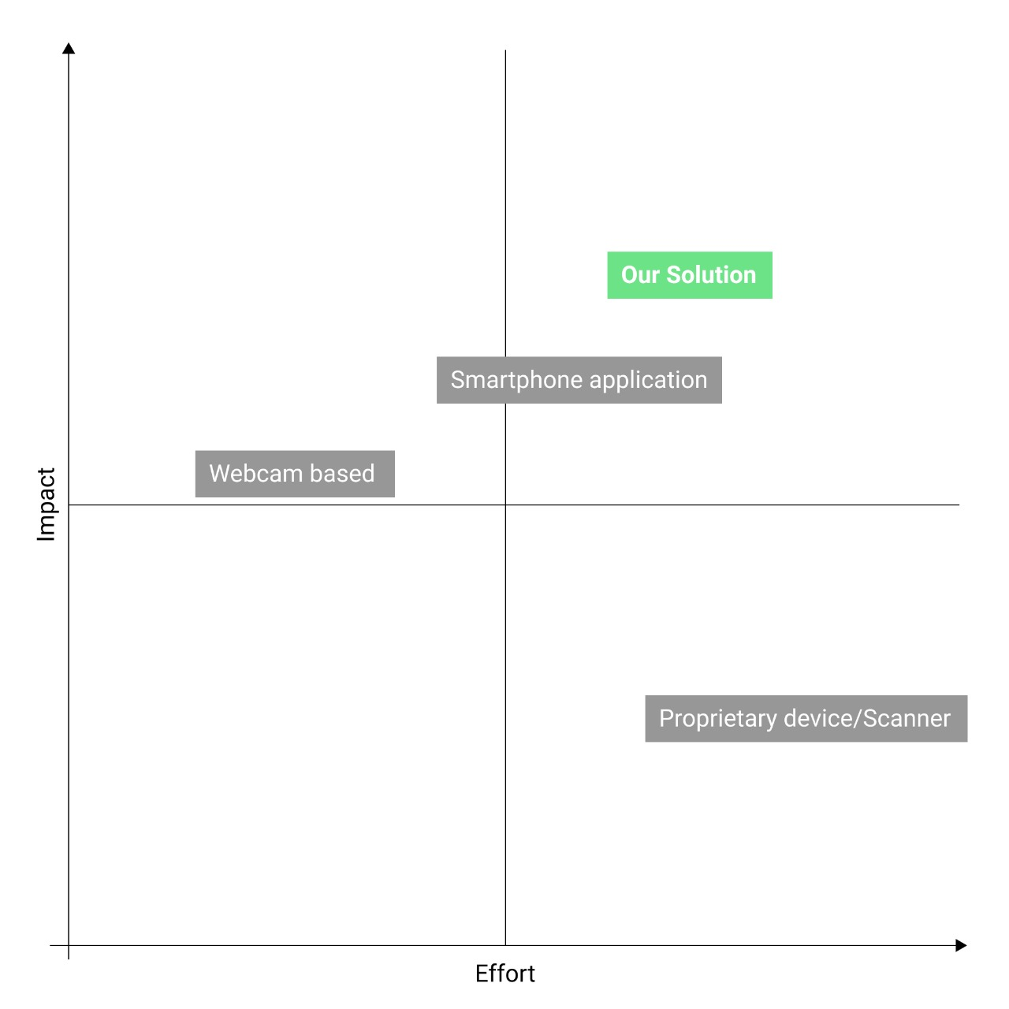
State of Art
Health monitoring and disease detection on plant is very critical for sustainable agriculture. It is very difficult to monitor the plant diseases manually.
Hence, here DCNNs, vgg16, resnet, InceptionV3 are used for the detection of plant diseases to prevent the losses in the yield and quantity of the agricultural product
.
DCNNs have high efficacy than the conventional technologies currently used , supported by drone Surveillance for more applicability especially in large-scale farming.

Slide 5
Methodology Adopted
Web App
Drone
Plant
Predict Plant Disease
Field

Slide 6
Proposed Solution
We have developed an application based on artificial intelligence which will be using Deep Learning Deep Convolutional neural networks (DCNNs).
The application will be using the image data received from the drone web camera (Square FOV) which will be processed through Raspberry Pi for Real Time detection of Plant leaf disease classification.

Slide 7
Developments and Efficacy(s)
Performed model training and explored various transfer learning techniques such as vgg16, resnet, InceptionV3.
Performed InceptionV3 on a Grape dataset and got a validation accuracy of 97.78%.
Performed InceptionV3 on an Apple And Potato dataset and got a validation accuracy of 98.51%. and 97.62% respectively.

Slide 8
Developments and Efficacy(s)
Performed transfer learning (InceptionV3) first on the tomato dataset and then over all the plant diseases dataset ( 78k train , 18k test images and total 38 classes ) and 91.12% accuracy was achieved in 4 epochs.
Worked on a Web application (Worked on Flask Framework) for detection of Plant diseases with a total of 38 classes.
Development of CAD model of drone consisting of various micro appliances on board required for real time analysis.

Slide 9
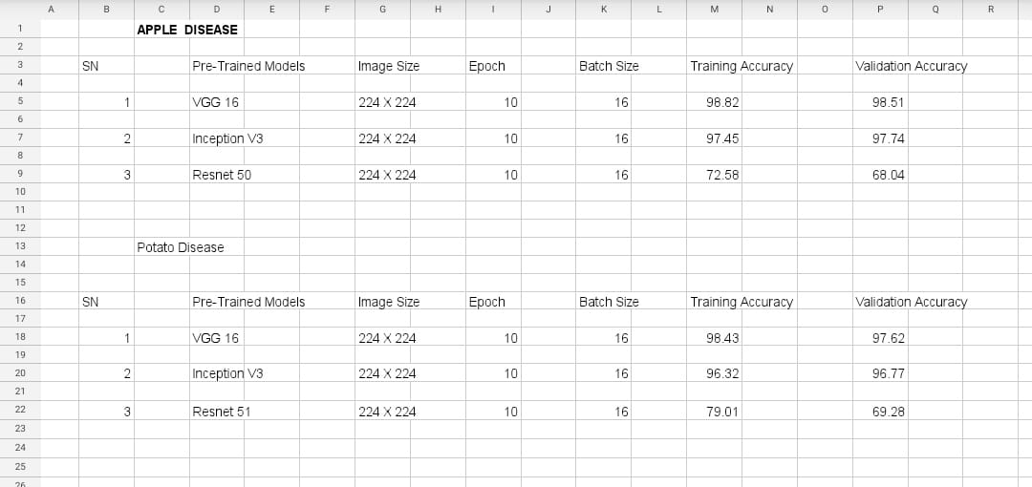

Slide 10
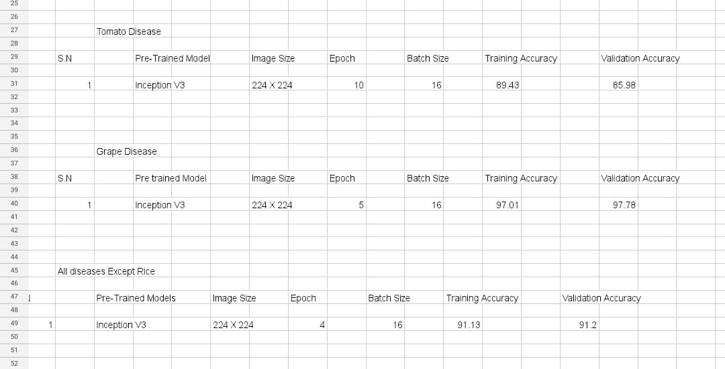

Slide 11

Animation/ Simulation

Slide 12
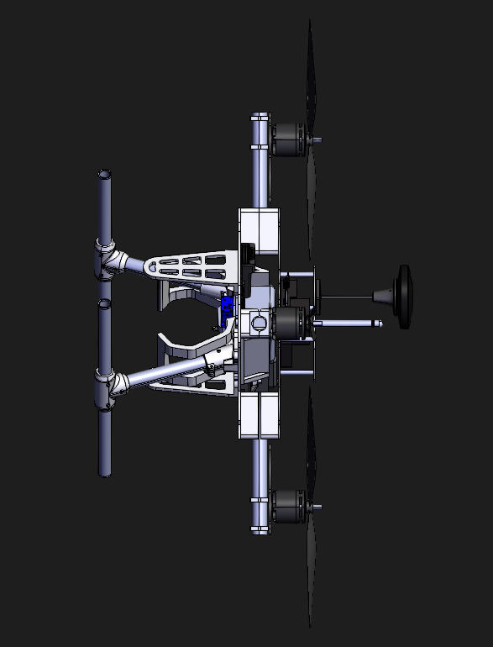
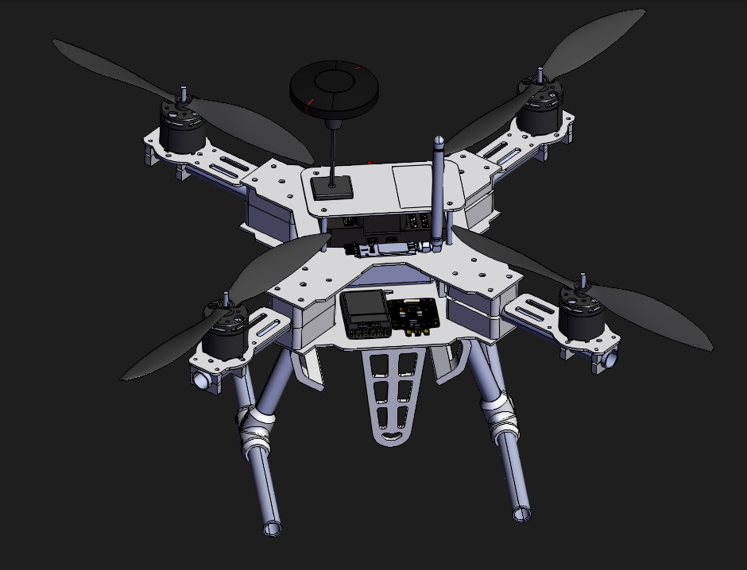
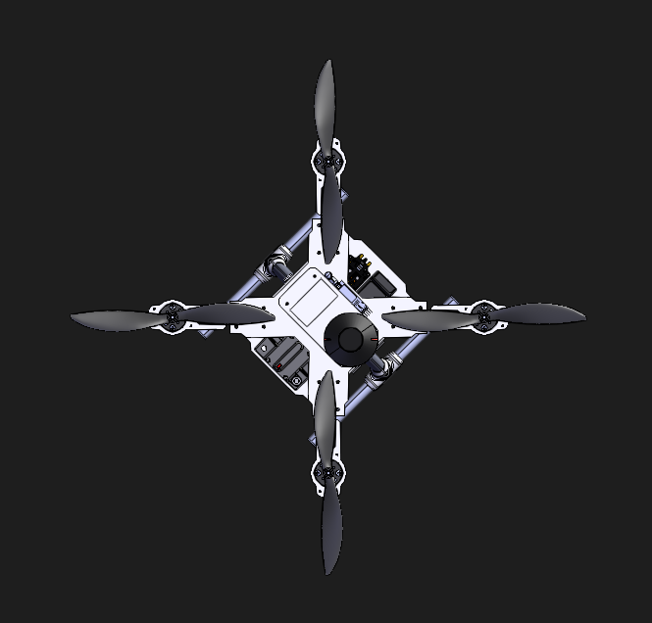
Drone CAD Model

Slide 13
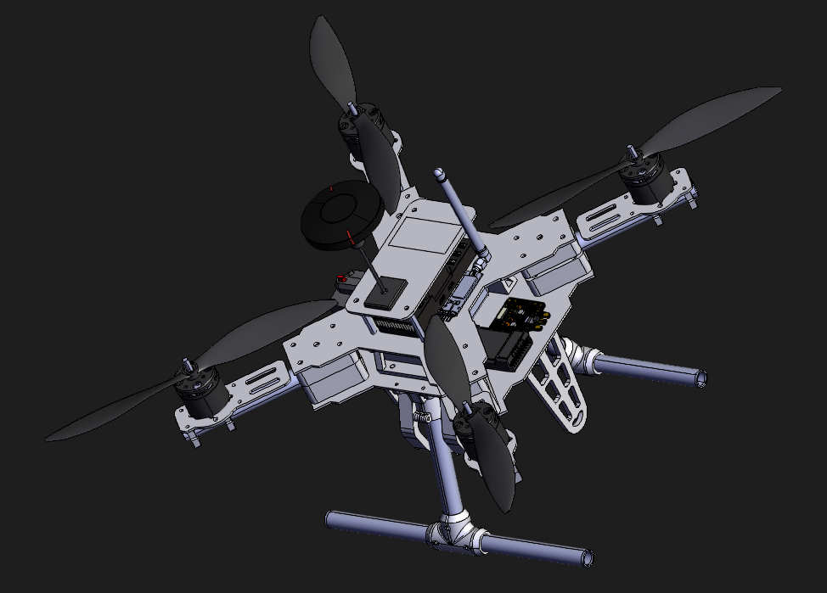
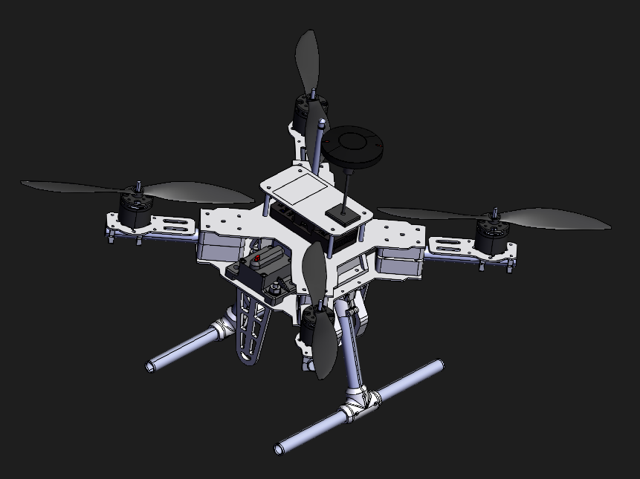

Slide 14
Outcome of the Project
A web application for showing the predicted results from the plant leaf image taken by the specifically designed Drone (carrying various micro appliances , processors , Raspberry pi, camera ,etc on board itself ).
Plant disease detection will help the farmers to take the right step beforehand.

Slide 15
Novelty of Work and Patentability
Since there were a lot of aspects in this project : Deploying Model in Raspberry Pi, taking Image input from drone camera, speed of drone, image resolution, height of drone in air, field of view, etc factors were to be tested. So it was a unique project and with proper hardware implementation it could be patentable. A lot of startup are working & research going over this. This Project can be made more convenient to use when linked with mobile App & directly sending results or SMS to the mobile of vulnerabilities.

Slide 16
Thank You!

