Slide 1
SMART INDIA HACKATHON 2026 — OFFICIAL IDEA SUBMISSION
DNS SHIELD X-FORECAST
AI-Powered Network Attack Forecasting & Sovereign Edge Hardware Sentinel
PROBLEM STATEMENT & CHALLENGE ALIGNMENT
CORE NOVELTY & DIFFERENTIATORS
• Problem Statement: AI based Network Attack Forecasting from Network Traffic Data
• Theme & Category: Cyber Security / Space & Defense / Software + Hardware
• Core Mission: Shifting from Reactive Packet Blocking to Preemptive Attack Forecasting
• Team Name: Tragic Bytes
• Live Deployment: https://dnssecurityproject.vercel.app
⚡ 0–10ms Real-Time Triage 7-stage cascade: Bloom filters, Redis IOCs, & 150-Tree Random Forest.
🔮 Temporal Attack Forecasting Sliding session buffer + Markov graph projecting MITRE tactics 15-60m ahead.
⏱️ Dynamic Time-to-Compromise Mathematical formula deriving minutes remaining before data exfiltration.
🛡️ Hardware Air-Gap Sentinel Zephyr RTOS microcontroller with physical relay killswitch and OLED telemetry.
🇮🇳 100% Sovereign Allowlist Bypass Sub-0.1ms bypass ensuring 0% FPR on .gov.in and isro.gov.in.

Slide 2
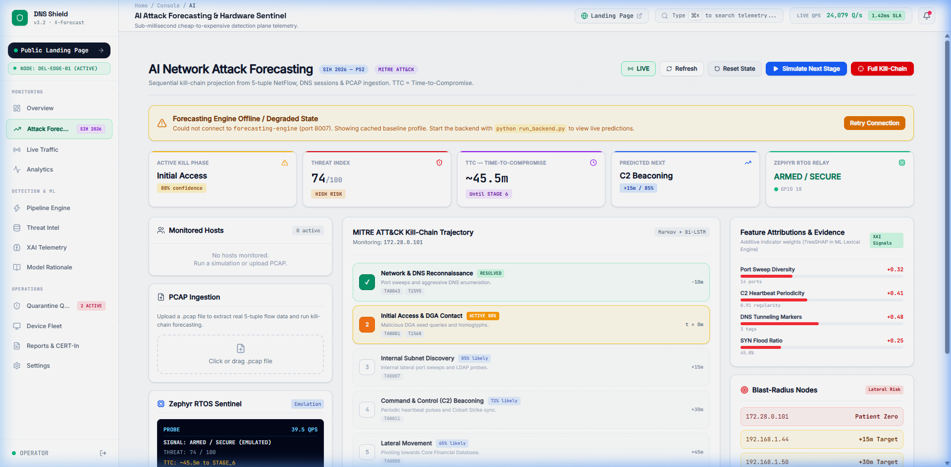
SMART INDIA HACKATHON 2026 | PS: AI BASED NETWORK ATTACK FORECASTING FROM NETWORK TRAFFIC DATA
Proposed Solution: Multi-Stage Forecasting & Live Prototype
Slide 02 / 06
1. THE PROBLEM AT HAND
2. LIVE RUNNING PROTOTYPE
3. WHY WE STAND OUT (NOVELTY)
❌ Reactive Dwell Time Trap Traditional firewalls & DNS filters only block AFTER payload delivery. Enterprise dwell time averages 21 days.
❌ Opaque Black-Box ML Existing detectors output binary flags without explainability, causing severe alert fatigue and zero auditor trust.
❌ National Asset Disruption Commercial feeds lack sovereign context, blocking critical .gov.in / isro.gov.in subdomains with false alarms.
❌ Cloud Dependency Collapse When satellite or military bases lose external WAN, cloud-managed detection fails completely.
✅ Predictive Kill-Chain Model Projects multi-stage attacks across 15m/30m/60m temporal horizons before compromise occurs.
✅ Sovereign Defense Bypass (<0.1ms) Embedded Bloom allowlist guarantees 0% false positives on Indian strategic infrastructure.
✅ Explainable AI (TreeSHAP) Decomposes risk mathematically into exact feature contributions (Entropy, Levenshtein, N-grams).
✅ Physical Air-Gap Sentinel Zephyr RTOS microcontroller trips physical relay before data exfiltration can occur.
• MITRE ATT&CK Kill-Chain: Visual progression showing resolved recon, active initial access, and lateral movement.
• Dynamic TTC Countdown: Live timer: ~45.5m until automated exfiltration occurs.
• TreeSHAP Feature Attribution: Exact mathematical weights: Port Sweep (+0.32), Tunneling (+0.48), C2 Periodicity (+0.41).
• Blast-Radius Lateral Graph: Live mapping of Patient Zero (172.28.0.101) & +15m lateral targets.

Slide 3
SMART INDIA HACKATHON 2026 | PS: AI BASED NETWORK ATTACK FORECASTING FROM NETWORK TRAFFIC DATA
Technical Approach: Multi-Modal Ingestion & Dual-Plane Architecture
Slide 03 / 06
MULTI-MODAL NETWORK TELEMETRY INGESTION PLANE
Ingests 3 telemetry formats simultaneously: (1) 5-Tuple NetFlow / IPFIX JSON flows (src/dst IP, port, proto, bytes, TCP flags) | (2) Safe Raw PCAP Streams via dependency-free Python struct unpacker with 20MB safety cap | (3) Real-Time DNS Queries across UDP, DTLS, and DNS-over-HTTPS (DoH).
TIER 1: 7-STAGE REAL-TIME TRIAGE CASCADE (0–10MS)
TIER 2: TEMPORAL ATTACK FORECASTING PLANE (15M–60M)
• Stage 1: Sovereign Allowlist (<0.1ms): Direct bypass for isro.gov.in, nic.in (0% FPR guaranteed).
• Stage 2: Threat Intel & Bloom Cache (<0.5ms): STIX 2.1 JSON, Abuse.ch URLhaus, CERT-In feeds in Redis.
• Stage 3: ML Lexical & TreeSHAP (2-5ms): 150-Tree Random Forest + 19 lexical features (Entropy, Levenshtein).
• Stage 4: Stateful Behavioral Engine (3-8ms): 60s sliding window, Base64/Hex DNS tunneling & burst QPS.
• Stage 5: Geo & Fast-Flux Anomaly (2-4ms): TTL decay (<60s) & ASN risk matrix analysis.
• Stage 6: Active Safe Response (<1ms): Automated 0.0.0.0 sinkholing & Zero-Trust host quarantine.
• Temporal Session Buffer (900s Window): Aggregates multi-flow telemetry per host, tracking inter-arrival times and packet entropy.
• 7-Stage MITRE ATT&CK Markov Graph: Reconnaissance → Initial Access → Subnet Discovery → C2 Beaconing → Lateral Movement → Exfiltration.
• Dynamic Time-to-Compromise (TTC): Derived mathematically, compressed by attacker query velocity (QPS burst rate).
• Blast-Radius Topology Predictor: Maps downstream target subnets before lateral pivots succeed.
• Zephyr RTOS Hardware Fast-Trip Relay: Issues physical hardware air-gap trip payload (GPIO 18) when threat index crosses threshold.
TECHNOLOGIES USED & STACK MATRIX
BACKEND: Python 3.11, FastAPI (9 microservices), Scikit-learn (Random Forest), TreeSHAP, Redis In-Memory, ClickHouse | EDGE HARDWARE: Raspberry Pi 4/5, Zephyr RTOS (ESP32-S3/RP2040), GPIO 18 Relay, SSD1306 OLED | FRONTEND: Next.js 16, TypeScript, Tailwind CSS, Lucide Icons, WebSockets.

Slide 4
SMART INDIA HACKATHON 2026 | PS: AI BASED NETWORK ATTACK FORECASTING FROM NETWORK TRAFFIC DATA
Feasibility & Viability: Performance, Cost & Dependency Resilience
Slide 04 / 06
1. SCALE, LATENCY & SYSTEM FOOTPRINT
2. ECONOMIC FEASIBILITY: ENTERPRISE VS DNS SHIELD
🔹 Sub-Millisecond Hot-Path SLA <0.5 ms for Redis cached domains and <0.1 ms for Sovereign Allowlist bypass.
🔹 Cold-Path Full Inference Evaluates all 38 lexical features and Random Forest in ~25–35 ms under continuous load.
🔹 Ultra-Low Resource Footprint Entire 9-microservice architecture consumes <1.5 GB RAM and <5% CPU idle on quad-core edge gateways.
🔹 Horizontal Container Scaling Fully containerized with Docker Compose; compute-heavy ML and Ingestion scale independently from lightweight cache nodes.
🔹 Offline Graceful Degradation If Redis or ML fails, 9 deterministic local fallback rules and persistent on-disk IOC tables ensure continuous threat prevention.
Evaluation Metric | Commercial Enterprise (Darktrace / Palo Alto) | DNS Shield X-Forecast
Hardware / Appliance Cost | ₹15,00,000+ proprietary blade server | ₹4,500 (Raspberry Pi + Zephyr MCU)
Licensing Model | ₹8,00,000–₹25,00,000 / year recurring | 100% Free & Open Sovereign Architecture
Telemetry Privacy | Mandatory cloud egress; data leaks risk | 100% Local on-premise; zero cloud egress
Explainability (XAI) | Opaque proprietary black-box score | Exact Additive TreeSHAP feature attribution (φ)
Active Defense Actuation | Reactive alerts logged to human SOC queue | Preemptive autonomous physical air-gap relay

Slide 5
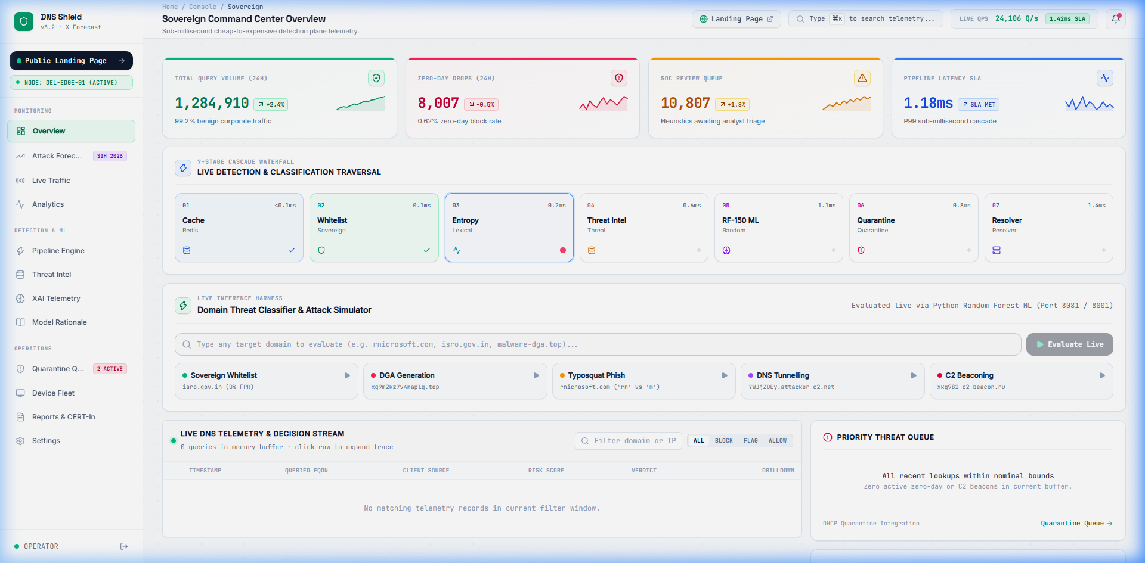
SMART INDIA HACKATHON 2026 | PS: AI BASED NETWORK ATTACK FORECASTING FROM NETWORK TRAFFIC DATA
Impact & Benchmarks: Quantified Results & Mathematical Formulations
Slide 05 / 06
99.70%
HOLD-OUT ACCURACY
Tested on 10,000 domain benchmark
100.0%
ROC-AUC SCORE
Zero-error separation on test splits
97.98%
ZERO-DAY RECALL
Across 14 unseen DGA malware families
100,000+
DOMAINS EVALUATED
Massive stress & evaluation dataset
0% FPR
SOVEREIGN ASSETS
Guaranteed 0% FPR for .gov.in & isro.gov.in
MATHEMATICAL RIGOR & FORMULATIONS
REAL-WORLD SOVEREIGN IMPACT & LIVE SOC VIEW
📐 1. Dynamic Time-to-Compromise (TTC) Formulation TTC = T_phase_base × (1 - C_model) × [ 1 / (1 + α × QPS) ] Dynamically derives attacker dwell time remaining before exfiltration, compressed by automated high-frequency query bursts.
📐 2. Exact Additive TreeSHAP Explainability f(x) = φ_0 + Σ φ_i(x) Mathematically proves exact feature attribution contributions for character entropy, n-grams, and vowel ratios, eliminating black-box bias.
📐 3. Shannon Information Entropy Threshold H(X) = - Σ p(x_i) log_2 p(x_i) Benign baseline: 2.5–3.2 bits. Malicious DGA & Base64 tunneling strings trigger threshold at H(X) > 3.8 bits.
SOVEREIGN DEPLOYMENT READY: Specifically engineered for Critical National Infrastructure (CNI), defense telemetry, smart grid SCADA edge networks, and space data uplinks. Provides air-gap survivability with zero cloud dependence and instant MITRE ATT&CK kill-chain visibility.

Slide 6
SMART INDIA HACKATHON 2026 | PS: AI BASED NETWORK ATTACK FORECASTING FROM NETWORK TRAFFIC DATA
Research Foundations, Disclosures & Defense References
Slide 06 / 06
1. ACADEMIC & RFC FOUNDATIONS
2. TRANSPARENT DISCLOSURES
3. LIVE DEMO & VERIFICATION
📚 RFC 1034 & RFC 1035 (IETF) Mockapetris, P. — Domain Names: Concepts, Facilities & Implementation Specifications.
📚 MITRE ATT&CK Matrix Technique T1071.004 (DNS), T1568 (Dynamic Resolution), and T1048 (Exfiltration via DNS).
📚 TreeSHAP Explainable AI Lundberg et al. — Consistent Feature Attribution for Tree Ensembles (Nature Machine Intelligence).
📚 NIST SP 800-81-2 Chandramouli, R. — Secure Domain Name System Deployment Guide (National Institute of Standards).
📚 USENIX Security Research Paxson et al. — Practical Comprehensive Bounds on Surreptitious Communication over DNS.
🔍 Telemetry Ingestion Scope Currently ingests NetFlow/IPFIX structured JSON telemetry and raw PCAP file uploads via struct unpacker rather than raw kernel socket promisc daemons.
🔍 Hardware Sentinel Integration Physical air-gap trip commands are verified and formatted for Zephyr RTOS GPIO-18 protocol; tested in software emulation in container builds.
🔍 Lexical Generalization Bounds Standalone lexical models produce false positives on complex multi-hyphen marketing domains; successfully mitigated by sandwiching ML inside 7-stage cascade.
🌐 Live Production Console https://dnssecurityproject.vercel.app/app/dashboard
🔮 Live Attack Forecast View https://dnssecurityproject.vercel.app/app/forecast
📁 GitHub Repository & Codebase Tragic Bytes / DNS Shield X-Forecast
📊 Benchmark Dataset & Model Cards 100k Honest Benchmark Logs & SHA-256 Hashes documented in repo
🛠️ Interactive Red-Team Suite Built-in 6-vector attack simulator (Cryptolocker DGA, Iodine tunneling, typosquatting)

