Slide 1



SLO / SLI Calculator
By: Kshitiz Anand
Registration No: 23FE10CSE00773
Course: CSE3253 DevOps (PE6)
Semester: VI (2025–2026)
Instructor: Mr. Jay Shankar Sharma

Slide 2
Problem Statement
Modern cloud services rely on reliability metrics to measure system performance. Two important reliability metrics are:
Service Level Indicators (SLIs) → actual performance metrics
Service Level Objectives (SLOs) → target reliability goals
Monitoring systems collect raw metrics, but teams need tools to evaluate whether their services meet reliability targets.
Goal: Build a system that calculates SLI values from monitoring metrics and determines whether the service meets its SLO.

Slide 3
Project Objectives
Calculate Service Level Indicators (SLI) from service metrics
Compare calculated SLI values with defined SLO targets
Provide a web interface for users to input monitoring data
Demonstrate containerized deployment using Docker
Implement DevOps practices such as CI/CD and monitoring configuration

Slide 4

System Architecture
User
SLI Calculation Logic
Result Display
Web Interface
Flask API
Notes:
Steps:
User enters monitoring metrics in the dashboard.
The UI sends a request to the /calculate API endpoint.
The backend calculates the SLI value.
The system compares SLI with the SLO target.
The result is returned and displayed to the user.

Slide 5
Technology Stack
Core Technologies
Python
Flask Web Framework
DevOps Tools
Git → Version control
Docker → Containerization
Docker Compose → Container orchestration
GitHub Actions → CI/CD pipeline
Puppet → Configuration management
Nagios → Monitoring configuration

Slide 6
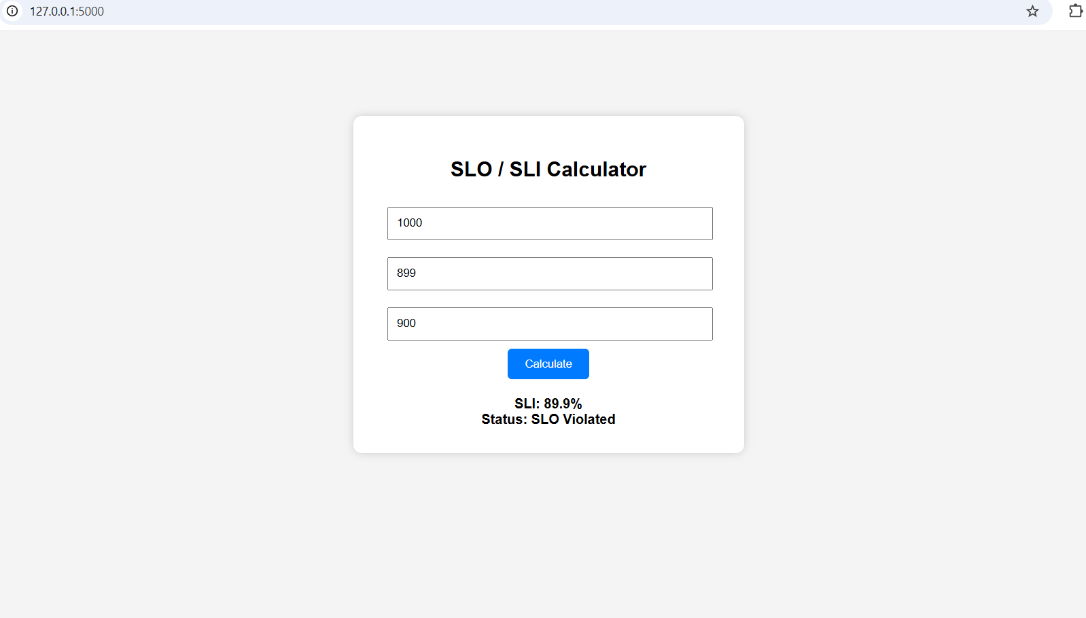
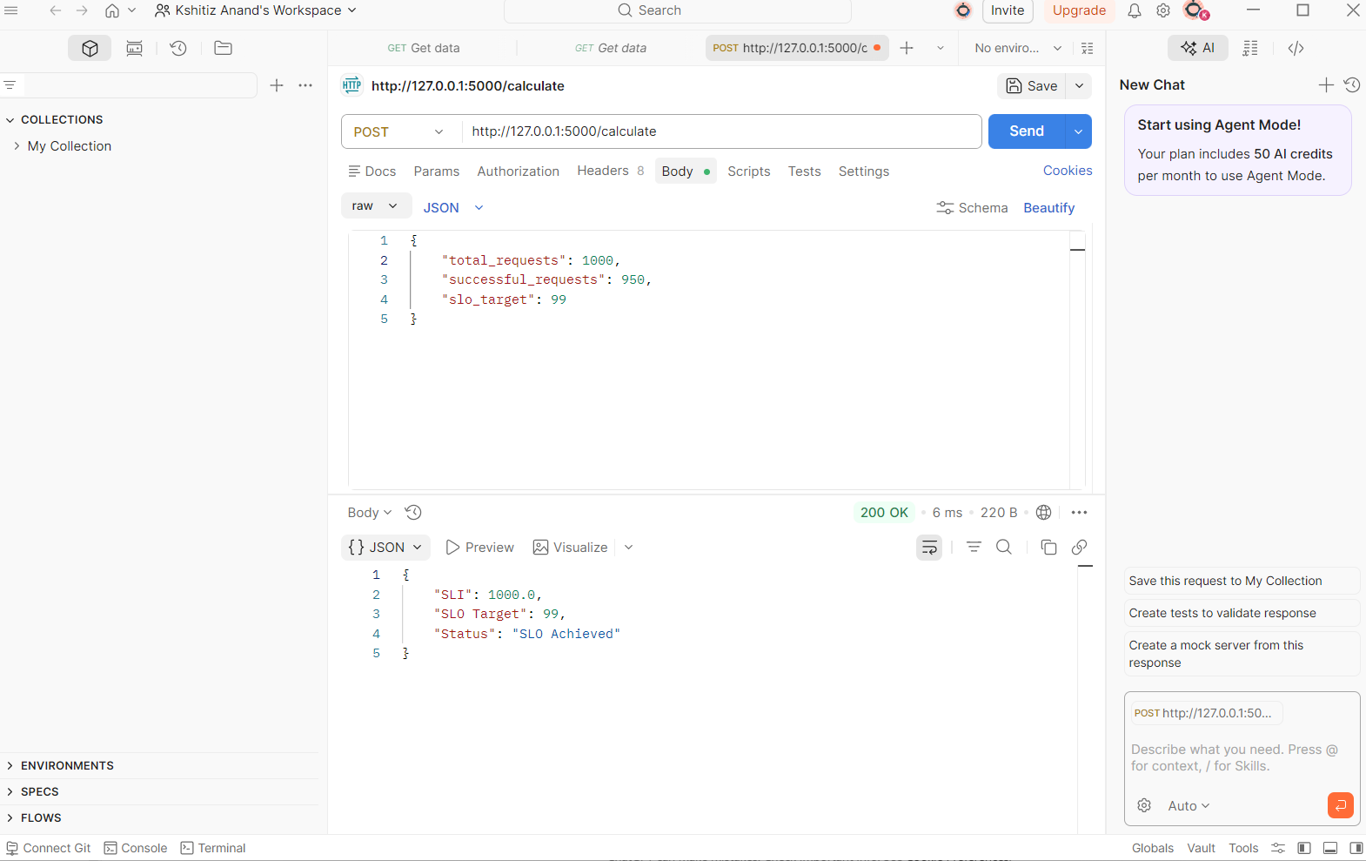
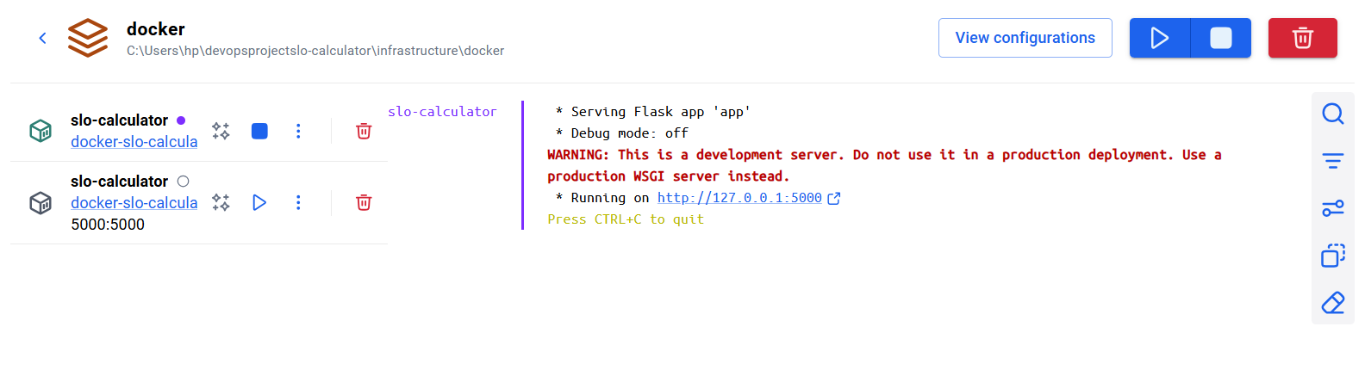
Project Demo
Web Dashboard
API Test (Postman)
Docker container running

Slide 7


Contact details
someone@example.com

