Slide 1


GOLANG OVERVIEW

Slide 2
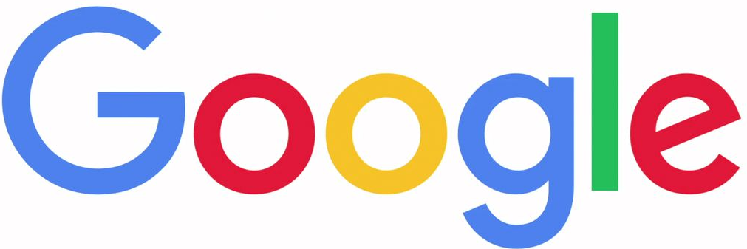
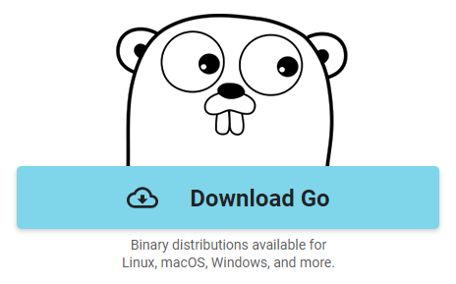

Golang/Go
Open Source Programming Language That Makes It Easy To Build Simple, Reliable, & Efficient Software
https://golang.org/

Slide 3

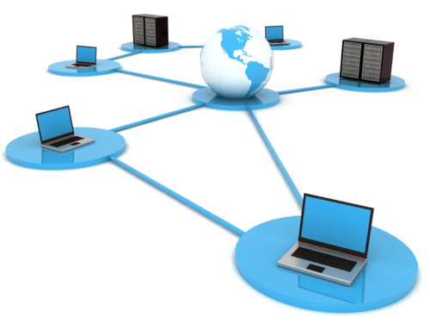

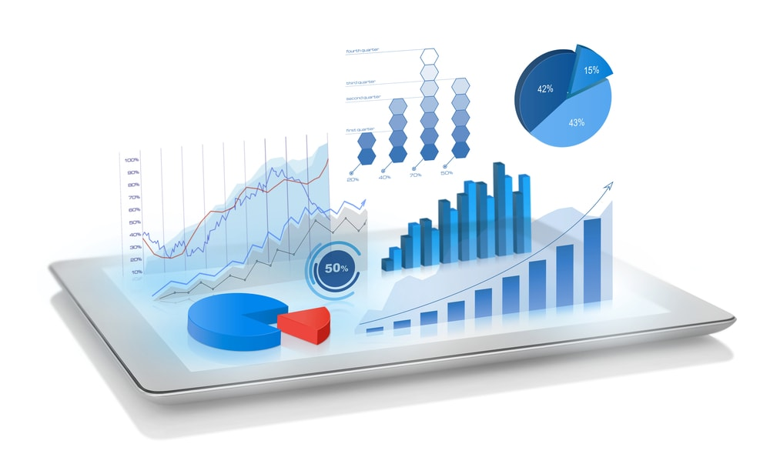
Application Areas
System &
Networking
Big Data
Audio &
Video
Editing
Data Visualization

Slide 4
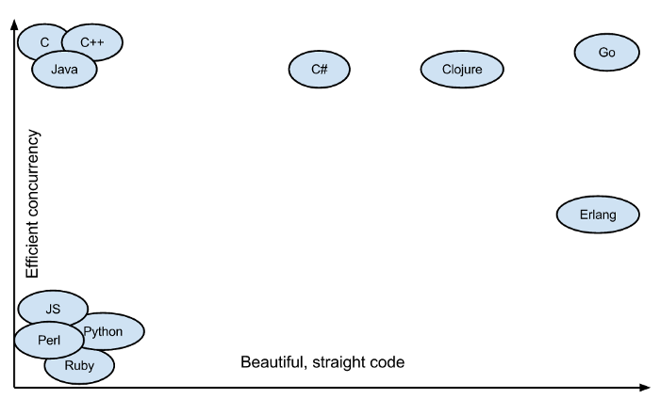
Key Features
Parallelism
Concurrency
Fast
Better Garbage Collection
Both Programmer & System Efficient

Slide 5
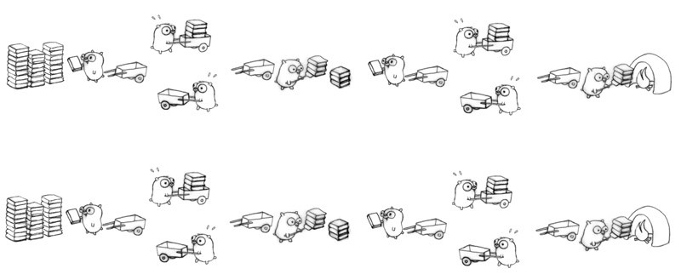
Goroutines
Light Weight & Cost Efficient Threads

Slide 6


Go For Cloud Computing
Addresses Concurrency Needs For Scaled Applications, Microservices, & Cloud Development
Over 75% Projects In Cloud Native Computing Foundation Are Written In Go
Docker - Manages Go Codes & Support Multiple Platforms
Kubernetes - Orchestration System Written In Go

Slide 7
Basic Structure
Package Declaration
package main
import "fmt"
func main() {
var a int = 5
var b int = 6
fmt.Println(sum(a, b))
}
func sum(a int, b int) int{
return a+b
}
// Output is 11
Import Packages
Variables
Statements & Expressions
Functions
Comments

Slide 8
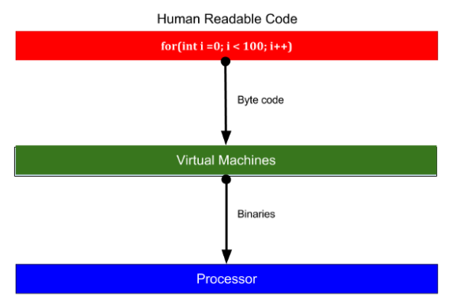
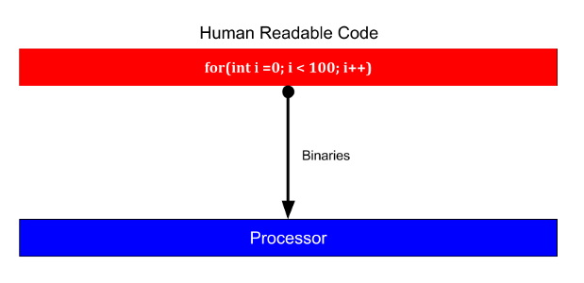
No Byte Code Creation
Direct Binary Conversion In Golang
Languages Like Java Form Bytecode

Slide 9
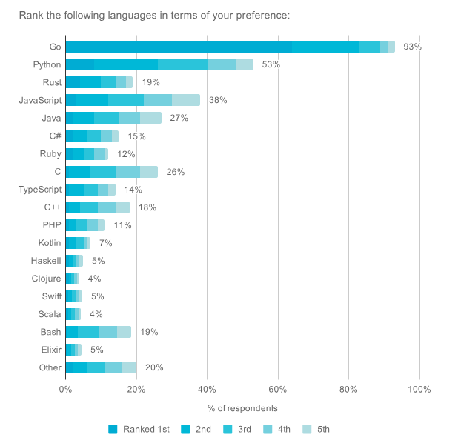
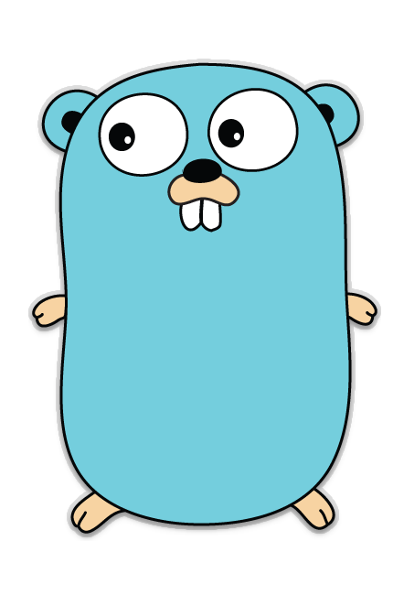
GOLANG
1st Preference - 65%
2nd Preference - 85%
3rd Preference - 90%
4th Preference - 92%
5th Preference - 93%

