Slide 1

Credit Card
Weekly Status Report

Slide 2

Content
Project Objective
Basic Requirements
Tables Details
SQL and Python Connection
SQL and Power BI Connection
SQL Queries and DAX
Dashboard and Insights

Slide 3

Objective
To develop a comprehensive credit
card weekly dashboard that
provides real-time insights into key
performance metrics and trends,
enabling stakeholders to monitor
and analyze credit card operations
effectively.

Slide 4



BASIC REQUIREMENTs
Download Dataset
Create tables in SQL
import CSV file into SQL
Download The Dataset :

Slide 5
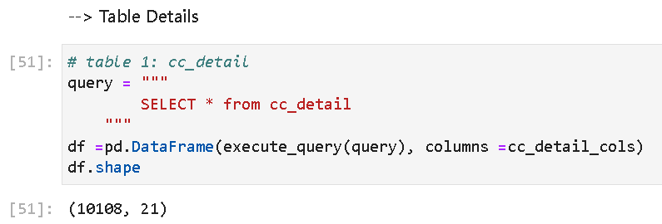
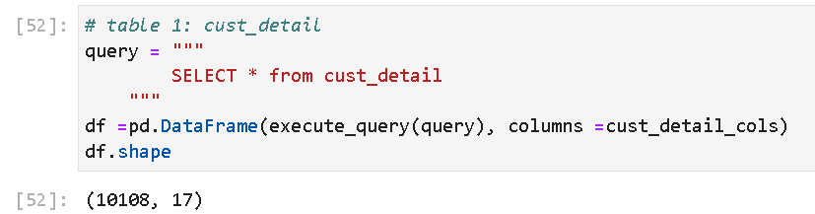
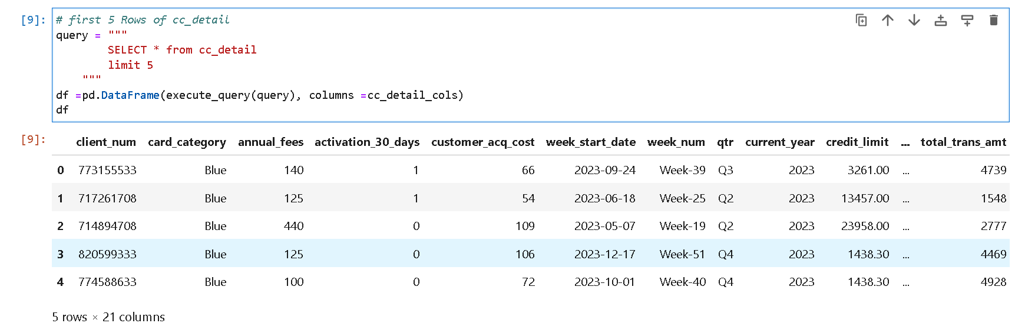
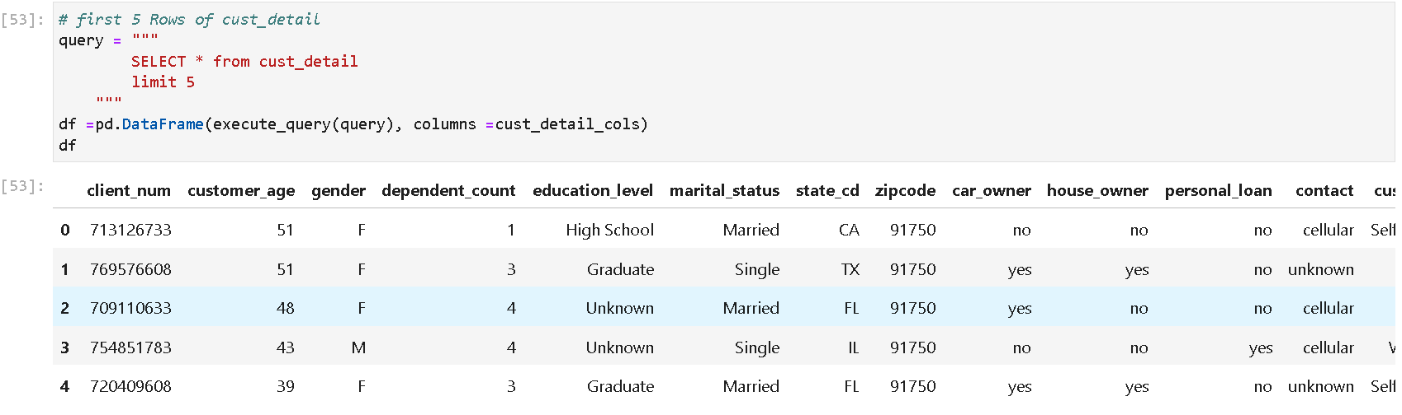
Table Details
Table 1: cc_detail
Table 1: cust_detail

Slide 6
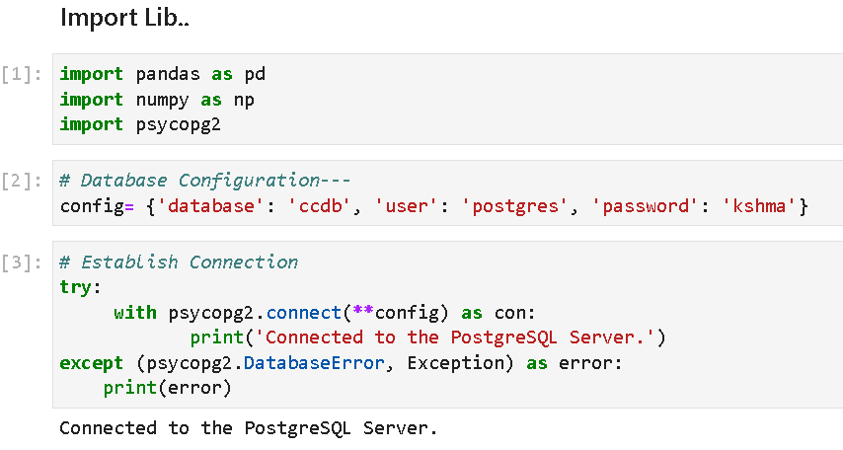
SQL and Python Connection
Success

Slide 7

This function will help to execute all SQL queries

Slide 8
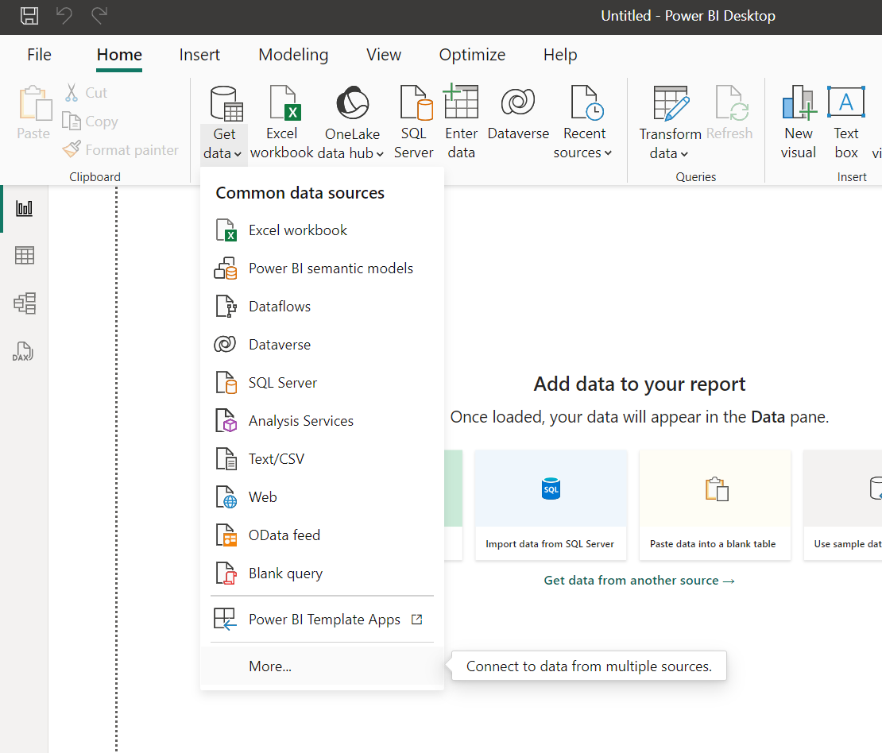
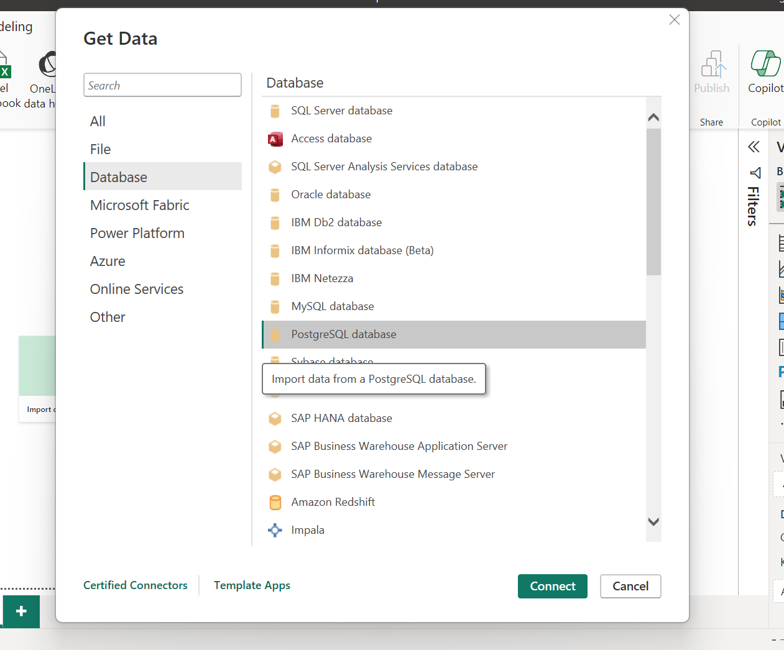
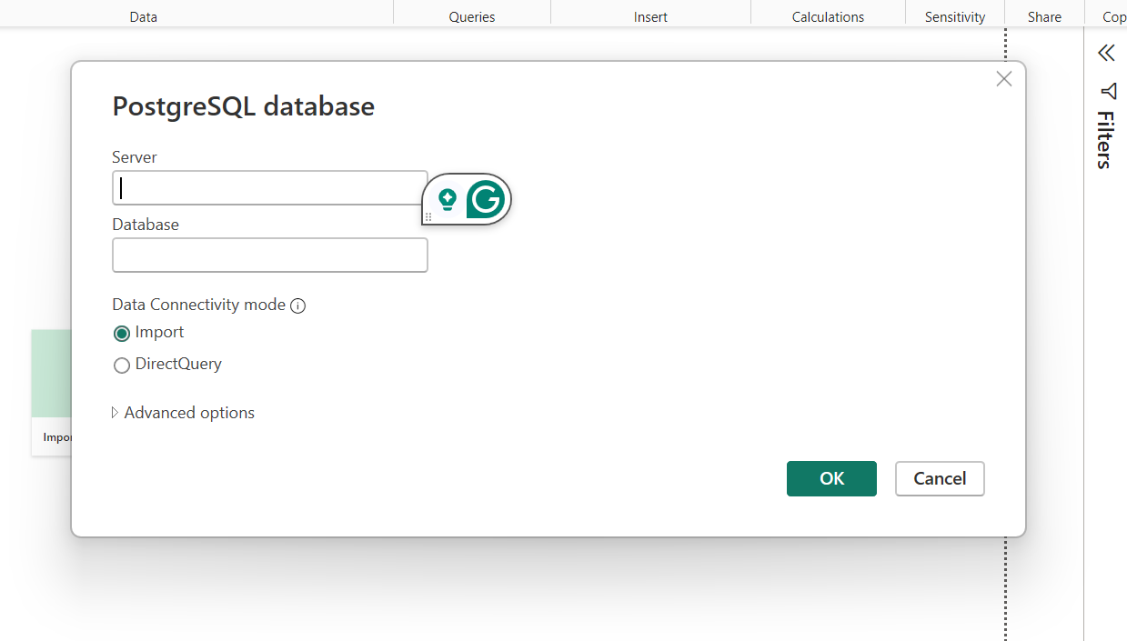
SQL and Power BI Connection

Slide 9
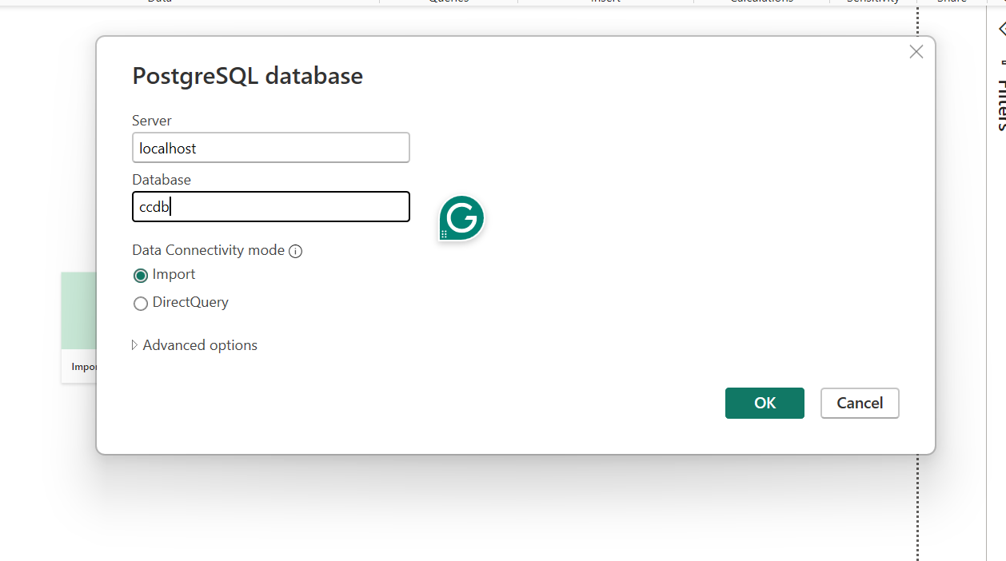
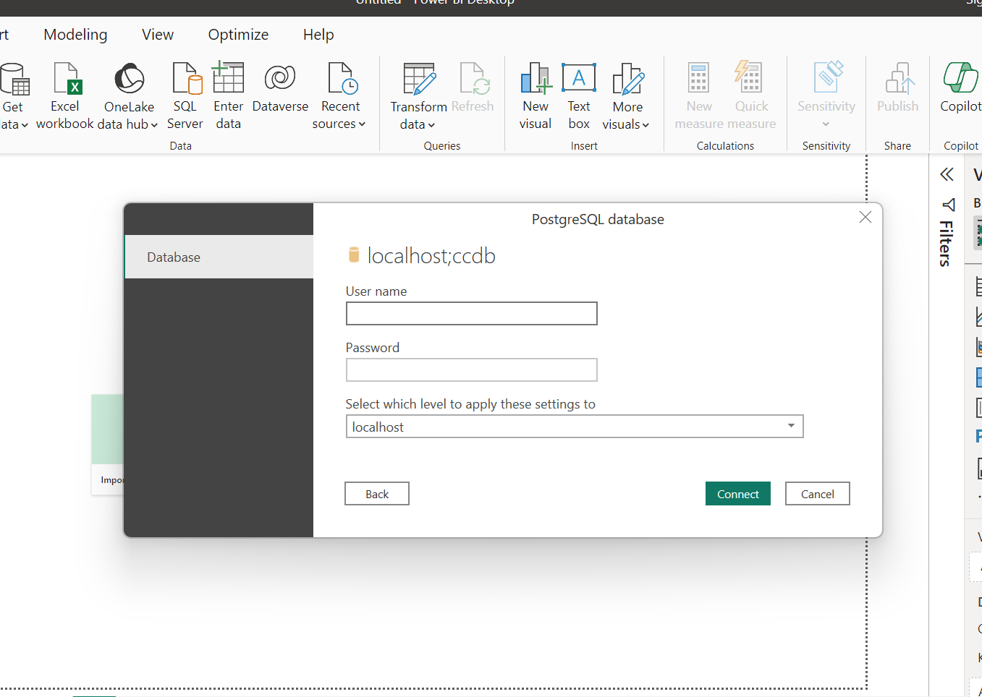
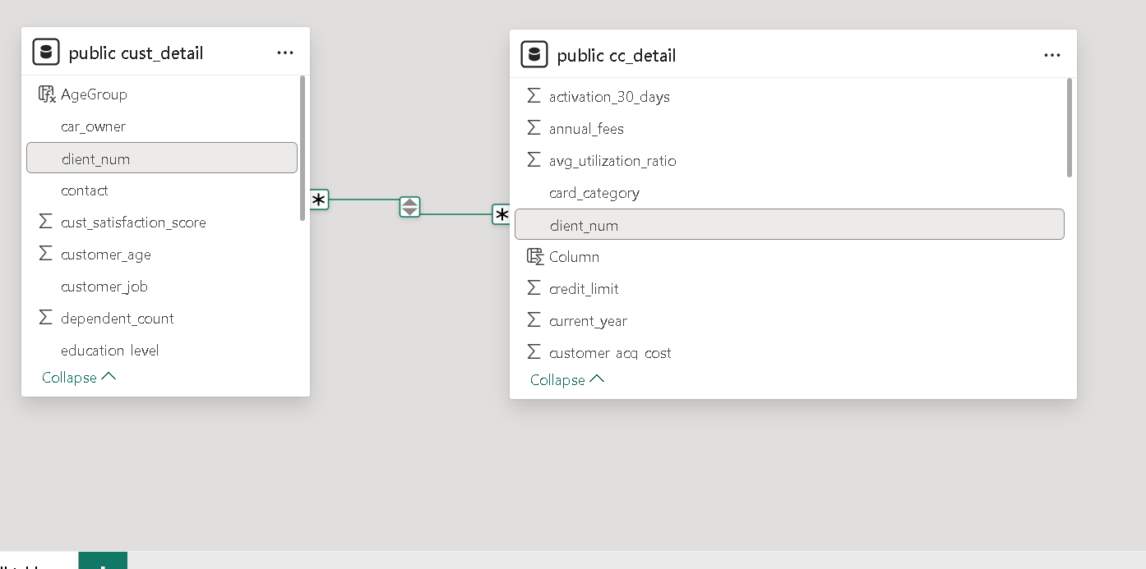
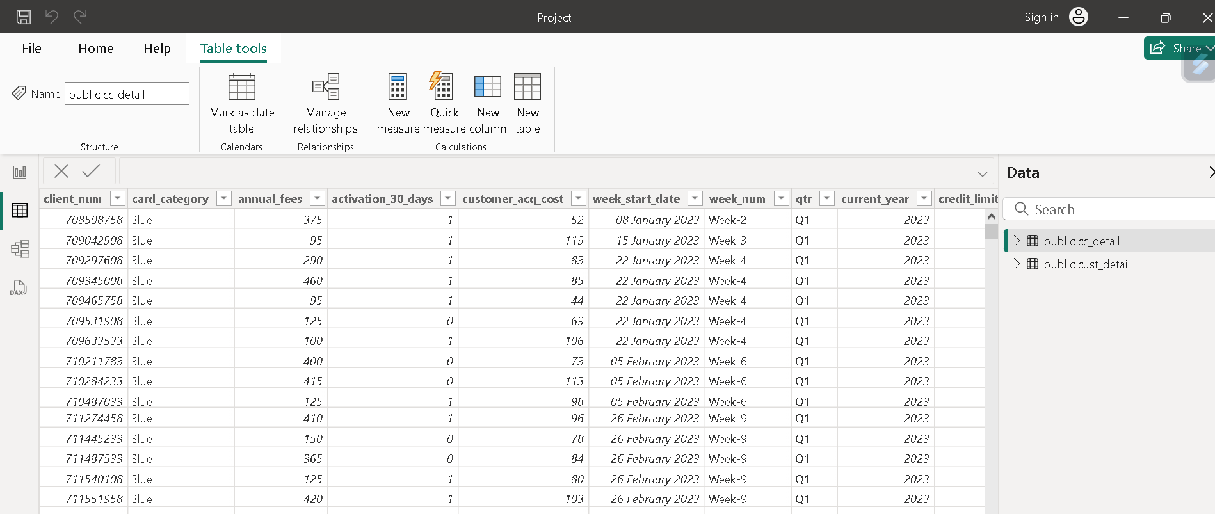
Enter the name
of the DB and server
Enter username and password
Data Loaded Successfully

Slide 10
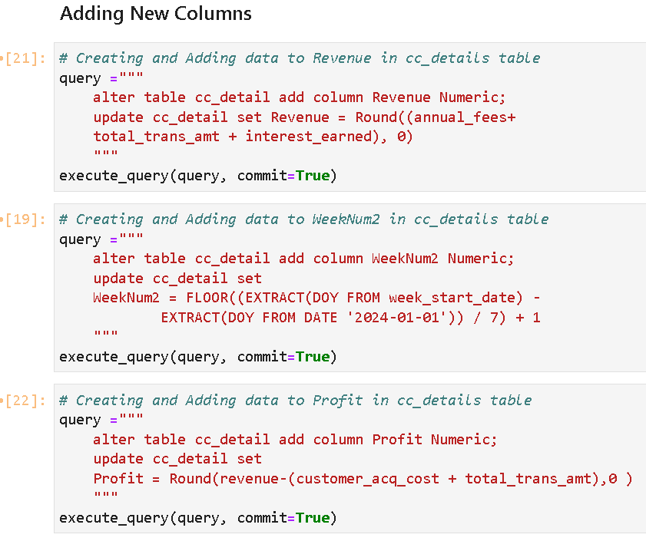
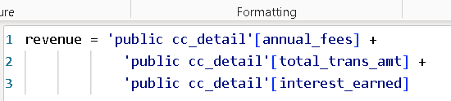
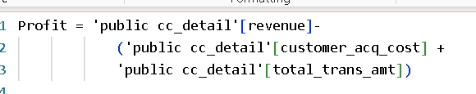
SQL Queries and DAX
New columns added in cc_detail table

Slide 11
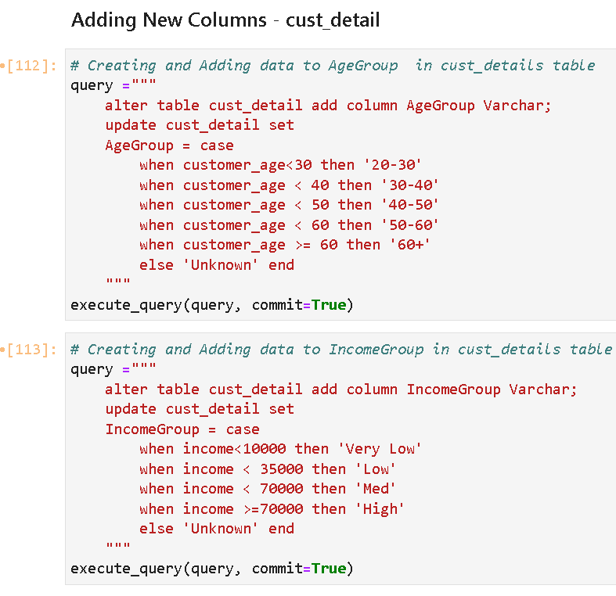
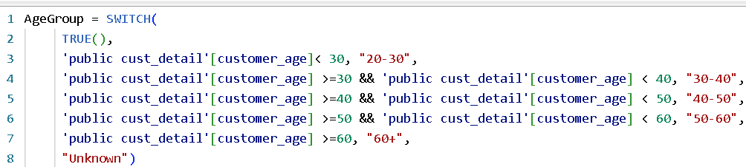

New Columns Added in cust_detail table

Slide 12
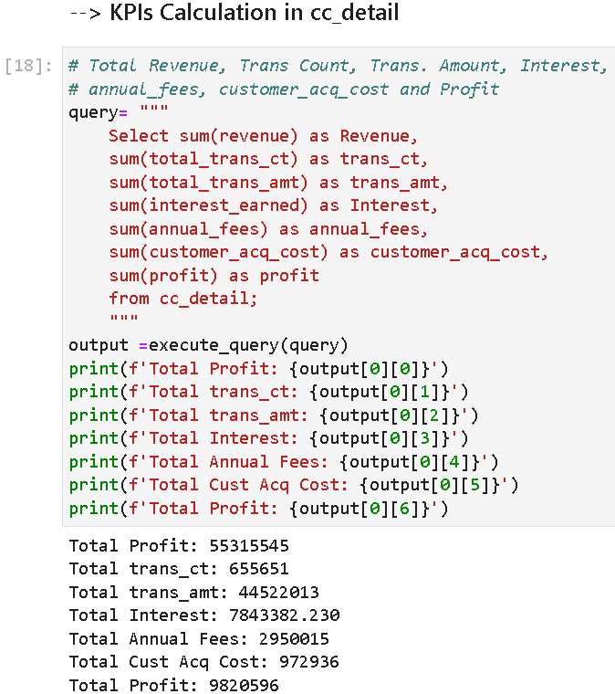
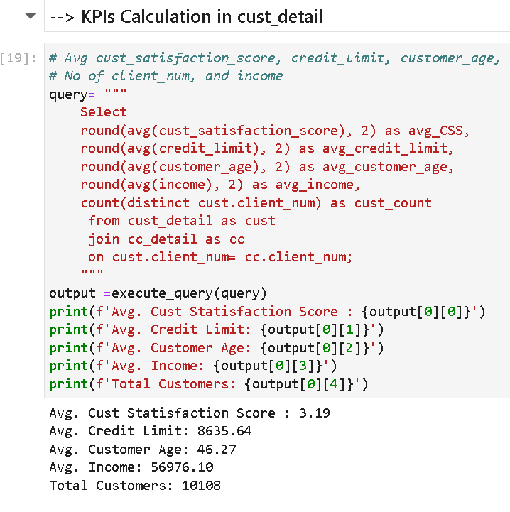
Key Performance Indicator

Slide 13
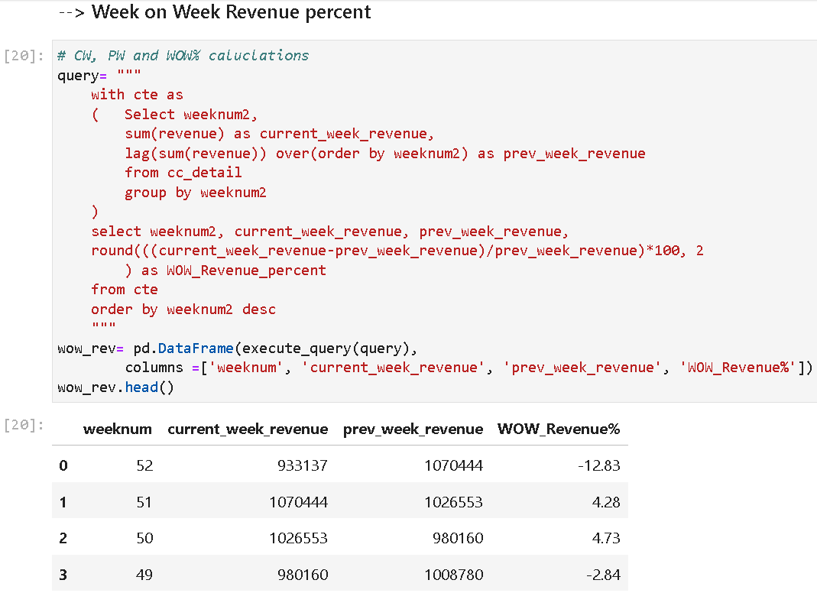


Week On Week Revenue
SQL
POWER BI

Slide 14
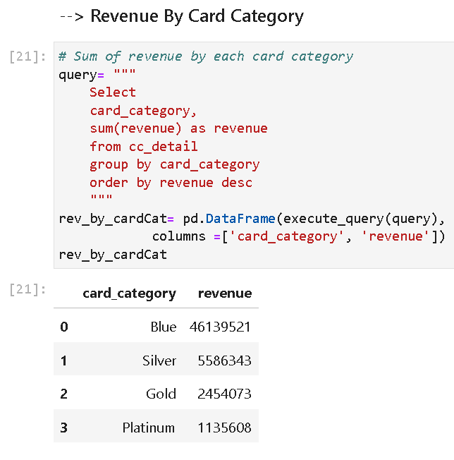
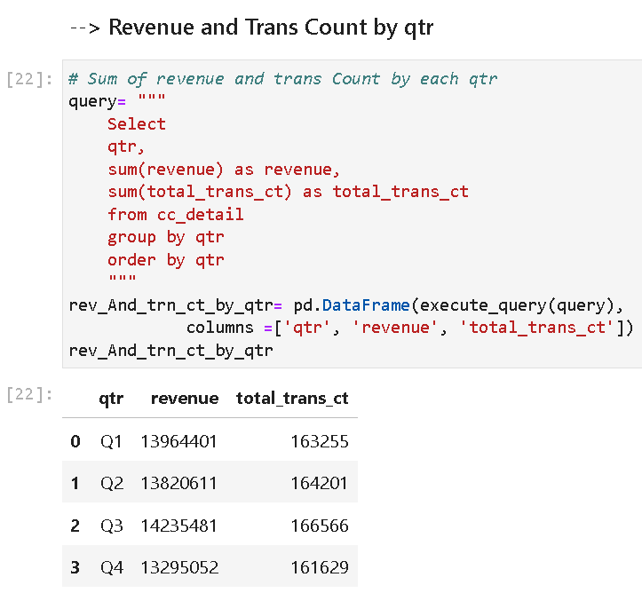
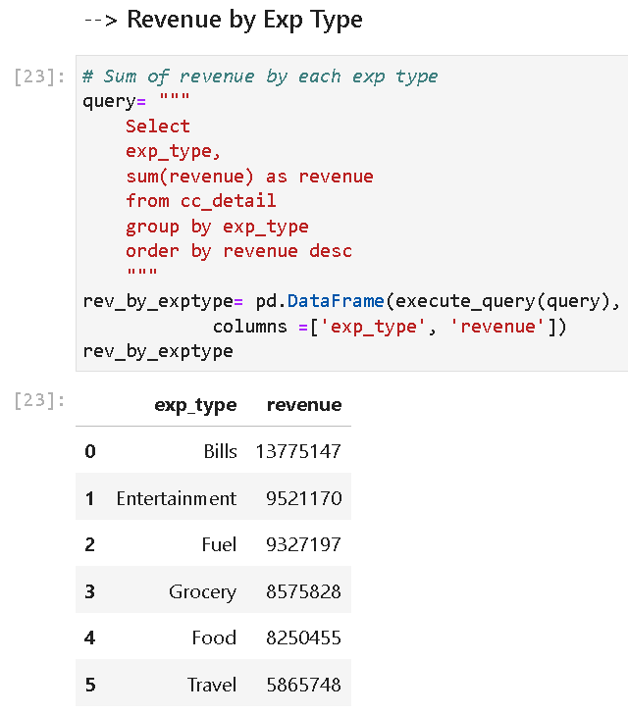
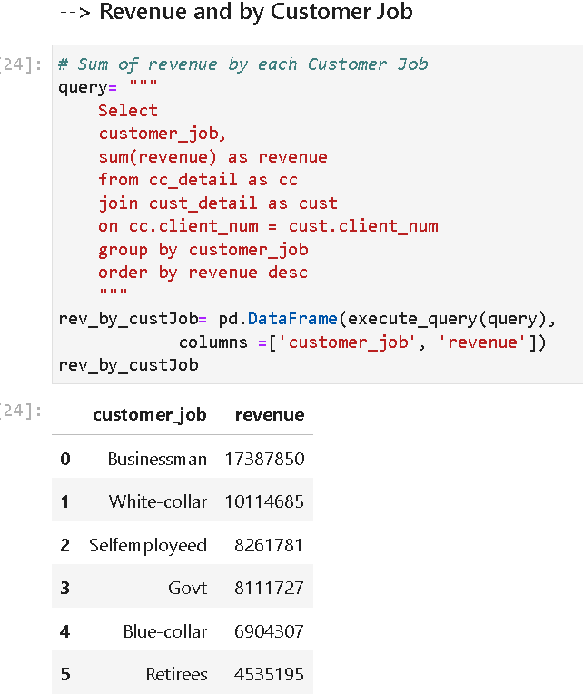
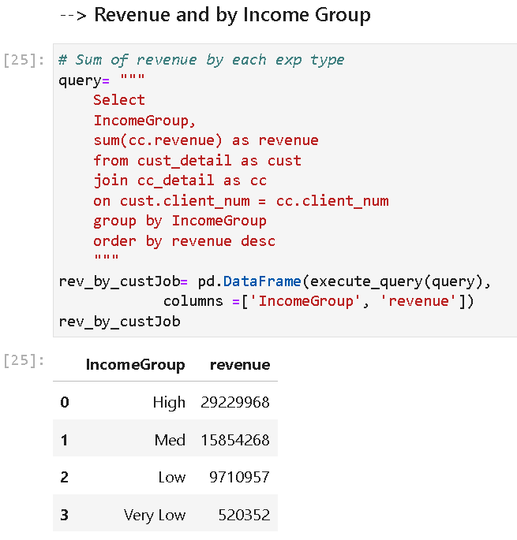
SQL Queries

Slide 15
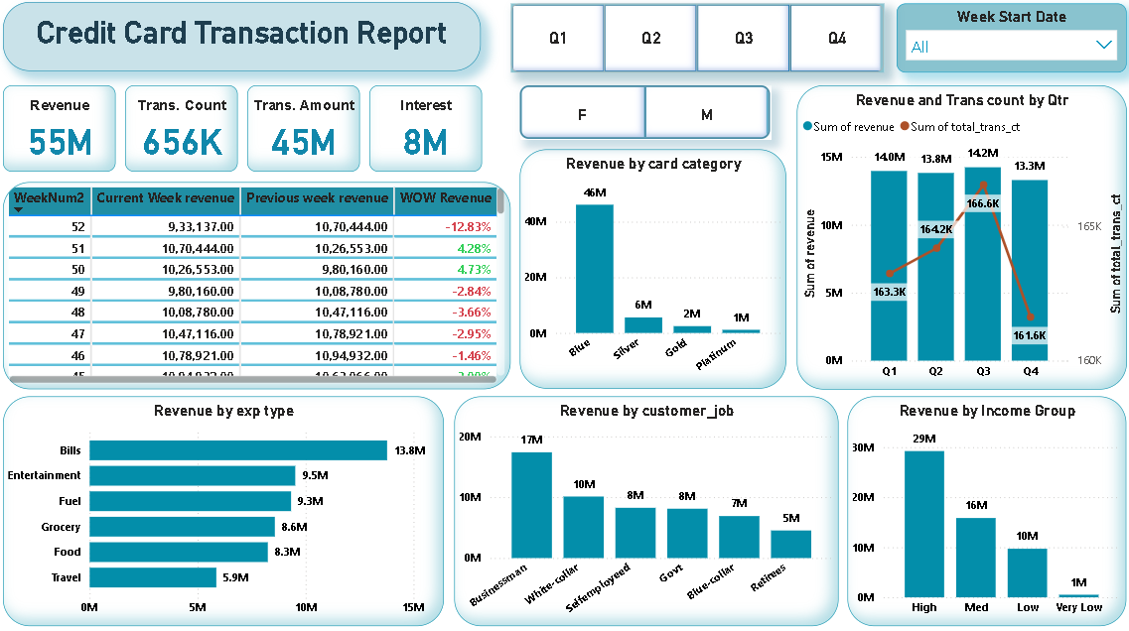
REPORT- 1

Slide 16

REPORT - 1
KEY INSIGHTS
1. Overall Revenue and Transactions:
Total Revenue: 55 M
Total Transaction Count: 656 K
Total Transaction Amount: 45 M
Total Interest: 8 M
2. Current Week (Week 52) 0.9 M, a decrease from the previous week’s 1 M (12.83% WoW revenue).
3. The Blue Card dominates revenue generation.
4. Bills are the largest revenue source, followed by entertainment and fuel.
5. Businessmen and high-income groups contribute significantly to revenue.
6. Revenue is relatively stable across quarters, with Q3 slightly leading and Q3 having the highest transaction count.

Slide 17
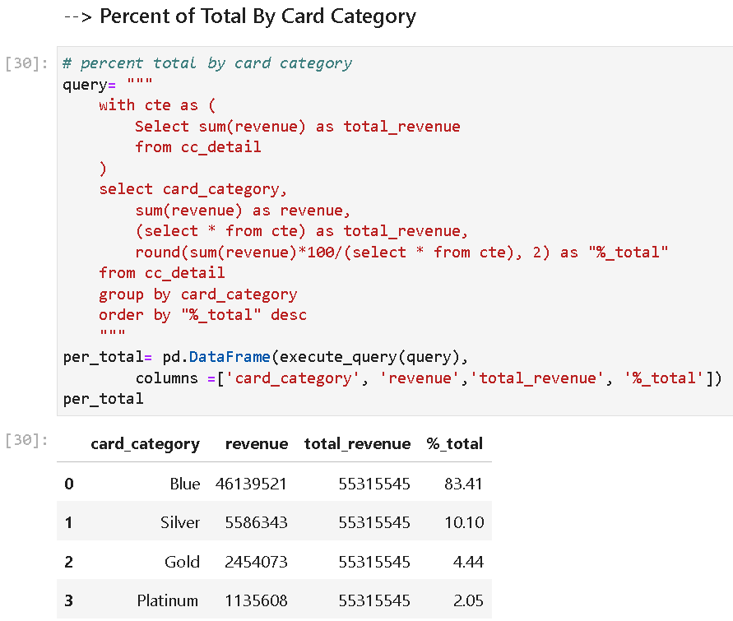
Percent Total
SQL
POWER BI
This can help to
calculate the overall
contribution of the
card category in
total revenue.

Slide 18
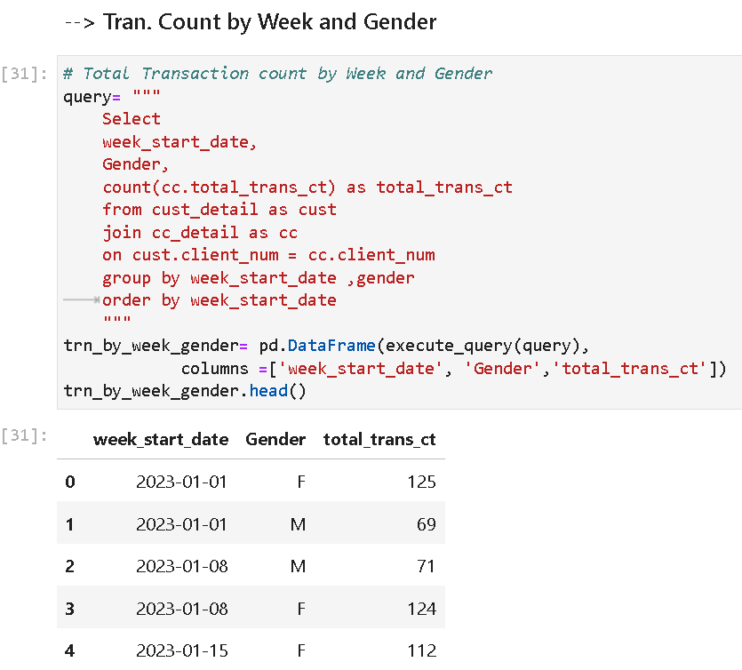
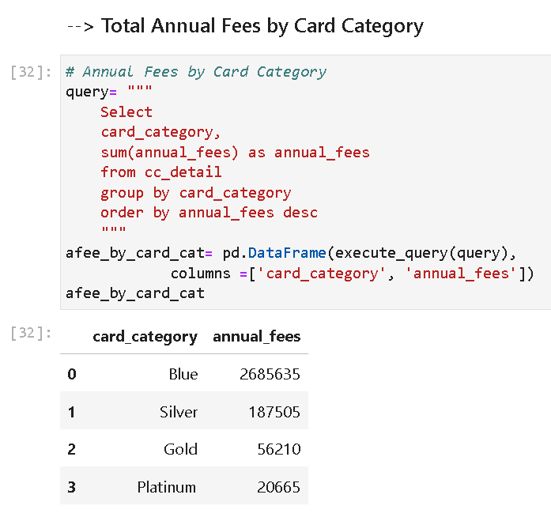
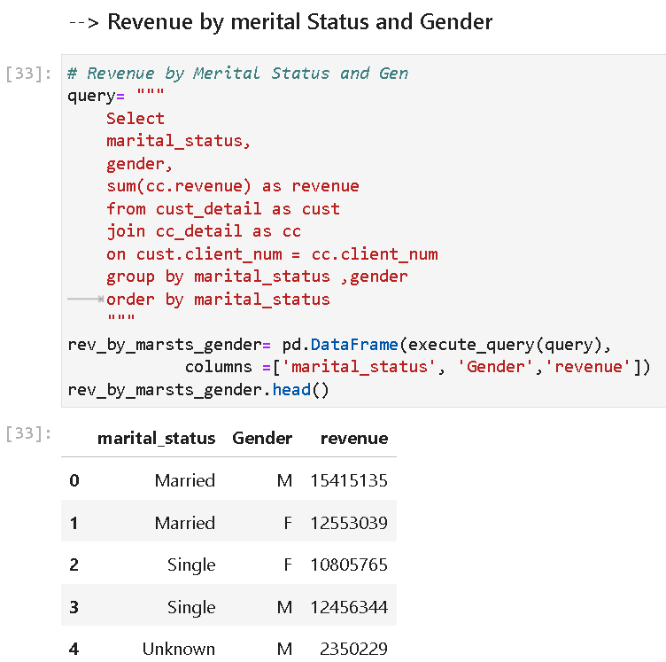
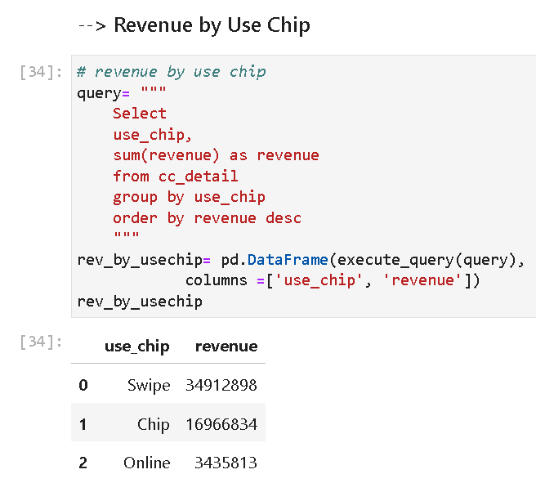
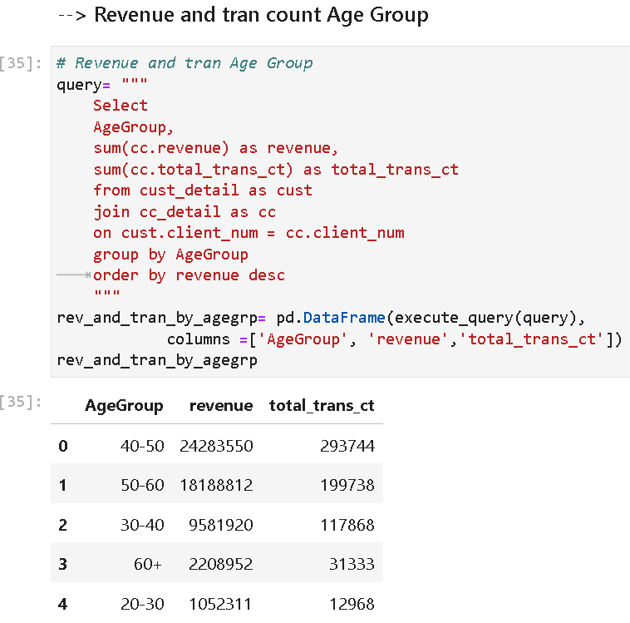

Slide 19
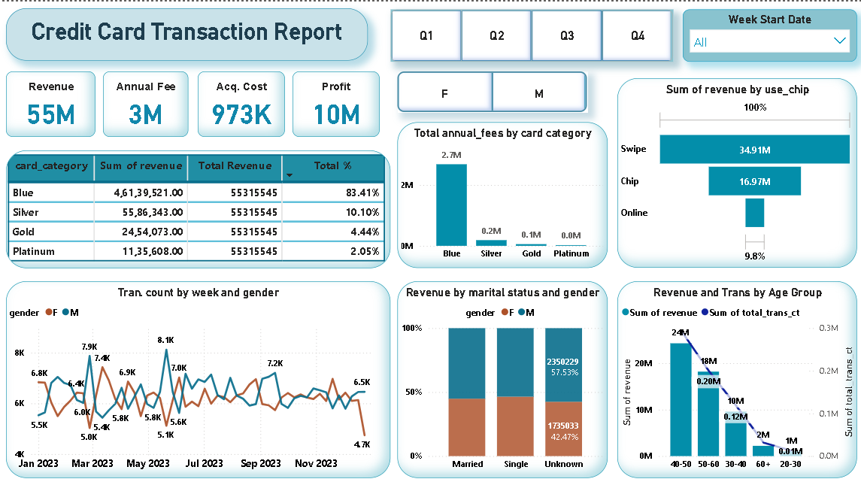
REPORT - 2

Slide 20
REPORT - 2
KEY INSIGHTS
1. Overall Metrics::
Total Revenue: 55 M
Annual Fee Revenue: 3M
Acquisition Cost: 973K
Profit: 10M
2. Blue Card: Dominates with 46.16M revenue (83.41% of total).
3. The Blue Card is the most significant revenue generator in terms of transaction amounts and annual fees.
4. Swipe transactions dominate, followed by chip and online transactions.
5. Females tend to have higher transaction counts and contribute significantly to revenue, especially among married individuals.
6. The 40-50 age group is the largest contributor to revenue, followed by the 50-60 age group. Younger and older age groups contribute less to revenue and transactions.

Slide 21
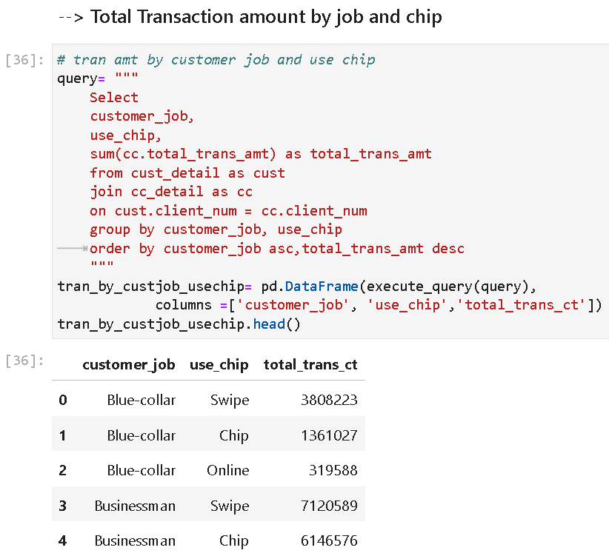
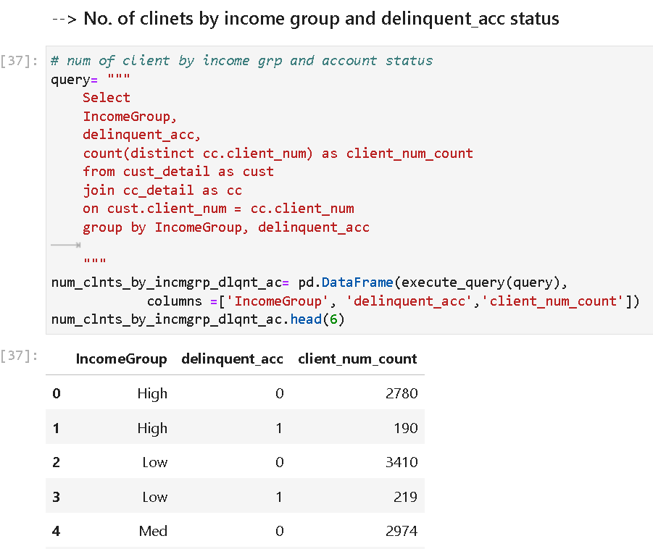
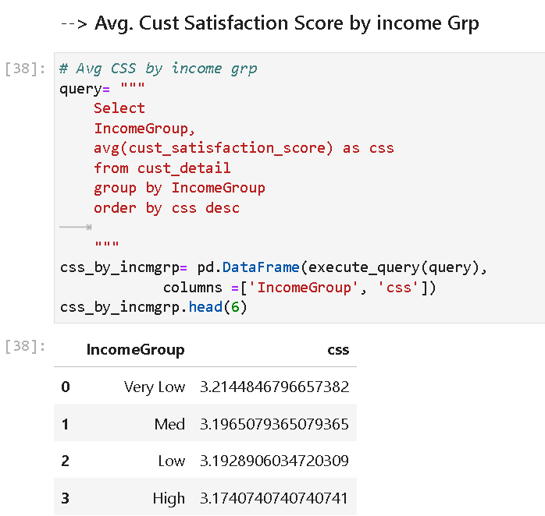
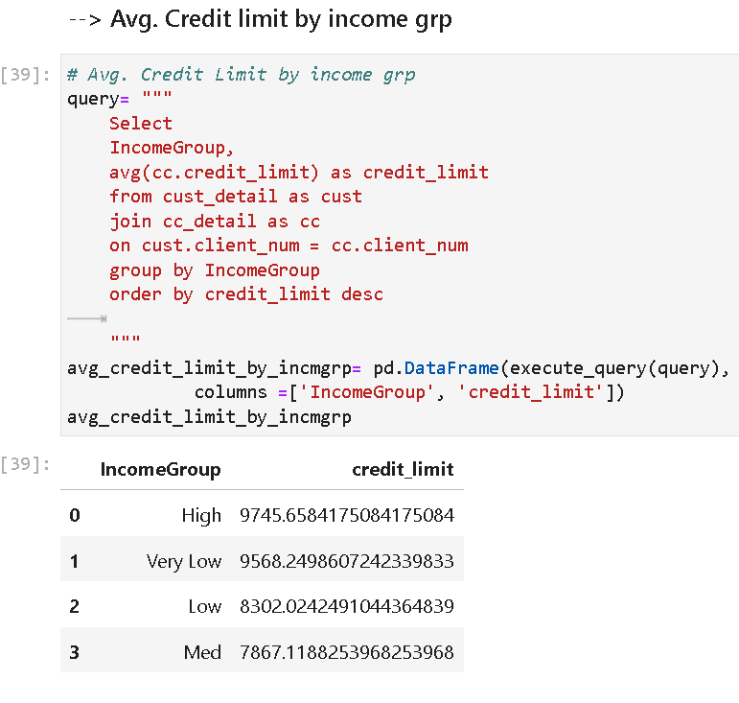
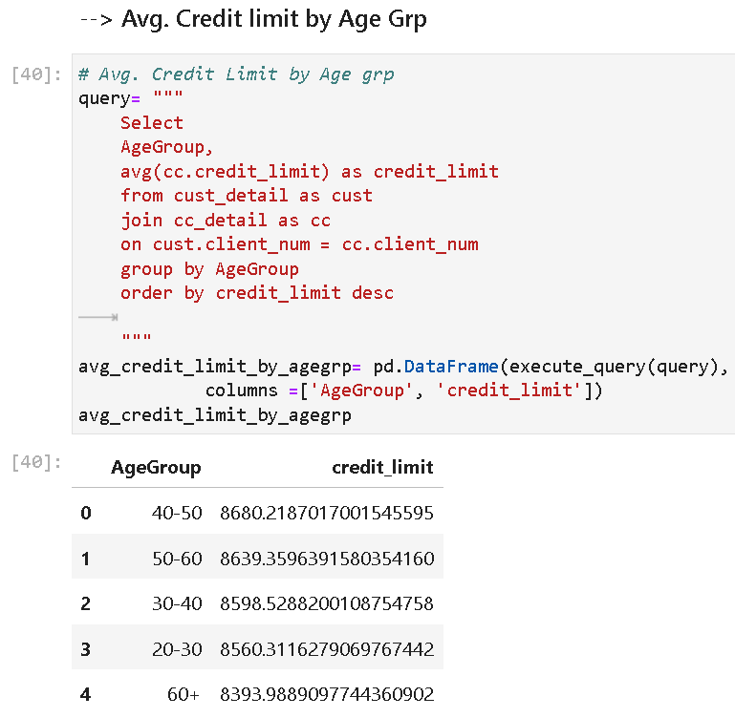
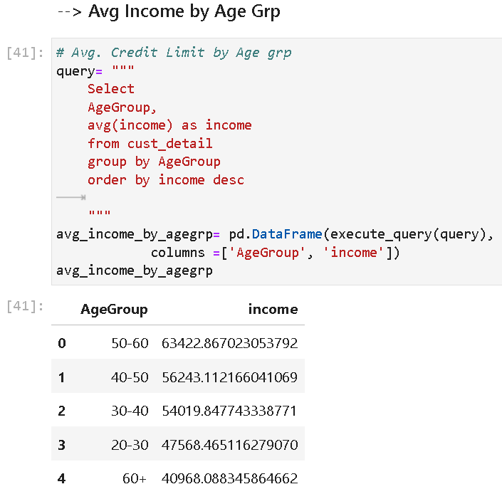

Slide 22
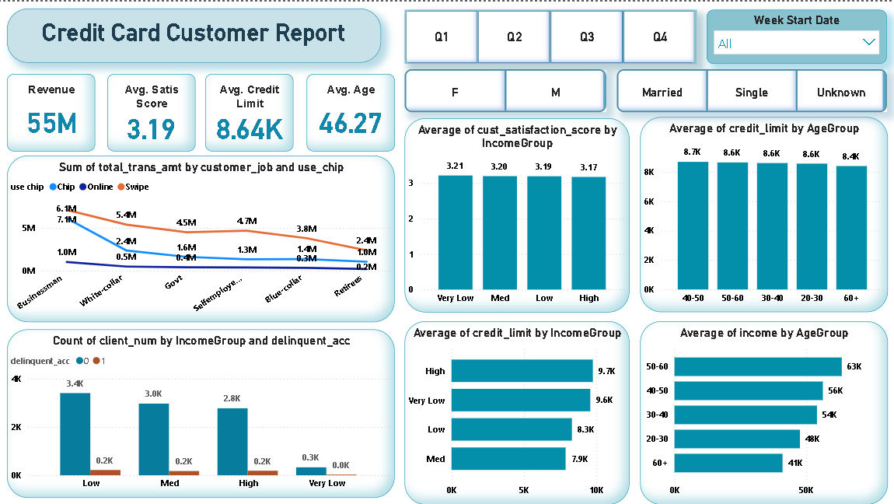
REPORT - 3

Slide 23
REPORT - 3
KEY INSIGHTS
1. Overall Metrics::
Total Revenue: 55 M
Average Satisfaction Score: 3.19
Average Credit Limit: 8.64K
Average Age: 46.27
2. Businessmen Prefer using chips with a total transaction amount of 7M, followed by swipe (6M) and online (1M).
3. Very Low-Income group has the Highest average satisfaction score of 3.21.
4. 40-50 group has the highest average credit limit of 8.7K.
5. Low-Income group has 3.4K clients with 0.2K delinquent accounts.
6. High Income has the highest average credit limit of 9.7K.
7. 50-60 group Highest average income of 63K..

Slide 24
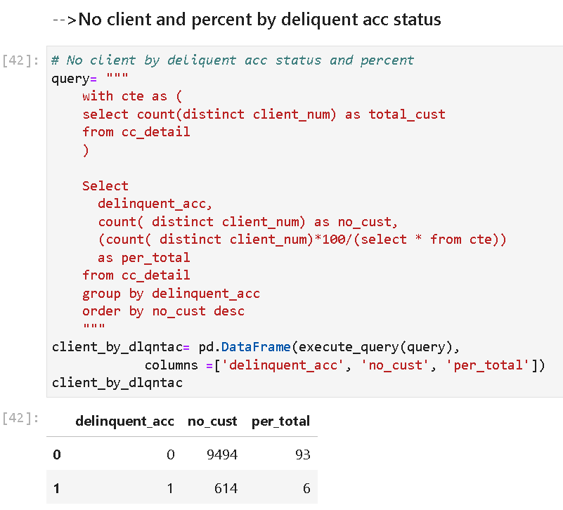
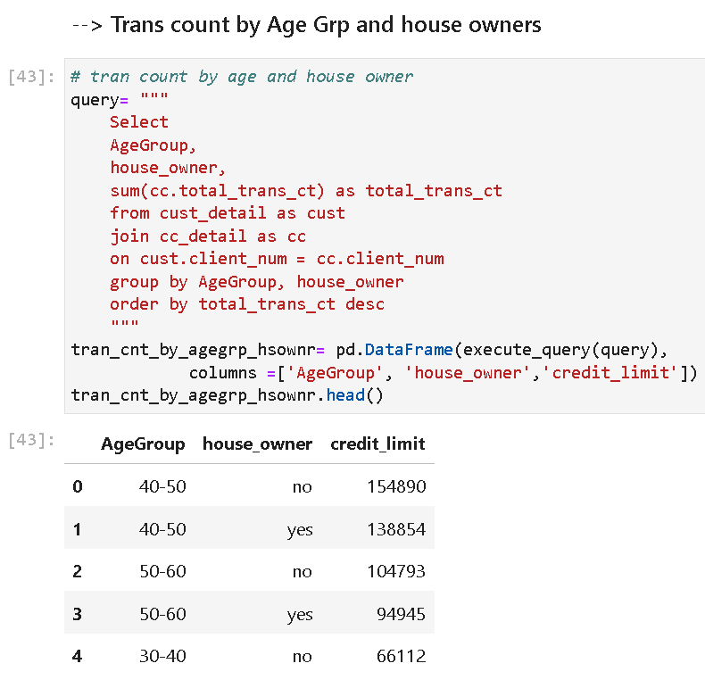
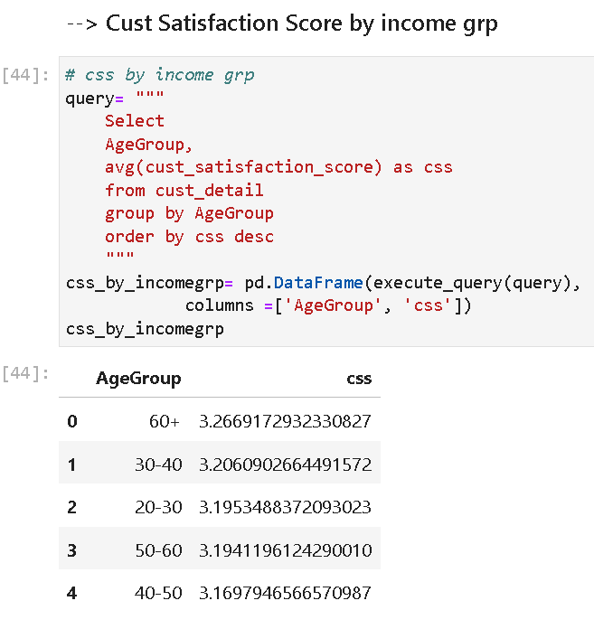
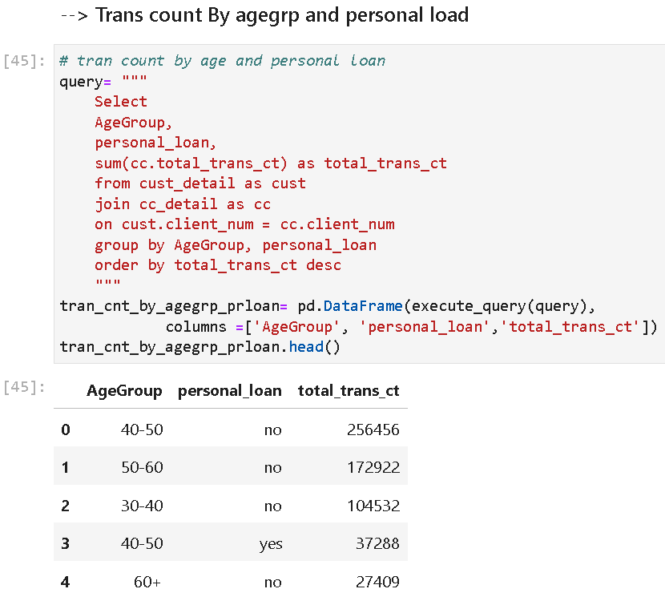
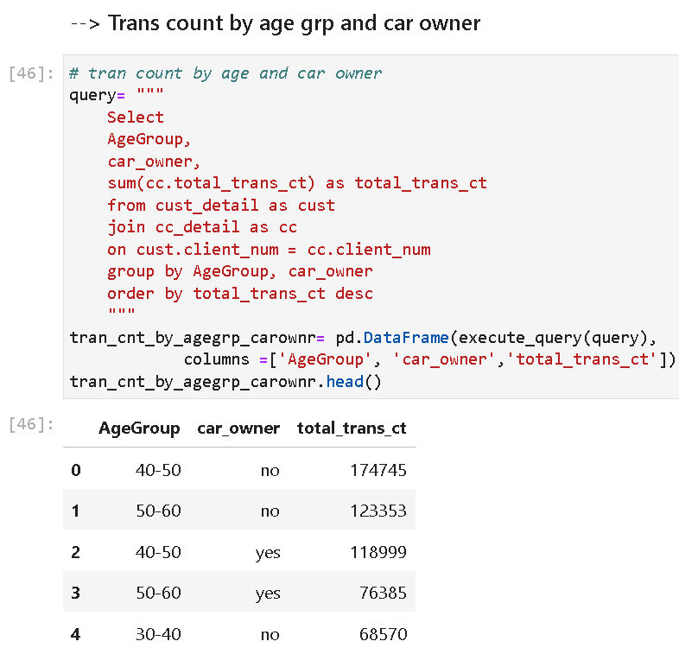

Slide 25
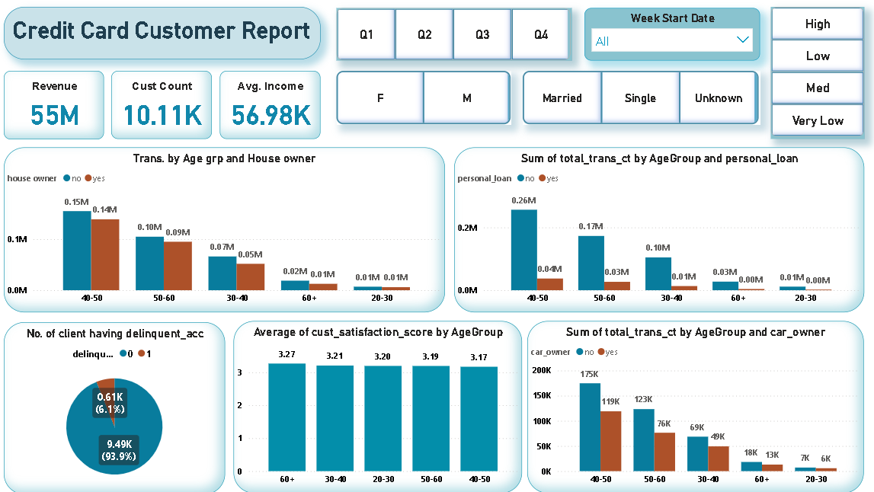
REPORT - 4

Slide 26
REPORT - 4
KEY INSIGHTS
1. Overall Metrics::
Total Revenue: 55 M
Customer Count: 10.11K
Average Income: 56.98K.
2. Age Group 40-50 Non-house owners have higher transaction amounts (0.15M) compared to house owners (0.14M).
3. Age Group 40-50 Customers without personal loans have significantly higher transaction counts (0.26M) compared to those with personal loans (0.04M).
4. Delinquent Accounts 0.61K (6.1%) of clients have delinquent accounts.
5. Age Group 60+ Highest average customer satisfaction score of 3.27.
6. Age Group 40-50 Car owners have higher transaction counts (175K) compared to non-car owners (119K).

Slide 27
FINAL PROJECT LINKS
DRIVE LINK : https://drive.google.com/drive/folders/1vq7WyUJQd5DK9zbQv-2q95gbh5yzJEXr?usp=drive_link
GITHUB LINK: https://github.com/KshmaKshma/Credit_Card_Financial_Analysis

Slide 28

THANK
YOU

