Slide 1
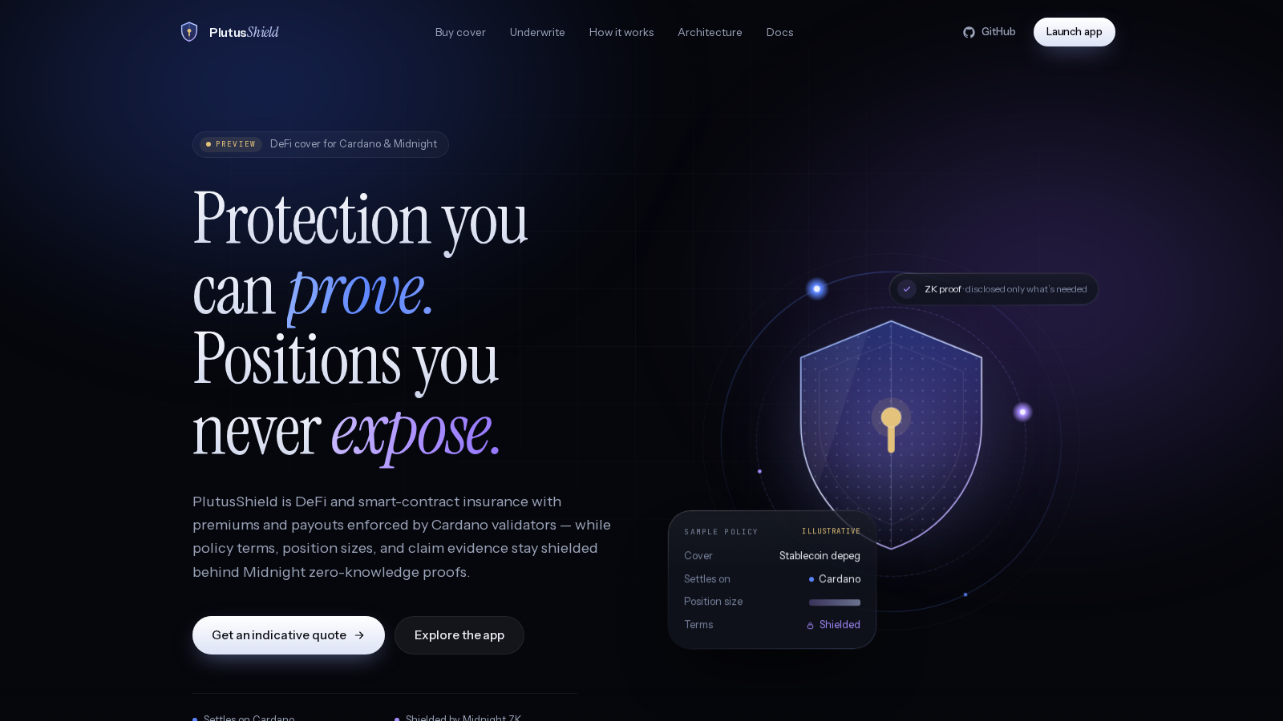
MIDNIGHT BUILDATHON · WAVE 2
Protection you
can prove.
Positions you
never expose.
PlutusShield is DeFi and smart-contract insurance. Cardano holds the money and pays claims. Midnight keeps who is covered, for how much, and the claim evidence private.
kshot3000.github.io/PlutusShield · github.com/Kshot3000/PlutusShield
PlutusShield · Midnight Buildathon Wave 2 · testnet only, not audited
01

Slide 2
THE PROBLEM
DeFi cover today makes you choose: get paid, or stay private.
Cover leaks your book
Claims leak your evidence
Payouts need trust
On a public chain a policy says who you are, what you hold and how much you insured. That is a map for anyone hunting large positions.
Exploit claims need proof: tx traces, screenshots, wallet history. Posting it publicly exposes the claimant and sometimes the bug.
Most cover relies on one assessor or a token vote. Users need to see that no single key can approve or block a payout.
PlutusShield · Midnight Buildathon Wave 2 · testnet only, not audited
02

Slide 3
HOW IT WORKS
Cardano settles. Midnight keeps the secrets.
Cardano Preview · Aiken, Plutus V3
Midnight Preprod · Compact, ZK
Premiums paid in ADA or test USDC (tUSDCx) into on-chain pools.
Depeg cover pays from oracle feeds; sales close by themselves if the feeds go stale or the peg breaks.
Exploit cover pays only with 2-of-3 committee signatures, enforced by the validator.
The policy datum holds a hash commitment, not the terms.
registerPolicy stores a commitment to the holder and terms.
proveCover(policyId, minCoverage) proves cover is at least X without revealing the real limit.
fileClaim puts only a commitment to the encrypted evidence on chain.
voteClaim tallies three committee seats; 2 approvals mark the claim PAID.
PlutusShield · Midnight Buildathon Wave 2 · testnet only, not audited
03

Slide 4
ARCHITECTURE
One policy, two chains, a relay in between.
Cardano Preview (Aiken, Plutus V3) Midnight Preprod (Compact, ZK)
───────────────────────────────── ───────────────────────────────
Buy tx: premium + policy datum ──relay──► registerPolicy(commitment)
(holds only a hash commitment) proveCover(id, ≥min) [ZK, holder]
Depeg pool: oracle feeds (2h) fileClaim(id, evidenceCommitment)
Exploit pool: Settle needs ◄─decision─ voteClaim × 3 seats → PAID at 2-of-3
2-of-3 committee signatures (claim round resets on reject)
Payout in ADA / tUSDCx Evidence: encrypted off chain, hash on chain
No wallet address, position size or evidence lands on Midnight in the clear. The relay only moves commitments one way and the committee decision the other.
PlutusShield · Midnight Buildathon Wave 2 · testnet only, not audited
04

Slide 5
BUILT ON MIDNIGHT
Two Compact contracts, deployed and exercised on Preprod.
policy-cover v1
policy-cover v2
Preprod contract d84c6187…925e8787
Circuits: registerPolicy, proveCover, rotateHolder, fileClaim, resolveClaim, expirePolicy.
5 policies registered and proven, 4 claims filed and resolved.
Single assessor: the first version, kept for the record.
Preprod contract 5430b803…4feb8110
Adds voteClaim: a 2-of-3 committee with per-round tallies; a reject resets the round.
First drill: approve, reject, approve, then PAID at 2 of 3.
Second: a holder-filed claim (claim kit), seats 1 + 3 approve, paid on Cardano.
4 Cardano Preview policies registered on v2.
compactc 0.31.1 · both contracts full-compile with prover and verifier keys
PlutusShield · Midnight Buildathon Wave 2 · testnet only, not audited
05

Slide 6
LIVE ON TESTNET
Every line here is backed by a transaction.
Depeg pool (ADA + tUSDCx)
11 live Preview policies, buy / claim / release from a CIP-30 wallet
Exploit cover in the browser
10 tADA bought with the website's own Buy builder, Buy 3c1fc629…
First exploit claim paid
50 tADA: Midnight claim PAID, then Cardano Settle 5509c2d9…
First committee payout
50 tADA co-signed by 2 of 3 assessors, Settle c35535dd…
Holder-filed claim paid
Claim kit fileClaim 00989a6a…, v2 voteClaim 2 of 3, 25 tADA Settle dbf0ba7a…
1-of-3 payout attempt
Rejected by the validator in both local and Blockfrost evaluation
Depeg oracle
52 recorded live publishes to 3 Preview feeds, latest 99.97% (Oct 12)
Midnight relay
registerPolicy + proveCover on Preprod (v1 + v2), readable via Blockfrost
PlutusShield · Midnight Buildathon Wave 2 · testnet only, not audited
06

Slide 7
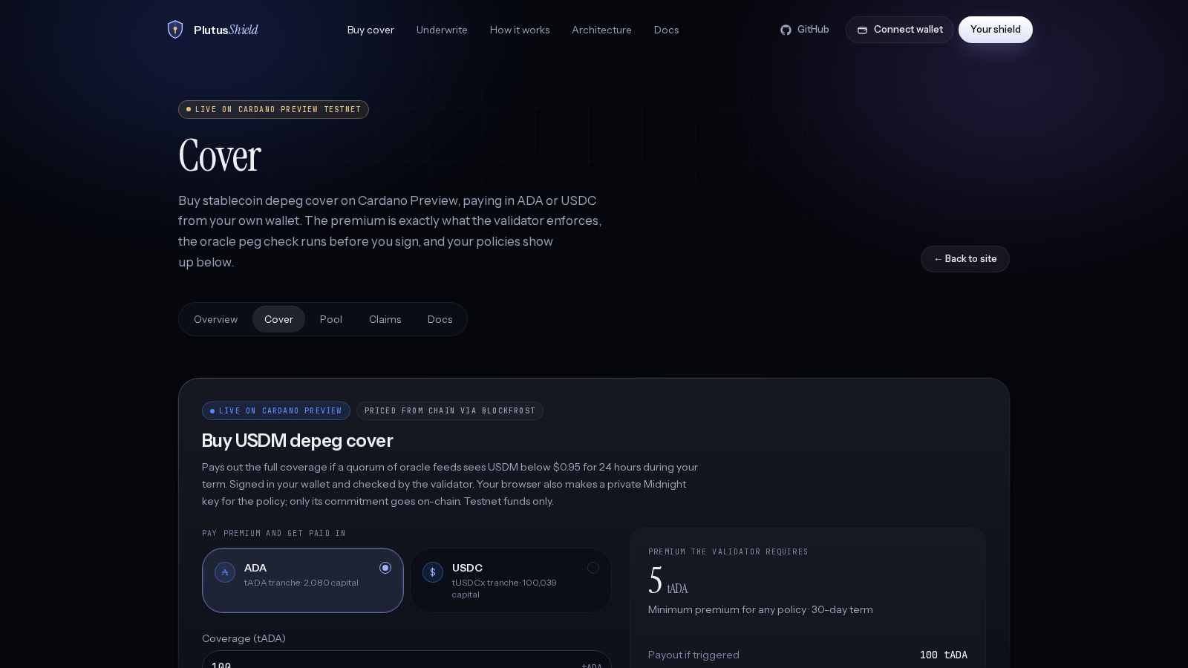
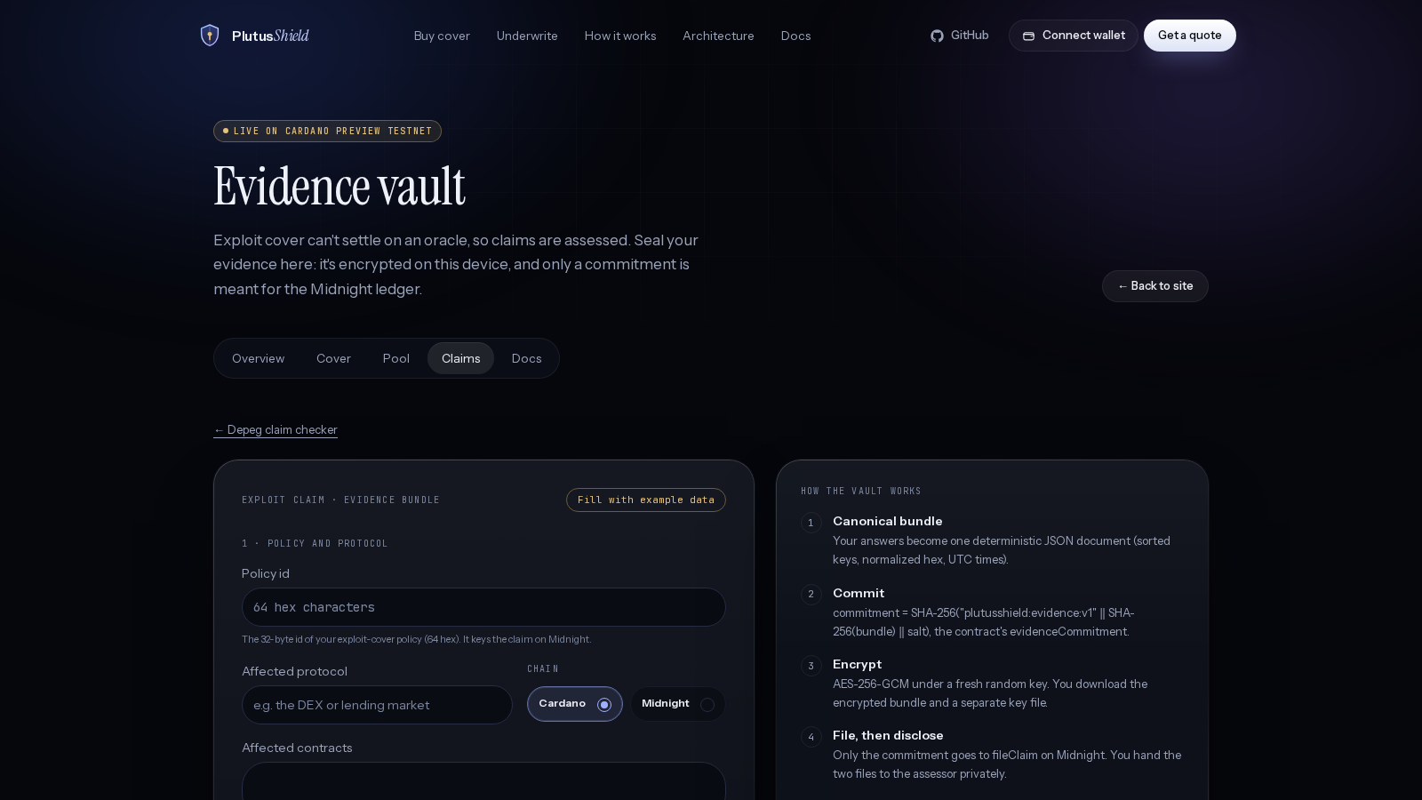
THE PRODUCT
A real app: quote, buy, prove, claim.
/cover: connect a Preview wallet, price depeg or exploit cover, pay in ADA or tUSDCx.
/claim/evidence: evidence is encrypted in the browser (AES-256-GCM); only its SHA-256 commitment goes to fileClaim.
PlutusShield · Midnight Buildathon Wave 2 · testnet only, not audited
07

Slide 8
ENGINEERING
354 unit tests plus an end-to-end emulator run, all green.
131
146
60
14 + 3
Aiken validator tests
SDK: quote engine, risk tiers, underwriting book, codecs, evidence vault, claim kit, Lace, prove bridge
Compact circuit simulation, claims relay, relay plan, state decode
oracle relay · committee kit
Lucid emulator e2e: pool, buy, settle, expire, exploit 2-of-3, every 1-of-3 combination rejected, exploit release.
Next.js static site, 18 routes, redeployed to GitHub Pages on every push; checked on iPhone (WebKit) and Pixel.
PlutusShield · Midnight Buildathon Wave 2 · testnet only, not audited
08

Slide 9
WHERE IT STANDS
Honest about today. Clear about next.
Today
Next
Testnet only (Cardano Preview, Midnight Preprod). Not audited.
The three committee seats are run by the team.
Exploit evidence in the drills is demo evidence.
Holders file claims with the claim kit; File with Lace proves locally, first finalized submit pending.
Independent assessor operators (offline keygen and signed enrollment kit is in the repo).
First finalized File with Lace submit: the holder prove bridge already proves proveCover / fileClaim in about 1 s; Lace balances and submits.
Security audit, then a capped mainnet launch.
Catalyst funding for claim capital.
PlutusShield · Midnight Buildathon Wave 2 · testnet only, not audited
09

Slide 10
TRY IT
Insurance that pays on Cardano and stays quiet on Midnight.
Live app https://kshot3000.github.io/PlutusShield/
Code https://github.com/Kshot3000/PlutusShield
Built by @kshot9000
PlutusShield · Midnight Buildathon Wave 2 · testnet only, not audited
10

