Slide 1

SRM HACKATHON CODING SPRINT
TEAM_TURBO
Team Members:
Kashish Verma
Adesh Mishra
Rudra Pratap Singh
Jai Sinha
Ayush Kumar Singh

Slide 2
WHY CHATBOT?
In todays life people are getting busy and busy.if a person have some confusion how to use a thing for performing a task or to gain knowledge about some thing it’s difficult for him to go and discuss his problem to an expert so the best solution of this problem is Chatbots.

Slide 3
OLD APPROACH
we initially tried to create a system in which a user would had beed able to click a link in the parent website which would redirect
the user to the chatbot which would show the linked information.
we planned to iterate through the pdf (of the laws) and used keywords to display relevent information.
we were trying to use python via flask(framework) but we faced some bugs while implementing the javascript with the backend.
so we had to discard our approach and try a fresh approach using jquery.
also we had initially designed the fronted(design),etc which occupied more of our time than we anticipated;

Slide 4
NEW APPROACH
We used html,css and javascript ...
We used html and css for front end and mainly everthing is done in js . The pdf which was given contained problem statement which contains
the questions ..which has to be answered by the chatbox..we used jquery in which we targeted each and every question by its index and
included the test-cases .We used javascript as it is more dynamic than python and efficient.Linked it through CSS and html and fired it into chrome.

Slide 5
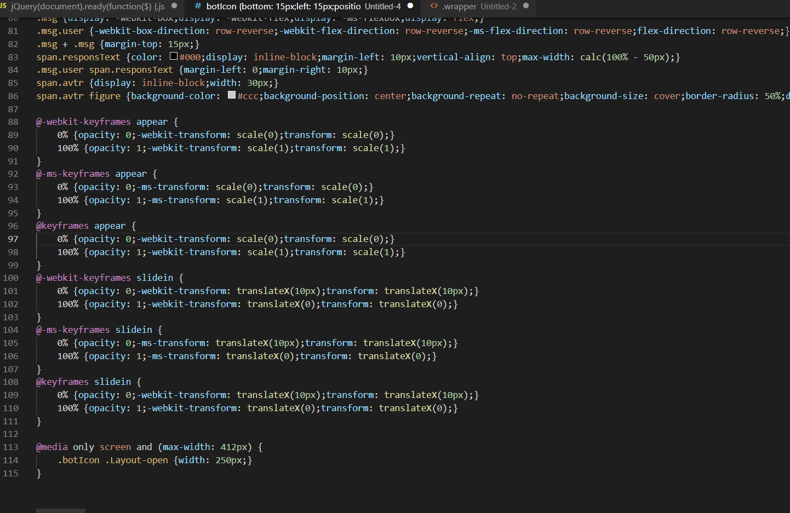
CSS USED

Slide 6
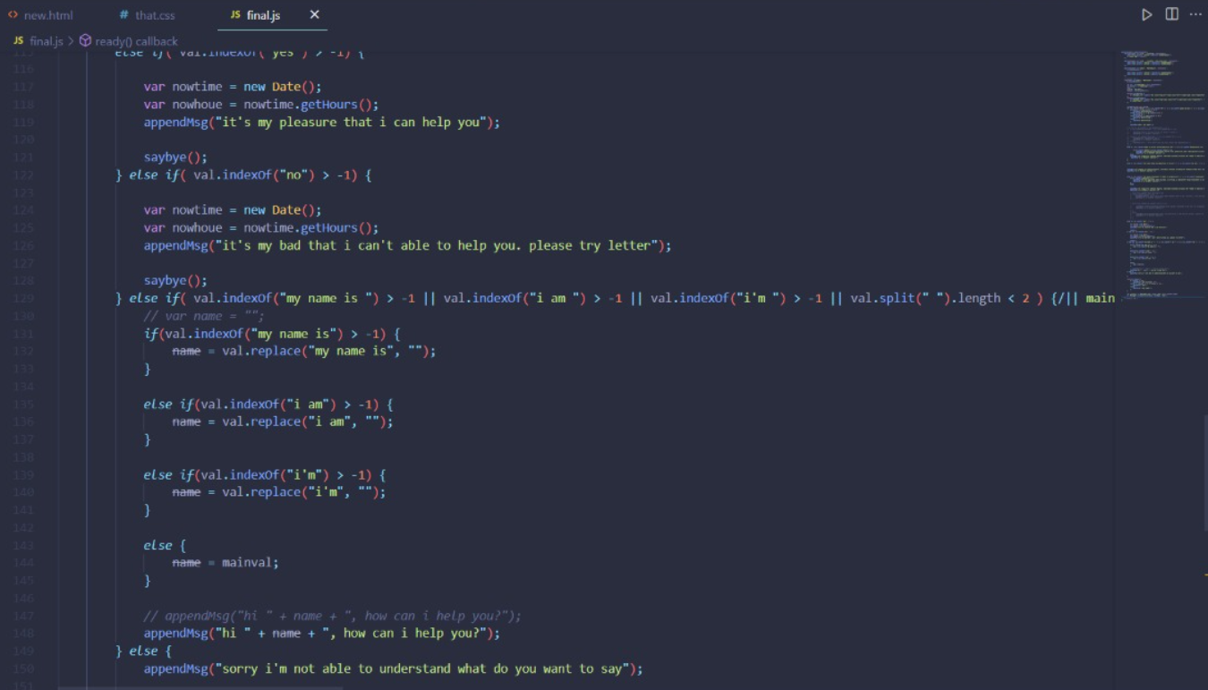
JS USED

Slide 7
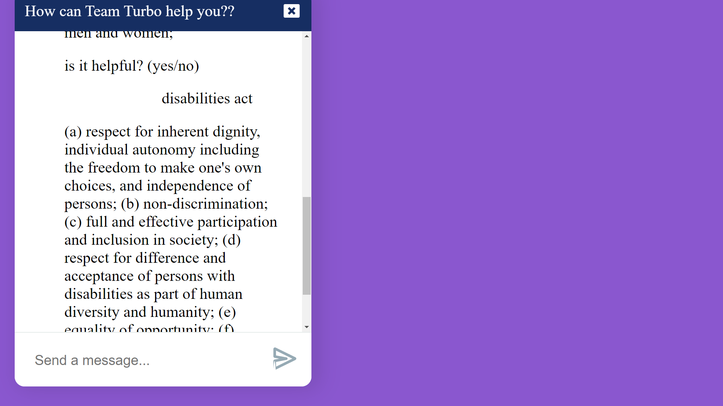

Slide 8
