Slide 1
Color Image Processing
Peter Cai, Rami Madbouly, Jonathan Ksiezopolski

Slide 2
Goal
To manipulate, filter, and track RGB colors using MATLAB
To demonstrate the various phenomena of color image processing
To observe and troubleshoot any hardware limitations or potential problems that may prevent the success of the project.

Slide 3
Recording
Luckily down sampling and reconstruction were not involved in the process. This would consist of additional Gaussian filtering for reconstruction.
For real time performance with a higher resolution camera down sampling may have been proven useful
All video input is set to RGB format. This is so we have three separate matrices of color

Slide 4
Color Filtering – Idea
RGB images and video can be separated into three matrices.
Extracting one color into a matrix and applying grayscale allows us to make out where that color is in the image.
In the function ‘rgb2gray ‘ the algorithm behind this function consists of converting RGB matrix values to a weighted sum of R,G, and B components.

Slide 5
Process of Color Filtering
Isolate any color by simply subtracting it from the weighted sum. This is done through ‘imsubtract()’.
Imsubtract(X,Y) subtracts each element in the array Y from the corresponding element in array X. X and Y must be real non sparse numeric arrays.

Slide 6
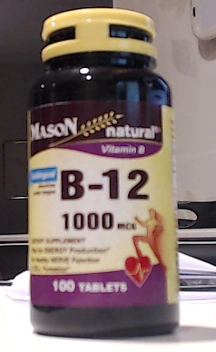
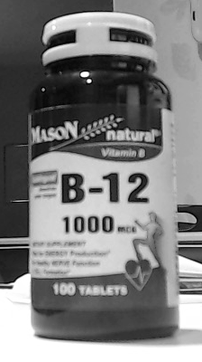
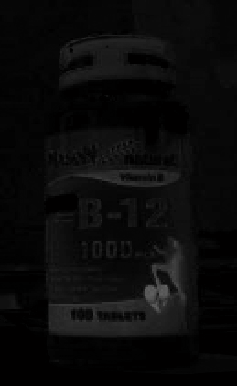
Visualization of Color Filtering

Slide 7
Process - Image Filtering
A median filter requires 2-D , real, non-sparse, numeric or logical matrix
Median filters in image processing eliminate noise by averaging the area around a point and padding zeros around its boundaries.
Through the MATLAB function medfilter2, we can smooth out the black and white areas where the color (in white) is dominant. Making it easier to detect that region of color.

Slide 8
Binary Conversion
The function im2bw(grayscale,level) replaces all pixels in the input image with greater luminance with a value of 1 or white. Everything else is turned into black or 0.
The level is based on a method to select a threshold automatically from a gray level histogram derived from discriminant analysis.

Slide 9
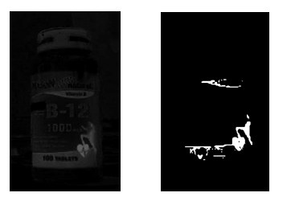
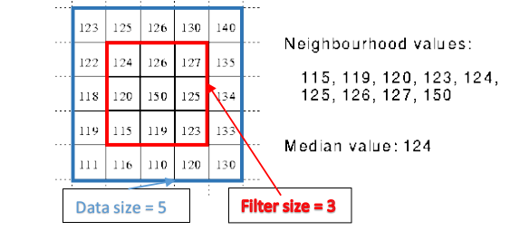
Visualization of Median Filter and Conversion

Slide 10
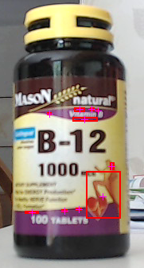
Basic Blob Analysis
the function bwlabel(img,x) labels individual adjacent binary clusters.
Grouping of x logic ‘1’s in the map to be considered a cluster/object.
In computer vision, blob detection methods are aimed at detecting regions in a digital image that differ in properties, such as brightness or color, compared to surrounding regions.

Slide 11
Basic Blob Analysis
We then establish a bounding box and its centroid to encompass each cluster using regionprops(x,y)
Bounding box returns the rectangular region which encompasses each cluster, while Centroid returns the [x,y] coordinates of the center of each mass.
Img = bwareaopen(img,x) removes any 20x20 pixel cluster or smaller from the binary map
Data(x).centroid and .boundingbox extract positioning and dimensions.

Slide 12
Results and Further Applications
Successfully found red, blue, and green areas on an image through RGB color manipulation, image filtering, and basic blob analysis.
Applications can range from autonomous vehicle control to
Speed detection.

Slide 13
