Slide 1
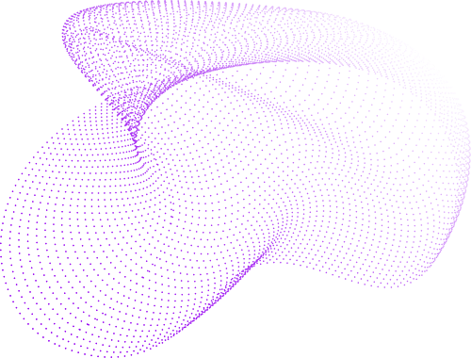

VASAVI COLLEGE OF ENGINEERING
Introduction & MANETs
Concepts, Applications, and Routing
UNIT - 1
REVATHI BUSA
Asst. Professor, Dept Of CSE

Slide 2
Agenda
Introduction To MANETs
Applications Of MANETs
Challenges Of MANETs
Routing in Ad Hoc Networks
4.1 Proactive Routing
4.2 Reactive Routing
4.3 Hybrid Routing
5. Position-Based Routing Protocols
5.1 Location Services and Forwarding Strategies

Slide 3
What is a MANET?
Definition:
A MANET (Mobile Ad hoc NETwork) is a self-configuring network of mobile devices connected by wireless links without fixed infrastructure.
An Ad hoc network as an autonomous system of mobile hosts (MHs) (also serving as routers) connected by wireless links, the union of which forms a communication network modeled in the form of an arbitrary communication graph.
MANET is infrastructurer less and network topology may change dynamically as nodes are free to move.
Mode of operation in ad hoc networks are basically peer-to?peer multi-hop mobile wireless networks where information packets are transmitted in a store-and-forward manner from a source to an arbitrary destination

Slide 4
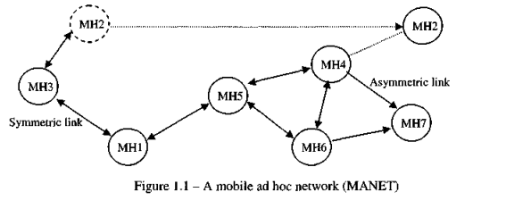
Architecture of MANETS
As the MHs move, the resulting change in network topology must be made known to the other nodes so that outdated topology information can be updated or removed
the MH2 in Figure changes its point of attachment from MH3 to MH4 other nodes part of the network should use this new route to forward packets to MH2.

Slide 5
Characteristics:
Dynamic Topologies
Energy-constrained Operation
Limited Bandwidth
Security Threats
Decentralized control
Rapid deployment
Multi-hop communication

Slide 6
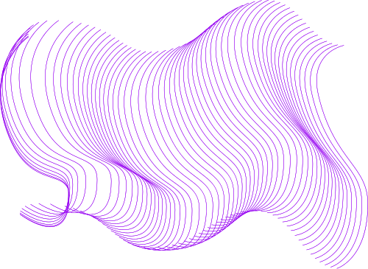
Key Features of MANETs
Self-organizing and self-healing.
No reliance on fixed infrastructure.
Supports mobility with dynamic topology.
Multi-hop communication.
Energy-efficient operation.

Slide 7
Advantages Of MANETs
Rapid deployment in disaster recovery and battlefield environments.
Cost-effective due to lack of infrastructure.
Flexibility to operate in diverse environments.

Slide 8
Applications of MANETs
Collaborative Work
Crisis-management Applications
Vehicular Area Network
Personal Area Networking

Slide 9
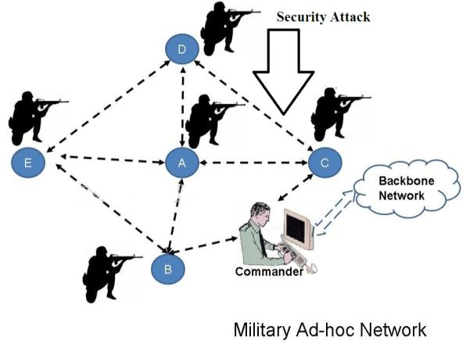
Military Applications
Battlefield communication without dependency
on infrastructure.
Secure, robust networks for dynamic
environments.

Slide 10
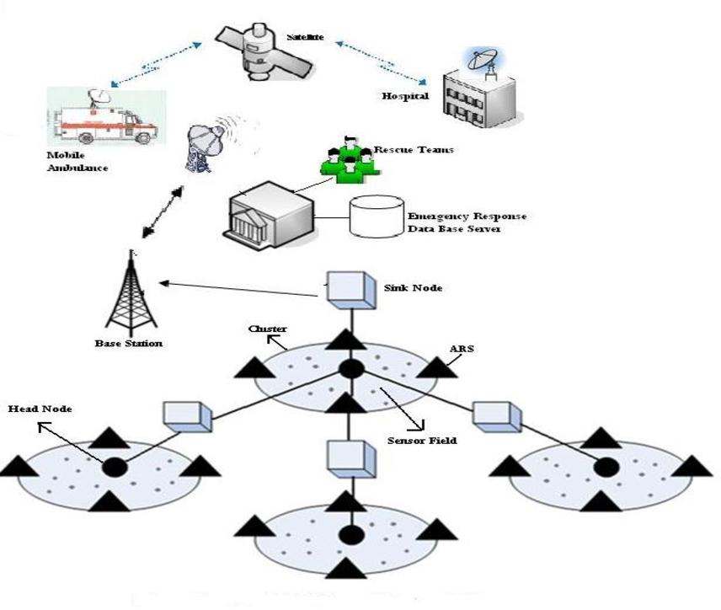
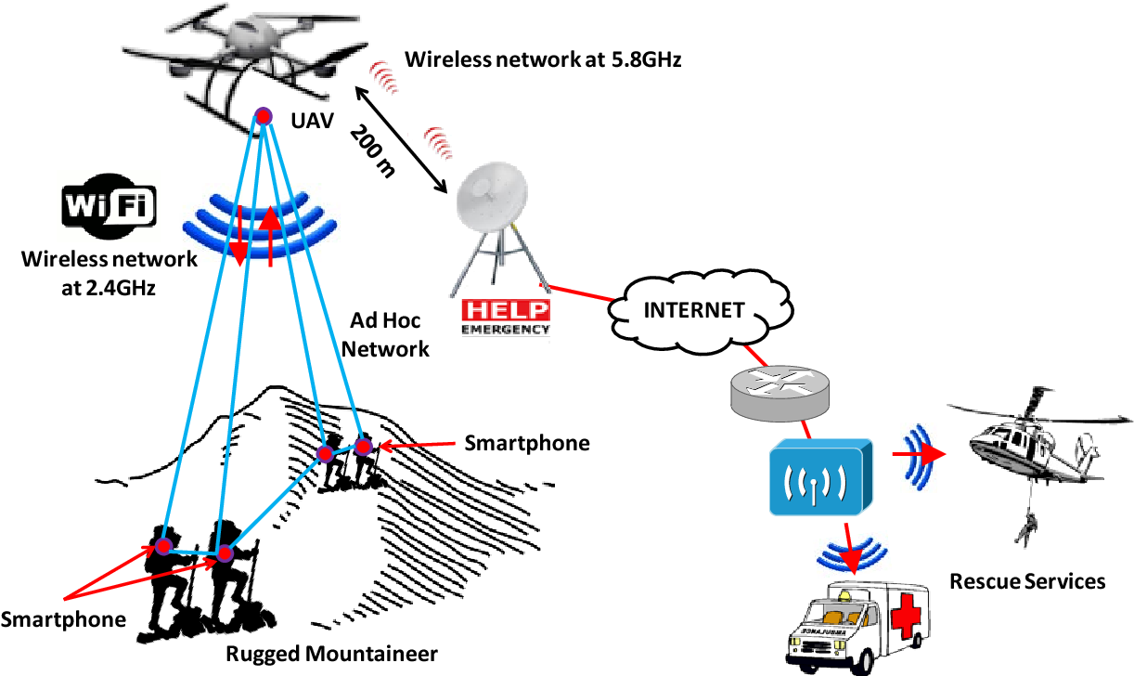
Emergency and Disaster Recovery
Facilitates communication in disaster-affected areas.
Temporary networks for first responders.

Slide 11
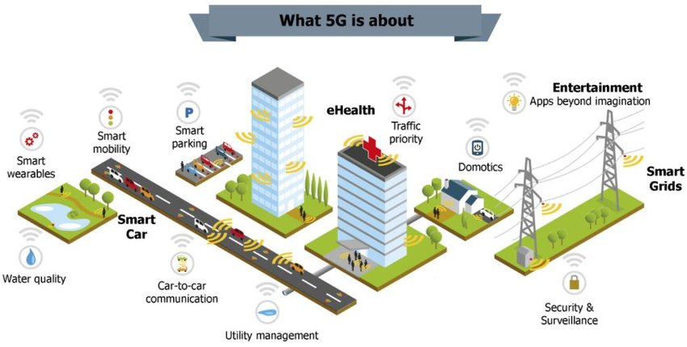
Internet of Things (IoT) and Smart Cities
Device-to-device communication.
Applications in healthcare, transport, and utilities.

Slide 12

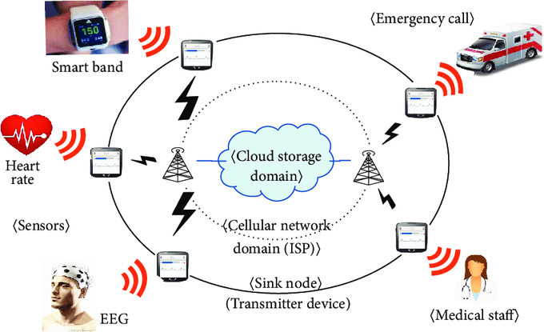
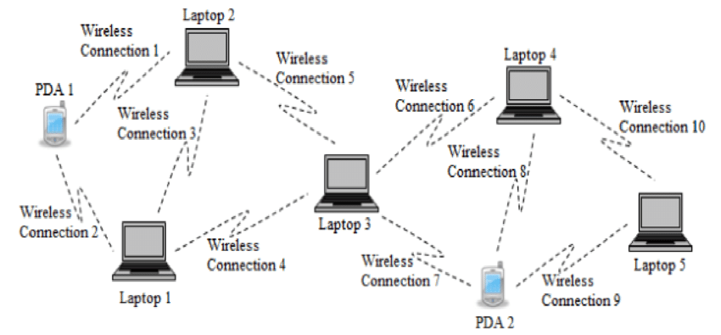
Other Applications
Healthcare: Mobile patient monitoring.
Education: Collaborative e-learning.
Personal Area Networks: Connecting wearable devices.

Slide 13
Challenges in MANETS
Scalability
Quality of service
Client server model shift;
Security
Interoperation with the Internet
Energy conservation
Node cooperation
Interoperation.

Slide 14
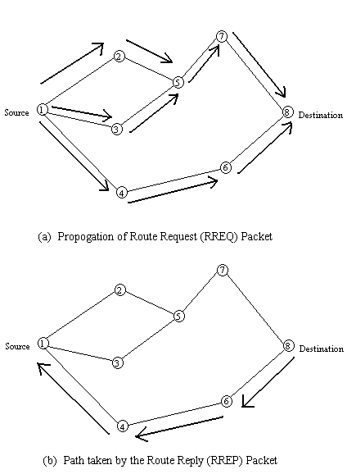
Routing in Ad Hoc Networks
Overview of Routing
Definition:
Routing is the process of determining paths for data packets to travel from source to destination in a network.
Importance:
Efficient routing ensures reliability, scalability, and performance in MANETs.
Types of Routing:
Topology-Based Routing
Position-Based Routing

Slide 15
Topology-Based Routing Protocols
Definition:
Topology-based routing uses information about the network's topology to forward data packets.
Subcategories:
Proactive Routing
Reactive Routing
Hybrid Routing

Slide 16
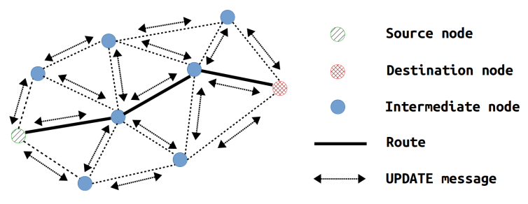
Proactive Routing Protocols
Definition:
Proactive routing maintains consistent and up-to-date routing information for every node in the network.
Mechanism:
Periodically updates routing tables.
Data is always routed using pre-established routes.
Examples:
Destination-Sequenced Distance-Vector (DSDV):
Based on Bellman-Ford Algorithm.
Ensures loop-free paths using sequence numbers.
Optimized Link State Routing (OLSR):
Reduces overhead by using Multipoint Relays (MPR).

Slide 17
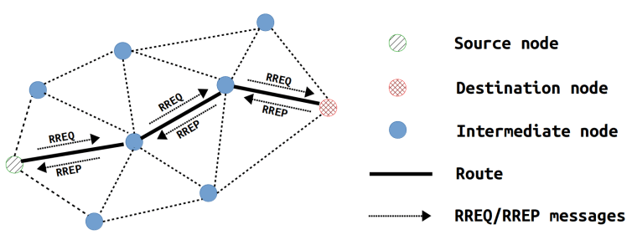
Reactive Routing Protocols
Definition:
Reactive routing discovers routes only when needed, reducing overhead.
Mechanism:
Route Request (RREQ) packets are sent when a route is needed.
Route Reply (RREP) packets confirm the path.
Examples:
Ad Hoc On-Demand Distance Vector (AODV):
Uses sequence numbers to prevent loops.
Finds shortest paths dynamically.
Dynamic Source Routing (DSR):
Maintains source routing where the entire path is included in the packet header.

Slide 18
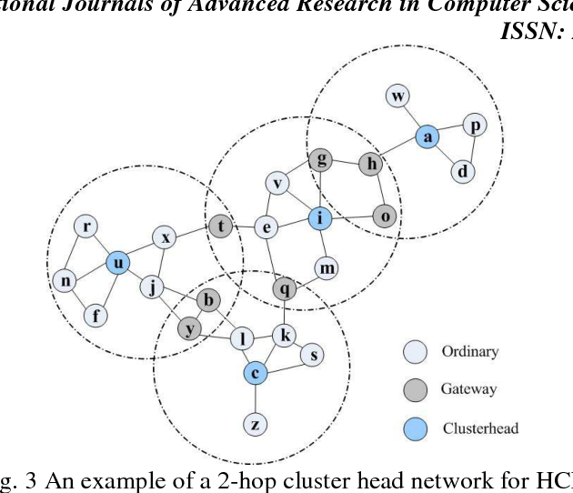
Hybrid Routing Protocols
Definition:
Hybrid routing combines proactive and reactive routing approaches to optimize performance.
Mechanism:
Proactive routing is used within a zone (intra-zone).
Reactive routing is used between zones (inter-zone).
Example:
Zone Routing Protocol (ZRP):
Defines zones for nodes.
Reduces overhead by limiting proactive updates to a zone.

Slide 19
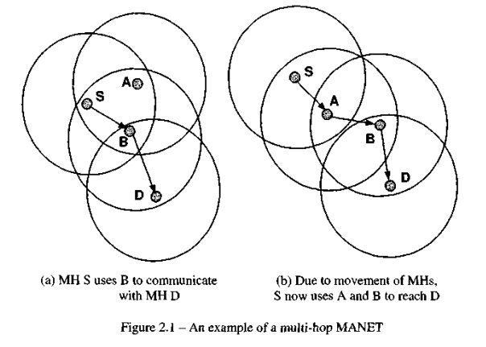
Routing protocols in MANETS

Slide 20
Proactive Routing Protocols

Slide 21
Destination-Sequenced Distance-Vector Protocol
Destination-sequenced distance-vector Routing (DSDV) is a proactive hop-by-hop distance vector routing protocol, requiring each node to broadcast routing updates periodically
Every MH in the network maintains a routing table for all possible destinations within the network and the number of hops to each destination.
Two types of packets can be employed:
full dumps or
small increment packets
A full dump type of packet carries all available routing information and can require multiple network protocol data units (NPDUs).
Smaller incremental packets are used to relay only the information that has changed since the last full dump.

Slide 22
New route broadcasts contain the address of the destination, the number of hops to reach the destination, the sequence number of the information received regarding the destination, as well as a new sequence number unique to the broadcast.
The route labeled with the most recent sequence number is always used. In the event that two updates have the same sequence number, the route with the smaller metric is used in order to optimize (shorten) the path
if each MH in the network advertises a monotonically increasing sequence number for itself, it may imply that the route just got broken.
MH B in Figure decides that its route to a destination D is broken, it advertises the route to D with an infinite metric.
This results in any node A, which is currently routing packets through B, to incorporate the infinite-metric route into its routing table until node A hears a route to D with a higher sequence number.

Slide 23
The Wireless Routing Protocol
The Wireless Routing Protocol (WRP) is a table?driven protocol with the goal of maintaining routing information among all nodes in the network.
Each node in the network is responsible for maintaining four tables: Distance table, Routing table, Link-cost table, and the Message Retransmission List (MRL) table.
Each entry of the MRL contains the sequence number of the update message, a re?transmission counter, an acknowledgment-required flag vector with one entry per neighbor, and a list of updates sent in the update message.
The MRL records which updates in an update message ought to be retransmitted and neighbors need to acknowledge the retransmission.

Slide 24
MHs keep each other informed of all link changes through the use of update messages. An update message is sent only between the neighboring MHs and contains a list of updates (the destination, the distance to the destination, and the predecessor of the destination), as well as a list of responses indicating which MHs should acknowledge (ACK) the update.
After processing updates from neighbors or detecting a change in a link, mobile nodes send update messages to a neighbor. Similarly, any new paths are relayed back to the original MHs so that they can update their tables accordingly.

Slide 25
If a MH does not send any message for a specified time period, it must send a hello message to ensure connectivity.
Otherwise, the lack of messages from the MH indicates the failure of that link and this may cause a false alarm. Whenever a MH receives a hello message from a new MH, it adds this new MH to its routing table and sends a copy of its routing table information to this new MH.
WRP belongs to the class of path-finding algorithms with an important exception that it avoids the "count-to-infinity" problem by forcing each node to perform consistency checks on predecessor information reported by all its neighbors.

Slide 26
Topology Broadcast based on Reverse Path Forwarding Protocol
The Topology Broadcast based on Reverse Path Forwarding (TBRPF) protocol considers the problem of broadcasting topology information (including link costs and up/down status) to all nodes of a communication network.
This information, together with a path selection algorithm, can be used by each node to compute preferred paths to all destinations, i.e., to perform routing based on link states.
Most link-state routing protocols, including the Open Shortest Path First (OSPF) are based on flooding.

Slide 27
The TBRPF protocol is based on the extended reverse-path forwarding (ERPF) algorithm
ERPF assumes the use of an underlying routing algorithm by each node i in selecting the next node pt(v) along the shortest path to each destination (or broadcast source) v.
The node Pi(v) then becomes the parent of i on the broadcast tree rooted at source v.
Each node informs its parent of this selection, so that each parent becomes aware of its children for each source. A node i receiving a broadcast message originating from source v from its parent p,(v) forwards the message to its children for source v (if it has children).

Slide 28
The use of minimum?hop trees instead of shortest-path trees (based on link costs) results in less frequent changes in the broadcast trees and therefore less communication cost to maintain the trees.
TBRPF has the following chicken-egg paradox: it computes the paths for the broadcast trees based on the information received along the trees themselves. Thus, the correctness of TBRPF is not obvious.
TBRPF is a simple, practical protocol that generates less update/control traffic than flooding and is therefore especially useful in networks that have frequent topology changes and have limited bandwidth.

Slide 29
Optimized Link State Routing Protocol
The Optimized Link State Routing (OLSR) protocol [Jacquet2001] is a proactive protocol based on the link state algorithm.
OLSR protocol is an optimization of a pure link state protocol for MANETs. First, it reduces the size of control packets: instead of all links, it declares only a subset of links amongst its neighbors which serves as its multipoint relay selectors (described next).
Secondly, it minimizes flooding of this control traffic by using only the selected nodes, called multipoint relays, in diffusing its messages throughout the network.
The protocol keeps the routes for all the destinations in the network, hence it is beneficial for the traffic patterns with a large subset of MHs are communicating with each other, and the pairs are also changing with time.

Slide 30
The protocol is particularly suitable for large and dense networks, as the optimization done using the multipoint relays works well in this context.
OLSR is designed to work in a completely distributed manner and thus does not depend upon any central entity.
It does not require a reliable transmission for its control messages: each node sends its control messages periodically, and can therefore sustain a loss of some packets from time to time, which happens very often in radio networks due to collisions or other transmission problems.
In addition, OLSR does note need an in-order delivery of its messages: each control message contains a sequence number of most recent information therefore reordering can be done at the receiving end

Slide 31
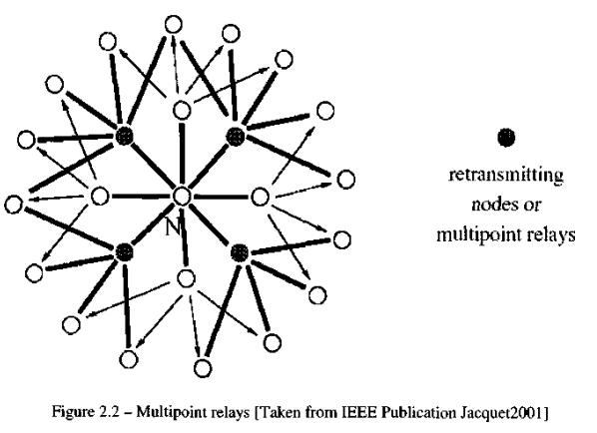
Multipoint Relays
Each MH in the network selects a set of neighboring MHs, to retransmit its packets and is called the multipoint relays (MPRs) of that node.
The neighbors of any node N which are not in its MPR set, receive the packet but do not retransmit it. Every broadcast message coming from these MPR Selectors of a node is assumed to be retransmitted by that node.

Slide 32
Each node selects its multipoint relay set MPR among its one hop neighbors in such a manner that the set covers (in terms of radio range) all the nodes that are two hops away.
The smaller is the multipoint relay set, the more optimal is the routing protocol.
Multipoint relays are selected among the one-hop neighbors with a bi-directional link.

Slide 33
Source Tree Adaptive Routing Protocol
STAR is an attempt to create the same routing performance as the other proactive protocols and still be equal or better on bandwidth efficiency.
To be able to do this, on demand route optimization has been put aside and the routes are allowed to be non-optimal to save bandwidth.
STAR depends on an underlying protocol which must reliably keep track of the neighboring MHs.
This could be implemented with periodic messages, but is not required.
The link layer must provide reliable broadcasting, or else this feature will have to be implemented into STAR with an extra routing rule.

Slide 34
Reactive Routing Protocols

Slide 35
Dynamic Source Routing
The Dynamic Source Routing algorithm is an innovative approach to routing in a MANET in which nodes communicate along paths stored in source routes carried by the data packets.
It is one of the purest examples of an on demand protocol.
In DSR, MHs maintain route caches that contain the source routes which the MH is aware of. Entries in the route cache are continually updated as new routes are learned.
Protocol consists of two major phases:
Route discovery
Route maintenance.

Slide 36
When a MH has a packet to send to some destination, it first consults its route cache to determine whether it already has a route to the destination. If it has a route to the destination, it will use this route to send the packet.
if the MH does not have such an unexpired route, it initiates route discovery by broadcasting a route request packet. This route request contains the address of the destination, along with the source MH's address and a unique identification number
Each node receiving the packet checks whether it knows of a route to the destination. If it does not, it adds its own address to the route record of the packet and then forwards the packet along its outgoing links.
A route reply is generated when the route request reaches either the destination itself, or an intermediate node that in its route cache contains an unexpired route to the destination.
By the time the packet reaches either the destination or such an intermediate node, it contains a route record with the sequence of hops taken.

Slide 37
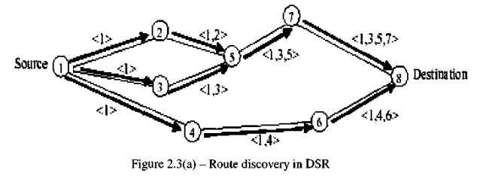
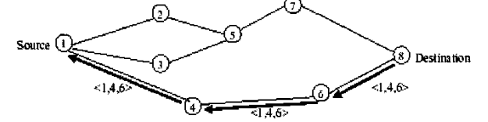

Slide 38
If the node generating the route reply is the destination, it places the route record contained in the route request into the route reply. If the responding node is an intermediate node, it appends its cached route to the route record and then generates the route reply.
Route maintenance is accomplished through the use of route error packets and acknowledgments. Route error packets are generated at a node when the data link layer encounters a fatal transmission problem.
When a route error packet is received, the hop in error is removed from tthat pointhe node's route cache and all routes containing the hop are truncated at that point
DSR also supports multi-path in its design as a built-in feature with no need for extra add-ons. This comes in very handy when a route fails, another valid route can be obtained from the route cache if one exists.

Slide 39
Ad Hoc On-Demand Distance Vector Protocol
The Ad Hoc On-Demand Distance Vector routing protocol is basically a combination of DSDV and DSR. It borrows the basic on-demand mechanism of Route Discovery and Route Maintenance from DSR, plus the use of hop-by-hop routing, sequence numbers, and periodic beacons from DSDV.
Route Discovery, Route Maintenance
Data forwarding.
When a source MH desires to send a message and does not already have a valid route to the destination, it initiates a path discovery process to locate the corresponding MH. It broadcasts a route request (RREQ) packet to its neighbors, which then forwards the request to their neighbors, and so on, until either the destination or an intermediate MH with a "fresh enough" route to the destination is reached.

Slide 40
AODV utilizes destination sequence numbers to ensure all routes are loop-free and contain the most recent route information. Each node maintains its own sequence number, as well as a broadcast ID.
The broadcast ID is incremented for every RREQ the node initiates, and together with the node's IP address, uniquely identifies an RREQ.
Along with the node's sequence number and the broadcast ID, the RREQ includes the most recent sequence number it has for the destination.
Intermediate nodes can reply to the RREQ only if they have a route to the destination whose corresponding destination sequence number is greater than or equal to that contained in the RREQ.

Slide 41
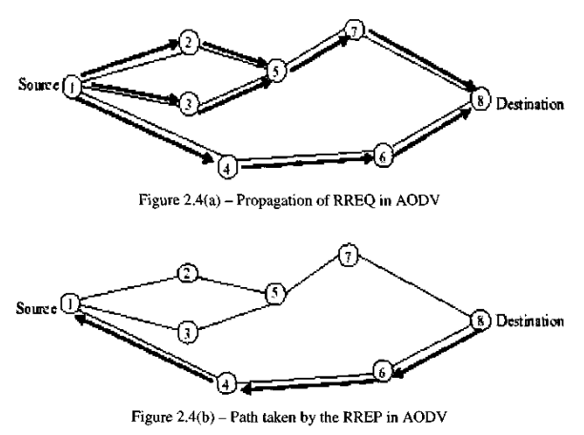

Slide 42
During the process of forwarding the RREQ, intermediate nodes record in their route tables the address of the neighbor from which the first copy of the broadcast packet was received, thereby establishing a reverse path.
If additional copies of the same RREQ are later received, they are discarded.
Once the RREQ reaches the destination or an intermediate node with a fresh enough route, the destination/intermediate node responds by unicasting a route reply (RREP) packet back to the neighbor from which it first received the RREQ.
RREP is routed back along the reverse path, nodes along this path set up forward route entries in their route tables that point to the node from which the RREP came
RREP is forwarded along the path established by the RREQ, AODV only supports the use of symmetric links.

Slide 43
If a source node moves, it is able to reinitiate the route discovery protocol to find a new route to the destination.
If a node along the route moves, its upstream neighbor notices the move and propagates a link failure notification message (an RREP with infinite metric) to each of its active upstream neighbors to inform them of the breakage of that part of the route.
These nodes in turn propagate the link failure notification to their upstream neighbors, and so on until the source node is reached.. The source node may then choose to re-initiate route discovery for that destination if a route is still desired.
An important aspect of the protocol is the use of hello messages as periodic local broadcasts to inform each MH in its neighborhood. Hello messages can be used to maintain the local connectivity in the form of beacon signals.

Slide 44
Link Reversal Routing and TORA
The Temporally Ordered Routing Algorithm (TORA) [Parkl997] is a highly adaptive loop-free distributed routing algorithm based on the concept of link reversal. It is designed to minimize reaction to topological changes.
A key design concept in TORA is that it decouples the generation of potentially far-reaching control messages from the rate of topological changes.
Route optimality (shortest-path) is considered of secondary importance, and longer routes are often used if discovery of newer routes could be avoided.
TORA is also characterized by a multi-path routing capability.
Each node has a height with respect to the destination that is computed by the routing protocol.

Slide 45
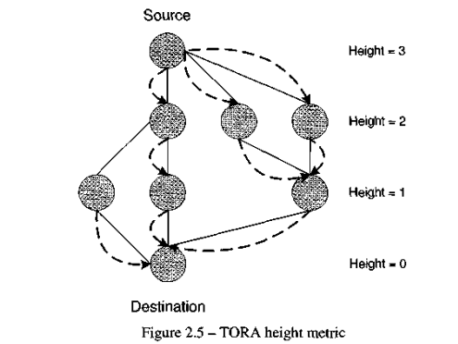
TORA is proposed to operate in a highly dynamic mobile networking environment. It is source initiated and provides multiple routes for any desired source/destination pair.
To accomplish this, nodes need to maintain routing information about adjacent (one-hop) nodes. The protocol performs three basic functions:
Route creation,
Route maintenance,
Route erasure.

Slide 46
TORA's metric comprises of quintuple elements:
Logical time of a link failure,
The unique ID of the node that defined the new reference level,
A reflection indicator bit,
A propagation ordering parameter,
The unique ID of the node.

Slide 47
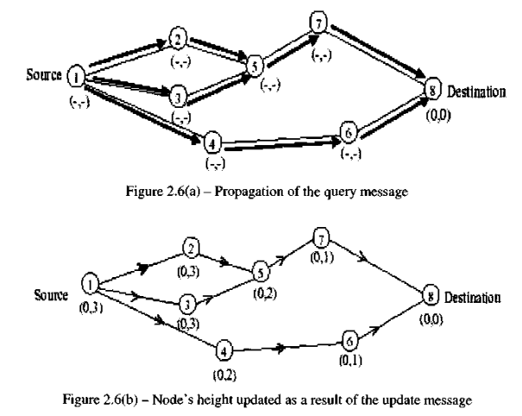
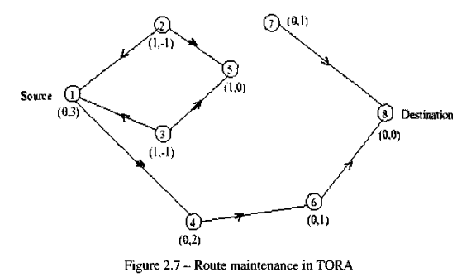

Slide 48
Hybrid Routing Protocols

Slide 49
Zone Routing Protocol
Zone Routing Protocol (ZRP) is an example of hybrid reactive and proactive schemes.
ZRP can be said to be a neighbor selection based protocol.
A node employing ZRP proactively maintains routes to destinations within a local neighborhood, which is referred to as a routing zone and is defined as a collection of nodes whose minimum distance in hops from the node in question is no greater than a parameter referred to as zone radius.
Each node maintains its zone radius and there is an overlap between neighboring zones.
The construction of a routing zone requires a node to first know who its neighbors are. A neighbor is defined as a node that can communicate directly with the node in question and is discovered through a MAC level Neighbor discovery protocol (NDP).

Slide 50
The ZRP maintains routing zones through a proactive component called the Intrazone routing protocol (IARP) which is implemented as a modified distance vector scheme
Interzone routing protocol (IERP) is responsible for acquiring routes to destinations that are located beyond the routing zone.
The IERP uses a query-response mechanism to discover routes ondemand.
The IERP is distinguished from the standard flooding algorithm by exploiting the structure of the routing zone, through a process known as bordercasting.
The ZRP provides this service through a component called Border resolution protocol (BRP).

Slide 51
Fisheye State Routing
The Fisheye State Routing (FSR) protocol introduces the notion of multi-level fisheye scope to reduce routing update overhead in large networks.
Nodes exchange link state entries with their neighbors with a frequency that depends on distance to destination.
From link state entries, nodes construct the topology map of the entire network and compute optimal routes.
FSR tries to improve the scalability of a routing protocol by putting most efforts in gathering data on the topology information that is most likely to be needed soon.
FSR tries to focus its view on nearby changes by observing them with the highest resolution in time and changes at distant nodes are observed with a lower resolution and less frequently.

Slide 52
Landmark Routing (LANMAR) for MANET with Group Mobility
Landmark Ad Hoc Routing (LANMAR) combines the features of FSR and Landmark routing.
The key feature is the use of landmarks for each set of nodes which move as a group (e.g., a group of soldiers in a battlefield) in order to reduce routing update overhead.
Like FSR, nodes exchange link state only with their neighbors. Routes within Fisheye scope are accurate, while routes to remote groups of nodes are"summarized" by the corresponding landmarks.
A packet directed to a remote destination, initially aims at the landmark; as it gets closer to destination it eventually switches to the accurate route provided by Fisheye.

Slide 53
Each node knows the routes to all the nodes within its hierarchical partition. Moreover, each node knows the routes to various "landmarks" at different hierarchical levels.
Packet forwarding is consistent with the landmark hierarchy and the path is gradually refined from top-level hierarchy to lower levels as a packet approaches the destination.
LANMAR borrows the notion of landmarks to keep track of logical subnets.
A subnet consists of members which have a commonality of interests and are likely to move as a "group" (e.g., soldiers in the battlefield).
A "landmark" node is elected in each subnet. The routing scheme itself is a modified version of FSR

Slide 54
Cluster-Based Routing Protocol
The Cluster-Based Routing Protocol (CBRP)is a partitioning protocol emphasizing support for unidirectional links.
Clusters are defined by bi-directional links, but inter-cluster connectivity may be obtained via a pair of unidirectional links.
Each node maintains two-hop topology information to define clusters. Each cluster includes an elected cluster head, with which each member node has a bi-directional link.
Clusters may be overlapping or disjoint; however, cluster-heads may not be adjacent.
Nodes must find and inform their cluster head(s) of the status of the "gateway" nodes, cluster members which can be reached from a node belonging to another cluster.
Thus, each cluster-head has knowledge of all the clusters with which it has bi-directional connectivity, possibly via a pair of unrelated unidirectional links

Slide 55
The latter are discovered by flooding adjacent cluster heads with a request for an appropriate link.
When a source has no route to a destination, it forwards a route request to its cluster head.
The cluster infrastructure is used to reduce the cost of disseminating the request.
When a cluster-head receives a request, it appends to the request packet its ID, as well as a list of (non-redundant) adjacent clusters, and rebroadcasts it.
Each neighboring node which is a gateway to one of these adjacent clusters unicasts the request to the appropriate cluster head.

Slide 56
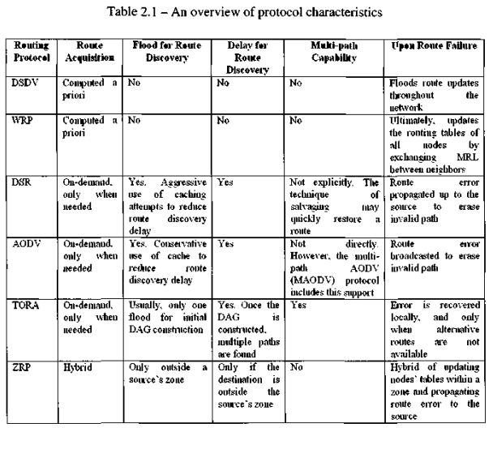

Slide 57
Position-Based Routing
Principles and Issues
Location Services
Forwarding Strategies

Slide 58
Principles and Issues
The philosophy of position-based routing is that it is necessary to determine the location of the destination before a packet can be sent.
Generally, a location service takes this responsibility.
Existing location services can be classified according to how many MHs have the service. This can be either some specific nodes or all the network nodes.
Moreover, each location server may maintain the position of some specific nodes or all the nodes in the network.
four possible combinations of location services are
some-for-some
some-for-all
all-for-some
all-for all MHs.

Slide 59
Forwarding decision by a MH is essentially based on the position of a packet's destination and the position of the node's immediate one-hop neighbor.
Clearly, the position of the destination is contained in the header of the packet. If a node happens to know an accurate position of the destination, it may choose to update the position of the packet before forwarding it.
The position of the neighbors is learned through one-hop broadcasts. These beacons are sent periodically by all nodes and contain the position of the sending node.
Three main packet forwarding schemes can be defined for position based routing:
• Greedy forwarding;
• Restricted directional flooding;
• Hierarchical approaches.

Slide 60
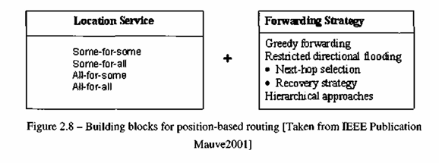
For the first two, a node forwards a given packet to one (greedy forwarding) or more (restricted directional flooding) one-hop neighbors that are located closer to the destination than the forwarding node itself.
The selection of the neighbor in the greedy case depends on the optimization criteria of the algorithm. It is fairly obvious that both forwarding strategies may fail if there is no one-hop neighbor that is closer to the destination than the forwarding node itself.
Recovery strategies that cope with this kind of failure are also discussed. The third forwarding strategy is to form a hierarchy in order to scale to a large number of MHs.
we investigate two representatives of hierarchical routing that use greedy forwarding for wide area routing and non-position based approaches for local area routing.

Slide 61
Location Services
In order to learn the current position of a specific node, help is needed from a location service.
MHs register their current position with this service. When a node does not know the position of a desired communication partner, it contacts the location service and requests that information.
In classical one-hop cellular networks, there are dedicated position servers (with well-known addresses) that maintain position information about the nodes in the network.
With respect to classification, this is some-for-all approach as the servers are some specific nodes, each maintaining the position information about all MHs.

Slide 62
In MANETs, such centralized approach is viable only as an eternal service that can be reached via non-ad hoc means.
There are two main reasons for this. First, it would be difficult to obtain the location of a position server if the server is a part of the MANET itself. This would represent a chicken-and-egg problem: without the position server it is not possible to get position information, but without the position information the server cannot be reached.
Second, since a MANET is dynamic, it might be difficult to guarantee that at least one position server will be present in a given MANET. we concentrate on decentralized location services that are part of the MANET.

Slide 63
Distance Routing Effect Algorithm for Mobility
Within Distance Routing Effect Algorithm for Mobility (DREAM) framework ,each node maintains a position database that stores the location information about other nodes that are part of the network.
It can be classified as an all-for-all approach.
An entry in the position database includes a node identifier, the direction of and distance to the node, as well as a time value that indicates when this information has been generated.
The accuracy of such an entry depends upon its age. Each node running DREAM periodically floods packets to update the position information maintained by the other nodes. A node can control the accuracy of its position information available to other nodes in two ways:
• By changing the frequency at which it sends position updates. This is known as temporal resolution;
• By indicating how far a position update may travel before it is discarded. This is known as spatial resolution.

Slide 64
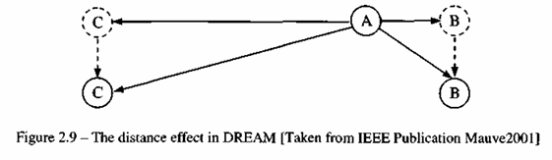
The temporal resolution of sending updates is coupled with the mobility rate of a node, i.e., the higher the speed is, more frequent the updates will be.
The spatial resolution is used to provide accurate position information in the direct neighborhood of a node and less accurate information at nodes farther away.
The costs associated with accurate position information at remote nodes can be reduced since greater the distance separating two nodes is, slower they appear to be moving with respect to each other.
Accordingly, the location information in routing tables can be updated as a function of the distance separating nodes without compromising the routing accuracy. This is called as the distance effect and is exemplified by Figure 2.9 where MH A is assumed stationary, while MHs B and C are moving in the same direction at the same speed.
From node A's perspective, the change in direction will be greater for node B than for node C. The distance effect allows low spatial resolution areas far away from the target node, provided that intermediate hops are able to update the position information contained in the packet header.

Slide 65
Quorum-Based Location Service
The concept of quorum systems is quite popular in distributed systems and information replication in databases.
Here, information updates (write operations) are sent to a subset (quorum) of available nodes, and information requests (read operations) are referred to a potentially different subset. When these subsets are designed such that their intersection is nonempty, it is ensured that an up-to-date version of the sought-after information can always be found.
It is instructive to discuss this scheme through a sample network shown in Figure 2.10. A set of MHs is chosen to host position databases, and this is illustrated by nodes 1-6 in Figure 2.10. Next, a virtual backbone is constructed among the nodes of the subset by utilizing a non-position-based ad hoc routing algorithm.
A MH sends position update messages to the nearest backbone node, which then chooses a quorum of backbone nodes to host the position information.
Here, node D sends its updates to node 6, which might then select quorum A with nodes 1, 2, and 6 to host the information. When a node S wants to obtain the position information, it sends a query to the nearest backbone node, which in turn contacts (through unicast or even multicast) the nodes of a (usually different) quoram.

Slide 66
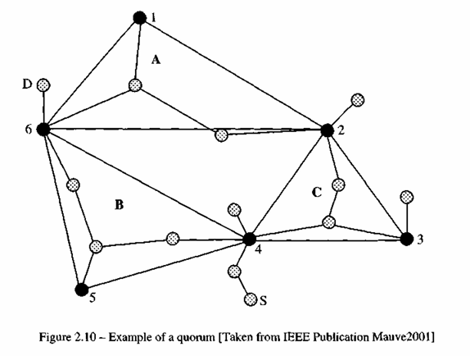
The intersection of two quorum systems is nonempty, the querying node is guaranteed to obtain at least one response with the desired position information. It is important to timestamp position updates.
An important trade-off in quorum-based position services is that larger the quorum set is, higher the cost for position updates and queries are, while larger the number of nodes in the intersection of two quorums will be. This improves resilience against unreachable backbone nodes.
The quorum-based position service can be configured to operate as all-for-all, all-for-some, or some for-some approach, depending upon how the size of the backbone and the quorum is chosen. However, it will typically work as some-for-some scheme.
Notes:
An important trade-off in quorum-based position services is that larger the quorum set is, higher the cost for position updates and queries are, while larger the number of nodes in the intersection of two quorums will be.

Slide 67
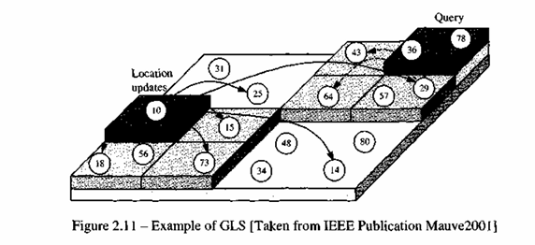
Grid Location Service
Grid Location Service (GLS) divides the area that contains the MANET into a hierarchy of squares.
In this hierarchy, n-order squares contain exactly (n - l)-order squares, forming a so-called quadtree. Each node maintains a table of all other nodes within the local first-order square. The table is constructed with the help of periodic position broadcasts scoped to the area of the first order square.
To determine where to store position information, GLS establishes a notion of near node IDs, defined as the least ID greater than a node's own ID.

Slide 68
When node 10 in Figure 2.11 wants to distribute its position information, it sends position updates to the respective node with the nearest ID in each of the three surrounding first-order squares.
Therefore, the position information is available at nodes 15, 18, 73, and at all nodes that are in the same first-order square as node 10 itself.
In the surrounding three second-order squares, again the nodes with the nearest ID are selected to host the node's position (nodes 14, 25, and 29 in the example of Figure 2.11). This process is repeated until the area of the MANET has been fully covered. As we can see, the density of the position information for a given node decreases logarithmically with the distance from that node.
Now node 78 wants to obtain the position of node 10.
Firstly, it should locate a nearby node that knows about the position of node 10. Here this is node 29. While node 78 does not know that node 29 possesses the required position, it is able to discover this information.
To understand how this process works, it is important to look at the position servers of node 29. Its position is stored in the three surrounding first-order squares at nodes 36, 43, and 64.
each of these nodes, including node 29, are also automatically the ones in their respective first-order square with the ID nearest to 10. Thus, there exists a "trail" of descending node IDs from each of the squares of all orders to the correct position server

Slide 69
Homezone
Two almost identical location services have been proposed independently in [Giordano 1999, Stojmenovic 1999b].
Both use the concept of a virtual Homezone where position information for a node is stored. By applying a well-known hash function to the node identifier, it is possible to derive the position C of the Homezone for a node.
All nodes within a disk of radius R centered at C have to maintain position information for the node. Thus, as in the case of GLS, a position database can be found by means of a hash function on which sender and receiver agree without having to exchange information.
If the Homezone is sparsely populated, R may have to be increased, resulting in increasing R for updates as well as for queries. Therefore the Homezone approaches are also all-for-some approaches.

Slide 70
Position queries for a node can now be directed to the node with the nearest ID of which the querying node knows. In our example, this would be node 36. The node with the nearest ID does not necessarily know the node sought, but will know the node with a nearer node ID. This would be node 29 in our example, which happens to be the sought position server. This process continues until a node that has the position information available is found.
Position information is forwarded to a certain position (e.g., the lower left corner) of each element in the quadtree and is then forwarded progressively to nodes with closer IDs to ensure that the position information reaches the correct node.
Since GLS requires that all nodes store the information on some other nodes, it can therefore be classified as an all-for-some approach.

Slide 71
Forwarding Strategies
Greedy Packet Forwarding
Using greedy packet forwarding, the sender of a packet includes an approximate position of the recipient in the packet. This information is gathered by an appropriate location service.
When an intermediate node receives a packet, it forwards the packet to a neighbor lying in the general direction of the recipient. Ideally, this process can be repeated until recipient has been reached.
There are three different strategies a node can use to decide to which neighbor a given packet should be forwarded, where node S and D denote the source and destination nodes of a packet
The circle with radius r indicates the maximum transmission range of node S

Slide 72
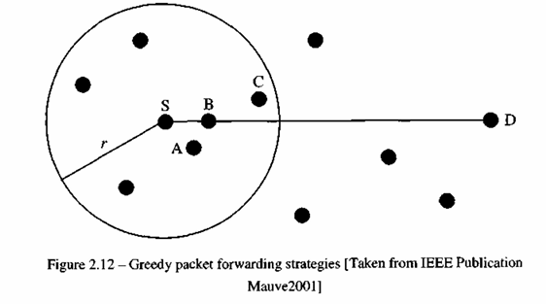

Slide 73
One intuitive strategy is to forward the packet to the node that makes the most progress towards (i.e., closest to) node D.
In Figure, this would be node C. This strategy is known as most forward within r (MFR).
MFR tries to minimize the number of hops a packet has to transverse in order to reach node D.
MFR may be a good strategy in scenarios where the sender of a packet cannot adjust the transmission signal strength to the distance between the sender and receiver.
However, it is shown that a different strategy performs better than MFR in situations where the sender can adapt its transmitting power.
In nearest with forward progress (NFP), the packet is transmitted to the nearest neighbor of the sender which is in the direction of the destination.
In Figure, this would be node A.
If all nodes employ NFP, the probability of packet collisions is significantly reduced. Thus, the average progress of the packet is calculated as p • f(a, b) where p is the likelihood of a successful transmission without collision and f(a, b) is the progress of the packet being successfully forwarded from a to b and is higher for NFP than for MFR.

Slide 74
Another strategy for forwarding packets is compass routing, in which the neighbor closer to the straight line between sender and destination is selected.
In our example of Figure 2.12, this would be node B.
Compass routing tries to minimize the spatial distance a packet travels. Finally, it is possible to let the sender randomly select one of the nodes closer to the destination than itself and forward the packet to that node.
This strategy minimizes the accuracy of information needed about the position of the neighbors and reduces the number of operations required to forward a packet.
Greedy routing may fail to find a path between a sender and a destination, even though one does exist.
This can be seen through Figure 2.13, where the circle around node D has the radius of the distance between nodes S and D, and circle around node S shows its transmission range.
Here exists a valid path from node S to node D. The problem here is that node S is closer to the destination node D than any of the nodes in its transmission range.
Greedy routing has therefore reached a local maximum from which it cannot recover.
To counter this problem, it has been suggested that the packet should be forwarded to the node with the least backward (negative) progress if no node can be found in the forward direction.
This raises the problem of looping, which cannot occur when packets are forwarded only toward the destination with positive progress.

Slide 75
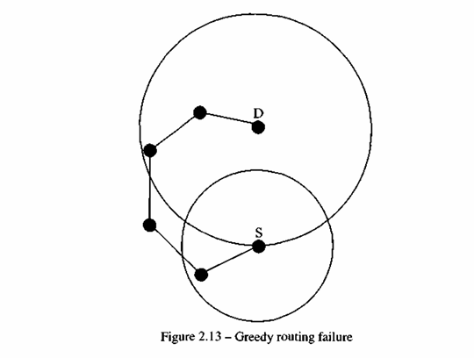

Slide 76
The face-2 algorithm [Bosel999] and the perimeter routing strategy of the Greedy Perimeter Stateless Routing Protocol (GPSR) [Karp2000] are two similar recovery approaches based on planar graph traversal.
Both are performed on a per-packet basis and do not require nodes to store any additional information.
A packet enters the recovery mode when it arrives at a local maximum. It returns to greedy mode when it reaches a node closer to the destination than the node where the packet entered the recovery mode.
Planar graphs are graphs with non intersecting edges. A set of nodes in a MANET can be considered a graph in which the nodes are vertices and an edge exists between two vertices if they are close enough to communicate directly with each other.
The graph formed by a MANET is generally not planar, and an example is in Figure 2.14 where the transmission range of each node contains all other nodes.

Slide 77
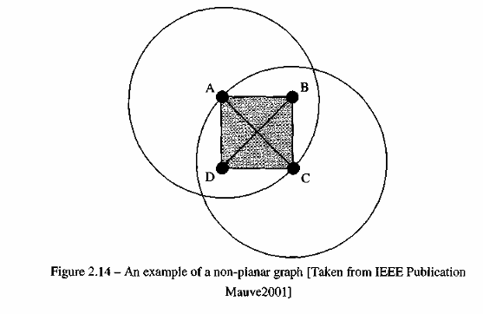
In order to construct a connected planar subgraph of the graph formed by the nodes in a MANET, a well-known mechanism is employed
An edge between two nodes A and B is included in the graph only if the intersection of the two circles with radii equal to the distance between node A and B around those two nodes does not contain any other nodes.
For example, in Figure 2.14 the edge between nodes A and C would not be included in the planar subgraph since nodes B and D are contained in the intersection of the circles.
It is important to realize that each node can locally make the decision as to whether an edge is within the planar subgraph, since each node knows the position of all its neighbors.

Slide 78
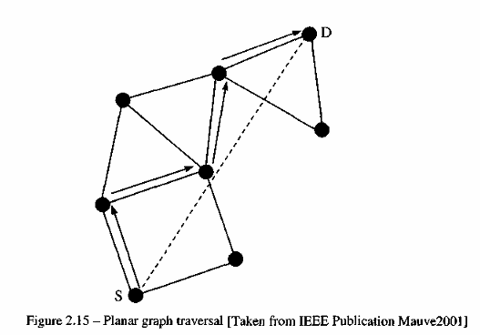
Based on the planar subgraph, a simple planar graph traversal is used to find a path toward the destination. The general concept is to forward the packet on faces of the planar subgraph progressively closer to the destination.
Figure 2.15 shows how this traversal is carried out when a packet is forwarded from node S toward node D on recovery mode.
On each face, the packet is forwarded along the interior of the face by using the right hand rule: forward the packet on the next edge counterclockwise from the edge on which it arrived.
Whenever the line between source and destination intersects the edge along which a packet is about to be forwarded, check if this intersection is closer to the destination than any other intersection previously encountered.
If this is true, switch to the new face bordering the edge the packet is about to transverse. The packet is then forwarded on the next edge counterclockwise to the edge it is about to be forwarded along before switching faces.
This algorithm guarantees that a path will be found from the source to the destination in case at least one exists in the original non planar graph

Slide 79
Restricted Directional Flooding
DREAM
In DREAM (discussed earlier), the sender node S of a packet with destination node D forwards the packet to all one-hop neighbors that lie "in the direction of node D".
In order to determine this direction, a node calculates the region that is likely to contain node D, called the expected region. As depicted in Figure 2.16, the expected region is a circle around the position of node D as it is known by node S.
Since this position information may be outdated, the radius r of the expected region is set to (tj - tS)Vmax, where tj is the current time, t0 is the timestamp of the position information node S has about node D, and vmax is the maximum speed that a node may travel in the MANET.
Given the expected region, the "direction towards node D" for the example in Figure 2.16 is defined by the line between nodes S and D and the angle.
The neighboring nodes repeat this procedure using their information on node D's position. If a node does not have a one-hop neighbor in the required direction, a recovery procedure has to be started. This procedure is not part of DREAM specification.

Slide 80
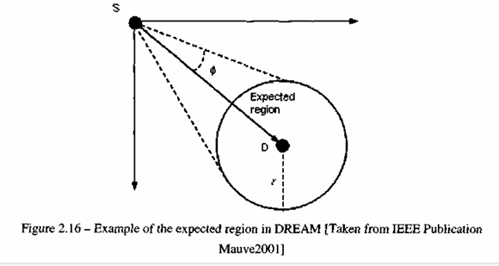
Location-Aided Routing

Slide 81
Location-Aided Routing
The Location-Aided Routing (LAR) [Kol998] protocol does not define a location-based routing protocol, but instead proposes the use of position information to enhance the route discovery phase of reactive ad hoc routing approaches, which often use flooding as a means of route discovery.
Under the assumption that nodes have information about other node's positions, LAR uses this position information to restrict the flooding to a certain area. This is carried out similar to DREAM.
LAR exploits location information to limit the scope of route request flood employed in protocols such as AODV and DSR. Such location information can be obtained, for example, through GPS.
LAR limits the search for a route to the so-called request zone, determined based on the expected location of the destination node at the time of route discovery. Two concepts are important to understand how LAR works:
Expected Zone and
Request Zone.

Slide 82
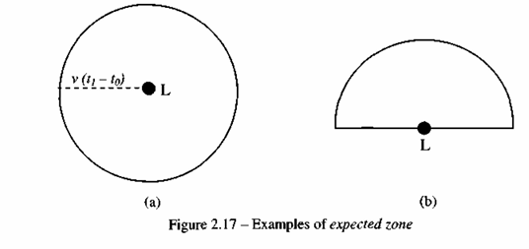
Expected Zone: Consider a node S that needs to find a route to node D.
Assume that node S knows that node D was at location L at time t0. Then, the "expected zone" of node D, from the viewpoint of node S at current time tj, is the region expected to contain node D.
For instance, if node S knows that node D travels with average speed v, then S may assume that the expected zone is the circular region of radius v(ti - t0), centered at location L
If actual speed happens to be larger than the average, then the destination may actually be outside the expected zone at time tj.
Thus, expected zone is only an estimate made by node S to determine a region that potentially contains D at time tj.
If node S does not know any previous location of node D, then node S cannot reasonably determine the expected zone
In this case, LAR reduces to the basic flooding algorithm. In general, having more information regarding mobility of a destination node can result in a smaller expected zone

Slide 83
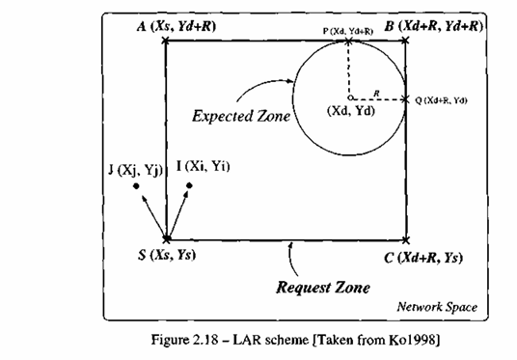

Slide 84
Based on the expected zone, we can define the request zone.
The proposed LAR algorithms use flooding with one modification. Node S defines (implicitly or explicitly) a request zone for the route request.
A node forwards a route request only if it belongs to the request zone (unlike the flooding algorithm in AODV and DSR). To increase the probability that the route request will reach node D, the request zone should include the expected zone (described above).
Additionally, the request zone may also include other regions around the request zone. Based on this information, the source node S can thus determine the four corners of the expected zone.
if node I receives the route request from another node, node I forwards the request to its neighbors, because I determines that it is within the rectangular request zone. However, when node J receives the route request, node J discards the request, as node J is not within the request zone
This algorithm is called LAR scheme 1.

Slide 85
The LAR scheme 2 is a slight modification to include two pieces of information within the route request packet: assume that node S knows the location (Xd ; Yd) of node D at some time to - the time at which route discovery is initiated by node S is ti, where ti > t0.
Node S calculates its distance from location (Xd; Yd), denoted as DISTS, and includes this distance with the route request message.
The coordinates (Xd ; Yd) are also included in the route request packet. With this information, a given node J forwards a route request forwarded by I (originated by node S), if J is within an expected distance from (Xd; Yd) than node I.

Slide 86
Relative Distance Micro-Discovery Ad Hoc Routing
The Relative Distance Micro-discovery Ad Hoc Routing (RDMAR) routing protocol [Aggeloul999], an adaptive and scalable routing protocol, is well suited in large mobile networks whose rate of topological changes is moderate.
A key concept in its design is a typical localized reaction to link failures to a very small region of the network near the change. This desirable behavior is achieved through the use of a flooding mechanism for route discovery, called Relative Distance Micro discovery (RDM).
To accomplish this, an iterative algorithm calculates an estimate of their RD given their previous RD, an average nodal mobility and information about the elapsed time since they last communicated.
Based on the newly calculated RD, the query flood is then localized to a limited region of the network centered at the source node of the route discovery and with maximum propagation radius that equals to the estimated relative distance.

Slide 87
In RDMAR, packets are routed between the stations of the network by using routing tables which are stored at each station of the network.
Each routing table lists all reachable destinations, wherein for each destination j , it includes: the "Default Router" field that indicates the next hop node through which the current node can reach;', the "RD" field which shows an estimate of the relative distance (in hops) between the node and j , the "Time_Last_Update" (TLU) field that indicates the time since the node last received routing information for j, a "RTJTimeout" field which records the remaining amount of time before the route isconsidered invalid, and a "Route Flag" field which declares whether the route to j is active. RDMAR comprises of two main algorithms:

Slide 88
Hierarchical Routing Protocols
In traditional networks, the complexity of the routing algorithm handled by each node can be reduced tremendously by establishing some form of hierarchy.
position-based routing for MANETs can also benefit from the use of hierarchy.

Slide 89
Terminodes Routing
One approach that combines hierarchical and position-based routing is a part of the Terminodes project [Blazevic2001] with two levels of hierarchy [Blazevic2000].
Packets are routed according to a proactive distance vector scheme if the destination is close (in terms of number of hops) to the sending node.
For long distance routing, a greedy position based approach is used. Once a long distance packet reaches the area close to the recipient, it continues to be forwarded by means of the local routing algorithm.
It is shown by simulations in [Blazevic2000] that the hierarchy can significantly improve the ratio of successfully delivered packets and the routing overhead compared to conventional reactive ad hoc routing protocols.
In order to prevent greedy forwarding for long distance routing from encountering a local maximum, the sender includes a list of positions in the packet header which are then traversed on its way to the sender.
In Terminodes routing, the sender requests this information from nodes it is already in contact with (e.g., the nodes that are reachable using the local routing protocol). Once a sender has this information, it needs to check at regular intervals whether the path of positions is still valid or can be improved.

Slide 90
Grid Routing
A second method for position-based ad hoc routing containing hierarchical elements is proposed within the Grid project.
The location proxy technique described in [Couto2001] is similar to the Terminodes routing: a proactive distance vector routing protocol is used at the local level, while position-based routing is employed for long-distance packet forwarding.
In Grid routing, however, the hierarchy is not only introduced to improve scalability. The main idea here is to have at least one position-aware node in each area to be used as proxies.
Packets that are addressed to a position-unaware node therefore arrive at a position-aware proxy and are then forwarded according to the information of the proactive distance vector protocol.
As a repair mechanism for greedy long-distance routing, a mechanism called Intermediate Node Forwarding (INF) is proposed [Couto2001].
If a forwarding node has no neighbor with forward progress, it discards the packet and sends a notification to the sender of the packet.

Slide 91
The sender of the packet then chooses a single intermediate position randomly for a circle around the midpoint of the line between the sender and the receiver.
Packets have to traverse that intermediate position. If the packet is discarded again, the radius of the circle is increased and another random position is chosen.
This is repeated until the packets are delivered to the destination, or until a predefined number has been attempted when the sender assumes that the destination is unreachable.

Slide 92
Location Services
A comparison between different location-based routing is given in [Stojmenovic2002, Hatami2005]. Table 2.2 summarizes various location services using several different criteria, where n represents the number of nodes and c is a constant.
The type criterion indicates how many nodes participate in providing location information and for how many other nodes each node is required to maintain location information.
The communication complexity describes the average number of one-hop transmissions required to look up or update a node's position.
The time complexity measures the average time it takes to perform a position update or position lookup. The amount of state required at each node to maintain the position of other nodes is indicated by the state volume.
Some location services provide localized information by maintaining a higher density or better quality of position information near the position of the node. This may be important if the communication in a MANET is mainly local.
The robustness of a location service is considered to be low, medium, or high, depending on whether it takes the failure of a single node, the failure of a small subset of all nodes, or the failure of all nodes to render the position of a given node inaccessible. The implementation complexity indicates how well the location service is understood and how complex it is to implement and test it. We note that this measure is highly subjective, while we have tried to be as fair as possible.

Slide 93
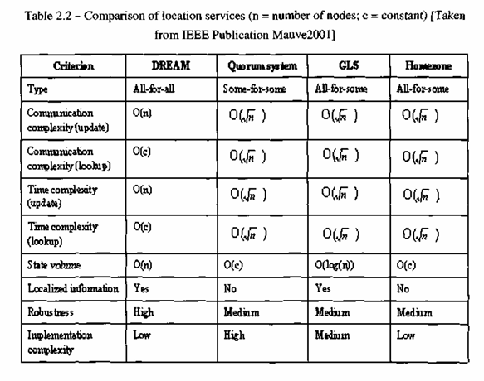
Location Services

Slide 94
Forwarding Strategies
Table 2.3 presents a summary of various forwarding strategies
Type describes the fundamental strategy used for packet forwarding
The communication complexity indicates the average number of one-hop transmissions required to send a packet from one node to another node with known position.
The strategies need to tolerate different degrees of inaccuracy with regard to the position of the receiver and is reflected by the tolerable position inaccuracy criterion.
The forwarding requires all-for-all location service indicates whether the forwarding strategy requires all-for-all location service in order to work properly.
The robustness of an approach is high if the failure of a single intermediate node does not prevent the packet from reaching its destination.
Its value is medium if the failure of a single intermediate node might lead to the loss of the packet but does not require the setup of a new route.
The robustness is low if the failure of an individual node might result in packet loss and requires setting up a new route.
The position-based strategies do not maintain routes and therefore have, at least, medium robustness.
As for the location service, the implementation complexity describes how complex it is to implement and test a given forwarding strategy.

Slide 95
Greedy forwarding is efficient, with a communication complexity of 0(Vn ), and is well suited for use in MANETs with a highly dynamic topology.
The face-2 algorithm [Bosel999] and the perimeter routing of GPSR [Karp2000] are currently the most advanced recovery strategies.
One drawback of the current greedy approaches is that the position of the destination needs to be known with an accuracy of a one-hop transmission range, or else the packets cannot be delivered
The robustness is medium, as the failure of an individual node may cause the loss of a packet in transit. However, it does not require setting up a new route as would be the case in topology-based routing protocols. Due to repair strategy like face-2 or perimeter routing, we consider the implementation efforts to be of medium complexity.

Slide 96
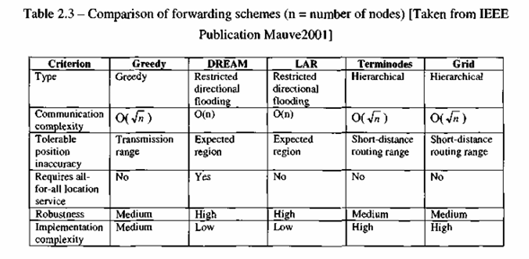

Slide 97
Other Routing Protocols
There are plenty of routing protocols for MANETs, and the most important ones have been covered in detail. However, below we describe some other routing protocols which employ optimization criteria different from the ones described earlier.

Slide 98
Other Routing Protocols
Signal Stability Routing
The on-demand Signal Stability-Based Adaptive Routing protocol (SSR) [Dubel997] selects routes based on the signal strength (weak or strong) between nodes and a node's location stability.
This route selection criterion of SSR has the effect of choosing routes that have "stronger" connectivity [Chlamtacl986].
Basically, SSR is comprised of two cooperative protocols, namely, the Dynamic Routing Protocol (DRP) and the Static Routing Protocol (SRP).
The DRP is responsible for the maintenance of Signal Stability Table (SST) and the Routing Table (RT).
After processing the packet and updating the appropriate tables, DRP passes the packet to the SRP.
The SRP of a node processes by passing the packet up the stack if it is the intended receiver, or looks up in the routing table for the destination and forwards the packet if it is not.

Slide 99
If no entry is found in the routing table for the destination, a route search process is initiated.
One difference between route-discovery-procedure used in SSR with respect to that employed in AODV is that route requests are only forwarded to the next hop in SSR if they are received over strong channels.
If there is no route reply received at the source within a specified timeout period, the source changes the PREF field in the packet header to indicate that weak channels have been accepted, as these may be the only links over which the packet can be propagated.
When a failed link is detected in the network, route error packets are sent and another search process is initiated. The source also sends an erase message to notify all the nodes about the broken link.

Slide 100
Power Aware Routing
In this protocol, power-aware metrics [Singhl998, Jin2000] are used for determining routes in MANETs.
It has been shown that using these metrics in a shortest-cost routing algorithm reduces the cost/packet of routing packets by 5 - 30 percent over shortest-hop routing (this cost reduction is on top of a 40-70 percent reduction in energy consumption over the MAC layer protocol used).
Furthermore, using these new metrics ensures that mean time to node failure is increased significantly, while packet delays do not increase. A recent work [Lee2000] concentrates on selecting a route based the traffic and congestion characteristics in the network.

Slide 101
Associativity-Based Routing
This is a totally different approach in mobile routing.
The Associativity-Based Routing (ABR) [Tohl997] protocol is free from loops, deadlock, and duplicate packets.
A fundamental objective of ABR is to derive long-lived routes for ad hoc networks.
In ABR, a route is selected based on a metric that is known as the degree of association stability. Each node periodically generates a beacon to signify its existence. When received by neighboring nodes, this beacon causes their associativity tables to be updated.
For each beacon received, the associativity tick of the current node with respect to the beaconing node is incremented. A high (low) degree of association stability may indicate a low (high) state of the node mobility.
Associativity ticks are reset when the neighbors of a node or the node itself move out of the proximity. The three phases of ABR are:
• Route discovery;
• Route reconstruction (RRC);
• Route deletion.

Slide 102
The route discovery phase is accomplished by a broadcast query and await-reply (BQ-REPLY) cycle. A node desiring a route broadcasts a BQ message in search of MHs that have a route to the destination.
All nodes receiving the query (that are not the destination) append their addresses and their associativity ticks with their neighbors along with QoS information to the query packet.
A successor node erases its upstream node neighbors' associativity tick entries and retains only the entry concerned with itself and its upstream node.
In this way, each resultant packet arriving at the destination contains the associativity ticks of the nodes along the route to the destination.
If multiple paths have the same overall degree of association stability, the route with the minimum number of hops is selected.
The destination then sends a REPLY packet back to the source along this path. Nodes propagating the REPLY mark their routes as valid. All other routes remain inactive, and the possibility of duplicate packets arriving at the destination is avoided.

Slide 103
QoS Routing
All the routing protocols discussed so far have been proposed either for routing messages along the shortest available path or within some system-level requirement.
Routing applications using these paths may not be adequate for applications which require QoS (e.g., real-timeapplications). In this section we overview some routing schemes that can support QoS in MANETs.

Slide 104
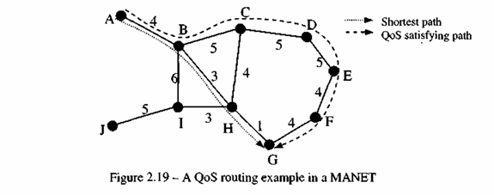
Figure 2.19 illustrates an example where nodes are labeled as A, B, C, ..., J. The numbers along each edge represent the available bandwidths of the wireless links.
If we want to find a route from a source node A to a destination node G, conventional routing using shortest path (in terms of number of hops) as a metric, selects the route A-B-H-G. However, the QoS-based route selection process from node A to node G with a minimum bandwidth of 4 would use A-B-C-D-E-F-G as one possible path over the shortest path route A-B-H-G.

Slide 105
Core Extraction Distributed Ad Hoc Routing
Core Extraction: A set of nodes is elected to form the core that maintains the local topology of the nodes in its domain, and alsoperforms route computation. The core nodes are elected by approximating a minimum dominating set of the MANET.
Link State Propagation: QoS routing in CEDAR is achieved by propagating the bandwidth availability information of stable links to all core nodes. The basic idea is that the information about stable high-bandwidth links can be made known to the nodes far away in the network, while information about the dynamic or low bandwidth links remains within the local area.
Route Computation: Route computation first establishes a core path from the domain of the source to the domain of the destination. Using the directional information provided by the core path, CEDAR iteratively tries to find a partial route from the source to the domain of the furthest possible node in the core path, satisfying the requested bandwidth. This node then becomes the source of the next iteration.

Slide 106
Incorporating QoS in Flooding-Based Route Discovery
A ticket-based probing algorithm with imprecise state model has been proposed in [Chenl998] for discovering a QoS-aware routing path, by issuing a number of logical tickets to limit the amount of flooding (routing) messages.
When a probing message arrives at a node, it may be split into multiple probes and forwarded to different next-hops with each child probe containing a subset of the tickets from their parents.
When one or more probe(s) arrive(s) at the destination, the hop-by-hop path known and delay/bandwidth information can be used to perform resource reservation for the QoS-satisfying path.

Slide 107
Multi-Path QoS Routing
A multi-path QoS routing protocol has been introduced in [Liao2001] which is suitable for ad hoc networks with very limited bandwidth for each path, unlike other existing protocols for MANETs, which try to find a single path between the source and the destination, this algorithm searches for multiple paths for the QoS route.
This protocol also adopts the idea of ticket-based probing scheme discussed earlier. Another rational for using multi-path routing is to enhance the routing resiliency by finding node/edge disjoint paths when link and/or node fail [Liang2005].
Another approach [Guo2005] is to use the extension of AODV to determine a backup source-destination routing path that could be used if the path gets disconnected frequently due to mobility or changing link signal quality.
An analytical model has been developed [Guo2005] to justify having a backup path which can be easily piggybacked in data packets. Steps for immediate repairs of broken backup routes have also been suggested and extensive simulations have been done to validate the effectiveness of this scheme.

Slide 108
Conclusions and Future Directions
Routing is undoubtedly the most studied aspect of ad hoc networks. Yet, many issues remain open which deserve appropriate handling such as more robust security solutions, routing protocol scalability, QoS support, and so on.
The integration of MANETs and infrastructure-based networks such as the Internet will be an important topic in wireless systems beyond 3G (discussed in Chapter 11).
Also, efficient broadcasting schemes need to be examined carefully as it may be a serious roadblock to the scalability of ad hoc networks. There is no centralized authority to obtain configuration information in MANETs

Slide 109
One example is the assignment of IP addresses which is usually done by the use of Dynamic Host Configuration Protocol (DHCP) servers in fixed networks [Tanenbauml996].
In MANETs, however, the availability of such server many not be practical. As a result, nodes have to resort to some heuristic to obtain their IP addresses which may, of course, cause conflicts with other nodes' IP addresses. While the use of IP version 6 [Tanenbauml996] may certainly help here due to its auto configuration capabilities, it is not a completely foolproof solution.
It may be noted that the routing algorithms for MANETs are equally applicable to sensor networks [Agrawal2006] as basic characteristics of wireless sensor networks are similar to MANETs, except for low mobility, much larger number of sensor nodes and use of battery.

Slide 110
THANK
YOU

