Slide 1
Wireless Mesh Networks

Slide 2
Wireless mesh networks (WMNs) has recently being emerged as a trend for the next generation wireless network with emerged as advantages, which are inherited and evolved from many successful wireless network technologies.
We briefly introduce key points that enable implementation of a WMN using existing technologies.
These days, people use cell phone in a server-client mode supported by a Base station (BS).
Like WLAN access point (AP), the coverage of a single BS is limited and if MH goes out of the service region, the wireless link becomes too weak to maintain.
Therefore, a multi-cell network is built with many BSs to cover a wider region whose combined coverage makes ubiquitous access to MHs, thereby supporting MHs' mobility. Learning from cellular system, WMN employs AP known as IGW (Internet Gate Way) to provide network access service for MHs.
The IGW does have Internet access that allows useful information for work or leisure; exchange e-mails, talk or chat with friends, or update recent events on Facebook [Facebook] or Linkedin [Linkedin].
WMN is a inherits technology from many existing schemes, thus offers combined merit from these network architectures in supporting next generation wireless communication.

Slide 3
260 IGW can accept multiple connections (within its capacity) and respond the inquiry from each MH. However, the coverage of a single IGW limited. With current technology, the typical transmission of an IGW is at the level of hundreds of meters.
To have a larger coverage, the transmission power of both IGW and MHs has to be increased greatly. which is not economical and could create strong interference betwe nearby wireless devices. Thus, to fit in the single cell formed by an IGW, is used only for the "hot" spots, such as office, coffee shop, airport waiting rooms, and so on, where the clients are always crowed.
To address such a problem, WMN uses relay stations known as Mesh Routers (MRs) in an ad hoc mode. Use of these MRS enable relay of packets originated at MHs by wireless radio links. The relay s achieved similar to the beacon towers used in ancient time for intrusion alarm.
Once someone at the border observes enemy's intrusion, a beacon light is fired and the process is continued hop-by-hop to the center at the lighed of light. A modern relay station (MR) operates like a beacon tower speed modulated wireless signals andkets from otherymuch information.
While MR receives the packets from other remote MR. either simply amplifies the signal strength or reconstructs the packets with error check, and then forwards to the next MR towards the IGW which is the only unit directly connected to the Internet.
To receive and forward packets from its MRs, WMN implements this approach by the ad hoc wireless connectivity so that the packets can be forwarded hop by-hop fashion to the destination or the IGW over a long distance. To provide the connection service to MHs, MRs also work like APs to aggregate the traffic from MHs, in addition to the relay function

Slide 4
WMNs have heavily inherited characteristics from the ad hoc networks as an ad hoc wireless network is formed between MRs primarily act as a backbone. With an increased demand in wireless communication, the information is expected to be delivered from one pom cony other random place.
Ad hoc network technology enables the MRs establish a "mesh" like network and in most cases, the only important exception is no mobility of MRs so that they can get power from A/C supply. Each MR connected with ad hoc technology will have multiple neighbouring MRs in its communication region.
MR may receive packets from these neighboring stations and forward packets to them. As a graph isdawn between the MRs, their links form a mesh. The packets can be delivered along the links from the source MR to the destination MR. To support such a kind of operation, WMN uses key technologies of ad hoc artworks such as: self-organization and ad hoc routing.
Self-organization sa process that constructs a network without centralized of external control. The MRs in the network are capable of finding its neighboring MRs and form the network automatically. As the MRs may appear or disappear in the network, validation of the links may change dynamically.
Thus, it needs to use self-organization to find active and/or disappeared MRs in a very short time and update the database or tables at the related MRS. On the other hand, ad hoc routing is essential for packet delivery in a WMN. Different from conventional relay stations located on a line, multiple paths are present in an ad hoc network between the source and the destination MRs.
To choose the optimal path is a challenging problem. WMN can implement routing protocols which have originally been proposed for ad hoc networks.

Slide 5
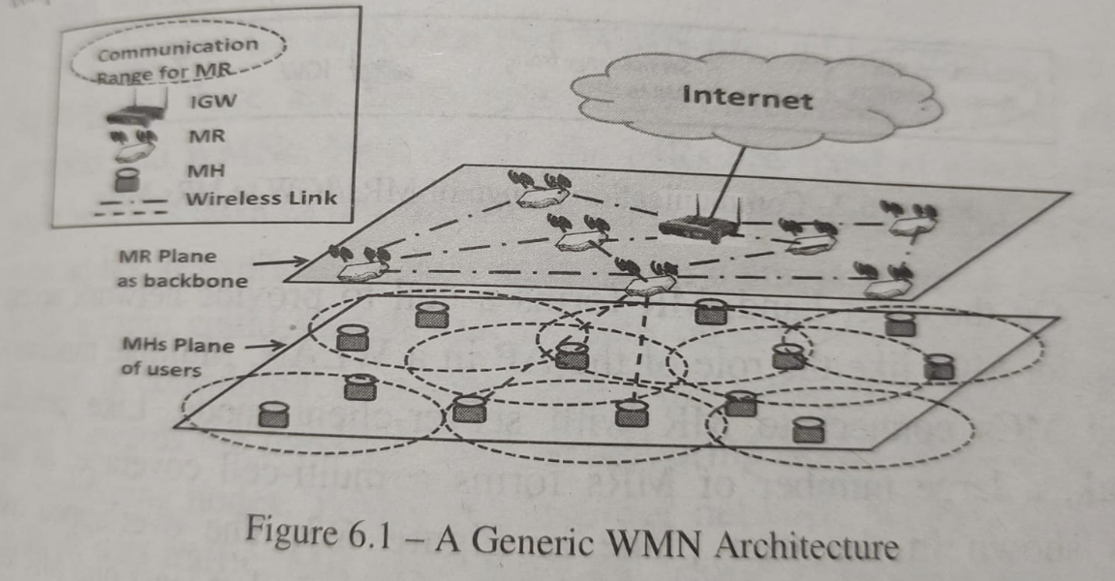
Network Architecture

Slide 6
Since WMN has adopted many useful characteristics from other networks, it forms new network architecture, which combines multi-hom and multi-cell fashions with no mobility of cells. Typically, a WMN comprised by mesh clients (MCs), MRs, and IGWs
As the backbone plane shown in Figure 6.1, MRs are interconnected with each other with wireless links. MRs have different communication range between MRs and MR to MHs and this is illustrated in Figure 6.2. MRs deliver information from one MR to another with multi-hop transmission using relay technology and has been developed with more advanced feature ad hoc routing function as descanted in Figure 6.3.
MRs can select the next hop MR according to certain measurement with aim to achieve better performance. Since MR usually has multiple neighboring MRs, the ability to select one or more neighboring MRs as the next hop MR will provide more flexibility as compared to a pure relay network. But MRs are usually located at those places where A/C power is readily available and there are no restrictions on the power availability

Slide 7
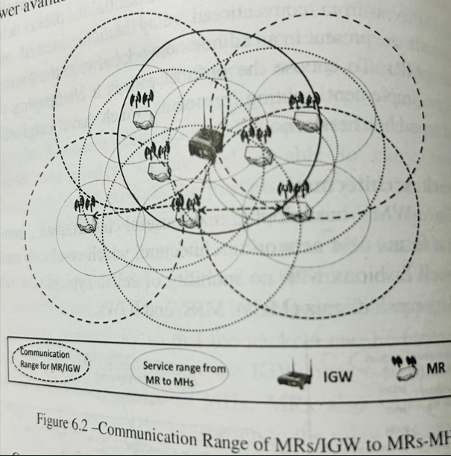
On the other hand, MR forms a cell to provide network access service for MCs like the role of the AP in a WLAN. Multiple randomly located MCs connect to MR with server-client mode.
Like cellular network, a large number of MRs forms a multi-cell coverage, as the circles shown in the user plane in Figure 6.3. The overlapped cell coverage is to ensure that every MC can always find at least one MR for accessing the network.
To enable the Internet functionality, there is a special kind of MRs having wired Internet connection and is called as an IGW, which is also shown in Figure 6.1

Slide 8
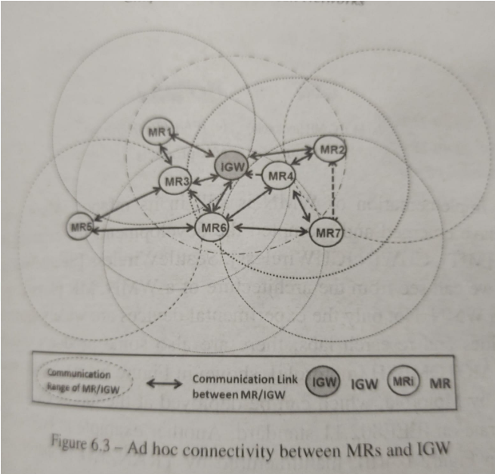
From the network architecture point of view, a WMN is observed as a two-tier network. Inter-connected MRs constitute a backbone which is formed on an ad hoc basis.
This performs ad hoc multi-hop routing; and has a multi-cell network constituted by multiple MRs. WMN has combined these features which has not been provided by other wireless networks.
Although the backbone of a WMN uses ad hoc routing and self-organization, there are some significant differences between ad hoc networks and WMNs. First of all, the MRs are fixed at given locations while wireless devices are mobile in an ad hoc network. The radio used in an ad hoc network may only operate on a single channel. In contrast, WMN's radio could switch and operate on different channels.
Ad hoc network is considered as a flat, single-tier network, where each node either forwards the message from neighboring nodes or sends messages to neighboring nodes. WMN is a two-tier network, whose MR does not generate data traffic.
MR aggregates the traffic from MCs in its cell and forwards to other neighboring MRs. These differences impose some changes while performing technology migration from basic ad hoc networks.

Slide 9
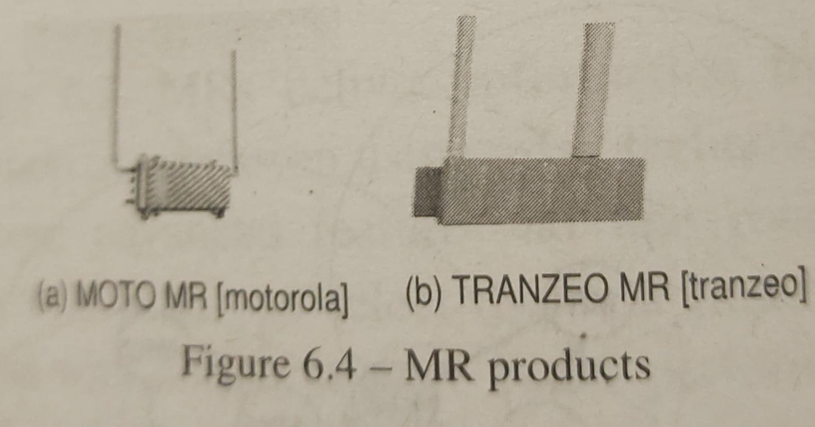
Implementation of WMN is still in its infancy. Many pioneer works have emerged and prompted the development, for example, MIT roofnet [MIT], CUWIN [CUWireless). Seattle Wireless [Seattle Wireless). etc. As we can see from the architecture of a WMN, MR plays a critical etc.
As WMN. Not only the experimental devices are widely used in the folkersities and research labs, there are also some products in current universe. MOTOMESH [motorola), shown in Figure 6.4(a), is MR product provide by Motorola, which can be deployed at the top of electric poles and operate on IEEE802.11 standard.
Another example is EnRouter500, shown in Figure 6.4(b), manufactured by TRANZEO [tranzeo], which has mesh radios to operate on either 2.4GHz or 5.8GHz bands. In current deployment, MRs are primarily assumed to be located statically.
There is also a trend to develop mobile WMN (MWMN), where MRs are also moving in a controlled or uncontrolled way. MWMNs provide more flexibility, but at the cost of increased implementation complexity. A lot of potential applications have been discussed in [meshdynamics].

Slide 10
Challenging Technologies
MR Deployment
IGW Deployment
Channel Assignment

Slide 11
MR Development
MR Deploy two assumptions for the MR locations. MRs could be deployed by service providers and located at the selected place. The other assumption is that MRs are deployed by users and the locations are randomly selected. If the location is selected by a service provider, the MR deployment problem can be described like minimizing the number of MRs while satisfying the constraints such as having adequate coverage in a given area and required quality of service. Typically, common MR deployment constraints can be summarized as follows
Multiple MRs can adequately cover a given region.
The overlapped coverage of two neighboring MRs should be enough to support the handoff.
The MR deployment can support required quality of service.The MR deployment shall have certain fault-tolerance.
The locations of MRs are such that they are able to form a connected network, given constraint on the transmission distance.
Sometime, geographical location may also be a constraint. It is very possible that MRs can be deployed only at certain locations.

Slide 12
In a realistic WMN, the MR deployment may consider additional geographical issues. In general, the deployment area of the network may not be flat. There may be tall buildings, hills, valley, and other obstacles in the area.
Some regions may be prohibitive for the MR installation. These geographical factors can be transformed in to obstacles. On the other hand, the traffic may also depend on some geographical attributes. Some region may have larger traffic demands while others may be light.
Those factors are additional considerations as constraints for the deployment problem.
In near future, MRs will be more likely to be deployed by the users. For example, MRs can be deployed by users at home or office to aggregate the traffic from local computers, cell phones or other wireless devices. Under such situations, MR selection issue may disappear. However, it poses a harder problem of IGW deployment

Slide 13
IGW Deployment
Besides channel assignment, the deployment of IGWs also has significant impact on the capacity and throughput of a WMN. Deployment of IGWs aims to minimize the number of IGWs while satisfying the requirement of quality of service.
As IGWs need a wired connection to Internet, the cost will greatly increase if the number of IGWs is large. There are several basic strategies for IGW deployment and main ones are briefly covered.
The location of IGWs can be modeled as a facility location problem. While dealing with random deployed WMN, the IGW deployment will be based on the connectivity graph and form a general facility location problem, which is a NP-hard in a general case.
To solve this kind of problem, approximation is desirable to obtain a quick and reasonable solution. If a WMN is deployed with a specified/regular topology, an optimization solution may be obtained in a polynomial time.
A method based on facility location has been implemented in [Qiu2004), which takes constraints such as co-channel interference, network capacity, fault-tolerance, traffic demands, and so on. In this scheme, it first prunes the search space of the problem with grouped equivalent classes from a set of available locations. Then, a greedy approach is used to iteratively locate IGWs that maximizes the capacity.

Slide 14
Another scheme is to utilize Cluster formation method that focuses on forming multiple disjoint clusters with given objective and constraints. Each cluster has an IGW as the cluster head and all the MRs in the same cluster are served by the IGW cluster. Such a scheme has been implemented in [He2010]. MR is assumed to have weights representing certain attributes.
The objective of the cluster formation is to minimize the number of clusters while satisfying the quality of service constraints. There are two approximation algorithms in cluster formation. One is based on divide-and-conquer method and second is a greedy dominant-independent-set approach.
Another scheme is tree formation which generates multiple trees in the connectivity graph formed by the network. The root of the tree is the selected IGW.
The objective is to minimize the number of trees and/or their depth. Such a tree-based IGW selection is used in [He2010]. First, it selects multiple trees from an initial network graph as a linear program.
Then, two heuristic algorithms are proposed: degree-based greedy dominating tree set partitioning and width based greedy dominating set partitioning.

Slide 15
Channel Assignment
To enhance the capacity of multi-hop transmission in the backbone of a WMN. MRs are usually equipped multiple radios which are able to switch and operate on multiple channels. The task in arranging the radios and their operating channels are called channel assignment. To establish communication for packet delivery, two neighboring MRs, each of them, is required to have a radio that employs a common channel. The objective of channel assignment is to assign optimal channels for MRs so as to avoid and/or mitigate interference and maximize the number of parallel transmissions. Optimal channel assignment is a NP-hard [Bejerano2004] problem. Many near-optimal solutions have been proposed in the past. In a board sense, these approaches can be divided into three categories as follows:
Static Channel Assignment: Static channel assignment assigns a channel to be employed by a radio for a long period.
Dynamical Channel Assignment: Dynamical channel assignment allows each node to potentially access all channels by dynamically switching its interfaces among available channels, which offers flexibility in channel usage according to the node density, traffic. channel conditions, etc.
Hybrid Channel Assignment: Some of the radios are fixed at certain channels for control purpose and others are dynamically operated.

Slide 16
Static channel assignment allocates the channels over radios of MRs with relatively long duration. It is noted that the allocation has to be carefully scheduled and assigned. While establishing the connection between two neighboring MRs for active communication, they have to employ a common channel on both radios. In a WMN, there are numerous active connections requiring appropriate channels for packet to be delivered over multiple hops.
To eliminate interference and ensure the throughput of the network, the channel assignment tries to allocate non-overlapped channels in the same interference region. However, to maintain the network connectivity, the channel assignment needs to keep the network connected with the constraint on the number of radios. Otherwise, the network may be partitioned if some essential links cannot be assigned with appropriate channels, or the performance will be serious degraded due to serious interference.
Dynamic channel assignment requires a radio switch between channels frequently. Channel switching and switching synchronization become two essential factors that affect the network performance. Radio switching from one channel to another costs time, called switching delay. It is negligible in static channel assignment because it is in very small fraction as compared to a long duration that a radio remains on using a switched channel.
In contrast, the switching delay becomes a major factor in a dynamic channel assignment as frequently switched radio makes the switching delay to be a relatively large fraction of the whole transmission. Most of the current commercial radios need several milliseconds to hundred milliseconds to switch across channels. Furthermore, switching delay depends on the slower of two scheduled transmitting MRs one has to wait for the completion of both the MRs.
Switching delay is a challenging parameter and the essential issue is the switching synchronization which not only needs two transmitting MRs to switch radios to one common channel simultaneously but also requires low overhead and high accuracy

Slide 17
There are two kinds of switching synchronization methods: out of-band and in-band. Out-of-band method utilizes external information by each MR for acknowledging the time. For example, GPS (Global Positioning System) technology can be used for MR acknowledgement time.
MR equipped with GPS receiver obtains the absolute time information from the satellite so that the radio can be switched to a channel at an agreed time, thereby minimizing the switching synchronization time However, it is still expensive for every MR to be equipped with a GPS receiver.
In-band method synchronizes the switching by exchanging information among MRs, which is cost-efficient. For instant, beacon signal by every MR is taken as an in-band synchronization method. Every MR broadcasts own beacon signal with certain interval and listens to neighboring MRs' beacon signals to have the relative time for channel switching.
However, while compared to implementing GPS synchronization, beacon signal suffers multiple negative factors (such as propagation delay of beacon signals) that decrease the accuracy.
In static channel assignment, each radio is assigned to a channel for a long duration, hence the number of links of a MR is limited by the number of the radios of that MR. In dynamic channel assignment, the radio switches across channels frequently, a radio can be used for transmissions over multiple neighboring MRs.
The ability to switch to any channel helps dynamic channel assignment, and avoids network partitioning which mayhappen in a static channel assignment.

Slide 18
Hybrid channel assignment approach allows some radios to be fixed while the rest are dynamically assigned.
The fixed channel is so called default channel which is used for exchanging control information. It is noted that the radio assigned on the default channel may be used for data transmission in some schemes.
The rest of radios of a MR are called "dynamic" which are able to switch to any channel freely. Hybrid channel assignment avoids the low efficiency of pure static assignment by adjusting some of the radios switching across channels on demand.
At the same time, it mitigates the requirements on switching delay and synchronization by using the default channels. However, as compared to the previous two approaches, implementation of hybrid channel assignment is more complicated.

