Slide 1
REST API

Slide 2
What is REST architecture?
REST stands for REpresentational State Transfer. REST is web standards based architecture and uses HTTP Protocol.
It revolves around resource where every component is a resource and a resource is accessed by a common interface using HTTP standard methods
A REST Server simply provides access to resources and REST client accesses and modifies the resources using HTTP protocol.
REST uses various representation to represent a resource like text, JSON, XML but JSON is the most popular one.

Slide 3
HTTP methods
Following four HTTP methods are commonly used in REST based architecture.
GET − This is used to provide a read only access to a resource.
PUT − This is used to create a new resource.
DELETE − This is used to remove a resource.
POST − This is used to update an existing resource or create a new resource.

Slide 4
RESTful Web Services
A web service is a collection of open protocols and standards used for exchanging data between applications or systems.
Software applications written in various programming languages and running on various platforms can use web services to exchange data over computer networks like the Internet on a single computer.
Web services based on REST Architecture are known as RESTful web services.
A RESTful web service usually defines a URI, Uniform Resource Identifier a service, which provides resource representation such as JSON and set of HTTP Methods.

Slide 5
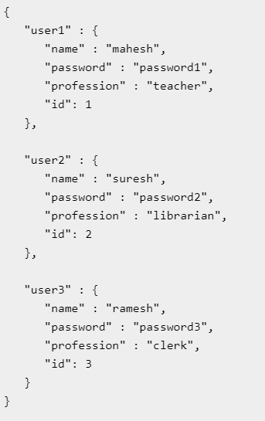
Creating RESTful for A Library

Slide 6
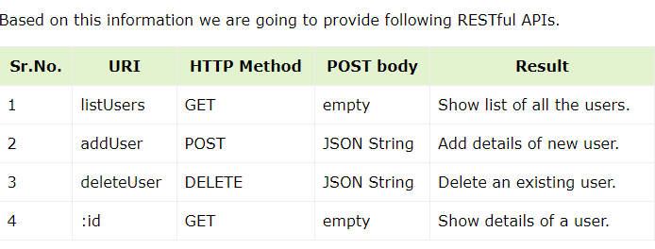

Slide 7
List Users
var express = require('express');
var app = express();
var fs = require("fs");
app.get('/listUsers', function (req, res) {
fs.readFile("users.json", 'utf8', function (err, data) {
console.log( data );
res.end( data );
});
})
var server = app.listen(8081, function () {
var host = server.address().address
var port = server.address().port
console.log("Example app listening at http://%s:%s", host, port)
})

Slide 8
Add User
var express = require('express’);
var app = express();
var fs = require("fs");
var path = require("path");
var bodyParser = require('body-parser'); app.use(bodyParser.urlencoded({extended: false}));
app.get("/",(req,res)=>{
res.sendFile(path.resolve("index.html"));
}) app.post('/addUser', function (req, res) {
// First read existing users.
const username=req.body.uname;
const password=req.body.password;
const Profession=req.body.prof;
const id=req.body.id;
console.log(username);
var user = {
"usery" : {
"name" : username,
"password":password,
"profession":Profession,
"id":id
}
}
fs.readFile("users.json", 'utf8', function (err, data) {
data = JSON.parse( data );
data["usery"] = user["usery"];
console.log( data );
res.end( JSON.stringify(data));
});

Slide 9
Index.HTML
<html><body>
<form action="/addUser" method="post">
Name <input type="text" name="uname" />
password <input type="text" name="password" />
profession <input type="text" name="prof" />
id <input type="text" name="id" />
<input type="submit" />
</form></body>
</html>

Slide 10
Show Detail
var express = require('express');
var app = express();
var fs = require("fs");
app.get('/:id', function (req, res) {
// First read existing users.
fs.readFile( __dirname + "/" + "users.json", 'utf8', function (err, data) {
var users = JSON.parse( data );
var user = users["user" + req.params.id]
console.log( user );
res.end( JSON.stringify(user));
});
})
var server = app.listen(8081, function () {
var host = server.address().address
var port = server.address().port
console.log("Example app listening at http://%s:%s", host, port)
})

