Slide 1
ARTIFICIAL INTELLIGENCE
A MODERN APPROACH
By
Stuart J. Russell
Peter Norving
Publisher: Pearson
Edition: Third

Slide 2
Course Objective
Understand issues and techniques involved in the creation of Intelligent Systems.

Slide 3
Course Outcomes
On completion of the course, students will be able to
1. Solve searching problems using A*.
2. Develop an algorithm for playing games. Represent
the knowledge using propositional logic.
3. Create logical agents to do inference using first
order logic.
4. Perform planning and solve problem with constraints.
5. Explain Bayesian Networks to do probabilistic reasoning.

Slide 4
INTRODUCTION
chapter 1

Slide 5
Outline
Introduction
What is AI?
The Foundations of AI
The History of AI
The State of Art

Slide 6
Introduction
We call ourselves Homo sapiens—man the wise—because our intelligence is so important to us.
For thousands of years, we have tried to understand how we think
how we can perceive, understand, predict, and manipulate a world
The field of Artificial Intelligence(AI) attempts not just to understand but also to build intelligent entities.

Slide 7
Introduction
AI currently encompasses a huge variety of subﬁelds, ranging from the general learning and perception
to speciﬁc, such as playing chess, proving mathematical theorems, writing poetry, driving a car on a crowded street, and diagnosing diseases.

Slide 8
Definition of AI
“The art of creating machines that perform functions that require intelligence when performed by people” (Kurzweil, 1990).
“The branch of computer science that is concerned with the automation of intelligent behavior.” (Luger and Stublefield, 1993)

Slide 9
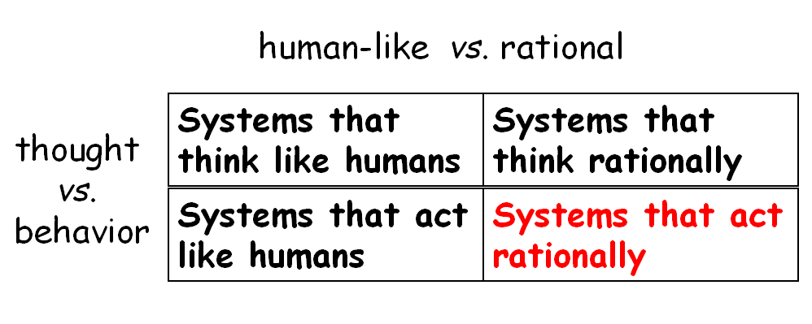
What is AI?
All 4 approaches have been followed each by different people with different methods
A human-centered approach - involving observations and hypotheses about human behavior.
A rationalist approach involves a combination of mathematics and engineering.

Slide 10
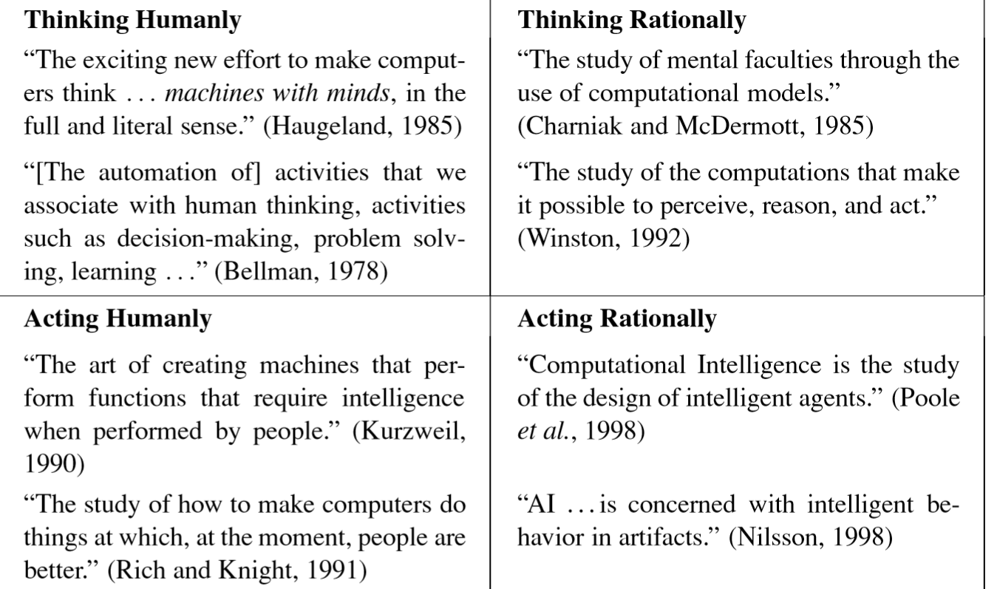
What is AI

Slide 11
Eight definitions of AI, laid out along two dimensions.
The definitions on top are concerned with thought processes and reasoning,
the ones on the bottom address behavior.
The definitions on the left measure success in terms of fidelity to human performance
the ones on the right measure against an ideal performance measure, called rationality.
A system is rational if it does the “right thing,” given what it knows.

Slide 12
Thinking humanly: The cognitive modeling approach
Need to get inside the actual workings of human minds. There are three ways to do this:
Through introspection-trying to catch thoughts as they go by
through psychological experiments—observing a person in action
Through brain imaging—observing the brain in action
Allen Newell and Herbert Simon, who developed GPS, the “General Problem Solver” (Newell and Simon, 1961), were not content merely to have their program solve problems correctly. They were more concerned with comparing the trace of its reasoning steps to traces of human subjects solving the same problems.

Slide 13
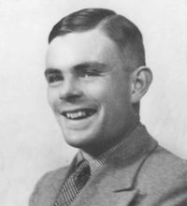
Acting Humanly : Turing Test
The Turing Test, proposed by Alan Turing (1950), was designed to provide a satisfactory operational definition of intelligence. A computer passes the test if a human interrogator, after posing some written questions, cannot tell whether the written responses came from a person or from a computer.
To pass the total Turing Test, the computer will need
• computer vision to perceive objects, and
• robotics to manipulate objects and move about.

Slide 14
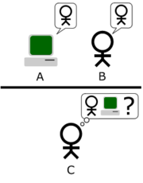

Slide 15
The computer would need to possess following capabilities:
natural language processing to enable it to communicate successfully in English
• knowledge representation to store what it knows or hears
• automated reasoning to use the stored information to answer questions and to draw new conclusions
• machine learning to adapt to new circumstances and to detect and extrapolate patterns.

Slide 16
Thinking rationally: The “laws of thought” approach
The Greek philosopher Aristotle was one of the first to attempt to codify “right thinking,” that is, irrefutable reasoning processes.
His syllogisms provided patterns for argument structures that always yielded correct conclusions when given correct premises—for example, “Socrates is a man; all men are mortal; therefore, Socrates is mortal.” These laws of thought were supposed to govern the operation of the mind; their study initiated the field called logic.

Slide 17
Acting rationally: The rational agent approach
An agent is just something that acts
Rational agent is one that acts so as to achieve the best outcome or, when there is uncertainty, the best expected outcome.
Making correct inferences is part of being a rational agent.
Knowledge representation and reasoning enable agents to take good decisions.

Slide 18
The Foundations Of Artificial Intelligence
Philosophy
Mathematics
Economics
Neuroscience
Psychology
Computer Engineering
Control Theory
Linguestics

Slide 19
The Foundations Of Artificial Intelligence
Philosophy
Dealt with questions like:
  Can formal rules be used to draw valid conclusions?
  How does the mind arise from a physical brain?
  Where does knowledge come from?
  How does it lead to action?

Slide 20
Mathematics
What ar ethe formal rules to draw valid conclusions?
What can be computed?
How do we reason with uncertain information?

Slide 21
Economics
How do we make decisions so as to maximize payoff?
How do we do this when the payoff may be far in the future?
Concept of utility (early 1900’s)
Game Theory (mid 1900’s)

Slide 22
Neuroscience
How do brains process information?
Study of the nervous system, esp. brain
A collection of simple cells can lead to thought and action
Neuroscience is the study of the nervous system, particularly the brain. Although the exact way in which the brain enables thought is one of the great mysteries of science.

Slide 23
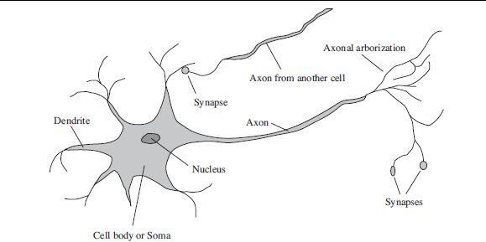
The parts of a nerve cell or neuron.

Slide 24
Psychology
Behaviourism- stimulus leads to response
Cognitive science
  Computer models can be used to understand the psychology of memory, language and thinking
  The brain is now thought of in terms of computer science constructs like I/O units, and processing center

Slide 25
Computer engineering
How can we build an efficient computer?
For artificial intelligence to succeed, we need two things: intelligence and an artifact.
The computer has been the artifact of choice.

Slide 26

Control Theory
How can artifacts operate under their own control?
Ctesibius Alexandria- built the first self-controlling machine: a water clock with a regulator that maintained a constant flow rate.
This invention changed the definition of what an artifact could do. Previously, only living things could modify their behavior in response to changes in the environment.

Slide 27
Linguistics
How does language relate to thought?
In 1957, B. F. Skinner published Verbal Behavior.
This was a comprehensive, detailed account of the behaviorist approach to language learning.
Modern linguistics and AI, were “born” at about the same time, and grew up together, intersecting in a hybrid field called computational linguistics or natural language processing.

Slide 28
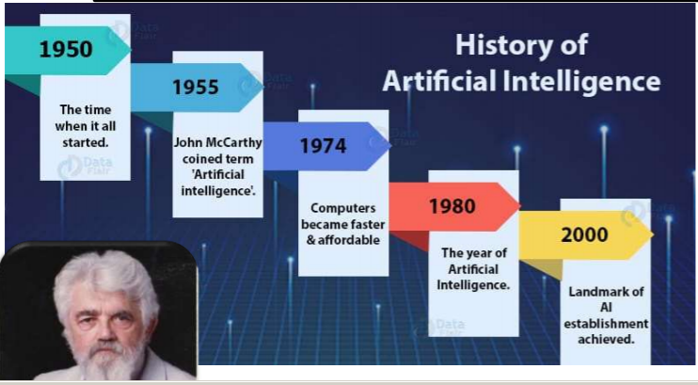

Slide 29
Real Time Applications

Slide 30
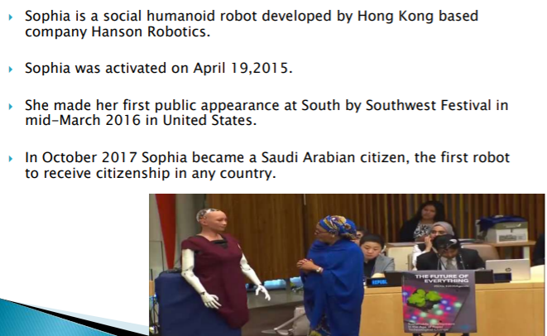
Robot

Slide 31
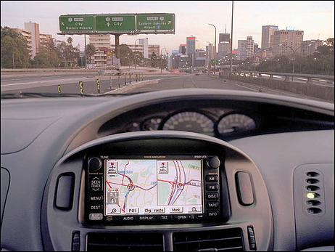
Speech Recognition
© Daniel S. Weld

Slide 32
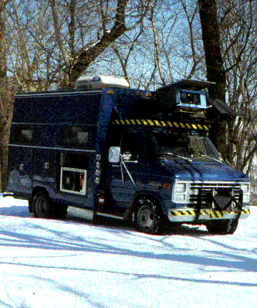
Autonomous Navigation: NAVLAB 1
© Daniel S. Weld

Slide 33
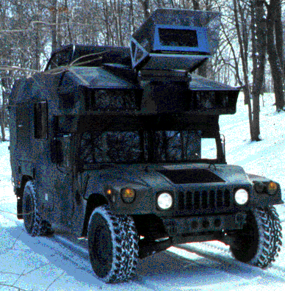
NAVLAB 2
© Daniel S. Weld

Slide 34
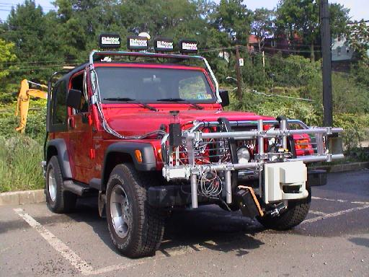
NAVLAB 11
© Daniel S. Weld

Slide 35
THE STATE OF THE ART
What can AI do today?
Robotic vehicles: A driverless robotic car
Speech recognition: A traveler calling United Airlines to book a flight can have the entire conversation guided by an automated speech recognition and dialog management system.
Autonomous planning and scheduling: A hundred million miles from Earth, NASA’s Remote Agent program became the first on-board autonomous planning program to control the scheduling of operations for a spacecraft
Game playing: IBM’s DEEP BLUE became the first computer program to defeat the world champion in a chess match
Spam fighting: Each day, learning algorithms classify over a billion messages as spam, saving the recipient from wasting time

Slide 36
Logistics planning: During the Persian Gulf crisis of 1991, U.S. forces deployed a Dynamic Analysis and Replanning Tool, DART, to do automated logistics planning and scheduling for transportation.
Robotics: The iRobot Corporation has sold over two million Roomba robotic vacuum cleaners for home use.
Machine Translation: A computer program automatically translates from Arabic to English,

Slide 37
AI as Science
Where did the physical universe come from? And what laws guide its dynamics?
How did biological life evolve? And how do living organisms function?
What is the nature of intelligent thought?
© Daniel S. Weld

Slide 38
AI as Engineering
How can we make software systems more powerful and easier to use?
  Speech & intelligent user interfaces
  Autonomic computing
  SPAM detection
  Mobile robots, softbots
  Data mining
  Modeling biological systems
  Medical expert systems...
© Daniel S. Weld

