Slide 1
Chapter 3
Artificial Intelligence -
Solving problems by searching

Slide 2
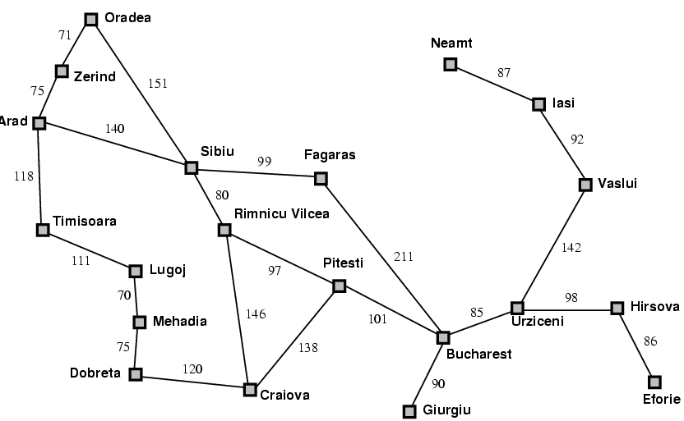
A Simplified Road Map of Romania
start
end
© Daniel S. Weld

Slide 3
Uninformed Vs informed search algorithms
Uninformed search algorithms—algorithms that are given no information about the problem other than its definition. Although some of these algorithms can solve any solvable problem, none of them can do so efficiently.
Informed search algorithms can do quite well given some guidance on where to look for solutions.

Slide 4
Problem solving
Goals help organize behavior by limiting the objectives that the agent is trying to achieve and hence the actions it needs to consider. Goal formulation, based on the current situation and the agent’s performance measure, is the first step in problem solving.
Problem formulation is the process of deciding what actions and states to consider, given a goal. The agent’s task is to find out how to act, now and in the future, so that it reaches a goal state. Before it can do this, it needs to decide what sorts of actions and states it should consider.

Slide 5
An agent with several immediate options of unknown value can decide what to do by first examining future actions that eventually lead to states of known value.
SEARCH : The process of looking for a sequence of actions that reaches the goal

Slide 6
A search algorithm takes a problem as input and returns a solution in the form of an action sequence.
Once a solution is found, the actions it recommends can be carried out. This is called the execution phase.

Slide 7
“formulate, search, execute” design for the agent
After formulating a goal and a problem to solve, the agent calls a search procedure to solve it. It then uses the solution to guide its actions, doing whatever the solution recommends as the next thing to do—typically, the first action of the sequence—and then removing that step from the sequence. Once the solution has been executed, the agent will formulate a new goal.

Slide 8
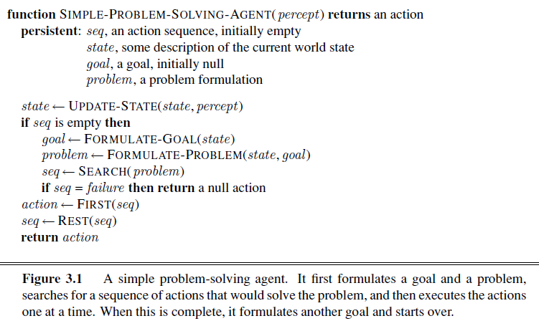

Slide 9
Well-deﬁned problems and solutions
A problem can be deﬁned formally by ﬁve components:
The initial state that the agent starts in.
For example, the initial state for our agent in Romania might be described as In(Arad).

Slide 10
Solving Problems by Searching
2. A description of the possible actions available to the agent. Given a particular state s, ACTIONS(s) returns the set of actions that can be executed in s. We say that each of these actions is applicable in s.
For example, from the state In(Arad), the applicable actions are {Go(Sibiu),Go(Timisoara),Go(Zerind)}.
3. A description of what each action does; the formal name for this is the transition model, speciﬁed by a function RESULT(s,a) that returns the state that results from doing action a in state s. We also use the term successor to refer to any state reachable from a given state by a single action.
For example, we have
RESULT(In(Arad),Go(Zerind)) = In(Zerind) .
Together, the initial state, actions, and transition model implicitly define the state space of the problem , the set of all states reachable from the initial state by any sequence of actions.

Slide 11
Solving Problems by Searching
The state space forms a directed network or graph in which the nodes are states and the links between nodes are actions. A path in the state space is a sequence of states connected by a sequence of actions.
4. The goal test, which determines whether a given state is a goal state. Sometimes there is an explicit set of possible goal states, and the test simply checks whether the given state is one of them. The agent’s goal in Romania is the singleton set {In(Bucharest)}. Sometimes the goal is specified by an abstract property rather than an explicitly enumerated set of states. For example, in chess, the goal is to reach a state called “checkmate,” where the opponent’s king is under attack and can’t escape.
5. A path cost function that assigns a numeric cost to each path. The problem-solving agent chooses a cost function that reﬂects its own performance measure. The step cost of taking action a in state s to reach state s’ is denoted by c(s, a, s’ )

Slide 12
A solution to a problem is an action sequence that leads from the initial state to a goal state. Solution quality is measured by the path cost function, and an optimal solution has the lowest path cost among all solutions.

Slide 13
Search through a Problem Space / State Space
Input:
  Set of states
  Operators [and costs]
  Start state
  Goal state [test]
Output:
  Path: start ⇒ a state satisfying goal test
  [May require shortest path]
© Daniel S. Weld
Notes:
State Space Search is basically a GRAPH SEARCH PROBLEM
STATES are whatever you like!
OPERATORS are a compact DESCRIPTION of possible STATE TRANSITIONS – the EDGES of the GRAPH
May have different COSTS or all be UNIT cost
OUTPUT may be specified either as ANY PATH (REACHABILITY), or a SHORTEST PATH

Slide 14
Example Problems
A toy problem is intended to illustrate or exercise various problem-solving methods. It can be given a concise, exact description and hence is usable by different researchers to compare the performance of algorithms.
A real-world problem is one whose solutions people actually care about. Such problems tend not to have a single agreed-upon description, but we can give the general flavor of their formulations.

Slide 15
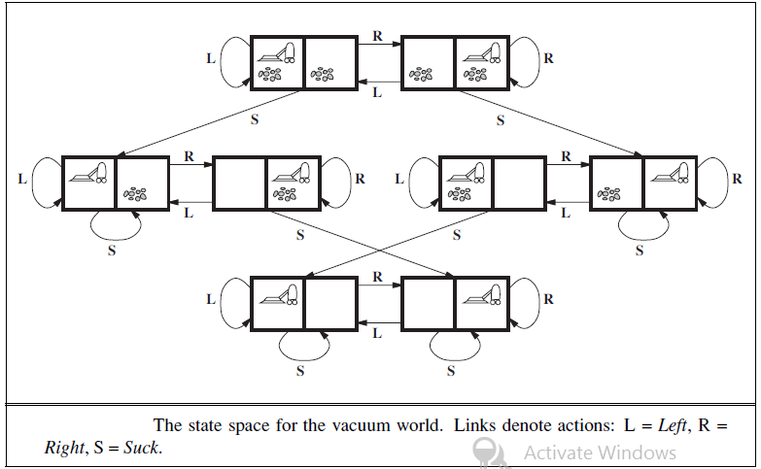
Vacuum World

Slide 16
States: The state is determined by both the agent location and the dirt locations. The agent is in one of two locations, each of which might or might not contain dirt. Thus, there are 2 × 2² = 8 possible world states. A larger environment with n locations has n ・ 2^{n} states.
• Initial state: Any state can be designated as the initial state.
• Actions: In this simple environment, each state has just three actions: Left, Right, and Suck. Larger environments might also include Up and Down.

Slide 17
• Transition model: The actions have their expected effects, except that moving Left in the leftmost square, moving Right in the rightmost square, and Sucking in a clean square have no effect. The complete state space is shown in
• Goal test: This checks whether all the squares are clean.
• Path cost: Each step costs 1, so the path cost is the number of steps in the path.

Slide 18
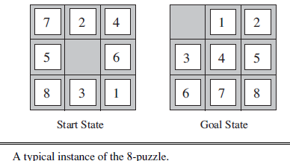
8-puzzle
consists of a 3×3 board with eight numbered tiles and a blank space. A tile adjacent to the blank space can slide into the space. The object is to reach a specified goal state

Slide 19
States: A state description specifies the location of each of the eight tiles and the blank in one of the nine squares.
• Initial state: Any state can be designated as the initial state. Note that any given goal can be reached from exactly half of the possible initial states
• Actions: The simplest formulation defines the actions as movements of the blank space Left, Right, Up, or Down. Different subsets of these are possible depending on where the blank is.
• Transition model: Given a state and action, this returns the resulting state; for example, if we apply Left to the start resulting state has the 5 and the blank switched.
• Goal test: This checks whether the state matches the goal configuration
• Path cost: Each step costs 1, so the path cost is the number of steps in the path.

Slide 20
N-puzzle
The 8-puzzle has 9!/2=181, 440 reachablestates and is easily solved. The 15-puzzle (on a 4×4 board) has around 1.3 trillion states, and random instances can be solved optimally in a few milliseconds by the best search algorithms.
The 24-puzzle (on a 5 × 5 board) has around 10²⁵ states, and random instances take several hours to solve optimally.

Slide 21
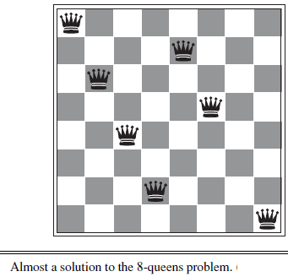
8-queens problem
place eight queens on a chessboard such that no queen attacks any other. (A queen attacks any piece in the same row, column or diagonal.)
An incremental formulation involves operators that augment the state
description, starting with an empty state; for the 8-queens problem, this means that each action adds a queen to the state
A complete-state formulation starts with all 8 queens on the board and moves them around. In either case, the path cost is of no interest because only
the final state counts.

Slide 22
incremental formulation
States: Any arrangement of 0 to 8 queens on the board is a state.
• Initial state: No queens on the board.
• Actions: Add a queen to any empty square.
• Transition model: Returns the board with a queen added to the specified square.
• Goal test: 8 queens are on the board, none attacked.
In this formulation, we have 64 ・ 63 ・ ・ ・ 57 ≈ 1.8×10¹⁴ possible sequences to investigate.

Slide 23
States: All possible arrangements of n queens (0 ≤ n ≤ 8), one per column in the leftmost n columns, with no queen attacking another.
• Actions: Add a queen to any square in the leftmost empty column such that it is not attacked by any other queen.
This formulation reduces the 8-queens state space from 1.8×10¹⁴ to just 2,057, and solutions are easy to find. On the other hand, for 100 queens the reduction is from roughly 10⁴⁰⁰ states to about 10⁵² —a big improvement,

Slide 24

starting with the number 4, a sequence of factorial, square root, and floor operations will reach any desired positive integer
States: Positive numbers.
Initial state: 4.
Actions: Apply factorial, square root, or floor operation (factorial for integers only).
Transition model: As given by the mathematical definitions of the operations.
Goal test: State is the desired positive integer.

Slide 25
Real-world problems-route-finding problem
States: Each state obviously includes a location (e.g., an airport) and the current time. Furthermore, because the cost of an action (a flight segment) may depend on previous segments, their fare bases, and their status as domestic or international, the state must record extra information about these “historical” aspects.
• Initial state: This is specified by the user’s query.
• Actions: Take any flight from the current location, in any seat class, leaving after the current time, leaving enough time for within-airport transfer if needed.
• Transition model: The state resulting from taking a flight will have the flight’s destination as the current location and the flight’s arrival time as the current time.
•

Slide 26
Goal test: Are we at the final destination specified by the user?
• Path cost: This depends on monetary cost, waiting time, flight time, customs and immigration procedures, seat quality, time of day, type of airplane, frequent-flyer mileage awards, and so on.
Touring problems
The traveling salesperson problem (TSP)
A VLSI layout problem
Robot navigation
Automatic assembly sequencing

Slide 27
SEARCHING FOR SOLUTIONS
The possible action sequences starting at the initial state form a search tree with the initial state at the root; the branches are actions and the nodes correspond to states in the state space of the problem.
Expanding the current state : applying each legal action to the current state, thereby generating a new set of states
The set of all leaf nodes available for expansion at any given point is called the frontier.
The process of expanding nodes on the frontier continues until either a solution is found or there are no more states to expand.
Explored set (closed list), which remembers every expanded node.

Slide 28
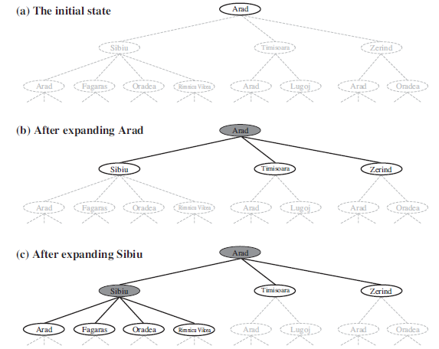

Slide 29
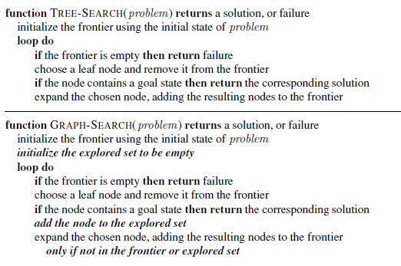

Slide 30
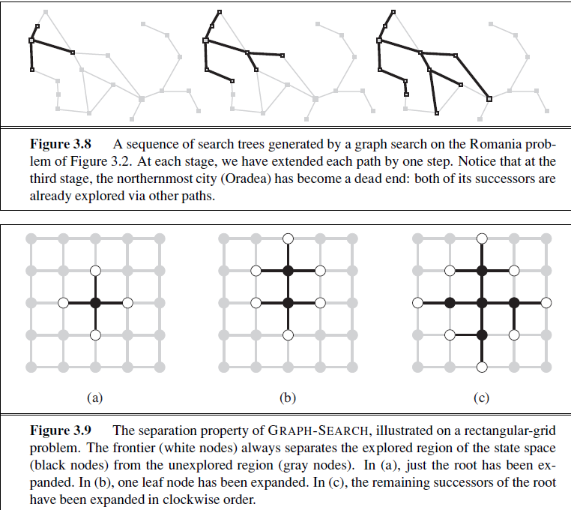

Slide 31
Infrastructure for search algorithms
For each node n of the tree, four components:
• n.STATE: the state in the state space to which the node corresponds;
• n.PARENT: the node in the search tree that generated this node;
• n.ACTION: the action that was applied to the parent to generate the node;
• n.PATH-COST: the cost, traditionally denoted by g(n), of the path from the initial state to the node, as indicated by the parent pointers.

Slide 32
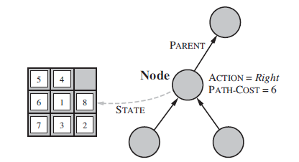
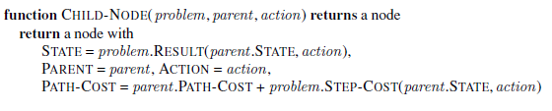

Slide 33
Measuring problem-solving performance
Completeness: Is the algorithm guaranteed to find a solution when there is one?
• Optimality: Does the strategy find the optimal solution,
• Time complexity: How long does it take to find a solution?
• Space complexity: How much memory is needed to perform the search?

Slide 34
Complexity is expressed in terms of three quantities: b, the branching factor or maximum number of successors of any node; d, the depth of the shallowest goal node (i.e., the number of steps along the path from the root); and m, the maximum length of any path in the state space.
Time is often measured in terms of the number of nodes generated during the search, and space in terms of the maximum number of nodes stored in memory.

Slide 35
Search Strategies
Blind Search
Informed Search
Constraint Satisfaction
Adversary Search
  Depth first search
  Breadth first search
  Depth limited search
  Iterative deepening search
  Bidirectional Search
© Daniel S. Weld

Slide 36
UNINFORMED and informed SEARCH STRATEGIES
Uninformed search (also called blind search). The term means that the strategies have no additional information about states beyond that provided in the problem definition. All they can do is generate successors and distinguish a goal state from a non-goal state. All search strategies are distinguished by the order in which nodes are expanded.
Strategies that know whether one non-goal state is “more promising” than another are called informed search or heuristic search strategies;

Slide 37
Breadth-first search -BFS
BFS is a simple strategy in which the root node is expanded first, then all the successors of the root node are expanded next, then their successors, and so on. In general, all the nodes are expanded at a given depth in the search tree before any nodes at the next level are expanded. new nodes (which are always deeper than their parents) go to the back of the queue, and old nodes, which are shallower than the new nodes, get expanded first.

Slide 38
Breadth First Search
Maintain queue of nodes to visit , is a simple strategy in which the root node is expanded first, then all the successors of the root node are expanded next, then their successors, and so on.
Evaluation
Complete? Yes (if branching factor is finite) Shallowest goal node searched no need to be optimal
Time Complexity? O(b^{d})
total number of nodes generated is
b + b² + b³ + ・ ・ ・ + b^{d} = O(b^{d}) .
Every node generated remains in memory. There will be O(b^{d-1}) nodes in the explored set and O(b^{d}) nodes in the frontier, Space Complexity: O(b^{d})
© Daniel S. Weld

Slide 39
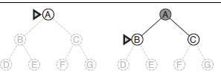

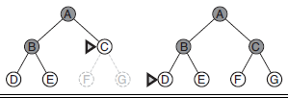

Slide 40
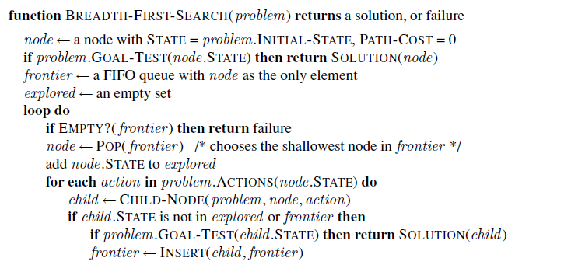

Slide 41
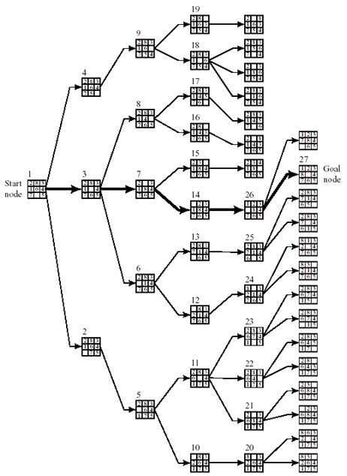

Slide 42
Evaluation
Complete? Yes (if branching factor is finite) Shallowest goal node searched
Time Complexity? O(b^{d})
  Total number of nodes generated is
  b + b² + b³ + ・ ・ ・ + b^{d} = O(b^{d}) .
Space Complexity? O(b^{d}) Every node generated remains in memory. There will be O(b^{d-1}) nodes in the explored set and O(b^{d}) nodes in the frontier,
Memory requirements are a bigger problem for breadth-first search than is the execution time.
Finds the path of minimal length to the goal
Exponential-complexity search problems cannot be solved by uninformed methods for any but the smallest instances.

Slide 43
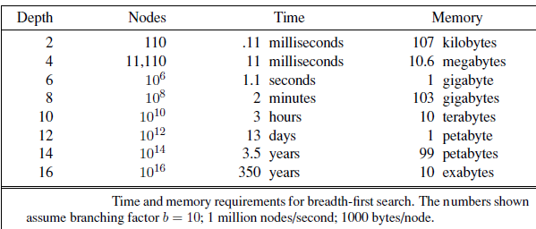

Slide 44
Uniform-cost search
When all step costs are equal, breadth-first search is optimal because it always expands the shallowest unexpanded node. Instead of expanding the shallowest node, uniform-cost search expands the node n with the lowest path cost g(n). This is done by storing the frontier as a priority queue ordered by g.

Slide 45
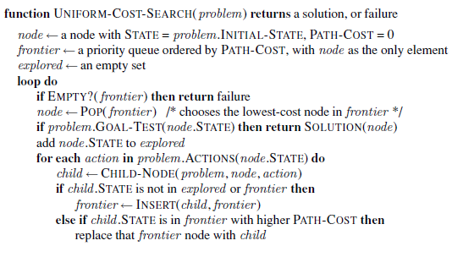

Slide 46
In addition to the ordering of the queue by path cost, there are two other significant differences from breadth-first search. The first is that the goal test is applied to a node when it is selected for expansion rather than when it is first generated. The reason is that the first goal node that is generated may be on a suboptimal path. The second difference is that a test is added in case a better path is found to a node currently on the frontier.

Slide 47
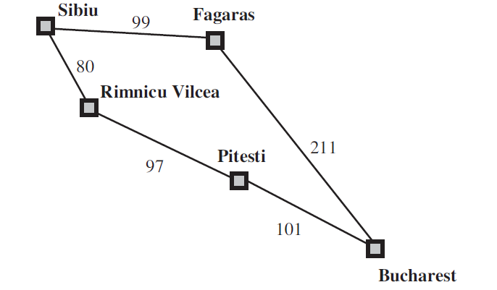

Slide 48
Both of these modifications come into play in the example shown in Figure 3.15, wherethe problem is to get from Sibiu to Bucharest. The successors of Sibiu are Rimnicu Vilcea andFagaras, with costs 80 and 99, respectively. The least-cost node, Rimnicu Vilcea, is expandednext, adding Pitesti with cost 80 + 97=177. The least-cost node is now Fagaras, so it isexpanded, adding Bucharest with cost 99+211=310. Now a goal node has been generated,but uniform-cost search keeps going, choosing Pitesti for expansion and adding a second path to Bucharest with cost 80+97+101= 278. Now the algorithm checks to see if this new path is better than the old one; it is, so the old one is discarded. Bucharest, now with g-cost 278, is selected for expansion and the solution is returned.

Slide 49
uniform-cost search expands nodes in order of their optimal path cost. Hence, the first goal node selected for expansion must be the optimal solution.
Uniform-cost search does not care about the number of steps a path has, but only about their total cost
Completeness is guaranteed provided the cost of every step exceeds some small positive constant .

Slide 50
DFS
Maintain stack of nodes to visit , expands the deepest node in the current frontier of the search tree.
Evaluation
  Complete? Not for infinite spaces
Time Complexity? A depth-first tree search, on the other hand, may generate all of the O(b^{m}) nodes in the search tree, where m is the maximum depth of any node
Space Complexity? For a state space with branching factor b and maximum depth m, depth-first search requires storage of only O(bm) nodes.
A variant of depth-first search called backtracking search uses still less memory . In backtracking, only one successor is generated at a time rather than all successors; only O(m) memory is needed

Slide 51

Depth-first search
Expand deepest unexpanded node
Implementation:
  fringe = Last In First Out (LIFO) queue, i.e., put successors at front
Is A a goal state?

Slide 52

Depth-first search
Expand deepest unexpanded node
Implementation:
  fringe = LIFO queue, i.e., put successors at front
queue=[B,C]
Is B a goal state?

Slide 53

Depth-first search
Expand deepest unexpanded node
Implementation:
  fringe = LIFO queue, i.e., put successors at front
queue=[D,E,C]
Is D = goal state?

Slide 54

Depth-first search
Expand deepest unexpanded node
Implementation:
  fringe = LIFO queue, i.e., put successors at front
queue=[H,I,E,C]
Is H = goal state?

Slide 55

Depth-first search
Expand deepest unexpanded node
Implementation:
  fringe = LIFO queue, i.e., put successors at front
queue=[I,E,C]
Is I = goal state?

Slide 56

Depth-first search
Expand deepest unexpanded node
Implementation:
  fringe = LIFO queue, i.e., put successors at front
queue=[E,C]
Is E = goal state?

Slide 57

Depth-first search
Expand deepest unexpanded node
Implementation:
  fringe = LIFO queue, i.e., put successors at front
queue=[J,K,C]
Is J = goal state?

Slide 58

Depth-first search
Expand deepest unexpanded node
Implementation:
  fringe = LIFO queue, i.e., put successors at front
queue=[K,C]
Is K = goal state?

Slide 59

Depth-first search
Expand deepest unexpanded node
Implementation:
  fringe = LIFO queue, i.e., put successors at front
queue=[C]
Is C = goal state?

Slide 60

Depth-first search
Expand deepest unexpanded node
Implementation:
  fringe = LIFO queue, i.e., put successors at front
queue=[F,G]
Is F = goal state?

Slide 61

Depth-first search
Expand deepest unexpanded node
Implementation:
  fringe = LIFO queue, i.e., put successors at front
queue=[L,M,G]
Is L = goal state?

Slide 62
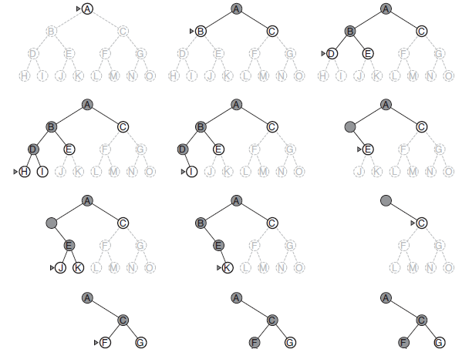

Slide 63
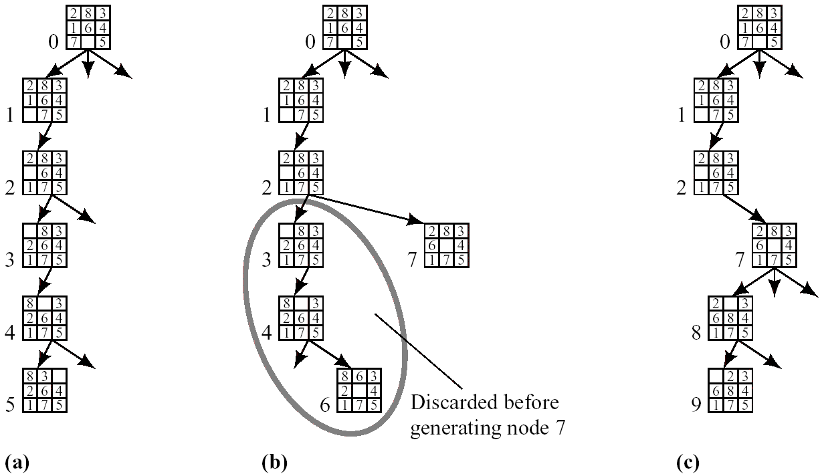
Depth-First Search
8-puzzle example
  Depth bound: 5
  Operator order: left → up → right → down
Generation of the First Few Nodes in a Depth-First Search
(c) 2000-2002 SNU CSE Biointelligence Lab

Slide 64
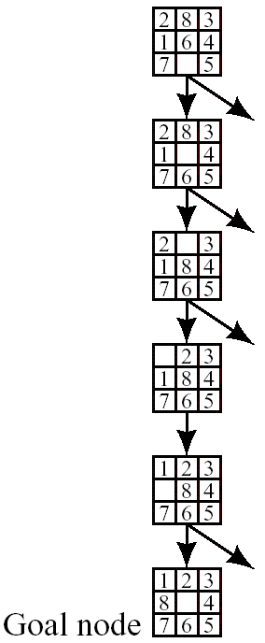
Depth-First Search
  The graph when the goal is reached in depth-first search
(c) 2000-2002 SNU CSE Biointelligence Lab

Slide 65
Advantage
  Low memory size: linear in the depth bound
    saves only that part of the search tree consisting of the path currently being explored plus traces
Disadvantage
  No guarantee for the minimal state length to goal state
  The possibility of having to explore a large part of the search space

Slide 66
Depth-limited search
Failure of depth-first search in infinite state spaces can be alleviated by supplying depth-first search with a predetermined depth limit l .
Depth-limited search will also be nonoptimal if we choose l > d. Its time complexity is O(b^{l}) and its space complexity is O(bl). Depth-first search can be viewed as a special case of depth-limited search with l=∞.

Slide 67
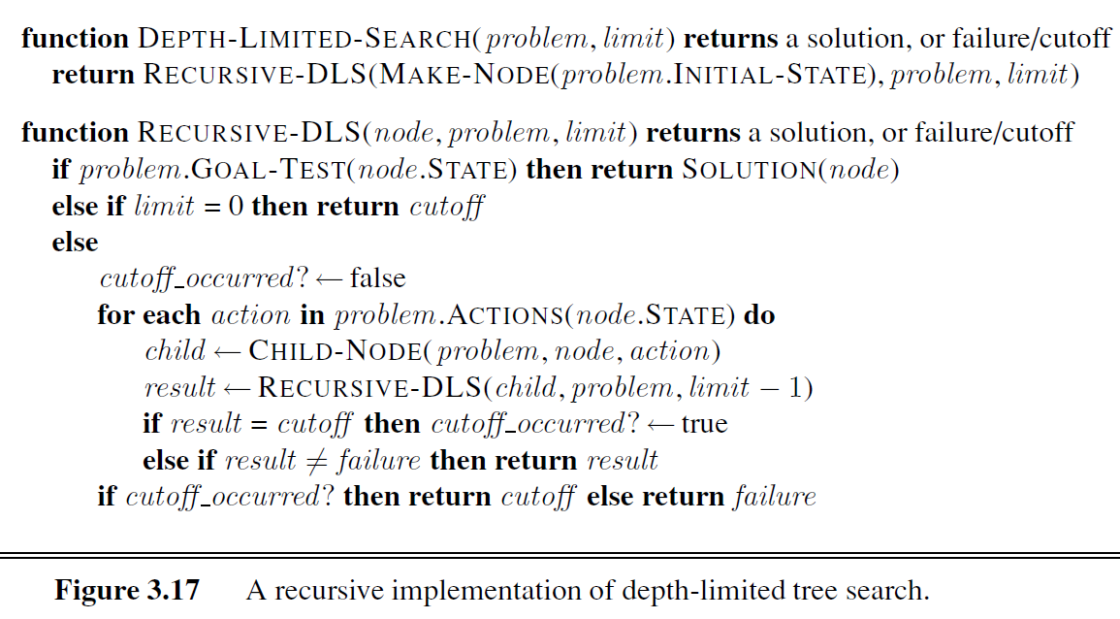

Slide 68
DFS with limit; incrementally grow limit
Evaluation
  Complete?
  Time Complexity?
  Space Complexity?
Yes
a
b
e
O(b^d)
c
d
f
g
h
O(d)
© Daniel S. Weld

Slide 69
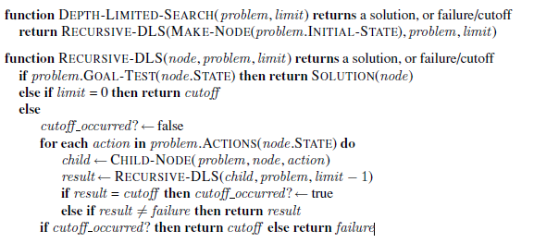

Slide 70
Iterative Deepening Search
Iterative deepening search (or iterative deepening depth-first search) is a general strategy, often used in combination with depth-first tree search, that finds the best depth limit. It does this by gradually increasing the limit l—first 0, then 1, then 2, and so on—until a goal is found.
  Complete? Yes
  Time Complexity? O(b^d)
  Space Complexity? O(d)
iterative deepening is the preferred uninformed search method when the search space is large and the depth of the solution is not known.

Slide 71
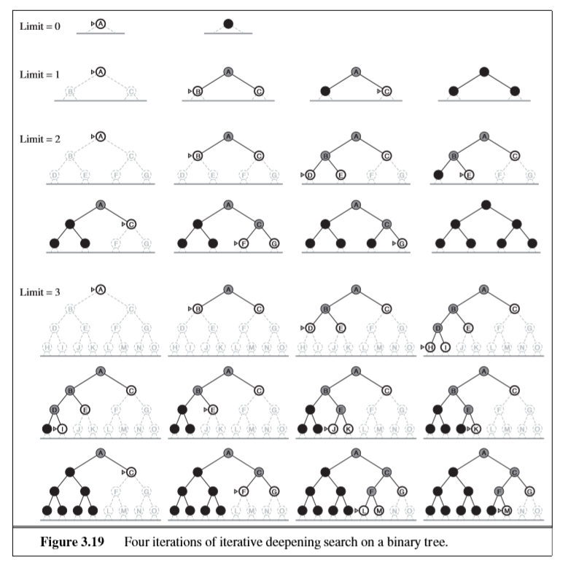
IDDFS

Slide 72
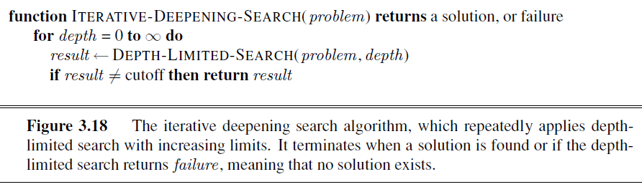

Slide 73
In an iterative deepening search, the nodes on the bottom level (depth d) are generated once, those on the next-to-bottom level are generated twice, and so on, up to the children of the root, which are generated d times. So the total number of nodes generated in the worst case is
N(IDS) = (d)^{b} + (d − 1)b² + ・ ・ ・ + (1)b^{d}
For example, if b = 10 and d = 5, the numbers are
N(IDS) = 50 + 400 + 3, 000 + 20, 000 + 100, 000 = 123, 450
N(BFS) = 10 + 100 + 1, 000 + 10, 000 + 100, 000 = 111, 110 .

Slide 74
If you are really concerned about repeating the repetition, you can use a hybrid approach that runs breadth-first search until almost all the available memory is consumed, and then runs iterative deepening from all the nodes in the frontier. In general, iterative deepening is the preferred uninformed search method when the search space is large and the depth of the solution is not known.

Slide 75
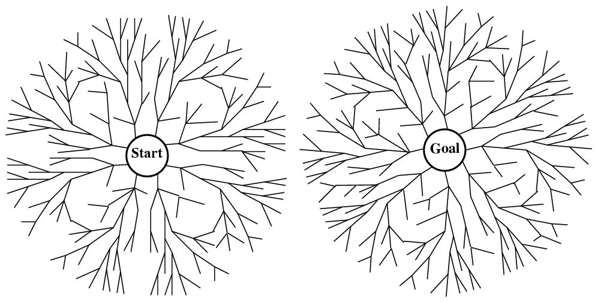
Bidirectional Search
The idea behind bidirectional search is to run two simultaneous searches—one forward from the initial state and the other backward from the goal—hoping that the two searches meet in the middle Thus, the time complexity of bidirectional search using breadth-first searches in both directions is O(b^{d/2}).
The space complexity is also O(b^{d/2}).
© Daniel S. Weld

Slide 76
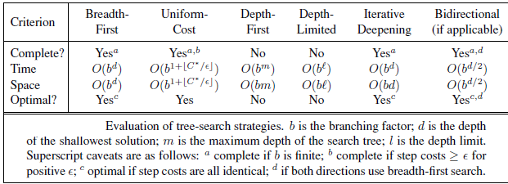

Slide 77
Search Strategies v2
Blind Search
Informed Search
Constraint Satisfaction
Adversary Search
  Best-first search
  A* search
  Iterative deepening A* search
  Local search
© Daniel S. Weld

Slide 78
The general approach we consider is called best-first search. Best-first search is an
instance of the general TREE-SEARCH or GRAPH-SEARCH algorithm in which a node is
selected for expansion based on an evaluation function, f(n). The evaluation function is
construed as a cost estimate, so the node with the lowest evaluation is expanded first. The
implementation of best-first graph search is identical to that for uniform-cost search except for the use of f instead of g to order the priority queue. The choice of f determines the search strategy.

Slide 79
Most best-first algorithms include as a component of f a heuristic function, denoted h(n):
h(n) = estimated cost of the cheapest path from the state at node n to a goal state.
For example, in Romania, one might estimate the cost of the cheapest path from Arad
to Bucharest via the straight-line distance from Arad to Bucharest.
Heuristic functions are the most common form in which additional knowledge of the problem is imparted to the search algorithm
if n is a goal node, then h(n)=0.

Slide 80
Greedy best-first search
Greedy best-first search tries to expand the node that is closest to the goal, on the grounds that this is likely to lead to a solution quickly. Thus, it evaluates nodes by using just the heuristic function; that is, f(n) = h(n).

Slide 81
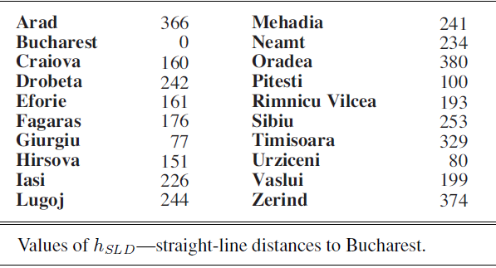

Slide 82
Best-first Search
Generalization of breadth first search
Priority queue of nodes to be explored
Cost function f(n) applied to each node
Add initial state to priority queue
While queue not empty
Node = head(queue)
If goal?(node) then return node
Add children of node to queue
© Daniel S. Weld

Slide 83
Best First Search
A node is selected for expansion based on an evaluation function, f(n). The evaluation function is construed as a cost estimate, so the node with the lowest evaluation is expanded first. The implementation of best-first graph search is identical to that for uniform-cost search, except for the use of f instead of g to order the priority queue.
F=h(n) = estimated cost of the cheapest path from the state at node n to a goal state.
Breadth first = best first With f(n) = depth(n)
Dijkstra’s Algorithm = best first With f(n) = g(n), i.e. the sum of edge costs from start to n
© Daniel S. Weld

Slide 84
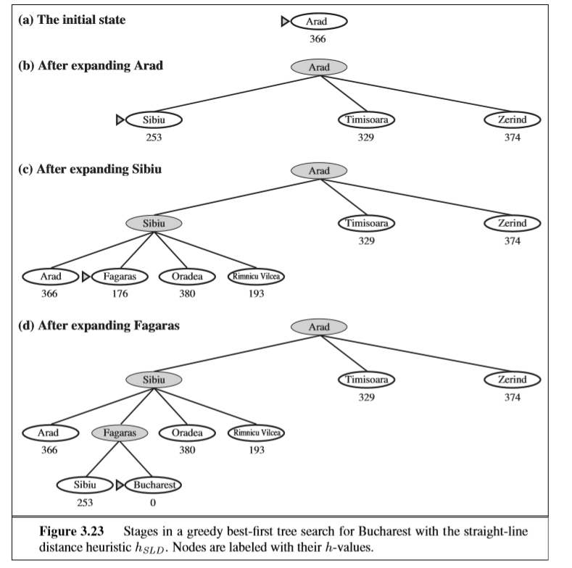
Greedy Best First Search

Slide 85
Best-first search (BFS)
Heuristic search
  proceeds preferentially using heuristics
  Basic idea
    Heuristic evaluation function : based on information specific to the problem domain
    Expand next that node, n, having the smallest value of h
    Terminate when the node to be expanded next is a goal node
Eight-puzzle
  The number of tiles out of places: measure of the goodness of a state description

Slide 86


The number of tiles out of places
goal

Slide 87
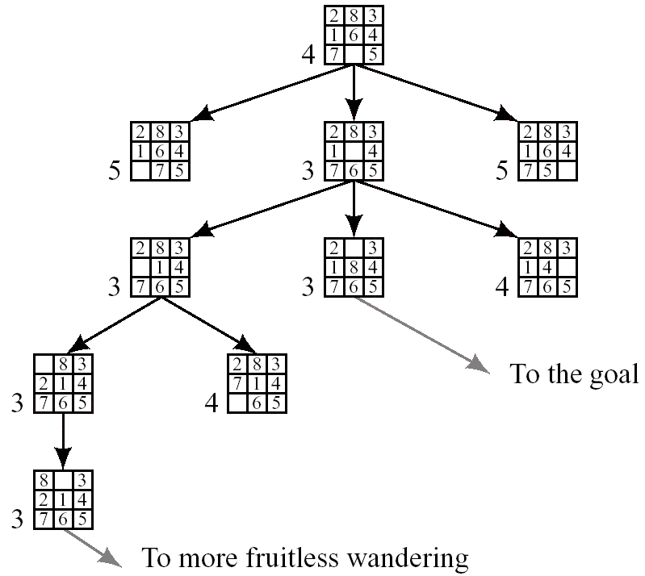

Slide 88
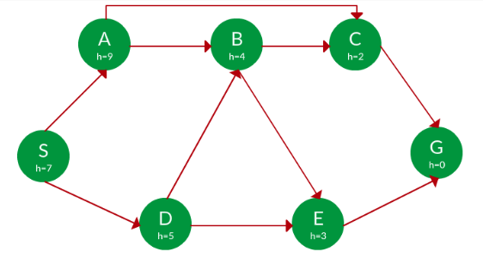

Slide 89
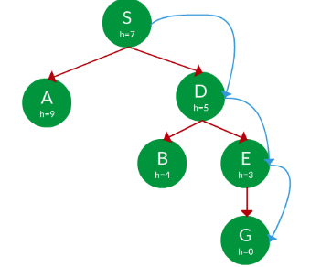
Path: S -> D -> E -> G

Slide 90
A* Search
A* search: Minimizing the total estimated solution cost
Hart, Nilsson & Rafael 1968
  Best first search with f(n) = g(n) + h(n)
g(n) gives the path cost from the start node to node n, and h(n) is the estimated cost of the cheapest path from n to the goal,
h(goal) = 0
f(n) = estimated cost of the cheapest solution through n .
Conditions for optimality: Admissibility and consistency
An admissible heuristic is one that never overestimates the cost to reach the goal. Because g(n)
is the actual cost to reach n along the current path, and f(n)=g(n) + h(n)
A heuristic h(n) is consistent if, for every node n and every successor n of n generated by any action a, the estimated cost of reaching the goal from n is no greater than the step cost of getting to n plus the estimated cost of reaching the goal from n h(n) ≤ c(n, a, n’)+ h(n’) .
© Daniel S. Weld

Slide 91
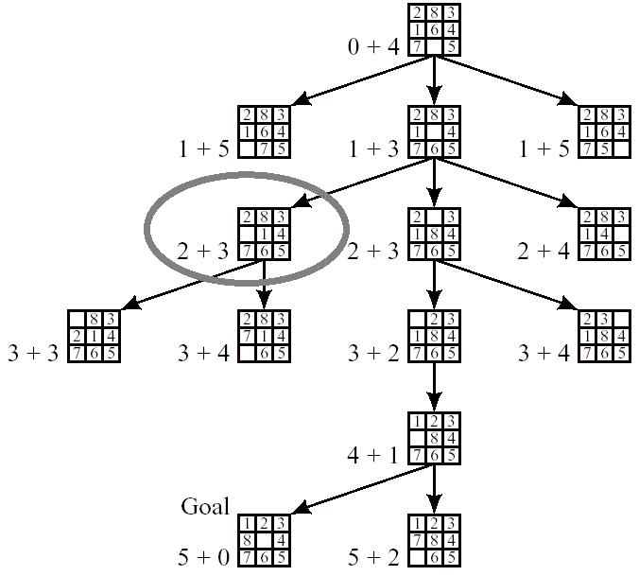

Slide 92
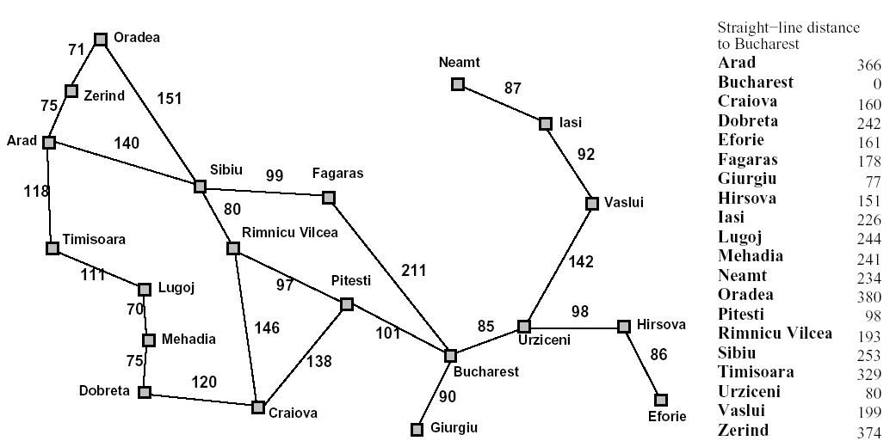
European Example
start
end
© Daniel S. Weld

Slide 93
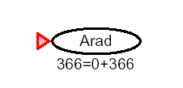
A* Example
© Daniel S. Weld

Slide 94
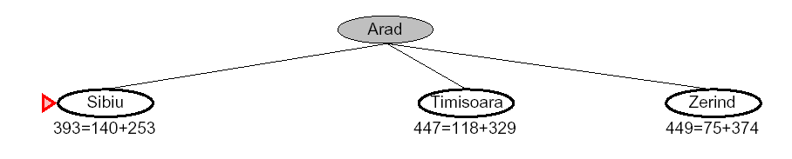
A* Example
© Daniel S. Weld

Slide 95
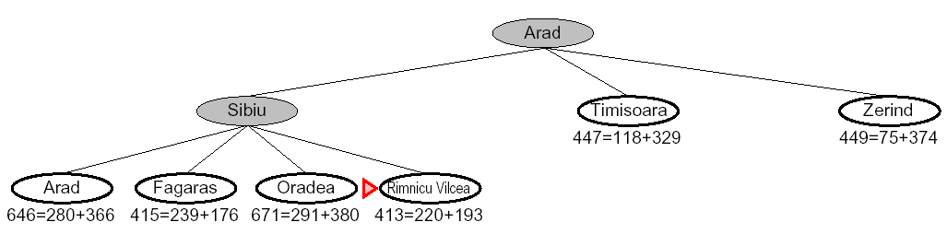
A* Example
© Daniel S. Weld

Slide 96
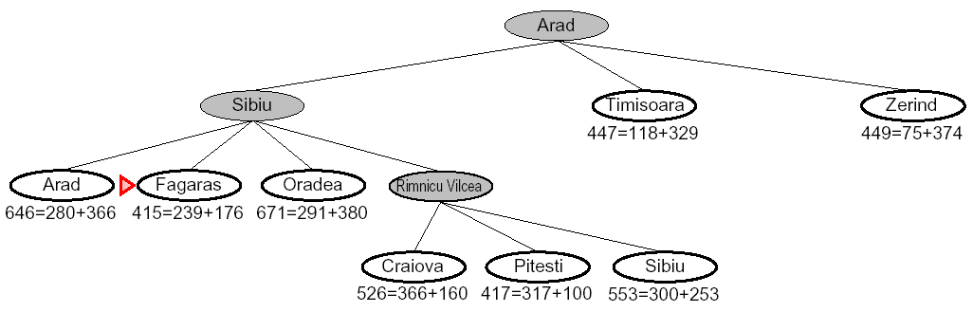
A* Example
© Daniel S. Weld

Slide 97
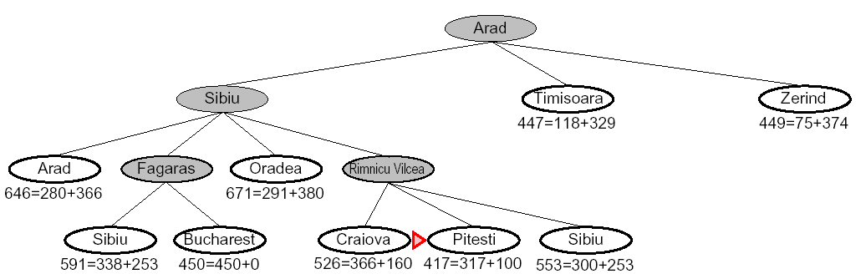
A* Example
© Daniel S. Weld

Slide 98
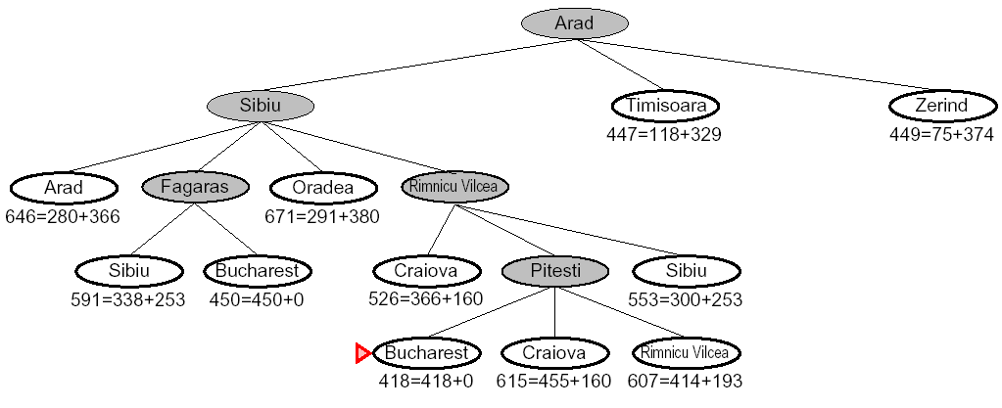
A* Example
© Daniel S. Weld

Slide 99
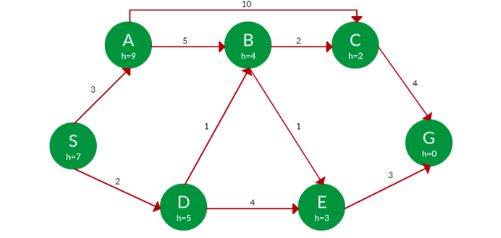

Slide 100
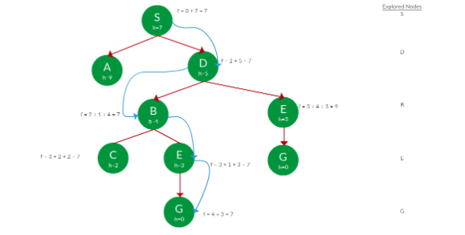
Path: S -> D -> B -> C -> E -> G
Cost: 7

Slide 101
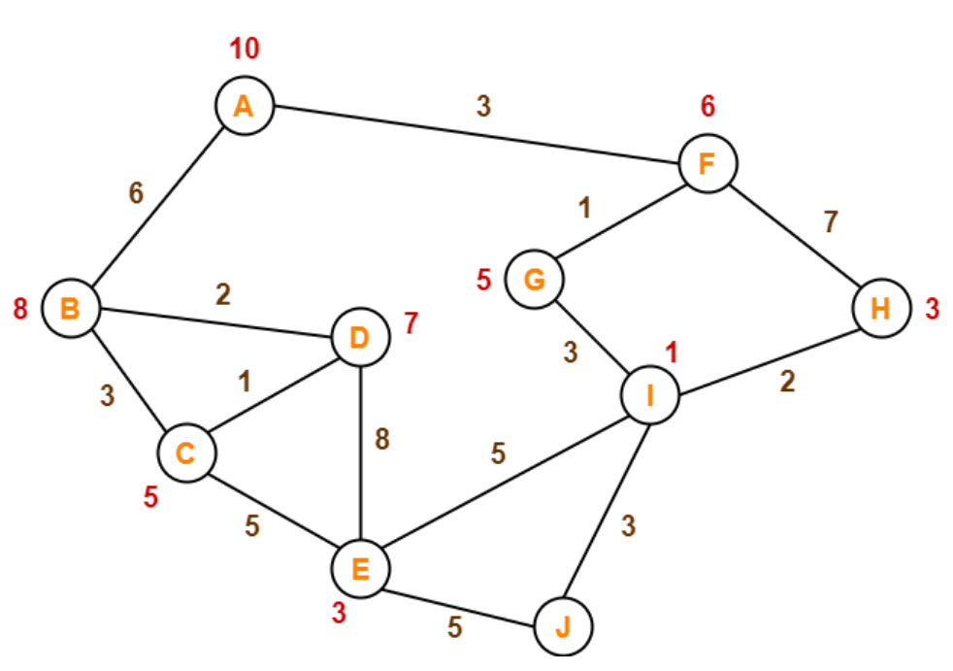
The numbers written on edges represent the distance between the nodes.
The numbers written on nodes represent the heuristic value.
Find the most cost-effective path to reach from start state A to final state J using A* Algorithm.

Slide 102
Step-01:
We start with node A.
Node B and Node F can be reached from node A.
A* Algorithm calculates f(B) and f(F).
f(B) = 6 + 8 = 14
f(F) = 3 + 6 = 9
Since f(F) < f(B), so it decides to go to node F.
Path- A → F
Step-02:
Node G and Node H can be reached from node F.
A* Algorithm calculates f(G) and f(H).
f(G) = (3+1) + 5 = 9
f(H) = (3+7) + 3 = 13
Since f(G) < f(H), so it decides to go to node G.
Path- A → F → G

Slide 103
Step-03:
Node I can be reached from node G.
A* Algorithm calculates f(I).
f(I) = (3+1+3) + 1 = 8
It decides to go to node I.
Path- A → F → G → I
Step-04:
Node E, Node H and Node J can be reached from node I.
A* Algorithm calculates f(E), f(H) and f(J).
f(E) = (3+1+3+5) + 3 = 15
f(H) = (3+1+3+2) + 3 = 12
f(J) = (3+1+3+3) + 0 = 10
Since f(J) is least, so it decides to go to node J.
Path- A → F → G → I → J
This is the required shortest path from node A to node J.

Slide 104
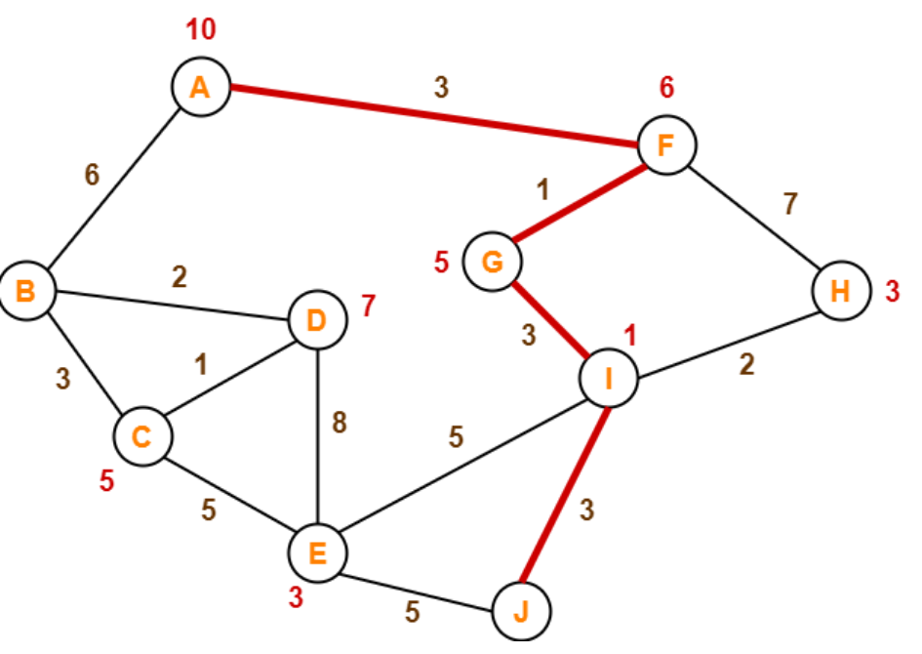

Slide 105
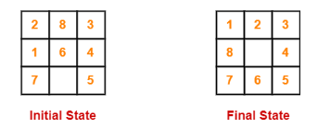
Find the most cost-effective path to reach the final state from initial state using A* Algorithm.
Consider g(n) = Depth of node and h(n) = Number of misplaced tiles.

Slide 106
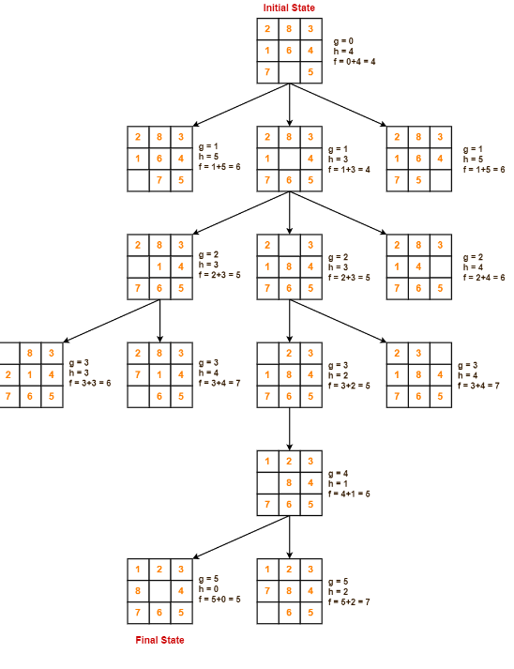

Slide 107
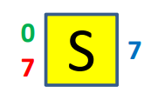
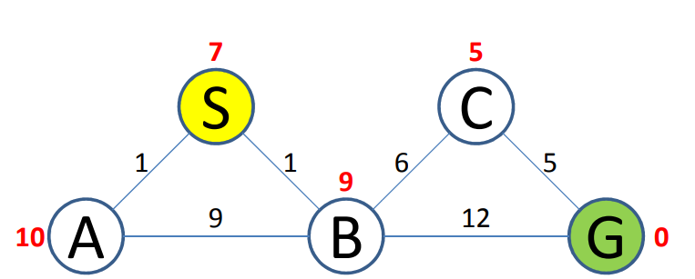
f = accumulated path cost + heuristic

Slide 108
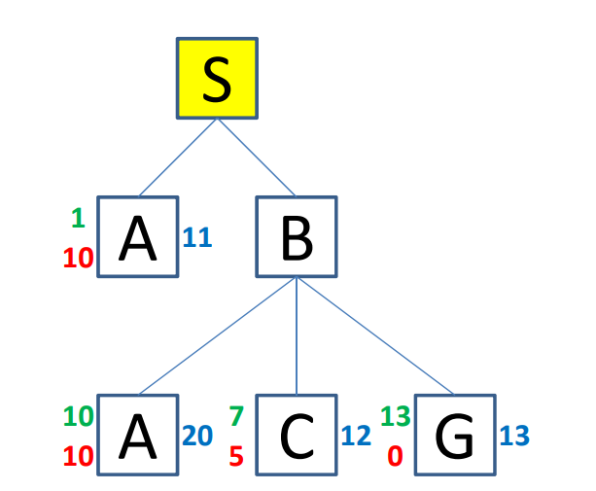
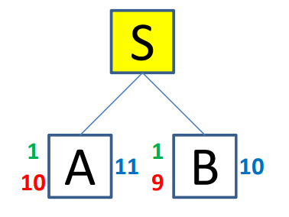
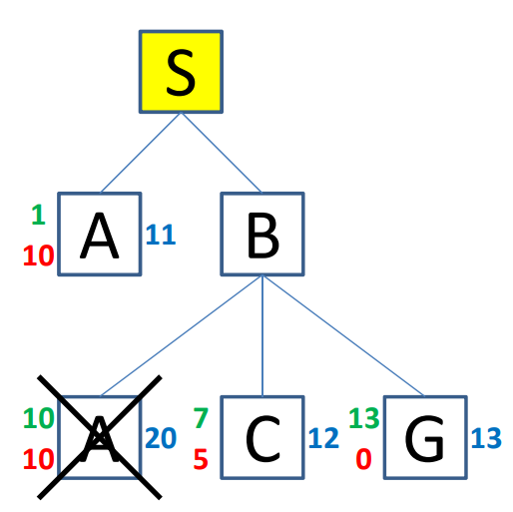


Slide 109



Slide 110


Slide 111

Heuristic Function

Slide 112
Heuristic Function
h1 = the number of misplaced tiles. All of the eight tiles are out of position, so the start state would have h1 =8 . h1 is an admissible heuristic because it is clear that any tile that is out of place must be moved at least once.
h2 = the sum of the distances of the tiles from their goal positions. Because tiles cannot move along diagonals, the distance we will count is the sum of the horizontal and vertical distances. This is sometimes called the city block distance or Manhattan distance. h2 is also admissible because all any move can do is move one tile one step closer to the goal. Tiles 1 to 8 in the start state give a Manhattan distance of
h2 = 3 + 1 + 2 + 2 + 2 + 3 + 3 + 2 = 18

