Slide 1
III-B.E. V-SEMESTER
AUTOMATA, LANGUAGES AND COMPUTATION (ALC)
Presented By
Dr. D. BASWARAJ
Professor, CSE DEPT.
VCE, HYDERABAD

Slide 2
UNIT-I
PART-1: Automata
  Introduction to Automata
  Central Concepts of Automata Theory
PART-2: Finite Automata
  An Informal Picture of Finite Automata (FA)
  Deterministic Finite Automata (DFA)
  Nondeterministic Finite Automata (NFA)
  An application
  Finite Automata with Epsilon Transitions
  Simulation of Finite Automata using JFLAP tool
PART-3: Regular Expressions and Languages
  Regular Expressions
  Finite Automata and Regular Expressions
  Applications of Regular Expressions
  Algebraic Laws for Regular Expressions

Slide 3
Part-2: Finite Automata (FA)
  1. An Informal Picture of Finite Automata:
FA was developed by Robin and Scott in 1950’s as a model of computer with limited memory.
FA or Finite State Machine (FSM) represents a mathematical model of a system with certain inputs and produce corresponding outputs.
FA are finite collections of states with transition rules that take you from one state to another.
Today, several kinds of software can be modeled by Finite Automata including lexical analysis (which is a component of Compiler), text editors, and systems verifying the correctness of circuits or protocols.

Slide 4
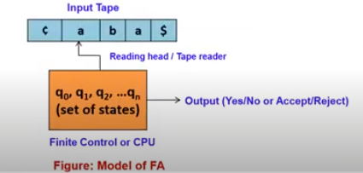
An Informal Picture of Finite Automata…
The model of block diagram of FA is shown below:

Slide 5
Formal Definition of Finite Automata
The formal or mathematical definition of FA: can be be defined as a Quin Tuple or 5-Tuple, denoted by M, i.e.
M = (Q, Σ, δ , q₀, F), where
Q : Finite or non-empty set of states or internal states
Σ : Input Alphabet
δ : Transition / Moving / Mapping Function
q₀ : Initial / start state in Q
F : Set of final or accepting states , F ⊆ Q
The transition function used to determine the next state on finite control and perform mapping from QxΣ to Q i.e., δ: QxΣ → Q.
This mapping is usually represented by a transition table of transition diagram.
Example: M = ({qo,q1}, {a,b}, δ, q0, {q1}) and δ is given below:
δ(q0,a)=q1, δ(q0, b)=q0, δ(q1,a)=q1 and δ(q1,b)=q0

Slide 6
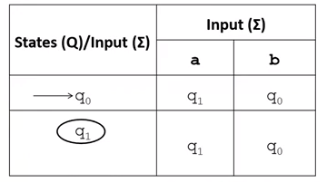
Formal Definition of Finite Automata…
Transition Table (TT):
In TT, each row indicates the states in FA and each column indicates each symbol included in alphabet Σ.
In the TT, initial/start state is represented by drawing a prefixed arrow to that state and final state is denoted by single circle or *.
The transition table is shown below, where q0 is start state and q1 is final state.

Slide 7
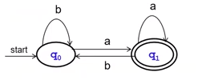
Formal Definition of Finite Automata…
Transition Diagram (TD):
Transition/state diagram/ Graph, is a directed graph, used to show the pictorial representation of FA, which consists states, transitions and labels.
In TG, usually, Nodes = states, Arcs indicate state transitions and Labels on arcs tell what causes the transition.
At particular time, it remember only the current state
The transition diagram is shown below, where q0 is start state and q1 is final state (represented by double circle).

Slide 8
Formal Definition of Finite Automata…
Exercise:
Draw Transition Table and Transition Diagram for given FA,
M = ({q0,q1,q2}, {0, 1}, δ, q0, {q0}) and δ is given below:
δ(q0, 0)=q0 δ(q0, 1)=q1
δ(q1, 0)=q0 δ(q1,1)=q2
δ(q2, 0)=q0 δ(q2,1)=q2

Slide 9
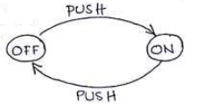
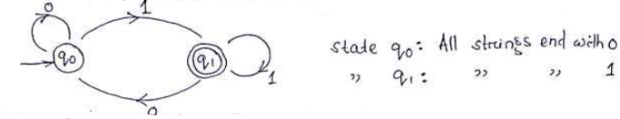
An Informal Picture of Finite Automata
Example-1: An electric switch, it has two state.
Example-2: Consider the following language
L = {w | w end with a 1}

Slide 10
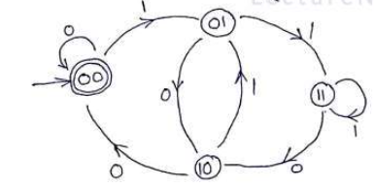
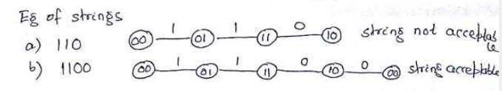
An Informal Picture of Finite Automata…
Example-3: We are looking for a set of strings, defined as:
L = { x : x is a binary string divisible by 4} = {100, 1000, 1100…}
Note: All binary numbers divisible by 4 have 00 at the end (suffix)
Note: current state = accept state = 00

Slide 11
2. Deterministic Finite Automata (DFA)
There are two types of finite automata:
  DFA (Deterministic Finite Automata)
  NFA (Non-deterministic Finite Automata)
Deterministic refers to the uniqueness of the computation.
In the DFA, the machine goes to one state only for a particular input character. DFA does not accept the null move.
NFA is used to transmit any number of states for a particular input. It can accept the null move.
Some important points about DFA and NFA:
  Every DFA is NFA, but NFA is not DFA.
  There can be multiple final states in both NFA and DFA.
  DFA is used in Lexical Analysis in Compiler.
  NFA is more of a theoretical concept.

Slide 12
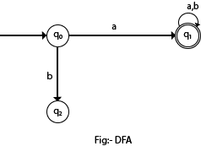
Deterministic Finite Automata (DFA)…
In the following diagram, we can see that from state q0 for input a, there is only one path which is going to q1. Similarly, from q0, there is only one path for input b going to q2.
Formal Definition of a DFA: A DFA can be represented by a 5-tuple (Q, ∑, δ, q₀, F) where −
  Q is a finite set of states.
  ∑ is a finite set of symbols, called as alphabet.
  δ is the transition function where δ: Q × ∑ → Q
  q₀ is the initial state from where any input is processed (q₀ ∈ Q).
  F is a set of final state/states of Q (F ⊆ Q).

Slide 13
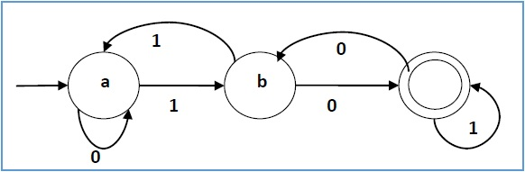
Deterministic Finite Automata (DFA)…
Example-1: Draw state diagram for given DFA →
  Q = {a, b, c},
  ∑ = {0, 1},
  q₀ = {a},
  F = {c}, and Transition function δ as shown by the following table −
Present State | Next State for Input 0 | Next State for Input 1
a | a | b
b | c | a
c | b | c

Slide 14

Deterministic Finite Automata (DFA)…
Example-2: Draw Transition Table for given DFA →
  Q = {q0, q1, q2},
  ∑ = {0, 1},
  q₀ = {q0},
  F = {q2}, and Transition function δ represented by following state transition diagram −
Present State | Next state for Input 0 | Next State of Input 1
→q0 | q0 | q1
q1 | q2 | q1
*q2 | q2 | q2

Slide 15
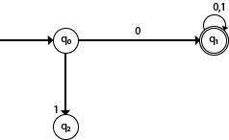
Deterministic Finite Automata (DFA)…
Example-3: Draw state transition diagram for given DFA with ∑ = {0, 1} accepts all starting with 0.
Solution:
Explanation: In the above diagram, we can see that on given 0 as input to DFA in state q0 the DFA changes state to q1 and always go to final state q1 on starting input 0. It can accept 00, 01, 000, 001....etc. It can't accept any string which starts with 1, because it will never go to final state on a string starting with 1.
Exercise: Draw state transition diagram for given DFA with ∑ = {0, 1} accepts all ending with 0.

Slide 16

Deterministic Finite Automata (DFA)…
Extension of transitions (δ) to Paths (δ^): The transition function can extend to path, that operates on states and strings (as opposed to states and symbols)
Basis:
Induction:
Now, formally, the language accepted by A is
The languages accepted by FA’s are called regular Languages.

Slide 17
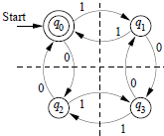
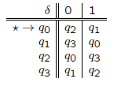
Deterministic Finite Automata (DFA)…
Example: DFA accepting all and only strings with an even number of 0’s and an even number of 1’s.
Tabular representation
of the automation:

Slide 18
3. Non-deterministic Finite Automata (NFA/NDFA)
NFA is defined in the same way as DFA but with the following two exceptions, it contains multiple next states, and ε transition.
NFA also has five states same as DFA, but with different transition function.
Formal Definition of a NFA: A NFA can be represented by a 5-tuple (Q, ∑, δ, q₀, F) where −
  Q is a finite set of states.
  ∑ is a finite set of symbols, called as alphabet.
  δ is the transition function where δ: Q × ∑ → 2^{Q}
  q₀ is the initial state from where any input is processed (q₀ ∈ Q).
  F is a set of final state/states of Q (F ⊆ Q).

Slide 19
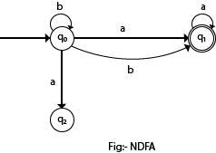
Non-deterministic Finite Automata (NFA)…
In the following figure, we can see that from state q0 for input a, there are two next states q1 and q2, similarly, from q0 for input b, the next states are q0 and q1.
Thus, it is not fixed or determined that with a particular input where to go next. Hence this FA is called non-deterministic finite automata.

Slide 20
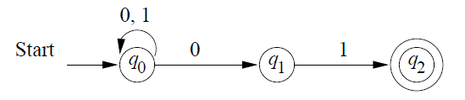
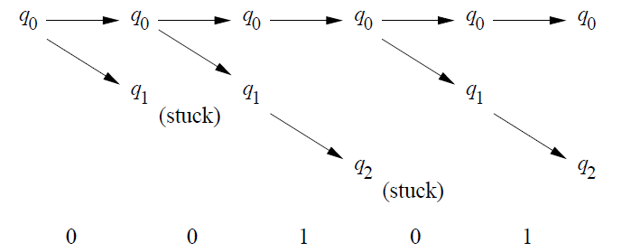
Non-deterministic Finite Automata (NFA)…
Example-2: An automaton shown below, that accepts all and only strings ending in 01.
Here is what happens, when the NFA process the input 00101

Slide 21

Non-Deterministic Finite Automata (DFA)…
Extension of transitions (δ) to Paths (δ^): The transition function can extend to path, that operates on states and strings (as opposed to states and symbols)
Basis:
Induction:
Now, formally, the language accepted by A is

Slide 22
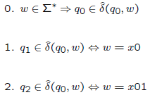
Non-Deterministic Finite Automata (DFA)…
Let’s prove formally that the NFA of example (refer previous slide)
Accepts the language
We will do a mutual induction on the three statements below:

Slide 23
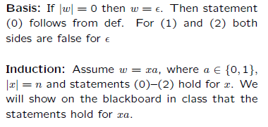
Non-Deterministic Finite Automata (DFA)…

Slide 24
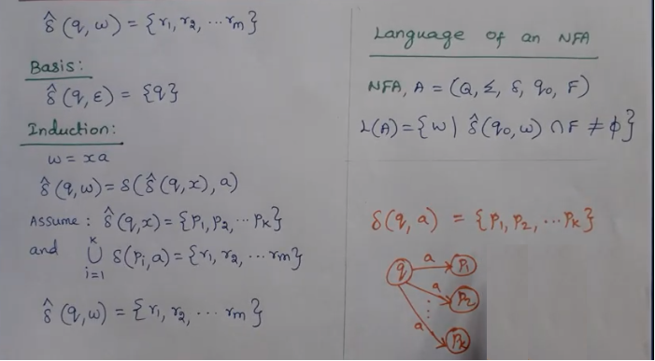
Non-Deterministic Finite Automata (DFA)…

Slide 25
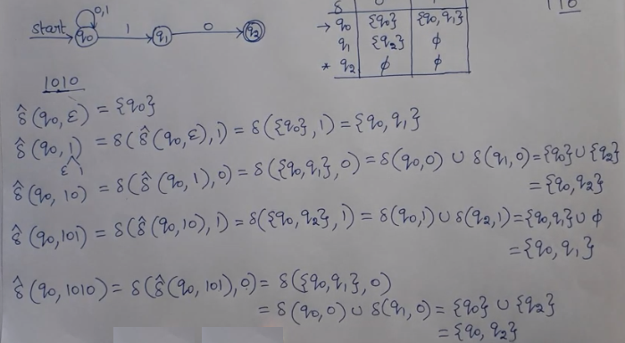
Non-Deterministic Finite Automata (DFA)…

Slide 26
DFA Vs NFA
DFA
All transitions are deterministic
  Each transition leads to exactly one state
For each state, transition on all possible symbols (alphabet) should be defined
Accepts input if the last state visited is in F
Sometimes harder to construct because of the number of states
Practical implementation is feasible
NFA
Some transitions could be non-deterministic
  A transition could lead to a subset of states
Not all symbol transitions need to be defined explicitly (if undefined will go to an error state – this is just a design convenience, not to be confused with “non-determinism”)
Accepts input if one of the last states is in F
Generally easier than a DFA to construct
Practical implementations limited but emerging (e.g., Micron automata processor)

Slide 27
5. Finite Automata with Epsilon Transitions
Definition: ε -NFAs are those NFAs with at least one explicit ε-transition defined.
We can allow explicit ε-transitions in finite automata
  i.e., a transition from one state to another state without consuming any additional input symbol
  Explicit ε-transitions between different states introduce non-determinism.
  Makes it easier sometimes to construct NFAs
ε -NFAs have one more column in their transition table

Slide 28
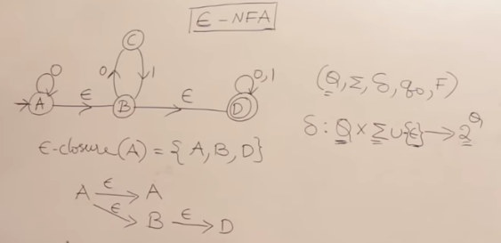
Finite Automata with Epsilon Transitions…
Example of an ε-NFA:
ε-closure of a state q, ECLOSE(q), is the set of all states (including itself) that can be reached from q by repeatedly making an arbitrary number of ε-transitions.

Slide 29
Finite Automata with Epsilon Transitions…
Example of an ε-NFA:
L = {w | w is empty, or if non-empty will end in 01}
0,1
δ_{E} | 0 | 1 | ECLOSE
*q’₀ | Ø | Ø | {q’₀,q₀}
q₀ | {q₀,q₁} | {q₀} | {q₀}
q₁ | Ø | {q₂} | {q₁}
*q₂ | Ø | Ø | {q₂}
0
1
q₀
q₁
q₂
ε
start
q’₀

Slide 30
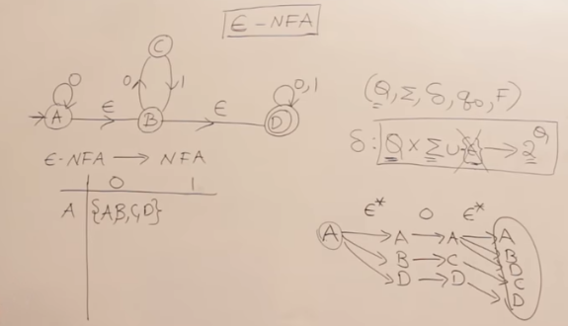
Finite Automata with Epsilon Transitions…
ε-NFA to NFA:

Slide 31
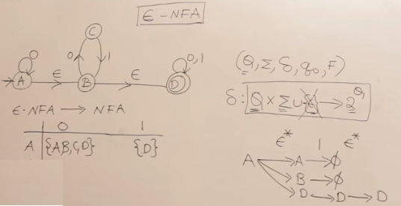
Finite Automata with Epsilon Transitions…
ε-NFA to NFA…

Slide 32
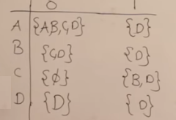
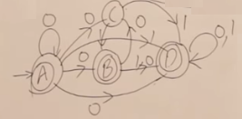
Finite Automata with Epsilon Transitions…
ε-NFA to NFA…

Slide 33
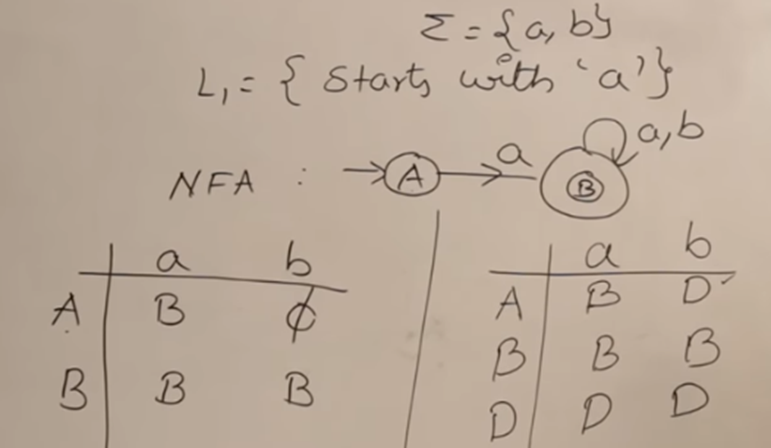
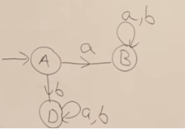
NFA to DFA
Method: Subset construction :
Step 1: Convert the given NFA to its equivalent transition table
Step 2: Create the DFA’s start state.
Step 3: Create the DFA’s transition table.
Step 4: Create the DFA’s final states.
Step 5: Simplify the DFA
Example – all strings start with a

Slide 34
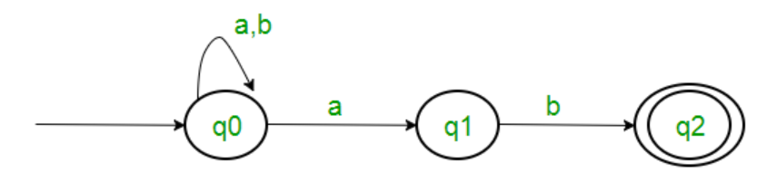
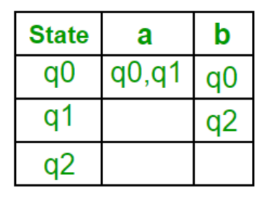
NFA to DFA
Example: Consider the following NFA shown in Figure
Following are the various parameters for NFA. Q = { q0, q1, q2 } ∑ = ( a, b ) F = { q2 } δ (Transition Function of NFA)

Slide 35
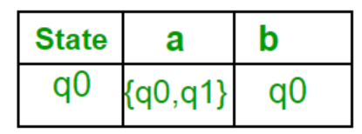
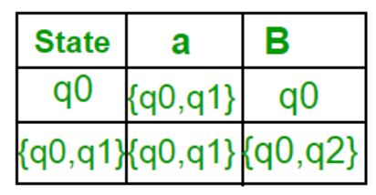
NFA to DFA
Step 1: Q’ = ɸ Step 2: Q’ = {q0} Step 3: For each state in Q’, find the states for each input symbol.
Now { q0, q1 } will be considered as a single state. As its entry is not in Q’, add it to Q’. So, Q’ = { q0, { q0, q1 } } Now, moves from state { q0, q1 } on different input symbols are not present in transition table of DFA.

Slide 36
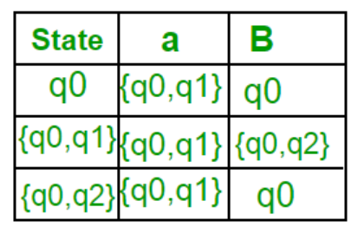
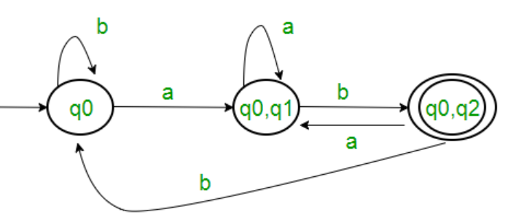
NFA to DFA
Now { q0, q2 } will be considered as a single state. As its entry is not in Q’, add it to Q’. So, Q’ = { q0, { q0, q1 }, { q0, q2 } } Now, moves from state {q0, q2} on different input symbols are not present in transition table of DFA.
As there is no new state generated, we are done with the conversion. Final state of DFA will be state which has q2 as its component i.e., { q0, q2 }.

Slide 37
ε-NFA to DFA
Method:
Step 1: Step 1 − Consider M={Q, Σ, δ,q0,F) is NFA with ε. We have to convert this NFA with ε to equivalent DFA denoted by
M0=(Q0,Σ, δ0,q0,F0)
Then obtain, ε-closure(q0) ={p1,p2,p3,……pn}
then [p1,p2,p2,….,pn] becomes a start state of DFA
now[p1,p2,p3,….,pn] ∈ Q0
Step 2: We will obtain δ transition on [p1,p2,p3,…,pn] for each input.
δ 0([p1,p2,p3,..pn],a) = ε-closure(δ(p1,a) U δ(p2,a2)U……… δ(pn, a))
= U (i=1 to n) ε-closure d(pi, a), where a is input ∈Σ.
Step 3: The state obtained [p1,p2,p3,…,pn] ∈ Q0.
Step 4: The states containing final state in pi is a final state in DFA.

Slide 38
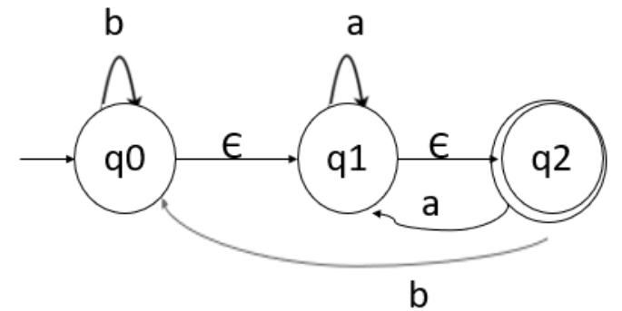
ε-NFA to DFA
Example: Consider the following NFA for conversion of NFA with epsilon to DFA .
Solution: To convert this NFA with epsilon, we will first find the ε-closures, as given below −
    ε-closure(q0)={q0,q1,q2}
    ε-closure(q1)={q1,q2}
    ε-closure(q2)={q2}

Slide 39
ε-NFA to DFA
Let us start from ε-closure of start state, as mentioned below −
When, ε-closure(q0)={q0,q1,q2}, we will call this state as A.
Now, let us find transition on A with every input symbol as follow:
δ'(A, a) = ε-closure(δ(A,a))
  = ε-closure(δ(q0,q1,q2), a))
  = ε-closure(δ(q0, a) ∪ δ(q1,a) U δ(q2,a) )
  = ε-closure(ΦUq1 ∪q2) = ε-closure(q1)
  = {q1, q2} let us call it as state B
δ'(A, b) = ε-closure(δ(A,b))
  = ε-closure(δ(q0,q1,q2), b))
  = ε-closure(δ(q0, b) ∪ δ(q1,b) U δ(q2,b) )
  = ε-closure(q0 U Φ∪q0) = ε-closure(q0)
  = {q0,q1, q2} its nothing but state A

Slide 40
ε-NFA to DFA
Now, let us find transition on B with every input symbol as follow:
δ'(B, a) = ε-closure(δ(B,a))
  = ε-closure(δ(q1,q2), a))
  = ε-closure(δ(q1,a) U δ(q2,a) )
  = ε-closure(q1 ∪q2) = ε-closure(q1)
  = {q1, q2} its nothing but state B
δ'(B, b) = ε-closure(δ(B,b))
  = ε-closure(δ(q1,q2), b))
  = ε-closure(δ(q1,b) U δ(q2,b) )
  = ε-closure(Φ∪q0) = ε-closure(q0)
  = {q0, q1, q2} its nothing but state A

Slide 41
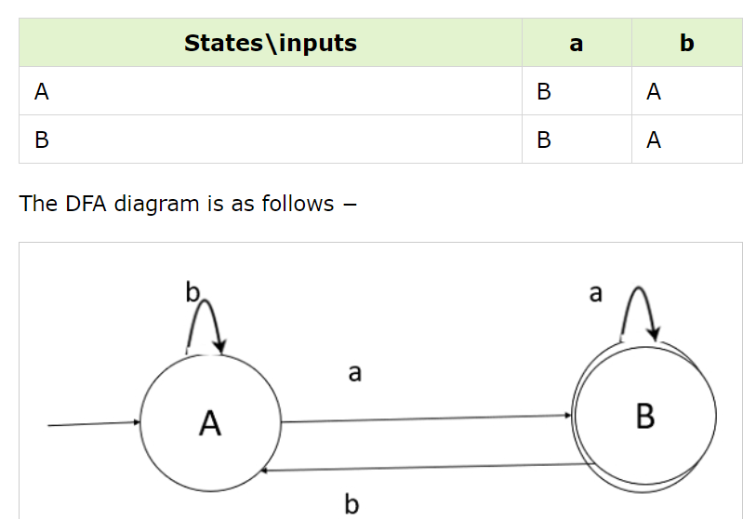
ε-NFA to DFA
Hence, the transition table for the generated DFA and equivalent DFA is as follows −
As, A={q0,q1,q2} in which the final state q2 lies. Hence, A is the final state. In B ={q1,q2} the state q2 lies. Hence, B is also the final state.

Slide 42
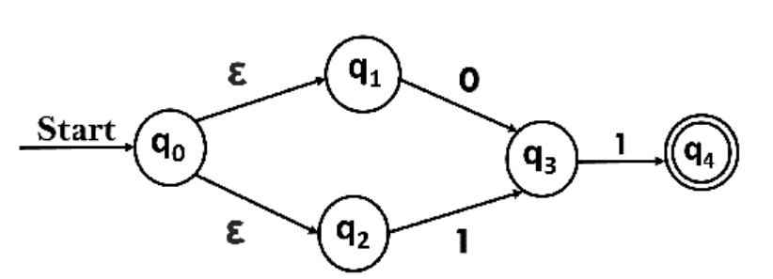
ε-NFA to DFA
Example: Consider the following NFA for conversion of NFA with epsilon to DFA .
Solution: To convert this NFA with epsilon, we will first find the ε-closures, as given below −
    ε-closure {q0} = {q0, q1, q2}
    ε-closure {q1} = {q1}
    ε-closure {q2} = {q2}
    ε-closure {q3} = {q3}
    ε-closure {q4} = {q4}

Slide 43
ε-NFA to DFA
When, ε-closure(q0)={q0,q1,q2}, we will call this state as A.
Now, let us find transition on A with every input symbol as follow:
δ'(A, 0) = ε-closure {δ((q0, q1, q2), 0) }
  = ε-closure {δ(q0, 0) ∪ δ(q1, 0) ∪ δ(q2, 0) }
  = ε-closure {q3}
  = {q3} Let call it as state B.
δ'(A, 1) = ε-closure {δ((q0, q1, q2), 1) }
  = ε-closure {δ((q0, 1) ∪ δ(q1, 1) ∪ δ(q2, 1) }
  = ε-closure {q3}
  = {q3} = B.
  δ'(B, 0) = ε-closure {δ(q3, 0) } = ϕ
  δ'(B, 1) = ε-closure {δ(q3, 1) }
  = ε-closure {q4} = {q4} Let call it as state C.

Slide 44
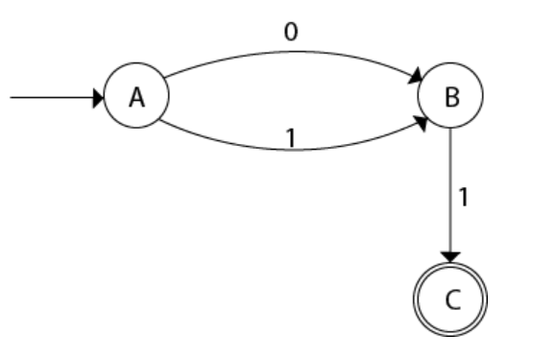
ε-NFA to DFA
δ'(C, 0) = ε-closure {δ(q4, 0) } = ϕ
δ'(C, 1) = ε-closure {δ(q4, 1) } = ϕ
The DFA will be,

Slide 45
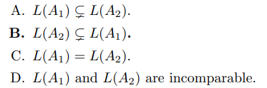
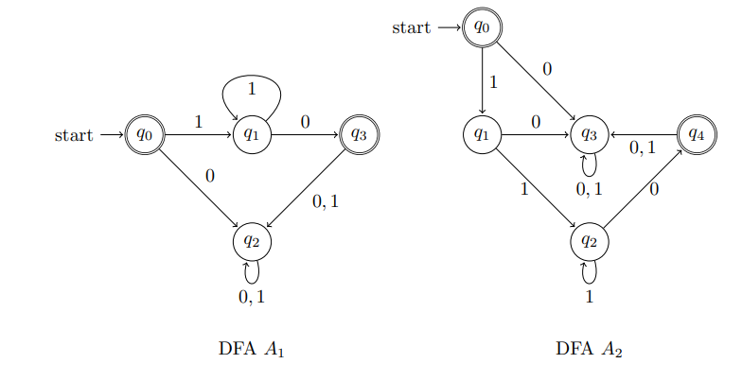
Example-1
Consider the following two DFAs A1 and A2, Which one of the following is true?

Slide 46
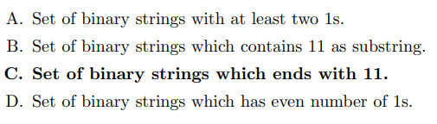
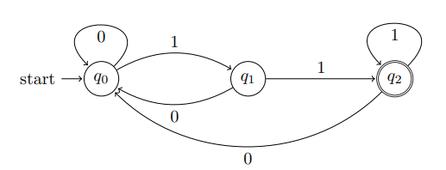
Example-2
Which of the following is the correct description of language recognized by the DFA below?

Slide 47
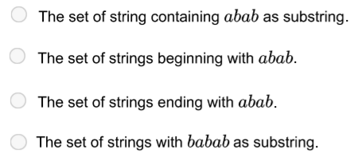
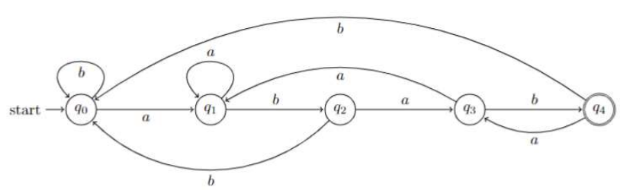
Example-3
What is the language recognized by the NFA below?

Slide 48
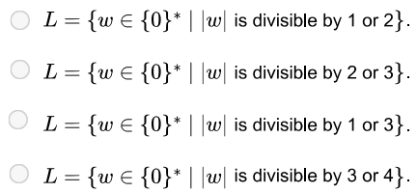
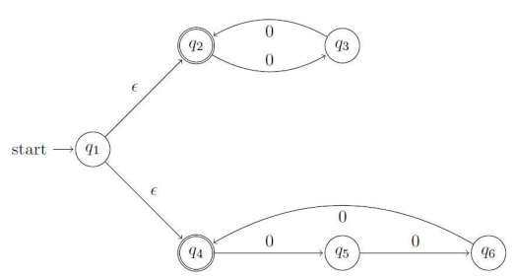
Example-4
Which of the following is the correct description of language recognized by the NFA below?

Slide 49
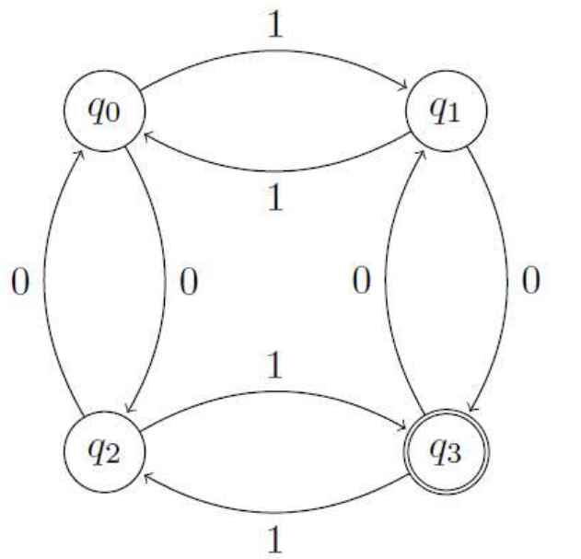
Example-5

Slide 50
END OF
UNIT-1
PART-2

