Slide 1
III-B.E. V-SEMESTER
AUTOMATA, LANGUAGES AND COMPUTATION (ALC)
Presented By
Dr. D. BASWARAJ
Professor, CSE DEPT.
VCE, HYDERABAD

Slide 2
UNIT-I
PART-1: Automata
  Introduction to Automata
  Central Concepts of Automata Theory
PART-2: Finite Automata
  An Informal Picture of Finite Automata (FA)
  Deterministic Finite Automata (DFA)
  Nondeterministic Finite Automata (NFA)
  An application
  Finite Automata with Epsilon Transitions
  Simulation of Finite Automata using JFLAP tool
PART-3: Regular Expressions and Languages
  Regular Expressions
  Finite Automata and Regular Expressions
  Applications of Regular Expressions
  Algebraic Laws for Regular Expressions

Slide 3
Part-3: Regular Expressions and Languages
  1. Regular Expressions:
A FA (NFA or DFA) is a “blueprint” for constructing a machine recognizing a regular language.
In other words, the language accepted by finite automata (FA) can easily described by simple expression called regular expression (RE). Such language is called regular language (RL).
A regular expression is a “user-friendly”," declarative way of describing a regular language.
A RE can also be described as a sequence of patterns that defines a string.
For instance, RE, x* (star-closure) means zero or more occurrence of x. It can generate {ε, x, xx, xxx, xxxx, …}
For instance, RE, x+ (positive-closure) means one or more occurrence of x. It can generate {x, xx, xxx, xxxx, …}

Slide 4
Regular Expressions…
Examples: Consider an alphabet ∑ = {a,b},
L1 = set of strings whose length is exactly two
= {aa, ab, ba, bb} = finite language
RE = Union of finite strings = aa+ab+ba+bb = a(a+b)+b(a+b)
= (a+b)(a+b)
L2 = set of strings whose length is at least two (2, 3, 4, …)
= {aa, ab, ba, bb, aaa, aba, aab, ….} = infinite language
RE = (a+b)(a+b)(a+b)*
L3 = set of strings whose length is at most two (0, 1, 2)
= {ε, a, b, aa, ab, ba, bb} = finite language
RE = ε+a+b+aa+ab+ba+bb = (a+b+ε)(a+b+ε)
RE = starting & ending with different symbol=a(a+b)*b or b(a+b)*a
RE = starting & ending with same symbol=a(a+b)*a or b(a+b)*b

Slide 5
Regular Expressions…
Examples: Consider an alphabet ∑ = {a,b},
L4 = set of strings whose length is even number
= {ε, aa, ab, ba, bb, …} = infinite language
RE = ((a+b)(a+b))*
L5 = set of strings whose length is odd number
= {a, b, aaa, aab, aba, …} = infinite language
RE = (a+b)((a+b)(a+b))*
L6 = set of strings whose length is divisible by 3
= {ε, aaa, aab, aba, …} = infinite language
RE = ((a+b)(a+b)(a+b))*
RE = a’s exactly two = b*ab*ab*
RE = a’s at least two = b*ab*a(a+b)*
RE = a’s at most two = b*(ε+a)b*(ε+a)b*

Slide 6
Regular Expressions…
Examples:
L7 = set of strings starts with 1 and end with 0 over ∑ = {0,1}
RE = 1(0+1)*0
L8 = set of strings starts with ‘a’ but not having consecutive b’s
RE = (a+ab)*
L9 = set of strings whose length is even over ∑ = {0}
RE = (00)* = ε, 00, 0000, …
L10 = set of strings which do not contain the substring 01 over ∑ = {0, 1}
RE = 1*0* = ε, 0, 1, 00, 11, 10, 100, …

Slide 7
Regular Expressions…
Operations on Regular Languages:
UNION: if L and M are two RLs, then the union of L and M is also the union. It is represented as:
L U M = { S | S is in L or S is in M}
Intersection: if L and M are two RLs, and their intersection is also an intersection. It is represented as:
L Ո M = { S | S is in L and S is in M}
Concatenation: L.M = LM = all strings that are of the form xy
s.t., x ∈ L and y ∈ M
Kleen Closure: if L RL, and its kleen closure L* will also be RL. It is represented as: L* = zero or more occurrence of language
Powers: L⁰ = {ε}; L¹ = L; L^{k+1} = L.L^{k}
Order of precedence for operators: 1. Star 2. Dot 3. Plus
Example: 01* +1 is grouped (0(1*))+1

Slide 8
2. Finite Automata and Regular Expressions
Regular
expressions
=
Finite Automata
(DFA, NFA, ε-NFA)
Syntactical
expressions
Regular
Languages
Formal language
classes

Slide 9
Finite Automata and Regular Expressions …
To show that FA and RE are interchangeable, consider the following theorems:
  Theorem 1: For every DFA A there exists a regular expression R, such that, L(R)=L(A)
  Theorem 2: For every RE R there exists an ε-NFA E, such that, L(E)=L(R)
ε -NFA
NFA
Kleene Theorem
Theorem 2
Reg Ex
DFA
Theorem 1

Slide 10
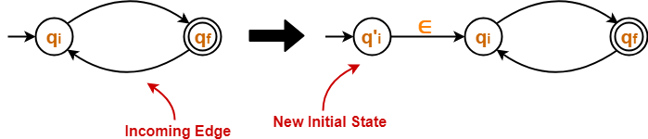
DFA to RE
The two popular methods for converting a DFA to its regular expression are-.
  Arden’s Method
  State Elimination Method
State Elimination Method: This method involves the following steps in finding the regular expression for any given DFA-
Step-01: If there exists any incoming edge to the initial state, then create a new initial state having no incoming edge to it.

Slide 11
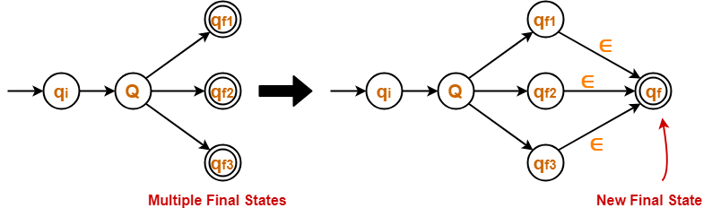
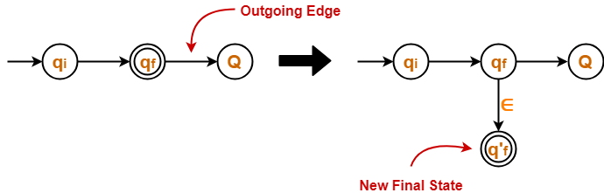
DFA to RE…
Step-02: If there exists multiple final states in the DFA, then convert all the final states into non-final states and create a new single final state.
Step-03: If there exists any outgoing edge from the final state, then create a new final state having no outgoing edge from it.

Slide 12
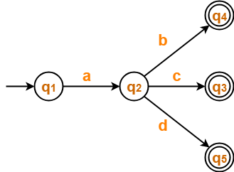
DFA to RE…
Step-04: Eliminate all the intermediate states one by one. These states may be eliminated in any order.
In the end,
  Only an initial state going to the final state will be left.
  The cost of this transition is the required regular expression.
NOTE: The state elimination method can be applied to any finite automata. (NFA, ∈-NFA, DFA etc)
Example: Find regular expression for the following DFA-

Slide 13
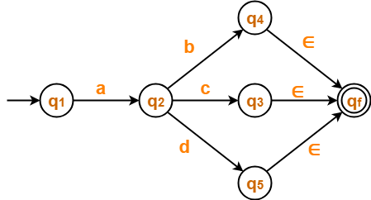
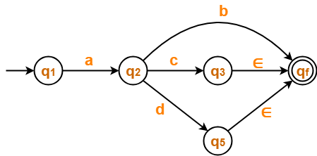
DFA to RE…
Step-01: There exist multiple final states. So, we convert them into a single final state.
Step-02: Now, we start eliminating the intermediate states. First, let us eliminate state q₄.
  There is a path going from state q₂ to state q_{f} via state q₄.
  So, after eliminating state q₄ , we put a direct path from state q₂ to state q_{f} having cost b.∈ = b.

Slide 14
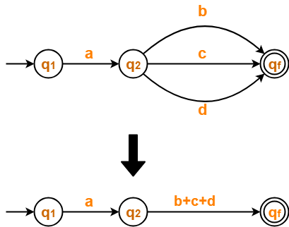
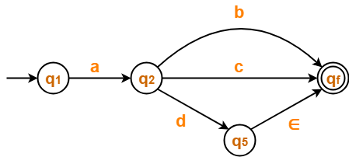
DFA to RE…
Step-03: Now, let us eliminate state q₃.
  There is a path going from state q₂ to state q_{f} via state q₃.
  So, after eliminating state q₃ , we put a direct path from state q₂ to state q_{f} having cost c.∈ = c.
Step-04: Now, let us eliminate state q₅.
  There is a path going from state q₂ to state q_{f} via state q₅.
  So, after eliminating state q₅ , we put a direct path from state q₂ to state q_{f} having cost d.∈ = d.

Slide 15

DFA to RE…
Step-05: Now, let us eliminate state q₂.
  There is a path going from state q₁ to state q_{f} via state q₂.
  So, after eliminating state q₂ , we put a direct path from state q₁ to state q_{f} having cost a.(b+c+d).
From here, Regular Expression = a(b+c+d)

Slide 16
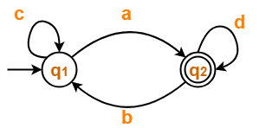
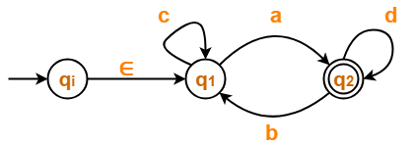
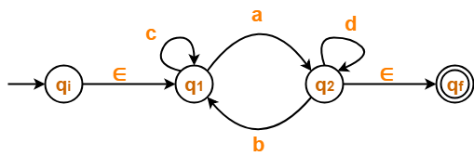
DFA to RE…
Example-2: Find RE from DFA
Step-1: Initial state q₁ has an incoming edge.
So, we create a new initial state q_{i}.
Step-2: Final state q₂ has an outgoing edge.
So, we create a new final state q_{f}.

Slide 17
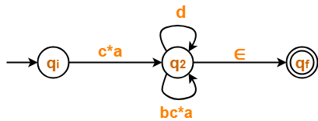

DFA to RE…
Step-3: let us eliminate state q₁.
There is a path going from state q_{i} to state q₂ via state q₁ .
So, after eliminating state q₁, we put a direct path from state q_{i} to state q₂ having cost ∈.c*.a = c*a
There is a loop on state q₂ using state q₁ .
So, after eliminating state q₁ , we put a direct loop on state q₂ having cost b.c*.a = bc*a
Step-4: Now, let us eliminate state q₂.
There is a path going from state q_{i} to state q_{f} via state q₂ .
So, after eliminating state q₂, we put a direct path from state q_{i} to state q_{f} having cost c*a(d+bc*a)*∈ = c*a(d+bc*a)*

Slide 18
DFA to RE…
  Arden’s Method:
Statement − Let P and Q be two regular expressions.
If P does not contain null string, then R = Q + RP has a unique solution that is R = QP*
Proof:−
    R = Q + (Q + RP)P [After putting the value R = Q + RP]
    = Q + QP + RPP
    When we put the value of R recursively again and again, we get the following equation −
    R = Q + QP + QP² + QP³…..
    R = Q (ε + P + P² + P³ + …. )
    R = QP* [As P* represents (ε + P + P2 + P3 + ….) ]
    Hence, proved.

Slide 19
DFA to RE…
Assumptions for Applying Arden’s Theorem
  The transition diagram must not have NULL transitions
  It must have only one initial state
Method:
Step 1 − Create equations as the following form for all the states of the DFA having n states with initial state q₁.
    q₁ = q₁R₁₁ + q₂R₂₁ + … + q_{n}R_{n1} + ε
    q₂ = q₁R₁₂ + q₂R₂₂ + … + q_{n}R_{n2} …
    … q_{n} = q₁R_{1n} + q₂R_{2n} + … + q_{n}R_{nn}
    R_{ij} represents the set of labels of edges from q_{i} to q_{j}, if no such edge exists, then R_{ij} = ∅
    Step 2 − Solve these equations to get the equation for the final state in terms of R_{ij}

Slide 20
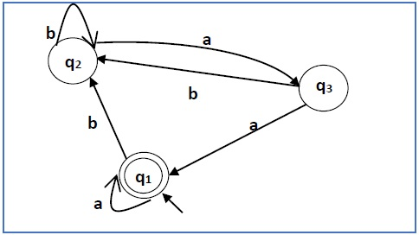
DFA to RE…
Example: Construct a regular expression corresponding to the automata given below −
Solution −
Here the initial state and final state is q₁.
The equations for the three states q1, q2, and q3 are as follows −
    q₁ = q₁a + q₃a + ε (ε move is because q1 is the initial state)
    q₂ = q₁b + q₂b + q₃b
    q₃ = q₂a

Slide 21
DFA to RE…
Now, we will solve these three equations −
q₂ = q₁b + q₂b + q₃b
    = q₁b + q₂b + (q₂a)b (Substituting value of q₃)
    = q₁b + q₂(b + ab)
    = q₁b (b + ab)* (Applying Arden’s Theorem)
q₁ = q₁a + q₃a + ε
    = q₁a + q₂aa + ε (Substituting value of q₃)
    = q₁a + q₁b(b + ab*)aa + ε (Substituting value of q₂)
    = q₁(a + b(b + ab)*aa) + ε
    = ε (a+ b(b + ab)*aa)* (Applying Arden’s Theorem)
    = (a + b(b + ab)*aa)*
Hence, the regular expression is (a + b(b + ab)*aa)*.

Slide 22
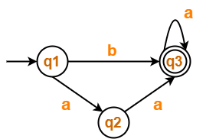
DFA to RE…
Example-2: Construct a regular expression corresponding to the DFA given below −
Solution −
Step-01: Form a equation for each state-
q1 = ∈ ……(1)
q2 = q1.a ……(2)
q3 = q1.b + q2.a + q3.a …….(3)

Slide 23
DFA to RE…
Example-2…
Step-02: Bring final state in the form R = Q + RP.
Using (1) in (2), we get-
    q2 = ∈.a
    q2 = a …….(4)
Using (1) and (4) in (3), we get-
    q3 = q1.b + q2.a + q3.a
    q3 = ∈.b + a.a + q3.a
    q3 = (b + a.a) + q3.a …….(5)
Using Arden’s Theorem in (5), we get-
q3 = (b + a.a)a*
Thus, Regular Expression for the given DFA = (b + aa)a*

Slide 24
DFA to RE…
Example:
1
0
0,1
q₀
0
q₁
1
q₂
(1*)
0
(0*)
1
(0 + 1)*
1*
00*
1
(0+1)*
1*00*1(0+1)*

Slide 25





RE to ε-NFA
  Theorem 2: For every RE R there exists an ε-NFA E such that L(E)=L(R)
RE to ε-NFA: Thompson's Algorithm: We will use following 5 rules which defined a RE as a basis for the construction:
The NFA representing the empty string is:
If the regular expression is just a character, eg. a, then the corresponding NFA is :
The union operator is represented by a choice of transitions from a node; thus a|b can be represented as:
Concatenation simply involves connecting one NFA to the other; eg. ab is:
The Kleene closure must allow for taking zero or more instances of the letter from the input; thus a* looks like:

Slide 26
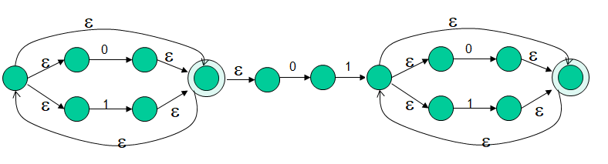
RE to ε-NFA
  Example:
(0+1)*01(0+1)*
(0+1)*
01
(0+1)*

Slide 27
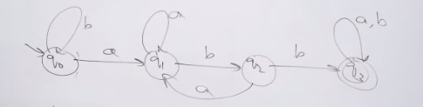
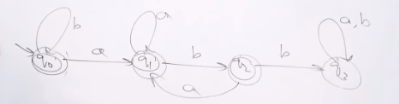
Problem-1
Design a DFA over an alphabet Σ = {a, b}, such that,
it accept any string ending with ‘abb’
it accept any string not ending with ‘abb’

Slide 28


Problem-2
Design a DFA over an alphabet Σ = {a, b}, such that,
it accept any string ending with ‘aba’
it accept any string not ending with ‘aba’

Slide 29
Problem-3
Determine RE for not accepting substring 01.
RE: 1*0*
Determine RE for accepting substring 00.
RE: (0+1)*00(0+1)*
Determine RE for not accepting substring 00.
RE: 0+1*+1*01*
Determine RE for not accepting substring 101.
RE: 0*(1*000*)1*0*

Slide 30
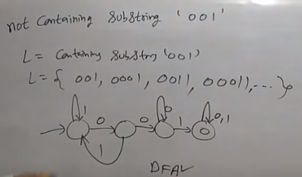
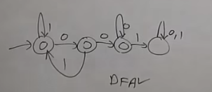
Problem-4
Design a DFA over an alphabet Σ = {0, 1}*, such that,
it accept any string ending with ‘001’
it accept any string not ending with ‘001’
RE = (1+01)* + (1+01)*0+(1+01)*000*
= (1+01)*[ε + 0 + 000*]
= (1+01)*[ε +0[ε + 00*]]
= (1+01)*[ε +00*] since ε + rr* = r*
= (1+01)*0*

Slide 31
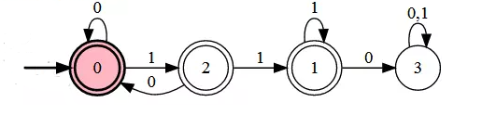
Problem-4
Determine RE for not accepting 110.
RE = (0+10)* + (0+10)*1+ (0+10)*11 + (0+10)*111*
= (0+10)* [ε + 1 + 11 + 111*]
= (1+01)*[ε +1 [ε + 1 + 11*]]
= (1+01)*[ε + 1[ε + 1 [ε + 11*]] ] since ε + rr* = r*
= (1+01)*[ε + 1[ε + 11*]]
= (1+01)*[ε + 11*]
= (1+01)*1*

Slide 32
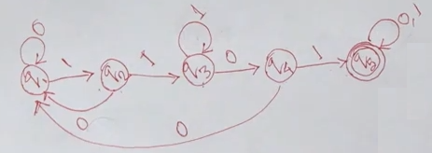
Problem-5
Determine RE for not accepting 1101.
RE = (0+10)* + (0+10)*1+ (0+10)*11 + (0+10)*111*0
= …

Slide 33
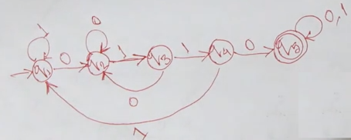
Problem-5
Determine RE for not accepting 0110
RE = …

Slide 34
4. Algebraic Laws for Regular Expressions
Commutative: E+F = F+E
Associative: (E+F)+G = E+(F+G)
  (EF)G = E(FG)
Distributive: E(F+G) = EF + EG
(F+G)E = FE+GE
Identity: E+ ε = ε + E = E
  ε E = E ε = E
Annihilator: ΦE = EΦ = Φ
Idempotent: E + E = E
EE = E

Slide 35
Algebraic Laws for Regular Expressions…
Involving Kleene closures:
  (E*)* = E*
  Φ* = ε
  ε* = ε
  E⁺ =EE*
  E? = ε +E
Exercise: Identify following REs are true or false?
  ((R*)*)* = R* ?
  (R+S)* = R* + S* ?
  (RS + R)* RS = (RR*S)* ?

Slide 36
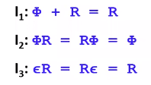
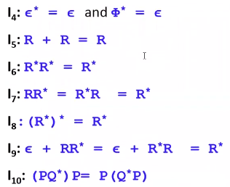
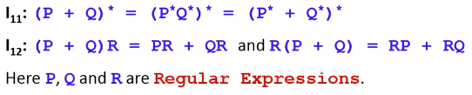
Identities or Algebraic laws of RE

Slide 37
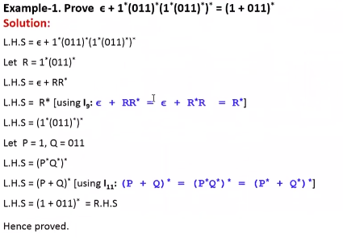
Identities or Algebraic laws of RE…

Slide 38
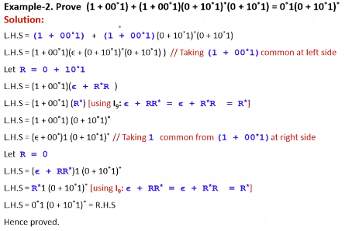
Identities or Algebraic laws of RE…

Slide 39
END OF
UNIT-1
PART-3

