Slide 1
III-B.E. V-SEMESTER
AUTOMATA, LANGUAGES AND COMPUTATION (ALC)
Presented By
Dr. D. BASWARAJ
Professor, CSE DEPT.
VCE, HYDERABAD

Slide 2
SYLLABUS
UNIT – I:
Automata: Introduction to Finite Automata, Central Concepts of Automata Theory.
Finite Automata: An Informal Picture of Finite Automata, Deterministic Finite Automata, Nondeterministic Finite Automata, An application, Finite Automata with Epsilon Transitions. Simulation of Finite Automata using JFLAP tool.
Regular Expressions and Languages: Regular Expressions, Finite Automata and Regular Expressions, Applications of Regular Expressions, Algebraic Laws for Regular Expressions
UNIT – II:
Properties of Regular Languages: Proving Languages not to be Regular, Closure properties of Regular Languages, Decision Properties of Regular Languages, Equivalence and Minimization of Automata.
Context Free Grammars and Languages: Context-Free Grammars, Parse Trees, Applications of CFG’s, Ambiguity in Grammars and Languages.

Slide 3
UNIT-II
PART-1: Properties of Regular Languages
  Proving Languages not to be Regular
  Closure properties of Regular Languages
  Decision Properties of Regular Languages
  Equivalence and Minimization of Automata
PART-2: Context Free Grammars and Languages
  Context-Free Grammars
  Parse Trees
  Applications of CFG’s
  Ambiguity in Grammars and Languages

Slide 4
Part-1: Properties of Regular Languages
  Introduction:
Pumping Lemma: Every regular language satisfies the pumping lemma. If somebody presents you with fake regular language, use the pumping lemma to show a contradiction.
Closure properties: Building automata from components through operations, e.g., given L and M we can build an automaton for LՈM.
Decision properties: Computational analysis of automata, e.g., are two automata equivalent.
Minimization Techniques: We can build economic, efficient and smaller machines.

Slide 5
1. Proving Languages not to be Regular
When language is regular?
If we can construct one of the following: DFA or NFA or ε -NFA or regular expression.
When language is not regular?
If we can show that no FA can be built for a language.
What if we cannot produce any FA?
A) Can it be language that is not regular?
B) Or is it that we tried wrong approaches?
How do we decisively prove that a language is not regular?

Slide 6
Proving Languages not to be Regular…
The Pumping Lemma (P/L) for Regular Languages:
The Pumping Lemma is a theorem, used to hold property of all regular languages. So, it cannot be used to prove a language is regular.
P/L is used to prove that a language is NOT regular.
If A is a regular language, then A has a pumping length ‘P’ such that any string ‘S’ where |S| ≤ P, may be divided in to three parts, S = x y z, such that the following conditions must be true:
  x y^{i} z ∈ A for every i ≥ 0
  |y| > 0
  |xy| ≤ P
Here, P is called the “Pumping Lemma Constant”
If the language does not satisfy all above three conditions simultaneously, then such language is called NOT regular.

Slide 7
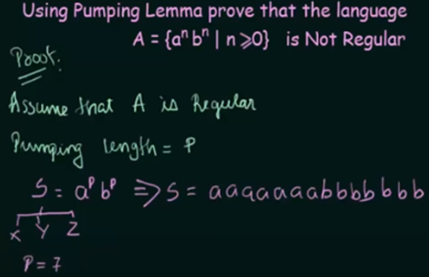
Proving Languages not to be Regular…
Example:

Slide 8
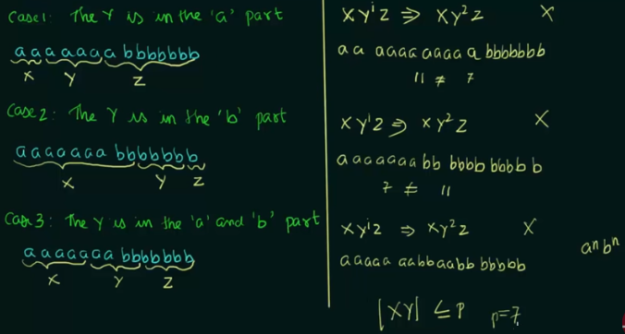
Proving Languages not to be Regular…
Example…

Slide 9
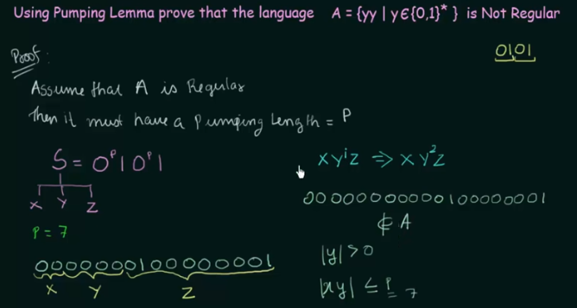
Proving Languages not to be Regular…
Example-2

Slide 10
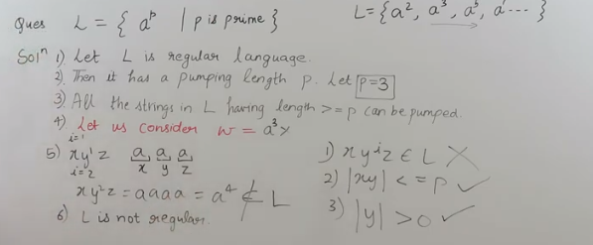
Proving Languages not to be Regular…
Example-3:

Slide 11
2. Closure properties of Regular Languages
A language class is a set of languages like
  regular languages, context-free language
  Context-sensitive language, recursively enumerable language
A Language class have two important kinds of properties:
  Closure properties
  Decision properties
Closure properties on regular languages are defined as certain operations on regular language which are guaranteed to produce regular language.
Closure refers to some operation on a language, resulting in a new language that is of same “type” as originally operated on i.e., regular.

Slide 12
Closure properties of Regular Languages…
Consider L and M are regular languages, regular languages are closed under following operations:
Kleen Closure: If R is a regular expression whose language is L, then, M.R* is a regular expression whose language is L*.
Positive closure: If R is a regular expression whose language is L, then, M.R⁺ is a regular expression whose language is L⁺.
Complement: The complement of a language L (with respect to an alphabet E such that E* contains L) is E*–L. Since E* is surely regular, the complement of a regular language is always regular.
Reverse Operator:
Given language L, L^{R} is the set of strings whose reversal is in L.
Example: L = {0, 01, 100}; L^{R} ={0, 10, 001}.
Proof: Let E be a regular expression for L. We show how to reverse E, to provide a regular expression E^{R} for L^{R}.

Slide 13
Closure properties of Regular Languages…
Union: Let L and M be the languages of regular expressions R and S, respectively. Then R+S is a regular expression whose language is (L U M).
Intersection: Let L and M be the languages of regular expressions R and S, respectively then it a regular expression whose language is (L Ո M).
proof: Let A and B be DFA’s whose languages are L and M, respectively. Construct C, the product automaton of A and B make the final states of C be the pairs consisting of final states of both A and B.
Set Difference operator: If L and M are regular languages, then so is L – M = strings in L but not M.
Proof: Let A & B are DFA’s with languages L & M, respectively. Construct C, the product automaton of A and B make the final states of C be the pairs, where A-state is final, but B-state is not.

Slide 14
Closure properties of Regular Languages…
Homomorphism:
A homomorphism on an alphabet is a function that gives a string for each symbol in that alphabet. Example: h(0) = ab; h(1) = ε. Extend to strings by h(a1…an) =h(a1)…h(an).
Example: h(01010) = ababab
If L is a regular language, and h is a homomorphism on its alphabet, then h(L)= {h(w) | w is in L} is also a regular language.
Proof: Let E be a regular expression for L. Apply h to each symbol in E. Language of resulting R, E is h(L).
Inverse Homomorphism : Let h be a homomorphism and L a language whose alphabet is the output language of h.
h⁻¹(L) = (w ∈ Σ : h(w) ∈ L, h : Σ → ∆ is a homomorphism}

Slide 15
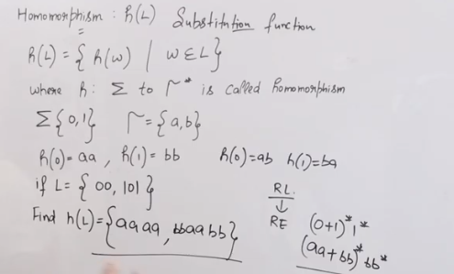
Closure properties of Regular Languages…
Homomorphism:

Slide 16
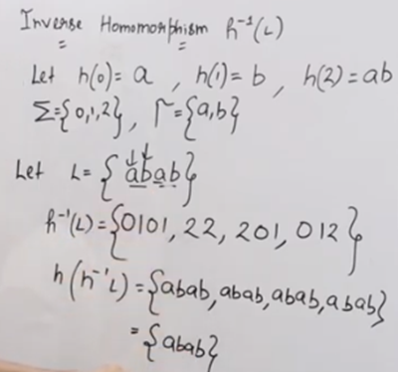
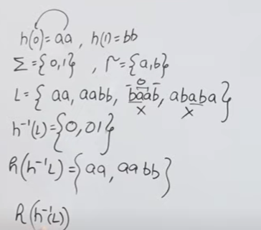
Closure properties of Regular Languages…
Inverse Homomorphism:

Slide 17
3. Decision properties of Regular Languages
A decision property for a class of languages is an algorithm that takes a formal description of a language for FA and tells whether some property holds or not.
Example: Is language L empty?
Why Decision Properties?
When we talked about protocols represented as FA’s, we noted that important properties of a good protocol were related to the language of the FA.
Example: “Does the protocol terminate?” = “Is the language finite?”
Example: “Can the protocol fail?” = “Is the language nonempty?”

Slide 18
Decision properties of Regular Languages…
Given regular languages, specified in any one of the four means (RE, DFA, NFA, ε-NFA), can we develop algorithms that answer the following questions:
  Is the language empty? emptiness problem
  Is the language finite? finiteness problem
  Is a given string in the language? membership problem
  Given 2 languages, are there strings that are in both? membership intersection problem
  Is the language being subset of another language? subset / containment problem
  Is the language being same as another regular language?-equivalence

Slide 19
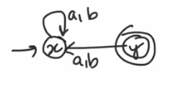
Decision properties of Regular Languages…
Emptiness problem: Test for emptiness
  Obtain the FA for the regular language
  L(M) will be empty if either
  • M has no accepting states
  • There is no path from the start state to any of the accepting states.
  – Can determine this by systematically mapping all paths from the start state?
  Algorithm:
  Eliminate inaccessible states (i.e., from initial state) in FA.
  In the remaining states, if there exist at least one final state, then the language is said to be non-empty.
  Otherwise, the language is empty.

Slide 20
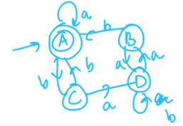
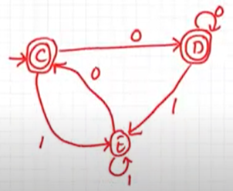

Decision properties of Regular Languages…
Finiteness problem: If the FA has n states, and the language contains any string of length >=n, then the language is infinite. Otherwise, the language is surely finite (string length <= n)
  Algorithm:
  Eliminate inaccessible states (i.e., from initial state) in FA.
  Eliminate states from which finite state not reachable.
  In the remaining FA, if there exist any loop or cycle, then FA accept infinite language otherwise it accepts finite language
  Examples:

Slide 21
Decision properties of Regular Languages…
Membership problem: If the input string is accepted by FA, then we say input string is the member of language. Otherwise, the input string is not the member of the language.
  Algorithm:
  Scan the input symbols of given string as per the transition function in FA one by one.
  If it reach the final state at the last symbol of input string, then we say it is member of language, otherwise, the input string is not the member of the language

Slide 22
Decision properties of Regular Languages…
  Example: 0 1 0 1 1
Next
symbol
0
0,1
1
1
A
B
C
Start
0
Current
state

Slide 23
Decision properties of Regular Languages…
Membership Intersection problem: Test for member in two FAs - intersection
Given two languages L1 and L2, is there a string x that is in both.
i.e., x ∈ (L1 ∩ L2)
We know how to build an FA for L1 ∩ L2 from the FAs that accept these languages.
Run x through this FA
If the FA accepts, x in both L1 and L2, otherwise, x not in L1 and L2

Slide 24
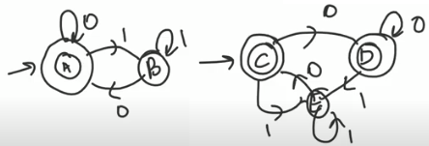
Decision properties of Regular Languages…
Equivalence problem: Test for equivalent - if two given FAs accepts same language, then we say both FAs are equivalent.
Comparison Table Algorithm:
  Group final and non-final states separately for both FA.
  Construct Transition Table (TT) from final and non-final state on input symbols.
  If TT contain group of final and non-final states only, then, we say both FAs are equivalent, otherwise, they are not equivalent.
  Example-1: TWO FAs Transition Table
  δ 0 1
  {A,C} {A,D} {B,E}
  {A,D} {A,D} {B,E}
  {B,E} {A,C} {B,E}

Slide 25
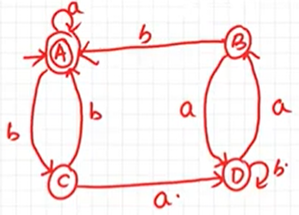
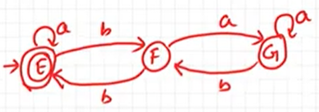
Decision properties of Regular Languages…
Example-2: Check following two DFSs are equivalent or not?
Subset / containment problem: Test for subset
Given 2 regular languages L1 and L2, is L1 ⊆ L2?
This is the same as asking: Is L1 – L2 = ∅ ?
We know how to build a FA for L1- L2 from the FAs that accept these languages.
Apply the empty test to the resultant FA .

Slide 26
4. State Equivalence and Minimization of Automata
State Equivalence: Two states in a finite automaton M are equivalent if and only if for every string x, if M is started in either state with x as input, it either accepts or rejects in both cases.
Minimization of Automata: Two Methods
  Myphill-Nerode Theorem or Table filling method
  Equivalence Theorem or Partition method
  Myphill-Nerode Theorem or Table filling method :
Step 1 − Draw a table for all pairs of states (Q_{i}, Q_{j}) not necessarily connected directly
Step 2 − Consider every state pair (Q_{i}, Q_{j}) in the DFA where Q_{i} ∈ F and Q_{j} ∉ F or vice versa and mark them. [Here F is the set of final states]
Step 3 − Repeat this step until we cannot mark anymore states − If there is an unmarked pair (Q_{i}, Q_{j}), mark it if the pair {δ (Q_{i}, A), δ (Q_{i}, A)} is marked for some input alphabet.
Step 4 − Combine all the unmarked pair (Q_{i}, Q_{j}) and make them a single state in the reduced DFA.

Slide 27
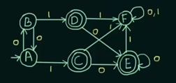
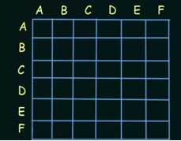
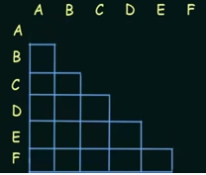
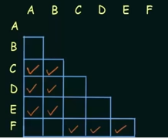
State Equivalence and Minimization of Automata…
Example: Minimize following DFA using Table filling method
Given DFA
Step-1 Step-2

Slide 28
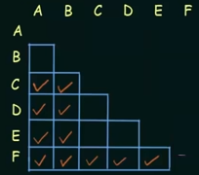

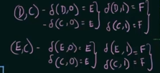


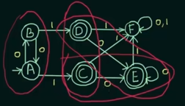
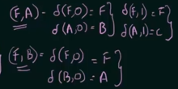
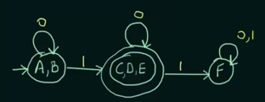
State Equivalence and Minimization of Automata…
Example… Step-3:
Step-4
Minimized
DFA

Slide 29
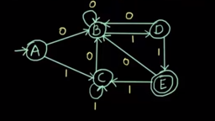
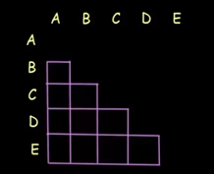
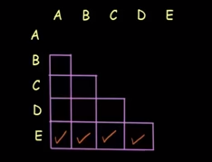
State Equivalence and Minimization of Automata…
Example-2: Minimize following DFA using Table filling method
Given DFA
Step-1 Step-2

Slide 30
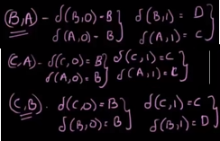
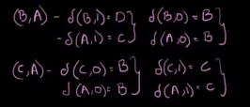
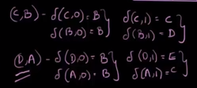

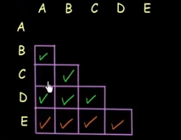
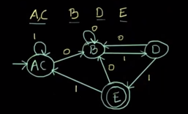


State Equivalence and Minimization of Automata…
Example-2… Step-3:
Minimized
DFA

Slide 31
State Equivalence and Minimization of Automata…
  Equivalence Theorem or Partition method :
  If X and Y are two states in a DFA, we can combine these two states into {X, Y} if they are not distinguishable.
  Two states are distinguishable, if there is at least one string S, such that one of δ (X, S) and δ (Y, S) is accepting and another is not accepting. Hence, a DFA is minimal if and only if all the states are distinguishable.
  Algorithm:
Step 1 − All the states Q are divided in two partitions − final states and non-final states and are denoted by P₀. All the states in a partition are 0th equivalent. Take a counter k and initialize it with 0.
Step 2 − Increment k by 1. For each partition in P_{k}, divide the states in P_{k} into two partitions if they are k-distinguishable. Two states within this partition X and Y are k-distinguishable if there is an input S such that δ(X, S) and δ(Y, S) are (k-1)-distinguishable.
Step 3 − If P_{k} ≠ P_{k-1}, repeat Step 2, otherwise go to Step 4.
Step 4 − Combine k^{th} equivalent sets and make them the new states of the reduced DFA.

Slide 32
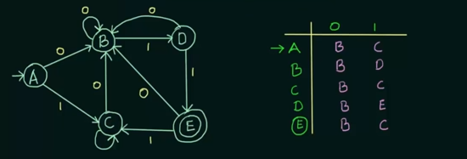
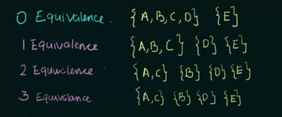
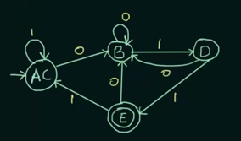
State Equivalence and Minimization of Automata…
  Example-1:

Slide 33
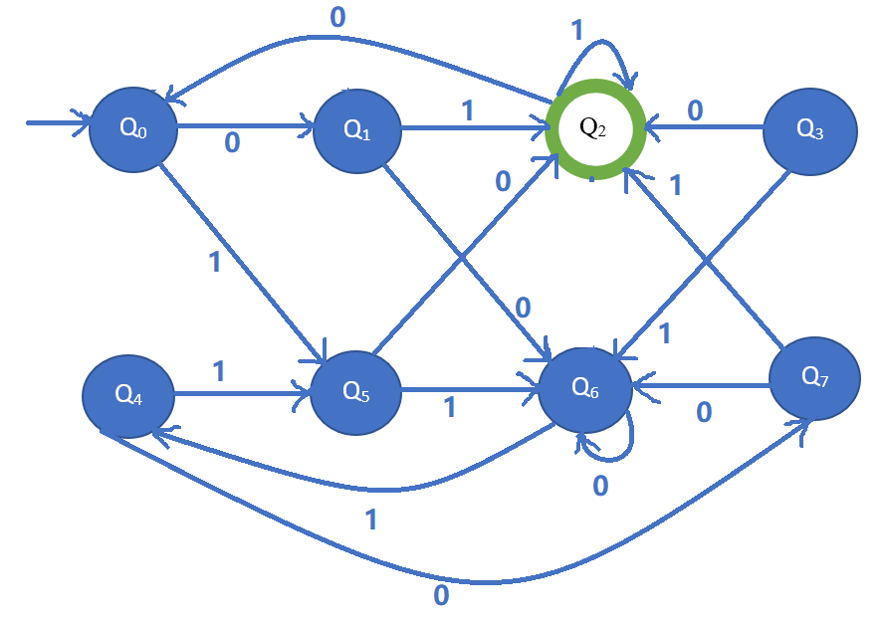
State Equivalence and Minimization of Automata…
  Example-2:
  Step-1: Try to delete all the states to which we cannot reach from initial state. In given DFA, all states are reachable from initial state.
  Step-2: Draw state transition table of DFA
  Step-3: Find out equivalent set of states
  Step-4: Draw minimized DFA

Slide 34
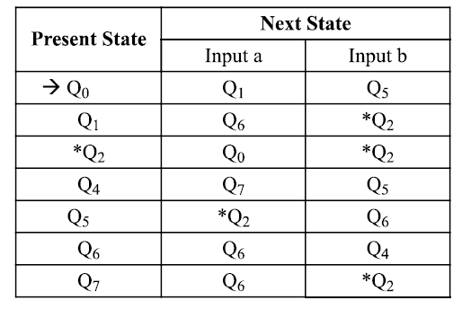
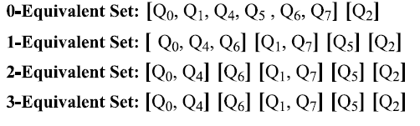
State Equivalence and Minimization of Automata…
  Step-2: Draw state transition table of DFA
  Step-3: Find out equivalent set of states

Slide 35
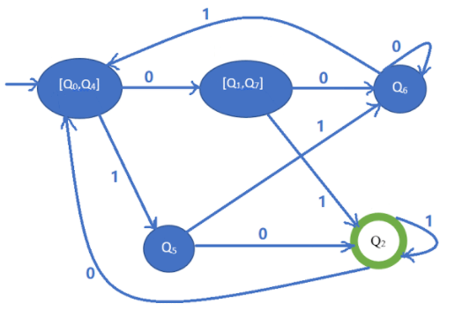
State Equivalence and Minimization of Automata…
  Step-4: Draw minimized DFA

Slide 36
END OF
UNIT-2
PART-1

