Slide 1
III-B.E. V-SEMESTER
AUTOMATA, LANGUAGES AND COMPUTATION (ALC)
Presented By
Dr. D. BASWARAJ
Professor, CSE DEPT.
VCE, HYDERABAD

Slide 2
SYLLABUS
UNIT – I:
Automata: Introduction to Finite Automata, Central Concepts of Automata Theory.
Finite Automata: An Informal Picture of Finite Automata, Deterministic Finite Automata, Nondeterministic Finite Automata, An application, Finite Automata with Epsilon Transitions. Simulation of Finite Automata using JFLAP tool.
Regular Expressions and Languages: Regular Expressions, Finite Automata and Regular Expressions, Applications of Regular Expressions, Algebraic Laws for Regular Expressions
UNIT – II:
Properties of Regular Languages: Proving Languages not to be Regular, Closure properties of Regular Languages, Decision Properties of Regular Languages, Equivalence and Minimization of Automata.
Context Free Grammars and Languages: Context-Free Grammars, Parse Trees, Applications of CFG’s, Ambiguity in Grammars and Languages.

Slide 3
UNIT-II
PART-1: Properties of Regular Languages
  Proving Languages not to be Regular
  Closure properties of Regular Languages
  Decision Properties of Regular Languages
  Equivalence and Minimization of Automata
PART-2: Context Free Grammars and Languages
  Context-Free Grammars
  Parse Trees
  Applications of CFG’s
  Ambiguity in Grammars and Languages

Slide 4
Part-2: Context Free Grammars and Languages
  Chomsky Hierarchy: According to Noam Chomsky Hierarchy, there are 4 types of grammars: Type0>Type1>Type 2>Type3. The following table shows how they differ from each other-
Grammar Type | Grammar Accepted | Language Accepted | Automaton
Type 0 | Unrestricted grammar | Recursively enumerable language | Turing Machine
Type 1 | Context-sensitive grammar | Context-sensitive language | Linear-bounded automaton
Type 2 | Context-free grammar | Context-free language | Pushdown automaton
Type 3 | Regular grammar | Regular language | Finite state automaton / Finite Automata

Slide 5
Context Free Grammars and Languages …
  Introduction:
Regular grammar (Type-3) generates regular language. They have a single non-terminal on the left-hand side and a right-hand side consisting of a single terminal or single terminal followed by a non-terminal.
The productions must be in the form:
      A → xB
      A → x
      A → Bx
where A, B ∈ Variable(V) and x ∈ T* i.e. string of terminals.
Types of regular grammar:
Left Linear grammar(LLG)
Right linear grammar(RLG)

Slide 6
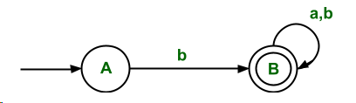
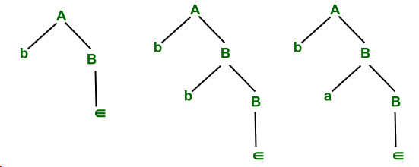
Context Free Grammars and Languages …
Example: FA for accepting strings that start with b.
The RLG corresponding to FA is
A → bB
B → ∈/aB/bB
The above grammar is RLG, which can be written directly through FA.

Slide 7
Context Free Grammars and Languages …
We have seen that many languages cannot be regular. Thus, we need to consider larger classes of languages. Such larger classes of languages are called Context Free Languages (CFL).
Context-Free Languages (CFL's) played a central role natural languages since the 1950's, and in compilers since the 1960's.
These languages have a natural, recursive notation, called context-free grammars (CFG). It is a formal grammar which is used to generate all possible patterns of strings in each formal language.
More recently, the CFG has been used to describe document formats via so called document-type definition (DTD), that is used in extensible markup language (XML) community for information exchange on the web.

Slide 8
1. Context-Free Grammars (CFG)
A CFG is a notation for describing languages. It is more powerful than finite automata or RE’s, but still cannot define all possible languages.
Useful for nested structures, e.g., parentheses in programming languages. Basic idea is to use “variables” to stand for sets of strings (i.e., languages). These variables are defined recursively, in terms of one another.
Recursive rules (“productions”) involve only concatenation. Alternative rules for a variable allow union.
Example: CFG for { 0^{n}1^{n} | n > 1}
Productions: S → 01
  S → 0S1
Basis: 01 is in the language.
Induction: if w is in the language, then so is 0w1.

Slide 9
Context-Free Grammars (CFG)…
Formal definition of CFG's.
A context-free grammar is a quadruple G = (V, T, P, S)
where, V is a finite set of variables.
T is a finite set of terminals.
P is a finite set of productions of the form:
A→α , where A is a variable and α ϵ (V Ս T)
S is a designated variable called the start symbol.
Example-1: Construct a CFG for the regular expression (0+1)*
Production rule (P): S → 0S | 1S
S → ε
The rules are in the combination of 0's and 1's with the start symbol. Since (0+1)* indicates {ε, 0, 1, 01, 10, 00, 11, ....}. In this set, ε is a string, so in the rule, we can set the rule S → ε.

Slide 10
Context-Free Grammars (CFG)…
Example-2: Construct a CFG for a language L = {w=w^{R} | where w € (a, b)*}.
The grammar could be S → aSa
S → bSb
S → ε | a | b
Example-3: Construct a CFG for a language L , which accept palindrome. G_{pal} = ({P}, {0,1}, A, P), where
A = { P → ε, P →0, P → 1, P → 0P0, P → 1P1}
Sometimes, we group production with the same head, e.g.
A = {P → ε | 0 | 1 | 0P0 | 1P1}
Example-4: Construct a CFG for the language L = a^{n}b^{2n} where n>=1.
The grammar could be S → aSbb | abb

Slide 11
Context-Free Grammars (CFG)…
Example-5:
Regular expressions over {0, 1} can be defined by the grammar
G_{regex} = ({E}, {0,1}, A, E)
where E = {E →0, E →1,E →E.E, E → E+E, E → E*E, E →(E)}
Example-6: Simple expressions in typical programming language (include + and * operator) L = ((a+b)(a+b+0+1))
The expression defined by CFG: G_{expr} = ({E,I}, T, P, E),
where,
T = {+,*,(,),a,b,0,1} and P is the following set of productions:
1. E → I 5. I →a 9. I →I0
2. E →E+E 6. I →b 10. I →I1
3. E → E*E 7. I →Ia
4. E → (E) 8. I →Ib

Slide 12
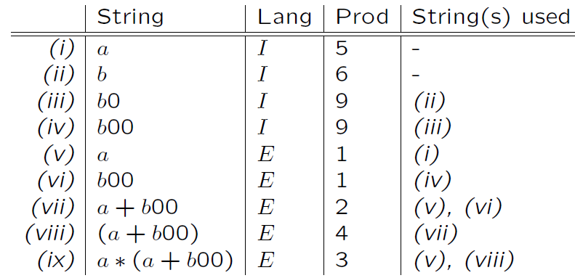
Context-Free Grammars (CFG)…
Derivations using grammars: We derive strings in the language of a CFG by starting with the start symbol, and repeatedly replacing some variable A by the right side of one of its productions.
Recursive inference, using productions from body to head
Derivations, using productions from head to body.
Example of recursive inference: for a*(a+b00) shown below:

Slide 13

Context-Free Grammars (CFG)…
Derivations:
Let G = (V, T, P, S) be a CFG, A ϵ V ,
(α, β) ⸦ (V U T)*, and A →γ ϵ P.
Then we write, αAβ αγβ
Or, if G is understood, αAβ ⟹ αγβ
And say that αAβ derives αγβ
Example: Derivation of a*(a+b00) from E in the grammar:
E ⟹ E * E ⟹ I * E ⟹ a * E ⟹ a * (E) ⟹
a *(E+E) ⟹ a * (I+E) ⟹ a * (a+E) ⟹ a*(a+I) ⟹
a * (a+I0) ⟹ a * (a+I00) ⟹ a * (a+b00)

Slide 14
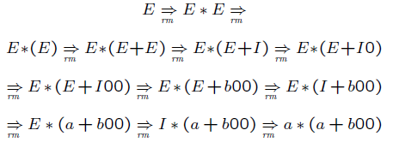
Context-Free Grammars (CFG)…
Leftmost and rightmost Derivations:
Leftmost derivation ⟹_{lm} : Always replace the leftmost variable by one of its rule-bodies. E.g., the derivation on the previous slide.
Rightmost derivation ⟹_{rm} : Always replace the rightmost variable by one of its rule-bodies.
Example of ⟹_{rm} : Rightmost derivation of a*(a+b00) from E in the grammar:

Slide 15
Context-Free Grammars (CFG)…
Sentential Forms : Let G=(V,T,P,S) be a CFG, and α ⸦ (V U T)*,
If S ⟹* α, then, we say that α is a sentential form.
If S ⟹_{lm} α, we say that is a left-sentential form, and
If S ⟹_{rm} α, we say that is a right-sentential form
Note: L(G) consists of those sentential forms that are in T*.
Example: Consider previous expr CFG, then E*(I +E) is a sentential form since
E ⟹E*E ⟹ E*(E) ⟹ ) E*(E+E) ⟹) E*(I+E)
This derivation is neither leftmost, nor right-most
Example: a*E is a left-sentential form, since
E ⟹_{lm} E*E ⟹_{lm} I*E ⟹_{lm} a*E
Example: E*(E+E) is a right-sentential form, since
E ⟹_{rm} E*E ⟹_{rm} E*(E) ⟹_{rm} E*(E +E)

Slide 16
Context-Free Grammars (CFG)…
Language of a Grammar:
A language that is defined by some CFG is called a context-free language (CFLs).
There are CFL’s that are not regular languages, such as the example just given. But not all languages are CFL’s.
If G is a CFG, then L(G), the language of G, is {w | S =>* w}.
Note: w must be a terminal string, S is the start symbol.
Example: G has productions S → ε and S -> 0S1.
L(G) = {0^{n}1^{n} | n > 0}.
Note: ε is a legitimate right side.

Slide 17
Context-Free Grammars (CFG)…
BNF Notations: Grammars for programming languages are often written in BNF (Backus-Naur Form).
Variables are words in <…>; Example: <statement>.
Terminals are often multi-character strings indicated by boldface or underline; Example: while or WHILE.
Symbol ::= is often used for →. Symbol | is used for “or.”
  A shorthand for a list of productions with the same left side.
Example: S → 0S1 | 01 is shorthand for S → 0S1 and S → 01.
Symbol … is used for “one or more.”
Example: <digit> ::= 0|1|2|3|4|5|6|7|8|9
<unsigned integer> ::= <digit>…
Translation: Replace α… with a new variable A and productions
A -> Aα | α.

Slide 18
Context-Free Grammars (CFG)…
BNF Notations…Example: Kleene Closure
Grammar for unsigned integers can be replaced by:
U -> UD | D
D -> 0|1|2|3|4|5|6|7|8|9
Optional Elements: Surround one or more symbols by […] to make them optional.
Example: <statement> ::= if <condition> then <statement> [; else <statement>]
Translation: replace [α] by a new variable A with productions
A -> α | ε.
Grammar for if-then-else can be replaced by:
S -> iCtSA
A -> ;eS | ε

Slide 19
Context-Free Grammars (CFG)…
BNF Notations…
Grouping: Use {…} to surround a sequence of symbols that need to be treated as a unit.
  Typically, they are followed by a … for “one or more.”
Example: <statement list> ::= <statement> [{;<statement>}…]
You may, if you wish, create a new variable A for {α}.
One production for A: A -> α. Use A in place of {α}.
Example: Consider Language L -> S [{;S}…]
Replace by L -> S [A…] A -> ;S →here A stands for {;S}.
Then by L -> SB B -> A…|ε A ->;S →here B stands for [A…] (zero or more A’s).
Finally by L -> SB B -> C | ε C -> AC | A A -> ;S
→here C stands for A… .

Slide 20
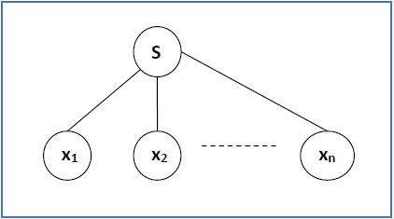
2. Parse Trees / Derivation Tree
A derivation tree or parse tree is an ordered rooted tree, that graphically represents the semantic information of a string derived from a CFG.
Representation Technique:
  Root vertex: Must be labeled by the start symbol.
  Vertex: Labeled by a non-terminal symbol.
  Leaves: Labeled by a terminal symbol or ε.
If S → x₁x₂ …… x_{n} is a production rule in a CFG, then the parse tree / derivation tree will be as follows:

Slide 21
Parse Trees..
Example: Parse Tree for S -> SS | (S) | ()
There are two different approaches to draw a derivation tree −
Top-down Approach −
  Starts with the starting symbol S
  Goes down to tree leaves using productions
Bottom-up Approach −
  Starts from tree leaves
  Proceeds upward to the root which is the starting symbol S
S
S
S
(
S
)
(
)
(
)

Slide 22
Parse Trees…
Derivation or yield of a Parse Tree:
The concatenation of the labels of the leaves in left-to-right order (That is, in the order of a preorder traversal) by ignoring Nulls is called the yield of the parse tree.
However, if all the leaves are Null, derivation is Null.
For example, the yield of given parse tree (below) is (( ))( )
S
S
S
(
S
)
(
)
(
)

Slide 23
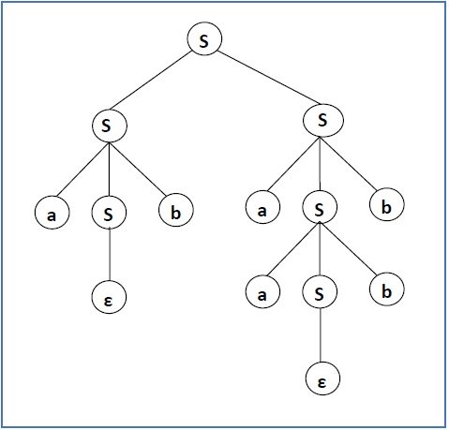
Parse Trees…
Example:
Let a CFG {N,T,P,S} be
N = {S}, T = {a, b}, Starting symbol = S,
P = S → SS | aSb | ε
One derivation from the above CFG is “abaabb”
S → SS → aSbS → abS → abaSb → abaaSbb → abaabb
The yield of parse tree is:
abaabb

Slide 24
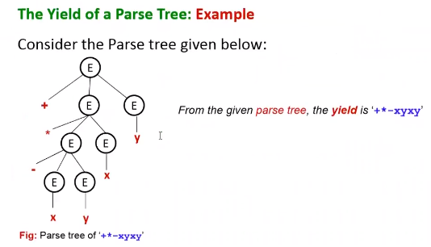
Parse Trees…

Slide 25
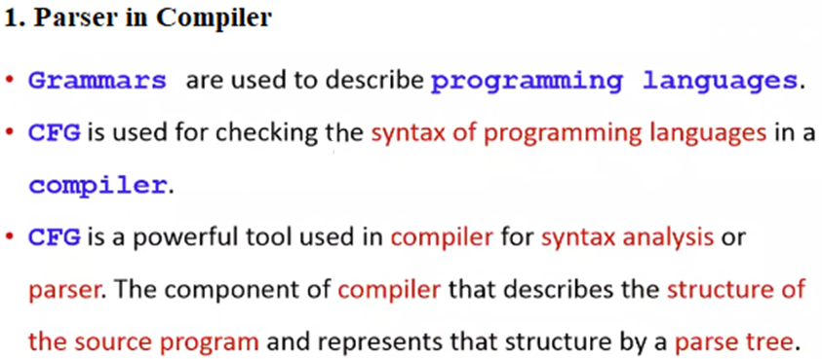
3. Applications of CFG’s

Slide 26
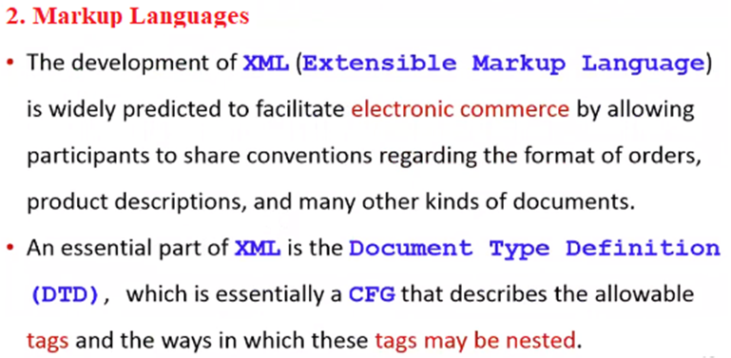
Applications of CFG’s…

Slide 27
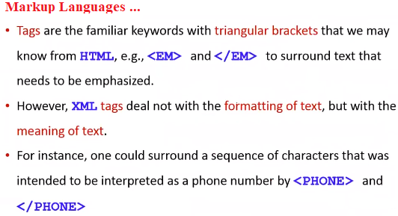
Applications of CFG’s…

Slide 28
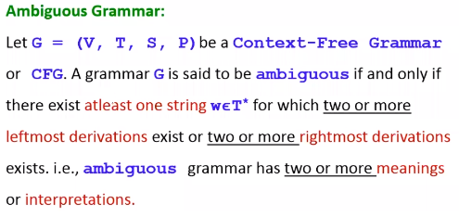
4. Ambiguity in Grammars and Languages

Slide 29
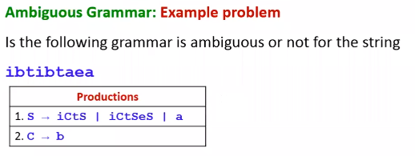
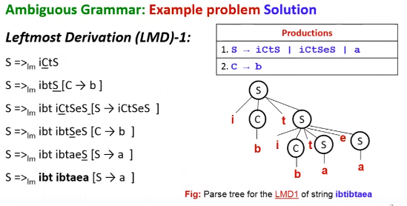
Ambiguity in Grammars and Languages…

Slide 30
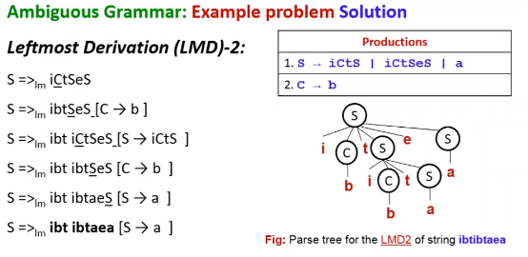
Ambiguity in Grammars and Languages…

Slide 31
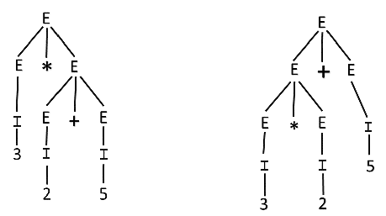
Ambiguity in Grammars and Languages…
Example-2: Let us consider a grammar G with the production rule
E → I | E + E | E * E | (E)
I → ε | 0 | 1 | 2 | ... | 9
For the string "3 * 2 + 5", the above grammar can generate two parse trees by leftmost derivation:

Slide 32
Ambiguity in Grammars and Languages…
Ambiguity in Context Free Languages (CFL):
A context free language is called ambiguous if there is no unambiguous grammar to define that language and it is also called inherently ambiguous Context Free Languages.
If a context free grammar G is ambiguous, language generated by grammar L(G) may or may not be ambiguous.
It is not always possible to convert ambiguous CFG to unambiguous CFG. Only some ambiguous CFG can be converted to unambiguous CFG.
There is no algorithm for resolving ambiguity (in the sense of automatically deriving an unambiguous grammar from a given grammar).
However, there are standard techniques for writing an unambiguous grammar that help in most cases.

Slide 33
END OF
UNIT-2
PART-2

