Slide 1
III-B.E. V-SEMESTER
AUTOMATA, LANGUAGES AND COMPUTATION (ALC)
Presented By
Dr. D. BASWARAJ
Professor, CSE DEPT.
VCE, HYDERABAD

Slide 2
SYLLABUS
UNIT – I:
Automata, Finite Automata, Regular Expressions and Languages
UNIT – II:
Properties of Regular Languages, Context Free Grammars and Languages
UNIT – III:
Pushdown Automata: Definition, Languages of a PDA, Equivalence of PDA’s and CFG’s, Deterministic Pushdown Automata. Simulation of Pushdown Automata using JFLAP tool.
Properties of Context Free Languages: Normal Forms for Context- Free Grammars, Pumping Lemma for CFL’s, Closure properties, Decision Properties of CFL’s.

Slide 3
UNIT-3
PART-1: Pushdown Automata (PDA)
  Definition of PDA
  Languages of a PDA
  Equivalence of PDA’s and CFG’s
  Deterministic Pushdown Automata
  Simulation of PDA using JFLAP tool
PART-2: Properties of Context Free Languages
  Normal Forms for Context- Free Grammars
  Pumping Lemma for CFL’s
  Closure properties
  Decision Properties of CFL’s

Slide 4
Part-1: Pushdown Automata (PDA)
  Introduction:
  Chomsky Hierarchy: According to Noam Chomosky Hierarchy, there are four types of grammars (Type0>Type1>Type2<Type3). The following table shows how they differ from each other:
Grammar Type | Grammar Accepted | Language Accepted | Automaton
Type 0 | Unrestricted grammar | Recursively enumerable language | Turing Machine
Type 1 | Context-sensitive grammar | Context-sensitive language | Linear-bounded automaton
Type 2 | Context-free grammar | Context-free language | Pushdown automaton
Type 3 | Regular grammar | Regular language | Finite state automaton / Finite Automata

Slide 5
1. PDA Definition
Introduction: PDA is type-2 acceptor.
PDA accepts context free language (CFL), which is described by context free grammar (CFG).
By default, PDA is Non-Deterministic PDA (or NDPDA or NPDA).
According to Chomskey hierarchy, the computation power of PDA is higher than Finite Automata (FA) and lower than Linear Bounded Automata (LBA) and Turing Machine (TM).
PDA has infinite auxiliary storage (memory) organized by using Stack (LIFO) storage.

Slide 6
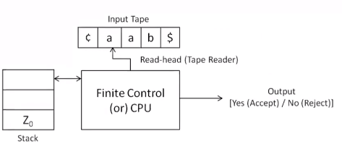
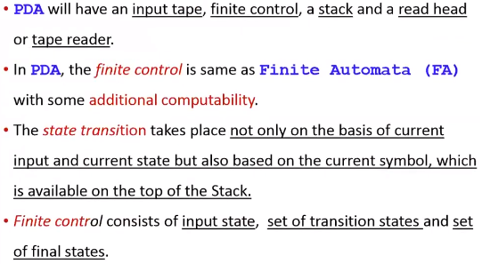
PDA Definition…
PDA Model:

Slide 7
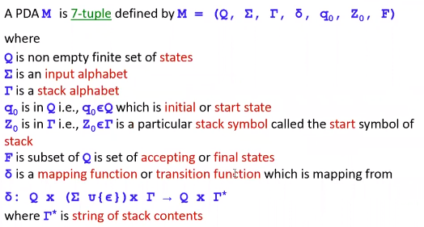
PDA Definition…
Formal definition of PDA:

Slide 8
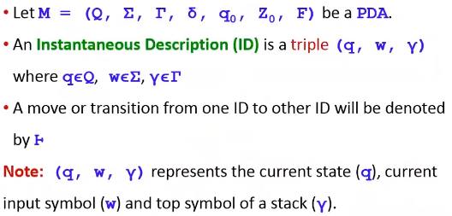
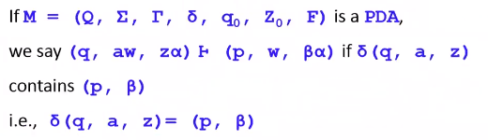
PDA Definition…
Instantaneous Description (ID) of PDA:

Slide 9
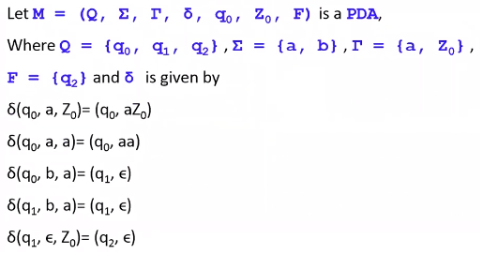
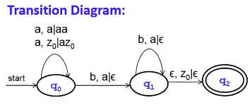
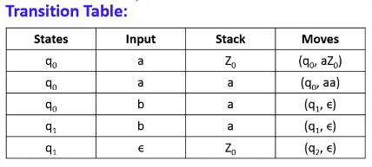
PDA Definition…
PDA Example:

Slide 10
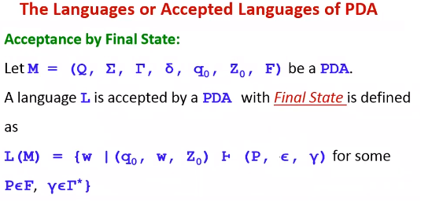
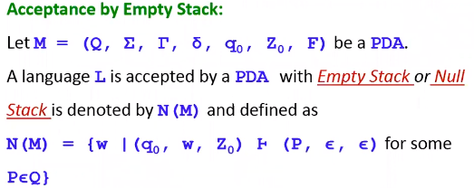
2. Languages of PDA
Introduction:

Slide 11
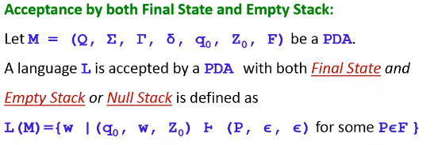
Languages of PDA…
Introduction:

Slide 12
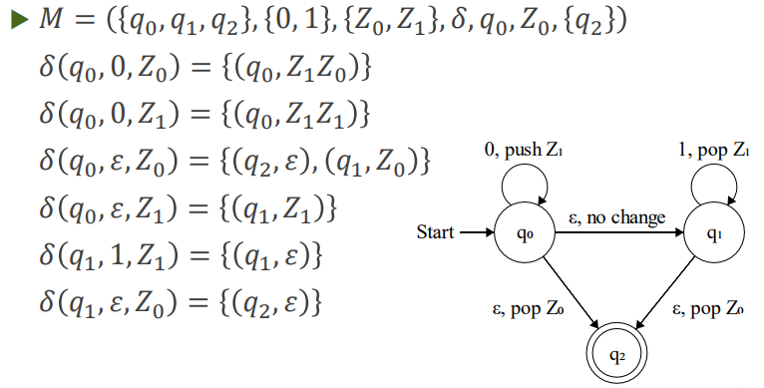
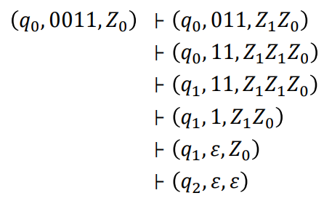
Languages of PDA…
Example-1: Check given PDA accept string 0011 or not.

Slide 13
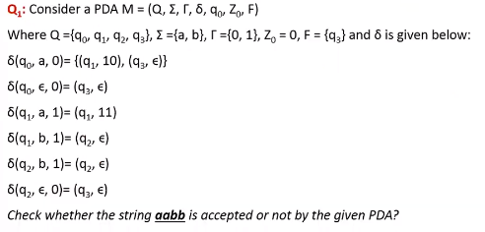
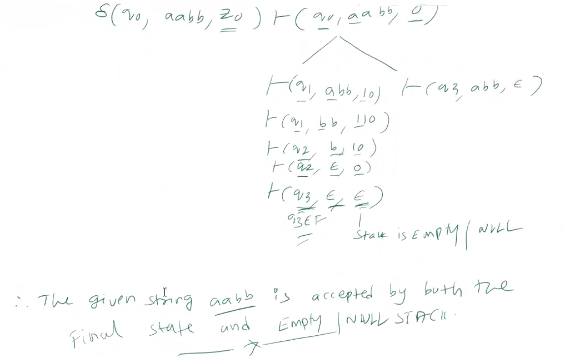
Languages of PDA…
Example-2:

Slide 14
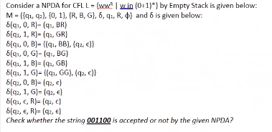
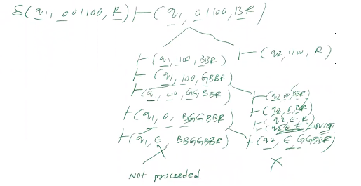
Languages of PDA…
Example-3:

Slide 15
Languages of PDA…
Problem-1:
Design a PDA (by default it is nondeterministic) for accepting the language L = {a^{n}b^{n} | n>=1}, by final state.
Solution:
Here, we need to maintain the order of a’s and b’s. That is, all the a’s are are coming first and then all the b’s are coming.
Thus, we need a stack along with the state diagram. The count of a’s and b’s is maintained by the stack. We will take 2 stack alphabets:
Г= { a, z }Where, Г = set of all the stack alphabet
z = stack start symbol
Thus every time ‘a’ comes before ‘b’. When ‘a’ comes then push it in stack. After that, when ‘b’ comes then pop one ‘a’ from the stack each time. So, at the end if the stack becomes empty then we can say that the string is accepted by the PDA.

Slide 16
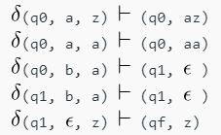
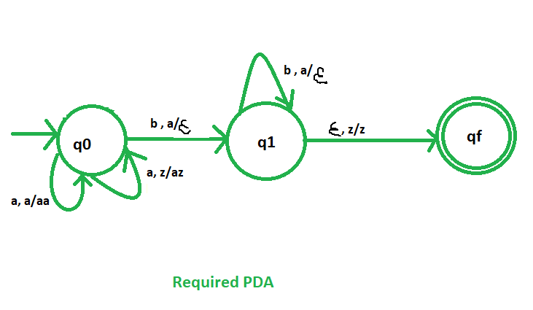
Languages of PDA…
Solution…
Stack transition functions –
Where, q0 = Initial state, qf = Final state, ε = indicates pop operation.
Transition diagram:

Slide 17
Languages of PDA…
Problem-2:
Design a PDA (by default it is non-deterministic) for accepting the language L = {a^{n}b^{n} | n>=1}, by empty stack.
Solution:
Everything same as solution by final state, except last transition.
The last transition function will be changed:
  δ (q1, ε, z) ├ δ (qf, ε)
  Where qf is not now final state, because of stack is empty.

Slide 18
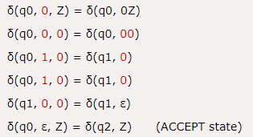
Languages of PDA…
Problem-3:
Design a PDA (by default it is non-deterministic) for accepting the language {0^{n}1^{m}0^{n} | m, n>=1}, by final state.
Solution: In this PDA, n number of 0's are followed by any number of 1's followed n number of 0's.
Hence the logic for design of such PDA will be as follows:
Push all 0's onto the stack on encountering first 0's. Then if we read 1, just do nothing. Then read 0, and on each read of 0, pop one 0 from the stack.

Slide 19
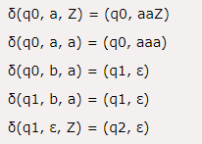
Languages of PDA…
Problem-4:
Design a PDA (by default it is nondeterministic) for accepting the language {a^{n}b^{2n} | n>=1}, by final state.
Solution: In this language, n number of a's should be followed by 2n number of b's. Hence, we will apply a very simple logic, and that is if we read single 'a', we will push two a's onto the stack.
As soon as we read 'b' then for every single 'b' only one 'a' should get popped from the stack.

Slide 20
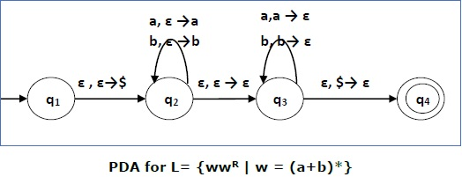
Languages of PDA…
Problem-5:
Construct a PDA that accepts L = { ww^{R} | w = (a+b)* }.
Solution: Initially we put a special symbol ‘$’ into the empty stack. At state q₂, the w is being read. In state q₃, each 0 or 1 is popped when it matches the input. If any other input is given, the PDA will go to a dead state. When we reach that special symbol ‘$’, we go to the accepting state q₄.

Slide 21
Languages of PDA…
Problem-6:
Construct a PDA for L = {0^{n}1^{m} | n >= 1, m >= 1, m > n+2}
Solution:
Approach used in this PDA – First 0’s are pushed into stack.When 0’s are finished, two 1’s are ignored. Thereafter for every 1 as input a 0 is popped out of stack. When stack is empty and still some 1’s are left then all of them are ignored.
Step-1: On receiving 0 push it onto stack. On receiving 1, ignore it and goto next state
Step-2: On receiving 1, ignore it and go to next state
Step-3: On receiving 1, pop a 0 from top of stack and go to next state
Step-4: On receiving 1, pop a 0 from top of stack. If stack is empty, on receiving 1 ignore it and go to next state
Step-5: On receiving 1 ignore it. If input is finished, then go to last state.

Slide 22
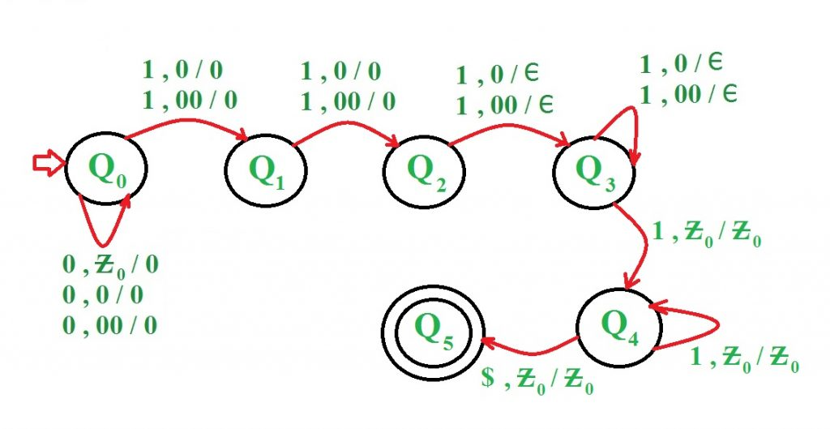
Languages of PDA…
Problem-6…
Examples:
Input : 0 0 0 1 1 1 1 1 1, Result : ACCEPTED
Input : 0 0 0 0 1 1 1 1, Result : NOT ACCEPTED

Slide 23
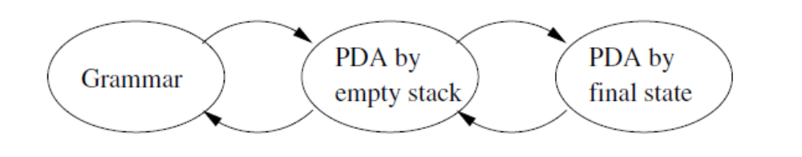
3. Equivalence of PDA’s and CFG’s
Motivation:
The goal is to prove that the following three classes of the languages are all the same class.
  1. The context-free languages (The language defined by CFG’s).
  2. The languages that are accepted by empty stack by some PDA.
  3. The languages that are accepted by final state by some PDA.
We have already shown that (2) and (3) are the same. Now, we prove that (1) and (2) are same.
Figure: Organization of constructions showing equivalence of three ways of defining the CFL’s

Slide 24
Equivalence of PDA’s and CFG’s…
Introduction:
CFG and PDA are equivalent in power: a CFG generates a context-free language, and a PDA recognizes a context-free language.
We show here how to convert a CFG into a PDA that recognizes the language specified by the CFG and vice versa.
Application: this equivalence allows a CFG to be used to specify a programming language and the equivalent PDA to be used to implement its compiler.
A language is context-free iff some pushdown automaton recognizes it.
Note: This means that:
1. if a language is context-free then there is a PDA that recognizes it 2. if a language is recognized by a PDA, then there is a CFG that generates CFL.

Slide 25
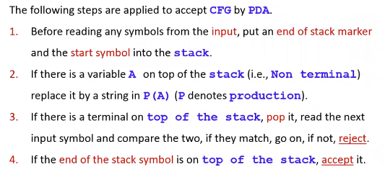
Equivalence of PDA’s and CFG’s…
Equivalence of PDAs and CFLs:

Slide 26
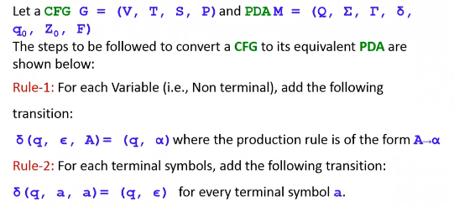
Equivalence of PDA’s and CFG’s…
Context Free Grammar (CFG) to PDA:

Slide 27
Equivalence of PDA’s and CFG’s…
Example-1: CFG to PDA
Construct PDA for the given CFG, S → 0BB, B → 0S | 1S | 0
Test whether 010⁴ is accepted or not.
Solution:
Given CFG = (V,T,S,P), where V = {S,B}, T={0,1}, S → start symbol
Step-1: Apply Rule-1 for each variable in CFG i.e. {S,B} to get δ.
For production S → 0BB, δ (q, ε, S) = (q, 0BB)
For production B → 0S | 1S | 0, δ (q, ε, B) = (q, 1S) | (q, 0S) | (q, 0)
Step-1: Apply Rule-2 for each terminal in CFG i.e. {0,1} to get δ.
For terminal ‘0’, δ (q, 0, 0) = (q, ε)
For terminal ‘1’, δ (q, 1, 1) = (q, ε)

Slide 28
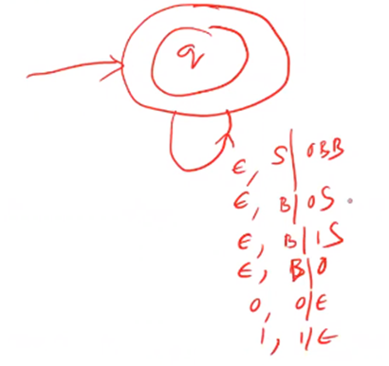
Equivalence of PDA’s and CFG’s…
Solution…
The final PDA M = (Q, Σ, Г, δ, q0, Z0, F),
where Q = {q}, Г = {S,B, 0, 1}, Σ ={0,1}, Z0 = S, q0 = q, F={q}
and δ is defined as:
1. δ (q, ε, S) = (q, 0BB)
2. δ (q, ε, B) = {(q, 1S) | (q, 0S) | (q, 0)}
3. δ (q, 0, 0) = (q, ε)
4. δ (q, 1, 1) = (q, ε)
Transition diagram:

Slide 29
Equivalence of PDA’s and CFG’s…
Solution…To accept the string 010⁴ = 010000
δ (q, 010000, Z0) ├ (q, 010000, S)
├ (q, 010000, 0BB) // S → 0BB
├ (q, 10000, BB) // δ (q, 0, 0) = (q, ε)
├ (q, 10000, 1SB) // B → 1S
├ (q, 0000, SB) // δ (q, 1, 1) = (q, ε)
├ (q, 0000, 0BBB) // S → 0BB
├ (q, 000, BBB) // δ (q, 0, 0) = (q, ε)
├ (q, 000, 0BB) // B → 0
├ (q, 00, BB) // δ (q, 0, 0) = (q, ε)
├ (q, 00, 0B) // B → 0
├ (q, 0, B) // δ (q, 0, 0) = (q, ε)
├ (q, 0, 0) // B → 0
├ (q, ε, S) // δ (q, 0, 0) = (q, ε)
Sine q is final state. Hence the given string is accepted by PDA with final state.

Slide 30
Equivalence of PDA’s and CFG’s…
Example-2: CFG to PDA
Construct PDA for the given CFG, S → AA | a, A → SA | b
Test whether “abbabb” is accepted or not by empty stack.
Solution:
Given CFG = (V,T,S,P), where V = {S,A}, T={a,b}, S → start symbol
Step-1: Apply Rule-1 for each variable in CFG i.e. {S,A} to get δ.
For production S → AA | a, δ (q, ε, S) = (q, AA) | (q, a)
For production A → SA | b , δ (q, ε, A) = (q, SA) | (q, b)
Step-1: Apply Rule-2 for each terminal in CFG i.e. {a,b} to get δ.
For terminal ‘a’, δ (q, a, a) = (q, ε)
For terminal ‘b’, δ (q, b, b) = (q, ε)

Slide 31
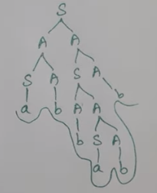
Equivalence of PDA’s and CFG’s…
Solution…
The final PDA M = (Q, Σ, Г, δ, q0, Z0, F),
where Q = {q}, Г = {S,A, a, b}, Σ ={a,b}, Z0 = S, q0 = q, F={q}
and δ is defined as:
1. δ (q, ε, S) = {(q, AA) | (q, a)}
2. δ (q, ε, A) = {(q, SA) | (q, b)}
3. δ (q, a, a) = (q, ε)
4. δ (q, b, b) = (q, ε)
Derivation of string abbabb by CFG is:

Slide 32
Equivalence of PDA’s and CFG’s…
Solution…To accept the string “abbabb” is:
δ (q, abbabb, Z0) ├ (q, abbabb, S)
├ (q, abbabb, AA) // S->AA
├ (q, abbabb, SAA) // A->SA
├ (q, abbabb, aAA) // S->0
├ (q, bbabb, AA) // δ (q, a, a) = (q, ε)
├ (q, bbabb, bA) // A->b
├ (q, babb, A) // δ (q, b, b) = (q, ε)
├ (q, babb, SA) // A->SA
├ (q, babb, AAA) // S->AA
├ (q, babb, bAA) // A->b
├ (q, abb, AA) // δ (q, b, b) = (q, ε)
├ (q, abb, SAA) // A->SA
├ (q, abb, aAA) // S->a
├ (q, bb, AA) // δ (q, a, a) = (q, ε)
├ (q, bb, bA) // A->b
├ (q, b, A) // δ (q, b, b) = (q, ε)
├ (q, b, b) // A->b
├ (q, ε, ε) // δ (q, b, b) = (q, ε)

Slide 33
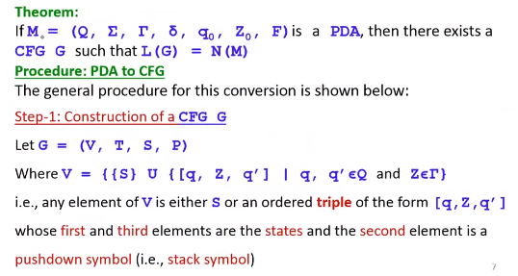
Equivalence of PDA’s and CFG’s…
PDA to CFG:

Slide 34
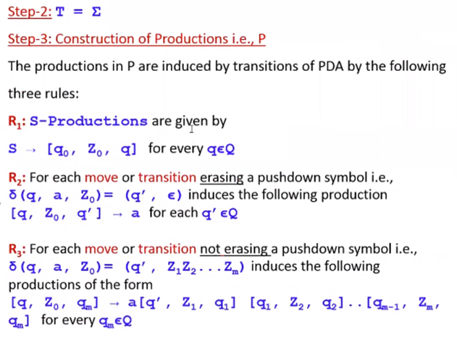
Equivalence of PDA’s and CFG’s…
PDA to CFG…

Slide 35
Equivalence of PDA’s and CFG’s…
Example-1: PDA to CFG
Generate a CFG for a given PDA M is defined as
M =({q0, q1}, {0,1}, {x,z0}, δ, q0, Z0, q1} where δ is given below:
1. δ (q0, 1, Z0) = (q0,xZ0)
2. δ (q0, 1, x) = (q0,xx)
3. δ (q0, 0, x) = (q0,x)
4. δ (q0, ε, x) = (q1, ε)
5. δ (q1, ε, x) = (q1, ε)
6. δ (q1, 0, x) = (q1,xx)
7. δ (q1, 0, Z0) = (q1, ε)
Solution: Apply Rule-1:
S → [q0, Z0, q0] / [q0, Z0, q1] => A | B

Slide 36
Equivalence of PDA’s and CFG’s…
Example-1: PDA to CFG…
For given transition-1, δ (q0, 1, Z0) = (q0,xZ0), Apply Rule-3
[q0, Z0, q0] → 1 [q0, x, q0] [q0, Z0, q0]
[q0, Z0, q0] → 1 [q0, x, q1] [q1, Z0, q0]
[q0, Z0, q1] → 1 [q0, x, q0] [q0, Z0, q1]
[q0, Z0, q1] → 1 [q0, x, q1] [q1, Z0, q1]
For given transition-2, δ (q0, 1, x) = (q0,xx), Apply Rule-3
[q0, x, q0] → 1 [q0, x, q0] [q0, x, q0]
[q0, x, q0] → 1 [q0, x, q1] [q1, x, q0]
[q0, x, q1] → 1 [q0, x, q0] [q0, x, q1]
[q0, x, q1] → 1 [q0, x, q1] [q1, x, q1]

Slide 37
Equivalence of PDA’s and CFG’s…
Example-1: PDA to CFG…
For given transition-3, δ (q0, 0, x) = (q0,x), Apply Rule-3
[q0, x, q0] → 0 [q0, x, q0]
[q0, x, q1] → 0 [q0, x, q1]
For given transition-4, δ (q0, ε, x) = (q1, ε), Apply Rule-2
[q0, x, q1] → ε
For given transition-5, δ (q1, ε, x) = (q1, ε), Apply Rule-2
[q1, x, q1] → ε
For given transition-6, δ (q1, 0, x) = (q1,xx), Apply Rule-2
[q1, x, q0] → 0 [q1, x, q0] [q0, x, q0]
[q1, x, q0] → 0 [q1, x, q1] [q1, x, q0]
[q1, x, q1] → 0 [q1, x, q0] [q0, x, q1]
[q1, x, q1] → 0 [q1, x, q1] [q1, x, q1]

Slide 38
Equivalence of PDA’s and CFG’s…
Example-1: PDA to CFG…
For given transition-7, δ (q1, 0, Z0) = (q1, ε), Apply Rule-2
[q1, Z0, q1] → 0
Hence, there are 19 (1+4+4+2+1+1+4+1) productions are generated from given PDA.
It is also possible to reduce the set of productions, by applying theorem for eliminating duplicate productions and useless productions.

Slide 39
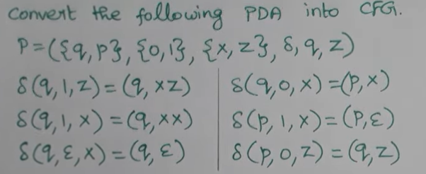
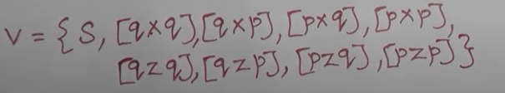
Equivalence of PDA’s and CFG’s…
Example-2: PDA to CFG

Slide 40
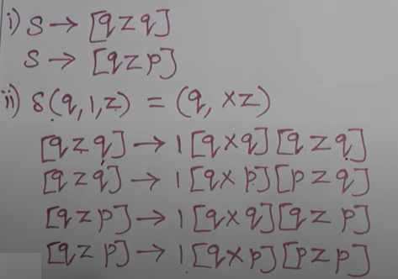
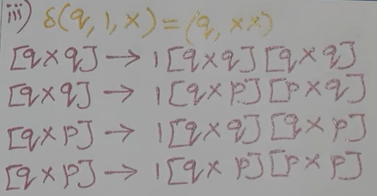
Equivalence of PDA’s and CFG’s…
Example-2: PDA to CFG…

Slide 41
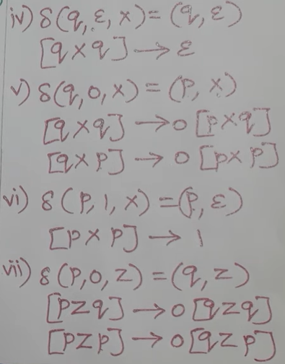
Equivalence of PDA’s and CFG’s…
Example-2: PDA to CFG…

Slide 42
4. Deterministic Pushdown Automata (DPDA)
In automata theory, a DPDA or DPA is a variation of the pushdown automaton. The class of deterministic pushdown automata accepts the deterministic context-free languages, a proper subset of CFLs.
A DPDA has at most one legal transition for the same combination of input symbol, state, and top stack symbol. This is where it differs from the nondeterministic pushdown automaton (NPDA).
M is deterministic if it satisfies both the following conditions:
For any q ∈ Q, a ∈ Σ U {ε}, x ∈ Г, the δ (q, a, x) has at most one element.
For any q ∈ Q, x ∈ Г, if δ (q, ε, x) ≠ 0, then, δ (q, a, x) = 0 for every a ∈ Σ .
The usual acceptance criterion is final state, and it is this acceptance criterion which is used to define the deterministic context-free languages.

Slide 43
DPDA…
DPDA | NPDA
It is less powerful than NPDA | It is more powerful than DPDA
It is possible to convert every DPDA to a corresponding NPDA | It is not possible to convert every NPDA to a corresponding DPDA
The language accepted by DPDA is called DCFL(Deterministic Context-free Language) which is a subset of NCFL(Non-deterministic Context-free Language) accepted by NPDA | The language accepted by NPDA is called NCFL(Non-deterministic Context-free Language).
For every input with the current state, there is only one move. δ: Q*∑*Γ→Q*Γ | For every input with the current state, We can have multiple moves. δ: Q*{∑∪∈}*Γ→2^{Q}*Γ*

Slide 44
DPDA…
Example-1: Is the PDA corresponding to the language L = {anbn | n>=1} by the finite state is deterministic ?
Solution: The shown transitions defined for this machine are shown below:
δ(q0, a, Z0) =δ(q0, aZ0)
δ(q0, a, a) =δ(q0, aa)
δ(q0, b, a) =δ(q1, ∈)
δ(q1, b, a) =δ(q1, ∈)
δ(q1, ∈, Z0) =δ(qf, ∈)
The PDA should satisfy the two conditions as per definition.

Slide 45
DPDA…
δ(q0, a, Z0) has only one element. In this case, for each q∈Q, a∈∑ , and Z∈Γ, there exists only one definition, so the first condition is satisfied.
To satisfy the second condition consider the transition. δ(q1,∈ , Z0) = (qf,∈,). Since the transition is defined, the transition δ(q, a, Z0) where a∈∑ should not be defined which is true.
since both conditions. are satisfied, then the given PDA is deterministic.

Slide 46
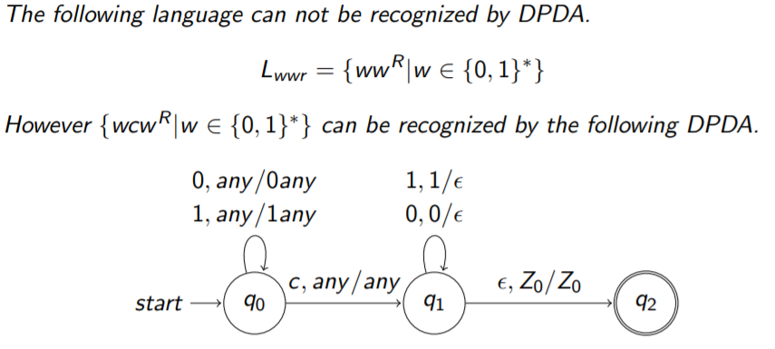
DPDA…
Example: 2

Slide 47
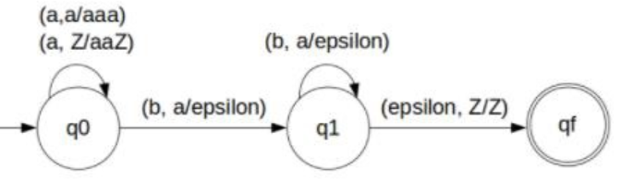
DPDA…
Example-3: Construct PDA for L = {a^{n}b^{2n} | n >= 1}
Solution:
So, the strings which are generated by the given language are as follows −
L={abb, aabbbb, aaabbbbbb,….}
Here a’s are followed by double the b’s. Whenever ‘a’ comes, push ‘a’ two times in the stack and if ‘a’ comes again then do the same.
When ‘b’ comes then pop one ‘a’ from the stack each time

Slide 48
END OF
UNIT-3
PART-1

