Slide 1
III-B.E. V-SEMESTER
AUTOMATA, LANGUAGES AND COMPUTATION (ALC)
Presented By
Dr. D. BASWARAJ
Professor, CSE DEPT.
VCE, HYDERABAD

Slide 2
SYLLABUS
UNIT – I:
Automata, Finite Automata
Regular Expressions and Languages
UNIT – II:
Properties of Regular Languages
Context Free Grammars and Languages
UNIT – III:
Pushdown Automata: Definition, Languages of a PDA, Equivalence of PDA’s and CFG’s, Deterministic Pushdown Automata. Simulation of Pushdown Automata using JFLAP tool.
Properties of Context Free Languages: Normal Forms for Context- Free Grammars, Pumping Lemma for CFL’s, Closure properties, Decision Properties of CFL’s.

Slide 3
UNIT-3
PART-1: Pushdown Automata (PDA)
  Definition
  Languages of a PDA
  Equivalence of PDA’s and CFG’s
  Deterministic Pushdown Automata
  Simulation of Pushdown Automata using JFLAP tool
PART-2: Properties of Context Free Languages
  Normal Forms for Context- Free Grammars
  Pumping Lemma for CFL’s
  Closure properties
  Decision Properties of CFL’s

Slide 4
1. Normal Forms for Context- Free Grammars
In linguistics and computer science, a context-free grammar (CFG) is a formal grammar in which every production rule is of the form
V → w where V is a “non-terminal symbol”, and w is a “string” consisting of terminals and/or non-terminals.
The term "context-free" expresses the fact that the non-terminal V can always be replaced by w, regardless of the context in which it occurs.
A formal language is context-free if there is a CFG that generates it.
CFGs are powerful enough to describe the syntax of most programming languages.
Not all formal languages are context-free. Just as any formal grammar, a CFG G can be defined as a 4-tuple:
G = (V,T,P,S) where V-Set of variables, T-Set of Terminals,
P – Set of Productions, S-Start Variable

Slide 5
Normal Forms for CFG…
A language L is said to be a Context-Free-Language (CFL) if its grammar is Context-Free. Usually, CFL is of the form L=L(G).
In CFG, there are two Normal forms:
  Chomsky Normal Form (CNF)
  Greibach Normal Form (GNF)
To convert CFG into any form, the CFG does not contain-
  Variable not deriving terminal string
  Useless productions which useless symbols
  Null productions like A → ε
  Unit productions like A → B
The process of eliminating all the above (a, b, c, d) is called simplification / minimization / normalization of CFG.

Slide 6
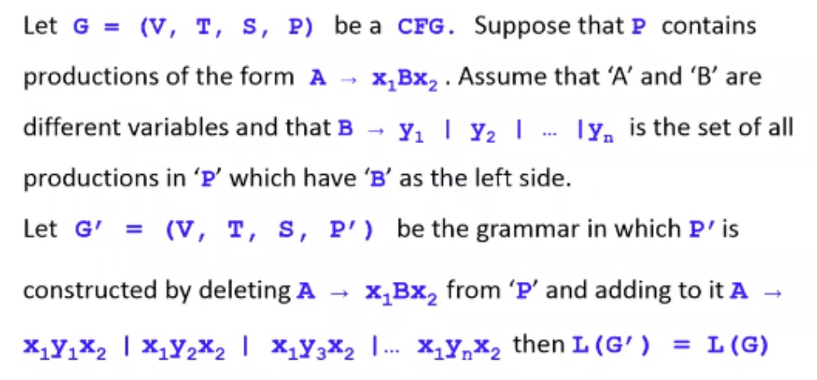
Normal Forms for CFG…
a. A Useful Substitution Rule:

Slide 7
Normal Forms for CFG…
b. Eliminating useless symbols:
A symbol X is useful for Grammar G = {V, T, P, S}, if there is some derivation of the form S →* a X b →* w , where w ∈ T* and X ∈ V or X ∈ T.
The sentential form of a X b might be the first or last derivation. If X is not useful, then X is useless.
Characteristics of useful symbols (for instance X):
  X is generating if X →* w for some terminal string w. Every terminal is generating since w can be that terminal itself, which is derived by 0 steps.
  X is reachable if there is a derivation
  S →* a X b for some a and b.
A symbol which is useful is surely to be both generating and reachable.

Slide 8
Normal Forms for CFG…
Eliminating useless symbols…
Eliminating the symbols which are not generating first followed by eliminating the symbols which are not reachable from the remaining grammar, this will generate a grammar consisting of only useful symbols.
Example: If we have the following grammar
S → AB | a
A → b
Notice that a and b generate themselves “terminals”, S generates a, and A generates b. B is not generating.
After eliminating B: S → a, A → b
Notice that only S and a are reachable after eliminating B. A is not reachable; so, it should be eliminated.
The result : S → a

Slide 9
Normal Forms for CFG…
c. Eliminating ε-productions:
The strategy is to have the following:
if L is CFG, then L – {ε} is also CFG
This is done through discovering the nullable variables. A variable for instance A, is nullable if: A →* ε .
Whenever A appears in a production body, A might or might not derive ε.
Basis: If A → ε is a production of G, then A is nullable
Induction: If there is a production
B → C1 C2 … Ck such that each C is a variable, and each C is nullable, then B is nullable.
If a grammar G₁ is constructed by the elimination of ε-productions “ using the previous method ” of grammar G, then
      L(G₁) = L(G) - {ε}

Slide 10
Normal Forms for CFG…
d. Eliminating Unit Productions:
Any production of the form A → B , where A and B are variables, is called a unit production.
These production introduce extra steps in the derivations that obviously are not needed in there.
Basis: (A, A) is a unit pair of any variable A, if
A →* A by 0 steps.
Induction: Let’s (A, B) be a unit pair, and let B → C is a production, where A, B, and C are variables, then we can conclude that (A, C) is also a unit pair.

Slide 11
CFG to CNF Conversion
CFG to CNF Algorithm:
Step 1. Eliminate start symbol from RHS.
If start symbol S is at the RHS of any production in the grammar, create a new production as:
S0 → S, where S0 is the new start symbol.
Step 2. If CFG contains null / unit / useless productions, eliminate them.
Step 3. Eliminate terminals from RHS, if they exist with other terminals or non-terminals. e.g., production rule X → xY can be decomposed as: X → ZY; Z → x
Step 4. Eliminate RHS with more than two non-terminals.
e.g., production rule X → XYZ can be decomposed as:
X → PZ ; P → XY

Slide 12
CFG to CNF Conversion…
Example-1: Convert given CFG G to CNF?
  S → ASB
  A → aAS|a|ε
  B → SbS|A|bb.
Step 1. As start symbol S appears on the RHS, we will create a new production rule S0 → S. Therefore, the grammar will become:
  S0 → S
  S → ASB
  A → aAS|a|ε
  B → SbS|A|bb

Slide 13
CFG to CNF Conversion…
Step 2. As G contains null production A → ε, its removal from G yields:
  S0 → S
  S → ASB|SB
  A → aAS|aS|a
  B → SbS| A|ε|bb
Now, it creates null production B→ ε, its removal from G yields:
  S0 → S
  S → AS|ASB| SB| S
  A → aAS|aS|a
  B → SbS| A|bb
Now, it creates unit production B → A, its removal from G yields:
  S0 → S
  S → AS|ASB| SB| S
  A → aAS|aS|a
  B → SbS|bb|aAS|aS|a

Slide 14
CFG to CNF Conversion…
Also, removal of unit production S0 →S from G yields:
  S0 → AS|ASB| SB| S
  S → AS|ASB| SB| S
  A → aAS|aS|a
  B → SbS|bb|aAS|aS|a
Also, removal of unit production S → S and S0 → S from G yields:
  S0 → AS|ASB| SB
  S → AS|ASB| SB
  A → aAS|aS|a
  B → SbS|bb|aAS|aS|a
Step 3. In A → aAS |aS and B →SbS|aAS|aS, terminals a and b exist on RHS with non-terminates. Removing them from RHS:
  S0 → AS|ASB| SB
  S → AS|ASB| SB
  A → XAS|XS|a
  B → SYS|bb|XAS|XS|a
  X →a
  Y→b

Slide 15
CFG to CNF Conversion…
Also, B → bb can’t be part of CNF, removing it from G yields:
  S0 → AS|ASB| SB
  S → AS|ASB| SB
  A → XAS|XS|a
  B → SYS|VV|XAS|XS|a
  X → a
  Y → b
  V → b
Step 4: In production rule S0 → ASB, RHS has more than two symbols, removing it from G yields:
  S0 → AS|PB| SB
  S → AS|ASB| SB
  A → XAS|XS|a
  B → SYS|VV|XAS|XS|a
  X → a
  Y → b
  V → b
  P → AS

Slide 16
CFG to CNF Conversion…
Also, B → bb can’t be part of CNF, removing it from G yields:
  S0 → AS|ASB| SB
  S → AS|ASB| SB
  A → XAS|XS|a
  B → SYS|VV|XAS|XS|a
  X → a
  Y → b
  V → b
Step 4: In production rule S0 → ASB, RHS has more than two symbols, removing it from G yields:
  S0 → AS|PB| SB
  S → AS|ASB| SB
  A → XAS|XS|a
  B → SYS|VV|XAS|XS|a
  X → a
  Y → b
  V → b
  P → AS

Slide 17
CFG to CNF Conversion…
Similarly, S→ASB has more than 2 symbols, removing it from G yields:
  S0 → AS|PB| SB
  S → AS|QB| SB
  A → XAS|XS|a
  B → SYS|VV|XAS|XS|a
  X → a Y → b V → b
  P → AS
  Q → AS
Similarly, A→XAS has more than 2 symbols, removing it from G yields:
  S0-> AS|PB| SB
  S → AS|QB| SB
  A → RS|XS|a
  B → SYS|VV|XAS|XS|a
  X → a Y → b V → b
  P → AS
  Q → AS
  R → XA

Slide 18
CFG to CNF Conversion…
Similarly, B→SYS has >= 2 symbols, removing it from G yields:
  S0 -> AS|PB| SB
  S → AS|QB| SB
  A → RS|XS|a
  B → TS|VV|XAS|XS|a
  X → a Y → b V → b
  P → AS Q → AS R → XA
  T → SY
Similarly, B→XAX has >=2 symbols, removing it from G yields:
  S0-> AS|PB| SB
  S → AS|QB| SB
  A → RS|XS|a
  B → TS|VV|US|XS|a
  X → a Y → b V → b
  P → AS Q → AS R → XA
  T → SY
  U → XA
  So, this is the required CNF for given grammar.

Slide 19
CFG to GNF Conversion
CFG to GNF Algorithm:
A context free grammar (CGF) is in Greibach Normal Form (GNF) if all production rules satisfy one of the following conditions:
  A non-terminal generating a terminal (e.g.; X →x)
  A non-terminal generating a terminal followed by any number of non-terminals (e.g.; X → xX1X2…Xn)
  Start symbol generating ε. (e.g.; S → ε)
Conversion of CFG to GNF done by using following steps:
  Step 1. If the given grammar is not in CNF, convert it to CNF.
  Step 2. Eliminate left recursion from grammar if it exists.
  Step 3. Convert the production rules into GNF form.
Let the productions is of the form A → Aα₁ | Aα₂ | ... | Aα_{m} | β₁ | β₂ | …. | β_{n}
Where no βi begins with an A . then we replace the A-productions by
A → β₁ A’ | β₂ A’ | ….. | β_{n} A’
A’ → α₁A’ | α₂A’ | α₃A’| ….. | α_{m}A’ | ε

Slide 20
CFG to GNF Conversion…
CFG to GNF Example: Consider following CFG-
  S → XB | AA
  A → a | SA
  B → b
  X → a
Solution:
As the given grammar G is already in CNF and there is no left recursion, so we can skip step 1 and step 2 and directly go to step 3.
The production rule A → SA is not in GNF, so we substitute S by XB | AA in the production rule A → SA as:
  S → XB | AA
  A → a | XBA | AAA
  B → b
  X → a

Slide 21
CFG to GNF Conversion…
CFG to GNF Example…
The production rule S → XB and A → XBA is not in GNF, so we substitute X → a in the production rule S → XB and A → XBA as:
  S → aB | AA
  A → a | aBA | AAA
  B → b
  X → a
Now we will remove left recursion (A → AAA), we get:
  S → aB | AA
  A → aC | aBAC
  C → AAC | ε
  B → b
  X → a

Slide 22
CFG to GNF Conversion…
CFG to GNF Example…
The production rule S → XB and B → XBA is not in GNF, so we substitute X → a in the production rule S → XB and B → XBA as:
  S → aB | AA
  A → a | aBA | AAA
  B → b
  X → a
Now we will remove left recursion (A → AAA), we get:
  S → aB | AA
  A → aC | aBAC
  C → AAC | ε
  B → b
  X → a

Slide 23
CFG to GNF Conversion…
CFG to GNF Example…
Now we will remove null production C → ε, we get:
  S → aB | AA
  A → aC | aBAC | a | aBA
  C → AAC | AA // with and without ε
  B → b
  X → a
The production rule S → AA is not in GNF, so we substitute first A by aC | aBAC | a | aBA in production rule S → AA as:
  S → aB | aCA | aBACA | aA | aBAA
  A → aC | aBAC | a | aBA
  C → AAC
  C → aCA | aBACA | aA | aBAA
  B → b
  X → a

Slide 24
CFG to GNF Conversion…
CFG to GNF Example…
The production rule C → AAC is not in GNF, so we substitute first A by aC | aBAC | a | aBA in production rule C → AAC as:
  S → aB | aCA | aBACA | aA | aBAA
  A → aC | aBAC | a | aBA
  C → aCAC | aBACAC | aAC | aBAAC
  C → aCA | aBACA | aA | aBAA
  B → b
  X → a
Hence, this is the GNF form for the grammar G.

Slide 25
2. Pumping Lemma for CFL’s
Theorem: Let L be a CFL. Then there exists a pumping constant p such that for any string z ϵ L, if |z| >= p, then z can be break up into 5 parts and written as uvxyz, where
    1. |vxy| <= p.
    2. |vy| >0 and
    3. uv^{i}xy^{i}z ϵ L, for all i >= 0.
    Applications of Pumping Lemma: Pumping lemma is used to check whether a grammar is context free or not. Let us take an example and show how it is checked.

Slide 26
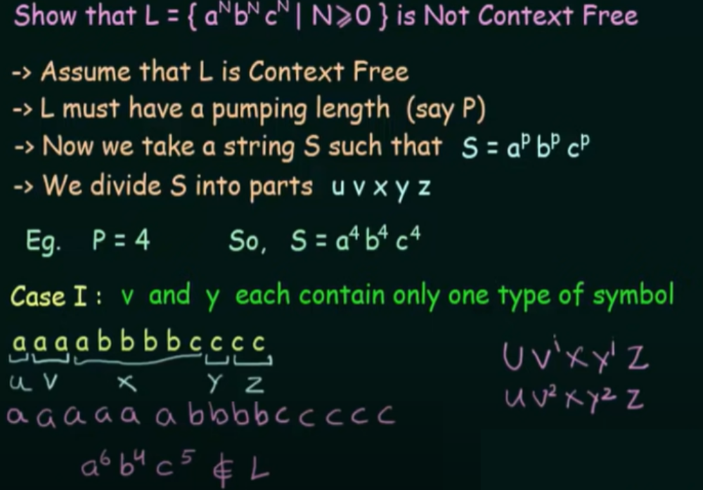
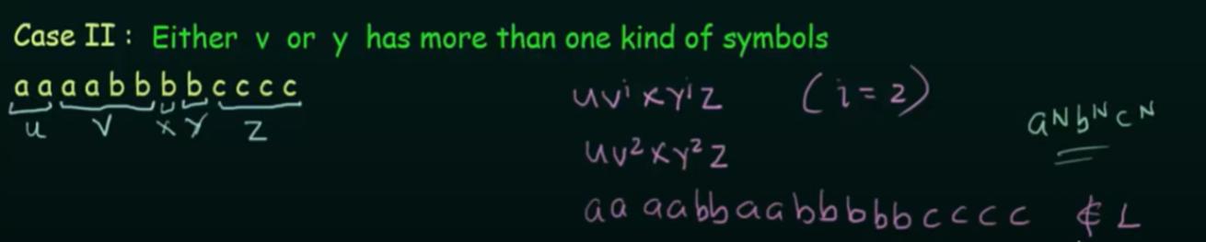
Pumping Lemma for CFL’s…
Problem-1:

Slide 27
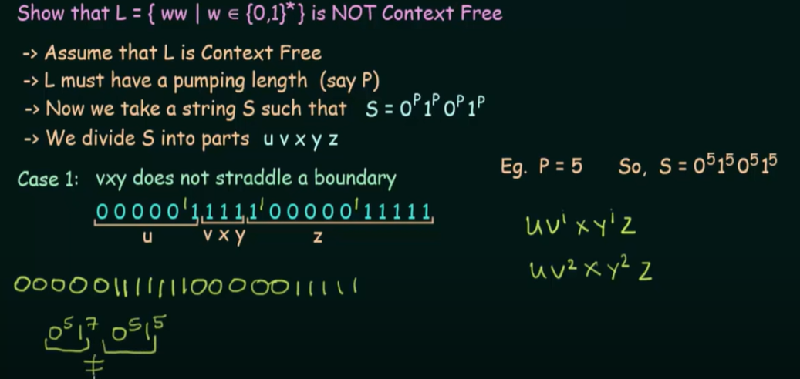
Pumping Lemma for CFL’s…
Problem-2:

Slide 28
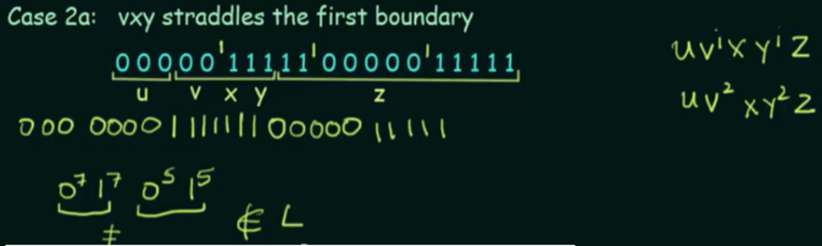
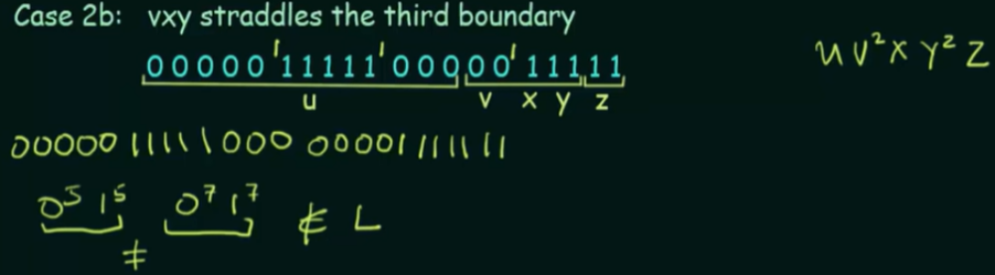
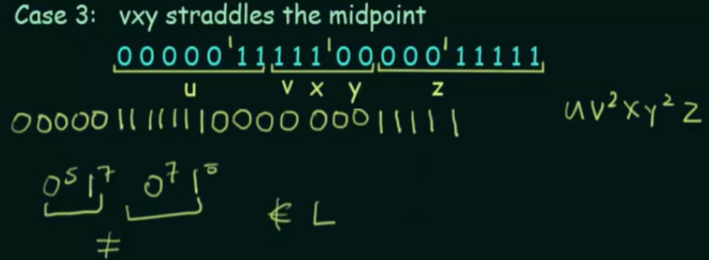
Pumping Lemma for CFL’s…
Problem-2…

Slide 29
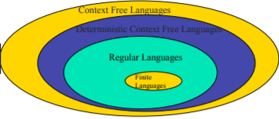
3. Closure properties of CFL’s
Context-free languages are closed under −
  Union
  Concatenation
  Kleene Star operation
  Substitution
  Homomorphism, inverse homomorphism
  Reversal
Context-free languages are not closed under −
Intersection − If L1 and L2 are context free languages, then L1 ∩ L2 is not necessarily context free.
Difference− If L1 is a regular language and L2 is a context free language, then L1 - L2 is not necessarily context free language.
Complement − If L1 is a context free language, then L1` may not be context free.

Slide 30
Closure properties of CFL’s…
Union: Let L1 and L2 be two CFL. Then L1 ∪ L2 is also CFL.
Example:
Let L1 = { a^{n}b^{n} , n > 0}. Corresponding grammar G1 will have P: S1 → aAb|ab
Let L2 = { c^{m}d^{m} , m ≥ 0}. Corresponding grammar G2 will have P: S2 → cBb| ε
Union of L1 and L2, L = L1 ∪ L2 = { a^{n}b^{n} } ∪ { c^{m}d^{m} }
Thus, G will have the additional production S → S1 | S2
Concatenation: If L₁ and L₂ are CFL, then L₁L₂ is also CFL.
Example:
Concatenation of the languages L₁ and L₂, L = L₁L₂ = { a^{n}b^{n}c^{m}d^{m} }
The corresponding grammar G will have the additional production S → S1S2

Slide 31
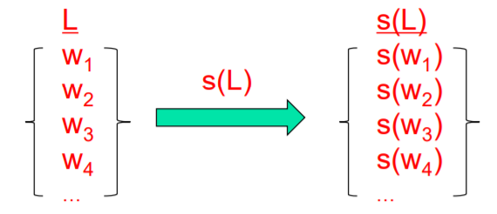
Closure properties of CFL’s…
Kleene Star: If L is a CFL , then L* is also CFL.
Example:
Let L = { a^{n}b^{n} , n ≥ 0}. Corresponding grammar G will have P: S → aAb| ε
Kleene Star L₁ = { a^{n}b^{n} }*
The corresponding grammar G₁ will have additional productions S1 → SS₁ | ε
Substitution: IF L is a CFL and a substitution defined on L, s(L), is s.t., s(a) is a CFL for every symbol a, then,
  s(L) is also a CFL

Slide 32
Closure properties of CFL’s…
Reversal:
Let L be a CFL, with grammar G=(V,T,P,S)
For L^{R}, construct G^{R}=(V,T,P^{R},S) s.t.,
If A → α is in P, then:
  A → α ^{R} is in P^{R}
  (that is, reverse every production)
  Homomorphism:
Suppose L is a CFL over alphabet ∑ and h is a homomorphism on ∑.
Let s be a substitution that replaces every a ∈ ∑, by h(a). ie s(a) = {h(a)}.
Then h(L) = s(L).
h(L) ={h(a₁)…h(a_{k}) | k ≥ 0} where h(a_{k}) is a homomorphism for every a_{k} ∈ ∑.

Slide 33
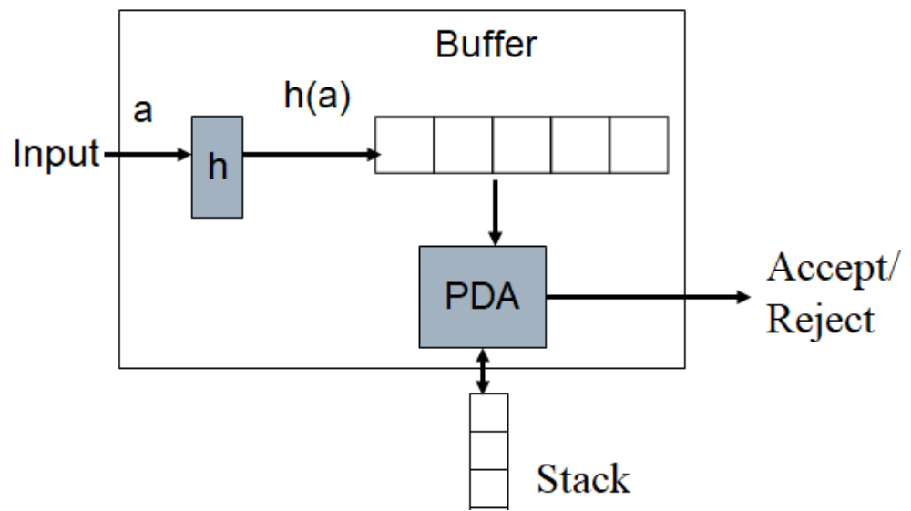
Closure properties of CFL’s…
Inverse homomorphism:
If L is a CFL and h is a homomorphism, then h⁻¹(L) is a CFL.
Intersection with Regular Language − If L1 is a regular language and L2 is a context free language, then L1 ∩ L2 is context free language.

Slide 34
4. Decision Properties of CFL’s
As usual, when we talk about “a CFL” we really mean “a representation for the CFL, e.g., a CFG or a PDA accepting by final state or empty stack. There are algorithms to decide if:
  CFL L is empty
  CFL L is infinite
  String w is in CFL i.e., Membership test
Non-Decision Properties:
Many questions that can be decided for regular sets cannot be decided for CFL’s.
  Is a given CFG G ambiguous?
  Is a given CFL inherently ambiguous?
  Is the intersection of two CFLs empty?
  Are two CFLs the same?
Need theory of Turing machines and decidability to prove no algorithm exists.

Slide 35
Decision Properties of CFL’s…
1. Testing Emptiness:
We already did this.
We learned to eliminate variables that generate no terminal string.
If the start symbol is one of these, then the CFL is empty; otherwise not.
2. CFL L is infinite:
The idea is essentially the same as for regular languages.
By pumping lemma for CFL, if L contains a word of length t, with |t| > k for a constant k (pumping length), then clearly L is infinite.
Conversely if L is infinite, it satisfies the conditions of the pumping lemma, otherwise L is finite.
Hence, we must test whether L contains a word of length greater than k.

Slide 36
Decision Properties of CFL’s…
3. Testing Membership:
Want to know if string w is in L(G).
Assume G is in CNF or convert the given grammar to CNF.
w = ε is a special case, solved by testing if the start symbol is nullable.
Cocke-Younger-Kasami (CYK) Algorithm is a good example of dynamic programming and runs in time O(n³), where n = |w|.
CYK Algorithm is a membership algorithm of CFG. It is used to decide whether a given string belongs to the CFL or not.

Slide 37
Decision Properties of CFL’s…
CYK Algorithm:
Let w be the n length string to be parsed. And G represent the set of rules in our grammar with start state S.
Construct a table DP for size n × n.
If w = ε (empty string) and S → ε is a rule in G then we accept the string else we reject.
For i = 1 to n:
    For each variable A:
    We check if A → b is a rule and b = w_{i} for some i:
    If so, we place A in cell (i, i) of our table.

Slide 38
Decision Properties of CFL’s…
For l = 2 to n:
  For i = 1 to n-l+1:
  j = i+l-1
  For k = i to j-1:
  For each rule A → BC:
  We check if (i, k) cell contains B and (k + 1, j) cell contains C:
  If so, we put A in cell (i, j) of our table.
We check if S is in (1, n):
    If so, we accept the string
    Else, we reject.

Slide 39
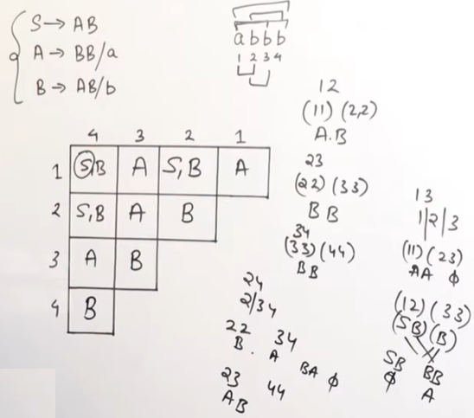
Decision Properties of CFL’s…
Example-1:

Slide 40
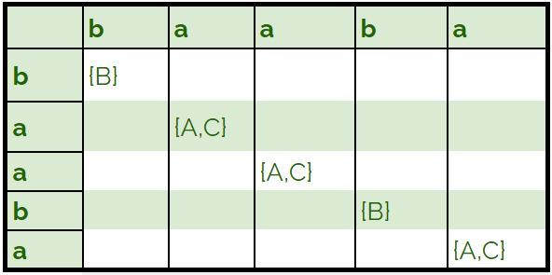
Decision Properties of CFL’s…
Example-2: Let our grammar G be:
    S → AB | BC
    A → BA | a
    B → CC | b
    C → AB | a
Check string baaba is in L(G)?
Solution:
We first insert single length rules into our table.

Slide 41
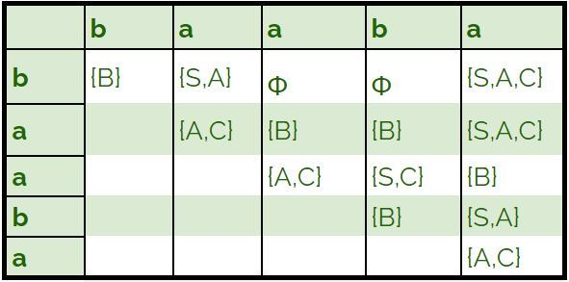
Decision Properties of CFL’s…
Example-3: Let our grammar G be: baaba
    S → AB | BC
    A → BA | a
    B → CC | b
    C → AB | a
We then fill the remaining cells of our table.
We observe that S is in the cell (1, 5), Hence, the string baaba belongs to L(G).

Slide 42
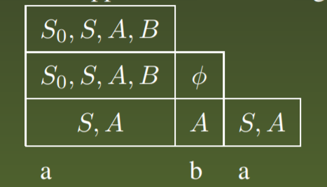
Decision Properties of CFL’s…
Example-4: Consider the CFG with the following productions:
    S0 → AB|SA
    S → AB|SA|a
    A → AB|SA|a|b
    B → SA
We shall test the membership of aba in L(G) using CYK algorithm.
The table thus produced on application of CYK algorithm is as below: Since X13 has S0, aba is in L(G).

Slide 43
END OF
UNIT-3
PART-2

