Slide 1
II-B.E. IV-SEMESTER
AUTOMATA, LANGUAGES AND COMPUTATION (ALC)
Presented By
Dr. D. BASWARAJ
Professor, CSE DEPT.
VCE, HYDERABAD

Slide 2
SYLLABUS
UNIT – I:
Introduction to Automata
Finite Automata
Regular Expressions and Languages
UNIT – II:
Properties of Regular Languages
Context Free Grammars and Languages
UNIT – III:
Pushdown Automata
Properties of Context Free Languages

Slide 3
SYLLABUS …
UNIT – IV:
Linear Bounded Automata: Context sensitive grammars and languages, Linear bounded automata.
Introduction to Turing Machines: Problems that Computers cannot Solve, the Turing Machine, Programming Techniques for Turing Machines, Extensions to the Basic Turing Machine, Restricted Turing Machines, Turing Machines and Computers. Simulation of Turing Machine using JFLAP tool
UNIT – V:
Undecidability: A Language that is not Recursively Enumerable, An undecidable Problem that is RE, Undecidable problems about Turing Machines, Post’s Correspondence Problem, Other Undecidable Problems.
Intractable Problems: The Classes P and NP, An NP-Complete Problem, A Restricted Satisfiability Problem.

Slide 4
UNIT-IV
PART-1: Linear Bounded Automata
  Context sensitive grammars and languages
  Linear bounded automata
PART-2: Introduction to Turing Machines
  Problems that Computers cannot Solve
  The Turing Machine
  Programming Techniques for Turing Machines
  Extensions to the Basic Turing Machine
  Restricted Turing Machines
  Turing Machines and Computers
  Simulation of Turing Machine using JFLAP tool

Slide 5
Part-1: Linear Bounded Automata (LBA)
  Chomsky Hierarchy: According to Noam Chomsky Hierarchy, there are 4 types of grammars: Type0>Type1>Type 2>Type3. The following table shows how they differ from each other-
Grammar Type | Grammar Accepted | Language Accepted | Automaton
Type 0 | Unrestricted grammar | Recursively enumerable language | Turing Machine
Type 1 | Context-sensitive grammar | Context-sensitive language | Linear-bounded automaton
Type 2 | Context-free grammar | Context-free language | Pushdown automaton
Type 3 | Regular grammar | Regular language | Finite state automaton / Finite Automata

Slide 6
1. Context sensitive grammars (CSG) and languages (CSL)
A CSG G defined as G={V,T,P,S}, where V = Set of Variables, T = Set of Terminals, S = Start Symbol and P = set of productions.
A CSG has productions of the form
αXγ → αβγ
where X is a non-terminal, and α, β, γ are sequences of terminals and non-terminals (i.e., α, β, γ ∈ (V ∪ T)∗) with the requirement that β is nonempty.
So, the rules for expanding X can be sensitive to the context in which the X occurs (contrasts with context-free).
Minor wrinkle: The nonempty restriction on β disallows rules with RHS . To remedy this, we also permit the special rule S →ε
where S is the start symbol, and with the restriction that this rule is only allowed to occur if the S does not appear on the RHS of any productions.

Slide 7
CSG and CSL…
A language is context sensitive if it can be generated by a context sensitive grammar.
The non-context-free languages:
{a^{n}b^{n}c^{n} | n ≥ 0}
{ss | s ∈ {a, b}∗ }
are context sensitive.
In practice, it can be quite an effort to produce context sensitive grammars, according to the definition above.
It is often more convenient to work with a more liberal notion of grammar for generating context-sensitive languages.

Slide 8
CSG and CSL…
In a general or unrestricted grammar, we allow productions of the form α → β
where α, β are sequences of terminals and non-terminals, i.e., α, β ∈ (V ∪ Σ)∗ , with α containing at least one nonterminal.
In a noncontracting grammar, we restrict productions to the form
α → β with α, β as above, subject to the additional requirement that |α| ≤ |β| (i.e., the sequence β is at least as long as α).
In a noncontracting grammar also permit the special production
S →ε
where S is the start symbol, as long as S does not appear on the right-hand-side of any productions.

Slide 9
CSG and CSL…
Example of noncontracting grammar:
Consider the noncontracting grammar with start symbol
S: S → abc
S → aSBc
cB → Bc
bB → bb
Example derivation (underlining the sequence to be expanded):
S ⇒ aSBc ⇒ aabcBc ⇒ aabBcc ⇒ aabbcc
Exercise: Convince yourself that this grammar generates exactly the strings a^{n}b^{n}c^{n} where n > 0. (Note: With noncontracting grammars and CSGs, need to think in terms of derivations, not syntax trees.)

Slide 10
CSG and CSL…
Noncontracting = Context sensitive:
Theorem: A language is context sensitive if and only if it can be generated by a noncontracting grammar.
That every context-sensitive language can be generated by a noncontracting grammar is immediate, since context-sensitive grammars are, by definition, noncontracting.
The proof that every noncontracting grammar can be turned into a context sensitive one is intricate, and beyond the scope of the course.
Sometimes (e.g., in Kozen) noncontracting grammars are also called context sensitive grammars; but this is not faithful to Chomsky’s original definition

Slide 11
CSG and CSL…
Context-sensitivity in programming languages:
Some aspects of typical programming languages can’t be captured by context-free grammars, e.g.
  Typing rules
  Scoping rules (e.g. variables can only be used in contexts where they have been ‘declared’)
  Access constraints (e.g. use of public vs. private methods in Java).
The usual approach is to give a CFG that’s a bit ’too generous’, and then separately describe these additional rules. (E.g. typechecking done as a separate stage after parsing.)
In principle, though, all the above features fall within what can be captured by context-sensitive grammars. In fact, no programming language known to humankind contains anything that can’t.

Slide 12
CSG and CSL…
Scoping constraints aren’t context-free:
Consider the simple language L1 given by
S → ε | declare v; S | use v; S
where v stands for a lexical class of variables.
Let L2 be the language consisting of strings of L1 in which variables must be declared before use.
Assuming there are infinitely many possible variables, it’s a little exercise to show L2 is not context-free but is context-sensitive.
If there are just n possible variables, we could in theory give a CFG for L2 with around 2^{n} non-terminals - but that’s obviously silly.

Slide 13
CSG and CSL…
Standard CSL examples:
L = {a^{n}b^{n}c^{n} | n >=1}, but n>=0 in not CSL
L = {a^{n} | n is prime}
L = {a^{n} | n is non-prime}
L = {a^{n!} | n >=a}
L = {ww | w ϵ (a,b)*}
L = {www^{R} | w ϵ (a,b)*}
L = {w^{n} | n>=1, w ϵ (a,b)*}
L = {a^{n} | n is perfect square}

Slide 14
CSG and CSL…
Closure Properties of CSL:
CSL Closed under
  Positive closure, Union, Concatenation, Intersection
  Reversal, substitution, ε-free homomorphism
  Inverse homomorphism
Not Closed under
  Kleen Closure

Slide 15
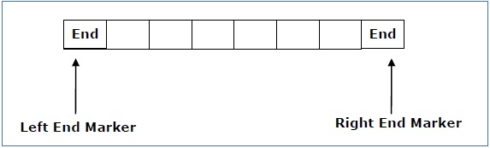
2. Linear Bounded Automata (LBA)
Machine Relation: FA < PDA < LBA < TM
Language Relation: Regular < Context Free < Context Sensitive < Recursively Enumerable
A LBA is a multi-track non-deterministic Turing machine with a tape of some bounded finite length.
Length = function (Length of the initial input string, constant c)
Here, Memory information ≤ c × Input information
The computation is restricted to the constant bounded area. The input alphabet contains two special symbols which serve as left end markers and right end markers.

Slide 16
Linear Bounded Automata (LBA)
LBA can be defined as an 8-tuple (Q, Г, ∑, q₀, M_{L}, M_{R}, δ, F) where
  Q is a finite set of states
  Г is the tape alphabet
  ∑ is the input alphabet
  q₀ is the initial state
  M_{L} & M_{R} is the left and right end marker, where M_{R} ≠ M_{L}
  δ is a transition function which maps each pair (state, tape symbol) to (state, tape symbol, constant ‘c’) where c can be 0 or +1 or -1
  δ: Q x Г → 2^{Q x Г x (L,R)} where L and R = left and right
  F is the set of final states
A deterministic linear bounded automaton is always context-sensitive and the linear bounded automaton with empty language is undecidable.

Slide 17
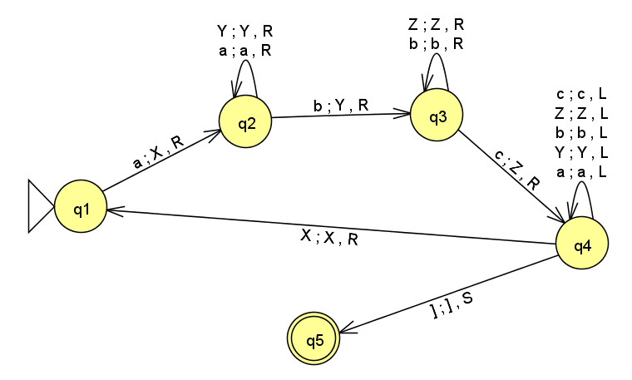
Linear Bounded Automata (LBA)
Example: Construct LBA for CSL L ={a^{n}b^{n}c^{n} | n >=1}. Also, check the input string aabbcc is accepted by LBA?

Slide 18
END OF
UNIT-1
PART-1

