Slide 1
III-B.E. V-SEMESTER
AUTOMATA, LANGUAGES AND COMPUTATION (ALC)
Presented By
Dr. D. BASWARAJ
Professor, CSE DEPT.
VCE, HYDERABAD

Slide 2
SYLLABUS
UNIT – I:
Introduction to Automata
Finite Automata
Regular Expressions and Languages
UNIT – II:
Properties of Regular Languages
Context Free Grammars and Languages
UNIT – III:
Pushdown Automata
Properties of Context Free Languages

Slide 3
SYLLABUS …
UNIT – IV:
Linear Bounded Automata: Context sensitive grammars and languages, Linear bounded automata.
Introduction to Turing Machines: Problems that Computers cannot Solve, the Turing Machine, Programming Techniques for Turing Machines, Extensions to the Basic Turing Machine, Restricted Turing Machines, Turing Machines and Computers. Simulation of Turing Machine using JFLAP tool
UNIT – V:
Undecidability: A Language that is not Recursively Enumerable, An undecidable Problem that is RE, Undecidable problems about Turing Machines, Post’s Correspondence Problem, Other Undecidable Problems.
Intractable Problems: The Classes P and NP, An NP-Complete Problem, A Restricted Satisfiability Problem.

Slide 4
UNIT-V
PART-1: Undecidability
  A Language that is not Recursively Enumerable
  An undecidable Problem that is RE
  Undecidable problems about Turing Machines
  Post’s Correspondence Problem
  Other Undecidable Problems
PART-2: Intractable Problems
  The Classes P and NP
  An NP-Complete Problem
  A Restricted Satisfiability Problem

Slide 5
1. The Classes P and NP
What is a problem?
A Problem is a question to be answered. For instance, what is the value of x/y?
A problem usually has parameters like x, and y.
A decision problem, is a version of the problem with only two possible answers: yes or no.
A decidable problem, is a problem that could be solved using a computer.
An undecidable problem, is a problem that can never be solved using a computer, neither now or in the future.

Slide 6
The Classes P and NP…
Tractable Problems:
These can be solved and verified in polynomial time. It is easy to solve.
Examples: Linear search – O(n), Binary Search – O(logn)
Insertion Sort – O(n²), Merge Sort – O(nlogn)
Matrix Multiplication – O(n³)
Intractable Problems:
These can be solved in exponential time and can be verified in polynomial time. It is not easy to solve.
Examples: 0/1 Knapsack – O(2^{n}), Sum of subsets – O(2^{n})
Graph Coloring – O(2^{n}),
Hamiltonian Cycle – O(2^{n})
Travelling Salesperson – O(2^{n})

Slide 7
The Classes P and NP…
Classification:
We need to classify problems in terms of their computability.
Three classes:
  P class: (Deterministic) Polynomial Class
  NP Class: Non-Deterministic Polynomial Class
  NP‐Complete class.
P class, wrt Computers:
Problems with at least one algorithm that solves the problem in polynomial time wrt to the input size.
Polynomial time: The number of steps needed relates polynomially to the size of the input.
O(n²), O(n⁹), O(n^{c}), where c is a constant.
but NOT O(n!), O(2^{n}), when n is the size of the input.

Slide 8
The Classes P and NP…
P class, wrt Turing Machines:
Problems solvable in polynomial time using a Deterministic Turing Machine (DTM) belong to the class P.
Polynomial time: The number of moves needed relates polynomially to the size of the input.
  n², 17n³, 9n⁴, but NOT 2^{n}
DTM: A Turing machine with a tape, head, transition function, and a set of states.
Example: Minimum Weight Spanning Tree (MWST)
Given a weighted graph G, find the minimum weight spanning tree.
In other words, convert the given graph into a tree, that includes all the nodes of the original graph, and minimizes the summation of weights of the edges in the resulting tree.

Slide 9
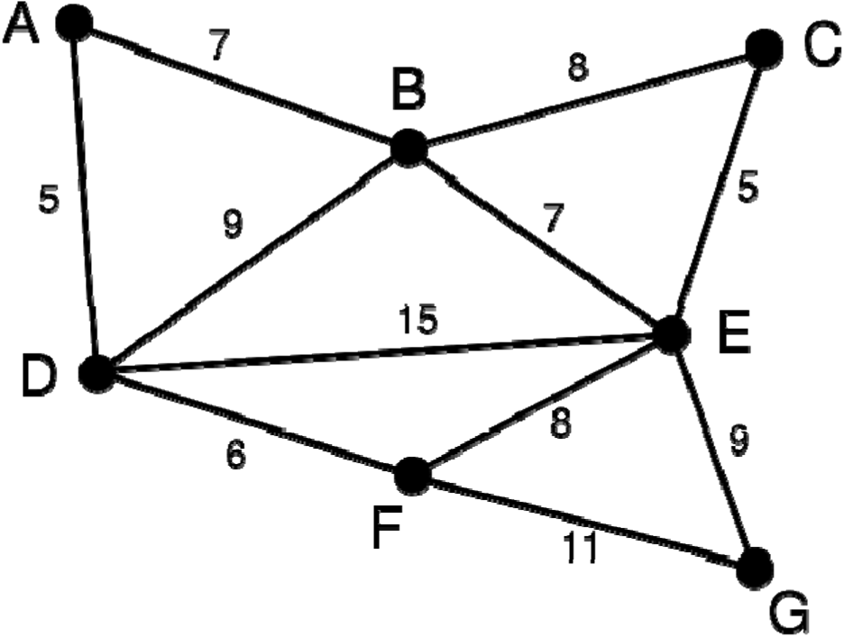
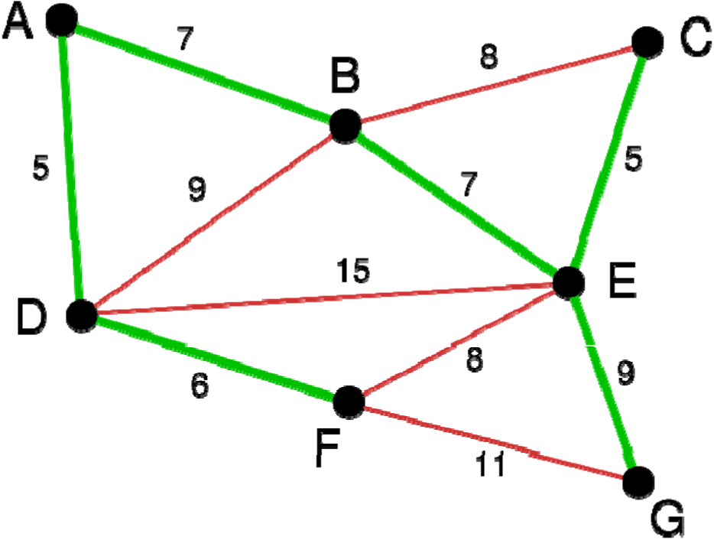
The Classes P and NP…
MWST Possible Solution (Kruskal’s Algorthm):

Slide 10
The Classes P and NP…
NP class, wrt Computers:
Problems that can be solved within an exponential time wrt the input size.
This includes problems that can be solved in polynomial time.
NP class, wrt Turing Machines:
Problems solvable in polynomial time using a Non-Deterministic Turing Machine (NDTM) belong to the class NP.
NDTM: A DTM, with 2 stages of processing: guessing & checking.
Guessing: Guess a solution, and then write it down to the tape.
Checking: Evaluate the guess to decide whether it solves the problem or not.
The number of guessed solutions, can be either polynomial or exponential. If the number of guessed solutions is polynomial, then, the NDTM is equivalent to a DTM.

Slide 11
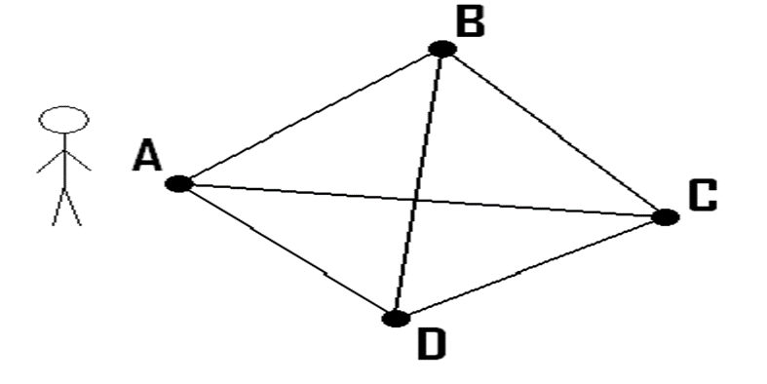
The Classes P and NP…
Example: Travelling Salesman Problem (TSP)
Given a number of cities and the costs of traveling from any city to any other city, what is the cheapest round‐trip route that visits each city exactly once and then returns to the starting city?
Solution: There is no one single algorithm that solves this problem in polynomial time.
The only way, is to enumerate all possible itineraries and checking them one‐by‐one.
For n cities, there are n! routes.

Slide 12
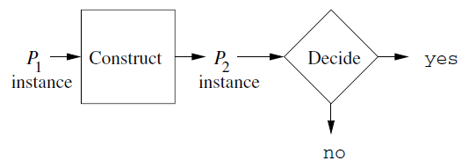
The Classes P and NP…
Polynomial Time Reduction:
A problem P1, is polynomial reducible to problem P2, if there is a process that takes an instance of P1 as an input, and outputs a corresponding instance of P2 in polynomial time.
Our principal methodology for proving that a problem P2 cannot be solved in polynomial time (i.e., P2 is not in P) is the reduction of a problem P1, which is known not to be in P, to P2.
Reprise of the picture of a reduction:

Slide 13
The Classes P and NP…
NP‐Complete Problems:
Let L be a language (problem). We say L is is NP‐Complete if the following statements are true about L:
  L is in NP
  For every problem L’ in NP, there is a polynomial-time reduction from L’ to L.
If P1 is NP‐Complete, and there is polynomial-time reduction from P1 to P2, then P2 is NP‐ Complete.
An example of an NP-complete problem, as we shall see, is the Traveling Salesman Problem.
Since it appears that P ≠ NP, and in particular, all the NP-complete problems are in NP-P, we generally view a proof of N- completeness for a problem as a proof that the problem is not in P.

Slide 14
The Classes P and NP…
We shall prove our first problem ( L is in NP), called SAT ( for Boolean satisfiability), to be NP-complete by showing that the language of every polynomial-time NTM has a polynomial-time reduction to SAT.
However, once we have some NP-complete problems, we can prove a new problem to be NP complete by reducing some known NP complete problem to it, using a polynomial-time reduction.
The following theorem shows why such a reduction proves the target problem to be NP complete.
Theorem-1:
If P1 is NP-complete, P2 is in NP, and there is a polynomial-time reduction of P1 to P2, then P2 is NP-complete.
Proof: We need to show that every language L in NP polynomial-time reduces to P2.

Slide 15
The Classes P and NP…
We know that there is a polynomial-time reduction of L to P1; this reduction takes some polynomial-time p(n). Thus, a string w in L of length n is converted to a string x in P1 of length at most p(n).
We also know that there is a polynomial-time reduction of P1 to P2; let this reduction take polynomial time q(m). Then this reduction transforms x to some string y in P2, taking time at most q(p(n)).
Thus, the transformation of w to y takes time at most p(n) + q(p(n)), which is a polynomial.
Theorem-2:
If some NP-complete problem P is in P, then P=NP.
Proof:
Suppose P is both NP-complete and in P. Then all languages L in NP reduce in polynomial-time to P. If P is in P, then L is in P.

Slide 16
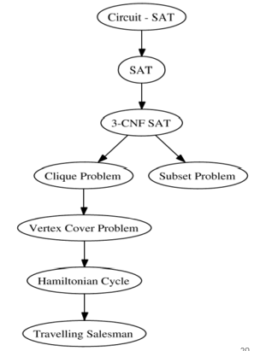
The Classes P and NP…
NP-Complete Problems Family Tree:

Slide 17
2. An NP-Complete Problem
The Satisfiability (SAT) Problem:
The Boolean expressions are built from:
  Variables whose values are Boolean; i.e., they either have the value 1 (true) or 0 (false).
  Binary operators ˄ and ˅ standing for the logical AND and OR of two expressions.
  Unary operator ¬ standing for logical negation.
  Parentheses to group operators and operands, if necessary to alter the default precedence of operators: highest, then and finally.
A truth assignment T satisfies Boolean expression E if E(T) i.e., the truth assignment T makes expression E true.
A Boolean expression E is said to be satisfiable if there exists at least one truth assignment T that satisfies E.

Slide 18
An NP-Complete Problem…
Example-1: consider F = x ˅ ¬y. The value of F is 1 for three assignments:
    T1(x)=1; T1(y)=1.
    T2(x)=1; T2(y)=0.
    T3(x)=0; T3(y)=0.
F has value only for the fourth assignment, where x=0 and y=1. Thus, F is satisfiable.
Example-2: (x ˅ y) ˄(¬ x ˅ ¬ y) is satisfiable.
  There are, in fact, two satisfying truth assignments:
  1. x=0; y=1 2. x=1; y=0.
Example-3: x ˄ (¬ x) is not satisfiable.
The satisfiability problem is: Given a Boolean expression, is it satisfiable?

Slide 19
An NP-Complete Problem…
Representing SAT instances: The symbols in a Boolean expression are ˄, ˅, ¬, the left and right parentheses, and symbols representing variables.
The satisfiability of an expression does not depend on the names of the variables, only on whether two occurrences of variables are the same variable or different variables.
An instance of SAT is a Boolean function.
  Must be coded in a finite alphabet.
  Use special symbols ˄, ˅, ¬, (, ) as themselves.
  The variable x_{i} is represented by the symbol x followed by 0s and 1s that represent i in binary.
Example-4: Consider the expression x˄¬ (y ˅ z). Since there are three variables, we must use x1, x2 and x3. Then, the given expression becomes x1˄¬ (x2 ˅ x3) and encoded as x1˄¬ (x10 ˅ x11).

Slide 20
An NP-Complete Problem…
NP-Completeness of the SAT Problem:
We now prove, Cook’s (Cook-Levin) Theorem, the fact that SAT is NP-complete.
To prove a problem is NP-complete, we need (i) to show that it is in NP. Then, (ii) we must show that every language L in NP reduces to the problem in question i.e., NP-Hard.
Theorem: (Cook’s Theorem) SAT is NP-complete.
Proof: The 1st part of the proof for “SAT is in NP” is easy:
Use the nondeterministic ability of an NTM to guess a truth assignment T for the given expression E. If the encoded E is of length n, then O(n) time suffices on a multi-tape NTM. Note that this NTM has many choices of move and may have as many as 2^{n} different ID’s reached at the end of the guessing process, where each branch represents the guess of a different truth assignment.

Slide 21
An NP-Complete Problem…
Evaluate E for the truth assignment T. If E(T)=1, then accept. Note that this part is deterministic. The fact that other branches of the NTM may not lead to acceptance has no bearing on the outcome, since if even one satisfying truth assignment is found, the NTM accepts.
The evaluation can be done easily in O(n²) time on a multi-tape NTM. Thus, the entire recognition of SAT by the multi-tape NTM takes O(n²) time. Converting to a single tape NTM may square the amount of time, so O(n⁴) time suffices on a single tape NTM.
Now, we must prove the 2nd part (NP-Hard), that if L is any language in NP, then there is a polynomial-time reduction of L to SAT.
We may assume that there is some single tape NTM M and a polynomial p(n) such that M takes no more than p(n) steps on an input of length n, along any branch.

Slide 22
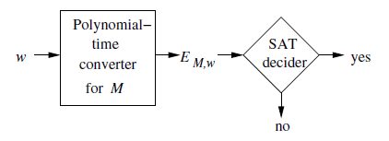
An NP-Complete Problem…
We know transitive relation i.e., if problem L in is NP, then the L1 which is reducible from L is also in NP.
if, L α L1 α L2, then L α L2
(Note: α means reduce in polynomial time)
Suppose SAT had a deterministic TM that recognized its instances in polynomial time, say time q(n). Then every language accepted by an NTM M that accepted within polynomial time p(n) would be accepted in deterministic polynomial time by the DTM whose operation is suggested in below figure:

Slide 23
3. A Restricted Satisfiability Problem
Our plan is to demonstrate a wide variety of problems, such as the TSP problem to be NP-complete.
In principle, we do so by finding polynomial-time reductions from the problem SAT to each problem of interest.
In this section, we introduce new terminology about Boolean expression i.e., normal form. We then reduce satisfiability for any expressions which are in the normal form.
Normal Forms for Boolean Expressions:
The following are three essential definitions:
A literal is either a variable, or a negated variable. E.g., x and ¬y.
A clause is the logical OR of one or more literals. Examples are x, y, x ˅ y and x ˅ ¬ y ˅ z.
A Boolean expression is said to be in conjunctive normal form or CNF, if it is the AND of clauses.

Slide 24
Restricted Satisfiability Problem…
Disjunctive Normal Form (DNF) - SOP:
A Boolean formula is in CNF if it is the OR of clauses.
Each clause is the AND of literals. A literal is either a variable or the negation of a variable.
In otherwards, DNF expression represented as “Sum of clauses”.
Example: (x ˄ ¬ y ) ˅ (¬ x) ˅ (¬ x ˄ y)
An expression is said to be in k-disjunctive normal form k-DNF, if it is the sum of clauses, each of which exactly k distinct literals.
For instance, (x ˄ ¬ y) ˅ (y ˄ ¬ z) ˅ (z ˄ ¬ x) is in 2-DNF, because each of its clauses has exactly two literals.

Slide 25
Restricted Satisfiability Problem…
Conjunctive Normal Form (CNF) - POS:
A Boolean formula is in Conjunctive Normal Form (CNF) if it is the AND of clauses.
Each clause is the OR of literals. A literal is either a variable or the negation of a variable.
In otherwards, CNF expression represented as “product of clauses”.
Example: (x ˅ ¬ y ˅ z) ˄(¬ x) ˄(¬ x ˅ y ˅ z)
An expression is said to be in k-conjunctive normal form k-CNF, if it is the product of clauses, each of which is the sum of exactly k distinct literals.
For instance, (x ˅ ¬ y)(y ˅ ¬ z)(z ˅ ¬ x) is in 2-CNF, because each of its clauses has exactly two literals.

Slide 26
Restricted Satisfiability Problem…
All these restrictions on Boolean expressions give rise to their own problems about satisfiability for expressions that meet the restriction.
Thus, we shall speak of the following problems:
Problem CSAT: Is a Boolean expression (formula) in CNF satisfiable?
Problem KSAT: Is a Boolean expression (formula) in k-CNF satisfiable?
Example: Let CNF Φ = (x ˅ ¬ y ˅ z) ˄(¬ x) ˄(¬ x ˅ y ˅ z)
For x=1, y=1, z=1 → Φ = (1+0+1)(0)(0+1+1) = 0 → not satisfiable.
For x=0, y=1, z=1 → Φ = (0+0+1)(1)(1+1+1) = 1 → satisfiable

Slide 27
Restricted Satisfiability Problem…
k-SAT: If a Boolean formula is in CNF and every clause consists of exactly k literals, we say the Boolean formula is an instance of k-SAT. Say the formula is in k-CNF .
Example: 3-SAT formula:
Φ = (x ˅ y ˅ z) ˄(x ˅ ¬y ˅ z) ˄(x ˅ ¬y ˅ ¬z).
k-SAT Facts:
  2-SAT is in P.
  3-SAT is NP-complete.
1. Proof: 2SAT is in P
Pick an assignment for some variable, say x = true.
Any clause with –x forces the other literal to be true.
  Example: (¬x + ¬y) forces y to be false.
Keep seeing what other truth values are forced by variables with known truth values.

Slide 28
Restricted Satisfiability Problem…
One of three things can happen:
  You reach a contradiction (e.g., z is forced to be both true and false).
  You reach a point where no more variables have their truth value forced, but some clauses are not yet made true.
  You reach a satisfying truth assignment.
Case 1: (Contradiction) There can only be a satisfying assignment if you use the other truth value for x.
  Simplify the formula by replacing x by this truth value and repeat the process.
Case 2: (You force values for some variables, but other variables and clauses are not affected).
  Adopt these truth values, eliminate the clauses that they satisfy, and repeat.
Case 3: You found a satisfying assignment, so answer “yes”.
In Cases 1 and 2 you have spent O(n²) time and have reduced the length of the formula by > 1, so O(n³) total.

Slide 29
Restricted Satisfiability Problem…
3-SAT:
This problem is NP-complete.
Clearly it is in NP:
  Guess an assignment of true and false to the variables
  Test whether the Boolean formula is true.
We need to reduce every CNF formula F to some 3-CNF formula that is satisfiable if and only if F is.
Reduction involves introducing new variables into long clauses, so we can split them apart.
Reduction of CSAT to 3SAT:
Let (x₁ ˅ x2… ˅ x_{n}) be a clause in some CSAT instance, with n> 3.
Note: the x’s are literals, not variables; any of them could be negated variables.
Introduce new variables y₁,…,y_{n-3} that appear in no other clause.

Slide 30
Restricted Satisfiability Problem…
Replace (x1 ˅ … ˅ xn) by (x1 ˅ x2 ˅ y1)(x3 ˅ y2 ˅ ¬y1) … (xi ˅ yi-1 ˅ ¬yi-2) … (xn-2 ˅ yn-3 ˅ ¬yn-4)(xn-1 ˅ xn ˅ ¬yn-3)
If there is a satisfying assignment of the x’s for the CSAT instance, then one of the literals xi must be made true.
Assign yj = true if j < i-1 and yj = false for larger j.
We are not done.
We also need to show that if the resulting 3SAT instance is satisfiable, then the original CSAT instance was satisfiable.
Suppose (x1 ˅ x2 ˅ y1)(x3 ˅ y2 ˅ ¬y1) …(xn-2 ˅ yn-3 ˅ ¬yn-4)(xn-1 ˅ xn ˅ ¬yn-3) is satisfiable, but none of the x’s is true.
The first clause forces y1 = true. Then the second clause forces y2 = true and so on … all the y’s must be true.
But then the last clause is false.

Slide 31
Restricted Satisfiability Problem…
There is a little more to the reduction, for handling clauses of 1 or 2 literals.
Replace (x) by (x ˅ y1 ˅ y2) (x ˅ y1 ˅ ¬ y2) (x ˅ ¬ y1 ˅ y2) (x ˅ ¬ y1 ˅ ¬ y2).
Replace (w ˅ x) by (w ˅ x ˅ y)(w ˅ x ˅ ¬ y).
Remember: the y’s are different variables for each CNF clause.
CSAT to 3SAT Running Time.
This reduction is surely polynomial.
In fact, it is linear in the length of the CSAT instance.
Thus, we have polytime-reduced CSAT to 3SAT.
Since CSAT is NP-complete, so is 3SAT.

Slide 32
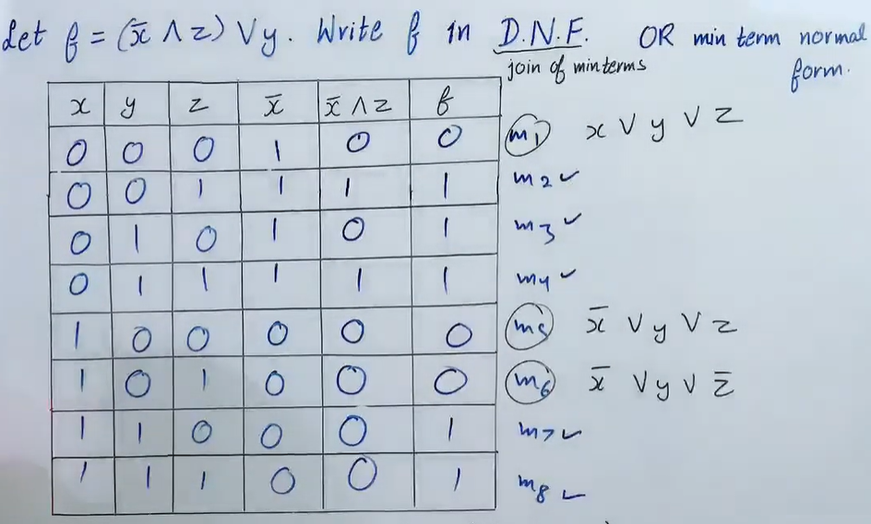
Restricted Satisfiability Problem…

Slide 33
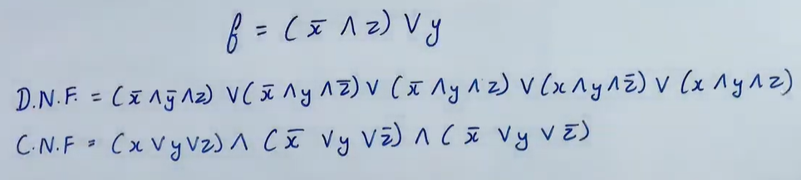
Restricted Satisfiability Problem…

Slide 34
END OF
UNIT-5
PART-2

