Slide 1

MESSAGE QUEUE TELEMETRY TRANSPORT MQTT- Protocol UNIT-IV

Slide 2
MQTT- Protocol
Message Queue Telemetry (Sensor + Actuator Data) Transport Protocol
Developed and released by IBM
It provides publish-and-subscribe messaging
It was specifically designed for resource-constrained devices and low bandwidth and high latency networks such as dial-up lines and satellite links
It offers three qualities of service
(1) fire-and-forget or unreliable
(2) at least once to ensure it is sent a minimum of one time
(but might be sent more than one time) and
(3) exactly once.
its main purpose is telemetry or remote monitoring means “to collect data from many devices and transport that data “ to the IT infrastructure.
Eg. Facebook is using MQTT in its mobile app

Slide 3
MQTT- Protocol (Conti..)
Asynchronous communication model
Publish / Subscribe (PubSub) Model
Decoupling of data producer(publisher) and data consumer(subscriber) through topics (Message queues)
Low complexity, low power and low footprint implementations

Slide 4
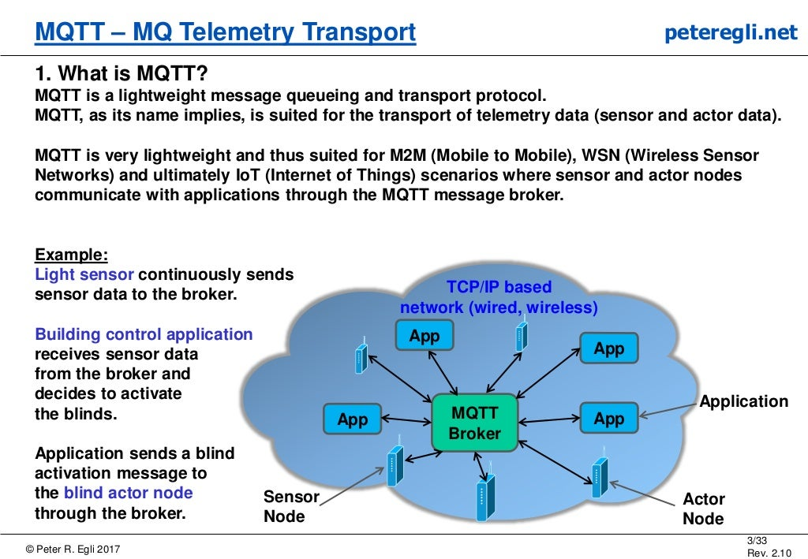

Slide 5
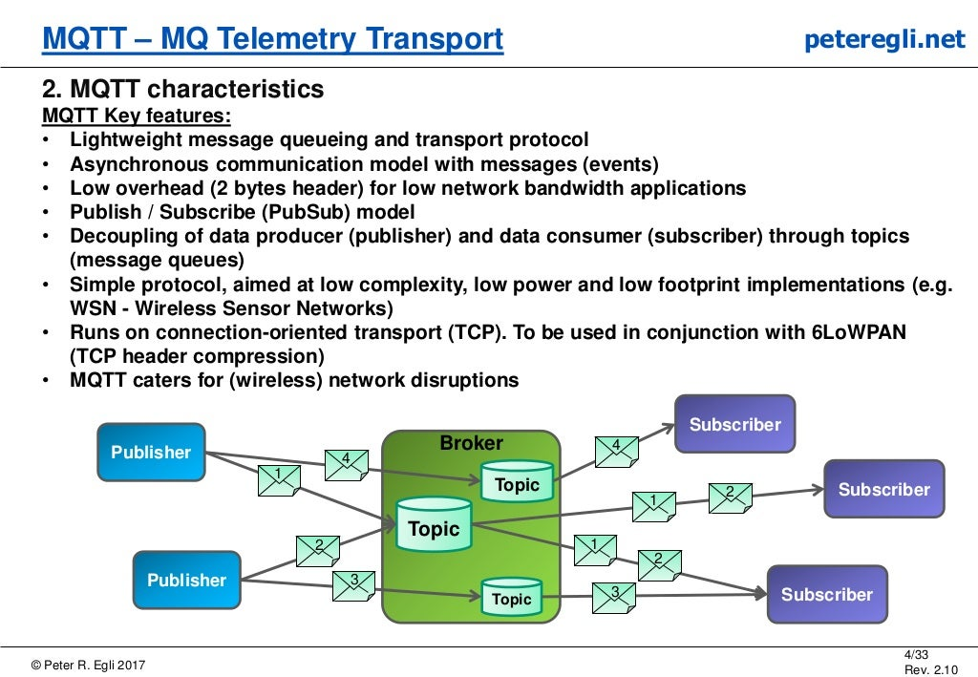

Slide 6
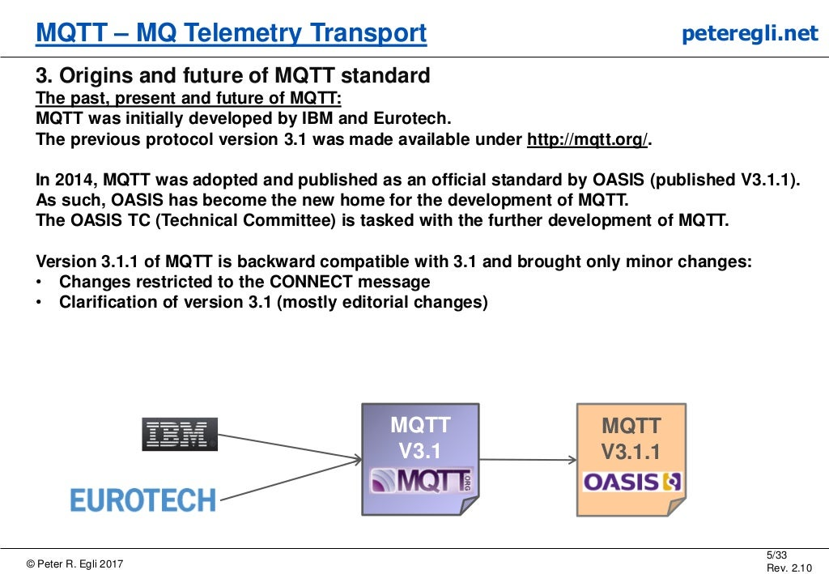

Slide 7
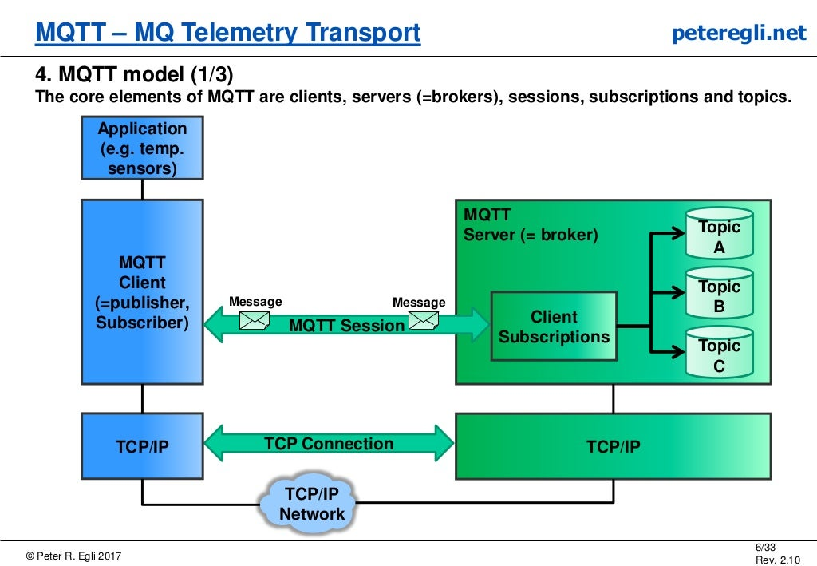

Slide 8
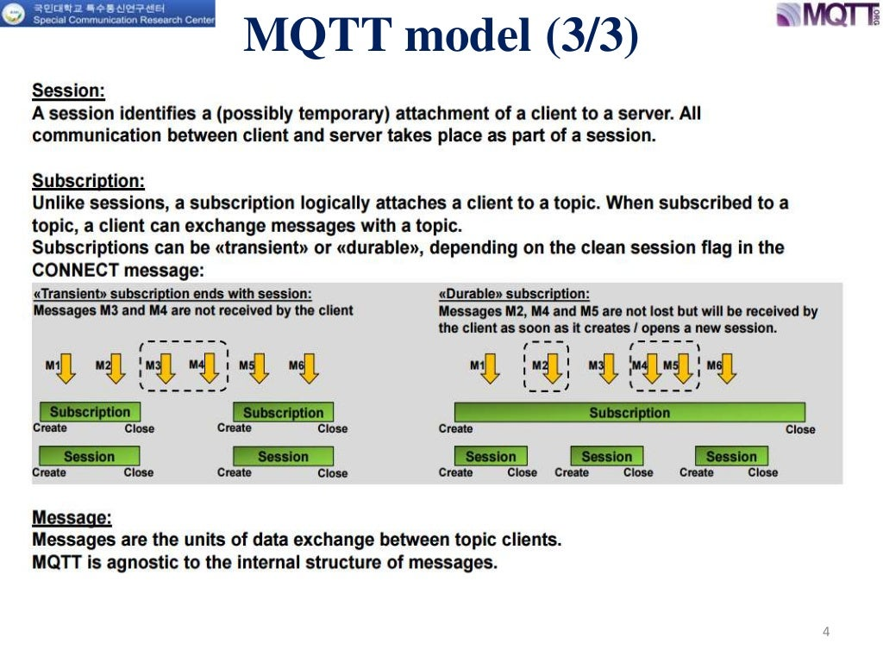

Slide 9
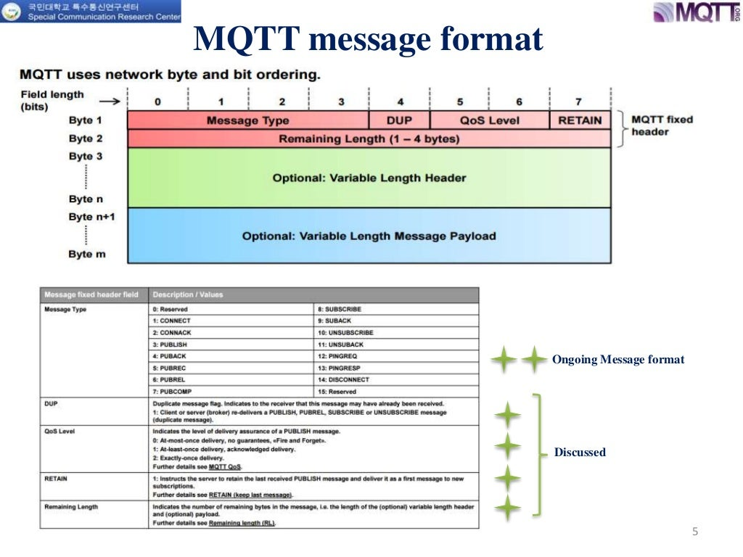

Slide 10
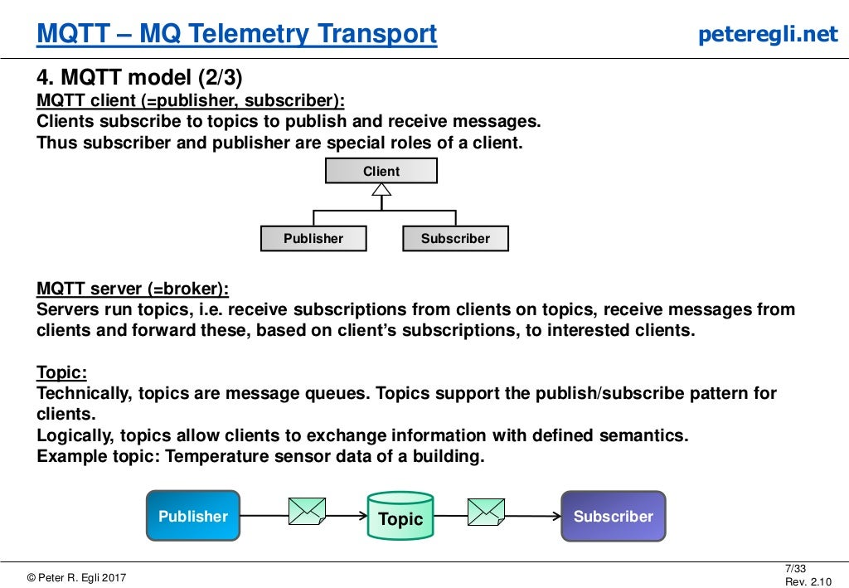

Slide 11
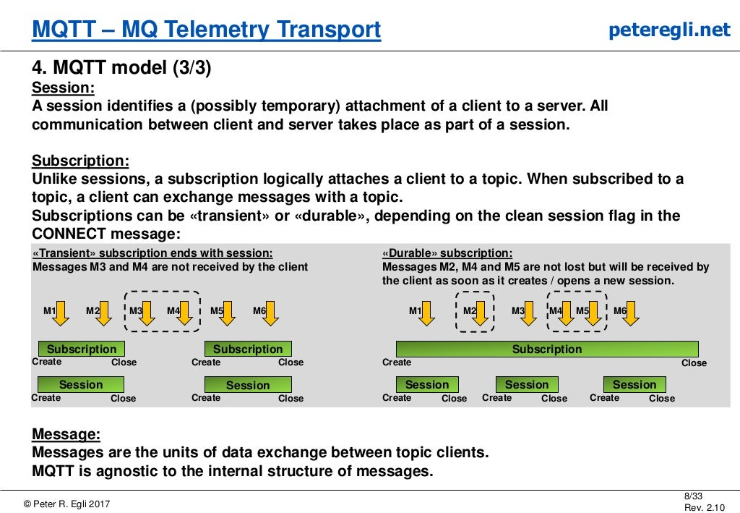

Slide 12
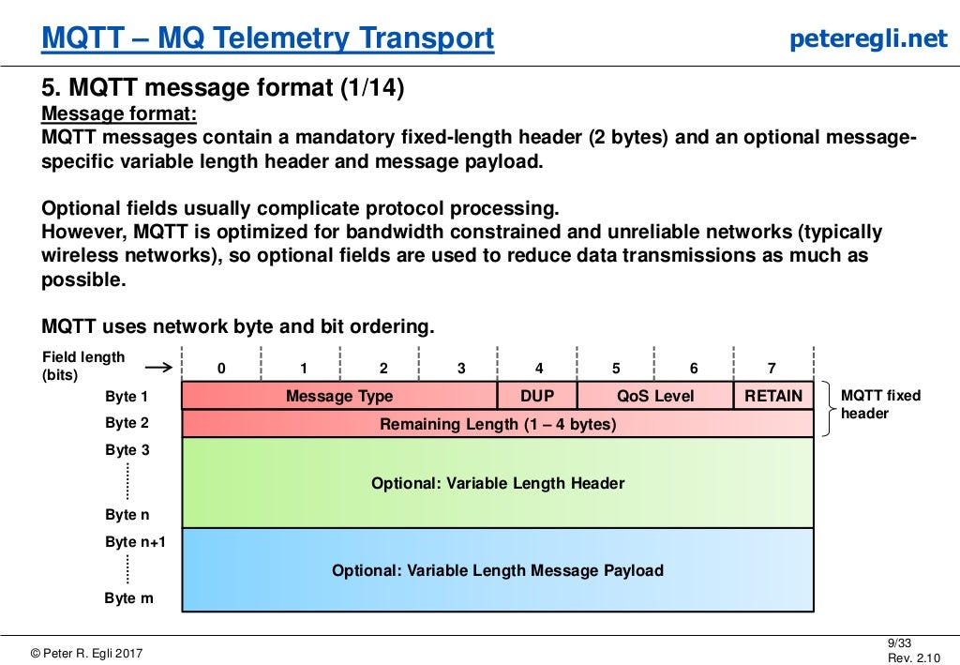

Slide 13
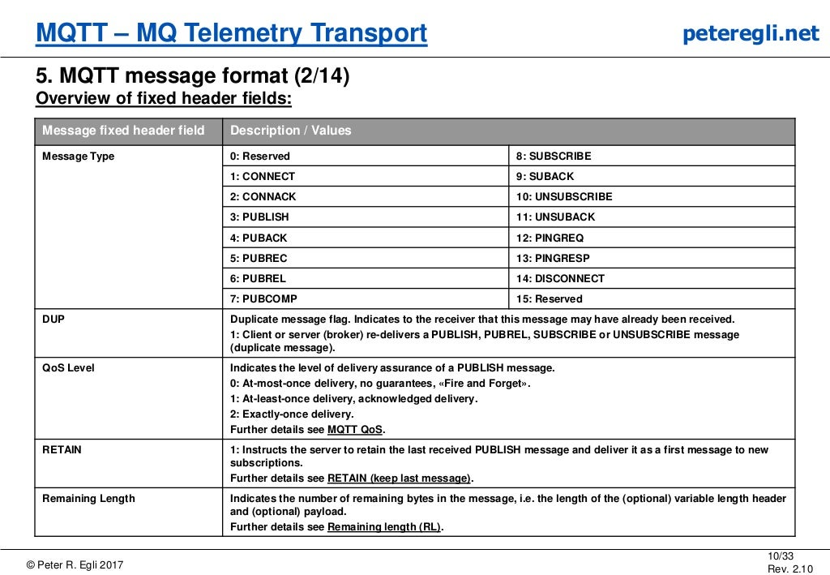

Slide 14
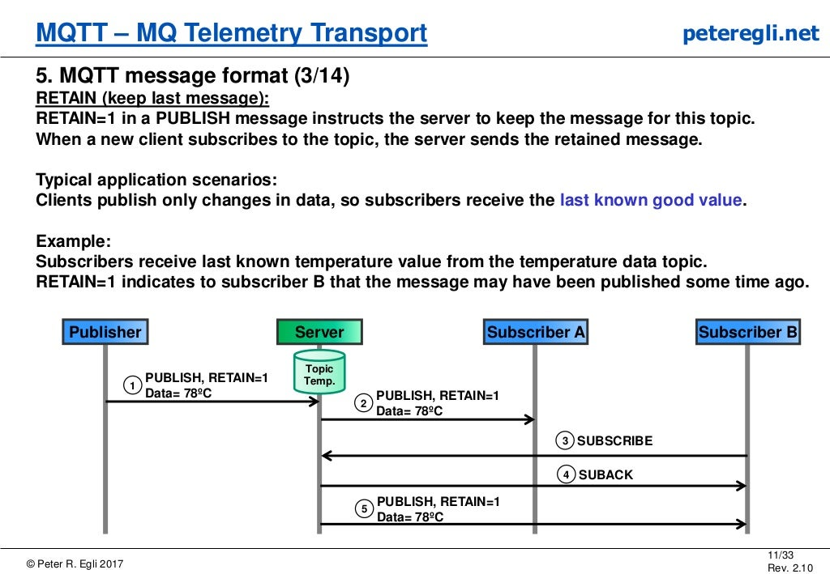

Slide 15
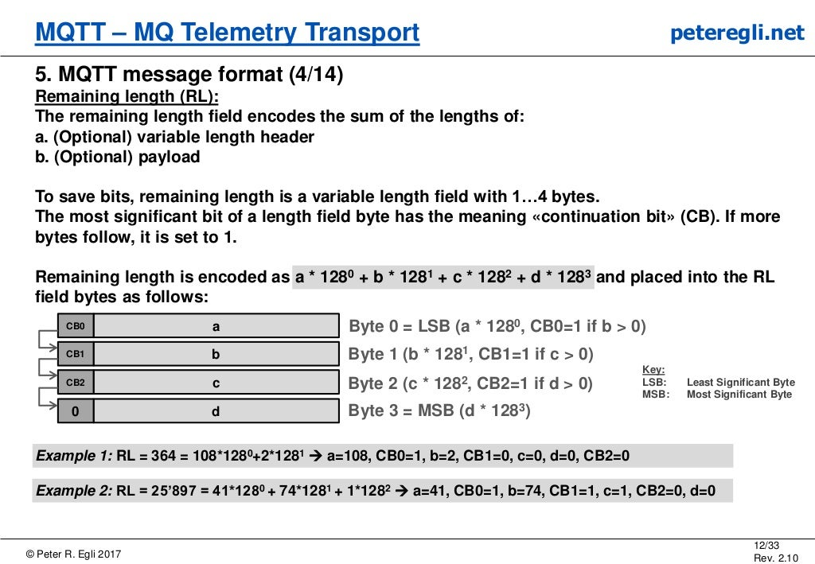

Slide 16
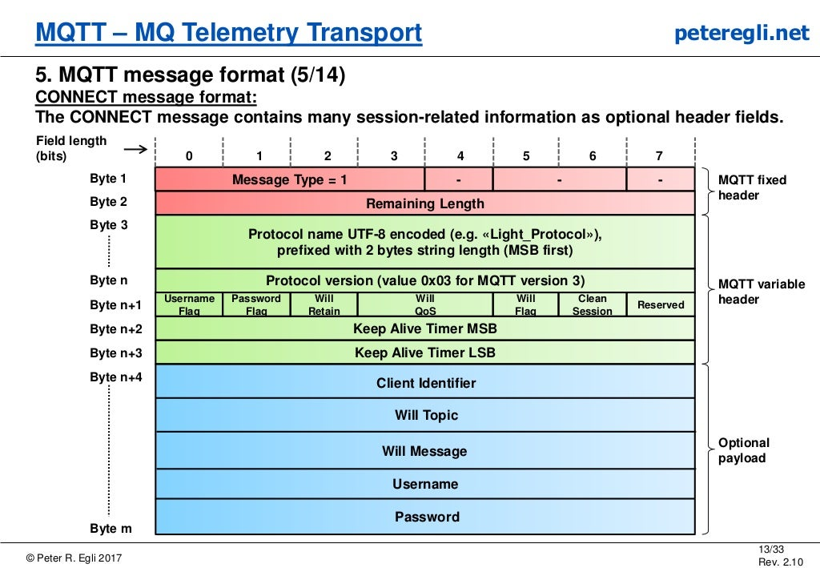

Slide 17
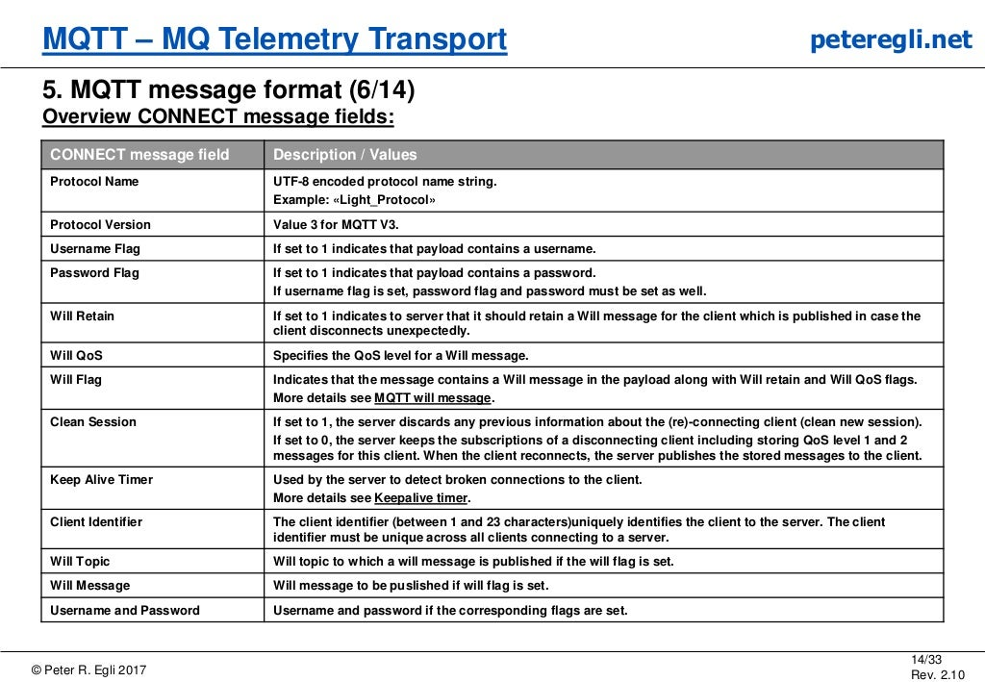

Slide 18
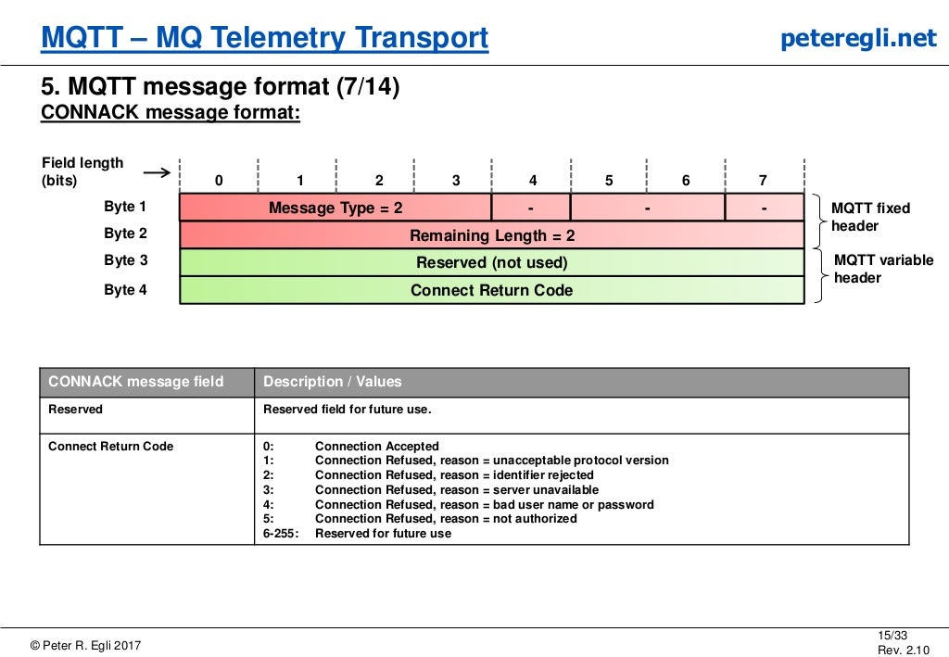

Slide 19
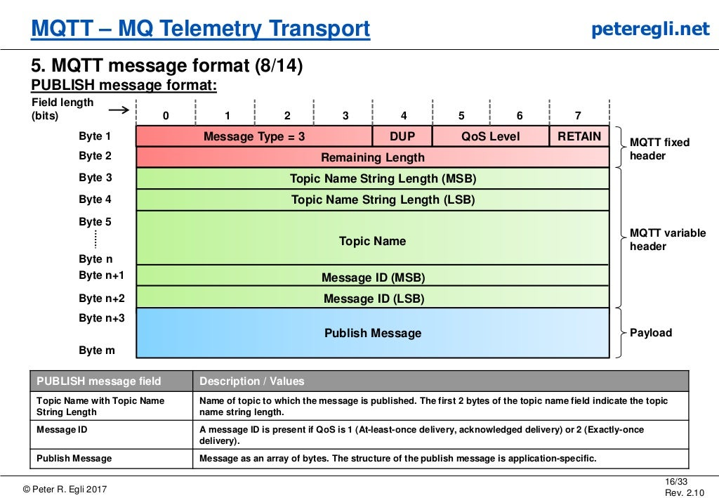

Slide 20
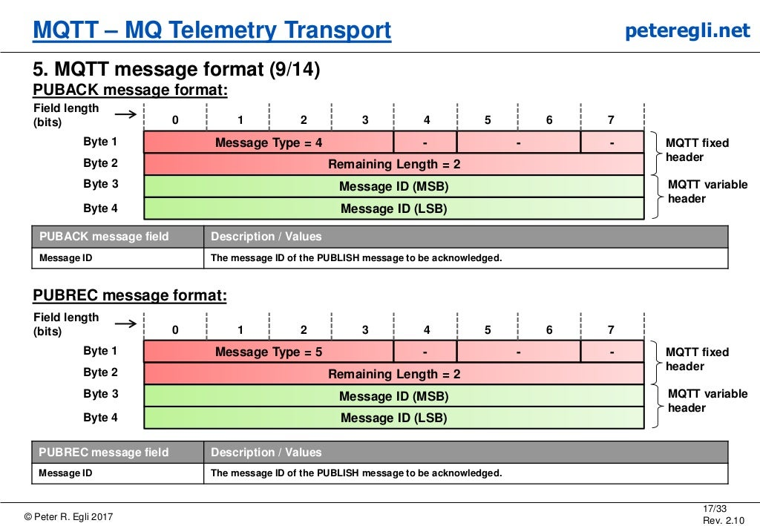

Slide 21
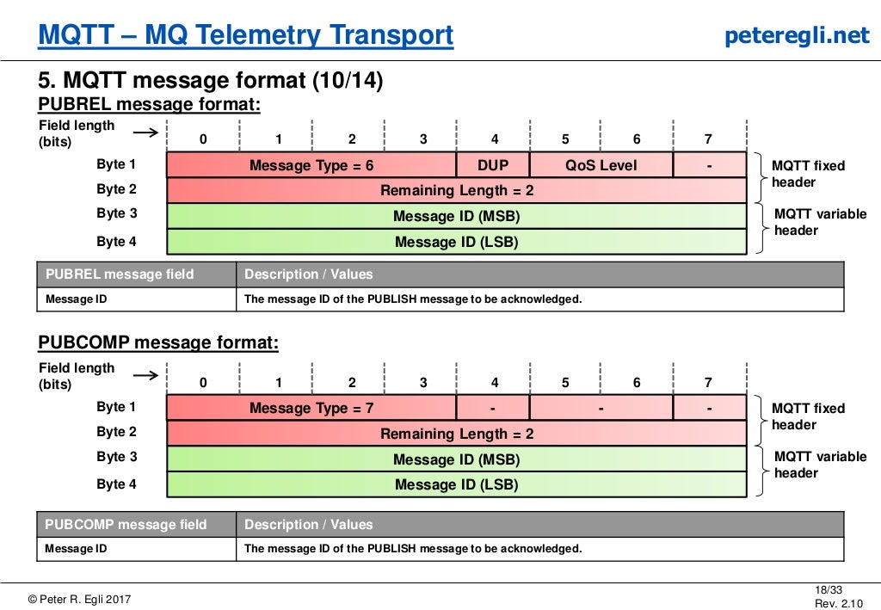

Slide 22
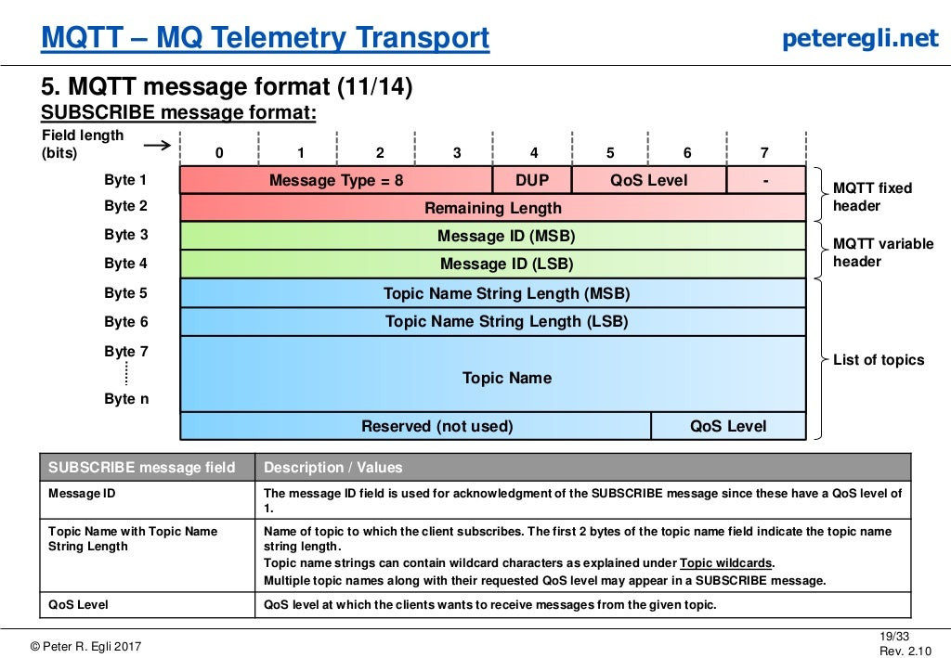

Slide 23
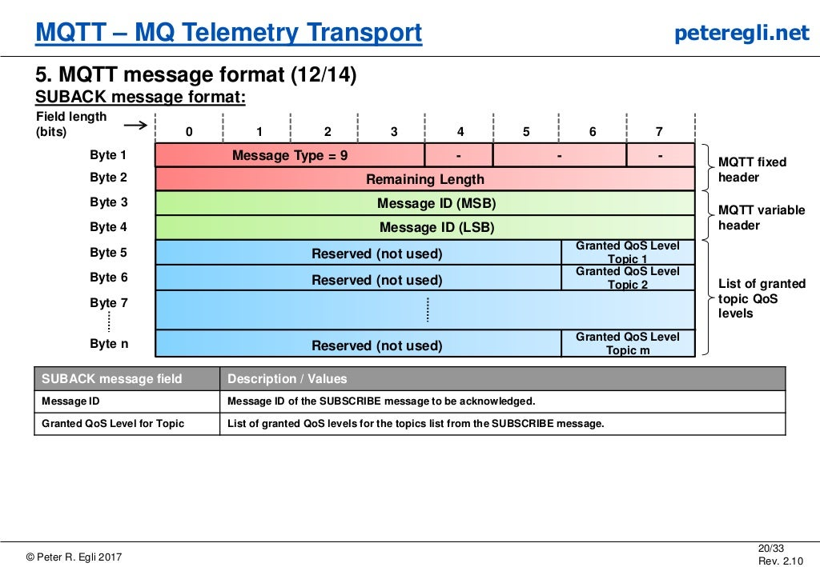

Slide 24
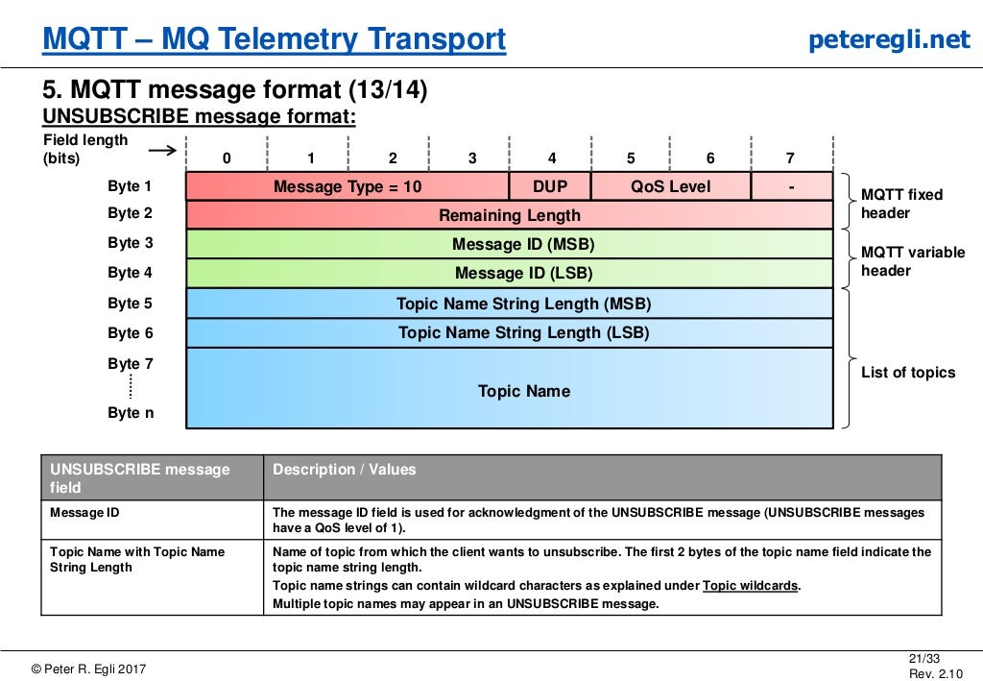

Slide 25
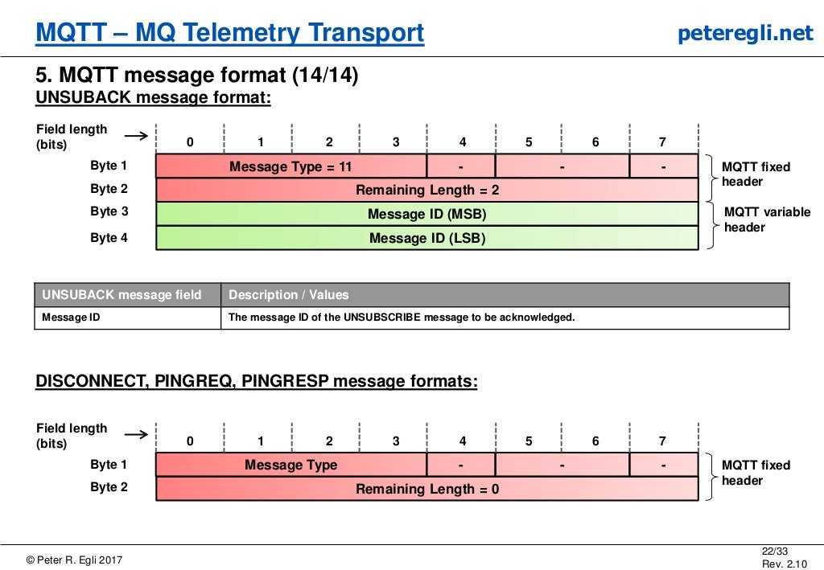

Slide 26
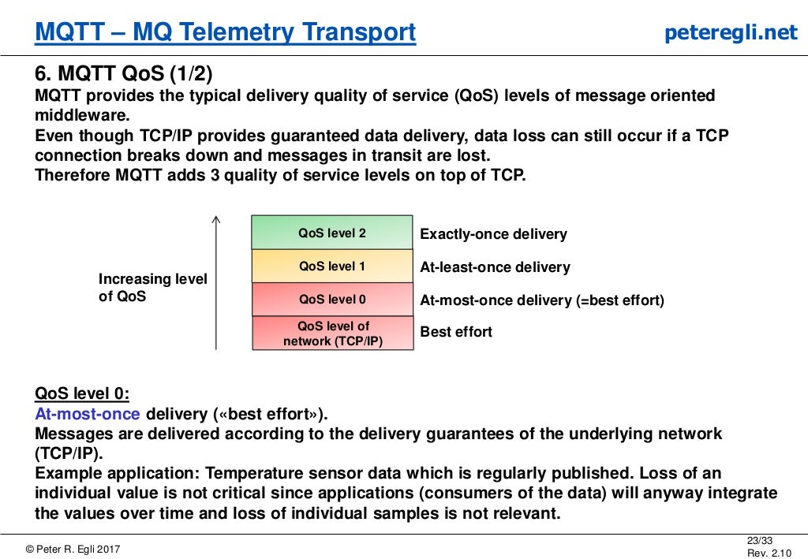

Slide 27
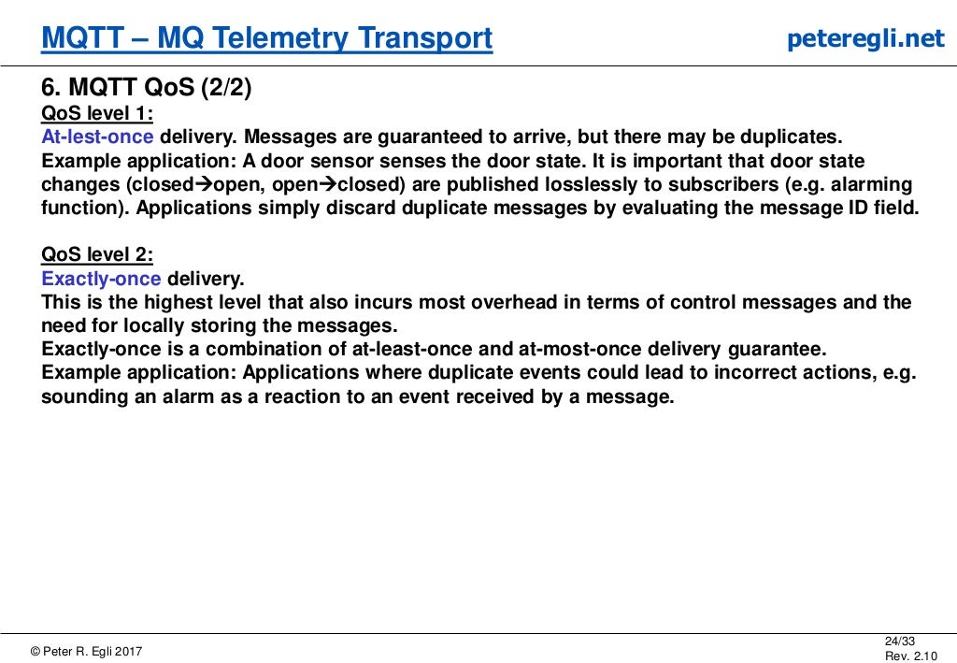

Slide 28
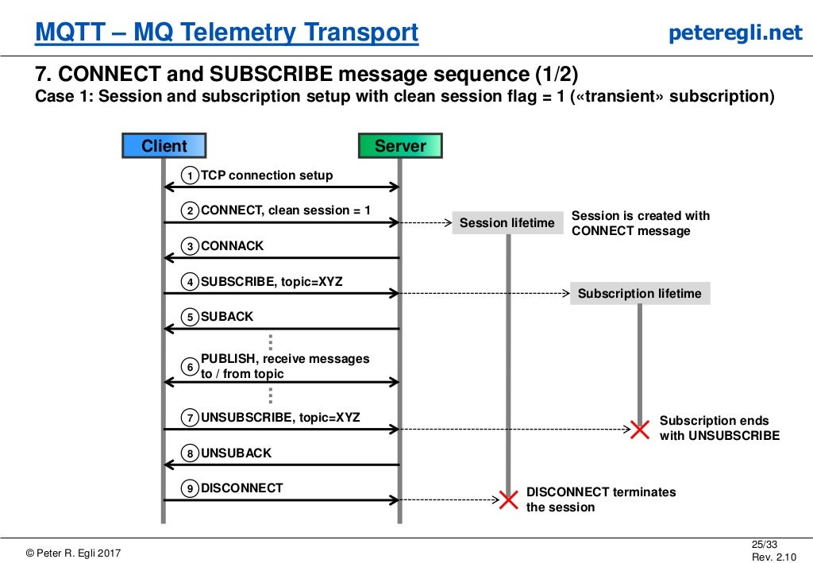

Slide 29
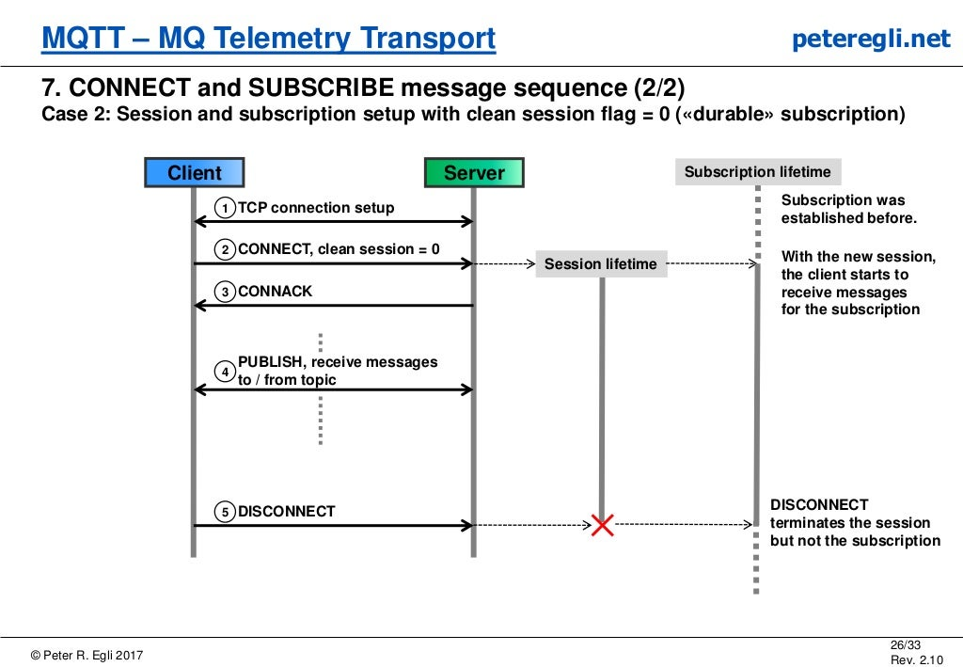

Slide 30
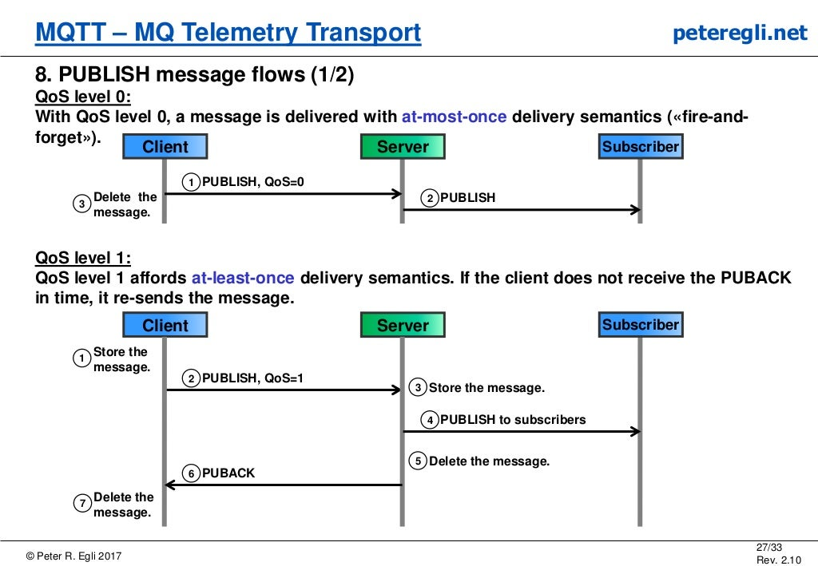

Slide 31
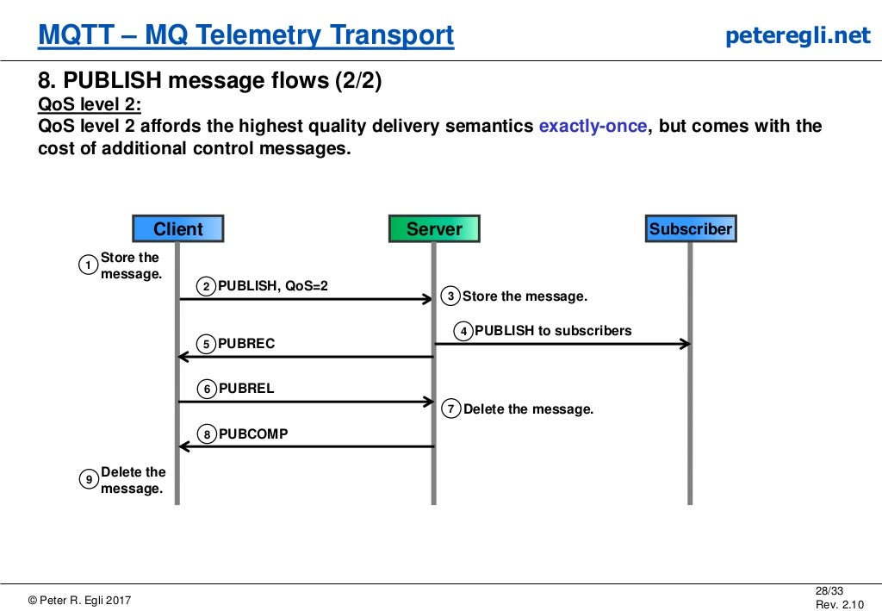

Slide 32
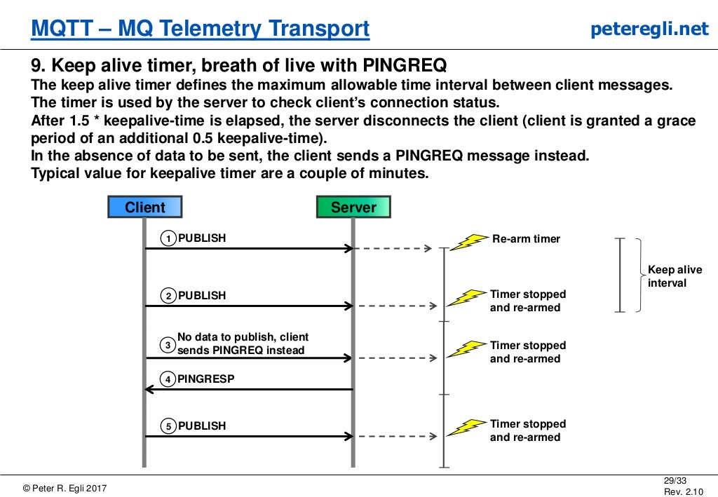

Slide 33
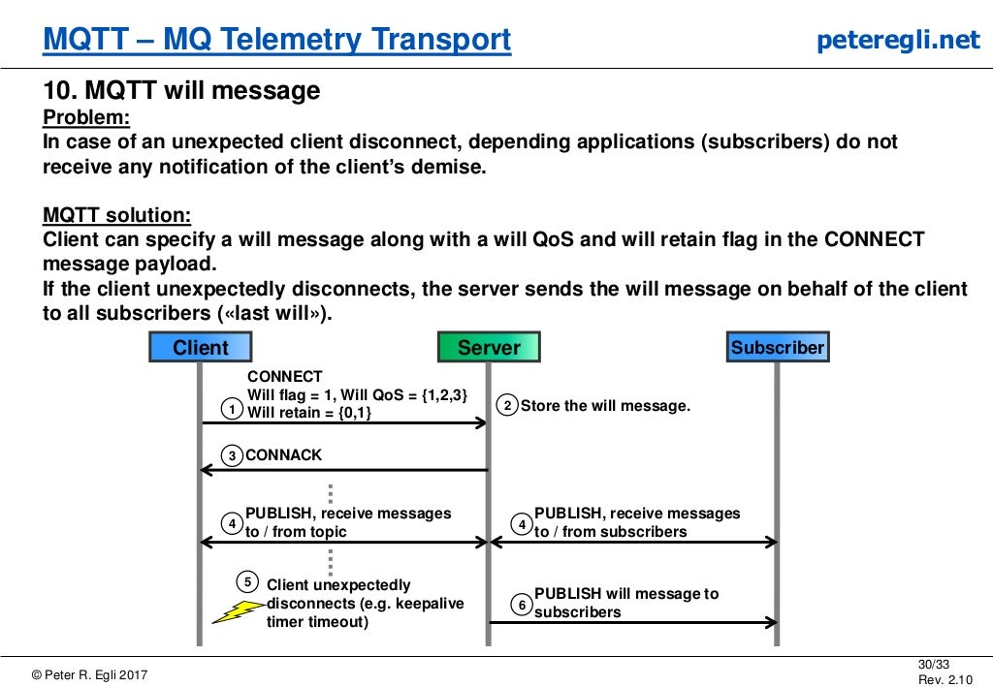

Slide 34
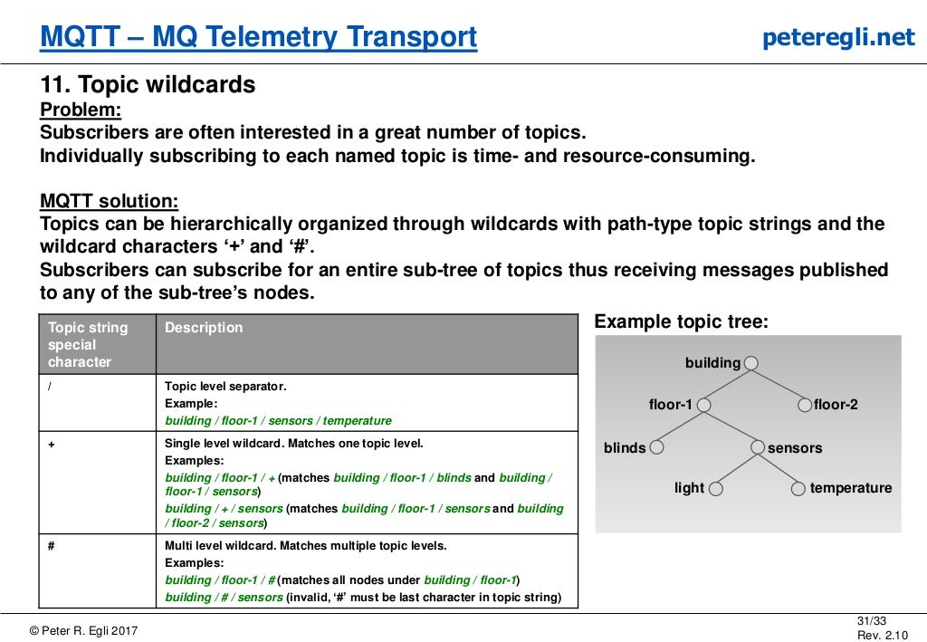

Slide 35
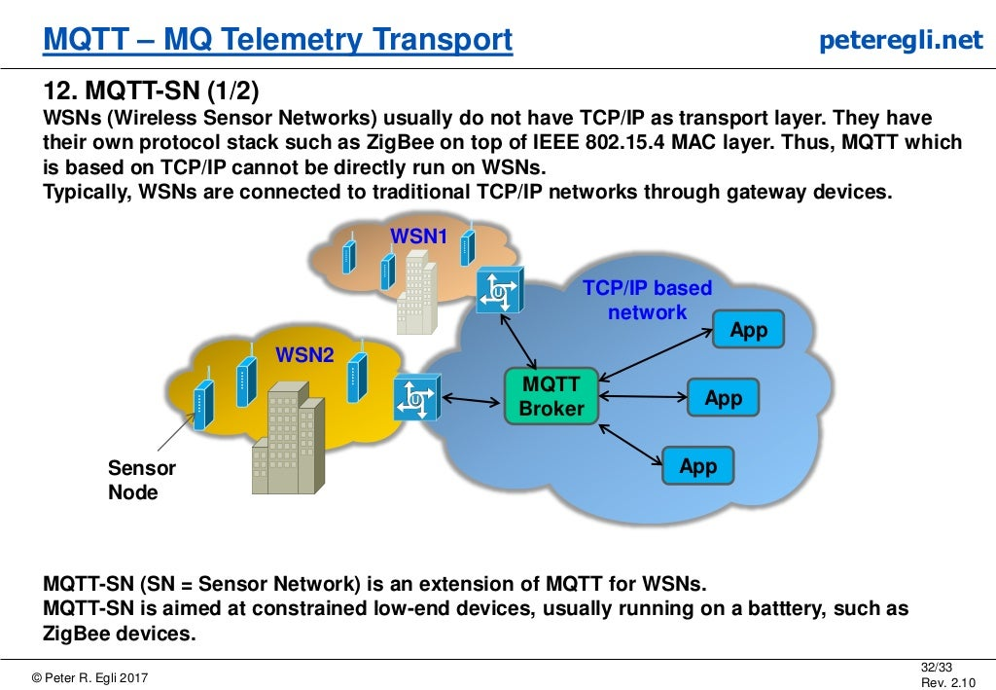

Slide 36
