Slide 1
Chapter 5
Syntax-Directed
Translation

Slide 2

outline
the translation of languages guided by context-free grammars.
A syntax-directed definition specifies the values of attributes by associating semantic rules with the grammar productions.
We associate information with a language construct by attaching attributes to the grammar symbol(s) representing the construct,

Slide 3
outline
a syntax-directed translation scheme embeds program fragments called semantic actions within production bodies.
E → E_{l} +T { print ' + ' }
The position of a semantic action in a production body determines the order in which the action is executed.
in general, semantic actions may occur at any position in a production body.

Slide 4
outline
The most general approach to syntax-directed translation is to construct a parse tree or a syntax tree, and then to compute the values of attributes at the nodes of the tree by visiting the nodes of the tree.
a class of syntax-directed translations called "L-attributed translations "
a smaller class, called "S-attributed translations" (S for synthesized )

Slide 5
5.1 Syntax-Directed Definitions
A syntax-directed definition (SDD) is a context-free grammar together with attributes and rules.
Attributes are associated with grammar symbols and rules are associated with productions.
X.a : denote the value of a at a particular parse-tree node labeled X.
Attributes may be of any kind: numbers, types, table references, or strings, for instance.

Slide 6
5.1.1 Inherited and Synthesized Attributes
A synthesized attribute: for a nonterminal A at a parse-tree node N is defined by a semantic rule associated with the production at N.
the production must have A as its head. A synthesized attribute at node N is defined only in terms of attribute values at the children of N and at N itself.

Slide 7
5.1.1 Inherited and Synthesized Attributes
An inherited attribute for a nonterminal B at a parse-tree node N is defined by a semantic rule associated with the production at the parent of N.
Note that the production must have B as a symbol in its body. An inherited attribute at node N is defined only in terms of attribute values at N's parent, N itself, and N's siblings.

Slide 8
5.1.1 Inherited and Synthesized Attributes
we do not allow an inherited attribute at node N to be defined in terms of attribute values at the children of node N.
we do allow a synthesized attribute at node N to be defined in terms of inherited attribute values at node N itself.
Terminals can have synthesized attributes, but not inherited attributes. Attributes for terminals have lexical values that are supplied by the lexical analyzer;

Slide 9
5.1.1 Inherited and Synthesized Attributes
PRODUCTION
  1) L → E n
  2) E → E _{l} + T
  3) E → T
  4) T → T_{l} * F
  5) T → F
  6) F → ( E )
  7) F → digit
SEMANTIC RULES
  L.val = E.val
  E.val=E₁.val+T.val
  E.val = T.val
  T.val=T_{l}.val ∗ F.val
  T.val = F.val
  F.val = E.val
  F. val = digit .lexval
S-attributed: An SDD that involves only synthesized attributes is called S-attributed.

Slide 10
5.1.1 Inherited and Synthesized Attributes
An S-attributed SDD can be implemented naturally in conjunction with an LR parser.
An SDD without side effects is sometimes called an attribute grammar.
The rules in an attribute grammar define the value of an attribute purely in terms of the values of other attributes and constants.

Slide 11
5.1.2 Evaluating an SDD at the Nodes of a Parse Tree
To visualize the translation specified by an SDD, it helps to work with parse trees, even though a translator need not actually build a parse tree.
annotated parse tree : A parse tree showing the value(s) of its attribute(s).

Slide 12
5.1.2 Evaluating an SDD at the Nodes of a Parse Tree
How do we construct an annotated parse tree?
In what order do we evaluate attributes?
Before we can evaluate an attribute at a node of a parse tree, we must evaluate all the attributes upon which its value depends.

Slide 13
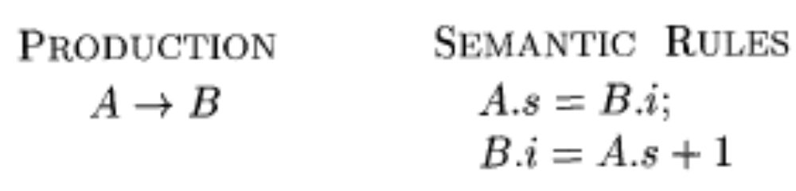
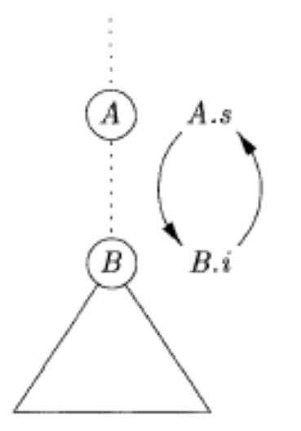
5.1.2 Evaluating an SDD at the Nodes of a Parse Tree
we can evaluate synthesized attributes in any bottom-up order.
For SDD's with both inherited and synthesized attributes, there is no guarantee that there is even one order in which to evaluate attributes at nodes.
These rules are circular; it is impossible to evaluate either A.s at a node N or B.i at the child of N without first evaluating the other.

Slide 14
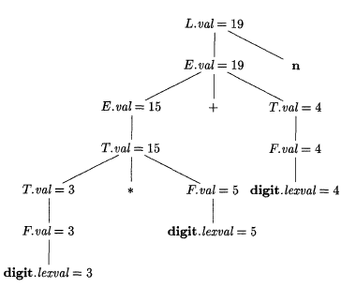
5.1.2 Evaluating an SDD at the Nodes of a Parse Tree
Example 5.2
Figure 5.3: Annotated parse tree for 3 * 5 + 4 n

Slide 15
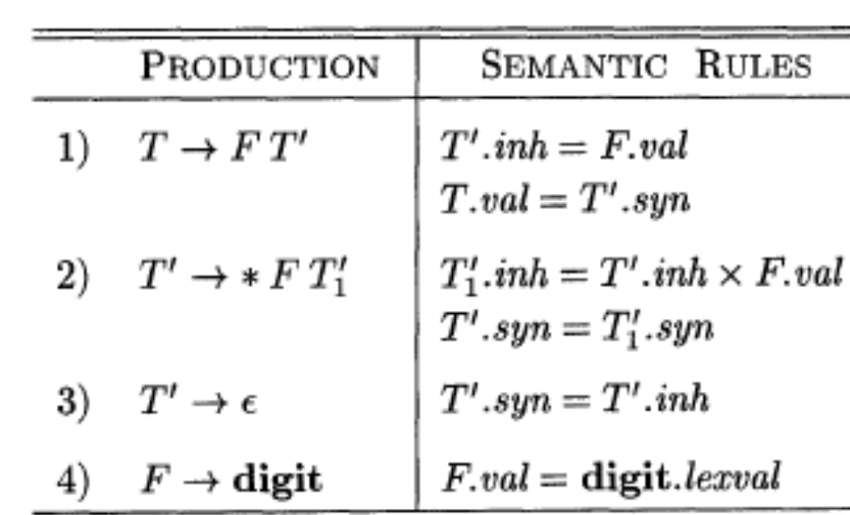
5.1.2 Evaluating an SDD at the Nodes of a Parse Tree
Inherited attributes are useful when the structure of a parse tree does not "match" the abstract syntax of the source code.
the left operand 3 appears in a different subtree of the parse tree from *.
An inherited attribute will therefore be used to pass the operand to the operator.

Slide 16
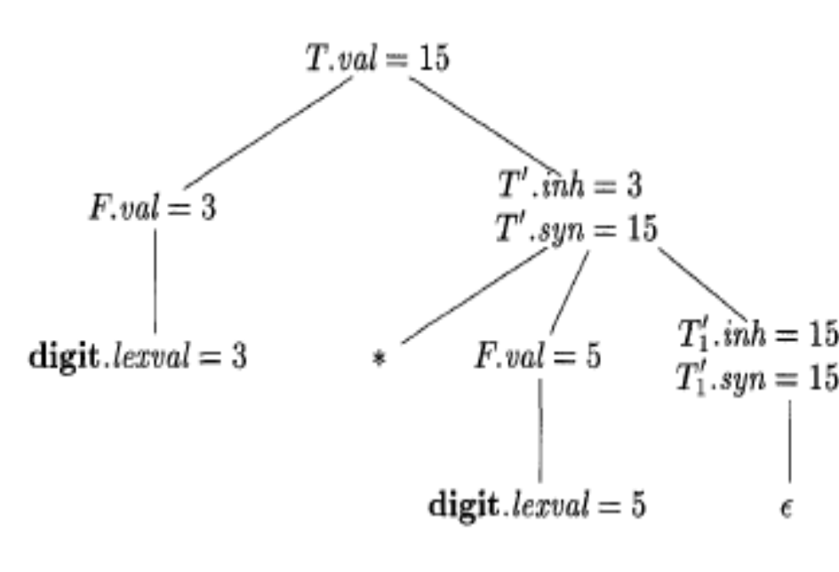
5.1.2 Evaluating an SDD at the Nodes of a Parse Tree
Each of the nonterminals T and F has a synthesized attribute val.
The terminal digit has a synthesized attribute lexval.
The nonterminal T' has two attributes: an inherited attribute inh and a synthesized attribute syn.
Example 5.3
Figure 5.5: Annotated parse tree for 3 * 5

Slide 17
5.2 Evaluation Orders for SDD's
"Dependency graphs" are a useful tool for determining an evaluation order for the attribute instances in a given parse tree.
two important classes of SDD's:
the "S-attributed"
the more general "L-attributed " SDD's.

Slide 18
5.2.1 Dependency Graphs
A dependency graph depicts the flow of information among the attribute instances in a particular parse tree.
Edges express constraints implied by the semantic rules.

Slide 19
5.2.1 Dependency Graphs
The dependency graph has a node for each attribute associated with X .
Suppose that a semantic rule associated with a production p defines the value of synthesized attribute A.b in terms of the value of X.c . Then, the dependency graph has an edge from X.c to A.b.
Suppose that a semantic rule associated with a production p defines the value of inherited attribute B.c in terms of the value of X.a. Then, the dependency graph has an edge from X.a to B.c.

Slide 20
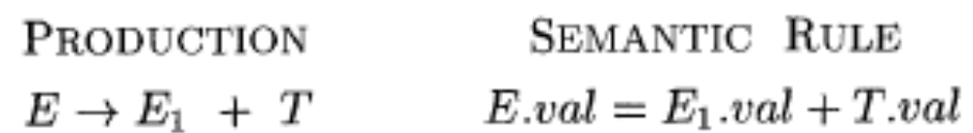
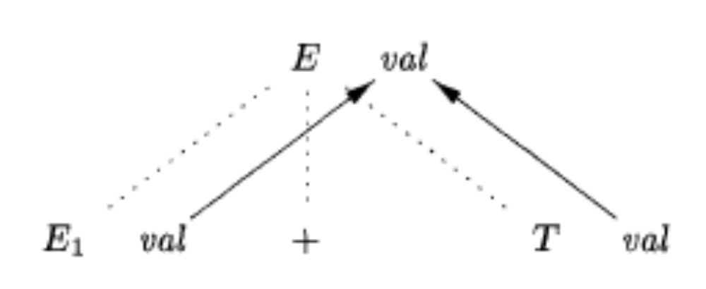
5.2.1 Dependency Graphs
Example 5.4
Figure 5.6: E. val is synthesized from El. val and E2. val

Slide 21
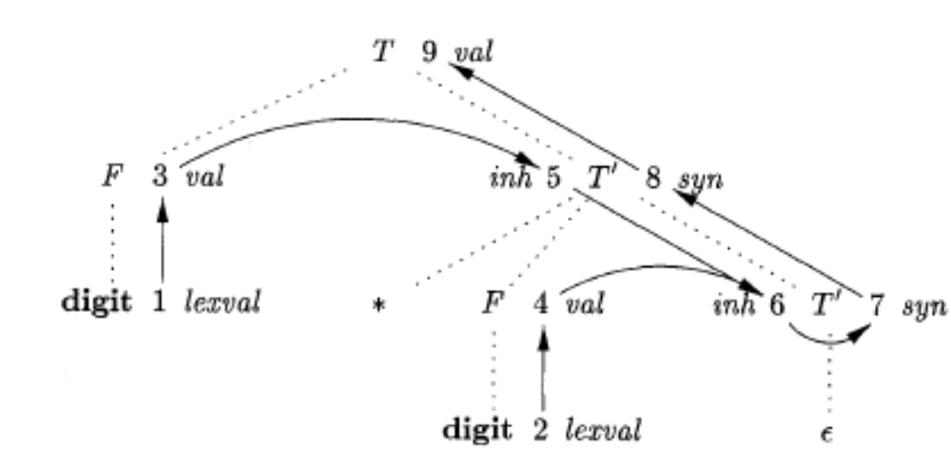
5.2.1 Dependency Graphs
Example 5.5
Figure 5.7: Dependency graph for the annotated parse tree of Fig. 5.5

Slide 22
5.2.2 Ordering the Evaluation of Attributes
the only allowable orders of evaluation are those sequences of nodes N_{l}, N₂,. . . , N_{k} such that if there is an edge of the dependency graph from N_{i} to N_{j}; then i < j.
Such an ordering embeds a directed graph into a linear order, and is called a topological sort of the graph.
If there is any cycle in the graph, then there are no topological sorts; that is,there is no way to evaluate the SDD on this parse tree.
If there are no cycles,however, then there is always at least one topological sort.

Slide 23
5.2.3 S-Attributed Definitions
An SDD is S-attributed if every attribute is synthesized.
Example 5.7 : The SDD of Fig. 5.1 is an example of an S-attributed definition. Each attribute, L.val, E.va1, T.val, and F.val is synthesized.
When an SDD is S-attributed, we can evaluate its attributes in any bottom up order of the nodes of the parse tree. (performing a postorder traversal of the parse tree)

Slide 24
5.2.3 S-Attributed Definitions
postorder (N) {
for ( each child C of N, from the left ) postorder(C);
evaluate the attributes associated with node N;
}
S-attributed definitions can be implemented during bottom-up parsing, since a bottom-up parse corresponds to a postorder traversal.

Slide 25
5.2.4 L-Attributed Definitions
between the attributes associated with a production body, dependency-graph edges can go from left to right, but not from right to left (hence "L-attributed").

Slide 26
5.2.4 L-Attributed Definitions
each attribute must be either
Synthesized, or
Inherited, but with the rules limited as follows. Suppose that there is a production A → X₁X₂ …… X_{n}, and that there is an inherited attribute X_{i}.a computed by a rule associated with this production.
Inherited attributes associated with the head A.
Either inherited or synthesized attributes associated with the occurrences of symbols X₁, X₂,. . . , X_{i-1} located to the left of X_{i}.
Inherited or synthesized attributes associated with this occurrence of X_{i} itself, but only in such a way that there are no cycles in a dependency graph formed by the attributes of this X_{i}.

Slide 27
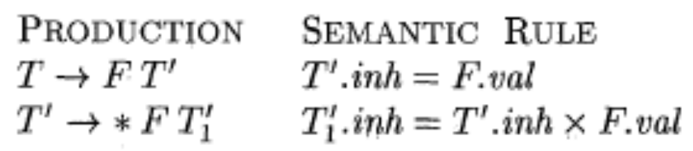

5.2.4 L-Attributed Definitions
Example 5.8 : The SDD in Fig. 5.4 is L-attributed.
Example 5.9 : Any SDD containing the following production and rules cannot be L-attributed:

Slide 28
5.2.5 Semantic Rules with Controlled Side Effects
we strike a balance between attribute grammars and translation schemes.
Attribute grammars have no side effects and allow any evaluation order consistent with the dependency graph.
Translation schemes impose left-to-right evaluation and allow semantic actions to contain any program fragment.

Slide 29
5.2.5 Semantic Rules with Controlled Side Effects
control side effects in SDD's in one of the following ways:
Permit incidental side effects that do not constrain attribute evaluation.
Constrain the allowable evaluation orders, so that the same translation is produced for any allowable order.

Slide 30
5.2.5 Semantic Rules with Controlled Side Effects
Example 5.10 : The SDD in Fig. 5.8 takes a simple declaration D consisting of a basic type T followed by a list L of identifiers.
1) D → T L
2) T → int
3) T → float
4) L → L₁ , id
5) L → id
L.inh = T.type
T. type = integer
T.type = float
L_{l}.inh=L.inh
addType(id.entry, L.inh)
add Type(id entry, L.inh)

Slide 31
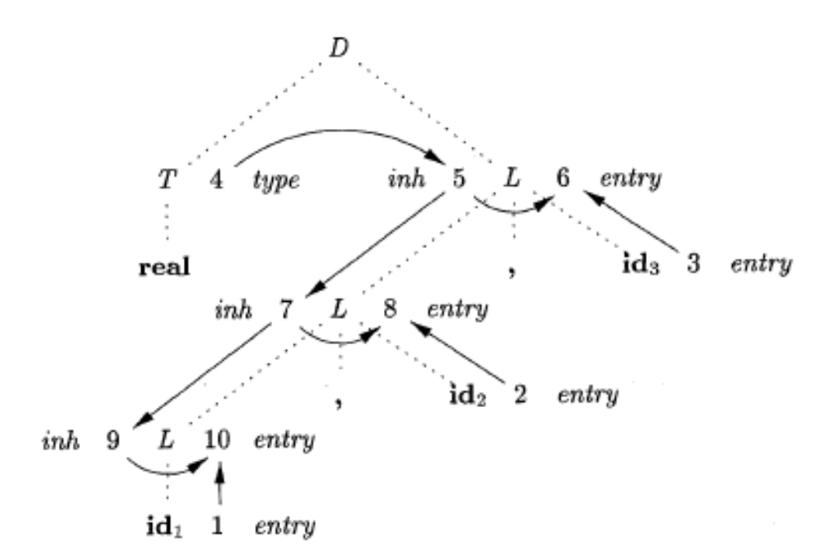
5.2.5 Semantic Rules with Controlled Side Effects
Figure 5.9: Dependency graph for a declaration float id_{l},id₂,id₃

Slide 32
5.3 Applications of Syntax-Directed Translation
two SDD's for constructing syntax trees for expressions.
  The first, an S-attributed definition, is suitable for use during bottom-up parsing.
  The second, L-attributed, is suitable for use during top-down parsing.
The final example of this section is an L-attributed definition that deals with basic and array types.

Slide 33
5.3.1 Construction of Syntax Trees
If the node is a leaf, an additional field holds the lexical value for the leaf. A constructor function Leaf ( op, val ) creates a leaf object.
If the node is an interior node, there are as many additional fields as the node has children in the syntax tree. A constructor function Node takes two or more arguments: Node(op, c_{l}, c₂, . . . , c_{k})

Slide 34
5.3.1 Construction of Syntax Trees
Example 5.1.1 : The S-attributed definition in Fig. 5.10 constructs syntax trees for a simple expression grammar involving only the binary operators +and -.
PRODUCTION
1) E → E₁ + T
2) E → E₁ - T
3) E → T
4) T →( E )
5) T → id
6) T → nurn
SEMANTIC RULES
E.node = new Node('+', E₁ .node, T.node)
E.node = new Node('-', E_{l} .node, T.node)
E.node = T.node
T.node = E.node
T.node = new Leaf (id, id.entry)
T.node = new Leaf (num, num.val)
Figure 5.10: Constructing syntax trees for simple expressions

Slide 35
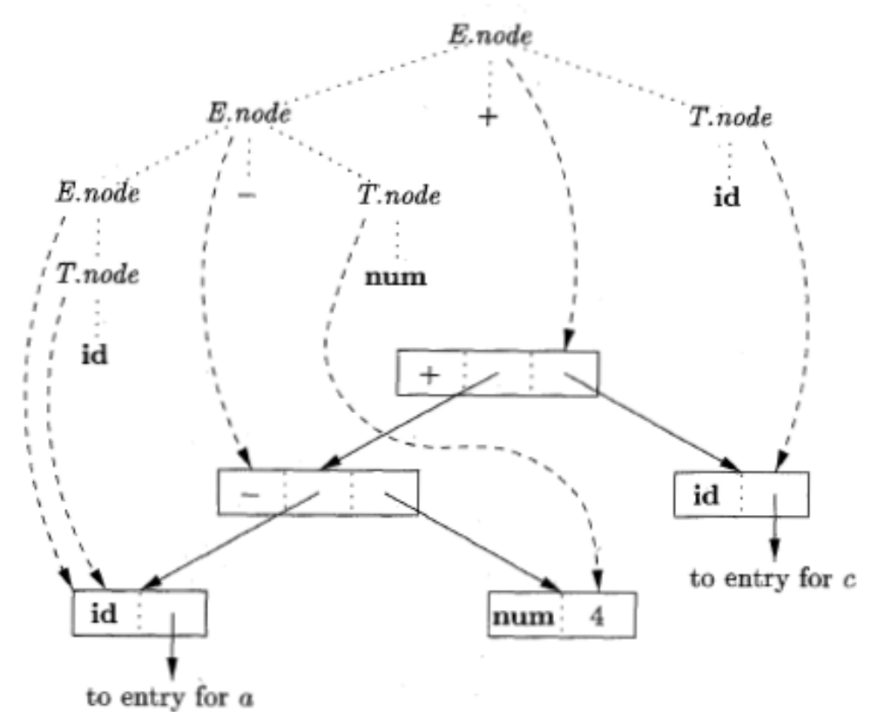
5.3.1 Construction of Syntax Trees
1) pl = new Leaf(id, entry-a);
2) p2= new Leaf (num, 4);
3) p3 = new Node('-', pl, p2);
4) p4 = new Leaf(id, entry-c);
5) p5 = new Node('+', p3,p4);
Figure 5.12: Steps in the construction of the syntax tree for a - 4 + c
Figure 5.11: Syntax tree for a - 4 + c

Slide 36
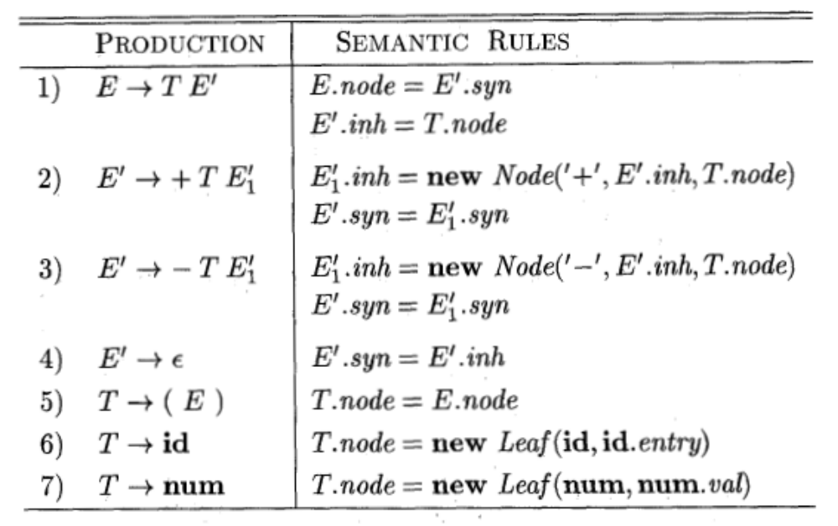
5.3.1 Construction of Syntax Trees
Example 5.12 : The L-attributed definition in Fig. 5.13
Figure 5.13: Constructing syntax trees during top-down parsing

Slide 37
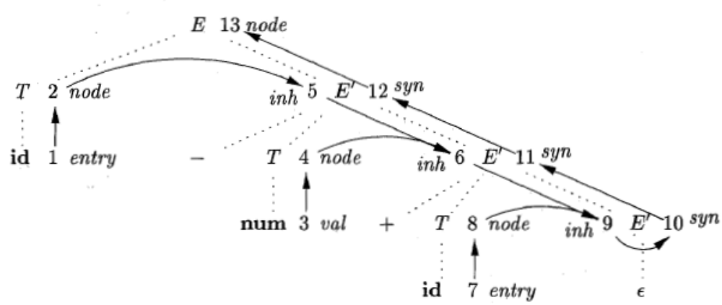
5.3.1 Construction of Syntax Trees
Figure 5.14: Dependency graph for a - 4 + c, with the SDD of Fig. 5.13

Slide 38
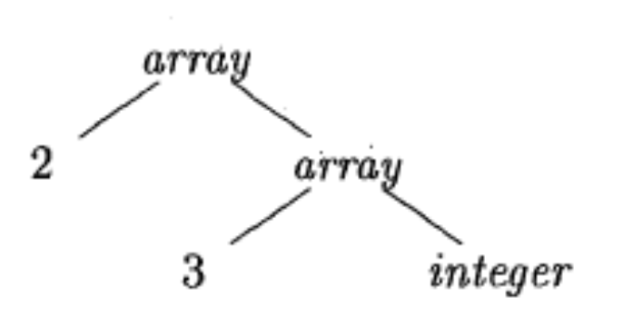
5.3.2 The Structure of a Type
Inherited attributes are useful when the structure of the parse tree differs from the abstract syntax of the input; attributes can then be used to carry information from one part of the parse tree to another.
Example 5.13: In C, the type int [2][3] can be read as, "array of 2 arrays of 3 integers." The corresponding type expression array(2, array(3, integer)) is
represented by the tree in Fig. 5.15
Figure 5.15: Type expression for int [2] [3]

Slide 39
5.3.2 The Structure of a Type
PRODUCTION
T → BC
B → int
B → float
C → [ num ] C₁
C → ε
SEMANTIC RULES
T.t = C.t
C.b = B.t
B.t = integer
B.t = float
C.t = array (num.val , C₁ .t)
C₁.b = C.b
C.t = C.b
Figure 5.16: T generates either a basic type or an array type

Slide 40
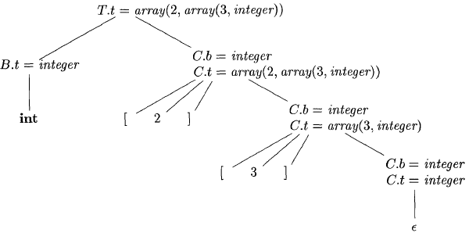
5.3.2 The Structure of a Type
Figure 5.17: Syntax-directed translation of array types

Slide 41
作业
5．2．2
5．2．3 （a, b, c）
5．3．1

