Slide 1
Neural Networks

Slide 2
What is a (Neural Network) NN?
Single neuron == linear regression without applying activation(perceptron)
Basically a single neuron will calculate weighted sum of input(W.T*X) and then we can set a threshold to predict output in a perceptron. If weighted sum of input cross the threshold, perceptron fires and if not then perceptron doesn't predict.
Perceptron can take real values input or boolean values.
Actually, when w⋅x+b=0 the perceptron outputs 0.
Disadvantage of perceptron is that it only output binary values and if we try to give small change in weight and bais then perceptron can flip the output. We need some system which can modify the output slightly according to small change in weight and bias. Here comes sigmoid function in picture.
If we change perceptron with a sigmoid function, then we can make slight change in output.
e.g. output in perceptron = 0, you slightly changed weight and bias, output becomes = 1 but actual output is 0.7. In case of sigmoid, output1 = 0, slight change in weight and bias, output = 0.7.
If we apply sigmoid activation function then Single neuron will act as Logistic Regression.
we can understand difference between perceptron and sigmoid function by looking at sigmoid function graph.

Slide 3
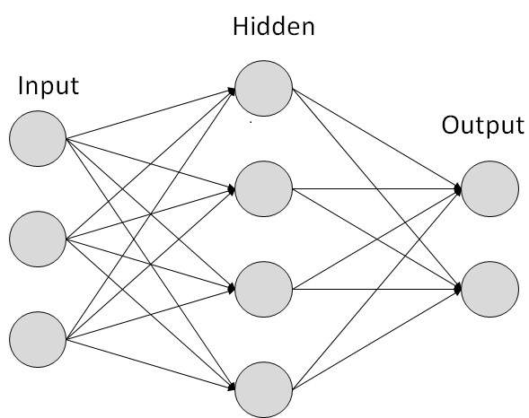
Simple NN graph:

Slide 4
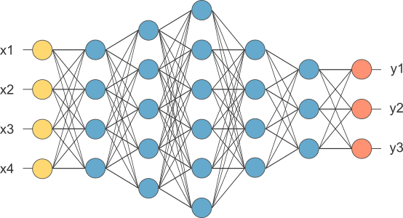
RELU stands for rectified linear unit is the most popular activation function right now that makes deep NNs train faster now.
Hidden layers predicts connection between inputs automatically, thats what deep learning is good at.
Deep NN consists of more hidden layers (Deeper layers)
Each Input will be connected to the hidden layer and the NN will decide the connections.
Supervised learning means we have the (X,Y) and we need to get the function that maps X to Y.

Slide 5
Supervised learning with neural networks
Different types of neural networks for supervised learning which includes:
CNN or convolutional neural networks (Useful in computer vision)
RNN or Recurrent neural networks (Useful in Speech recognition or NLP)
Standard NN (Useful for Structured data)
Hybrid/custom NN or a Collection of NNs types
Structured data is like the databases and tables.
Unstructured data is like images, video, audio, and text.
Structured data gives more money because companies relies on prediction on its big data.

Slide 6
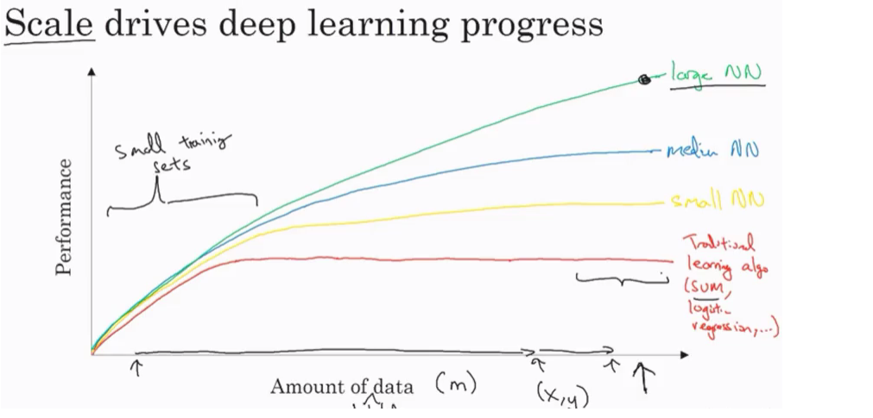
Why is deep learning taking off?
Deep learning is taking off for 3 reasons:
Data:
Using this image we can conclude

Slide 7
For small data NN can perform as Linear regression or SVM (Support vector machine)
For big data a small NN is better that SVM
For big data a big NN is better that a medium NN is better that small NN.
Hopefully we have a lot of data because the world is using the computer a little bit more
Mobiles
IOT (Internet of things)
Computation:
GPUs.
Powerful CPUs.
Distributed computing.
ASICs
Algorithm:
Creative algorithms has appeared that changed the way NN works.
For example using RELU function is so much better than using SIGMOID function in training a NN because it helps with the vanishing gradient problem.
​

Slide 8
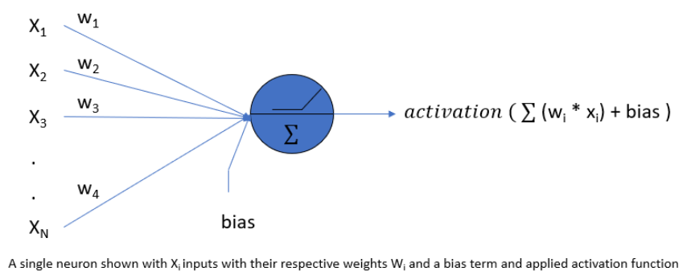
What are Neural Networks?
Neural networks mimic the basic functioning of the human brain and are inspired by how the human brain interprets information. They solve various real-time tasks because of its ability to perform computations quickly and its fast responses.

Slide 9
Artificial Neural Network has a huge number of interconnected processing elements, also known as Nodes. These nodes are connected with other nodes using a connection link. The connection link contains weights, these weights contain the information about the input signal. Each iteration and input in turn leads to updating of these weights. After inputting all the data instances from the training data set, the final weights of the Neural Network along with its architecture is known as the Trained Neural Network. This process is called Training of Neural Networks. These trained neural networks solve specific problems as defined in the problem statement.
Types of tasks that can be solved using an artificial neural network include Classification problems, Pattern Matching, Data Clustering, etc.
What are Neural Networks Used For?
Neural networks are employed across various domains for:
Identifying objects, faces, and understanding spoken language in applications like self-driving cars and voice assistants.
Analyzing and understanding human language, enabling sentiment analysis, chatbots, language translation, and text generation.
Diagnosing diseases from medical images, predicting patient outcomes, and drug discovery.
Predicting stock prices, credit risk assessment, fraud detection, and algorithmic trading.
Personalizing content and recommendations in e-commerce, streaming platforms, and social media.
Powering robotics and autonomous vehicles by processing sensor data and making real-time decisions.

Slide 10
Types of Neural Network in Machine Learning
Explore different kinds of neural networks in machine learning in this section:
(i) ANN
ANN is also known as an artificial neural network. It is a feed-forward neural network because the inputs are sent in the forward direction. It can also contain hidden layers which can make the model even denser. They have a fixed length as specified by the programmer. It is used for Textual Data or Tabular Data. A widely used real-life application is Facial Recognition. It is comparatively less powerful than CNN and RNN.
(ii) CNN
Convolutional Neural Networks is mainly used for Image Data. It is used for Computer Vision. Some of the real-life applications are object detection in autonomous vehicles. It contains a combination of convolutional layers and neurons. It is more powerful than both ANN and RNN.
(iii) RNN
It is also known as Recurrent Neural Networks. It is used to process and interpret time series data. In this type of model, the output from a processing node is fed back into nodes in the same or previous layers. The most known types of RNN are LSTM (Long Short Term Memory) Networks

Slide 11
Classification Algorithm in Machine Learning
As we know, the Supervised Machine Learning algorithm can be broadly classified into Regression and Classification Algorithms. In Regression algorithms, we have predicted the output for continuous values, but to predict the categorical values, we need Classification algorithms.
What is the Classification Algorithm?
The Classification algorithm is a Supervised Learning technique that is used to identify the category of new observations on the basis of training data. In Classification, a program learns from the given dataset or observations and then classifies new observation into a number of classes or groups. Such as, Yes or No, 0 or 1, Spam or Not Spam, cat or dog, etc. Classes can be called as targets/labels or categories.
Unlike regression, the output variable of Classification is a category, not a value, such as "Green or Blue", "fruit or animal", etc. Since the Classification algorithm is a Supervised learning technique, hence it takes labeled input data, which means it contains input with the corresponding output.
In classification algorithm, a discrete output function(y) is mapped to input variable(x).
y=f(x), where y = categorical output

Slide 12
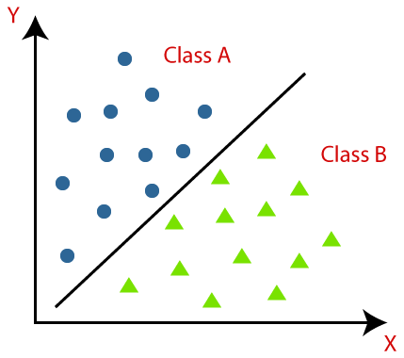
The best example of an ML classification algorithm is Email Spam Detector.
The main goal of the Classification algorithm is to identify the category of a given dataset, and these algorithms are mainly used to predict the output for the categorical data.
Classification algorithms can be better understood using the below diagram. In the below diagram, there are two classes, class A and Class B. These classes have features that are similar to each other and dissimilar to other classes.

Slide 13
The algorithm which implements the classification on a dataset is known as a classifier. There are two types of Classifications:
Binary Classifier: If the classification problem has only two possible outcomes, then it is called as Binary Classifier. Examples: YES or NO, MALE or FEMALE, SPAM or NOT SPAM, CAT or DOG, etc.
Multi-class Classifier: If a classification problem has more than two outcomes, then it is called as Multi-class Classifier. Example: Classifications of types of crops, Classification of types of music.
Learners in Classification Problems:
In the classification problems, there are two types of learners:
Lazy Learners:
Lazy Learner firstly stores the training dataset and wait until it receives the test dataset. In Lazy learner case, classification is done on the basis of the most related data stored in the training dataset. It takes less time in training but more time for predictions. Example: K-NN algorithm, Case-based reasoning
2. Eager Learners: Eager Learners develop a classification model based on a training dataset before receiving a test dataset. Opposite to Lazy learners, Eager Learner takes more time in learning, and less time in prediction.
Example: Decision Trees, Naïve Bayes, ANN.

Slide 14
Logistic Regression
Logistic regression is one of the most popular Machine Learning algorithms, which comes under the Supervised Learning technique. It is used for predicting the categorical dependent variable using a given set of independent variables.
Logistic regression predicts the output of a categorical dependent variable. Therefore the outcome must be a categorical or discrete value. It can be either Yes or No, 0 or 1, true or False, etc. but instead of giving the exact value as 0 and 1, it gives the probabilistic values which lie between 0 and 1.
Logistic Regression is much similar to the Linear Regression except that how they are used. Linear Regression is used for solving Regression problems, whereas Logistic regression is used for solving the classification problems.
In Logistic regression, instead of fitting a regression line, we fit an "S" shaped logistic function, which predicts two maximum values (0 or 1).
The curve from the logistic function indicates the likelihood of something such as whether the cells are cancerous or not, a mouse is obese or not based on its weight, etc.
Logistic Regression is a significant machine learning algorithm because it has the ability to provide probabilities and classify new data using continuous and discrete datasets.

Slide 15
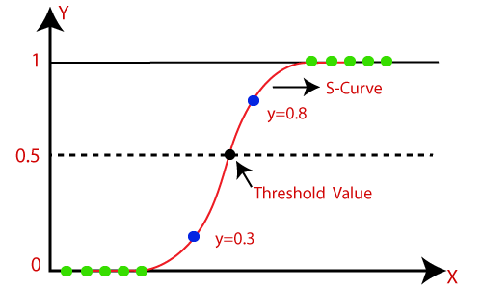
Logistic Regression can be used to classify the observations using different types of data and can easily determine the most effective variables used for the classification. The below image is showing the logistic function:

Slide 16
Logistic Function (Sigmoid Function):
The sigmoid function is a mathematical function used to map the predicted values to probabilities.
It maps any real value into another value within a range of 0 and 1.
The value of the logistic regression must be between 0 and 1, which cannot go beyond this limit, so it forms a curve like the "S" form. The S-form curve is called the Sigmoid function or the logistic function.
In logistic regression, we use the concept of the threshold value, which defines the probability of either 0 or 1. Such as values above the threshold value tends to 1, and a value below the threshold values tends to 0.
Assumptions for Logistic Regression:
The dependent variable must be categorical in nature.
The independent variable should not have multi-collinearity.
Logistic Regression Equation:
The Logistic regression equation can be obtained from the Linear Regression equation. The mathematical steps to get Logistic Regression equations are given below:
We know the equation of the straight line can be written as:

Slide 17


In Logistic Regression y can be between 0 and 1 only, so for this let's divide the above equation by (1-y):
But we need range between -[infinity] to +[infinity], then take logarithm of the equation it will become:
The above equation is the final equation for Logistic Regression.
Type of Logistic Regression:
On the basis of the categories, Logistic Regression can be classified into three types:
Binomial: In binomial Logistic regression, there can be only two possible types of the dependent variables, such as 0 or 1, Pass or Fail, etc.
Multinomial: In multinomial Logistic regression, there can be 3 or more possible unordered types of the dependent variable, such as "cat", "dogs", or "sheep"
Ordinal: In ordinal Logistic regression, there can be 3 or more possible ordered types of dependent variables, such as "low", "Medium", or "High".

Slide 18
Deep Feed Forward Networks

Slide 19
Now, we know how with the combination of lines with different weight and biases can result in non-linear models. How does a neural network know what weight and biased values to have in each layer? It is no different from how we did it for the single based perceptron model.
We are still making use of a gradient descent optimization algorithm which acts to minimize the error of our model by iteratively moving in the direction with the steepest descent, the direction which updates the parameters of our model while ensuring the minimal error. It updates the weight of every model in every single layer. We will talk more about optimization algorithms and backpropagation later.
It is important to recognize the subsequent training of our neural network. Recognition is done by dividing our data samples through some decision boundary.
"The process of receiving an input to produce some kind of output to make some kind of prediction is known as Feed Forward." Feed Forward neural network is the core of many other important neural networks such as convolution neural network.

Slide 20
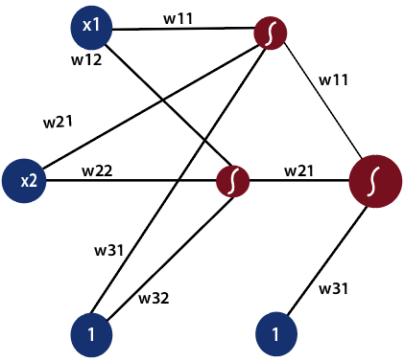
In the feed-forward neural network, there are not any feedback loops or connections in the network. Here is simply an input layer, a hidden layer, and an output layer.

Slide 21


There can be multiple hidden layers which depend on what kind of data you are dealing with. The number of hidden layers is known as the depth of the neural network. The deep neural network can learn from more functions. Input layer first provides the neural network with data and the output layer then make predictions on that data which is based on a series of functions. ReLU Function is the most commonly used activation function in the deep neural network.
To gain a solid understanding of the feed-forward process, let's see this mathematically.
The first input is fed to the network, which is represented as matrix x1, x2, and one where one is the bias value.
2) Each input is multiplied by weight with respect to the first and second model to obtain their probability of being in the positive region in each model.
So, we will multiply our inputs by a matrix of weight using matrix multiplication.

Slide 22



3) After that, we will take the sigmoid of our scores and gives us the probability of the point being in the positive region in both models.
4) We multiply the probability which we have obtained from the previous step with the second set of weights. We always include a bias of one whenever taking a combination of inputs.
And as we know to obtain the probability of the point being in the positive region of this model, we take the sigmoid and thus producing our final output in a feed-forward process.

Slide 23
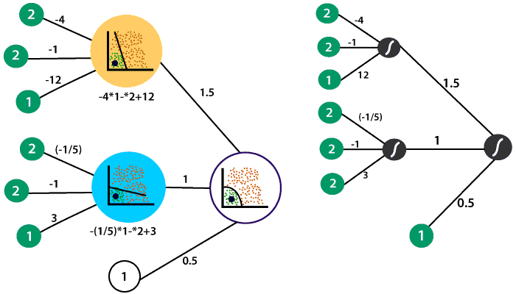
Let takes the neural network which we had previously with the following linear models and the hidden layer which combined to form the non-linear model in the output layer.

Slide 24



So, what we will do we use our non-linear model to produce an output that describes the probability of the point being in the positive region. The point was represented by 2 and 2. Along with bias, we will represent the input as
The first linear model in the hidden layer recall and the equation defined it
Which means in the first layer to obtain the linear combination the inputs are multiplied by -4, -1 and the bias value is multiplied by twelve.

Slide 25
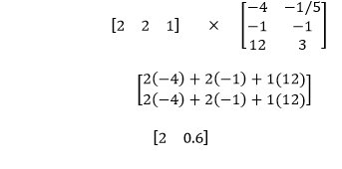

The weight of the inputs are multiplied by -1/5, 1, and the bias is multiplied by three to obtain the linear combination of that same point in our second model.
Now, to obtain the probability of the point is in the positive region relative to both models we apply sigmoid to both points as
The second layer contains the weights which dictated the combination of the linear models in the first layer to obtain the non-linear model in the second layer. The weights are 1.5, 1, and a bias value of 0.5.

Slide 26


Now, we have to multiply our probabilities from the first layer with the second set of weights as
Now, we will take the sigmoid of our final score
It is complete math behind the feed forward process where the inputs from the input traverse the entire depth of the neural network. In this example, there is only one hidden layer. Whether there is one hidden layer or twenty, the computational processes are the same for all hidden layers.

Slide 27
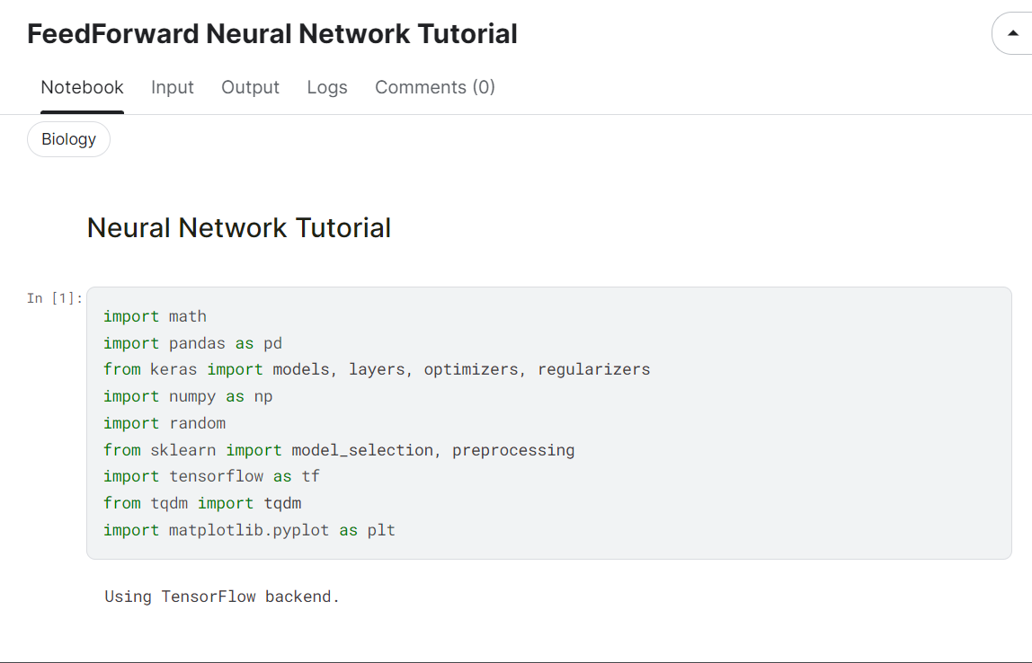

Slide 28
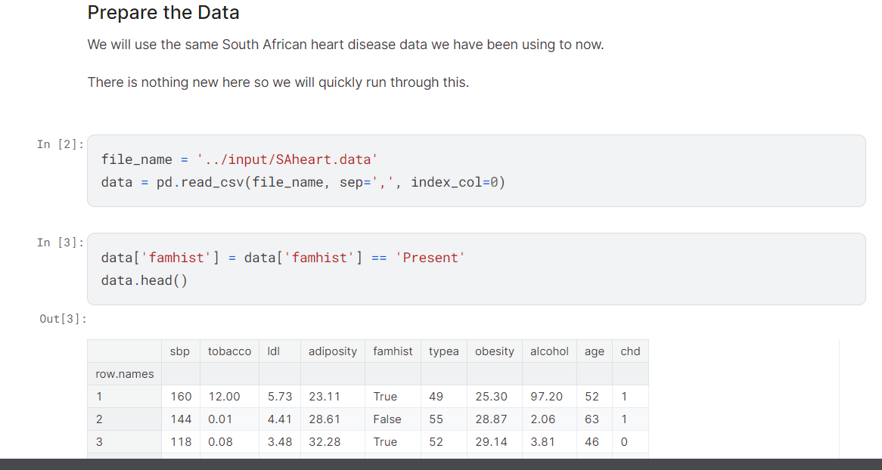

Slide 29
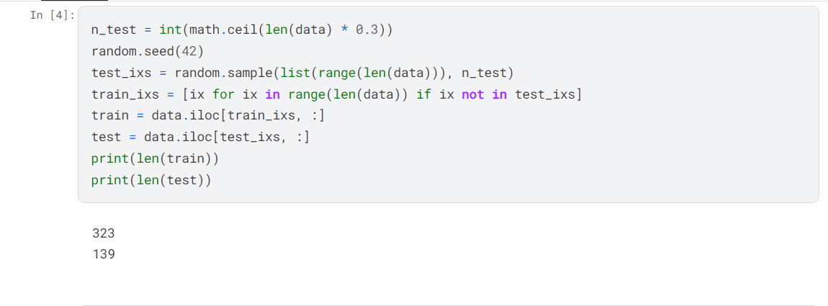
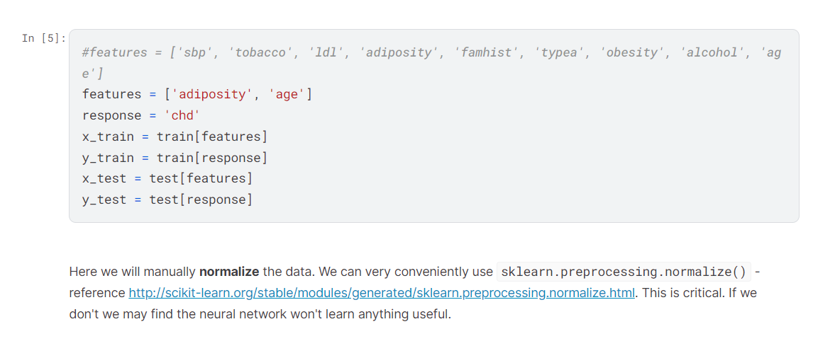

Slide 30
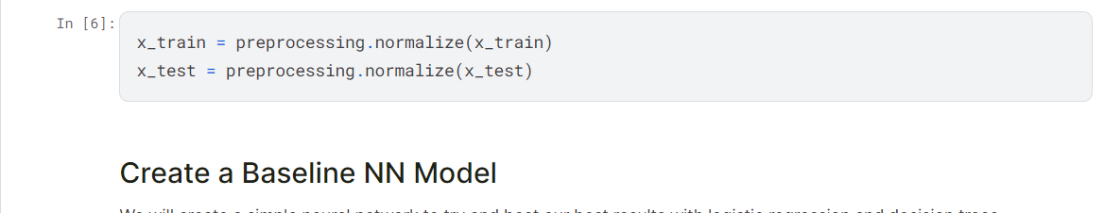
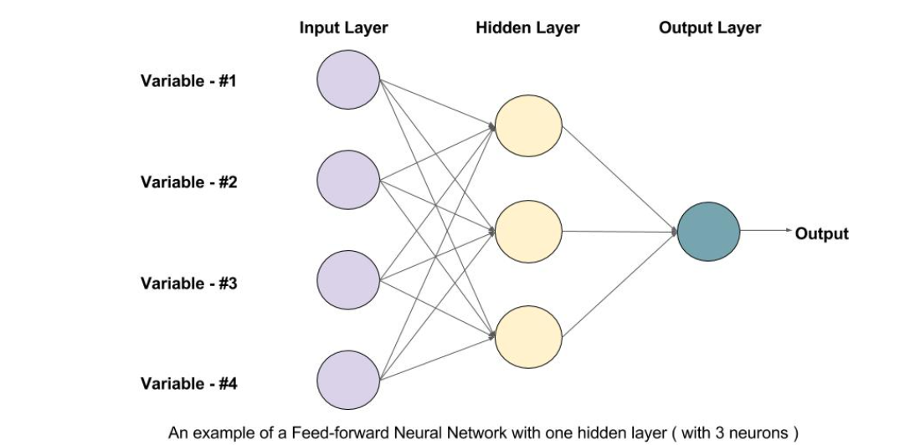

Slide 31
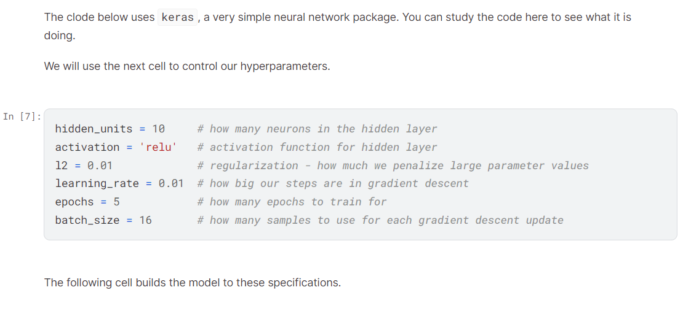

Slide 32
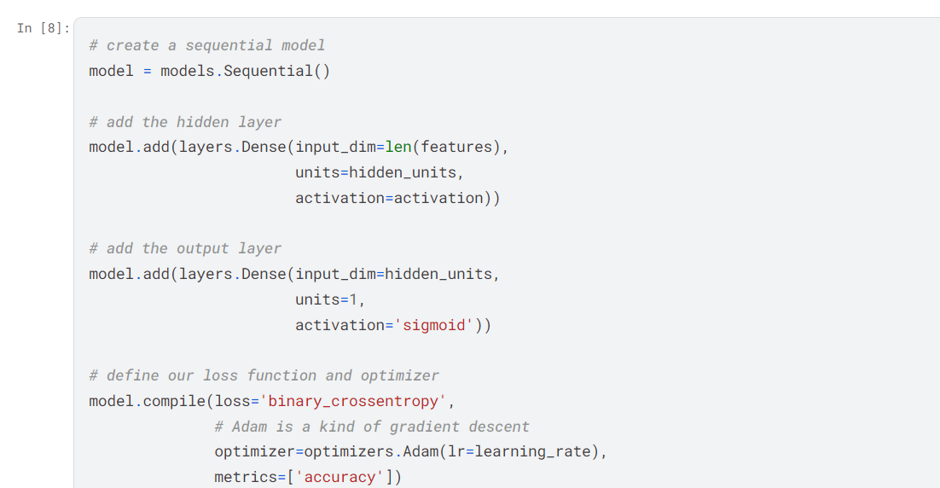

Slide 33
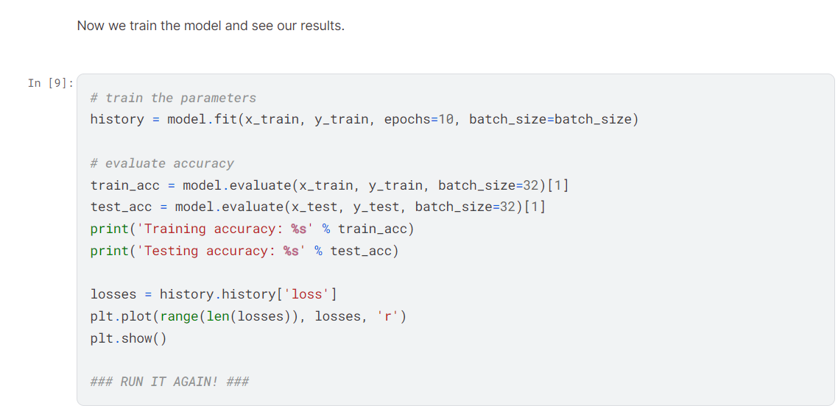

Slide 34
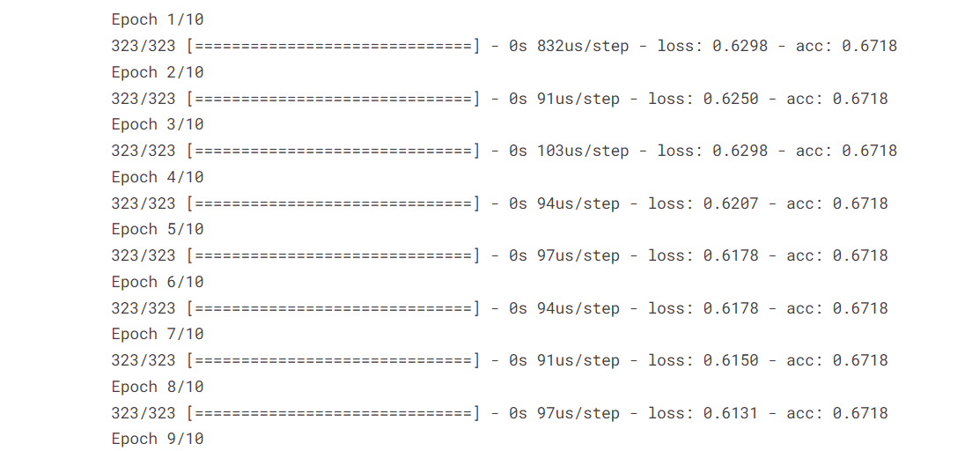
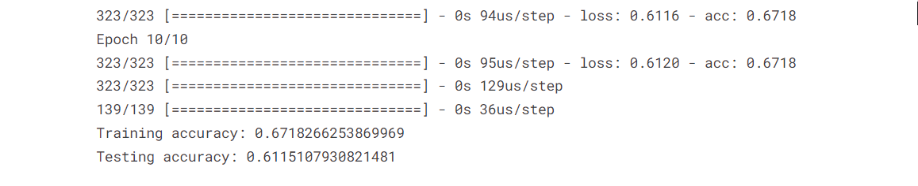

Slide 35
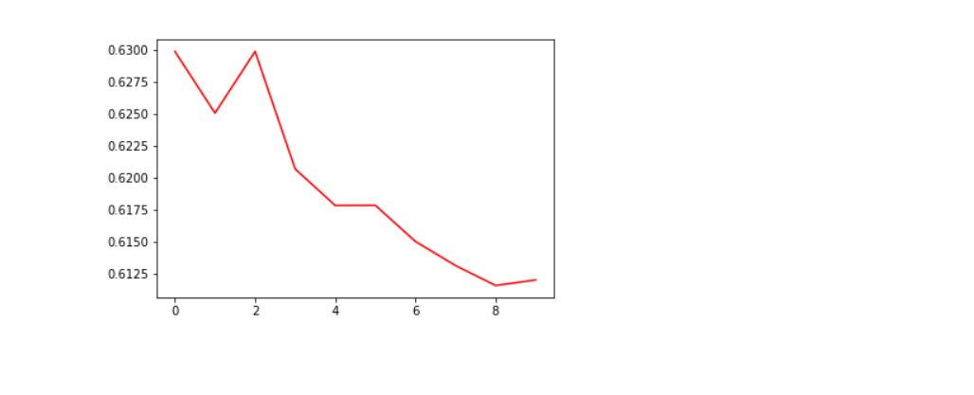

Slide 36
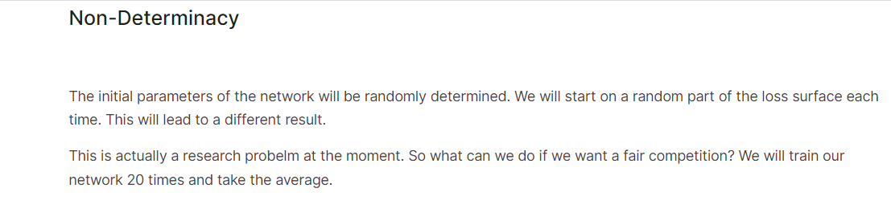
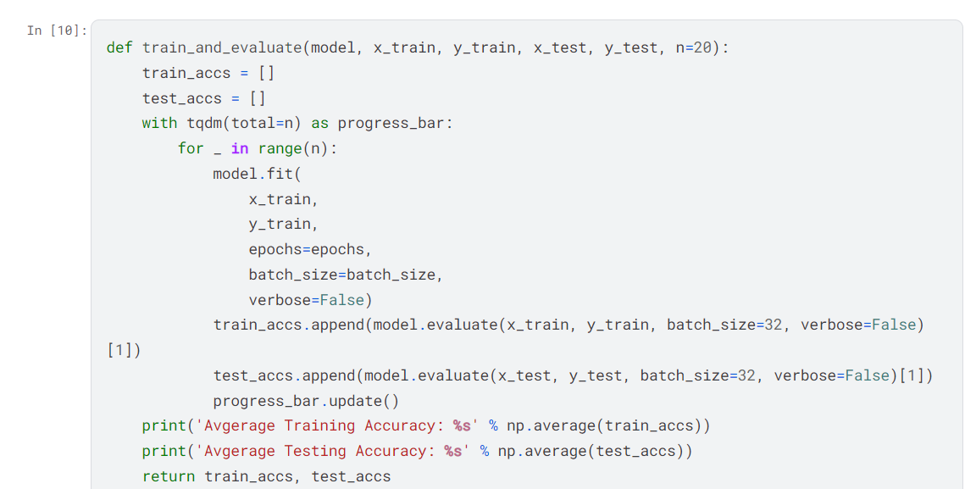

Slide 37
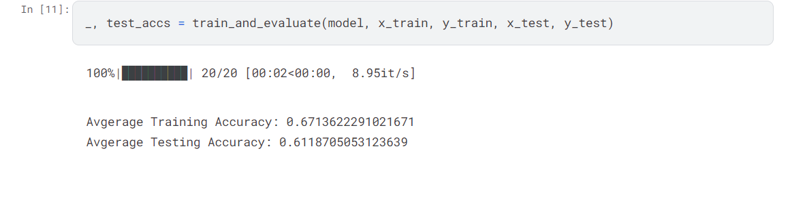
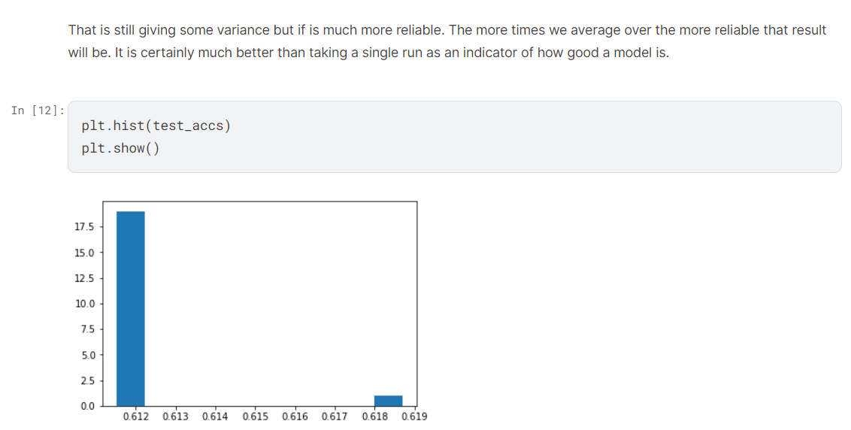

Slide 38
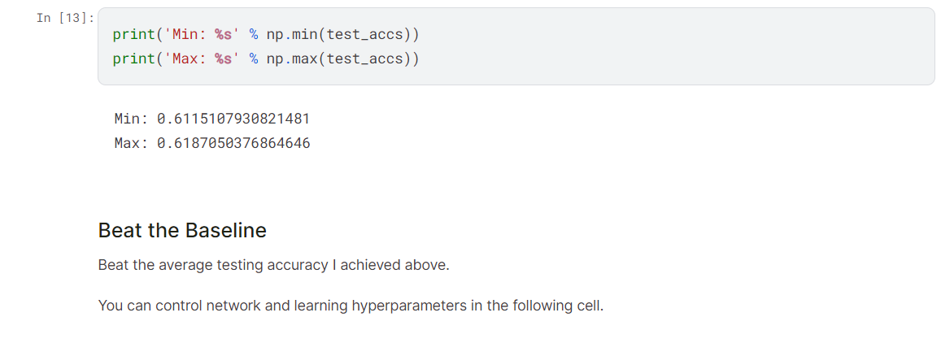
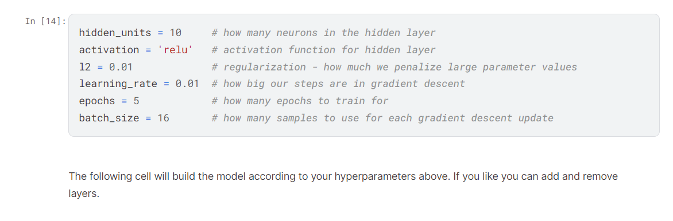

Slide 39
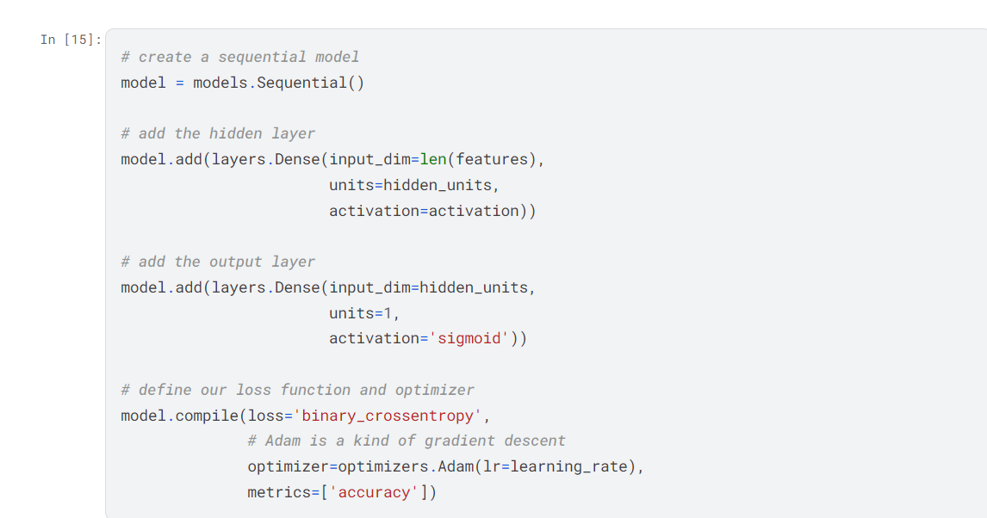

Slide 40
