Slide 1
II-B.E. III-SEMESTER
COMPUTER ARCHITECTURE (CA)
Presented By
Dr. D. BASWARAJ
Professor, CSE DEPT.
VCE, HYDERABAD

Slide 2
COURSE OBJECTIVES
Learn the structure and behavior of various functional modules of a computer and identify how they interact to provide the processing needs of the user.
Understand memory hierarchy and analyze different ways of communicating with I/O of digital computers

Slide 3
COURSE OUTCOMES
Analyze the major components of a computer and design basic hardware for functional modules of digital computer.
Analyze micro programmed control unit for designing a digital computer.
Apply pipeline concepts to increase computational speed of CPU and analyze the flow of data and instructions in the CPU operations.
Analyze techniques used by a computer to communicate with I/O devices.
Evaluate the memory organization techniques and assess the performance of a CPU

Slide 4
SYLLABUS
UNIT – I:
Overview of Computer Function and Interconnection: Computer Components, Interconnection Structures, Bus Interconnection, Bus Structure, Data Transfer.
Register Transfer Micro operations: Register Transfer Language, Register Transfer, Bus and Memory Transfers, Arithmetic, Logic, Shift Micro operations, Arithmetic Logic Shift Unit.
UNIT – II:
Basic Computer organization and Design: Instruction codes, Computer Registers, Computer Instructions, Timing and Control, Instruction Cycle, Memory Reference Instruction, Input-Output and Interrupt.
Micro programmed Control: Control memory, Address Sequencing, Micro program Example, Design of Control Unit.

Slide 5
SYLLABUS
UNIT – III:
Central Processing Unit: General Register organization, Stack Organization, Instruction Formats, Addressing Modes, Data Transfer and Manipulation, Program Control, RISC.
Pipeline: Parallel processing, Pipelining, Arithmetic pipeline, Instruction Pipeline.
Computer Arithmetic: Addition and Subtraction, Multiplication, Division, Floating Point Arithmetic Operations, Decimal Arithmetic Unit.

Slide 6
SYLLABUS …
UNIT – IV:
Input-Output organization: Peripheral Devices, Input-Output Interface, Asynchronous Data Transfer, Modes of Transfer, Priority Interrupt, Direct Memory Access, Input-Output Processor (IOP), Serial Communication
UNIT – V:
Memory Organization: Memory Hierarchy, Main Memory, RAM and ROM, Auxiliary Memory, Associative Memory, Cache Memory, Virtual Memory, Memory Management Hardware.
Assessing and Understanding Performance: CPU Performance and its Factors, Evaluating Performance.

Slide 7
SYLLABUS …
Learning Resources:
M. Morris Mano, Computer System Architecture, 3rd Edition (2007), Pearson Education Asia.
William Stallings, Computer Organization & Architecture, 8th Edition (2011), Pearson Education Asia.
David A Patterson, John L Hennessy, Computer Organization and Design, 4th Edition (2014), Morgan Kaufmann.
Carl.V Hamacher, Vranesic Z.G, Zaky S.G, Computer Organization, 5th Edition (2011), McGraw Hill.
Pal Chaudhuri.P, Computer Organization and Design, , 3rd Edition(2009), Prentice Hall of India

Slide 8
SYLLABUS …
Learning Resources:
https://nptel.ac.in/courses/106105163
http://nptel.ac.in/courses/106102157
https://ocw.mit.edu/courses/electrical-engineering-and-computer- science/6-823-computer-system-architecture-fall-2005/
https://www.coursera.org/learn/comparch
https://www.coursera.org/learn/parallelism-ia
https://www.edx.org/learn/computer-architecture

Slide 9
UNIT-I
PART-1: Overview of Computer Function and Interconnection
  Computer Components
  Interconnection Structures
  Bus Interconnection
  Bus Structure
  Data Transfer
PART-2: Register Transfer Micro operations
  Register Transfer Language
  Register Transfer
  Bus and Memory Transfers
  Arithmetic, Logic, Shift Micro operations
  Arithmetic Logic Shift Unit

Slide 10
Part-1: Overview of Computer Function and Interconnection
  1. Computer Components:
Computer Organization describes the function and design of the various units of digital computers that store and process information.
In other words, computer organization is concerned with design of components and functional units using which computers are built.
Analogy: Civil Engineer’s task during building construction (e.g., cement, bricks, steels, sand etc.)
Computer architecture concerned with, how to integrate the components to build a computer system to achieve desired level of performance.
Analogy: Architect’s tasks during the planning of a building (e.g., floor plan, basement plan, building layout etc.)

Slide 11
Computer Components…
Computer types:
Digital computer is a fast electronic calculating machine that accepts digitized input information, processes it according to a list of internally stored instructions, and produces the resulting output information
Personal computer: have processing and storage units, visual display and audio output units, and a keyboard that can all be located easily on a home or office desk.
Workstations: are high resolution graphics input/output capability, have significantly more computational power than personal computers.
Enterprise systems or mainframes are used for business data processing in medium to large corporations that require much more computing power and storage capacity than workstations.

Slide 12
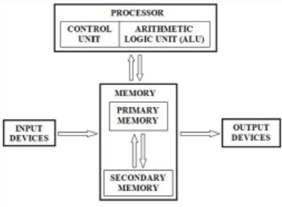
Computer Components…
Servers contain sizable database storage units and are capable of handling large volumes of requests to access the data.
Super Computers are used for the large-scale numerical calculations required in applications such as weather forecasting, aircraft design and simulation.
Functional units:
A computer consists of
five functionally
independent
blocks / components.

Slide 13
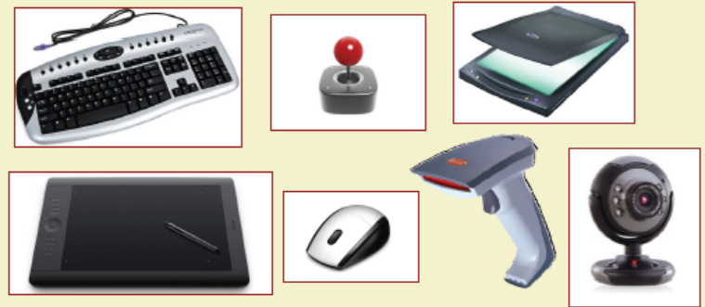
Computer Components…
Input unit: Computers accept coded information through input units. The most well-known input device is keyboard.
Whenever a key is pressed, the corresponding letter or digit is automatically translated into its corresponding binary code and transmitted over a cable to either the memory or the processor.

Slide 14
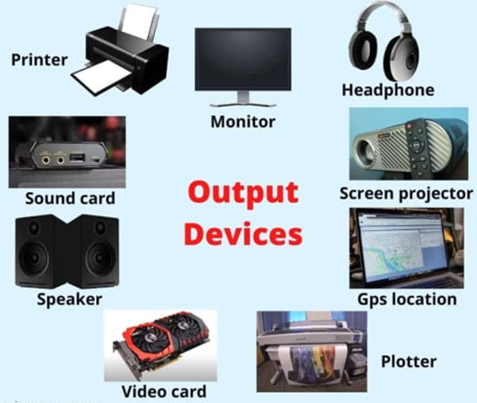
Computer Components…
Output unit: It is the counterpart of input unit. Its function is to send processed results to the outside world. The most familiar example of such a device are monitor/screen and printer.

Slide 15
Computer Components…
Memory unit: The function of the memory is to store programs and data. There are two classes of storage, called primary and secondary.
The size of main/prime memory is very small as compared to secondary memory. An important characteristics of memory is access time, which is required to access one word from memory by CPU.
Arithmetic and logic unit (ALU): It is main part of computer system used to perform various arithmetic and logical operations like addition, subtraction, shift , rotation, complement, compare etc.
Control unit: It coordinates the all tasks performed by computer system. It uses the control signals to determine when a given task to take place.
It control the input output operations, data transfer between the processor, memory, and Input/Output devices using timing signals.

Slide 16
Computer Components…
Components:
Central processing unit (CPU)
The CPU controls the computer processes and communicates with the other components of a personal computer. A computer's CPU may be one of the most complicated parts of the computer because of its intricacies.
Motherboard
The motherboard provides the structure for all other components and connects them, while also providing a way to distribute power, deliver information and connect to devices such as a printer or mouse. It controls how data transfers and what type of monitor or screen device to use, for example. It houses the CPU, memory and secondary storage devices such as hard drives.

Slide 17
Computer Components…
Random Access Memory (RAM)
RAM is where data lives temporarily while it's being actively used by programs, such as when a user launches a computer application..
Video graphics array port
A video graphics array (VGA) port is a video input that is primarily used on PC monitors.
Power supply provides electricity to all components of a computer system. Typically, it's a power cord connected from the back of a PC tower into an electricity socket.
Cooling fan Cooling fans are a computer's system to decrease overheating. Many computers have more than one cooling fan to help users who run their computer heavily, such as video streaming or gaming.

Slide 18
Computer Components…
Hard drives are data storage devices used to store files, programs or other information on a computer system. They use magnetically coated discs called hard disks that store digital representations of information.
Monitor
A computer monitor is an electronic device that displays what's what programs are running on your computer so a user can see.
Printer
This is a machine that produces copies of text or images on paper using ink. Popular printers include laser or inkjet, and computer technicians may be skilled in troubleshooting issues across multiple brands and varieties.

Slide 19
Computer Components…
Scanner
A scanner is a device that digitally copies an image or and makes it available as a file for access on a computer..
Computer mouse
A computer mouse can have a wire or is wireless and is an input device used to control a cursor on the computer monitor. A wired computer mouse has a cord that connects to a USB port on a computer while a wireless mouse has no physical connection with a computer system. Instead, a wireless mouse communicates using an adapter that is usually plugged into an available USB port and runs off its own batteries using Bluetooth technology.
Bus – A group of wires that carry information from one component to another. Three Types: Data Bus, Address Bus, Control Bus

Slide 20
2. Interconnection Structures
A computer consists of a set of components or modules of three basic types (processor, memory, I/O) that communicate with each other. In effect, a computer is a network of basic modules. Thus, there must be paths for connecting the modules.
The collection of paths connecting the various modules is called the interconnection structure. The design of this structure will depend on the exchanges that must be made among modules.
Memory: Typically, a memory module will consist of N words of equal length. Each word is assigned a unique numerical address (0, 1, . . . , N – 1). A word of data can be read from or written into the memory. The nature of the operation is indicated by read and write control signals. The location for the operation is specified by an address.

Slide 21
Interconnection Structures …
I/O module: From an internal (to the computer system) point of view, I/O is functionally like memory. There are two operations, read and write. Further, an I/O module may control more than one external device. We can refer to each of the interfaces to an external device as a port and give each a unique address (e.g., 0, 1,..., M – 1).
In addition, there are external data paths for the input and output of data with an external device. Finally, an I/O module may be able to send interrupt signals to the processor.
Processor: The processor reads instructions and/or data, writes out data after processing, and uses control signals to control the overall operation of the system. It also receives interrupt signals.

Slide 22
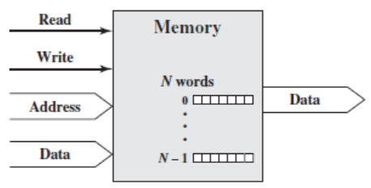
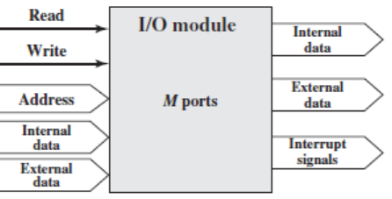
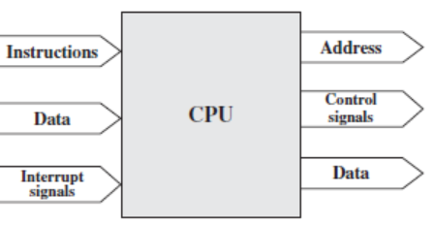
Interconnection Structures …
Following figure suggests the types of exchanges that are needed by indicating the major forms of I/O for each module type.

Slide 23
Interconnection Structures …
The interconnection structure must support the following types of transfers:
Memory to processor: The processor reads an instruction or a unit of data from memory.
Processor to memory: The processor writes a unit of data to memory.
I/O to processor: The processor reads data from an I/O device via an I/O module.
Processor to I/O: The processor sends data to the I/O device.
I/O to/from memory: For these two cases, an I/O module is allowed to exchange data directly with memory, without going through the processor, using direct memory access (DMA).

Slide 24
3. Bus Interconnection
A bus is a communication pathway connecting two or more devices.
A key characteristic of a bus is that it is a shared transmission medium. Multiple devices connect to the bus, and a signal transmitted by any one device is available for reception by all other devices attached to the bus.
If two devices transmit during the same time period, their signals will overlap and become garbled. Thus, only one device at a time can successfully transmit.
Typically, a bus consists of multiple communication pathways / wires / lines. Each line is capable of transmitting signals representing binary 1 and 0.
Taken together, several lines of a bus can be used to transmit binary digits simultaneously (in parallel). For example, an 8-bit unit of data can be transmitted over eight bus lines.

Slide 25
Bus Interconnection …
Computer systems contain several different buses that provide pathways between components at various levels of the computer system hierarchy.
A bus that connects major computer components (processor, memory, I/O) is called a system bus.

Slide 26
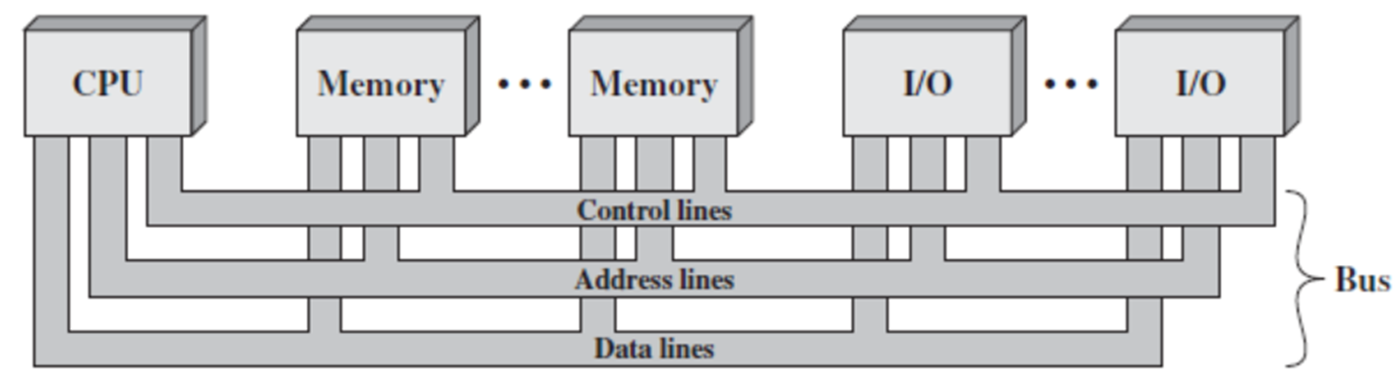
4. Bus Structure
A system bus consists, typically, of from about 50 - 100 separate lines. Each line is assigned a particular meaning or function. Although there are many different bus designs, on any bus the lines can be classified into three functional groups as shown below: data, address, and control lines.
In addition, there may be power distribution lines that supply power to the attached modules.

Slide 27
Bus Structure …
The data lines provide a path for moving data among system modules. The number of lines being referred to as the width of the data bus..
The address lines are used to designate the source or destination of the data on the data bus.
The control lines are used to control the access to and the use of the data and address lines.
Typical control lines include:
Memory write: Causes data on the bus to be written into the addressed location
Memory read: Causes data from the addressed location to be placed on the bus

Slide 28
Bus Structure …
I/O write: Causes data on the bus to be output to the addressed I/O port
I/O read: Causes data from the addressed I/O port to be placed on the bus
Transfer ACK: Indicates that data have been accepted from or placed on the bus
Bus request: Indicates that a module needs to gain control of the bus
Bus grant: Indicates that a requesting module has been granted control of the bus
Interrupt request: Indicates that an interrupt is pending
Interrupt ACK: Acknowledges that the pending interrupt has been recognized
Clock: Is used to synchronize operations
Reset: Initializes all modules

Slide 29
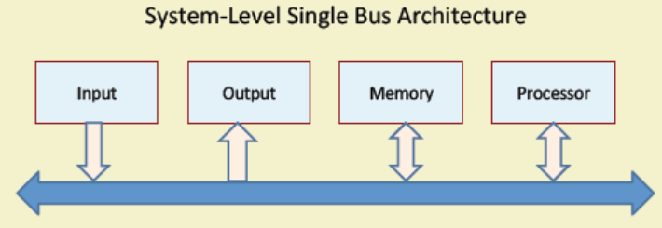
5. Data Transfer
Data transfer instructions cause transfer of data from one location or device to another location or device.
System-Level Single Bus Architecture
The different functional modules simply connect through single bus.
Only one data transfer allowed in one clock cycle.

Slide 30
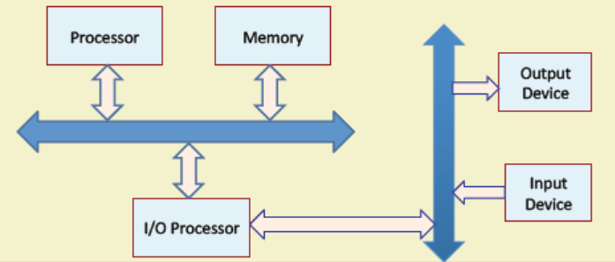
Data Transfer …
System-Level Two-Bus Architecture
The different functional modules simply connect through two bus.
Multiple data transfers allowed in one clock cycle.

Slide 31
END OF
UNIT-1
PART-1

