Slide 1
II-B.E. III-SEMESTER
COMPUTER ARCHITECTURE (CA)
Presented By
Dr. D. BASWARAJ
Professor, CSE DEPT.
VCE, HYDERABAD

Slide 2
SYLLABUS
UNIT – I:
Overview of Computer Function and Interconnection: Computer Components, Interconnection Structures, Bus Interconnection, Bus Structure, Data Transfer.
Register Transfer and Microoperations: Register Transfer Language, Register Transfer, Bus and Memory Transfers, Arithmetic, Logic, and Shift Microoperations, Arithmetic Logic Shift Unit.
UNIT – II:
Basic Computer organization and Design: Instruction codes, Computer Registers, Computer Instructions, Timing and Control, Instruction Cycle, Memory Reference Instruction, Input-Output and Interrupt.
Micro programmed Control: Control memory, Address Sequencing, Micro program Example, Design of Control Unit.

Slide 3
UNIT-I
PART-1: Overview of Computer Function and Interconnection
  Computer Components
  Interconnection Structures
  Bus Interconnection
  Bus Structure
  Data Transfer
PART-2: Register Transfer and Microoperations
  Register Transfer Language
  Register Transfer
  Bus and Memory Transfers
  Arithmetic, Logic, and Shift Microoperations
  Arithmetic Logic Shift Unit

Slide 4
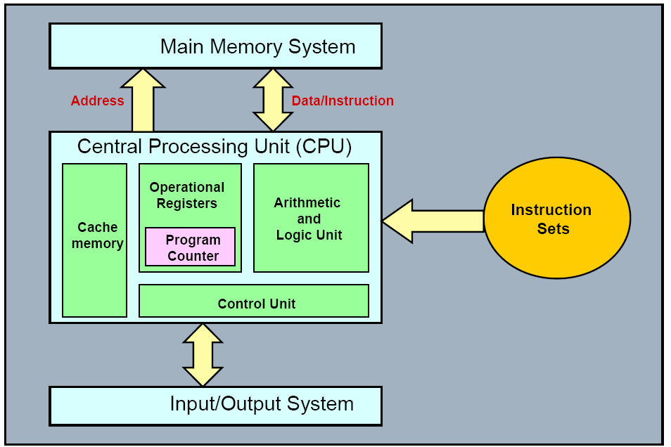
Part-2: Register Transfer Micro operations
  Introduction: This part introduces a register transfer language and shows how it is used to express microoperations in symbolic form.

Slide 5
1. Register Transfer Language
A digital system is an interconnection of digital hardware modules that accomplish a specific information-processing task.
Digital systems vary in size and complexity from a few integrated circuits to a complex of interconnected and interfacing digital computers.
Digital system design invariably uses a modular approach. The modules are constructed from such digital components as registers, decoders, arithmetic elements and control logic.
The various modules are interconnected with common data and control paths to form a digital computer systems
Digital modules are best defined by the registers they contain and the operations that are performed on the data stored in them.
The operations executed on data stored in registers are called microoperations.

Slide 6
Register Transfer Language…
A microoperation is an elementary operation performed on the information stored in one or more registers.
The result of the operation may replace the previous binary information of a register or may be transfer to another register.
Examples of microoperations are shift, count, clear, and load.
The internal hardware organization of a digital computer is best defined by specifying:
  The set of registers it contains and their function.
  The sequence of microoperations performed on the binary information stored in the registers.
  The control that initiates the sequence of microoperations.

Slide 7
Register Transfer Language…
It is possible to specify the sequence of microoperations in a computer by explaining every operation in words, but this procedure usually involves a lengthy descriptive explanation.
The symbolic notation used to describe the microoperation transfers among registers is called a register transfer language.
The term "register transfer" implies the availability of hardware logic circuits that can perform a stated microoperation and transfer the result of the operation to the same or another register.
A register transfer language is a system for expressing in symbolic form the microoperation sequences among the registers of a digital module.
The symbolic designation used to specify the register transfers, the microoperations, and the control functions that describe the internal hardware organization of digital computers.

Slide 8
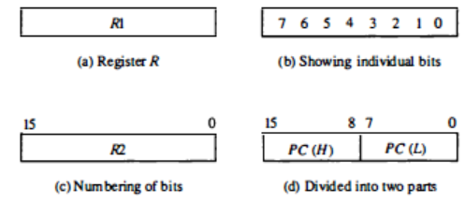
2. Register Transfer
An elementary operation performed (during one clock pulse), on the information stored in one or more registers is called microoperation.
Computer registers are designated by capital letters (sometimes followed by numerals) to denote the function of the register.
For example, the register that holds an address for the memory unit is called a memory address register (MAR), MDR, PC, IR etc.
Following figure shows the various representation of registers.

Slide 9
Register Transfer…
Information transfer from one register to another is designated in sym­bolic form by means of a replacement operator. The statement
R2 ← R1
denotes a transfer of the content of register R1 into register R2. It designates a replacement of the content of R2 by the content of Rl.
Normally, we want the transfer to occur only under a predetermined control condition. This can be shown by means of an if-then statement.
if (P = 1) then (R2 ← R1)
Where P is a control signal generated in the control section.
A control function is a Boolean variable that is equal to 1 or 0. The control function is included in the statement as follows:
P: R2 ← R1

Slide 10
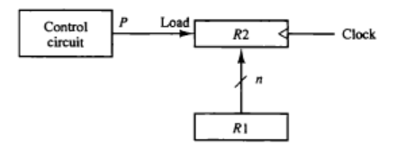
Register Transfer…
Every statement written in a register transfer notation implies a hardware construction for implementing the transfer.
Following figure shows the block diagram that depicts the transfer from R1 to R2 when P=1. The n outputs of register R1 are connected to the n inputs of register R2. The letter n will be used to indicate any number of bits for the register.
Register R2 has a load input that is activated by the control variable P. It is assumed that the control variable is synchronized with the same clock as the one applied to the register.

Slide 11
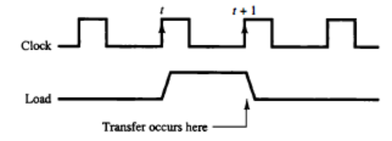
Register Transfer…
In below timing diagram, P is activated in the control section by the rising edge of a clock pulse at time t.
The next positive transition of the clock at time t + 1 finds the load input active and the data inputs of R2 are then loaded into the register in parallel.
P may go back to 0 at time t + 1; otherwise, the transfer will occur with every clock pulse transition while P remains active.

Slide 12
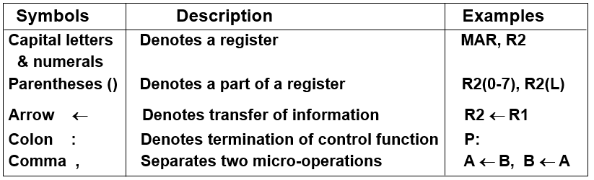
Register Transfer…
The basic symbols of the register transfer notation are listed in in following table.

Slide 13
3. Bus and Memory Transfers
BUS TRANSFERS: A typical digital computer has many registers, and paths must be provided to transfer information from one register to another.
The number of wires will be excessive if separate lines are used between each register and all other registers in the system.
A more efficient scheme for transferring information between registers in a multiple-register configuration is a common bus system.
A bus structure consists of a set of common lines, one for each bit of a register, through which binary information is transferred one at a time.
Control signals determine which register is selected by the bus during each register transfer.
One way of constructing a common bus system is with multiplexers.

Slide 14
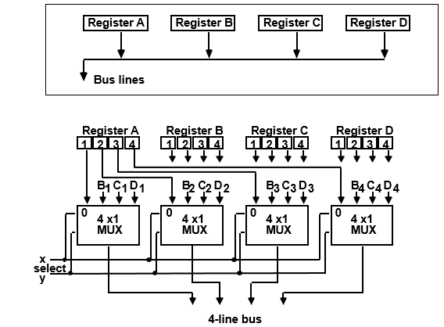
Bus and Memory Transfers…
The construction of a bus system for four registers is shown below.
Each register has 4 bits (0-3). The bus consists of 4 MUXs each having 4 data inputs (0-3), and 2 selection inputs, S1 and S0.
Following Fig. shows data transfer from a register to bus: BUS ← R

Slide 15
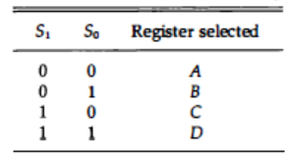
Bus and Memory Transfers…
The diagram shows that the bits in the same significant position in each register are connected to the data inputs of one multiplexer to form one line of the bus.
Thus MUX 0 multiplexes the four 0 bits of the registers, MUX 1 multiplexes the four 1 bits of the registers, and so on.
The selection lines choose the four bits of one register and transfer them into the four-line common bus. When S1S0 = 00, the 0 data inputs of all four multiplexers are selected and applied to the outputs that form the bus.

Slide 16
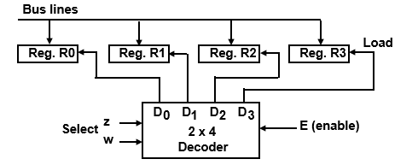
Bus and Memory Transfers…
Following Fig. shows data transfer from bus-register: R ← BUS
Here, decoder (2x4) selects one of the register for storing data from bus.

Slide 17
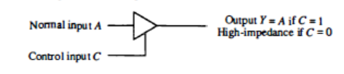
Bus and Memory Transfers…
Three-State Bus Buffers: A bus system can be constructed with three-state gates instead of multiplexers. A three-state gate is a digital circuit that exhibits three states. Two of the states are signals equivalent to logic 1 and 0 as in a conventional gate. The third state is a high-impedance state.
The high-impedance state behaves like an open circuit, which means that the output is disconnected and does not have a logic significance. However, the one most used in the design of a bus system is the buffer gate.

Slide 18
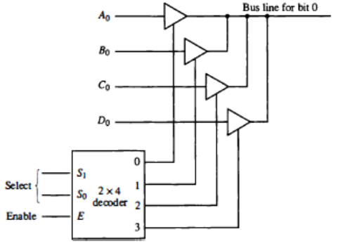
Bus and Memory Transfers…
The construction of a bus system with three-state buffers is demonstrated below. The outputs of four buffers are connected to form a single bus line.
Careful investigation will reveal that below figure is another way of constructing a 4 x 1 multiplexer since the circuit can replace the multiplexer shown in previous slide.

Slide 19
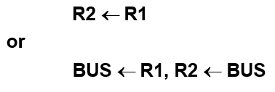
Bus and Memory Transfers…
To construct a common bus for four registers of n bits each using three-state buffers, we need n circuits with four buffers in each as shown in Fig. Each group of four buffers receives one significant bit from the four registers.
Each common output produces one of the lines for the common bus for a total of n lines. Only one decoder is necessary to select between the four registers.
Depending on whether the bus is to be mentioned explicitly or not, register transfer can be indicated as either
In the former case the bus is implicit, but in the latter, it is explicitly indicated.

Slide 20
Bus and Memory Transfers…
MEMORY TRANSFERS:
A memory unit is a collection of storage cells together with associated circuits needed to transfer information in and out of storage.
The memory stores binary information in groups of bits called words. The internal structure of a memory unit is specified by the number of words it contains and the number of bits in each word.
Special input lines called address lines select one word. Each word in memory is assigned an identification number, called an address, starting from 0 to 2^{k-1} where k is the number of address lines. The selection of a specific word inside the memory is done by applying the k-bit binary address to the address lines.

Slide 21
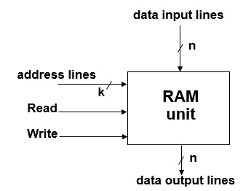
Bus and Memory Transfers…
The transfer of information from a memory word to the outside environment is called a read operation.
The transfer of new information to be stored into the memory is called a write operation.
A memory word will be symbolized by the letter M.
Assume the RAM contains r = 2^{k} words. It needs the following
- n data input lines
- n data output lines
- k address lines
- Read control line
- Write control line

Slide 22
Bus and Memory Transfers…
Collectively, the memory is viewed at the register level as a device, M. Since it contains multiple locations, we must specify which address in memory we will be using. This is done by indexing memory references.
Memory is usually accessed in computer systems by putting the desired address in a special register, the Memory Address Register (MAR, or AR)
When memory is accessed, the contents of the MAR get sent to the memory unit’s address lines.
Memory
unit
Read
AR
Write
Data out
Data in

Slide 23
Bus and Memory Transfers…
Consider a memory unit that receives the address from a register, called the address register (MAR). The data are transferred to another register, called the data register (MDR).
The read operation can be stated as follows:
MDR ← M[MAR]
This causes a transfer of information into MDR from the memory word M selected by the address in MAR.
The write operation transfers the content of a data register to a memory word M selected by the address.
The write operation can be stated as follows:
M[MAR] ← MDR
This causes a transfer of information from MDR into the memory word M selected by the address in MAR.

Slide 24
4. Arithmetic, Logic, and Shift Microoperations
MICROOPERATIONS:
In computer central processing units, micro-operations (also known as micro-ops or μ-ops , historically also as micro-actions) are detailed low-level instructions used in some designs to implement complex machine instructions.
Types of Micro-operations:
Register Transfer μ-ops: Transfer binary information from one register to another.
Arithmetic μ-ops: Perform arithmetic operation on numeric data stored in registers.
Logical μ-ops : Perform bit manipulation operations on data stored in registers.
Shift μ-ops : Perform shift operations on data stored in registers.

Slide 25
Arithmetic, Logic, and Shift Microoperations…
Register Transfer μ-ops doesn’t change the information content when the binary information moves from source register to destination register.
Other three types of μ-ops change the information change the information content during the transfer.
ARITHMETIC MICROOPERATIONS:
The basic arithmetic μ-ops are Addition, Subtraction, Increment and Decrement.
The additional arithmetic μ-ops are Add with carry, Subtract with borrow, Transfer/Load etc.
For example, the μ-op R3←R1+R2 specifies the add microoperation. It states that the contents of R1 are added to contents of R2 and sum is transferred to R3. To implement this statement hardware requires 3 registers and digital component that performs addition.

Slide 26
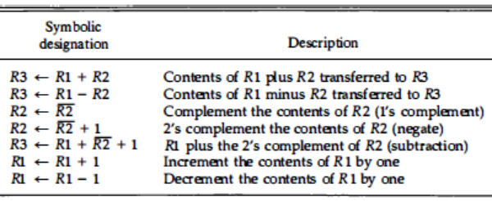
Arithmetic Microoperations…
The following table shows some of arithmetic μ-ops .

Slide 27
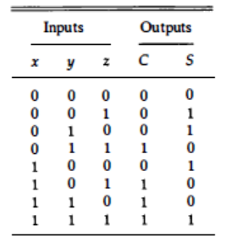
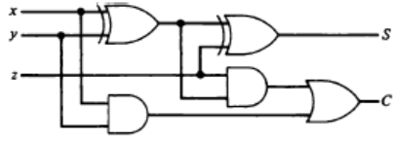
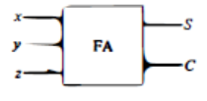
Arithmetic Microoperations…
Binary Adder: To implement the add μ-op with hardware, we need the registers that hold the data and the digital component that performs the arithmetic addition. The digital circuit that forms the arithmetic sum of two bits and a previous carry is called a full-adder (FA) shown below:

Slide 28
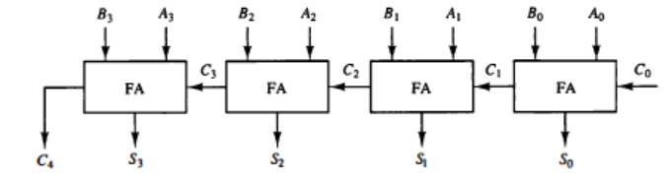
Arithmetic Microoperations…
Binary Adder…
The digital circuit that generates the arithmetic sum of two binary numbers of any length is called a binary adder.
The binary adder is constructed with full-adder circuits connected in cascade, with the output carry from one full-adder connected to the input carry of the next full-adder.
Following figure shows the interconnections of four full-adders (FA) to provide a 4-bit binary adder:

Slide 29
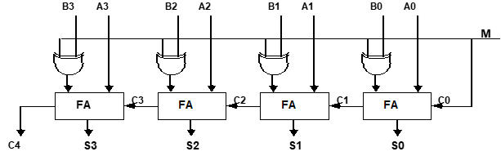
Arithmetic Microoperations…
Binary Adder-Subtractor: The subtraction of binary numbers can be done most conveniently by means of 2’s complements.
The addition and subtraction operations can be combined into one com­mon circuit by including an exclusive-OR gate with each FA.
A 4-bit adder-subtractor circuit is shown below. The mode input M controls the operation. When M = 0 the circuit is an adder and when M = 1 the circuit becomes a subtractor.

Slide 30
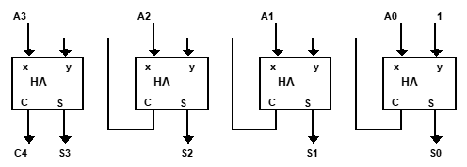
Arithmetic Microoperations…
Binary Incrementer:
The increment μ-op adds one to a number in a register. For example, if a 4-bit register has 0110, it will go to 0111 after it is incremented.
This can be accomplished by means of half-adders connected in cascade.
The below diagram shows a 4-bit combinational circuit:

Slide 31
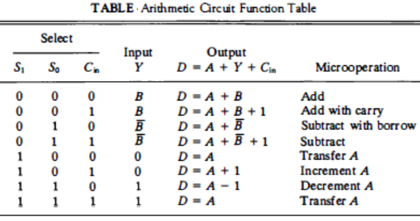
Arithmetic Microoperations…
Arithmetic Circuit
The arithmetic μ-ops listed earlier can be implemented in one composite arithmetic circuit. The basic component of an arithmetic circuit is the parallel adder. By controlling the data inputs to the adder, it is possible to obtain different types of arithmetic operations.

Slide 32
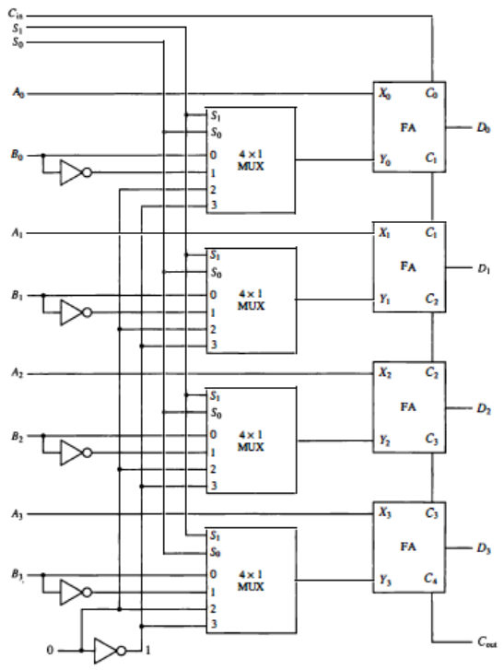
Arithmetic Microoperations…

Slide 33

Logic Microoperations
Logic μ-ops specify binary operations for strings of bits stored in registers. These operations consider each bit of the register separately and treat them as binary variables.
For example, the exclusive-OR microoperation with the contents of two registers R 1 and R2 is symbolized by the statement:
P: R1 ← R1 ⊕ R2
It specifies a logic μ-op to be executed on the individual bits of the registers provided that the control variable P = 1.
For example, let R1 and R2 be 1010 and 1100, respectively. The XOR μ-op symbol­izes the following logic computation:

Slide 34
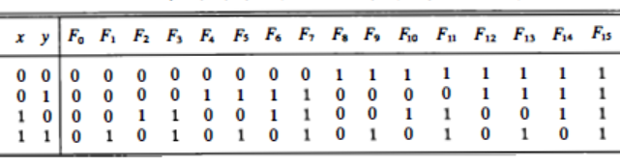
Logic Microoperations…
Special symbols will be adopted for the logic μ-ops OR, AND, and complement, to distinguish them from the corresponding symbols used to express Boolean functions.
List of Logic Microoperations
There are 16 different logic μ-ops that can be performed with two binary variables. They can be determined from al possible truth tables obtained with two binary variables as shown below:

Slide 35
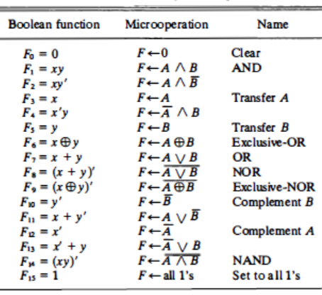
Logic Microoperations…
The 16 Boolean functions of 2 variables x & y are expressed in algebraic form in the first column of below Table. These μ-ops are derived by replacing variable x with content of register A and y with content of register B:

Slide 36
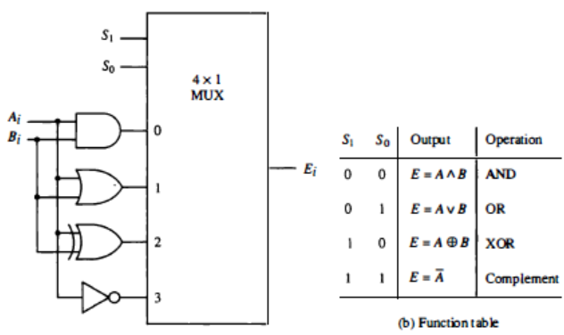
Logic Microoperations…
Hardware Implementation of logic μ-ops requires that logic gates be inserted for each bit or pair of bits in the registers to perform the required logic function. Although there are 16 logic μ-ops, most computers use only AND, OR, XOR, and complement­ from which all others can be derived. Below Figure shows one stage of a circuit that generates the four basic logic μ-ops :

Slide 37


Logic Microoperations…
Applications: Logic μ-ops are very useful for manipulating individual bits or a portion of a word stored in a register. They can be used to change bit values, delete a group of bits, or insert new bit values into a register.
The selective-set operation sets to 1 the bits in register A where there are corresponding 1's in register B. It does not affect bit positions that have 0's in B.
The selective-complement operation complements bits in A where there are corresponding l's in B. It does not affect bit positions that have 0's in B. The following numerical example clarifies this operation:

Slide 38




Logic Microoperations…
Applications…
The selective-clear operation clears to 0 the bits in A only where there are corresponding 1's in B.
The mask operation is like the selective-clear operation except that bits of A are cleared only where there are corresponding 0's in B.
The insert operation inserts a new value into a group of bits. This is done by first masking the bits and then ORing them with the required value.
The following numerical example clarifies this operation:

Slide 39
Shift Microoperations
Shift μ-ops are used for serial transfer of data. They are also used in conjunction with arithmetic, logic, and other data-processing operations.
The contents of a register can be shifted to the left or the right. While the bits are shifted, the first flip-flop receives its binary information from the serial input.
During a shift-left operation the serial input transfers a bit into the rightmost position.
During a shift-right operation the serial input transfers a bit into the leftmost position.
The information transferred through the serial input determines the type of shift.
There are three types of shifts: logical, circular, and arithmetic.

Slide 40
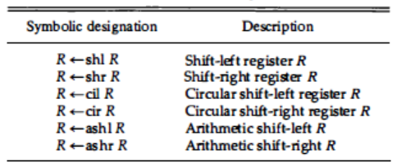
Shift Microoperations…
Shift Microoperations

Slide 41
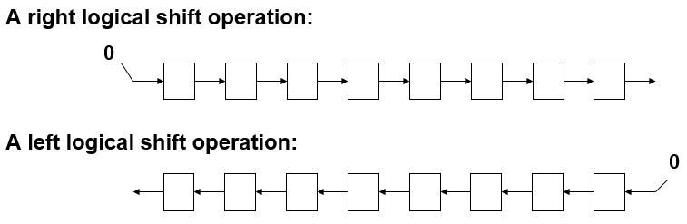
Shift Microoperations…
Logical shift:
A logical shift is one that transfers 0 through the serial input. This μ-op either a 1-bit shift to the left of the content of register R1 or a 1-bit shift to the right of the content of register R2.
The bit transferred to the end position through the serial input is assumed to be 0 during a logical shift.

Slide 42
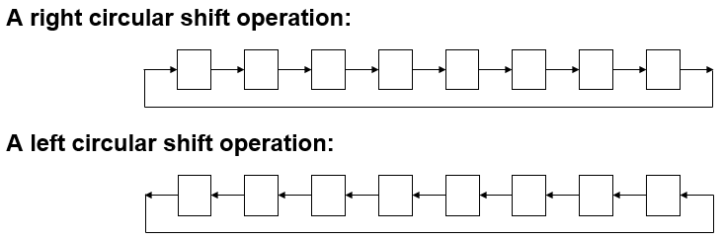
Shift Microoperations…
Circular / rotate shift:
The circular shift (rotate operation) circulates the bits of the register around the two ends without loss of information.
This is accomplished by connecting the serial output of the shift register to its serial input.

Slide 43
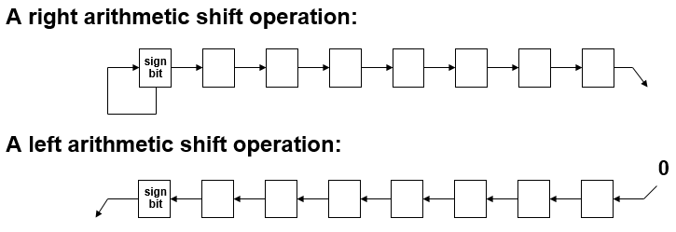
Shift Microoperations…
Arithmetic shift: This μ-ops shifts a signed binary number to the left or right. An arithmetic shift-left multiplies a signed binary number by 2. An arithmetic shift-right divides the number by 2.
The main distinction of an arithmetic shift is that it must keep the sign of the number the same as it performs the multiplication or division.

Slide 44
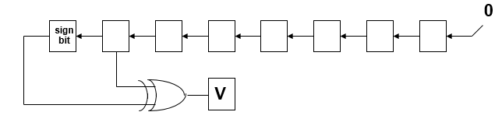
Shift Microoperations…
Arithmetic shift:
An left arithmetic shift operation must be checked for the overflow.
Before the shift, if the leftmost two bits differ, the shift will result in an overflow

Slide 45
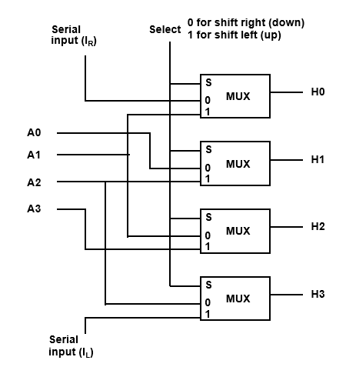
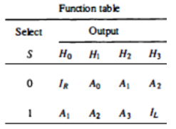
Hardware Implementation: Shift Microoperations
4-bit combinational shifter: When the selection input S = 0, the input data are shifted right (down in the diagram). When S = 1, the input data are shifted left (up in the diagram).

Slide 46
5. Arithmetic Logic Shift Unit
Instead of having individual registers performing the μ-ops directly, computer systems employ several storage registers connected to a common operational unit called an arithmetic logic unit, abbreviated ALU.
To perform μ-ops, the contents of specified register are placed in the inputs of the common ALU. The ALU performs an operation, and the result of the operation is then transferred to a destination register.
The ALU is a combinational circuit so that the entire register transfer operation from the source registers through the ALU and into the destination register can be performed during one clock pulse period.
The shift μ-ops are often performed in a separate unit, but sometime the shift unit is made part of the overall ALU.

Slide 47
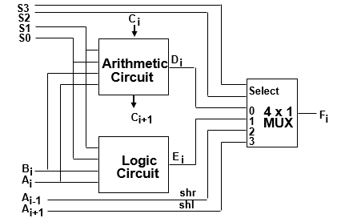
Arithmetic Logic Shift Unit…
One stage of an ALU shown below. The subscript i designates a typical stage. Inputs A_{i} & B_{i} are applied to the ALU units.

Slide 48
Arithmetic Logic Shift Unit…
A particular μ-op is selected with inputs S1 and S0. A 4x1 multiplexer at the output chooses between an arithmetic output in E and a logic output in H.
The data in the multiplexer are selected with inputs S3 and S2. The other two data inputs to the multiplexer receive inputs A_{i-1} for the shift-right operation and A_{i+1} for the shift-left operation. Note that the diagram shows just one typical stage.
The circuit of previous slide must be repeated n times for an n-bit ALU. The output carry C_{i+1} of a given arithmetic stage must be connected to the input carry C_{i} of the next stage in sequence.
The input carry to the first stage is the input carry C_{in}, which provides a selection variable for the arithmetic operations.

Slide 49
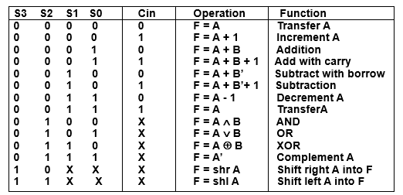
Arithmetic Logic Shift Unit…
Following function table lists the 14 operations of the ALU. The first 8 are arithmetic operations selected with S3S2=00. The next 4 are logic operations selected with S3S2 = 01.
The C_{in} has no effect during the logic operations (marked with X).
The last 2 operations are shift operations selected with S3S2 = 1X. The other 3 selection inputs have no effect on the shift.

Slide 50
END OF
UNIT-1
PART-2

