Slide 1
II-B.E. III-SEMESTER
COMPUTER ARCHITECTURE (CA)
Presented By
Dr. D. BASWARAJ
Professor, CSE DEPT.
VCE, HYDERABAD

Slide 2
SYLLABUS
UNIT – I:
Overview of Computer Function and Interconnection: Computer Components, Interconnection Structures, Bus Interconnection, Bus Structure, Data Transfer.
Register Transfer Micro operations: Register Transfer Language, Register Transfer, Bus and Memory Transfers, Arithmetic, Logic, Shift Micro operations, Arithmetic Logic Shift Unit.
UNIT – II:
Basic Computer organization and Design: Instruction codes, Computer Registers, Computer Instructions, Timing and Control, Instruction Cycle, Memory Reference Instruction, Input-Output and Interrupt.
Micro programmed Control: Control memory, Address Sequencing, Micro program Example, Design of Control Unit.

Slide 3
SYLLABUS …
Learning Resources:
M. Morris Mano, Computer System Architecture, 3rd Edition (2007), Pearson Education Asia.
William Stallings, Computer Organization & Architecture, 8th Edition (2011), Pearson Education Asia.
David A Patterson, John L Hennessy, Computer Organization and Design, 4th Edition (2014), Morgan Kaufmann.
Carl.V Hamacher, Vranesic Z.G, Zaky S.G, Computer Organization, 5th Edition (2011), McGraw Hill.
Pal Chaudhuri.P, Computer Organization and Design, , 3rd Edition(2009), Prentice Hall of India

Slide 4
UNIT-II
PART-1: Basic Computer organization and Design
  Instruction codes, Computer Registers
  Computer Instructions
  Timing and Control, Instruction Cycle
  Memory Reference Instruction
  Input-Output and Interrupt
  PART-2: Micro programmed Control
  Control memory
  Address Sequencing
  Micro program Example
  Design of Control Unit

Slide 5
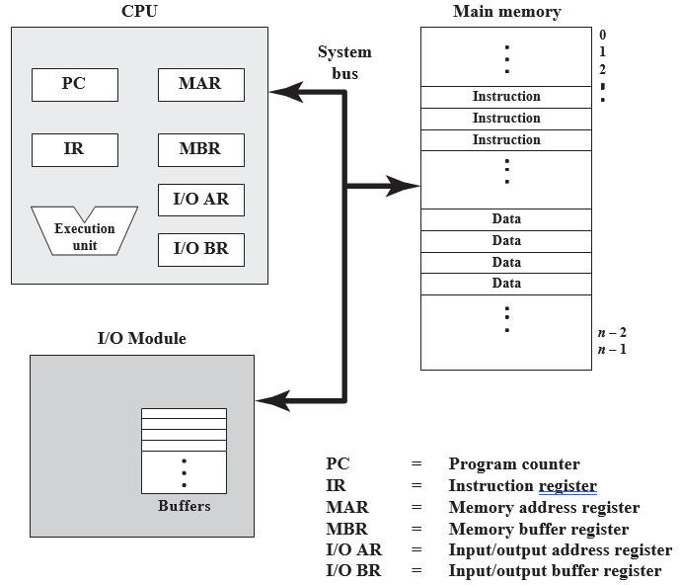
Part-1: Basic Computer organization and Design
  Introduction:
Figure:
Top-level
components
and suggests
the interactions
among them.

Slide 6
Part-1: Basic Computer organization and Design
  Introduction…
The basic function performed by a computer is execution of a program, which consists of a set of instructions stored in memory.
The processor does the actual work by executing instructions specified in the program.
In its simplest form, instruction processing consists of two steps: (1) the processor reads ( fetches) instructions from memory one at a time and (2) executes each instruction.
Program execution consists of repeating the process of instruction fetch and instruction execution.
The instruction execution may involve several operations and depends on the nature of the instruction .

Slide 7
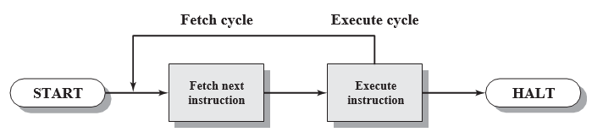
Part-1: Basic Computer organization and Design
  Introduction…
The processing required for a single instruction is called an instruction cycle.
Using the simplified two-step description given previously, the instruction cycle is depicted below. The two steps are referred to as the fetch cycle and the execute cycle.

Slide 8
1. Instruction codes, Computer Registers
In this Section, we introduce a basic computer and show how its operation can be specified with register transfer statements.
The organization of the com­puter is defined by its internal register, the timing & control structure, and the set of instruction that it uses.
The internal organization of a digital system is defined by the sequence of microoperations it performs on data stored in its register.
The general­ purpose digital computer can execute various microoperations and, in addition, can be instructed as to what specific sequence of operations it must perform.
The user of a computer can control the process by means of a program.
A program is a set of instructions that specify the operations, operands, and the sequence by which processing must occur.

Slide 9
Instruction codes
Instruction codes:
An instruction code is a group of bits that instruct the computer to perform a specific operation. It is usually divided into parts: opcode and operand, each having its own particular interpretation. .
The operation code (opcode) of an instruction is a group of bits that define operations such as add, subtract, multiply, shift, and complement.
The number of bits (n) required for the opcode of an instruction depends on the total number of operations (2^{n}) available in the computer.
For every opcode, the control issues a sequence of microoperations needed for the hard­ ware implementation of the specified operation. For this reason, an opcode is sometimes called a microoperation because it specifies a set of micro­operations.

Slide 10
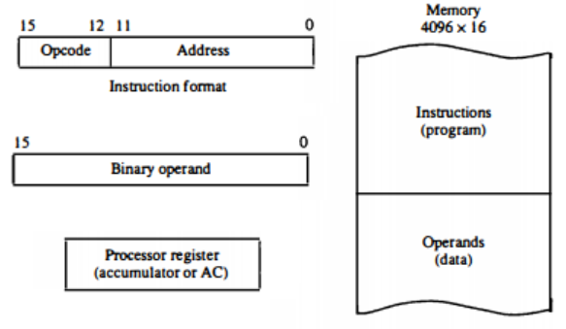
Instruction codes
The operation part of an instruction code specifies the operation to be performed. This operation must be performed on some data stored in processor registers or in memory, called operand.
Computers that have a single-processor register called accumulator (AC). The operation is performed with the memory operand and the content of AC. Below Figure depicts stored program organization.

Slide 11
Instruction codes
Indirect Address:
If an operation in an instruction code does not need an operand from memory, the rest of the bits in the instruction can be used for other purposes.
When the second part of an instruction code specifies an operand, the instruction is said to have an immediate operand.
When the second part specifies the address of an operand, the instruction is said to have a direct address.
When the bits in the second part of the instruction designate an address of a memory word in which the address of the operand is found, , the instruction is said to have an indirect address.
One bit of the instruction code can be used to distinguish between a direct and an indirect address.

Slide 12
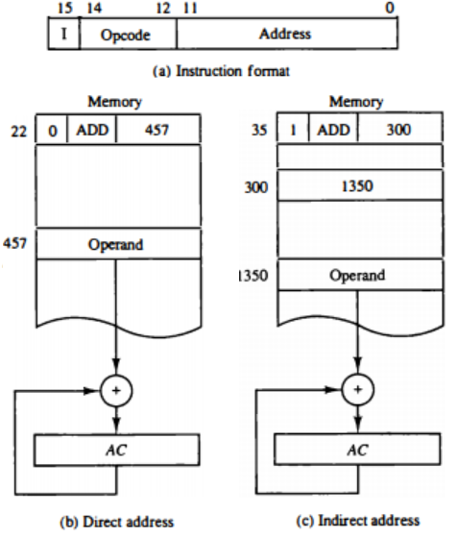
Instruction codes
Indirect Address:

Slide 13
Computer Registers
Computer Registers:
Computer instructions are normally stored in consecutive memory locations and are executed sequentially one at a time.
The control reads an instruction from a specific address in memory and executes it. It then continues by reading the next instruction in sequence and executes it, and so on.
This type of instruction sequencing needs a counter (PC) to calculate the address of the next instruction after execution of the curent instruction is completed.
It is also necessary to provide a register in the control unit for storing the instruction code after it is read from memory.

Slide 14
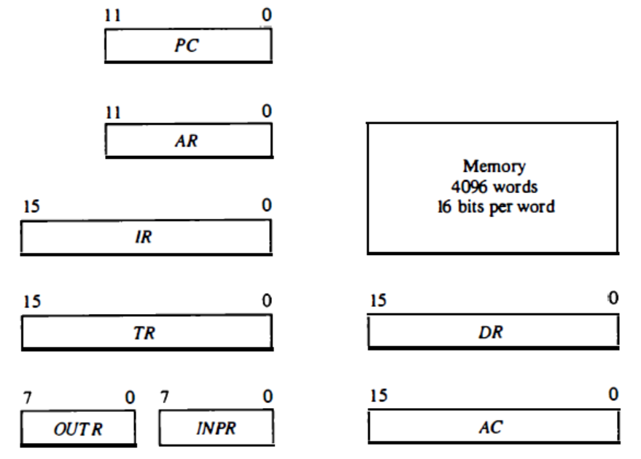
Computer Registers
The computer needs processor registers for manipulating data and a register for holding a memory address. These requirements dictate the register configuration shown in Fig. 2-1.

Slide 15
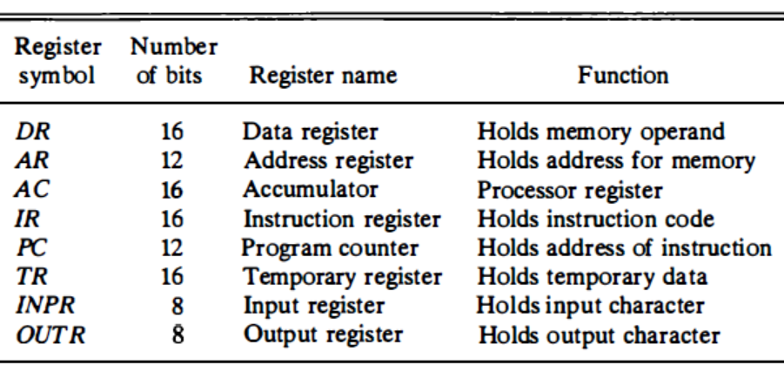
Computer Registers
The registers are also listed in Table 2-1 together with a brief description of their function and the number of bits that they contain.

Slide 16
Computer Registers
Common Bus System: The connection of the registers and memory of the basic computer to a common bus system is shown in Fig. 2.2.
S1
Bus
S0
Memory unit
7
4096 x 16
Address
Write
Read
AR
1
LD INR CLR
PC
2
LD INR CLR
DR
3
LD INR CLR
E
ALU
AC
4
LD INR CLR
INPR
IR
5
LD
TR
6
LD INR CLR
OUTR
Clock
LD

Slide 17
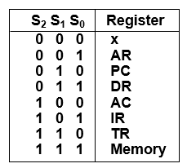
Computer Registers
Three control lines, S2, S1, and S0 control which register the bus selects as its input
Either one of the registers will have its load signal activated, or the memory will have its read signal activated
The 12-bit registers, AR and PC, have 0’s loaded onto the bus in the high order 4-bit positions.
When the 8-bit register OUTR is loaded from the bus, the data comes from the low order 8-bits on the bus.

Slide 18
Computer Registers
Common Bus System:
Note that the content of any register can be applied onto the bus and an operation can be performed in ALU during the same clock cycle.
The clock transition at the end of the cycle transfers the content of the bus into the designated destination register and the output of the ALU into AC .
For example, the two microoperations: DR ←AC and AC ← DR
can be executed at the same time.
This can be done by placing the content of AC on the bus (S2S1S0=100), enabling the LD input of DR, transferring the content of DR through the ALU into AC, and enabling the LD input of AC, all during the same clock cycle.
The two transfers occur upon the arrival of the clock pulse transition at the end of the clock cycle.

Slide 19
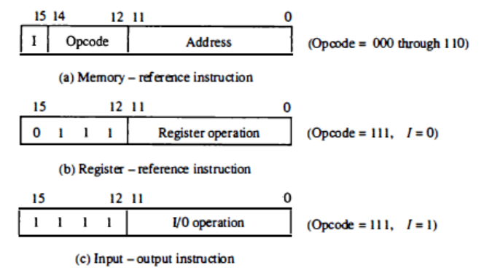
2. Computer Instructions
The basic computer has three instruction code formats, as shown in Fig. 2.3, each format has 16 bits.
The operation code (opcode) part of the instruction contains three bits and the meaning of the remaining 13 bits depends on the operation code encountered.

Slide 20
Computer Instructions
Only three bits of the instruction are used for the operation code. It may seem that the computer is restricted to a maximum of eight distinct operations.
However, since register-reference and input-output instructions use the remain­ing 12 bits as part of the operation code, the total number of instructions can exceed eight.
In fact, the total number of instructions chosen for the basic computer is equal to 25.
The instructions for the computer are listed in Table 2-2.
The symbol designation is a three-letter word and represents an abbreviation intended for programmers and users.
The hexadecimal code is equal to the equivalent hexadecimal number of the binary code used for the instruction.

Slide 21
Computer Instructions
Hex Code
Symbol I = 0 I = 1 Description
Table 2.2:
  AND 0xxx 8xxx AND memory word to AC
  ADD 1xxx 9xxx Add memory word to AC
  LDA 2xxx Axxx Load AC from memory
  STA 3xxx Bxxx Store content of AC into memory
  BUN 4xxx Cxxx Branch unconditionally
  BSA 5xxx Dxxx Branch and save return address
  ISZ 6xxx Exxx Increment and skip if zero
  CLA 7800 Clear AC
  CLE 7400 Clear E
  CMA 7200 Complement AC
  CME 7100 Complement E
  CIR 7080 Circulate right AC and E
  CIL 7040 Circulate left AC and E
  INC 7020 Increment AC
  SPA 7010 Skip next instr. if AC is positive
  SNA 7008 Skip next instr. if AC is negative
  SZA 7004 Skip next instr. if AC is zero
  SZE 7002 Skip next instr. if E is zero
  HLT 7001 Halt computer
  INP F800 Input character to AC
  OUT F400 Output character from AC
  SKI F200 Skip on input flag
  SKO F100 Skip on output flag
  ION F080 Interrupt on
  IOF F040 Interrupt off

Slide 22
Computer Instructions
Instruction Set Completeness:
Before investigating the operations performed by the instructions, let us discuss the type of instructions that must be included in a computer.
The set of instructions are said to be complete if the computer includes enough instructions in each of the following categories:
Functional Instructions - Arithmetic, logic, and shift instructions - ADD, CMA, INC, CIR, CIL, AND, CLA
  Transfer Instructions - Data transfers between the main memory
  and the processor registers - LDA, STA
  Control Instructions - Program sequencing and control
  - BUN, BSA, ISZ
  Input/Output Instructions - Input and output
  - INP, OUT

Slide 23
3. Timing and Control, Instruction Cycle
The timing for all registers in the basic computer is controlled by a master clock generator.
The clock pulses are applied to all flip-flops and registers in the system, including the flip-flops and registers in the control unit.
The clock pulses do not change the state of a register unless the register is enabled by a control signal.
The control signals are generated in the control unit and provide control inputs for the multiplexers in the common bus, control inputs in processor registers, and microoperations for the accumulator.
There are two major types of control organization:
  Hardwired control
  Microprogrammed control

Slide 24
Timing and Control
In the hardwired organization, the control logic is implemented with gates, flip-flops, decoders, and other digital circuits.
It has the advantage that it can be optimized to produce a fast mode of operation.
In the microprogrammed organization, the control information is stored in a control memory.
The control memory is programmed to initiate the required sequence of microoperations.
The block diagram of the control unit is shown in Fig. 2-6. It consists of two decoders, a sequence counter, and several control logic gates. An instruction read from memory is placed in the instruction register (IR).
The position of this register in the common bus system is indicated in Fig. 2.2.

Slide 25
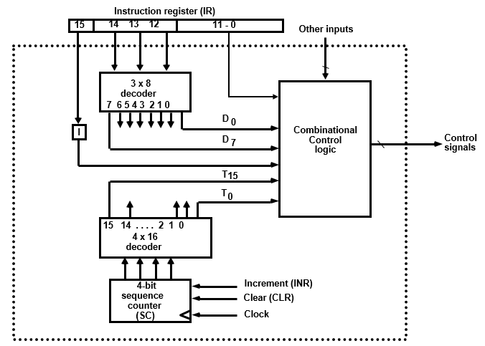
Timing and Control
Fig. 2.6
Control Unit of Basic Computer

Slide 26
Timing and Control
The sequence counter SC can be incremented or cleared synchronously.
Most of the time, the counter is incremented to provide the sequence of timing signals out of the 4 x 16 decoder.
Occasionally, the counter is cleared to 0, causing the next active timing signal to be To.
As an example, consider the case where SC is incremented to provide timing signals T0, T1 T2, T3, and T4 in sequence. At time T4, SC is cleared to 0 if decoder output D3 is active. This is expressed symbolically by the statement
D3T4: SC ← 0.
The timing diagram of Fig. 2-7 shows the time relationship of the control signals. The sequence counter SC responds to the positive transition of the clock. Initially, the CLR input of SC is active.

Slide 27
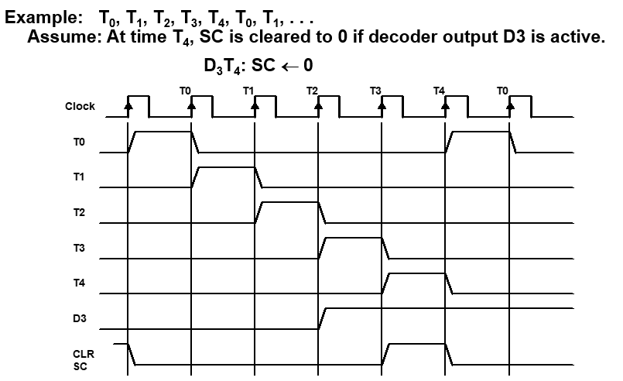
Timing and Control

Slide 28
Timing and Control
To fully comprehend the operation of the computer, it is crucial that one understands the timing relationship between the clock transition and the timing signals.
For example, the register transfer statement
T0: AR ← PC
specifies a transfer of the content of PC into AR if timing signal T0 is active. T0 is active during an entire clock cycle interval.
During this time, the content of PC is placed onto the bus (with S2S1S0 = 010) and the LD (load) input of AR is enabled.
The actual transfer does not occur until the end of the clock cycle when the clock goes through a positive transition.
This same positive clock transition increments the sequence counter SC from 0000 to 0001 .
The next clock cycle has T1 active and T0 inactive.

Slide 29
Instruction Cycle
In Basic Computer, a machine instruction is executed in the following steps known as Instruction cycle:
  Fetch an instruction from memory
  Decode the instruction
  Read the effective address from memory if the instruction has an indirect address
  Execute the instruction
Upon the completion of step 4, the control goes back to step 1 to fetch, decode, and execute the next instruction.
This process (cycle) continues indefinitely unless a HALT instruction is encountered.
Note: Every different processor has its own (different) instruction cycle

Slide 30
Instruction Cycle
Fetch and Decode:
Initially, the program counter PC is loaded with the address of the first instruction in the program.
The sequence counter SC is cleared to 0, providing a decoded timing signal T0.
After each clock pulse, SC is incremented by one, so that the timing signals go through a sequence T0, T1, T2, and so on.
The microoperations for the fetch and decode phases can be specified by the following register transfer statements.
  T0: AR ← PC (S₀S₁S₂=010, T0=1)
  T1: IR ← M [AR], PC ← PC + 1 (S0S1S2=111, T1=1)
  T2: D0, . . . , D7 ← Decode IR(12-14), AR ← IR(0-11), I ← IR(15)

Slide 31
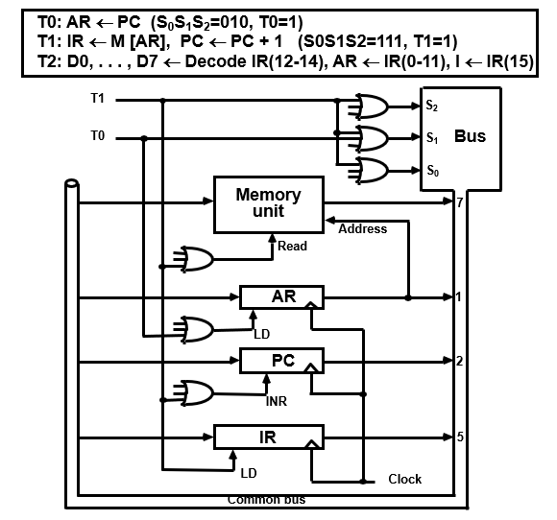
Instruction Cycle
Fetch and Decode:
Fig-2.8

Slide 32
Instruction Cycle
Figure 2.8 shows how the first two register transfer statements are implemented in the common bus system.
To provide the data path for the transfer of PC to AR we must apply timing signal T0 to achieve the following connection:
  Place the content of PC onto the bus by making the bus selection inputs i.e., S2S1S0 equal to 010.
  Transfer the content of the bus to AR by enabling the LD input of AR.
The next clock transition initiates the transfer from PC to AR since T0 = 1. In order to implement the second statement, use T1.
T1: IR ← M[AR], PC ← PC + 1
T1 provide the following connections in the bus system.
  Enable the read input of memory.
  Place the content of memory onto the bus (S2S1S0 = 111).
  Transfer the content of the bus to IR by enabling the LD of IR .
  Increment PC by enabling the INR input of PC.

Slide 33
Instruction Cycle
DETERMINE THE TYPE OF INSTRUCTION:
The timing signal that is active after the decoding is T3.
During time T3, the control unit determines the type of instruction that was just read from memory.
The flowchart of Fig. 2.9 presents an initial configuration for the instruction cycle and shows how the control determines the instruction type (among three types – memory, register, or IO) after the decoding.
D'7IT3: AR ← M[AR]
D'7I'T3: Nothing
D7I'T3: Execute a register-reference instr.
D7IT3: Execute an input-output instr.

Slide 34
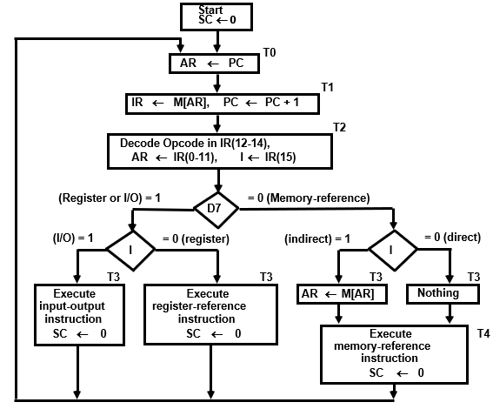
Instruction Cycle
Flowchart Fig. 2.9

Slide 35
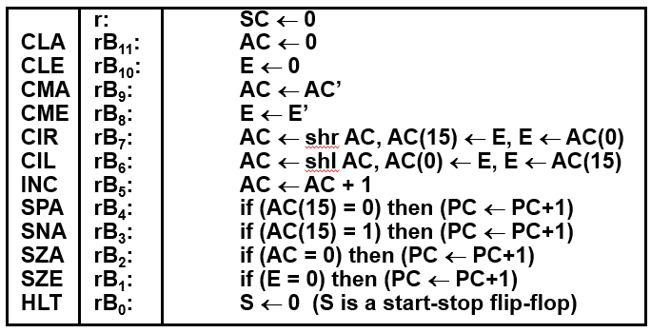
Instruction Cycle
Register-Reference Instructions: These are identified, when,
- D₇ = 1, I = 0
- Register Ref. Instr. is specified in b₀ ~ b₁₁ of IR
- Execution starts with timing signal T₃
r = D₇ I′T₃ => Register Reference Instruction
B_{i} = IR(i) , i=0,1,2,...,11

Slide 36
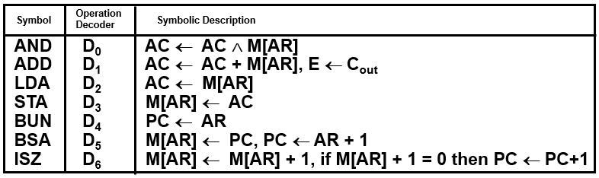
4. Memory Reference Instruction
In order to specify the microoperations needed for the execution of each instruction, it is necessary that the function that they are intended to perform be defined precisely.
The effective address of the instruction is in AR and was placed there during timing signal T2 when I = 0, or during timing signal T3 when I = 1.
Memory cycle is assumed to be short enough to complete in a CPU cycle. The execution of MR instruction starts with T4.

Slide 37
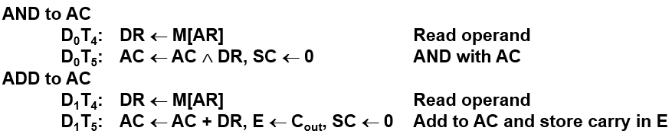
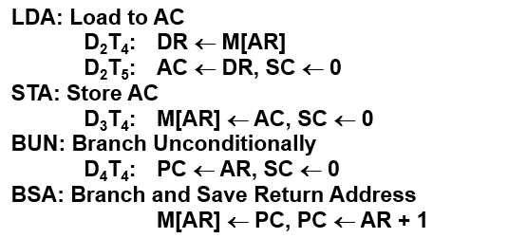

Memory Reference Instruction
We now explain the operation of each instruction and list the control functions and microoperations needed for their execution.

Slide 38
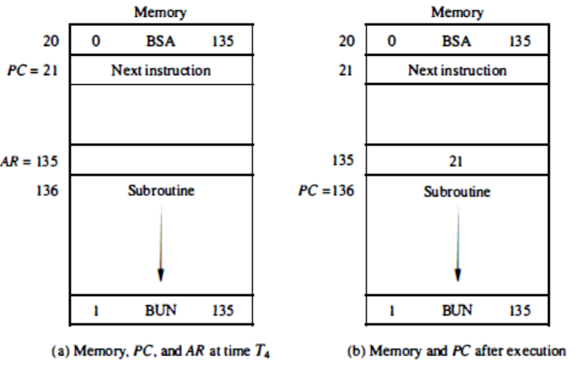
Memory Reference Instruction
A numerical example that demonstrates how this instruction is used with a subroutine is shown below:

Slide 39
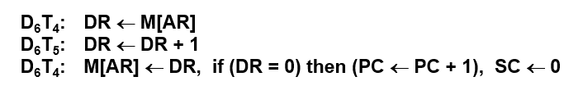
Memory Reference Instruction
ISZ: Increment and Skip if Zero
This instruction increments the word specified by the effective address, and if the incremented value is equal to 0, PC is incremented by 1.
Since it is not possible to increment a word inside the memory, it is necessary to read the word into DR, increment DR, and store the word back into memory. This is done with the following sequence of microoperations:

Slide 40
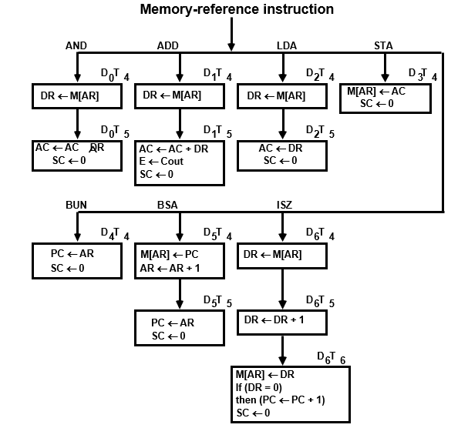
Memory Reference Instruction
Control Flowchart:

Slide 41
5. Input-Output and Interrupt
A computer can serve no useful purpose unless it communicates with the external environment.
Instructions and data stored in memory must come from some input device.
Computational results must be transmitted to the user through some output device.
Commercial computers include many types of input and output devices. To demonstrate the most basic requirements for input and output communication, we will use as an illustration a terminal unit with a keyboard and printer.

Slide 42
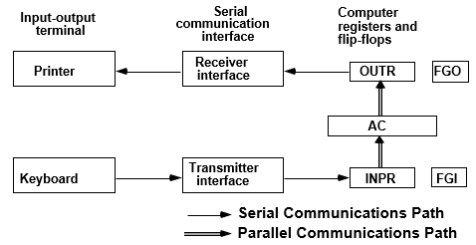
Input-Output and Interrupt
Input-Output Configuration:
The terminal sends and receives serial information. Each quantity of information has eight bits of an alphanumeric code. The serial information from the keyboard is shifted into the input register INPR . The serial information for the printer is stored in the output register OUTR.

Slide 43
Input-Output and Interrupt
Input-Output Configuration:
The flags are needed to synchronize the timing difference between I/O device and the computer
The process of information transfer is as follows. Initially, the input flag FGI (1-bit length) is cleared to 0.
When a key is struck in the keyboard, an 8-bit alphanumeric code is shifted into INPR and the input flag FGI is set to 1.
As long as the flag is set, the information in INPR cannot be changed by striking another key.
The computer checks the flag bit; if it is 1, the information from INPR is transferred in parallel into AC and FGI is cleared to 0.
Once the flag is cleared, new information can be shifted into INPR by striking another key.

Slide 44
Input-Output and Interrupt
Input-Output Configuration:
Initially, the output flag FGO is set to 1.
The computer checks the flag bit; if it is 1, the information from AC is transferred in parallel to OUTR and FGO is cleared to 0.
The output device accepts the coded information, prints the corresponding character, and when the operation is completed, it sets FGO to 1.
The computer does not load a new character into OUTR when FGO is 0 because this condition indicates that the output device is in the process of printing the character.

Slide 45
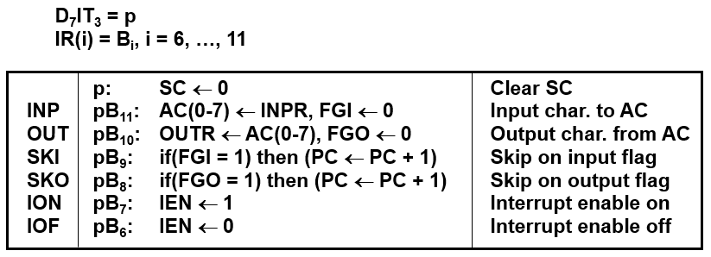
Input-Output and Interrupt
Input-Output Instructions:
I/O instructions are needed for transferring information to and from AC, for checking flag bits, and controlling the interrupt facility.
I/O instructions have an operation code 1111 and are recognized by the control when D7 = 1 and I = 1. The remaining bits specify the operation. The control functions and microoperations are listed:

Slide 46
Input-Output and Interrupt
Program Interrupt:
The process of communication just described is referred to as programmed control transfer.
The computer keeps checking the flag bit, and when it finds it set, it initiates an information transfer.
The difference of information flow rate between the computer and that of the input-Output device makes this type of transfer inefficient.
An alternative to the programmed controlled procedure is to let the external device inform the computer when it is ready for the transfer.
In the meantime the computer can be busy with other tasks. This type of transfer uses the interrupt facility.

Slide 47
Input-Output and Interrupt
Program Interrupt:
Open communication only when some data has to be passed through interrupt.
The I/O interface, instead of the CPU, monitors the I/O device. When the interface founds that the I/O device is ready for data transfer, it generates an interrupt request to the CPU
Upon detecting an interrupt, the CPU stops momentarily the task it is doing, branches to the service routine to process the data transfer, and then returns to the task it was performing.
IEN (Interrupt-enable flip-flop) flag: can be set and cleared by instructions. When IEN=0, the computer cannot be interrupted. When IEN=1, the computer can be interrupted.
The interrupt cycle is a HW implementation of a branch and save return address operation

Slide 48
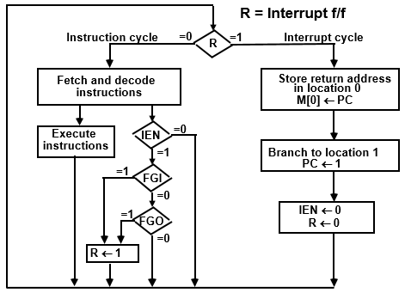
Input-Output and Interrupt
FLOWCHART FOR INTERRUPT CYCLE:
At the beginning of the next instruction cycle, the instruction that is read from memory is in address 1. At memory address 1, the programmer must store a branch instruction that sends the control to an interrupt service routine.
The instruction that returns the control to the original program is "BUN 0"

Slide 49
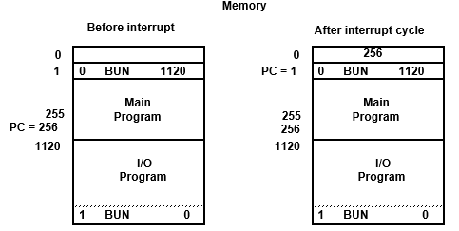
Input-Output and Interrupt
Register Transfer Operations In Interrupt Cycle:
Register Transfer Statements for Interrupt Cycle
- R F/F ← 1 if IEN (FGI + FGO)T₀′T₁′T₂′
⇔ T₀′T₁′T₂′ (IEN)(FGI + FGO): R ← 1
- The fetch and decode phases of the instruction cycle must be modified
➔Replace T₀, T₁, T₂ with R'T₀, R'T₁, R'T₂
- The interrupt cycle :
RT₀: AR ← 0, TR ← PC
RT₁: M[AR] ← TR, PC ← 0
RT₂: PC ← PC + 1, IEN ← 0, R ← 0, SC ← 0

Slide 50
END OF
UNIT-2
PART-1

