Slide 1
II-B.E. III-SEMESTER
COMPUTER ARCHITECTURE (CA)
Presented By
Dr. D. BASWARAJ
Professor, CSE DEPT.
VCE, HYDERABAD

Slide 2
SYLLABUS
UNIT – I:
Overview of Computer Function and Interconnection: Computer Components, Interconnection Structures, Bus Interconnection, Bus Structure, Data Transfer.
Register Transfer Micro operations: Register Transfer Language, Register Transfer, Bus and Memory Transfers, Arithmetic, Logic, Shift Micro operations, Arithmetic Logic Shift Unit.
UNIT – II:
Basic Computer organization and Design: Instruction codes, Computer Registers, Computer Instructions, Timing and Control, Instruction Cycle, Memory Reference Instruction, Input-Output and Interrupt.
Micro programmed Control: Control memory, Address Sequencing, Micro program Example, Design of Control Unit.

Slide 3
SYLLABUS …
Learning Resources:
M. Morris Mano, Computer System Architecture, 3rd Edition (2007), Pearson Education Asia.
William Stallings, Computer Organization & Architecture, 8th Edition (2011), Pearson Education Asia.
David A Patterson, John L Hennessy, Computer Organization and Design, 4th Edition (2014), Morgan Kaufmann.
Carl.V Hamacher, Vranesic Z.G, Zaky S.G, Computer Organization, 5th Edition (2011), McGraw Hill.
Pal Chaudhuri.P, Computer Organization and Design, , 3rd Edition(2009), Prentice Hall of India

Slide 4
UNIT-II
PART-1: Basic Computer organization and Design
  Instruction codes, Computer Registers
  Computer Instructions
  Timing and Control, Instruction Cycle
  Memory Reference Instruction
  Input-Output and Interrupt
  PART-2: Micro programmed Control
  Control memory
  Address Sequencing
  Micro program Example
  Design of Control Unit

Slide 5
1. Control memory
The function of the control unit in a digital computer is to initiate sequences of microoperations.
The number of different types of microoperations that are available in a given system is finite.
The complexity of the digital system is derived from the number of sequences of microoperations that are performed.
When the control signals are generated by hardware using conventional logic design techniques, the control unit is said to be hardwired.
Microprogram is a second alternative for designing the control unit of a digital computer. The principle of microprogramming is an elegant and systematic method for controlling the microoperation sequences in a digital computer..

Slide 6
Control memory
The control function that specifies a microoperation is a binary variable. When it is in one binary state, the corresponding microoperation is executed.
The active state of a control variable may be either the 1 state or the 0 state, depending on the application.
The control variables at any given time can be represented by a string of l's and 0's called a control word (CW).
As such, control words can be programmed to perform various operations on the components of the system. A control unit whose binary control variables are stored in memory is called a microprogrammed control unit.
Each word in control memory contains within it a microinstruction. The microinstruction specifies one or more microoperations for the system. A sequence of microinstructions constitutes a microprogram.

Slide 7
Control memory
Since alterations of the microprogram are not needed once the control unit is in operation, the control memory can be a read-only memory (ROM).
A more advanced development known as dynamic microprogramming permits a microprogram to be loaded initially from an auxiliary memory such as a magnetic disk.
Control units that use dynamic microprogramming employ a writable control memory.
This type of memory can be used for writing (to change the microprogram) but is used mostly for reading. A memory that is part of a control unit is referred to as a control memory.
A computer that employs a microprogrammed control unit will have two separate memories: a main memory and a control memory.

Slide 8
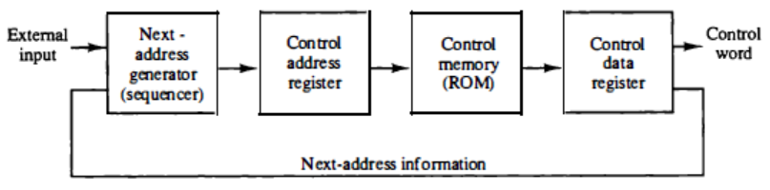
Control memory
The user's program in main memory consists of machine instructions and data. In contrast, the control memory holds a fixed microprogram that cannot be altered by the occasional user.
The general configuration of a microprogrammed control unit is demonstrated in the block diagram of Fig. 2-1.

Slide 9
Control memory
The control memory address register (CAR) specifies the address of the microinstruction, and the control data register (CDR) holds the microinstruction read from memory.
The microinstruction contains a control word that specifies one or more micro­operations for the data processor.
Once these operations are executed, the control must determine the next address.
The next address generator is sometimes called a microprogram sequencer, as it determines the address sequence that is read from control memory.
Typical functions of a microprogram sequencer are incrementing the control address register by one, loading into the control address register an address from control memory, transferring an external address, or loading an initial address to start the control operations.

Slide 10
Control memory
The control data register holds the present microinstruction while the next address is computed and read from memory. The data register is some­ times called a pipeline register.
It allows the execution of the microoperations specified by the control word simultaneously with the generation of the next microinstruction.
This configuration requires a two-phase clock, with one clock applied to the address register and the other to the data register.
The main advantage of the microprogrammed control is the fact that once the hardware configuration is established, there should be no need for further hardware or wiring changes.
The hardware configuration should not be changed for different operations; the only thing that must be changed is the microprogram residing in control memory.

Slide 11
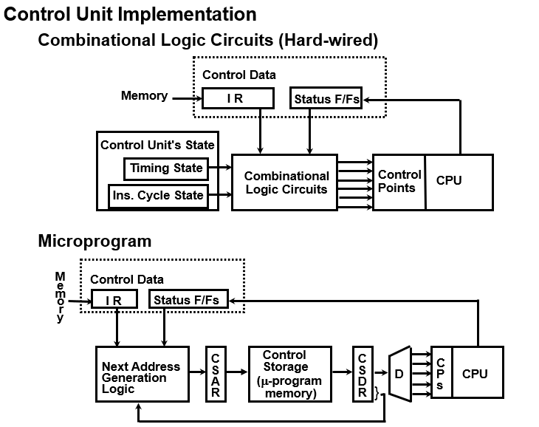
Control memory

Slide 12
2. Address Sequencing
Microinstructions are stored in control memory in groups, with each group specifying a routine.
Each computer instruction has its own microprogram routine in control memory to generate the microoperations that execute the instruction.
An initial address is loaded into the control address register when power is turned on in the computer.
This address is usually the address of the first microinstruction that activates the instruction fetch routine.
The control memory next must go through the routine that determines the effective address of the operand.
When the effective address computation routine is completed, the address of the operand is available in the memory address register.

Slide 13
Address Sequencing…
The transformation from the instruction code bits to an address in control memory where the routine is located is referred to as a mapping process.
A mapping procedure is a rule that transforms the instruction code into a control memory address.
In summary, the address sequencing capabilities required in a control memory are:
  Incrementing of the control address register.
  Unconditional branch or conditional branch, depending on status bit conditions.
  A mapping process from the bits of the instruction to an address for control memory.
  A facility for subroutine call and return.

Slide 14
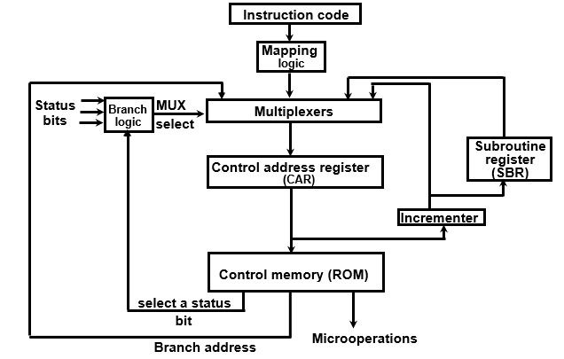
Address Sequencing…
Figure 2-2 shows a block diagram of a control memory and the associated hardware needed for selecting the next microinstruction address.

Slide 15
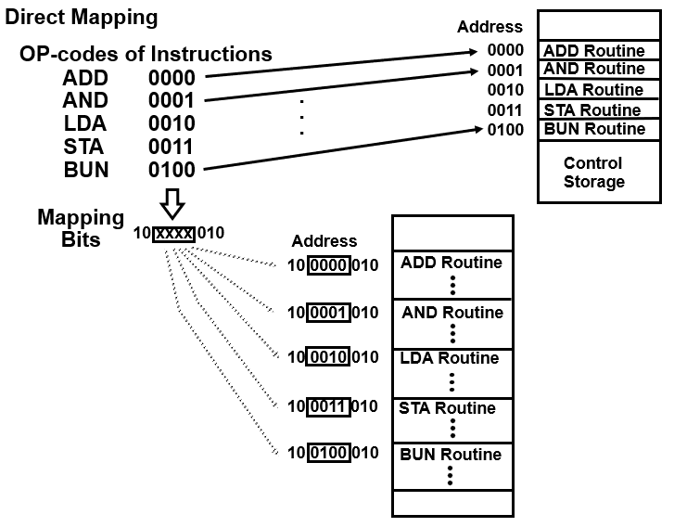
Address Sequencing…
Mapping of Instruction:

Slide 16
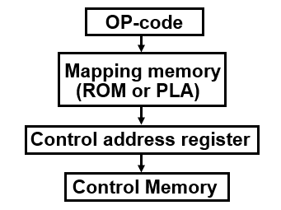
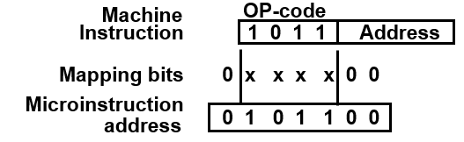
Address Sequencing…
Mapping of Instruction: Mapping from the OP-code of an instruction to the address of the Microinstruction which is the starting microinstruction of its execution microprogram.
Mapping function implemented by ROM or PLA:

Slide 17
3. Micro program Example
Once the configuration of a computer and its microprogrammed control unit is established, the designer's task is to generate the microcode for the control memory.
This code generation is called microprogramming and is a process like conventional machine language programming.
To appreciate this process, we present here a simple digital computer and show how it is mi­croprogrammed.
The block diagram of the computer is shown in Fig. 2-4.
It consists of two memory units: a main memory for storing instructions and data, and a control memory for storing the microprogram. Four registers are associated with the processor unit and two with the control unit.
The control unit has a control address register CAR and a subroutine register SBR

Slide 18
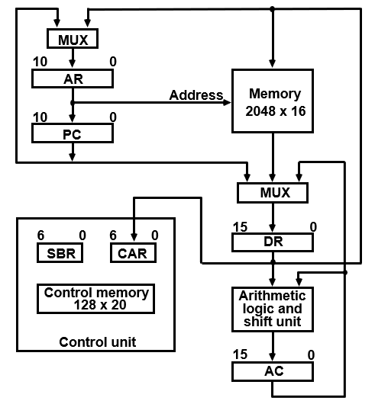
Micro program Example…
Computer Configuration:

Slide 19
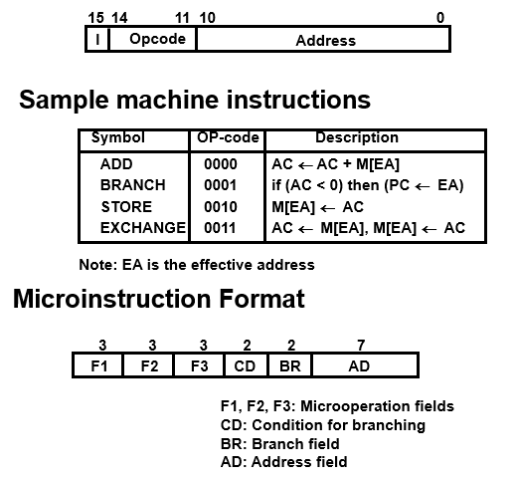
Micro program Example…
Machine instruction format:

Slide 20
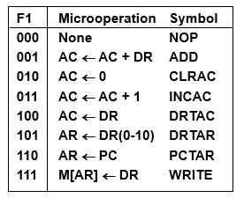
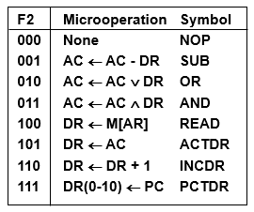
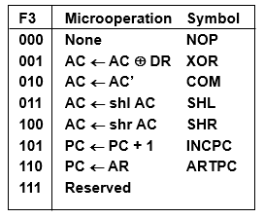
Micro program Example…
Microinstruction Field Descriptions - F1,F2,F3:

Slide 21
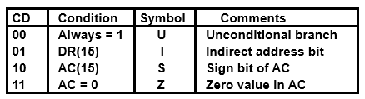
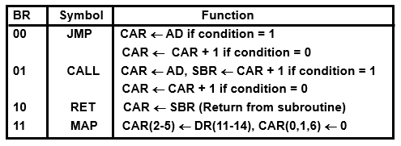
Micro program Example…
Microinstruction Field Descriptions – CD and BR:

Slide 22
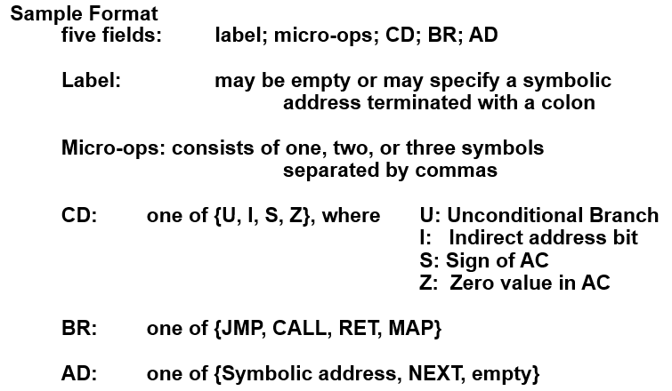
Micro program Example…
Symbolic Microinstructions: Symbols are used in microinstructions as in assembly language.
A symbolic microprogram can be translated into its binary equivalent by a microprogram assembler.

Slide 23
Symbolic Microprogram - Fetch Routine
During FETCH, Read an instruction from memory
and decode the instruction and update PC
Sequence of microoperations in the fetch cycle:
AR ← PC
DR ← M[AR], PC ← PC + 1
AR ← DR(0-10), CAR(2-5) ← DR(11-14), CAR(0,1,6) ← 0
Symbolic microprogram for the fetch cycle: ORG 64 indicates microinstructions are kept in control memory starts at 64 address.
FETCH:
ORG 64
PCTAR U JMP NEXT
READ, INCPC U JMP NEXT
DRTAR U MAP
Binary equivalents translated by an assembler
Binary
address F1 F2 F3 CD BR AD
1000000 110 000 000 00 00 1000001
1000001 000 100 101 00 00 1000010
1000010 101 000 000 00 11 0000000

Slide 24
Symbolic Microprogram
Control Storage: 128 20-bit words
The first 64 words: Routines for the 16 machine instructions
The last 64 words: Used for other purpose (e.g., fetch routine and other subroutines)
Mapping: OP-code XXXX into 0XXXX00, the first address for the 16 routines are
0(0 0000 00), 4(0 0001 00), 8, 12, 16, 20, ..., 60
Partial Symbolic Microprogram
Label Microops CD BR AD
ADD:
BRANCH:
OVER:
STORE:
EXCHANGE:
FETCH:
INDRCT:
ORG 0
NOP
READ
ADD
ORG 4
NOP
NOP
NOP
ARTPC
ORG 8
NOP
ACTDR
WRITE
ORG 12
NOP
READ
ACTDR, DRTAC
WRITE
ORG 64
PCTAR
READ, INCPC
DRTAR
READ
DRTAR
I
U
U
S
U
I
U
I
U
U
I
U
U
U
U
U
U
U
U
CALL
JMP
JMP
JMP
JMP
CALL
JMP
CALL
JMP
JMP
CALL
JMP
JMP
JMP
JMP
JMP
MAP
JMP
RET
INDRCT
NEXT
FETCH
OVER
FETCH
INDRCT
FETCH
INDRCT
NEXT
FETCH
INDRCT
NEXT
NEXT
FETCH
NEXT
NEXT
NEXT

Slide 25
Binary Microprogram
  Address Binary Microinstruction
  Micro Routine Decimal Binary F1 F2 F3 CD BR AD
ADD 0 0000000 000 000 000 01 01 1000011
  1 0000001 000 100 000 00 00 0000010
  2 0000010 001 000 000 00 00 1000000
  3 0000011 000 000 000 00 00 1000000
BRANCH 4 0000100 000 000 000 10 00 0000110
  5 0000101 000 000 000 00 00 1000000
  6 0000110 000 000 000 01 01 1000011
  7 0000111 000 000 110 00 00 1000000
STORE 8 0001000 000 000 000 01 01 1000011
  9 0001001 000 101 000 00 00 0001010
  10 0001010 111 000 000 00 00 1000000
  11 0001011 000 000 000 00 00 1000000
EXCHANGE 12 0001100 000 000 000 01 01 1000011
  13 0001101 001 000 000 00 00 0001110
  14 0001110 100 101 000 00 00 0001111
  15 0001111 111 000 000 00 00 1000000
FETCH 64 1000000 110 000 000 00 00 1000001
  65 1000001 000 100 101 00 00 1000010
  66 1000010 101 000 000 00 11 0000000
INDRCT 67 1000011 000 100 000 00 00 1000100
  68 1000100 101 000 000 00 10 0000000
This microprogram can be implemented using ROM

Slide 26
4. Design of Control Unit
The encoding of control bits was demonstrated in the programming example of the preceding section.
The nine bits of the microoperation field are divided into three subfields of three bits each.
The control memory output of each subfield must be decoded to provide the distinct microoperations.
The outputs of the decoders are connected to the appropriate inputs in the processor unit.
Figure shows (in next slide) the three decoders and some of the connections that must be made from their outputs.
Each of the three fields of the microinstruction presently available in the output of control memory are decoded with a 3 x 8 decoder to provide eight outputs.
Each of these outputs must be connected to the proper circuit to initiate the corresponding microoperation

Slide 27
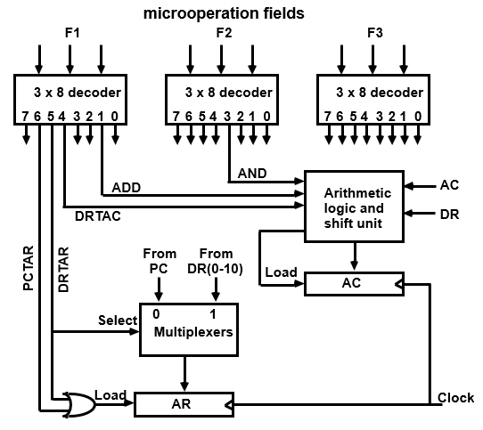
Design of Control Unit
Figure: Decoding of Microoperation Fields

Slide 28
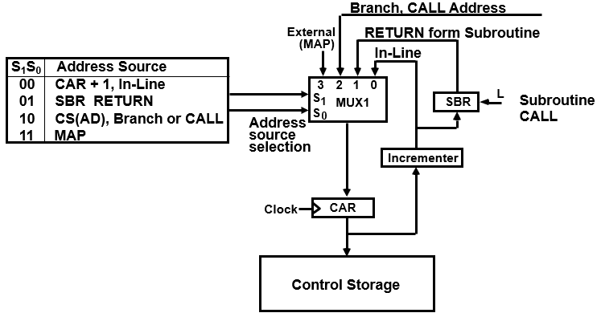
Design of Control Unit
Next Microinstruction Address Logic: MUX-1 selects an address from one of four sources and routes it into a CAR
  In-Line Sequencing → CAR + 1
  Branch, Subroutine Call → CS(AD)
  Return from Subroutine → Output of SBR
  New Machine instruction → MAP

Slide 29
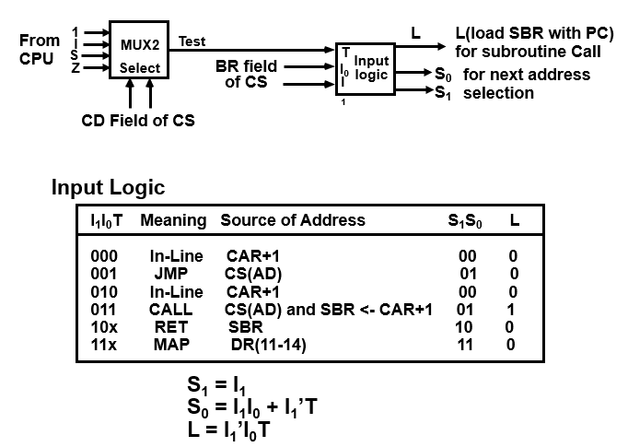
Design of Control Unit
CONDITION AND BRANCH CONTROL:

Slide 30
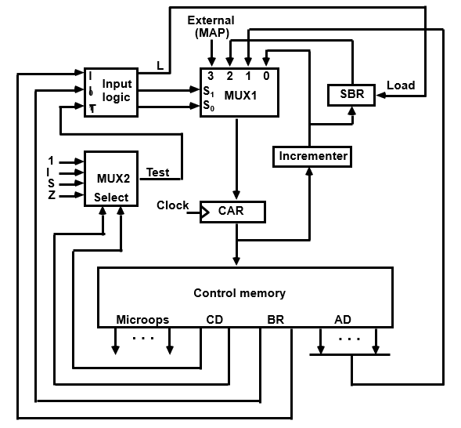
Design of Control Unit
MICROPROGRAM SEQUENCER:

Slide 31
END OF
UNIT-2
PART-2

