Slide 1
II-B.E. III-SEMESTER
COMPUTER ARCHITECTURE (CA)
Presented By
Dr. D. BASWARAJ
Professor, CSE DEPT.
VCE, HYDERABAD

Slide 2
SYLLABUS
UNIT – I:
Overview of Computer Function and Interconnection, Register Transfer Micro operations
UNIT – II:
Basic Computer organization and Design, Micro programmed Control
UNIT – III:
Central Processing Unit: General Register organization, Stack Organization, Instruction Formats, Addressing Modes, Data Transfer and Manipulation, Program Control, RISC.
Pipeline: Parallel processing, Pipelining, Arithmetic pipeline, Instruction Pipeline.
Computer Arithmetic: Addition and Subtraction, Multiplication, Division, Floating Point Arithmetic Operations, Decimal Arithmetic Unit.

Slide 3
SYLLABUS …
Learning Resources:
M. Morris Mano, Computer System Architecture, 3rd Edition (2007), Pearson Education Asia.
William Stallings, Computer Organization & Architecture, 8th Edition (2011), Pearson Education Asia.
David A Patterson, John L Hennessy, Computer Organization and Design, 4th Edition (2014), Morgan Kaufmann.
Carl.V Hamacher, Vranesic Z.G, Zaky S.G, Computer Organization, 5th Edition (2011), McGraw Hill.
Pal Chaudhuri.P, Computer Organization and Design, , 3rd Edition(2009), Prentice Hall of India

Slide 4
UNIT-III
PART-1: Central Processing Unit
  General Register organization
  Stack Organization
  Instruction Formats
  Addressing Modes
  Data Transfer and Manipulation
  Program Control
  RISC

Slide 5
1. General Register organization
The part of the computer that performs the bulk of data-processing operations is called the central processing unit and is referred to as the CPU.
The CPU is made up of three major parts, as shown below:
The CPU performs a variety of functions dictated by the type of instructions that are incorporated in the computer
Memory access is most time-consuming operation in a computer. It is then more convenient and more efficient to store these intermediate values in processor registers, which are connected through common bus system.
Register set
Control
ALU

Slide 6
General Register organization…
Accumulator based CPU:
Characteristics:
Initially, computers had accumulator-based CPUs.
It is a simple CPU in which the accumulator contains an operand for the Instruction.
The instruction leaves the result in the accumulator.
These CPUs have zero address & single address instruction.
The Advantages:
Short Instruction & less memory space.
Instruction cycle takes less time because it saves time in Instruction fetching due to the absence of operand fetch.
The Disadvantages:
Program Size increases, memory size increases.
Program execution time increases due to increase in program size.

Slide 7
General Register organization…
Register based CPU :
Characteristics:
Multiple registers are used.
The use of registers result in short programs with limited instructions.
The Advantages:
Shorter Program size
Increase in the number of registers, increases CPU efficiency.
The Disadvantages:
Additional memory accesses are needed.
Compilers need to be more efficient in this aspect

Slide 8
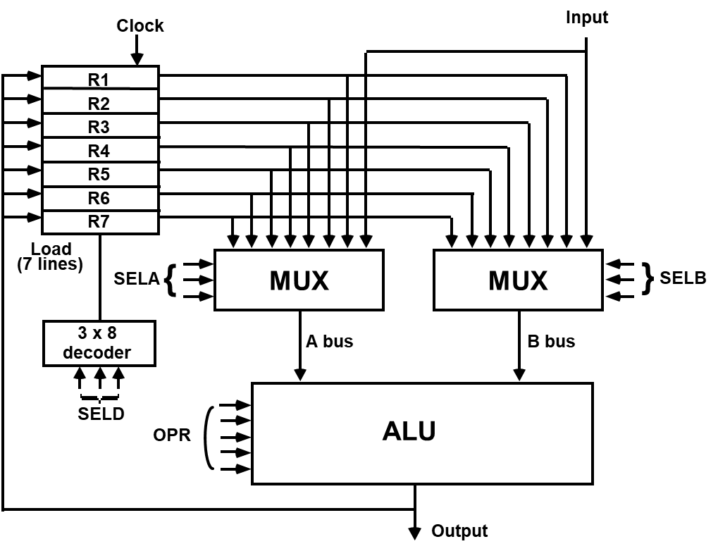

General Register organization…
When many registers are included in the CPU, it is most efficient to connect them through a common bus system.

Slide 9
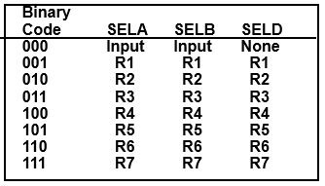
General Register organization…
The control unit directs the information flow through ALU by:
- Selecting various Components in the system
- Selecting the Function of ALU
Example: R1 ← R2 + R3
  MUX A selector (SELA): BUS A ← R2
  MUX B selector (SELB): BUS B ← R3
  ALU operation selector (OPR): ALU to ADD
  Decoder destination selector (SELD): R1 ← Out Bus
Encoding of register selection fields

Slide 10
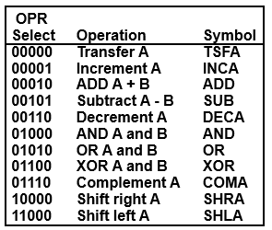
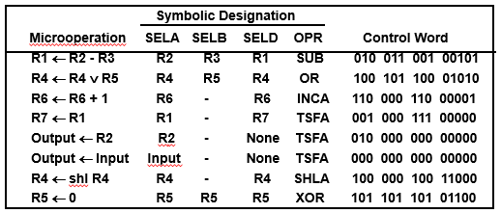
General Register organization…
The ALU provides arithmetic and logic operations. In addition, the CPU must provide shift operations.
Encoding of ALU operations Examples of ALU Microoperations

Slide 11
2. Stack Organization
A useful feature that is included in the CPU of most computers is a stack or Last-in, first-out (LIFO) list.
The stack in digital computers is essentially a memory unit with an address register (Stack Pointer SP) that count only after an initial value is loaded into the stack.
SP value always point at the top item in the stack. The 2 operations of stacks are the insertion (push), and deletion (pop) of items.
A stack can be organized as a collection of a finite number of memory words or registers.
In a 64-word stack, SP contains 6 bits because 26 = 64.
The 1-bit register FULL is set to 1 when stack is full.
The 1-bit register EMTY is set to 1 when stack is empty.
DR is data register that holds the binary data to be written into or read out of the stack.

Slide 12
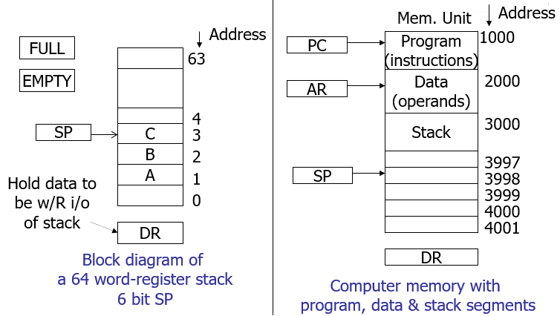
Stack Organization…
Register Stack Vs Memory Stack:

Slide 13
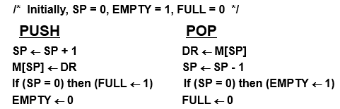
Stack Organization…
Stack Organization in Register stack: Push, Pop operations
Stack Organization in Memory stack: Push, Pop operations
A portion of memory is used as a stack with a processor register as a stack pointer
- PUSH: SP ← SP - 1
  M[SP] ← DR
- POP: DR ← M[SP]
  SP ← SP + 1
Most computers do not provide hardware to check stack overflow (full stack) or underflow(empty stack)

Slide 14
Stack Organization…
Reverse Polish Notation:
A stack organization is very effective for evaluating arithmetic expressions. The Polish mathematician Lukasiewicz showed that arithmetic expressions can be represented in prefix notation .
This representation, often referred to as Polish notation, places the operator before the operands.
The postfix notation, referred to as Reverse Polish notation (RPN), places the operator after the operands. The following examples demonstrate the three representations:
  A + B Infix notation
  +AB Prefix or Polish notation
  AB + Postfix or reverse Polish notation
Infix expression: A*B+C*D in Reverse Polish Notation (RPN or postfix notation) written as: AB*CD*+

Slide 15
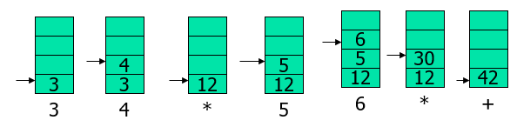
Stack Organization…
Evaluation of Arithmetic Expression:
Reverse Polish notation, combined with a stack arrangement of registers, is the most efficient way known for evaluating arithmetic expressions.
The stack is particularly useful for handling long, complex problems involving chain calculations. It is since any arithmetic expression can be expressed in parentheses-free Polish notation.
Stack operation to evaluate expression: 3*4+5*6 => 34*56*+ (in RPN) as follows:

Slide 16
Stack Organization…
The advantages of stack-based CPU:
Easy Programming /high compiler Efficiency.
Instructions don’t have address field, short instructions.
The disadvantages :
Additional hardware circuitry needed for stack implementation.
Increased program size.

Slide 17
3. Instruction Formats
A computer will usually have a variety of instruction code formats.
It is the function of the control unit within the CPU to interpret each instruction code and provide the necessary control functions needed to process the instruction
The format of an instruction is usually depicted in a rectangular box symbolizing the bits of the instruction as they appear in memory words or in a control register. The bits of the instruction are divided into groups called fields.
The most common fields found in instruction formats are:
  An operation code field that specifies the operation to be performed.
  An address field that designates a memory address or a processor register.
  A mode field that specifies the way the operand or the effective address is determined.
Other special fields are sometimes employed under certain circumstances, like the number of shifts in a shift-type instruction

Slide 18
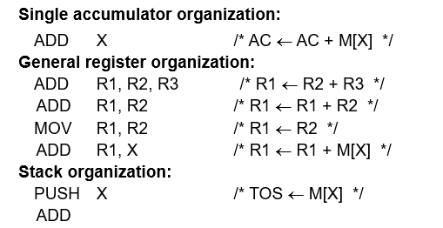
Instruction Formats…
Computers may have instructions of several different lengths containing varying number of addresses.
The number of address fields in the instruction format of a computer depends on the internal organization of its registers.
Most computers fall into one of three types of CPU organizations:
  Single accumulator organization.
  General register organization.
  Stack organization.

Slide 19
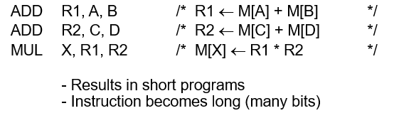
Instruction Formats…
Instruction types:
Based on the number of addresses required to access operands for concerned operation of instruction, we classify instructions in to zero, one, two, and three address instructions.
Example: To illustrate the influence of the number of addresses on computer programs, we will evaluate the following arithmetic statement using zero, one, two, or three address instructions:
X= (A+B)*(C+D)
Three-Address Instructions:

Slide 20
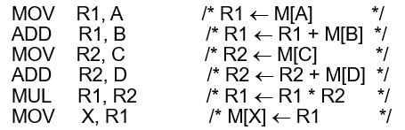
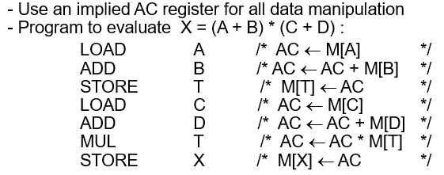
Instruction Formats…
Instruction types: Example: X= (A+B)*(C+D)
Two-Address Instructions:
One-Address Instructions:

Slide 21
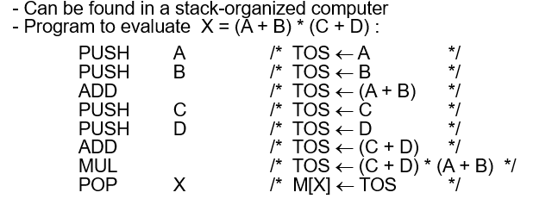
Instruction Formats…
Instruction types: Example: X= (A+B)*(C+D)
Zero-Address Instructions:

Slide 22

4. Addressing Modes
The addressing mode specifies a rule for interpreting or modifying the address field of the instruction before the operand is executed.
Computer uses addressing mode techniques for the purpose of accommodating one of the following provisions:
  To give programming versatilities to the user to be more flexible.
  To use the bits in the address field of the instruction efficiently
In some computers, the addressing mode of the instruction is specified with distinct binary code.
Instruction format:
The availability of the addressing modes gives the experienced assembly language programmer flexibility for writing programs that are more efficient with respect to the number of instructions and execution time.

Slide 23
Addressing Modes…
TYPES OF ADDRESSING MODES:
Different ways in which the address of an operand in specified in an instruction is referred to as addressing modes.
The most well-known addressing mode then are:
  Implied mode.
  Immediate mode
  Register mode
  Register Indirect mode
  Auto-increment or Auto-decrement mode
  Direct Mode
  Indirect Mode
  Relative Address Mode
  Index Addressing Mode

Slide 24
Addressing Modes…
TYPES OF ADDRESSING MODES:
Implied mode:
Address of the operands are specified implicitly in the definition of the instruction
  No need to specify address in the instruction
  EA = AC, or EA = Stack[SP], where EA: Effective Address.
Immediate mode:
Instead of specifying the address of the operand, operand itself is specified
  No need to specify address in the instruction
  However, operand itself needs to be specified
  Sometimes, require more bits than the address
  Fast to acquire an operand

Slide 25
Addressing Modes…
TYPES OF ADDRESSING MODES:
Register mode: Address specified in the instruction by register
  Designated operand need to be in a register
  Shorter address than the memory address
  Saving address field in the instruction
  Faster to acquire an operand than the memory addressing
  EA = IR(R) (IR(R): Register field of IR)
Register Indirect mode: Instruction specifies a register which contains the memory address of the operand
  Saving instruction bits since register address is shorter than the memory address
  Slower to acquire an operand than both the register or memory addressing
  EA = [IR(R)] ([x]: Content of x)

Slide 26
Addressing Modes…
TYPES OF ADDRESSING MODES:
Auto-increment or Auto-decrement mode:
Same as the Register Indirect, but when the address in the register is used to access memory, the value in the register is incremented or decremented by 1 (after or before the execution of the instruction)
Direct Mode: Instruction specifies the memory address which can be used directly to the physical memory
  Faster than the other memory addressing modes
  Too many bits are needed to specify the address for a large physical memory space
  EA = IR(address), (IR(address): address field of IR)

Slide 27
Addressing Modes…
TYPES OF ADDRESSING MODES:
Indirect Mode: The address field of an instruction specifies the address of a memory location that contains the address of the operand
  When the abbreviated address is used, large physical memory can be addressed with a relatively small number of bits
  Slow to acquire an operand because of an additional memory access
  EA = M[IR(address)]
Relative Address Mode: The Address fields of an instruction specifies the part of the address which can be used along with a designated register to calculate the address of the operand
  PC Relative Addressing Mode(R = PC) - EA = PC + IR(address)
  Address field of the instruction is short
  Large physical memory can be accessed with a small number of address bits

Slide 28
Addressing Modes…
TYPES OF ADDRESSING MODES:
Index Addressing Mode:
XR: Index Register:
EA = XR + IR(address)
Base Register Addressing Mode:
BAR: Base Address Register:
EA = BAR + IR(address)

Slide 29
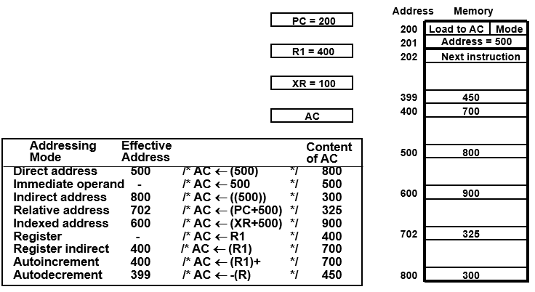
Addressing Modes…
Addressing Modes Example:

Slide 30
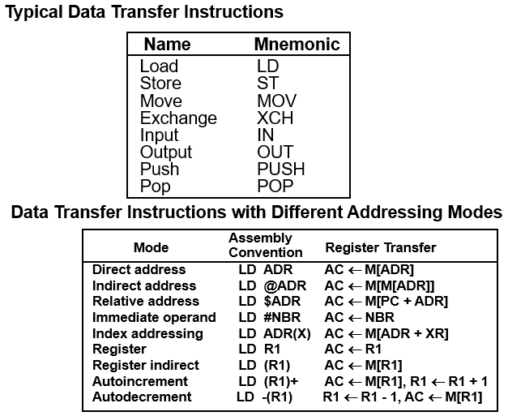
5. Data Transfer and Manipulation Instructions
DATA TRANSFER INSTRUCTIONS.

Slide 31
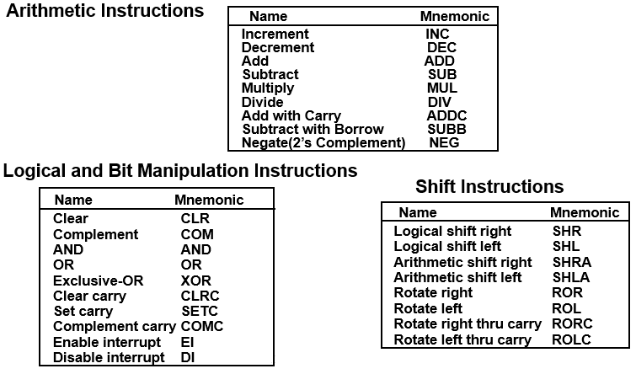
Data Transfer and Manipulation Instructions
Manipulation Instructions: Three Basic Types-

Slide 32
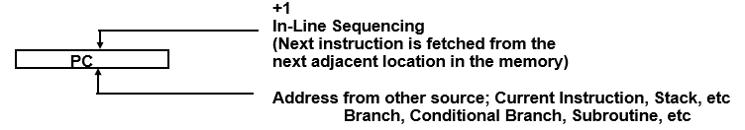
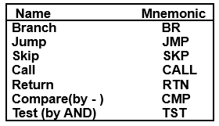
6. Program Control Instructions
Status Flag Circuit:
Program Control Instructions:
CMP and TST instructions do not retain their results of operations (- and AND, respectively). They only set or clear certain Flags.

Slide 33
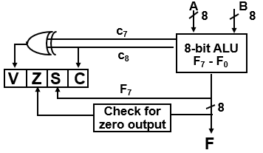
Program Control Instructions
Status Flag Circuit:
Bit C (carry) is set to 1 if the end carry C8 is 1. It is cleared to 0 if the carry is 0.
Bit S (sign) is set to 1 if the highest-order bit F, is 1. It is set to 0 if the bit is 0.
Bit Z (zero) is set to 1 if the output of the ALU contains all O's. !t is cleared to 0 otherwise. In other words, Z = 1 if the output is zero and Z = 0 if the output is not zero.
Bit V (overflow) is set to 1 if the exclusive-OR of the last two carries is equal to 1 and cleared to 0 otherwise. This is the condition for an overflow when negative numbers are in 2's complement. For the 8-bit ALU, V = 1 if the output is greater than + 127 or less than - 128.

Slide 34
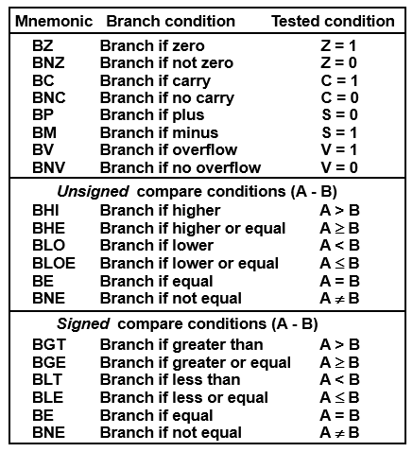
Program Control Instructions
Conditional Branch Instructions:

Slide 35
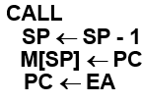

Program Control Instructions
SUBROUTINE CALL AND RETURN:
Two Most Important Operations are Implied;
* Branch to the beginning of the Subroutine
- Same as the Branch or Conditional Branch
* Save the Return Address to get the address of the location in the Calling Program upon exit from the Subroutine
- Locations for storing Return Address: 1. Fixed Location in the subroutine(Memory), 2. Fixed Location in memory 3. In a processor Register 4. In a memory stack (most efficient way)

Slide 36
Program Control Instructions
PROGRAM INTERRUPT:
The concept of program interrupt is used to handle a variety of problems that arise out of normal program sequence
Types of Interrupts: External interrupts, Internal interrupts (traps), Software Interrupts
External interrupts - initiated from the outside of CPU and Memory
  I/O Device -> Data transfer request or Data transfer complete
  Timing Device -> Timeout
  Power Failure
Internal interrupts - are caused by the currently running program
  Register, Stack Overflow
  Divide by zero
  OP-code Violation
  Protection Violation

Slide 37
Program Control Instructions
PROGRAM INTERRUPT…
Software Interrupts - both External and Internal Interrupts are initiated by the computer Hardware. Software Interrupts are initiated by executing an instruction.
Supervisor Call: Switching from a user mode to the supervisor mode, which Allows to execute a certain class of operations, which are not allowed in the user mode
Interrupt Procedure and Subroutine Call:
The interrupt is usually initiated by an internal or an external signal rather than from the execution of an instruction (except for the software interrupt)
The address of the interrupt service program is determined by the hardware rather than from the address field of an instruction
An interrupt procedure usually stores all the information necessary to define the state of CPU rather than storing only the PC.

Slide 38
Program Control Instructions
Interrupt Procedure and Subroutine Call…
The state of the CPU is determined from;
  Content of the PC
  Content of all processor registers
  Content of status bits
Many ways of saving the CPU state depending on the CPU architectures

Slide 39
7. RISC: Reduced Instruction Set Computers
An important aspect of computer architecture is the design of the instruction set for the processor.
The instruction set chosen for a particular computer determines the way that machine language programs are constructed.
Early computers had small and simple instruction sets, forced mainly by the need to minimize the hardware used to implement them.
As digital hardware became cheaper with the advent of integrated circuits, computer instructions tended to increase both in number and complexity.
A computer with a large number of instructions is classified as a complex instruction set computer, abbreviated CISC.

Slide 40
RISC…
In the early 1980s, a number of computer designers recommended that computers use fewer instructions with simple constructs so they can be executed much faster within the CPU without having to use memory as often.
This type of computer is classified as a reduced instruction set computer or RISC.
Characteristics of CISC:
  A large number of instructions (from 100-250 usually)
  Some instructions that performs a certain tasks are not used frequently.
  Many addressing modes are used (5 to 20)
  Variable length instruction format.
  Instructions that manipulate operands in memory.

Slide 41
RISC…
Characteristics of RISC:
The concept of RISC architecture involves an attempt to reduce execution time by simplifying the instruction set of the computer.
The major characteristics of a RISC processor are:
  Relatively few instructions
  Relatively few addressing modes
  Memory access limited to load and store instructions
  All operations done within the registers of the CPU
  Fixed-length, easily decoded instruction format
  Single-cycle instruction execution
  Hardwired rather than microprogrammed control

Slide 42
RISC…
Other characteristics attributed to RISC architecture are:
  A relatively large number of registers in the processor unit
  Use of overlapped register windows to speed-up procedure call and return
  Efficient instruction pipeline
  Compiler support for efficient translation of high-level language programs into machine language programs
Advantages of RISC
  VLSI Realization
  Computing Speed
  Design Costs and Reliability
  High Level Language Support

Slide 43
END OF
UNIT-3
PART-1

