Slide 1
II-B.E. III-SEMESTER
COMPUTER ARCHITECTURE (CA)
Presented By
Dr. D. BASWARAJ
Professor, CSE DEPT.
VCE, HYDERABAD

Slide 2
SYLLABUS
UNIT – I:
Overview of Computer Function and Interconnection, Register Transfer Micro operations
UNIT – II:
Basic Computer organization and Design, Micro programmed Control
UNIT – III:
P1: Central Processing Unit: General Register organization, Stack Organization, Instruction Formats, Addressing Modes, Data Transfer and Manipulation, Program Control, RISC.
P2: Pipeline: Parallel processing, Pipelining, Arithmetic pipeline, Instruction Pipeline.
P3: Computer Arithmetic: Addition and Subtraction, Multiplication, Division, Floating Point Arithmetic Operations, Decimal Arithmetic Unit.

Slide 3
SYLLABUS …
Learning Resources:
M. Morris Mano, Computer System Architecture, 3rd Edition (2007), Pearson Education Asia.
William Stallings, Computer Organization & Architecture, 8th Edition (2011), Pearson Education Asia.
David A Patterson, John L Hennessy, Computer Organization and Design, 4th Edition (2014), Morgan Kaufmann.
Carl.V Hamacher, Vranesic Z.G, Zaky S.G, Computer Organization, 5th Edition (2011), McGraw Hill.
Pal Chaudhuri.P, Computer Organization and Design, , 3rd Edition(2009), Prentice Hall of India

Slide 4
UNIT-III
PART-2: Pipeline
  Parallel processing
  Pipelining
  Arithmetic pipeline
  Instruction Pipeline

Slide 5
1. Parallel processing
Parallel processing is a term used to denote a large class of techniques that are used to provide simultaneous data-processing tasks for the purpose of increasing the computational speed of a computer system.
Instead of processing each instruction sequentially as in a conventional computer, a parallel processing system is able to perform concurrent data processing to achieve faster execution time.
For example, while an instruction is being executed in the ALU, the next instruction can be read from memory.
The system may have two or more ALUs and be able to execute two or more instructions at the same time.
Furthermore, the system may have two or more processors operating concurrently.

Slide 6
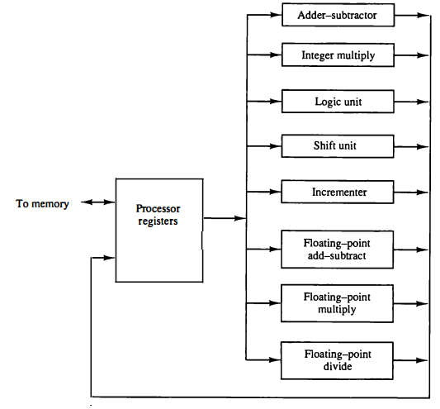
Parallel processing
Figure shows one possible way of separating the execution unit into eight functional units operating in parallel.

Slide 7
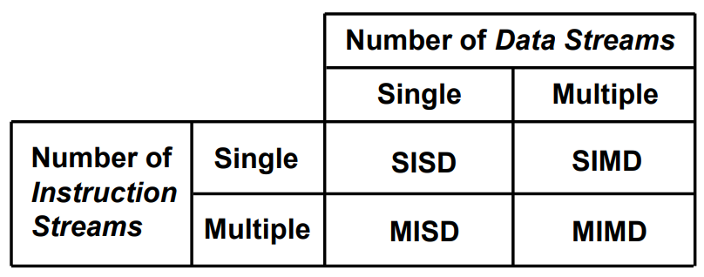
Parallel processing
Levels of Parallel Processing
  Job or Program level, Task or Procedure level
  Inter-Instruction level, Intra-Instruction level
Flynn's classification:
Based on the multiplicity of Instruction Streams and Data Streams
Instruction Stream - Sequence of Instructions read from memory
Data Stream - Operations performed on the data in the processor.

Slide 8
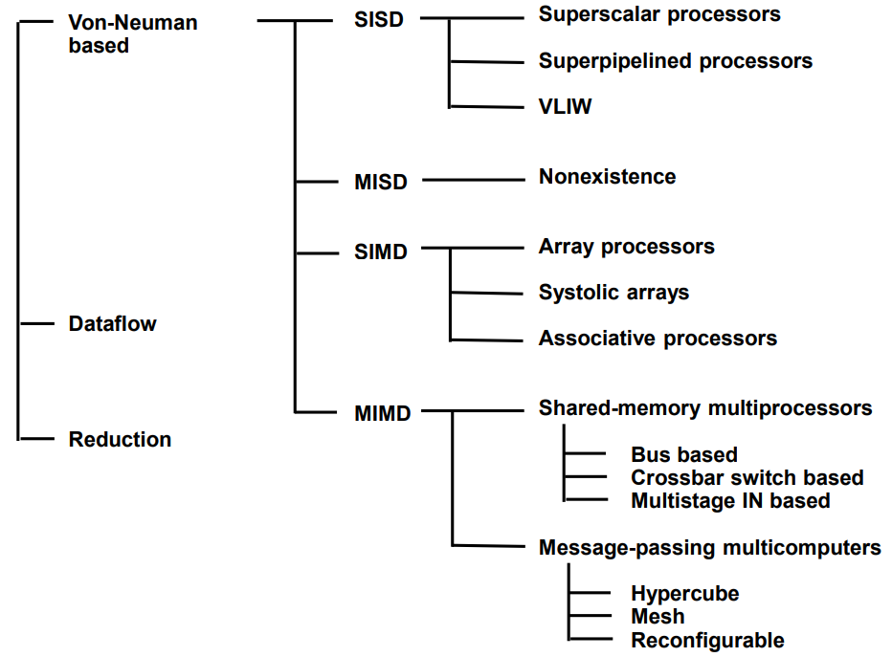
Parallel processing
Computer Architectures For Parallel Processing

Slide 9
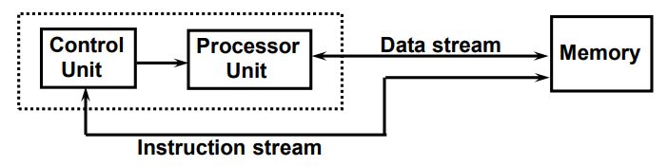
Parallel processing
SISD COMPUTER SYSTEMS
Characteristics:
- Standard von Neumann machine
- Instructions and data are stored in memory
- One operation at a time
Limitations:
- Limitation on Memory Bandwidth
- Memory is shared by CPU and I/O

Slide 10
Parallel processing
SISD PERFORMANCE IMPROVEMENTS
Multiprogramming
Spooling
Multifunction processor
Pipelining
Exploiting instruction-level parallelism
  - Super scalar
- Super pipelining
- VLIW (Very Long Instruction Word)

Slide 11
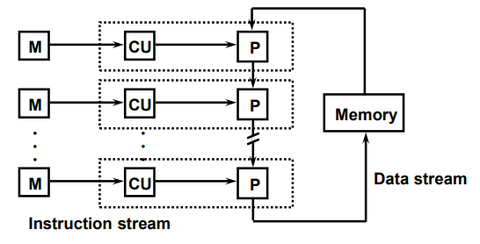
Parallel processing
MISD COMPUTER SYSTEMS
Characteristics:
- There is no computer at present that can be classified as MISD

Slide 12
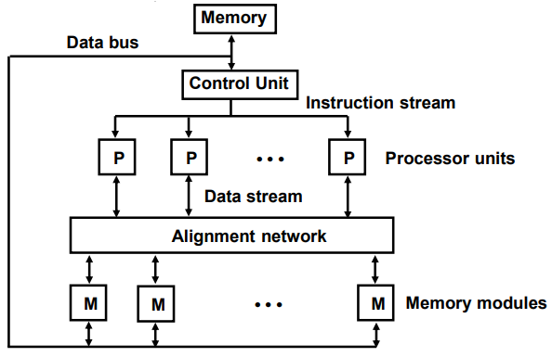
Parallel processing
SIMD COMPUTER SYSTEMS
Characteristics:
- Only one copy of the program exists
- A single controller executes one instruction at a time

Slide 13
Parallel processing
TYPES OF SIMD COMPUTERS
Array Processors: The control unit broadcasts instructions to all PEs, and all active PEs execute the same instructions
Example: ILLIAC IV, GF-11, Connection Machine, DAP, MPP
Systolic Arrays: Regular arrangement of a large number of very simple processors constructed on VLSI circuits
Example: CMU Warp, Purdue CHiP
Associative Processors
Content addressing
Data transformation operations over many sets of arguments with a single instruction
Example: STARAN, PEPE

Slide 14
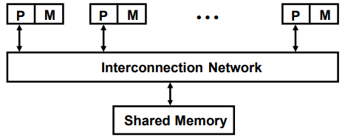
Parallel processing
MIMD COMPUTER SYSTEMS
Characteristics:
- Multiple processing units
- Execution of multiple instructions on multiple data
Types of MIMD computer systems:
- Shared memory multiprocessors
- Message-passing multicomputers

Slide 15
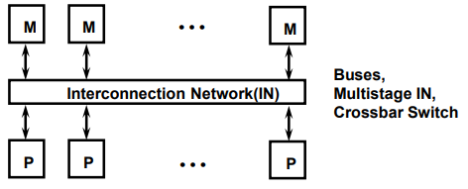
Parallel processing
SHARED MEMORY MULTIPROCESSORS
Characteristics:
- All processors have equally direct access to one large memory address space
Example systems:
Tree structure: Teradata, DADO
Mesh-connected: Rediflow, Series 2010, J-Machine
Hypercube: Cosmic Cube, iPSC, NCUBE, FPS T Series, Mark III
Limitations: Communication overhead, Hard to programming

Slide 16
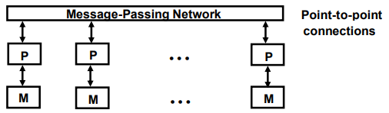
Parallel processing
MESSAGE-PASSING MULTICOMPUTER
Characteristics:
- Interconnected computers
- Each processor has its own memory, and communicate via message-passing
Example systems:
Bus and cache-based systems - Sequent Balance, Encore Multimax
Multistage IN-based systems - Ultracomputer, Butterfly, RP3, HEP
Crossbar switch-based systems - C.mmp, Alliant FX/8
Limitations: Memory access latency, Hot spot problem

Slide 17
2. Pipelining
Pipelining is a technique of decomposing a sequential process into suboperations, with each subprocess being executed in a special dedicated segment that operates concurrently with all other segments.
A pipeline can be visualized as a collection of processing segments through which binary information flows.
Each segment performs partial processing dictated by the way the task is partitioned. The result obtained from the computation in each segment is transferred to the next segment in the pipeline.
The result is obtained after the data have passed through all segments.
It is characteristic of pipelines that several computations can be in progress in distinct segments at the same time.
The registers provide isolation between each segment so that each can operate on distinct data simultaneously

Slide 18
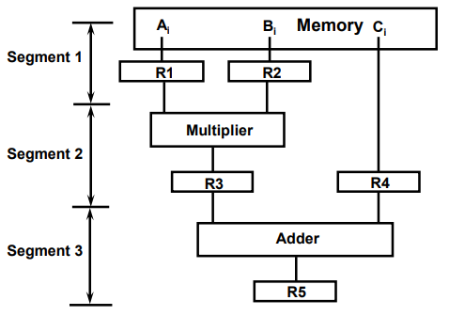
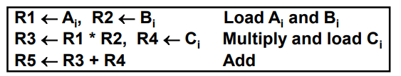
Pipelining…
Example: Suppose that we want to perform the combined multiply and add operations with a stream of numbers.
Ai * Bi + Ci for i = 1, 2, 3, . .. , 7.

Slide 19
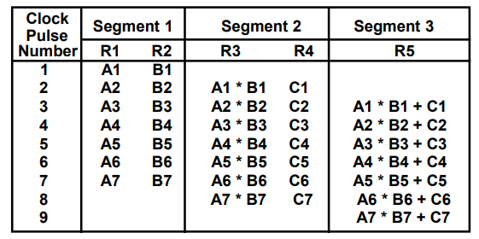
Pipelining…
Operations In Each Pipeline Stage:

Slide 20
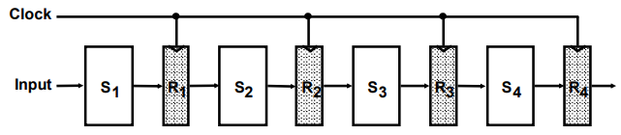
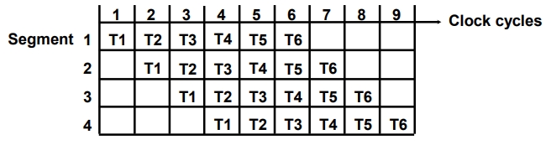
Pipelining…
GENERAL PIPELINE: Any operation that can be decomposed into a sequence of suboperations of about the same complexity can be implemented by a pipeline processor.
General Structure of a 4-Segment Pipeline
Space-Time Diagram

Slide 21
Pipelining…
PIPELINE SPEEDUP:
Now consider the case where a k-segment pipeline with a clock cycle time t, is used to execute n tasks.
The first task T1 requires a time equal to kt_{p}, to complete its operation since there are k segments in the pipe.
The remaining n - 1 tasks emerge from the pipe at the rate of one task per clock cycle and they will be completed after a time equal to (n - 1)t_{p}.
Therefore, to complete n tasks using a k-segment pipeline requires k + (n - 1) clock cycles.
For example, the space-time diagram shows four segments and six tasks. The time required to complete all the operations is 4 + (6 - 1) = 9 clock cycles, as indicated in the diagram.

Slide 22

Pipelining…
PIPELINE SPEEDUP…
Next consider a non-pipeline unit that performs the same operation and takes a time equal to t_{n} to complete each task. The total time required for n tasks is nt_{n}.
The speedup of a pipeline processing over an equivalent non-pipeline processing is defined by the ratio:
As the number of tasks increases, n becomes much larger than k - 1, and k + n - 1 approaches the value of n.
Under this condition, the speedup becomes: S = t_{n}/t_{p}
If we assume that the time it takes to process a task is the same in the pipeline and non-pipeline circuits, we will have t_{n} = kt_{p}
Including this assumption, the speedup reduces to: S = kt_{p} / t_{p} = k
This shows that the theoretical maximum speedup that a pipeline can provide is k, where k is the number of segments in the pipeline.

Slide 23
Pipelining…
PIPELINE SPEEDUP EXAMPLE:
Consider 4-stage pipeline and time required to complete sub-operation in each stage is tp = 20ns. Assume 100 tasks to be executed. Find the speedup of pipeline?
Time to complete 1 task in non-pipelined system = 20*4 = 80ns
Time to complete 100 tasks in pipelined System =
(k + n - 1)*tp = (4 + 99) * 20 = 2060ns
Time to complete 100 tasks in non-pipelined System =
n*k*tp = 100 * 80 = 8000n
Speedup: Sk = 8000 / 2060 = 3.88
Hence, 4-Stage Pipeline is basically identical to the system with 4 identical function units.

Slide 24
3. Arithmetic pipeline
Pipeline arithmetic units are usually found in very high-speed computers.
They are used to implement floating-point operations, multiplication of fixed-point numbers, and similar computations encountered in scientific problems.
A pipeline multiplier is essentially an array multiplier with special adders designed to minimize the carry propagation time through the partial products.
Floating-point operations are easily decomposed into suboperations, we will now show an example of a pipeline unit for floating-point addition and subtraction.

Slide 25



Arithmetic pipeline…
The inputs to the floating-point adder pipeline are two normalized floating-point binary numbers.
The following numerical example may clarify the suboperations performed in each segment.
Consider the two normalized floating-point numbers:
The two exponents are subtracted in the first segment to obtain 3 - 2 = 1. The larger exponent 3 is chosen as the exponent of the result.
The next segment shifts the mantissa of Y to the right to aligns the two mantissas under the same exponent. The addition of the two mantissas in segment 3 produces the sum:

Slide 26
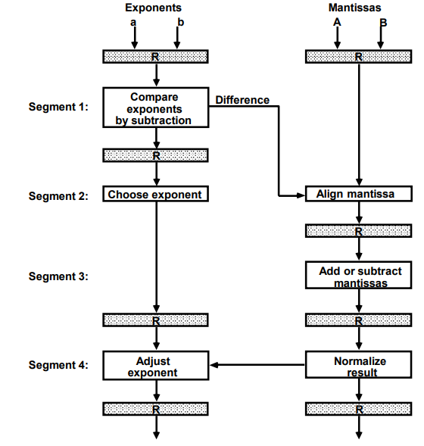
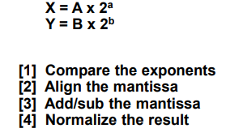
Arithmetic pipeline…
The inputs to the floating-point adder pipeline are two normalized floating-point binary numbers.

Slide 27
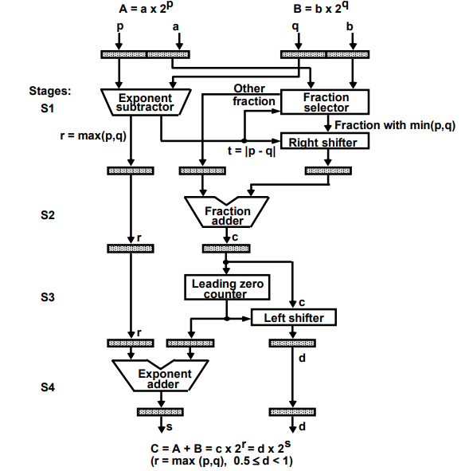
Arithmetic pipeline…
4-STAGE FLOATING POINT ADDER.

Slide 28
4. Instruction Pipeline
An instruction pipeline reads consecutive instructions from memory while previous instructions are being executed in other segments.
This causes the instruction fetch and execute phases to overlap and perform simultaneous operations.
One possible digression associated with such a scheme is that an instruction may cause a branch out of sequence.
In that case the pipeline must be emptied and all the instructions that have been read from memory after the branch instruction must be discarded.
The instruction stream queuing mechanism provides an efficient way for reducing the average access time to memory for reading instructions.

Slide 29
Instruction Pipeline…
INSTRUCTION CYCLE:
Six Phases* in an Instruction Cycle
[1] Fetch an instruction from memory
[2] Decode the instruction
[3] Calculate the effective address of the operand
[4] Fetch the operands from memory
[5] Execute the operation
[6] Store the result in the proper place
* Some instructions skip some phases
* Effective address calculation can be done in the part of the decoding phase
* Storage of the operation result into a register is done automatically in the execution phase

Slide 30
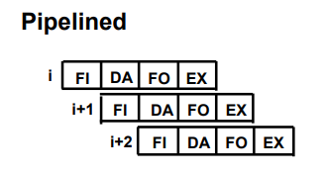
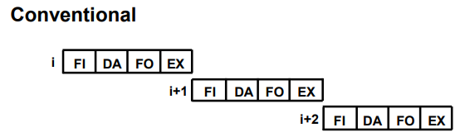
Instruction Pipeline…
INSTRUCTION CYCLE: 4-Stage Pipeline
[1] FI: Fetch an instruction from memory
[2] DA: Decode the instruction and calculate the effective address of the operand
[3] FO: Fetch the operand
[4] EX: Execute the operation
Execution of Three Instructions in a 4-Stage Pipeline:

Slide 31
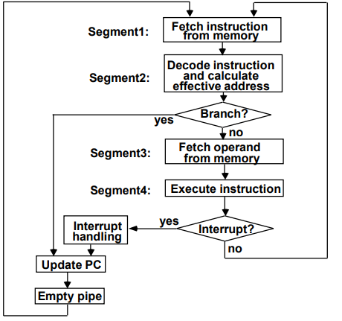
Instruction Pipeline…
FLOWCHART for 4-stage Instruction Pipeline:

Slide 32
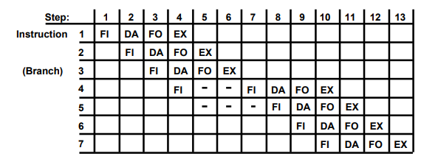
Instruction Pipeline…
SPACE-TIME Diagram for 4-stage 7-Instructions Pipeline:
Assume now that instruction 3 is a branch instruction. As soon as this instruction is decoded in segment DA in step 4, the transfer from FI to DA of the other instructions is halted until the branch instruction is executed in step 6.
If the branch is taken, a new instruction is fetched in step 7. If the branch is not taken, the instruction fetched previously in step 4 can be used. The pipeline then continues until a new branch instruction is encountered.

Slide 33
Instruction Pipeline…
MAJOR HAZARDS IN PIPELINED EXECUTION:
Structural hazards(Resource Conflicts)
Hardware Resources required by the instructions in simultaneous overlapped execution cannot be met.
Data hazards (Data Dependency Conflicts)
An instruction scheduled to be executed in the pipeline requires the result of a previous instruction, which is not yet available.
Control hazards
Branches and other instructions that change the PC make the fetch of the next instruction to be delayed.

Slide 34
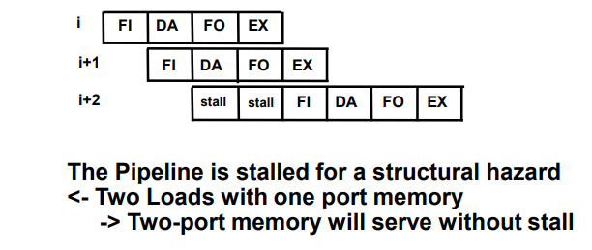
Instruction Pipeline…
STRUCTURAL HAZARDS:
It occur when some resource has not been duplicated enough to allow all combinations of instructions in the pipeline to execute
Example: With one memory-port, a data and an instruction fetch cannot be initiated in the same clock

Slide 35
Instruction Pipeline…
DATA HAZARDS: Occurs when the execution of an instruction depends on the results of a previous instruction
      ADD R1, R2, R3
      SUB R4, R1, R5
Data hazard can be dealt with either hardware / software technique
Hardware Technique: Interlock - hardware detects the data dependencies and delays the scheduling of the dependent instruction by stalling enough clock cycles
Forwarding (bypassing, short-circuiting) - Accomplished by a data path that routes a value from a source (usually an ALU) to a user, bypassing a designated register.
This allows the value to be produced to be used at an earlier stage in the pipeline than would otherwise be possible
Software Technique: Instruction Scheduling for delayed load.

Slide 36
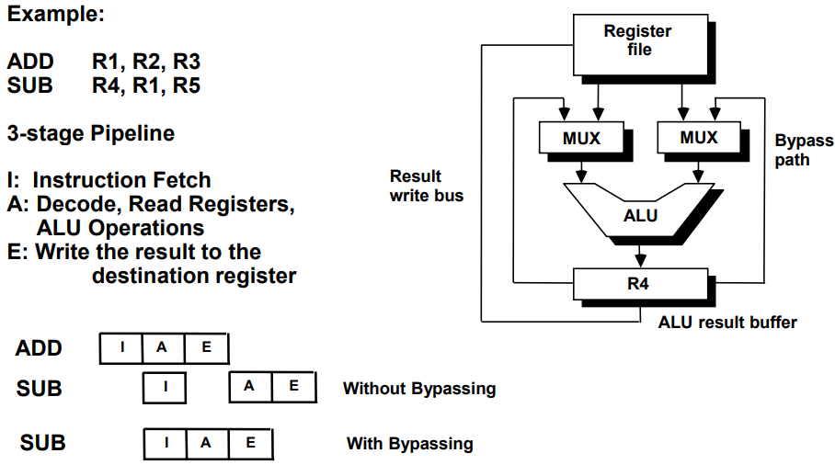
Instruction Pipeline…
FORWARDING HARDWARE:

Slide 37
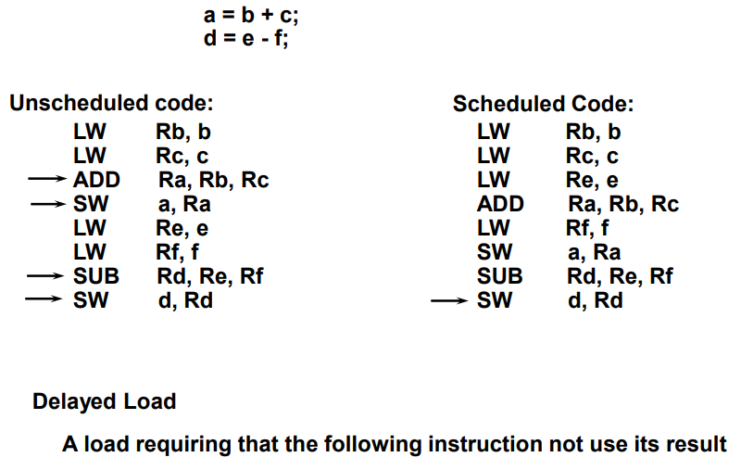
Instruction Pipeline…
INSTRUCTION SCHEDULING:

Slide 38
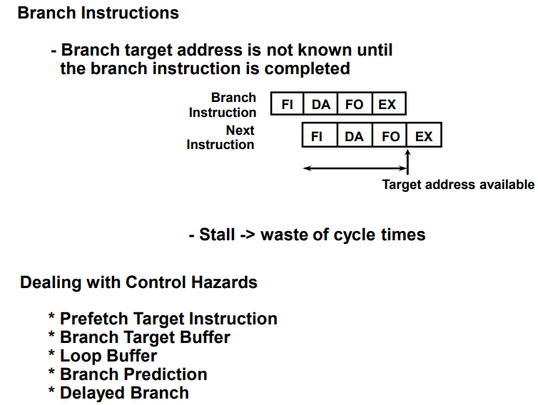
Instruction Pipeline…
CONTROL HAZARDS:

Slide 39
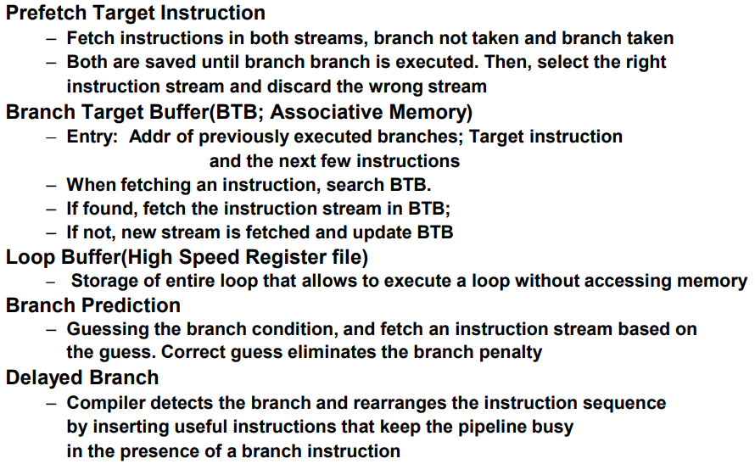
Instruction Pipeline…
CONTROL HAZARDS:

Slide 40
END OF
UNIT-3
PART-2

