Slide 1
II-B.E. III-SEMESTER
COMPUTER ARCHITECTURE (CA)
Presented By
Dr. D. BASWARAJ
Professor, CSE DEPT.
VCE, HYDERABAD

Slide 2
SYLLABUS
UNIT – I:
Overview of Computer Function and Interconnection, Register Transfer Micro operations
UNIT – II:
Basic Computer organization and Design, Micro programmed Control
UNIT – III:
P1: Central Processing Unit: General Register organization, Stack Organization, Instruction Formats, Addressing Modes, Data Transfer and Manipulation, Program Control, RISC.
P2: Pipeline: Parallel processing, Pipelining, Arithmetic pipeline, Instruction Pipeline.
P3: Computer Arithmetic: Addition and Subtraction, Multiplication, Division, Floating Point Arithmetic Operations, Decimal Arithmetic Unit.

Slide 3
SYLLABUS …
Learning Resources:
M. Morris Mano, Computer System Architecture, 3rd Edition (2007), Pearson Education Asia.
William Stallings, Computer Organization & Architecture, 8th Edition (2011), Pearson Education Asia.
David A Patterson, John L Hennessy, Computer Organization and Design, 4th Edition (2014), Morgan Kaufmann.
Carl.V Hamacher, Vranesic Z.G, Zaky S.G, Computer Organization, 5th Edition (2011), McGraw Hill.
Pal Chaudhuri.P, Computer Organization and Design, , 3rd Edition(2009), Prentice Hall of India

Slide 4
UNIT-III
PART-3: Computer Arithmetic
  Addition and Subtraction
  Multiplication
  Division
  Floating Point Arithmetic Operations
  Decimal Arithmetic Unit

Slide 5
1. Addition and Subtraction
Arithmetic instructions in digital computers manipulate data to produce re­sults necessary for the solution of computational problems.
The four basic arithmetic operations are addition, subtraction, multiplication, and division. From these four basic operations, it is possible to formulate other arithmetic functions and solve scientific problems by means of numerical analysis methods.
An arithmetic processor is the part of a processor unit that executes arithmetic operations.
The data type assumed to reside in processor registers during the execution of an arithmetic instruction is specified in the definition of the instruction.
An arithmetic instruction may specify binary or decimal data, and in each case the data may be in fixed point or floating-point form.

Slide 6
Addition and Subtraction…
In this part, we develop the various arithmetic algorithms and show the procedure for implementing them with digital hardware.
We consider following types of data for arithmetic operations:
  Fixed-point binary data in signed-magnitude representation
  Fixed-point binary data in signed-2's complement representation
  Floating-point binary data
  Binary-coded decimal (BCD) data.
There are 3 ways of representing negative fixed-point binary numbers: signed-magnitude, signed-l's complement, or signed-2's complement.
Most computers use the signed-2's complement representation when performing arithmetic operations with integers.
For floating-point operations, most computers use the signed-magnitude representation for the mantissa.

Slide 7
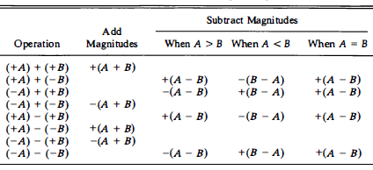
Addition and Subtraction…
Addition and Subtraction with Signed-Magnitude Data:
We designate the magnitude of the two numbers by A and B. When the signed numbers are added or subtracted, we find that there are eight different conditions to consider, depending on the sign of the numbers and the operation performed.
These conditions are listed in the first column of Table 10-1.

Slide 8
Addition and Subtraction…
Addition (Subtraction) algorithm:
When the signs of A and B are identical (different), add the two magnitudes and attach the sign of A to the result.
When the signs of A and B are different (identical), compare the magnitudes and subtract the smaller number from the larger.
Choose the sign of the result to be the same as A if A > B or the complement of the sign of A if A < B. If the two magnitudes are equal, subtract B from A and make the sign of the result positive.
The two algorithms are similar except for the sign comparison.
The procedure to be followed for identical signs in the addition algorithm is the same as for different signs in the subtraction algorithm, and vice versa.

Slide 9
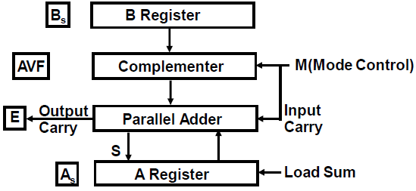
Addition and Subtraction…
Hardware Implementation: Figure 10-1 shows a block diagram of the hardware for implementing the addition and subtraction operations. It consists of registers A, B and sign flip-flops A_{s}, B_{s}.
Subtraction is done by adding A to the 2's complement of B. The output carry is transferred to flip-flop E, where it can be checked to determine the relative magnitudes of the two numbers.
The add-overflow flip-flop AVF holds the overflow bit when A and B are added.

Slide 10
Addition and Subtraction…
Hardware Implementation…
The addition of A & B is done through the parallel adder. The S (sum) output of the adder is applied to the input of the A register. The complementer provides an output of B or the complement of B depending on the state of the mode control M.
When M = 0, the output of B is transferred to the adder, the input carry is 0, and the output of the adder is equal to the sum A + B.
When M =1, the l's complement of B is applied to the adder, the input carry is 1, and output S = A + B’ + 1.
This is equal to A plus the 2's complement of B, which is equivalent to the subtraction A - B.

Slide 11
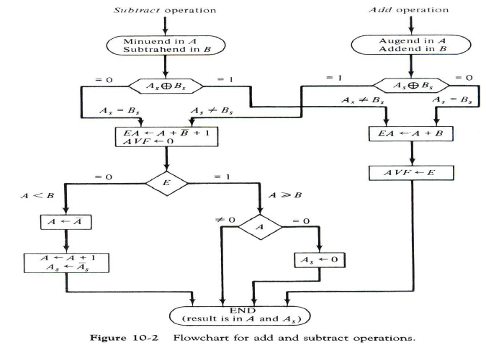
Addition and Subtraction…
The flowchart for the hardware algorithm is presented in Fig. 10-2:

Slide 12
Addition and Subtraction…
Addition and Subtraction with Signed-2's Complement Data:
The leftmost bit of a binary number represents the sign bit: 0 for positive and 1 for negative. If the sign bit is 1, the entire number is represented in 2' s complement form.
The addition of two numbers in signed-2's complement form consists of adding the numbers with the sign bits treated the same as the other bits of the number. A carry-out of the sign-bit position is discarded.
When two numbers of n digits each are added and the sum occupies n + 1 digits, we say that an overflow occurred.
An overflow can be detected by inspecting the last two carries out of the addition. When the two carries are applied to an XOR gate, the overflow is detected when the output of the gate is equal to 1.

Slide 13
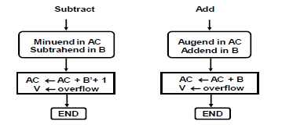
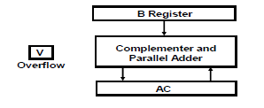
Addition and Subtraction…
Addition and Subtraction with Signed-2's Complement Data…
The register configuration for the hardware implementation is shown in Fig. 10-3. The algorithm for adding and subtracting two binary numbers in signed- 2' s complement representation is shown in the flowchart of Fig. 10-4.
Figure 10.3 Figure 10.4

Slide 14
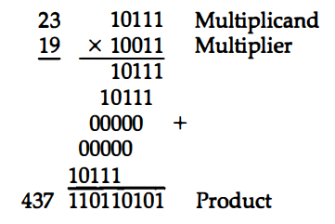
2. Multiplication
Multiplication of two fixed-point binary numbers in signed-magnitude representation is done with paper and pencil by a process of successive shift and add operations.
The process consists of looking at successive bits of the multiplier, least significant bit first. If the multiplier bit is a 1, the multiplicand is copied down; otherwise, zeros are copied down. Finally, the numbers are added, and their sum forms the product.
This process is best illustrated with a numerical example:

Slide 15
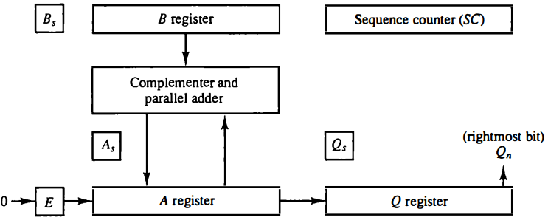
Multiplication…
Hardware Implementation for Signed-Magnitude Data:
The multiplier is stored in the Q register and its sign in Q_{s}.
The sequence counter SC is initially set to a number equal to the number of bits in the multiplier. The counter is decremented by 1 after forming each partial product. When the content of the counter reaches zero, the product is formed, and the process stops.

Slide 16
Multiplication…
Hardware Implementation for Signed-Magnitude Data…
Initially, the multiplicand is in register B and the multiplier in Q. The sum of A and B forms a partial product which is transferred to the EA register.
Both partial product and multiplier are shifted to the right. This shift will be denoted by the statement shr EAQ to designate the right shift depicted in Fig. 10-5.
The LSB of A is shifted into the MSB of Q, the bit from E is shifted into the MSB of A, and 0 is shifted into E.
After the shift, one bit of the partial product is shifted into Q, pushing the multiplier bits one position to the right.
In this manner, the rightmost flip-flop in register Q, designated by Q_{s}, will hold the bit of the multiplier, which must be inspected next.

Slide 17
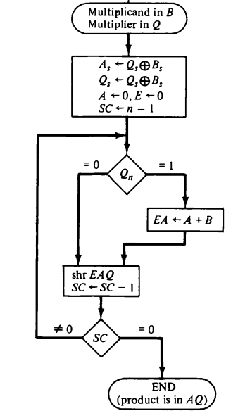
Multiplication…
Hardware Algorithm: Figure 10-6 is a flowchart of the hardware multiply algorithm.

Slide 18
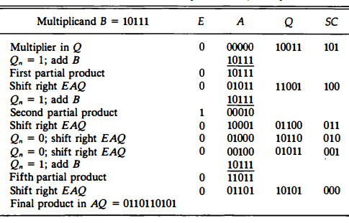
Multiplication…
Example: 23 x 19 = 143
M = 23 = 10111, Q = 19 =10011 AQ = 437 = 01101 10101

Slide 19
Multiplication…
Booth’s (Multiplication) Algorithm:
Booth algorithm gives a procedure for multiplying binary integers in signed-2’s complement representation.
It operates on the fact that strings of 0's in the multiplier require no addition but just shifting, and a string of 1's in the multiplier from bit weight 2^{k} to weight 2^{m} can be treated as 2^{k+1} - 2^{m}.
For example, the binary number 001 110 (+14) has a string of 1's from 2³ to 2¹ (k = 3, m = 1).
The number can be represented as 2^{k+l} - 2^{m} = 2⁴ - 2¹ = 16 - 2 = 14.
Therefore, the multiplication M x 14, where M is the multiplicand and 14 the multiplier, can be done as M x 2⁴ - M X 2¹
Thus, the product can be obtained by shifting the binary multiplicand M four times to the left and subtracting M shifted left once.

Slide 20
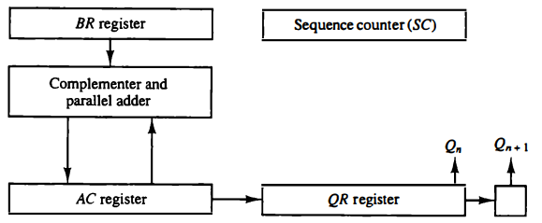
Multiplication…
Booth’s (Multiplication) Algorithm…
The algorithm works for positive or negative multipliers in 2's complement representation.
This is because a negative multiplier ends with a string of 1's and the last operation will be a subtraction of the appropriate weight.
For example, a multiplier equal to -14 is represented in 2's complement as 110010 and is treated as -2⁴ + 2² - 2¹ = - 14.

Slide 21
Multiplication…
Booth’s (Multiplication) Algorithm… This is like Fig. 10-5 except that the sign bits are not separated from the rest of the registers.
To show this difference, we rename registers A, B, and Q, as AC, BR, and QR, respectively. Q_{n}, designates the LSB of the multiplier QR. An extra flip-flop Q_{n+1}, is appended to QR to facilitate a double bit inspection of the multiplier.
Initial, AC = 0, Q_{n+1} r=0 and the sequence counter SC = n equal to the number of bits in the multiplier. The two bits of the multiplier in Q_{n}Q_{n+1} are inspected.
If Q_{n}Q_{n+1} = 10, it means that the first 1 in a string of 1's has been encountered. This requires a subtraction of the multiplicand from the partial product in AC.
If Q_{n}Q_{n+1} = 01, it means that the first 0 in a string of 0' s has been encountered. This requires the addition of the multiplicand to the partial product in AC.
When the two bits are equal, the partial product does not change.

Slide 22
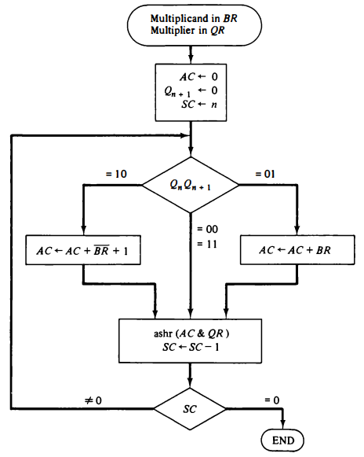
Multiplication…
Flowchart of Booth’s Algorithm:

Slide 23
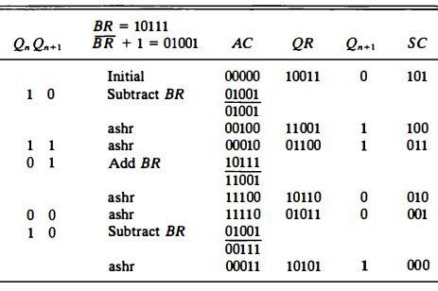
Multiplication…
Example: -9 x -13 = +117
BR = -9 = 10111, QR = -13 =10011 AQ = 117 = 00011 10101

Slide 24
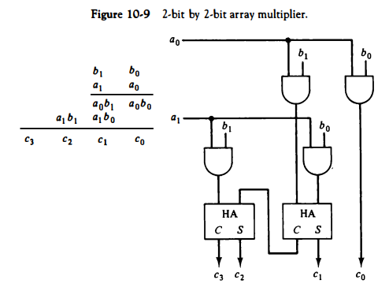
Multiplication…
Array Multiplier:

Slide 25
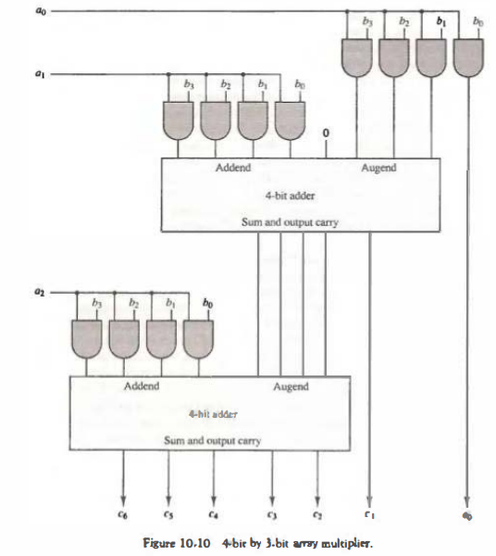
Multiplication…
Array Multiplier:

Slide 26
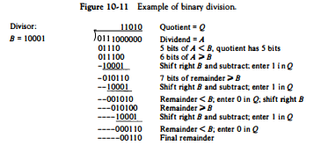
3. Division
Division of two fixed-point binary numbers in signed-magnitude representation is done with paper and pencil by a process of successive compare, shift, and subtract operations.
Binary division is simpler than decimal division because the quotient digits are either 0 or 1 and there is no need to estimate how many times the dividend or partial remainder fits into the divisor.
The division process is illustrated by an example in Fig. 10-11.

Slide 27
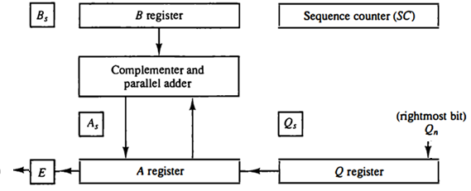
Division…
Hardware Implementation for Signed-Magnitude Data:
When the division is implemented in a digital computer, instead of shifting the divisor to the right, the dividend, or partial remainder, is shifted to the left, thus leaving the two numbers in the required relative position. Register EAQ is now shifted to the left with 0 inserted into Q_{n}, and the previous value of E lost.
Subtraction may be achieved by adding A to the 2's complement of B. The information about the relative magnitudes is then available from the end-carry.

Slide 28
Division…
Divide Overflow:
The division operation may result in a quotient with an overflow.
This is not a problem when working with paper and pencil but is critical when the operation is implemented with hardware.
This is because the length of registers is finite and will not hold a number that exceeds the standard length.
From the example of Fig. 10-11 we note that the quotient will consist of six bits if the five most significant bits of the dividend constitute a number greater than the divisor. The quotient is to be stored in a standard 5-bit register, so the overflow bit will require one more flip-flop for storing the sixth bit.
A divide-overflow condition occurs if the high-order half bits of the dividend constitute a number greater than or equal to the divisor. Another problem associated with division is the fact that a division by zero must be avoided.

Slide 29
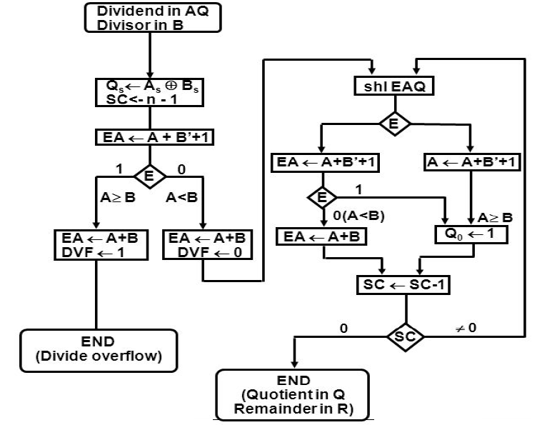
Division…
Hardware Algorithm:

Slide 30
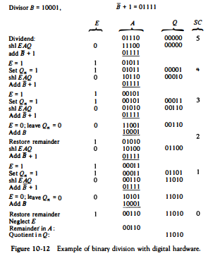
Division…
Example:

Slide 31
4. Floating Point Arithmetic Operations
Many high-level programming languages have a facility for specifying floating point numbers.
The most common way is to specify them by a real declaration statement as opposed to fixed-point numbers, which are specified by an integer declaration statement.
Basic Considerations: A floating point number in computer registers consists of two parts: a mantissa m and an exponent e. The two parts represent a number obtained from multiplying m times a radix r raised to the value of e; thus, m x r^{e}
The mantissa may be a fraction or an integer. The location of the radix point and the value of the radix r are assumed and are not included in the registers.
For example, assume a fraction representation and a radix 10. The decimal number 537.25 is represented in a register with m = 0.53725 and e = 3 as: 0.53725 x 10³

Slide 32
Floating Point Arithmetic Operations…
A floating-point number is said to be normalized if the most significant digit of the mantissa in nonzero. So the mantissa contains the maximum possible number of significant digits.
We cannot normalize a zero because it does not have a nonzero digit. It is represented in floating-point by all 0’s in the mantissa and exponent.
Arithmetic operations with floating-point numbers are more complicated than with fixed-point numbers. Their execution also takes longer time and requires more complex hardware.
Adding or subtracting two numbers requires first an alignment of the radix point since the exponent parts must be made equal before adding or subtracting the mantissas.
We do this alignment by shifting one mantissa while its exponent is adjusted until it becomes equal to the other exponent.

Slide 33

Floating Point Arithmetic Operations…
Consider the sum of the following floating-point numbers:
+0.5372400 x 10²
+0.1580000 x 10⁻¹
It is necessary that the two exponents be equal before the mantissas can be added. We can either shift the first number three positions to the left or shift the second number three positions to the right.
The usual alignment procedure is to shift the mantissa that has the smaller exponent to the right by a number of places equal to the difference between the exponents. After this is done, the mantissas can be added:

Slide 34

Floating Point Arithmetic Operations…
When two normalized mantissas are added, the sum may contain an overflow digit. An overflow can be corrected easily by shifting the sum once to the right and incrementing the exponent.
When two numbers are subtracted, the result may contain most significant zeros as shown in the following example:
A floating-point number that has a 0 in the most significant position of the mantissa is said to have an underflow.
To normalize a number that contains an underflow, it is necessary to shift the mantissa to the left and decrement the exponent until a nonzero digit appears in the first position.
In the example above, we shift left two times: 0.35000 x 10³

Slide 35
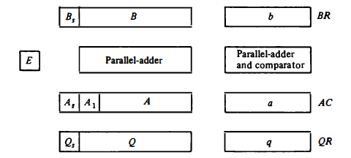
Floating Point Arithmetic Operations…
Register Configuration: The register configuration for floating-point operations is quite similar to the layout for fixed-point operations.
As a general rule, the same registers and adder used for fixed-point arithmetic are used for processing the mantissas. The difference lies in the way the exponents are handled.
The register organization for floating-point operations is shown in Fig. 10-14. The registers, BR, AC, and QR are subdivided into two parts. The mantissa part uses uppercase letter symbols and exponent part uses the corresponding lowercase letter symbols.

Slide 36
Floating Point Arithmetic Operations…
Addition and Subtraction: During addition or subtraction, the two floating-point operands are in AC and BR. The sum or difference is formed in the AC. The algorithm can be divided into four consecutive parts:
  Check for zeros.
  Align the mantissas.
  Add or subtract the mantissas.
  Normalize the result.
A floating-point number that is zero cannot be normalized. If this number is used during the computation, the result may also be zero.
Instead of checking for zeros during the normalization process we check for zeros at the beginning and terminate the process if necessary.

Slide 37
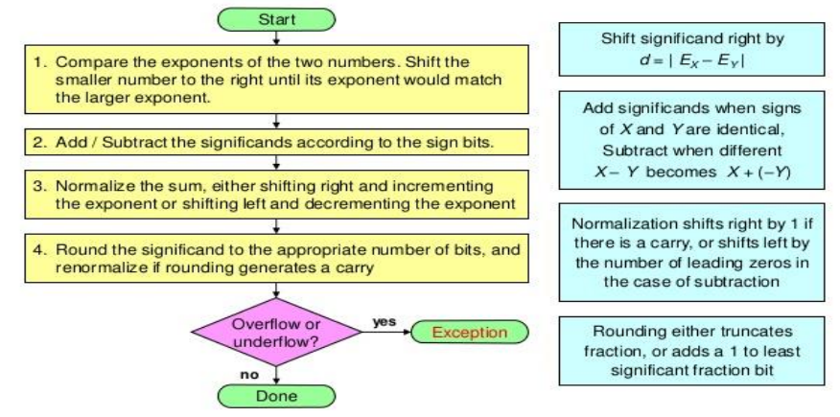
Floating Point Arithmetic Operations…
Flowchart for addition / subtraction:

Slide 38
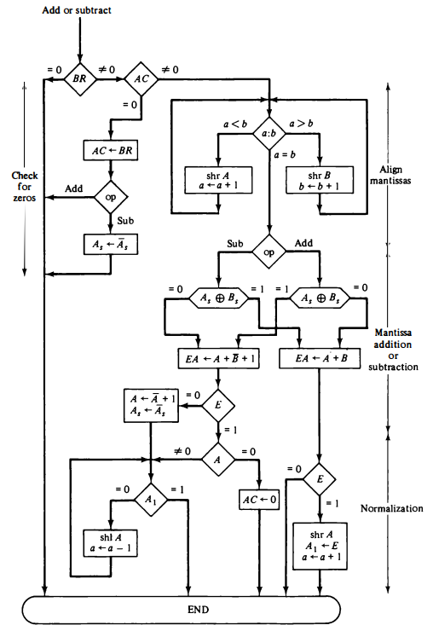
Floating Point Arithmetic Operations…
Flowchart for addition / subtraction:

Slide 39
Floating Point Arithmetic Operations…
Multiplication: The multiplication of two floating-point numbers requires that we multiply the mantissas and add the exponents:
  Check for zeros.
  Add the exponents.
  Multiply the mantissas.
  Normalize the product. .
The multiplication of the mantissas is performed in the same way as in fixed-point to provide a double-precision product used to increase the accuracy of the product.
In floating-point, the range of a single-precision mantissa combined with the exponent is usually accurate enough so that only single precision numbers are maintained.
Thus, the half most significant bits of the mantissa product and the exponent will be taken together to form a single precision.

Slide 40
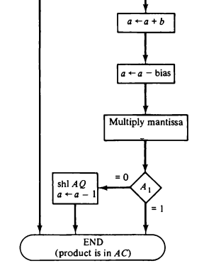
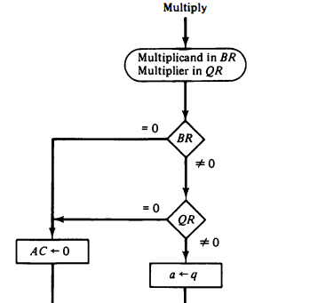
Floating Point Arithmetic Operations…
Flowchart for Multiplication:

Slide 41
Floating Point Arithmetic Operations…
Division: Floating-point division requires that the exponents be subtracted, and the mantissas divided. The mantissa division is done as in fixed-point except that the dividend has a single-precision mantissa that is placed in the AC. R:
  Check for zeros
  Initialize registers and evaluate the sign
  Align the dividend
  Subtract the exponents
  Divide the mantissas
The check for divide-overflow is the same as in fixed-point representation. However, with floating-point numbers the divide-overflow imposes no problems.
The division always result in a normalized quotient provided that a dividend alignment is carried out before the division. Therefore, the quotient obtained after the division does not require a normalization.

Slide 42
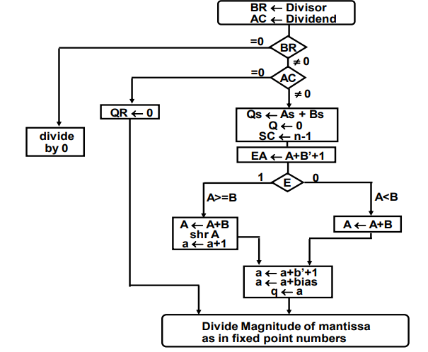
Floating Point Arithmetic Operations…
Flowchart for Division:

Slide 43
5. Decimal Arithmetic Unit
The user of a computer prepares data with decimal numbers and receives results in decimal form.
A CPU with an arithmetic logic unit can perform arithmetic rnicrooperations with binary data.
To perform arithmetic operations with decimal data, it is necessary to convert the input decimal numbers to binary, to perform all calculations with binary numbers, and to convert the results into decimal.
A decimal arithmetic unit is a digital function that performs decimal microoperations. It can add or subtract decimal numbers, usually by forming the 9's or 10's complement of the subtrahend.
The unit accepts coded decimal numbers and generates results in the same adopted binary code.

Slide 44
Decimal Arithmetic Unit…
BCD Adder:
Consider the arithmetic addition of two decimal digits in BCD, together with a possible carry from a previous stage. Since each input digit does not exceed 9, the output sum cannot be greater than 9 + 9 + 1 = 19, the 1 in the sum being an input-carry.
Suppose that we apply two BCD digits to a 4-bit binary adder. The adder will form the sum in binary and produce a result that may range from 0 to 19.
These binary numbers are listed in Table 10-4 and are labeled by symbols K, Z8, Z4, Z2, and Z1. K is the carry and the subscripts under the letter Z represent the weights 8, 4, 2, and 1 that can be assigned to the four bits in the BCD code.

Slide 45
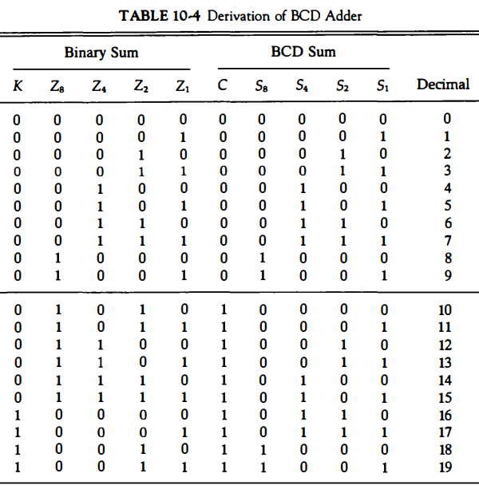
Decimal Arithmetic Unit…
BCD Adder:

Slide 46
Decimal Arithmetic Unit…
BCD Adder:
In examining the contents of the table, it is apparent that when the binary sum is equal to or less than 1001, the corresponding BCD number is identical and therefore no conversion is needed.
When the binary sum is greater than 1001, we obtain a nonvalid BCD representation. The addition of binary 6 (0110) to the binary sum converts it to the correct BCD representation and also produces an output-carry as required.
One method of adding decimal numbers in BCD would be to employ one 4-bit binary adder and perform the arithmetic operation one digit at a time.
The low-order pair of BCD digits is first added to produce a binary sum. If the result is equal or greater than 1010, it is corrected by adding 0110 to the binary sum.

Slide 47

Decimal Arithmetic Unit…
BCD Adder:
The logic circuit that detects the necessary correction can be derived from the table entries. It is obvious that a correction is needed when the binary sum has an output carry K = 1.
The other six combinations from 1010 to 1111 that need a correction have a 1 in position Z8.
To distinguish them from binary 1000 and 1001 which also have a 1 in position Z₈, we specify further that either Z₄ or Z₂, must have a 1.
The condition for a correction and an output-carry can be expressed by the Boolean function
When C = 1, it is necessary to add 0110 to the binary sum and provide an output-carry for the next stage.

Slide 48
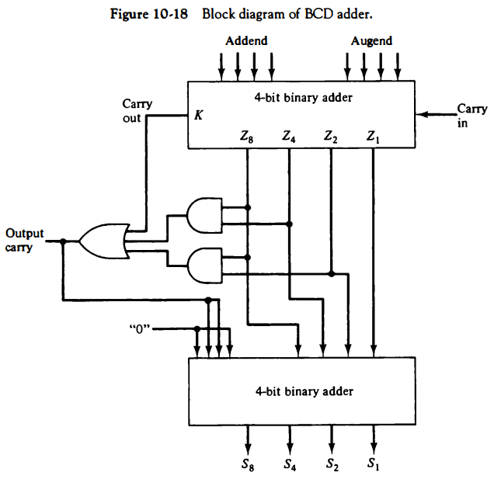
Decimal Arithmetic Unit…
BCD Adder:

Slide 49
Decimal Arithmetic Unit…
BCD Subtraction:
It is more economical to perform the subtraction by taking the 9's or 10's complement of the subtrahend and adding it to the minuend.
The 9's complement of a decimal digit represented in BCD may be obtained by complementing the bits in the coded representation of the digit provided a correction is included.
There are two possible correction methods. In the first method, binary 1010 (decimal 10) is added to each complemented digit and the carry discarded after each addition. In the second method, binary 0110 (decimal 6) is added before the digit is complemented.
Example: the 9's complement of BCD 0111 (decimal 7) is computed by first complementing each bit to obtain 1000. Adding binary 1010 and discarding the carry, we obtain 0010 (decimal 2). By the second method, we add 0110 to 0111 to obtain 1101. Complementing each bit, we obtain the required result of 0010.

Slide 50


Decimal Arithmetic Unit…
BCD Subtraction:
The 9's complement of a BCD digit can also be obtained through a combinational circuit. When this circuit is attached to a BCD adder, the result is a BCD adder/subtractor.
Let the subtrahend (or addend) digit be denoted by the four binary variables B8, B4, B2, and B1. Let M be a mode bit that controls the add/subtract operation. When M = 0, the two digits are added; when M = 1, the digits are subtracted.
Let the binary variables x8, x4, x2,, and x1 be the outputs of the 9's complementer circuit. The Boolean functions for the 9' s complementer circuit are:

Slide 51
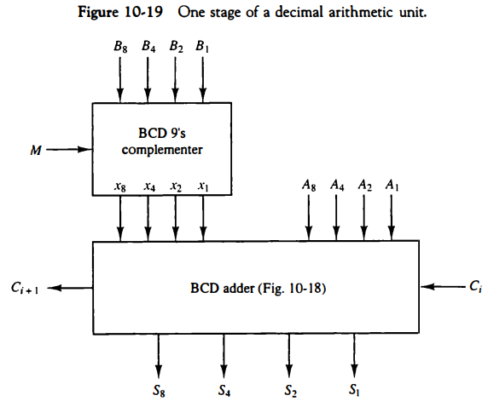
Decimal Arithmetic Unit…
Decimal arithmetic unit : can add or subtract two BCD digits

Slide 52
Decimal Arithmetic Unit…
Decimal Arithmetic Operations:
The algorithms for arithmetic operations with decimal data are similar to the algorithms for the corresponding operations with binary data.
In fact, except for a slight modification in the multiplication and division algorithms, the same flowcharts can be used for both types of data provided that we interpret the microoperation symbols properly.
For convenience, we will use the same symbols for binary and decimal arithmetic microoperations but give them a different interpretation.
As shown in Table 10-5, a bar over the register letter symbol denotes the 9' s complement of the decimal number stored in the register. Adding 1 to the 9's complement produces the 10's complement.

Slide 53
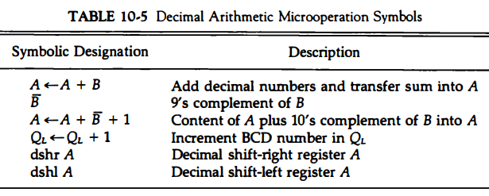
Decimal Arithmetic Unit…
Decimal Arithmetic Operations:

Slide 54
END OF
UNIT-3
PART-3

