Slide 1
II-B.E. III-SEMESTER
COMPUTER ARCHITECTURE (CA)
Presented By
Dr. D. BASWARAJ
Professor, CSE DEPT.
VCE, HYDERABAD

Slide 2
SYLLABUS
UNIT – I:
Overview of Computer Function and Interconnection
Register Transfer Micro operations
UNIT – II:
Basic Computer organization and Design
Micro programmed Control
UNIT – III:
Central Processing Unit
Pipeline
Computer Arithmetic

Slide 3
SYLLABUS …
UNIT – IV:
Input-Output organization: Peripheral Devices, Input-Output Interface, Asynchronous Data Transfer, Modes of Transfer, Priority Interrupt, Direct Memory Access, Input-Output Processor (IOP), Serial Communication
UNIT – V:
Memory Organization: Memory Hierarchy, Main Memory, RAM and ROM, Auxiliary Memory, Associative Memory, Cache Memory, Virtual Memory, Memory Management Hardware.
Assessing and Understanding Performance: CPU Performance and its Factors, Evaluating Performance.

Slide 4
SYLLABUS …
Learning Resources:
M. Morris Mano, Computer System Architecture, 3rd Edition (2007), Pearson Education Asia.
William Stallings, Computer Organization & Architecture, 8th Edition (2011), Pearson Education Asia.
David A Patterson, John L Hennessy, Computer Organization and Design, 4th Edition (2014), Morgan Kaufmann.
Carl.V Hamacher, Vranesic Z.G, Zaky S.G, Computer Organization, 5th Edition (2011), McGraw Hill.
Pal Chaudhuri.P, Computer Organization and Design, , 3rd Edition(2009), Prentice Hall of India

Slide 5
UNIT-IV
PART-1: Input-Output organization
  Peripheral Devices
  Input-Output Interface
  Asynchronous Data Transfer
  Modes of Transfer
  PART-2: Input-Output organization…
  Priority Interrupt
  Direct Memory Access
  Input-Output Processor (IOP)
  Serial Communication

Slide 6
1. Peripheral Devices
The input-output subsystem of a computer, referred to as I/O, provides an efficient mode of communication between the central system and the outside environment.
Devices that are under the direct control of the computer are said to be connected on-line (smart devices like smartphone, smart car).
Input or output devices attached to the computer are also called peripherals. Among the most common peripherals are keyboards, display units, and printers.
Peripherals that provide auxiliary storage for the system are magnetic disks, tapes, pen drives.
Video monitors are the most used peripherals. They consist of a keyboard as the input device and a display unit as the output device.
There are different types of video monitors, but the most popular uses a cathode ray tube (CRT), LED, LCD, Plasma.

Slide 7
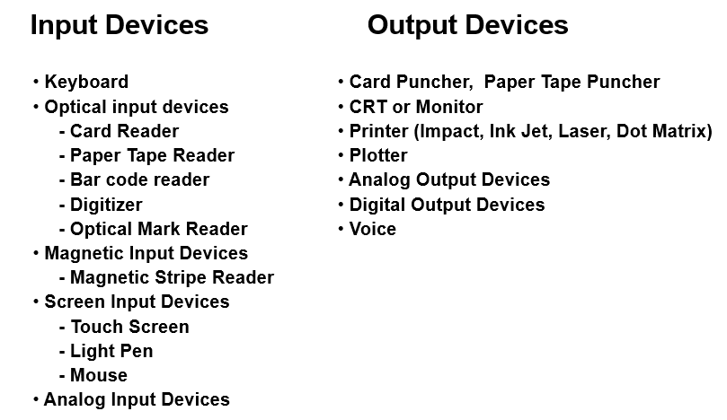
Peripheral Devices…

Slide 8
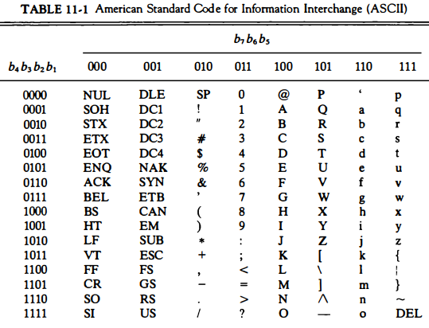
Peripheral Devices…
ASCII Alphanumeric Characters: I/O devices that communicate with people & computer are usually involved in the transfer of alphanumeric information. The standard binary code for the alphanumeric characters is ASCII which uses 7 bits to code 128 characters as shown below:

Slide 9
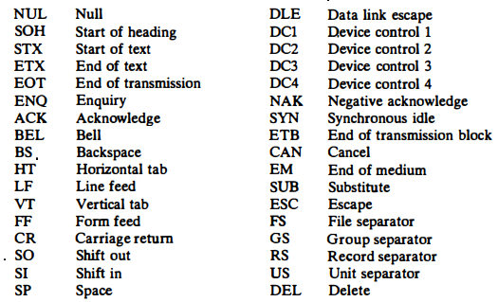
Peripheral Devices…
Control Characters: The 34 control characters are designated in the ASCII table with abbreviated names. They are listed again below the table with their functional names.
The control characters are used for routing data & arranging the printed text into a prescribed format. Types: format effectors, information separators, and communication control characters.

Slide 10
2. Input-Output Interface
Input-output interface provides a method for transferring information between internal storage and external I/0 devices.
Peripherals connected to a computer need special communication links for interfacing them with the central processing unit.
Resolves the differences between the computer and peripheral devices
  Peripherals - Electromechanical Devices
  CPU or Memory - Electronic Device
  Data Transfer Rate
    Peripherals - Usually slower
    CPU or Memory - Usually faster than peripherals - Synchronization
  Unit of Information
    Peripherals – Byte, Block, …
    CPU or Memory – Word
  Data representations may differ.

Slide 11
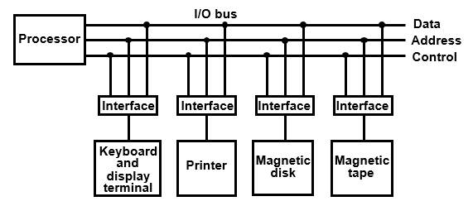
Input-Output Interface…
I/O Bus and Interface Modules: A typical communication link between the processor and several peripherals is shown below:
Each peripheral has an interface module associated with it. The functionalities of interface are:
  Decodes the device address (device code)
  Decodes the commands (operation)
  Provides signals for the peripheral controller
  Synchronizes the data flow and supervises the transfer rate between peripheral and CPU or Memory

Slide 12

Input-Output Interface…
I/O Bus and Interface Modules: Typical I/O instruction format:
There are four types of commands that an interface may receive. They are classified as control, status, data output, and data input.
A control command is issued to activate the peripheral and to inform it what to do. For example, a magnetic tape unit may be instructed to backspace the tape by one record, to rewind the tape, or to start the tape moving in the forward direction.
A status command is used to test various status conditions in the interface and the peripheral. For example, the computer may wish to check the status of the peripheral before a transfer is initiated.

Slide 13
Input-Output Interface…
A data output command causes the interface to respond by transferring data from the bus into one of its registers.
Consider an example with a tape unit. When the tape is in the correct position, the processor issues a data output command. The interface responds to the address and command and transfers the information from the data lines in the bus to its buffer register.
The interface then communicates with the tape controller and sends the data to be stored on tape.
The data input command is the opposite of the data output. In this case the interface receives an item of data from the peripheral and places it in its buffer register. The processor checks if data are available by means of a status command and then issues a data input command. The interface places the data on the data lines, where they are accepted by the processor.

Slide 14
Input-Output Interface…
I/O versus Memory Bus:
In addition to communicating with I/O, the processor must communicate with the memory unit. Like the I/O bus, the memory bus contains data, address, and read/write control lines.
There are three ways that computer buses can be used to communicate with memory and I/O :
  Use two separate buses, one for memory and the other for I/O.
  Use one common bus for both memory and I/O but have separate
  control lines for each.
  Use one common bus for memory and I/O with common control lines.
In the first method, the computer has independent sets of data, address, and control buses, one for accessing memory and the other for I/O. This is done in computers that provide a separate I/O processor (lOP) in addition to the central processing unit (CPU).

Slide 15
Input-Output Interface…
Isolated versus Memory-Mapped I/O:
Many computers use one common bus to transfer information between memory or I/O and the CPU.
The distinction between a memory transfer and I/O transfer is made through separate read and write lines.
The CPU specifies whether the address on the address lines is for a memory word or for an interface register by enabling one of two possible read or write lines.
The I/O read, and I/O write control lines are enabled during an I/O transfer. The memory read and memory write control lines are enabled during a memory transfer.
This configuration isolates all I/O interface addresses from the addresses assigned to memory and is referred to as the isolated I/O method for assigning addresses in a common bus.

Slide 16
Input-Output Interface…
Isolated versus Memory-Mapped I/O…
The isolated I/O method isolates memory and I/O addresses since each has its own address space.
The other alternative is to use the same address space for both memory and I/O. This is the case in computers that employ only one set of read and write signals and do not distinguish between memory and I/O addresses.
This configuration is referred to as memory-mapped I/O. In this there are no specific I/O instructions provided.
The CPU can manipulate I/O data residing in interface registers with the same instructions that are used to manipulate memory words.
Hence, computers with memory-mapped I/O can use memory-type instructions to access I/O data.

Slide 17
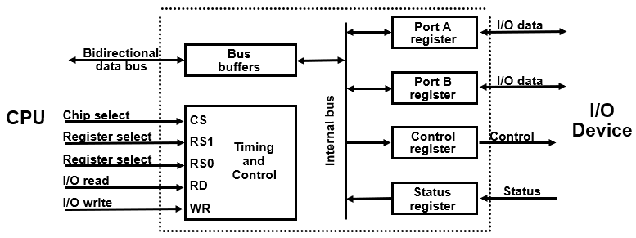
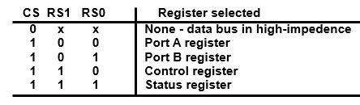
Input-Output Interface…
Example of I/O Interface:

Slide 18
3. Asynchronous Data Transfer
The internal operations in a digital system are synchronized by means of clock pulses supplied by a common pulse generator.
Clock pulses are applied to all registers within a unit and all data transfers among internal registers occur simultaneously during the occurrence of a clock pulse.
Two units, such as a CPU and an I/O interface, are designed independently of each other.
If the registers in the interface share a common clock with the CPU registers, the transfer between the two units is said to be synchronous.
In most cases, the internal timing in each unit is independent from the other in that each uses its own private clock for internal registers. In that case, the two units are said to be asynchronous to each other.
This approach is widely used in most computer systems.
systems.

Slide 19
Asynchronous Data Transfer…
Asynchronous data transfer between two independent units requires that control signals be transmitted between the communicating units to indicate the time at which data is being transmitted.
One way of achieving this is by means of a strobe pulse supplied by one of the units to indicate to the other unit when the transfer has to occur.
Another method commonly used is to accompany each data item being transferred with a control signal that indicates the presence of data in the bus.
The unit receiving the data item responds with another control signal to acknowledge receipt of the data. This type of agreement between two independent units is referred to as handshaking.

Slide 20
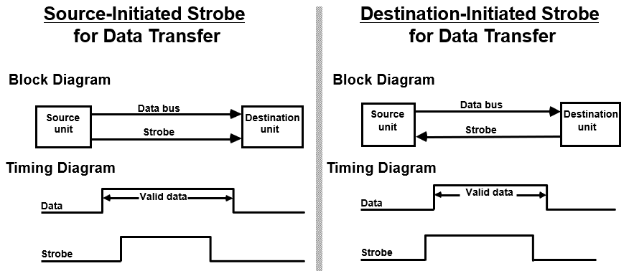
Asynchronous Data Transfer…
Strobe Control:
Employs a single control line to time each transfer. The strobe may be activated by either the source or the destination unit

Slide 21
Asynchronous Data Transfer…
Handshaking:
In destination initiated strobe mode, the destination unit that initiates the transfer no way of knowing whether the source has actually placed the data on the bus.
To solve this problem, the HANDSHAKE method introduces a second control signal to provide a Reply to the unit that initiates the transfer.
Figure 11-5 shows the data transfer procedure when initiated by the source.
The two handshaking lines are data valid, which is generated by the source unit, and data accepted, generated by the destination unit.
The timing diagram shows the exchange of signals between the two units.

Slide 22
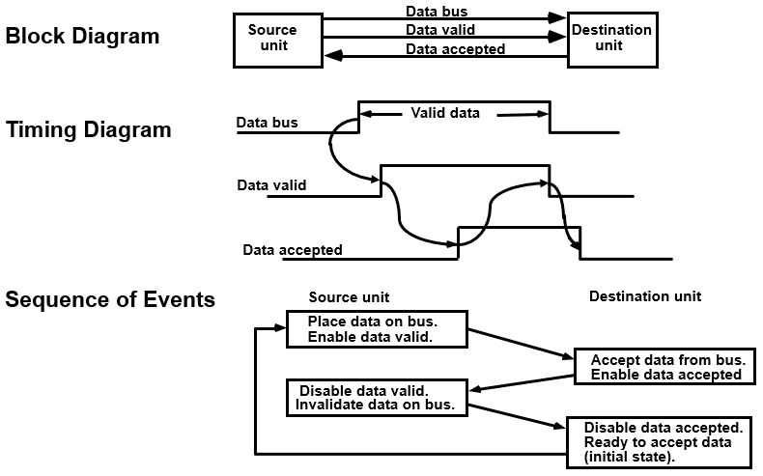
Asynchronous Data Transfer…
Source-initiated Transfer Using Handshake:
  Allows arbitrary delays from one state to the next
  Permits each unit to respond at its own data transfer rate
  The rate of transfer is determined by the slower unit

Slide 23
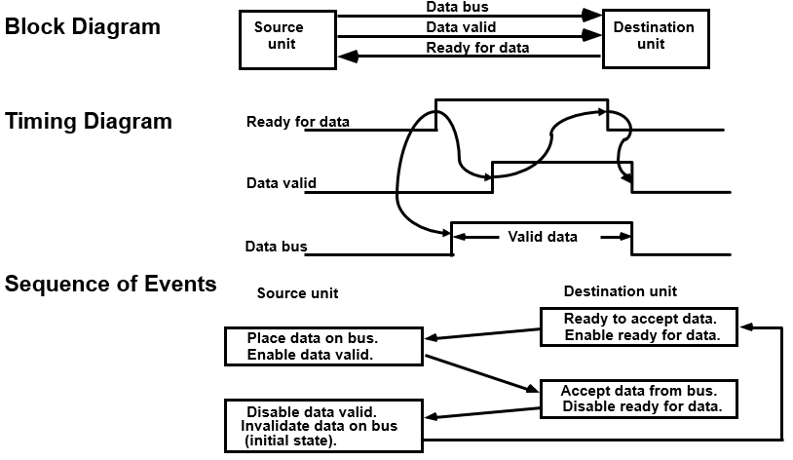
Asynchronous Data Transfer…
Destination-initiated Transfer Using Handshake:
  Handshaking provides a high degree of flexibility and reliability If one unit is faulty, data transfer will not be completed -> Can be detected by means of a timeout mechanism

Slide 24
Asynchronous Data Transfer…
Asynchronous Serial Transfer:
The transfer of data between two units may be done in parallel or serial.
In parallel data transmission, each bit of the message has its own path, and the total message is transmitted at the same time. This means that an n-bit message must be transmitted through n separate conductor paths.
In serial data transmission, each bit in the message is sent in sequence one at a time. This method requires the use of one pair of conductors or one conductor and a common ground.
Parallel transmission is faster but requires many wires and more expensive. It is used for short distances and where speed is important.
Serial transmission is slower but is less expensive since it requires only one pair of conductors.

Slide 25
Asynchronous Data Transfer…
Asynchronous Serial Transfer:
Serial transmission can be synchronous or asynchronous.
In synchronous transmission, the two units share a common clock frequency and bits are transmitted continuously at the rate dictated by the clock pulses.
Synchronization signals are transmitted periodically between the two units to keep their clocks in step with each other.
In asynchronous transmission, binary information is sent only when it is available, and the line remains idle when there is no information to be transmitted.
This contrasts with synchronous transmission, where bits must be transmitted continuously to keep the clock frequency in both units synchronized with each other.

Slide 26
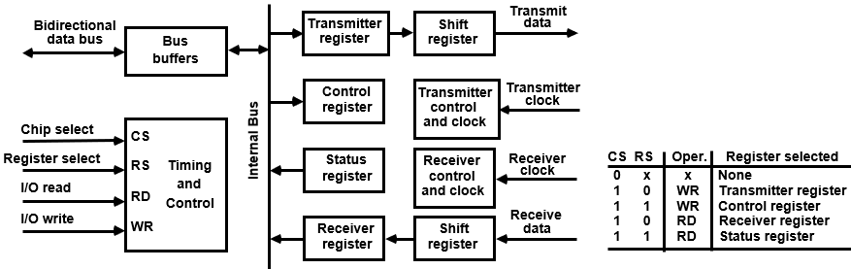
Asynchronous Data Transfer…
Asynchronous Communication Interface Or Universal Asynchronous Receiver-transmitter (UART):
The block diagram of a typical asynchronous communication interface is shown in Fig. 1 1-8. It functions as both a transmitter and a receiver

Slide 27
Asynchronous Data Transfer…
First-In, First-Out Buffer:
It is a memory unit that stores information in such a manner that the item first in is the item first out.
A FIFO buffer comes with separate input and output terminals.
The important feature of this buffer is that it can input data and output data at two different rates and the output data are always in the same order in which the data entered the buffer.
When placed between two units, the FIFO can accept data from the source unit at one rate of transfer and deliver the data to the destination unit at another rate.

Slide 28
4. Modes of Transfer
Binary information received from an external device is usually stored in memory for later processing. Information transferred from the CPU into an external device originates in the memory unit.
The CPU merely executes the I/O instructions and may accept the data temporarily, but the ultimate source/destination is the memory.
Data transfer between the central computer and I/O devices may be handled in a variety of modes. Some modes use the CPU as an intermediate path; others transfer the data directly to and from the memory unit.
Data transfer to and from peripherals may be handled in one of three possible modes:
  Programmed I/O
  Interrupt-initiated I/O
  Direct memory access (DMA)

Slide 29
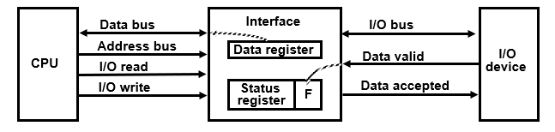
Modes of Transfer…
Program-Controlled I/O (Input Dev to CPU):
Programmed I/O operations are the result of I/O instructions written in the computer program. Each data item transfer is initiated by an instruction in the program.
An example of data transfer from an I/O device through an interface into the CPU is shown in Fig. 11-10.

Slide 30
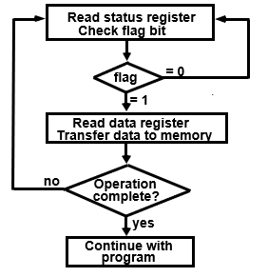
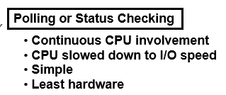
Modes of Transfer…
Program-Controlled I/O (Input Dev to CPU): A flowchart of the program that must be written for the CPU is shown in Fig. 11-11. It is assumed that the device is sending a sequence of bytes that must be stored in memory. The transfer of each byte requires three instructions:
  Read the status register.
  Check the status of flag bit and branch to step 1 if not set or to step 3 if set.
  Read the data register

Slide 31
Modes of Transfer…
Interrupt-Initiated I/O:
An alternative to the CPU constantly monitoring the flag is to let the interface inform the computer when it is ready to transfer data.
This mode of transfer uses the interrupt facility. While the CPU is running a program, it does not check the flag.
However, when the flag is set, the computer is momentarily interrupted from proceeding with the current program and is informed of the fact that the flag has been set.
The CPU deviates from what it is doing to take care of the input or output transfer.
After the transfer is completed, the computer returns to the previous program to continue what it was doing before the interrupt.

Slide 32
END OF
UNIT-4
PART-1

