Slide 1
II-B.E. III-SEMESTER
COMPUTER ARCHITECTURE (CA)
Presented By
Dr. D. BASWARAJ
Professor, CSE DEPT.
VCE, HYDERABAD

Slide 2
SYLLABUS
UNIT – I:
Overview of Computer Function and Interconnection
Register Transfer Micro operations
UNIT – II:
Basic Computer organization and Design
Micro programmed Control
UNIT – III:
Central Processing Unit
Pipeline
Computer Arithmetic

Slide 3
SYLLABUS …
UNIT – IV:
Input-Output organization: Peripheral Devices, Input-Output Interface, Asynchronous Data Transfer, Modes of Transfer, Priority Interrupt, Direct Memory Access, Input-Output Processor (IOP), Serial Communication
UNIT – V:
Memory Organization: Memory Hierarchy, Main Memory, RAM and ROM, Auxiliary Memory, Associative Memory, Cache Memory, Virtual Memory, Memory Management Hardware.
Assessing and Understanding Performance: CPU Performance and its Factors, Evaluating Performance.

Slide 4
SYLLABUS …
Learning Resources:
M. Morris Mano, Computer System Architecture, 3rd Edition (2007), Pearson Education Asia.
William Stallings, Computer Organization & Architecture, 8th Edition (2011), Pearson Education Asia.
David A Patterson, John L Hennessy, Computer Organization and Design, 4th Edition (2014), Morgan Kaufmann.
Carl.V Hamacher, Vranesic Z.G, Zaky S.G, Computer Organization, 5th Edition (2011), McGraw Hill.
Pal Chaudhuri.P, Computer Organization and Design, , 3rd Edition(2009), Prentice Hall of India

Slide 5
UNIT-IV
PART-1: Input-Output organization
  Peripheral Devices
  Input-Output Interface
  Asynchronous Data Transfer
  Modes of Transfer
  PART-2: Input-Output organization…
  Priority Interrupt
  Direct Memory Access
  Input-Output Processor (IOP)
  Serial Communication

Slide 6
5. Priority Interrupt (PI)
Data transfer between the CPU and an I/O device is initiated by the CPU. However, the CPU cannot start the transfer unless the device is ready to communicate with the CPU.
The readiness of the device can be determined from an interrupt signal. The CPU responds to the interrupt request by storing the return address from PC into a memory stack and then the program branches to a service routine that processes the required transfer.
In a typical application several I/O devices are attached to the computer, with each device being able to originate an interrupt request.
The first task of the interrupt system is to identify the source of the interrupt. There is also the possibility that several sources will request service simultaneously.
In this case the system must also decide which device to service first.

Slide 7
Priority Interrupt…
Priority Interrupt:
  Determines which interrupt is to be served first when two or more requests are made simultaneously
  Also determines which interrupts are permitted to interrupt the computer while another is being serviced
  Higher PI can make requests while servicing a lower PI
PI by Software (Polling)
  Priority is established by the order of polling the devices
  Flexible since it is established by software
  Low cost since it needs a very little hardware, Very slow
PI by Hardware
  Require a PI manager which accepts all the interrupt requests to determine the highest priority request
  Fast since identification of the highest PI request is identified by the hardware
  Fast since each interrupt source has its own interrupt vector to access directly to its own service routine

Slide 8
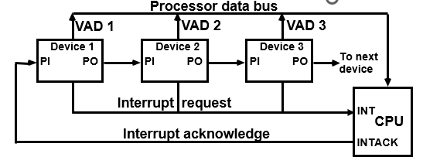
Priority Interrupt…
Hardware Priority Interrupt - Daisy-chain :
The daisy-chaining method of establishing priority consists of a serial connection of all devices that request an interrupt.
The device with the highest priority is placed in the first position, followed by lower-priority devices up to the device with the lowest priority, which is placed last in the chain.
This method of 3 devices and the CPU is shown in Fig. 11-12.

Slide 9
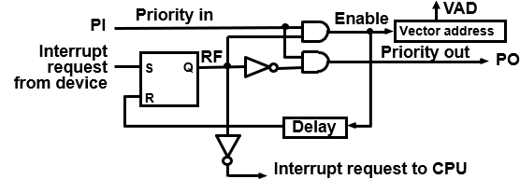
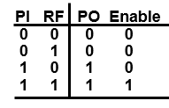
Priority Interrupt…
Hardware Priority Interrupt - Daisy-chain :
Interrupt Request from any device(>=1)
  CPU responds by INTACK <- 1
  Any device receives signal(INTACK) 1 at PI puts the VAD (Vector address) on the bus
Among interrupt requesting devices the only device which is physically closest to CPU gets INTACK=1, and it blocks INTACK to propagate to the next device.
One stage of the daisy chain priority arrangement shown below:

Slide 10
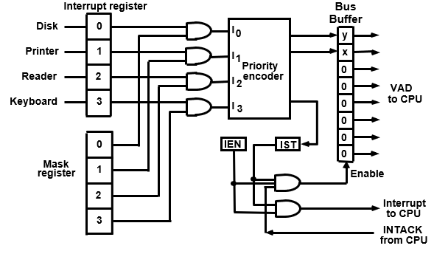
Priority Interrupt…
Parallel Priority Interrupt:
It uses a register whose bits are set separately by the interrupt signal from each device.
Priority is established according to the position of bits in the register. The priority logic of four interrupt sources shown in Fig. 11-14.

Slide 11
Priority Interrupt…
Parallel Priority Interrupt…
The priority encoder generates two bits of the vector address, which is transferred to the CPU.
Another output from the encoder sets an interrupt status flip-flop IST, when an interrupt that is not masked occurs.
The interrupt enable flip-flop IEN can be set or cleared by the program to provide an overall control over the interrupt system.
The outputs of IST ANDed with IEN provide a common interrupt signal for the CPU.
The interrupt acknowledge IN'TACK signal from the CPU enables the bus buffers in the output register and a vector address VAD is placed into the data bus.

Slide 12
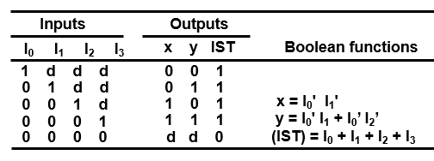
Priority Interrupt…
Parallel Priority Interrupt…
The priority encoder is a circuit that implements the priority function.
The logic of the priority encoder is such that if two or more inputs arrive at the same time, the input having the highest priority will take precedence. The truth table of a four-input priority encoder is given in Table 11·2.

Slide 13
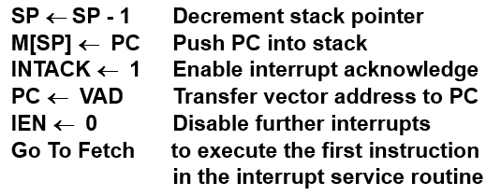
Priority Interrupt…
Parallel Priority Interrupt…
The interrupt enable flip-flop IEN can be set or cleared by program instructions.
When IEN is cleared, the interrupt request coming from IST is neglected by the CPU. The program-controlled IEN bit allows the programmer to choose whether to use the interrupt facility.
At the end of each Instruction cycle , CPU checks IEN and IST. If IEN & IST = 1, the CPU goes to an Interrupt Cycle:

Slide 14
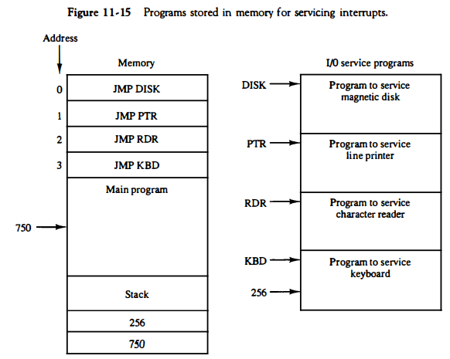
Priority Interrupt…
Software Routine: Apart from hardware aspects, the computer must also have software routines for servicing the interrupt requests and for controlling the interrupt hardware registers. Figure 11-15 shows the programs that must reside in memory for handling the interrupt system.

Slide 15
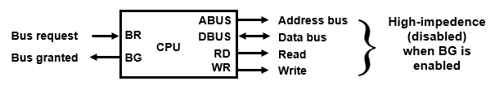
6. Direct Memory Access
The transfer of data between a fast storage device such as magnetic disk and memory is often limited by the speed of the CPU.
Removing the CPU from the path and letting the peripheral device manage the memory buses directly for data transfer.
Features:
  Block of data transfer from high-speed devices, Drum, Disk, Tape
  DMA controller - Interface which allows I/O transfer directly between Memory and Device, freeing CPU for other tasks
  CPU initializes DMA Controller by sending memory address and the block size(number of words)
CPU bus signals for DMA transfer:

Slide 16
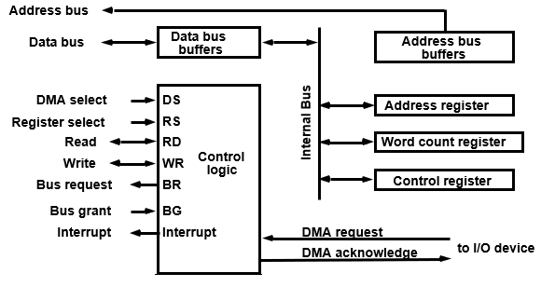
Direct Memory Access…
Block diagram of DMA controller:

Slide 17
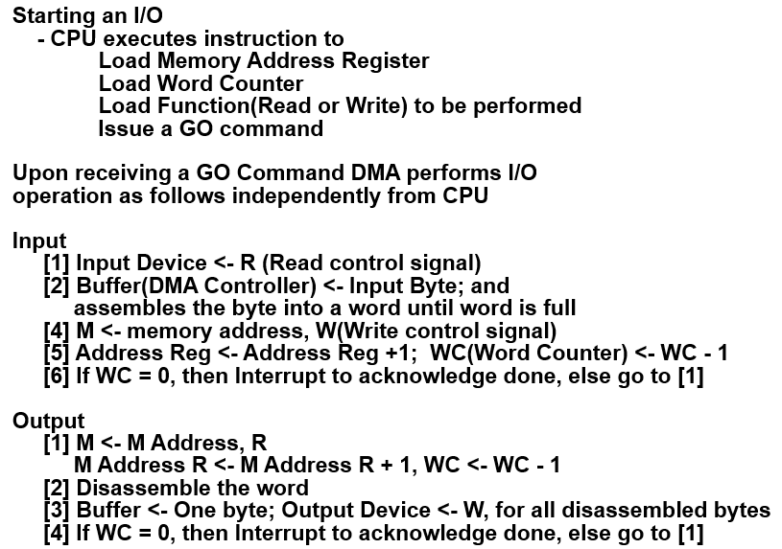
Direct Memory Access…
DMA I/O OPERATION:

Slide 18
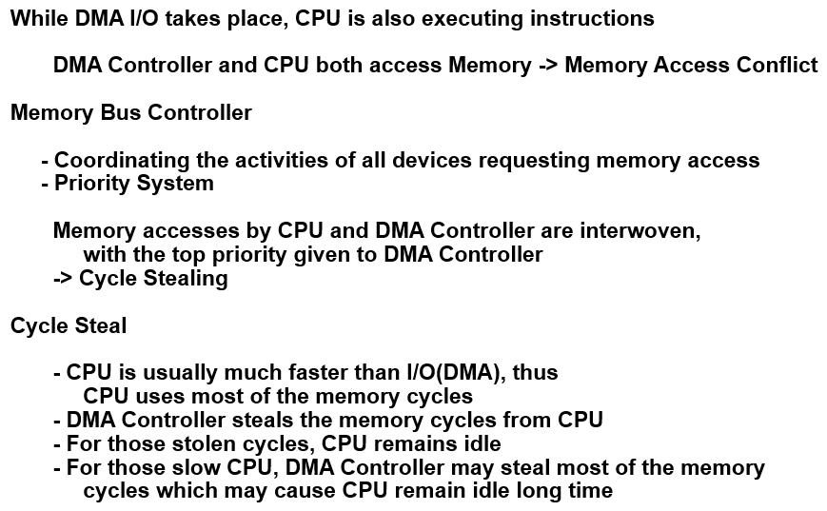
Direct Memory Access…
CYCLE STEALING:

Slide 19
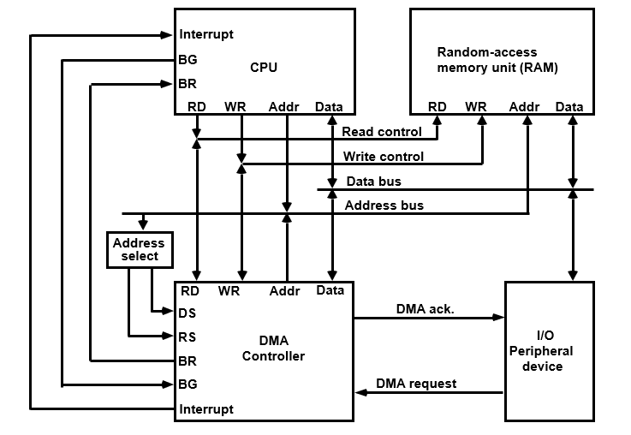
Direct Memory Access…
DMA TRANSFER:

Slide 20
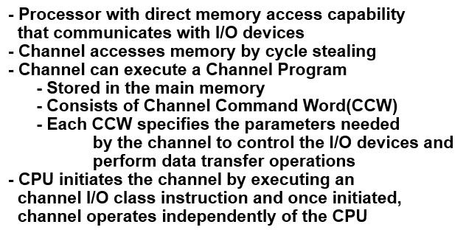
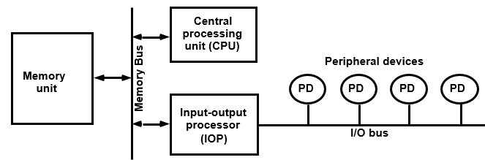
7. Input-Output Processor (IOP) - Channel

Slide 21
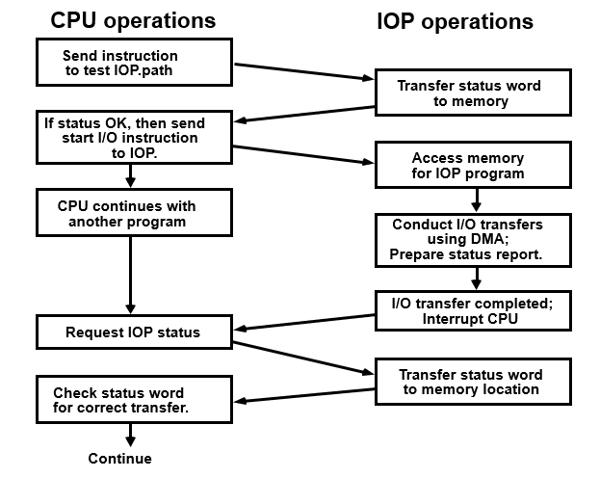
Input-Output Processor (IOP) – Channel…
CHANNEL / CPU COMMUNICATION

Slide 22
8. Serial Communication
In synchronous transmission, where an entire block of characters is transmitted, each character has a parity bit for the receiver to check.
After the entire block is sent, the transmitter sends one more character that constitutes a parity over the length of the message.
This character is called a longitudinal redundancy check (LRC) and is the accumulation of the XOR of all transmitted characters.
The receiving station calculates the LRC as it receives characters and compares it with the transmitted LRC.
The calculated and received LRC should be equal for error-free messages. If the receiver finds an error in the transmitted block, it informs the sender to retransmit the same block once again.
Another method used for checking errors in transmission is the cyclic redundancy check (CRC).

Slide 23
Serial Communication…
Since telephone lines were originally designed for voice communication and computers communicate in terms of digital signals, some form of conversion must be used.
The converters are called data sets, acoustic couplers, modem (from "modulator-demodulator").
A modem converts digital signals into audio tones to be transmitted over telephone lines and also converts audio tones from the line to digital signals for machine use.
A communication line may be connected to a synchronous or asynchronous interface, depending on the transmission method of the remote terminal.

Slide 24
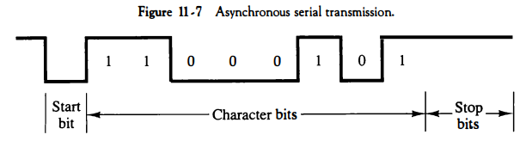
Serial Communication…
Asynchronous Serial Transfer:
With this technique, each character consists of three parts: a start
bit, the character bits, and stop bits.
Example: consider the serial transmission of a terminal whose transfer rate is 10 characters per second. Each transmitted character consists. of a start bit, eight information bits, and two stop bits, for a total of 11 bits. Ten characters per second means that each character takes 0.1s for transfer. Since there are 11 bits to be transmitted, it follows that the bit time is 9.09 ms.

Slide 25
Serial Communication…
Synchronous Serial Transfer:
Contrary to asynchronous transmission, where each character can be sent separately with its own start and stop bits, synchronous transmission must send a continuous message in order to maintain synchronism.
The message consists of a group of bits transmitted sequentially as a block of data. The entire block is transmitted with special control characters at the beginning and end of the block.
One of the functions of the data communication processor is to check for transmission errors. An error can be detected by checking the parity in each information.
Protocols are divided into two major categories according to the message-framing technique used. These are character-oriented protocol and bit-oriented protocol.

Slide 26
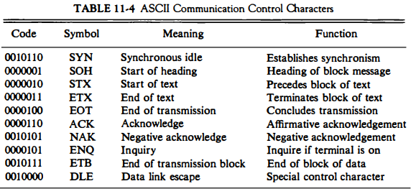
Serial Communication…
Character-Oriented Protocol:
The character-oriented protocol is based on the binary code of a character set. The code most used is ASCII (American Standard Code for Information Interchange). It is a 7-bit code with an eighth bit used for parity.
The characters that control the transmission are called communication control characters. These are listed in Table 11-4.

Slide 27

Serial Communication…
Character-Oriented Protocol…
Messages are transmitted through the data link with an established format consisting of a header field, a text field, and an error-checking field.
The two SYN characters assure proper synchronization at the start of the message. Following the SYN is the header, which starts with an SOH character. The STX character terminates the header and signifies the beginning of the text transmission and terminated with the ETX character.
The block check character (BCC) used for error checking using either a longitudinal redundancy check (LRC) or a cyclic redundancy check (CRC).

Slide 28
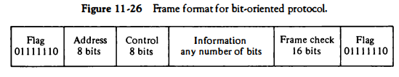
Serial Communication…
Bit-oriented protocol:
The bit-oriented protocol does not use characters in its control field and is independent of any particular code.
It allows the transmission of serial bit stream of any length without the implication of character boundaries.
The frame format for the bit-oriented protocol is shown in Fig. 11-26. A frame starts with the 8-bit flag 01111110 followed by an address and control sequence.
The information field is not restricted in format or content and can be of any length. The CRC (cyclic redundancy check) sequence used for detecting errors in transmission.

Slide 29
Serial Communication…
Bit-oriented protocol…
To prevent a flag from occurring in the middle of a frame, the bit-oriented protocol uses a method called zero insertion . This requires that a 0 be inserted by the transmitting station after any succession of five continuous 1' s.
The receiver always removes a 0 that follows a succession of five l's. Thus, the bit pattern 0111111 is transmitted as 0111110l and restored by the receiver to its original value by removal of the 0 following the five l’s.
Following the flag is the address field, which is used by the primary
station to designate the secondary station address. When a secondary station transmits a frame, the address tells the primary station which secondary station originated the frame
Following the address field is the control field.

Slide 30
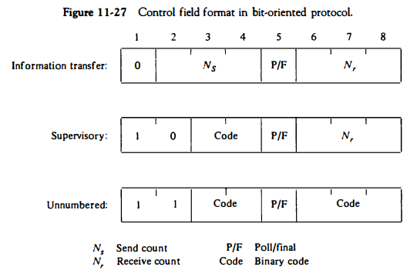
Serial Communication…
Bit-oriented protocol…
The control field comes in three different formats, as shown in Fig. 11-27.

Slide 31
END OF
UNIT-4
PART-2

