Slide 1
II-B.E. III-SEMESTER
COMPUTER ARCHITECTURE (CA)
Presented By
Dr. D. BASWARAJ
Professor, CSE DEPT.
VCE, HYDERABAD

Slide 2
SYLLABUS
UNIT – I:
Overview of Computer Function and Interconnection
Register Transfer Micro operations
UNIT – II:
Basic Computer organization and Design
Micro programmed Control
UNIT – III:
Central Processing Unit
Pipeline
Computer Arithmetic

Slide 3
SYLLABUS …
UNIT – IV:
Input-Output organization: Peripheral Devices, Input-Output Interface, Asynchronous Data Transfer, Modes of Transfer, Priority Interrupt, Direct Memory Access, Input-Output Processor (IOP), Serial Communication
UNIT – V:
Memory Organization: Memory Hierarchy, Main Memory, RAM and ROM, Auxiliary Memory, Associative Memory, Cache Memory, Virtual Memory, Memory Management Hardware.
Assessing and Understanding Performance: CPU Performance and its Factors, Evaluating Performance.

Slide 4
SYLLABUS …
Learning Resources:
M. Morris Mano, Computer System Architecture, 3rd Edition (2007), Pearson Education Asia.
William Stallings, Computer Organization & Architecture, 8th Edition (2011), Pearson Education Asia.
David A Patterson, John L Hennessy, Computer Organization and Design, 4th Edition (2014), Morgan Kaufmann.
Carl.V Hamacher, Vranesic Z.G, Zaky S.G, Computer Organization, 5th Edition (2011), McGraw Hill.
Pal Chaudhuri.P, Computer Organization and Design, , 3rd Edition(2009), Prentice Hall of India

Slide 5
UNIT-V
PART-1: Memory Organization
  Memory Hierarchy
  Main Memory
  RAM and ROM
  Auxiliary Memory
  Associative Memory
  Cache Memory
  Virtual Memory
  Memory Management Hardware
  PART-2: Assessing and Understanding Performance
  CPU Performance and its Factors
  Evaluating Performance.

Slide 6
1. Memory Hierarchy
The memory unit is an essential component in any digital computer, since it is needed for storing programs and data.
A very small computer with a limited application may be able to fulfill its intended task without the need of additional storage capacity.
Most general purpose computers would run more efficiently if they were equipped with additional storage beyond the capacity of the main memory.
There is just not enough space in one memory unit to accommodate all the programs used in a typical computer.
Moreover, most computer users accumulate and continue to accumulate large amounts of data-processing software.
Not all accumulated information is needed by the processor at the same time.

Slide 7
Memory Hierarchy…
Therefore, it is more economical to use low-cost storage devices to serve as a backup for storing the information that is not currently used by the CPU.
The memory unit that communicates directly with the CPU is called the main memory. Devices that provide backup storage are called auxiliary memory.
The most common auxiliary memory devices used in computer systems are magnetic disks and tapes. They are used for storing system programs, large data files, and other backup information. The total memory capacity of a computer can be visualized as being a hierarchy of components.
The memory hierarchy system consists of all storage devices employed in a computer system from the slow but high-capacity auxiliary memory to a relatively faster main memory, to an even smaller and faster cache memory accessible to the high-speed processing logic.

Slide 8
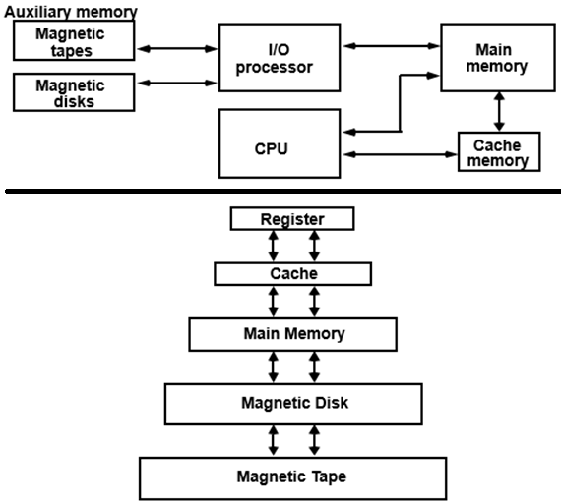
Memory Hierarchy…
Figure 12-1 illustrates the components in a typical memory hierarchy. It is used to obtain the highest possible access speed while minimizing the total cost of the memory system

Slide 9
2. Main Memory
The main memory is the central storage unit in a computer system. It is a relatively large and fast memory used to store programs and data during the computer operation.
The principal technology used for the main memory is based on semiconductor integrated circuits. Integrated circuit RAM chips are available in two possible operating modes, static and dynamic.
The static RAM consists essentially of internal flip-flops that store the binary information. The stored information remains valid as long as power is applied to the unit.
The dynamic RAM stores the binary information in the form of electric charges that are applied to capacitors.
The capacitors are provided inside the chip by MOS transistors. The stored charge on the capacitors tend to discharge with time and the capacitors must be periodically recharged by refreshing the dynamic memory.

Slide 10
Main Memory…
Refreshing is done by cycling through the words every few milliseconds to restore the decaying charge.
The dynamic RAM offers reduced power consumption and larger storage capacity in a single memory chip.
The static RAM is easier to use and has shorter read & write cycles.
Most of the main memory in a general-purpose computer is made up of RAM integrated circuit chips, but a portion of the memory may be constructed with ROM chips.
Originally, RAM was used to refer to a random-access memory, but now it is used to designate a read/write memory to distinguish it from a read-only memory, although ROM is also random access.
RAM is used for storing the bulk of the programs and data that are subject to change. ROM is used for storing programs that are permanently resident in the computer that do not change in value once the production of the computer is completed.

Slide 11
Main Memory…
Among other things, the ROM portion of main memory is needed for storing an initial program called a bootstrap loader.
The bootstrap loader is a program whose function is to start the computer software operating when power is turned on.
Since RAM is volatile, its contents are destroyed when power is turned off. The contents of ROM remain unchanged after power is turned off and on again.
The startup of a computer consists of turning the power on and starting the execution of an initial program.
Thus, when power is turned on, the hardware of the computer sets the program counter to the first address of the bootstrap loader.
The bootstrap program loads a portion of the operating system from disk to main memory and control is then transferred to the operating system, which prepares the computer for general use.

Slide 12
3. RAM and ROM
RAM and ROM chips are available in a variety of sizes.
If the memory needed for the computer is larger than the capacity of one chip, it is necessary to combine a number of chips to form the required memory size.
A RAM chip is better suited for communication with the CPU if it has one or more control inputs that select the chip only when needed.
Bidirectional data bus allows the transfer of data either from memory to CPU during a read operation, or from CPU to memory during a write operation.
A bidirectional data bus can be constructed with three-state buffers and its output can be placed in one of three possible states: logic 1, logic 0, or a high impedance state. The logic 1 & 0 are normal digital signals. The high impedance state does not carry a signal and has no logic significance.

Slide 13
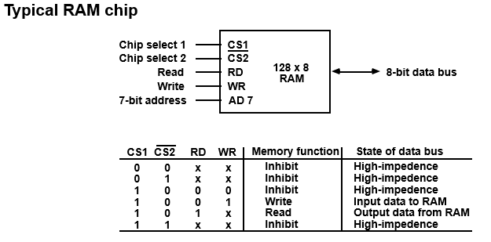
RAM and ROM…
The block diagram of a RAM chip is shown in Fig. 12-2. The capacity of the memory is 128 x 8 (128 words of 8 bits per word)

Slide 14
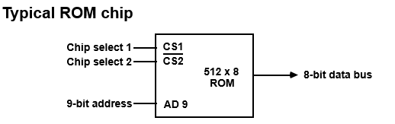
RAM and ROM…
A ROM chip is organized externally in a similar manner. However, since a ROM can only read, the data bus can only be in an output mode. The block diagram of a ROM chip is shown in Fig. 12-3.
For the same-size chip, it is possible to have more bits of ROM than of RAM, because the internal binary cells in ROM occupy less space than in RAM.
For this reason, the diagram specifies a 512-byte ROM, while the RAM has only 128 bytes. The nine address lines in the ROM chip specify any one of the 512 bytes stored in it.

Slide 15
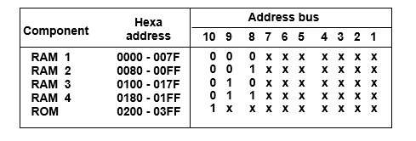
RAM and ROM…
The memory address map for this configuration is shown in Table 12-1 . The component column specifies whether a RAM or a ROM chip is used.
The hexadecimal address column assigns a range of hexadecimal equivalent addresses for each chip. The address bus lines are listed in the third column.
Although there are 16 lines in the address bus, the table shows only 10 lines because the other 6 are not used in this example and are assumed to be zero.

Slide 16
RAM and ROM…
Memory Connection to CPU:
RAM and ROM chips are connected to a CPU through the data and address buses. The low-order lines in the address bus select the byte within the chips and other lines in the address bus select a particular chip through its chip select inputs.
The connection of memory chips to the CPU is shown in Fig. 12-4. This configuration gives a memory capacity of 512 bytes of RAM and 512 bytes of ROM. It implements Table 12-1.
Each RAM receives the 7 low-order bits of the address bus to select one of 128 bytes. The RAM chip selected is determined from lines 8 and 9 in the address bus through a 2 x 4 decoder whose outputs go to the CS1 inputs in each RAM chip.
The RD and WR outputs from the microprocessor are applied to the inputs of each RAM chip. The RAMs are selected when the bit in this line is 0, and the ROM when the bit is 1.

Slide 17
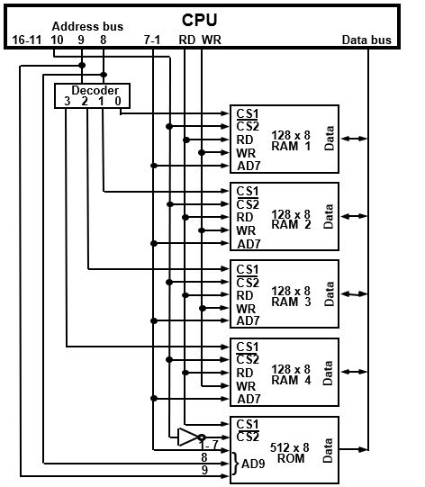
RAM and ROM…
Memory
Connection
to CPU…

Slide 18
4. Auxiliary Memory
The most common auxiliary memory devices used in computer systems are magnetic disks and tapes.
Other components used, but not as frequently, are magnetic drums, magnetic bubble memory, and optical disks.
The important characteristics of any device are its access mode, access time, transfer rate, capacity, and cost.
The average time required to reach a storage location in memory and obtain its contents is called the access time.
In electromechanical devices with moving parts such as disks and tapes, the access time consists of a seek time required to position the read-write head to a location and a transfer time required to transfer data to or from the device.

Slide 19
Auxiliary Memory…
Because the seek time is usually much longer than the transfer time, auxiliary storage is organized in records or blocks.
A record is a specified number of characters or words. Reading or writing is always done on entire records. The transfer rate is the number of characters or words that the device can transfer per second, after it has been positioned at the beginning of the record.
Magnetic Disks:
A magnetic disk is a circular plate constructed of metal or plastic coated with magnetized material.
Often both sides of the disk are used and several disks may be stacked on one spindle with read/write heads available on each surface.
All disks rotate together at high speed and are not stopped or started for access purposes.

Slide 20
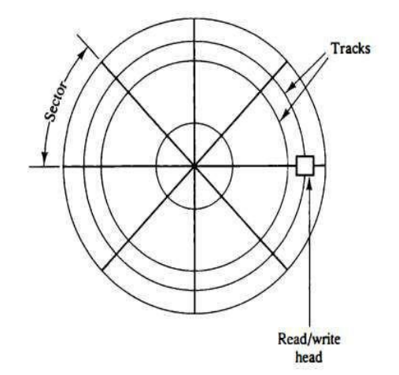
Auxiliary Memory…
Bits are stored in the magnetized surface in spots along concentric circles called tracks. The tracks are commonly divided into sections called sectors. In most systems, the minimum quantity of information which can be transferred is a sector.
The subdivision of one disk surface into tracks and sectors is shown in Fig. 12-5.

Slide 21
Auxiliary Memory…
Magnetic Tape
A magnetic tape transport consists of the electrical, mechanical, and electronic components to provide the parts and control mechanism for a magnetic-tape unit. The tape itself is a strip of plastic coated with a magnetic recording medium.
Bits are recorded as magnetic spots on the tape along several tracks. Usually, seven or nine bits are recorded simultaneously to form a character together with a parity bit.
Read/write heads are mounted one in each track so that data can be recorded and read as a sequence of characters.
Magnetic tape units can be stopped, started to move forward or in reverse, or can be rewound. However, they cannot be started or stopped fast enough between individual characters.

Slide 22
Auxiliary Memory…
Magnetic Tape…
For this reason, information is recorded in blocks referred to as records. Gaps of unrecorded tape are inserted between records where the tape can be stopped.
The tape starts moving while in a gap and attains its constant speed by the time it reaches the next record.
Each record on tape has an identification bit pattern at the beginning and end. By reading the bit pattern at the beginning, the tape control identifies the record number.
By reading the bit pattern at the end of the record, the control recognizes the beginning of a gap. A tape unit is addressed by specifying the record number and the number of characters in the record. Records may be of fixed or variable length.

Slide 23
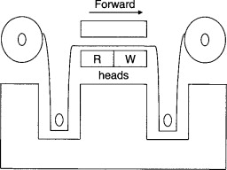
Auxiliary Memory…
Advantages Magnetic Tape…
  Cost
  Storage capacity
  Portability.
  Reusable
Application Areas of Magnetic Tapes:
  Serial or sequential processing.
  Backing up data on tape is very cheap.
  It is applicable for the transfer of data between multiple machines.
  It is suitable for the storage of a large volume of data..

Slide 24
5. Associative Memory (CAM)
Many data-processing applications require the search of items in a table stored in memory.
The search procedure is a strategy for choosing a sequence of addresses, reading the content of memory at each address, and comparing the information read with the item being searched until a match occurs.
The number of accesses to memory depends on the location of the item and the efficiency of the search algorithm.
Many search algorithms have been developed to minimize the number of accesses while searching for an item in a random or sequential access memory.
The time required for search can be reduced considerably if stored data can be identified for access by the content of the data itself rather address. A memory unit accessed by content is called an associative memory or content addressable memory (CAM).

Slide 25
Associative Memory (CAM)…
This type of memory is accessed simultaneously and in parallel on the basis of data content rather than by specific address or location.
When a word is written in an associative memory, no address is given. The memory can find an empty unused location to store the word.
When a word is to be read from an associative memory, the content of the word, or part of the word, is specified. The memory locates all words which match the specified content and marks them for reading.
Hardware Organization: The block diagram of an associative memory is shown in Fig. 12-6.
It consists of a memory array and logic for m words with n bits per word. The argument register A and key register K each have n bits, one for each bit of a word. The match register M has m bits, one for each memory word.

Slide 26
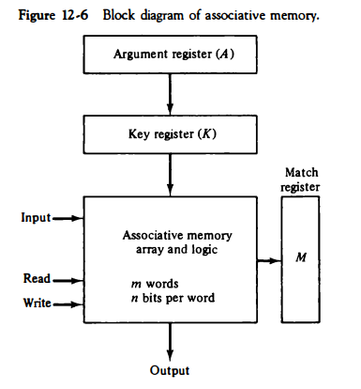
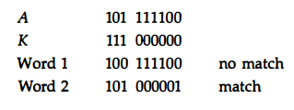
Associative Memory (CAM)…
Hardware Organization:

Slide 27
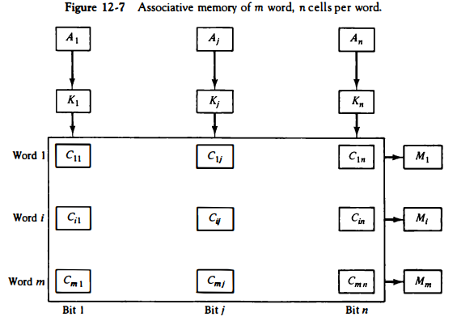
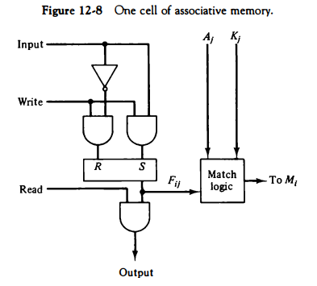
Associative Memory (CAM)…
Hardware Organization: The relation between the memory array and external registers in an associative memory is below Fig. 12-7. and individual cell shown in below Fig. 12-8

Slide 28
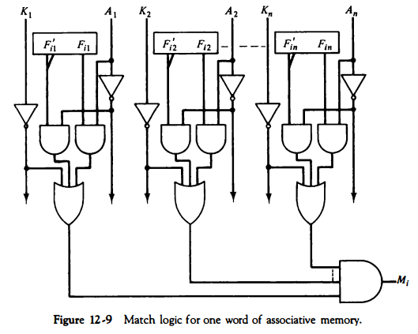
Associative Memory (CAM)…
Hardware Organization: The circuit for matching one word is shown in Fig. 12-9. The output of all OR gates in the cells of the same word go to the input of a common AND gate to generate the match signal for M,. M, will be logic 1 if a match occurs and 0 if no match occurs.

Slide 29
6. Cache Memory
Analysis of a large number of typical programs has shown that the references to memory at any given interval of time tend to be confined within a few localized areas in memory. This phenomenon is known as the property of locality of reference.
For example, loops and subroutines tend to localize the references to memory for fetching instructions.
If the active portions of the program and data are placed in a fast small memory, the average memory access time can be reduced, thus reducing the total execution time of the program.
Such a fast small memory is referred to as a cache memory. It is placed between the CPU and main memory.
The cache memory access time is less than the access time of main memory by a factor of 5 to 10. The cache is the fastest component in the memory hierarchy and approaches the speed of CPU components.

Slide 30
Cache Memory…
The performance of cache memory is frequently measured in terms of a quantity called hit ratio .
When the CPU refers to memory and finds the word in cache, it is said to produce a hit. If the word is not found in cache, it is in main memory and it counts as a miss.
The ratio of the number of hits divided by the total CPU references to memory (hits plus misses) is the hit ratio.
The cache memory access time is less than the access time of main memory by a factor of 5 to 10. The average memory access time of a computer system can be improved considerably by use of a cache.
If the hit ratio is high enough so that most of the time the CPU accesses the cache instead of MM, the average access time is closer to the access time of the fast cache memory.

Slide 31
Cache Memory…
Hit ratio = hits/ (hits + misses)
Average access time for a memory with a single-level cache for
A = C + (1-H)M
Where, A is the average access time of the system, M is the access time of the main memory, C is the access time of the cache, H is the percent of accesses that are satisfied from the cache.
For example, Determine an average access time of a computer with cache access time of 100 ns, a MM access time of 1000 ns, and a hit ratio of 0.9?
Solution: A = C + (1-H)M = 100 + (1-0.9)1000 = 200 ns.
This is a considerable improvement over a similar computer without a cache memory, whose access time is 1000 ns.

Slide 32
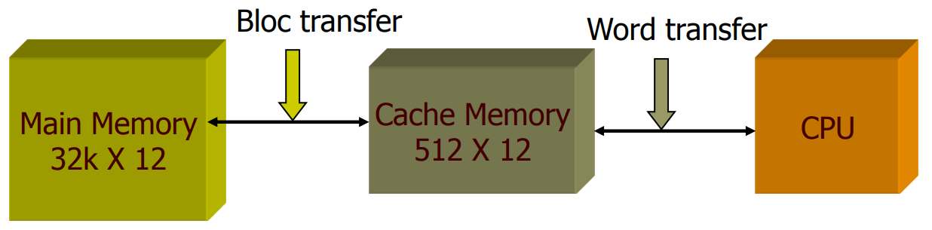
Cache Memory…
The basic characteristic of cache memory is its fast access time. Therefore, very little or no time must be wasted when searching for words in the cache.
The transformation of data from MM to cache memory is referred to as a mapping process. Three types of mapping procedures followed when considering cache memory:
  Associative mapping
  Direct mapping
  Set-associative mapping
To illustrate these 3 mapping procedures, a specific example of a memory organization will be used as shown below:

Slide 33
Cache Memory…
The main memory can store 32K words of 12 bits each. The cache is capable of storing 512 of these words at any given time.
For every word stored in cache, there is a duplicate copy in main memory. The CPU communicates with both memories.
It first sends a 15-bit address to cache. If there is a hit, the CPU accepts the 12-bit data from cache. If there is a miss, the CPU reads the word from main memory and then transferred to cache.
Associative Mapping The fastest and most flexible cache organization uses an associative memory.
This organization is shown in Fig. 12-11. The associative memory stores both the address and content (data) of the memory word.
A CPU address of 15 bits is placed in the argument register and the associative memory is searched for a matching address.

Slide 34
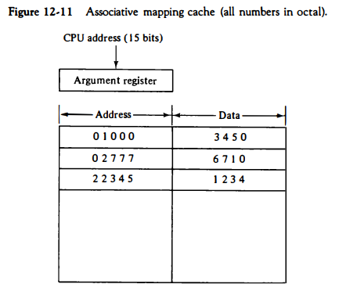
Cache Memory…
If address is found, the corresponding 12-bit data is read and sent to the CPU. If no match occurs, the MM is accessed for the word. The address-data pair is then transferred to the associative cache memory. If the cache is full, an address-data pair must be displaced to make room for a pair that is needed and not presently in the cache using FIFO policy.

Slide 35
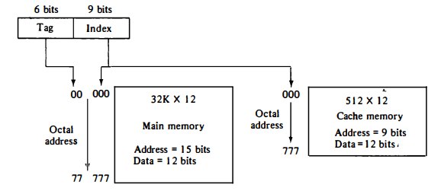
Cache Memory…
Direct mapping: Associative memories are expensive compared to RAM because of the added logic associated with each cell.
The possibility of using a main memory (MM) for the cache is investigated in Fig. 12-12. The CPU address of 15 bits is divided into two fields. The nine least significant bits constitute the index field, and the remaining six bits form the tag field.
The number of bits in the index field is equal to the number of address bits required to access the cache memory.

Slide 36
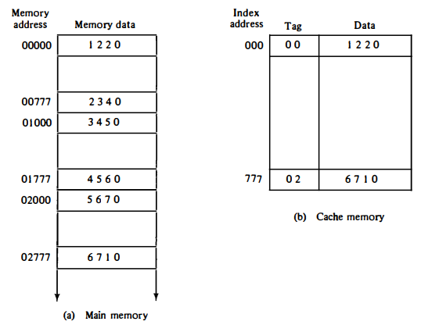
Cache Memory…
Direct mapping… To see how the direct-mapping organization operates, consider the numerical example shown in Fig. 12-13. The word at address zero is presently stored in the cache (index = 000, tag = 00, data = 1220).
Suppose, CPU now wants to access the word at 02000. The index address is 000, so it is used to access the cache. The two tags are then compared. The cache tag is 00 but the address tag is 02, which does not a match. Therefore, the RAM is accessed and the data 5670 is transferred to the CPU. The cache word at index address 000 is then replaced with a tag of 02 and data of 5670.

Slide 37
Cache Memory…
Set-Associative Mapping: In direct mapping two words with the same index in their address but with different tag values cannot reside in cache memory at the same time.
So, set-associative mapping, is an improvement over the direct mapping organization in that each word of cache can store two or more words of memory under the same index address.
Each data word is stored together with its tag and the number of tag-data items in one word of cache is said to form a set.
An example of a set-associative cache organization for a set size of two is shown in Fig. 12-15.
Each index address refers to two data words and their associated tags. Each tag requires six bits, and each data word has 12 bits, so the word length is 2(6 + 12) = 36 bits

Slide 38
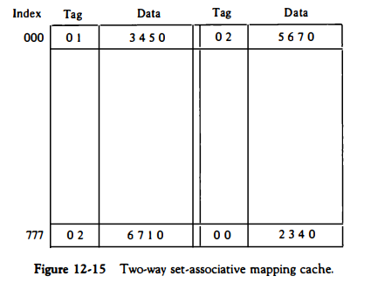
Cache Memory…
Set-Associative Mapping… In direct mapping two words with the same index in their address but with different tag values cannot reside in cache memory at the same time.
The octal numbers listed in Fig. 12-15 are with reference to the MM contents illustrated in Fig. 12-13(a). The words stored at addresses 01000 and 02000 of MM are stored in cache memory at index address 000. Similarly, the words at addresses 02777 & 00777 are stored in cache at index address 777

Slide 39
Cache Memory…
Replacement algorithms: When a miss occurs in a set-associative cache and the set is full, it is necessary to replace one of the tag-data items with a new value.
The most common replacement algorithms: random replacement, first-in, first-out (FIFO), and least recently used (LRU).
Writing into Cache: An important aspect of cache organization is concerned with memory write requests.
When the CPU finds a word in cache during a read operation, the main memory is not involved in the transfer. However, if the operation is a write, there are two ways that the system can proceed.
Write-through - update main memory with cache memory being updated in parallel if it contains the word at the specified address
Write-back – only the cache location is updated during a write operation

Slide 40
7. Virtual Memory (VM)
Virtual memory is a concept used in some large computer systems that permit the user to construct programs as though a large memory space were available, equal to the totality of auxiliary memory.
Each address that is referenced by the CPU goes through an address mapping from the so-called virtual address to a physical address in MM.
A VM system provides a mechanism for translating program-generated addresses into correct main memory locations.
This is done dynamically, while programs are being executed in the CPU. The translation or mapping is handled automatically by the hardware by means of a mapping table.

Slide 41
Virtual Memory…
Address Space and Memory Space:
An address used by a programmer will be called a virtual address, and the set of such addresses the address space.
An address in MM is called a location or physical address. The set of such locations is called the memory space.
Thus, the address space is the set of addresses generated by programs as they reference instructions and data; the memory space consists of the actual MM locations directly addressable for processing.
In most computers the address and memory spaces are identical. The address space is allowed to be larger than the memory space in computers with virtual memory.
As an illustration, consider a computer with a MM capacity of 32K words. Fifteen bits are needed to specify a physical address in memory since 32K = 2¹⁵

Slide 42
Virtual Memory…
Address Space and Memory Space…
Suppose that the computer has available auxiliary memory for storing 2²⁰ = 1024K words. Thus, auxiliary memory has a capacity for storing information equivalent to the capacity of 32 main memories.
Denoting the address space by N and the memory space by M, we then have for this example N = 1024K and M = 32K.
Suppose that program 1 is currently being executed in the CPU. Program 1 and a portion of its associated data are moved from auxiliary memory into MM as shown in Fig. 12-16.
Portions of programs and data need not be in contiguous locations in memory since information is being moved in and out, and empty spaces may be available in scattered locations in memory.

Slide 43
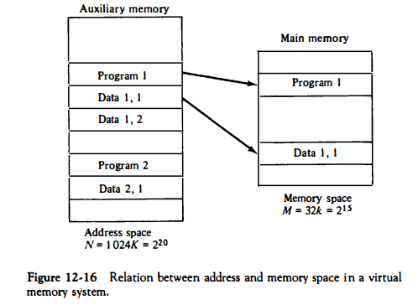
Virtual Memory…
Address Space and Memory Space…

Slide 44
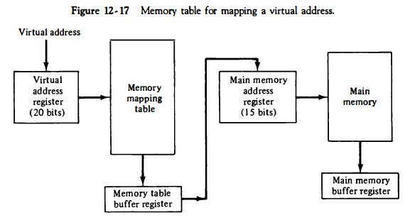
Virtual Memory…
Address Space and Memory Space…
A table is then needed, as shown in Fig. 12-17, to map a virtual address of 20 bits to a physical address of 15 bits. The mapping is a dynamic and every address is translated immediately as a word is referenced by CPU. The mapping table may be stored in a separate memory as shown in Fig. 12-17 or in MM.

Slide 45
Virtual Memory…
Address Mapping Using Pages:
The table implementation of the address mapping is simplified if the information in the address space and the memory space are each divided into groups of fixed size.
The physical memory is broken down into groups of equal size called blocks, which may range from 64 to 4096 words each. The term page refers to groups of address space of the same size.
Example-1: If a page or block consists of 1K words, then, using the previous example, address space is divided into 1024 pages and main memory is divided into 32 blocks.
Example-2: Consider a computer with an address space of 8K and a memory space of 4K. If we split each into groups of 1K words we obtain eight pages and four blocks as shown in Fig. 12-18. At any given time, up to 4 pages of address space may reside in MM in any one of the 4 blocks

Slide 46
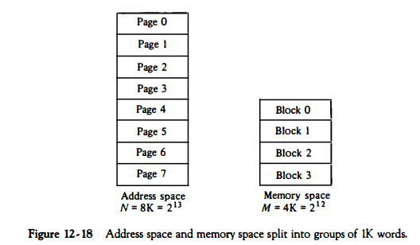
Virtual Memory…
Address Mapping Using Pages…

Slide 47
Virtual Memory…
Memory table in a paged system:
The mapping from address space to memory space is facilitated if each virtual address is considered to be represented by two numbers: a page number address and a line within the page.
In a computer with 2^{p} words per page, p bits are used to specify a line address and the remaining high-order bits of the virtual address specify the page number.
In the example of Fig. 12-18, a virtual address has 13 bits. Since each page consists of 2¹⁰ = 1024 words, the high-order three bits of a virtual address will specify one of the eight pages and the low-order 10 bits give the line address within the page.
Note that the line address in address space and memory space is the same; the only mapping required is from a page number to a block number.

Slide 48
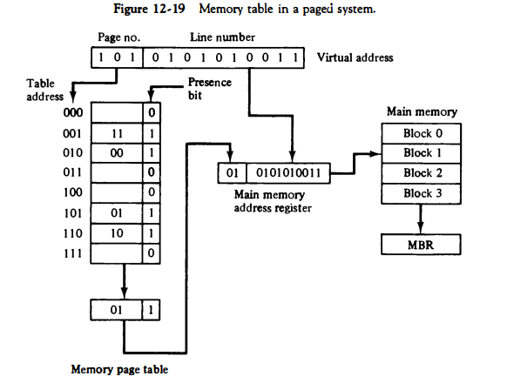
Virtual Memory…
Memory table in a paged system… The organization of the memory mapping table in a paged system is shown in Fig. 12-19. The table shows that pages 1, 2, 5, and 6 are now available in MM in blocks 3, 0, 1, and 2, respectively.

Slide 49
Virtual Memory…
Associative Memory Page Table:
A random-access memory page table is inefficient with respect to storage utilization. In the example of Fig. 12-19 we observe that eight words of MM are needed, one for each page, but at least four words will always be marked empty because MM cannot accommodate more than four blocks.
In general, a system with n pages and m blocks would require a memory-page table of n locations of which up to m blocks will be marked with block numbers and all others will be empty.
As a second numerical example, consider an address space of 1024K words and memory space of 32K words. If each page or block contains 1K words, the number of pages is 1024 and the number of blocks 32. The capacity of the memory-page table must be 1024 words and only 32 presence bit equal to 1. At any given time, at least 992 locations will be empty and not in use.

Slide 50
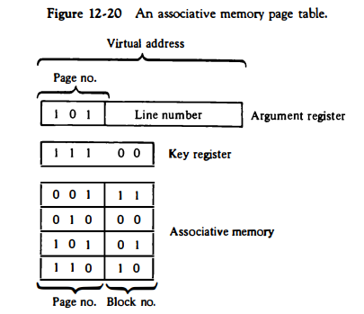
Virtual Memory…
Associative Memory Page Table… A more efficient way to organize the page table would be to construct it with equal to the number of blocks in MM to reduce memory size.
It will be implemented by associative memory with each word in memory containing a page# together with its corresponding block#.

Slide 51
Virtual Memory…
Page Replacement:
A VM system is a combination of hardware & software techniques. The memory management software system handles all the software operations for the efficient utilization of memory space.
It must decide (1) which page in MM to be removed to make room for a new page, (2) when a new page is to be transferred from auxiliary memory to MM, and (3) where the page is to be placed in MM.
The hardware mapping mechanism and the memory management software together constitute the architecture of a VM.
The program is executed from MM until it attempts to reference a page that is still in auxiliary memory. This condition is called page fault. When page fault occurs, the execution of the present program is suspended until the required page is brought into MM.

Slide 52
Virtual Memory…
Page Replacement…
If MM is full, it would be necessary to remove a page from a MM block to make room for the new page.
The policy for choosing pages to remove is determined from the replacement algorithm that is used. The goal of a replacement policy is to try to remove the page least likely to be referenced in the immediate future.
Two of the most common replacement algorithms used are the first-in, first-out (FIFO) and the least recently used (LRU).
The FIFO algorithm selects for replacement the page that has been in memory the longest time.
The LRU policy is more difficult to implement but has been more attractive on the assumption that the least recently used page is a better candidate for removal than the least recently loaded page as in FIFO.

Slide 53
Virtual Memory…
Page Replacement…
The LRU algorithm can be implemented by associating a counter with every page that is in main memory.
When a page is referenced, its associated counter is set to zero. At fixed intervals of time, the counters associated with all pages presently in memory are incremented by 1.
The least recently used page is the page with the highest count.
The counters are often called aging registers, as their count indicates their age, that is, how long ago their associated pages have been referenced.

Slide 54
8. Memory Management Hardware
In a multiprogramming environment where many programs reside in memory it becomes necessary to move programs and data around the memory, to vary the amount of memory in use by a given program, and to prevent a program from changing other programs.
A memory management system is a collection of hardware and software procedures for managing the various programs residing in memory.
The memory management software is part of an overall operating system available in many computers. Here we are concerned with the hardware unit associated with the memory management system.
The basic components of a memory management unit are:
  Dynamic storage relocation
  Sharing common programs stored in memory
  Protection of information against unauthorized access

Slide 55
Memory Management Hardware…
The dynamic storage relocation hardware is a mapping process like the paging system.
The fixed page size used in the virtual memory system causes certain difficulties with respect to program size and the logical structure of programs.
It is more convenient to divide programs and data into logical parts called segments.
A segment is a set of logically related instructions or data elements associated with a given name.
Segments may be generated by the programmer or by the operating system. Examples of segments are a subroutine, an array of data, a table of symbols, or a user’s program.

Slide 56
Memory Management Hardware…
The sharing of common programs is an integral part of a multiprogramming system.
For example, several users wishing to compile their Fortran programs should be able to share a single copy of the compiler rather than each user having a separate copy in memory.
Other system programs residing in memory are also shared by all users in a multiprogramming system without having to produce multiple copies.

Slide 57
Memory Management Hardware…
The third issue in multiprogramming is protecting one program from unwanted interaction with another.
An example of unwanted interaction is one user's unauthorized copying of another user's program.
Another aspect of protection is concerned with preventing the occasional user from performing operating system functions and thereby interrupting the orderly sequence of operations in a computer installation.
The secrecy of certain programs must be kept from unauthorized personnel to prevent abuses in the confidential activities of an organization.

Slide 58
Memory Management Hardware…
Segmented-Page Mapping: The property of logical space is that it uses variable-length segments.
The length of each segment is allowed to grow and contract according to the needs of the program being executed.
One way of specifying the length of a segment is by associating with it a number of equal-size pages.
In Segmented Paging, the main memory is divided into variable size segments which are further divided into fixed size pages.
  Pages are smaller than segments.
  Each Segment has a page table which means every program has multiple page tables.
  The logical address is represented as Segment Number (base address), Page number and page offset.

Slide 59
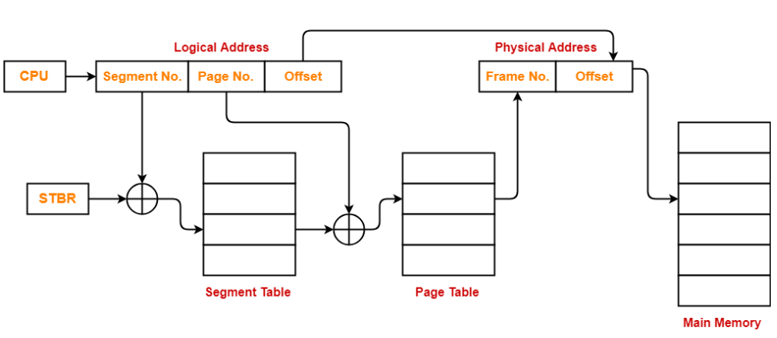
Memory Management Hardware…
Segmented-Page Mapping… The following diagram illustrates the above steps of translating logical address into physical address:

Slide 60
Memory Management Hardware…
Segmented-Page Mapping…
The segment number of the logical address specifies the address for the segment table.
The entry in segment table is a pointer address for a page table base.
The page table base is added to the page number given in the logical address.
The sum produces a pointer address to an entry in the page table.
The value found in the page table provides the block number in physical memory.
The concatenation of the block field with the word field produces the final physical mapped address.

Slide 61
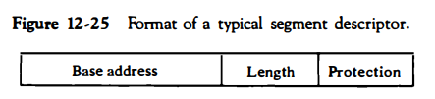
Memory Management Hardware…
Segmented-Page Mapping… The protection field in a segment descriptor specifies the access rights available to the segment. In a segmented-page organization, each entry in the page table may have its own protection field to describe the access rights of each page.
The protection information is set into the descriptor by the master control program of the operating system. Some of the access rights of interest that are used for protecting the programs residing in memory are:
  Full read and write privileges
  Read only (write protection)
  Execute only (program protection)
  System only (operating system protection).

Slide 62
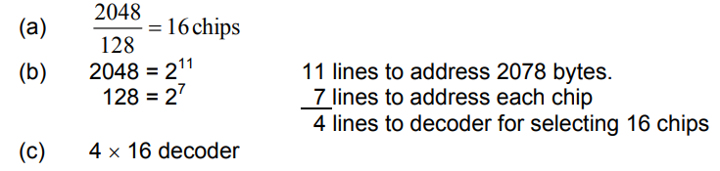
Memory Management Hardware…
Example-1:
(a) How many 128 x 8 RAM chips are needed to provide a memory capacity of 2048 bytes?
(b) How many lines of the address bus must be used to access 2048 bytes of memory? How many of these lines will be common to all chips?
(c) How many lines must be decoded for chip select? Specify the size of the decoders?

Slide 63
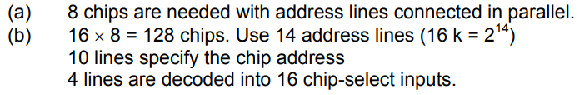
Memory Management Hardware…
Example-2: A computer uses RAM chips of 1024 x 1 capacity.
(a) How many chips are needed, and how should their address lines be connected to provide a memory capacity of 1024 bytes?
(b) How many chips are needed to provide a memory capacity of 16K bytes? Explain in words how the chips are to be connected to the address bus?

Slide 64
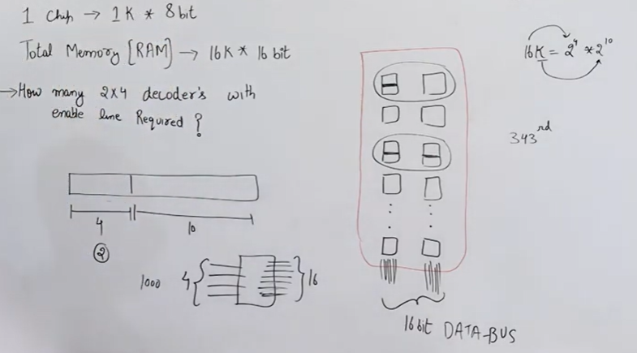
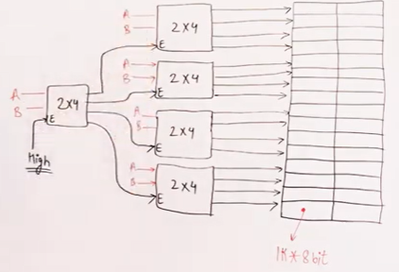
Memory Management Hardware…
Example-3: A RAM chip has a capacity of 1024 words of 8 bits each (1K x 8). Fine the number of 2x4 decoders with enable line needed to construct a 16K x 16 RAM from 1K x 8 RAM?
Ans: 5 decoder

Slide 65
END OF
UNIT-5
PART-1

