Slide 1
II-B.E. III-SEMESTER
COMPUTER ARCHITECTURE (CA)
Presented By
Dr. D. BASWARAJ
Professor, CSE DEPT.
VCE, HYDERABAD

Slide 2
SYLLABUS
UNIT – I:
Overview of Computer Function and Interconnection
Register Transfer Micro operations
UNIT – II:
Basic Computer organization and Design
Micro programmed Control
UNIT – III:
Central Processing Unit
Pipeline
Computer Arithmetic

Slide 3
SYLLABUS …
UNIT – IV:
Input-Output organization: Peripheral Devices, Input-Output Interface, Asynchronous Data Transfer, Modes of Transfer, Priority Interrupt, Direct Memory Access, Input-Output Processor (IOP), Serial Communication
UNIT – V:
Memory Organization: Memory Hierarchy, Main Memory, RAM and ROM, Auxiliary Memory, Associative Memory, Cache Memory, Virtual Memory, Memory Management Hardware.
Assessing and Understanding Performance: CPU Performance and its Factors, Evaluating Performance.

Slide 4
SYLLABUS …
Learning Resources:
M. Morris Mano, Computer System Architecture, 3rd Edition (2007), Pearson Education Asia.
William Stallings, Computer Organization & Architecture, 8th Edition (2011), Pearson Education Asia.
David A Patterson, John L Hennessy, Computer Organization and Design, 4th Edition (2014), Morgan Kaufmann.
Carl.V Hamacher, Vranesic Z.G, Zaky S.G, Computer Organization, 5th Edition (2011), McGraw Hill.
Pal Chaudhuri.P, Computer Organization and Design, , 3rd Edition(2009), Prentice Hall of India

Slide 5
UNIT-V
PART-1: Memory Organization
  Memory Hierarchy
  Main Memory
  RAM and ROM
  Auxiliary Memory
  Associative Memory
  Cache Memory
  Virtual Memory
  Memory Management Hardware
  PART-2: Assessing and Understanding Performance
  CPU Performance and its Factors
  Evaluating Performance.

Slide 6
1. CPU Performance and its Factors
Performance: When trying to choose among different computers, performance is one of the first key attributes that comes to mind.
Assessing the performance of computers can be quite challenging.
The scale and intricacy of modern software systems, together with the wide range of performance improvement techniques employed by hardware designers, have made performance assessment much more difficult.
When trying to choose among different computers, performance is an important attribute. Accurately measuring and comparing different computers is critical to purchasers and therefore to designers.
The rest of this section describes different ways in which performance can be determined; then, we describe the metrics for measuring performance from the viewpoint of both a computer user and a designer.

Slide 7
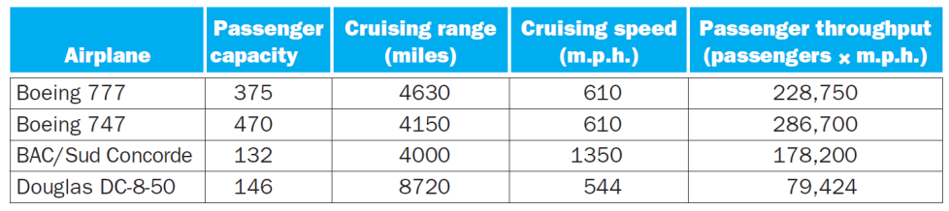
CPU Performance and its Factors…
Understanding Performance: When we say one computer has better performance than another, what do we mean? Consider an analogy with passenger airplanes shows how subtle the question of performance can be. Figure 1.13 shows some typical passenger airplanes, together with their cruising speed, range, and capacity.
If we wanted to know which of the planes in this table had the best performance. For example, considering different measures of performance, we see that the plane with the highest cruising speed is the Concorde, the plane with the longest range is the DC-8, and the plane with the largest capacity is the 747.

Slide 8
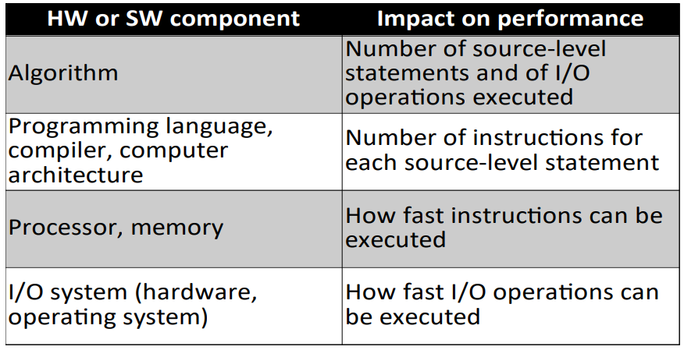
CPU Performance and its Factors…
Program Performance:
There are 2 distinct classes of performance metrics:
Performance metrics for processors – speed or the number of operations that it does in a certain period of time
Performance metrics for parallel applications – comparing the execution time with multiple processing units against the execution time with just one unit.

Slide 9
CPU Performance and its Factors…
How to define computer performance?
Basic criteria
  What do we need?
  What do we compare?
Basic metrics
  Execution time (response time / latency)
    Time to complete a particular task
    Important for users
  Throughput
    Amount of work completed in unit time
    Important for server or data center operators.

Slide 10
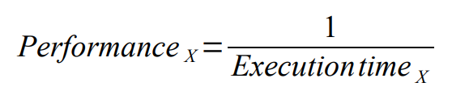
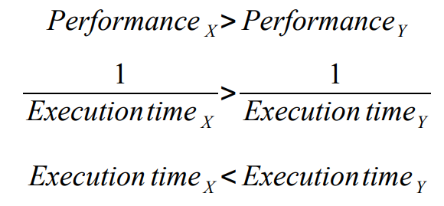
CPU Performance and its Factors…
How to define computer performance…
Performance based on execution time
  We desire higher number = higher performance
  Execution time is the opposite → needs fixing
Now we can compare performance

Slide 11
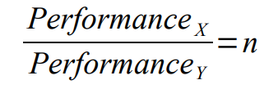
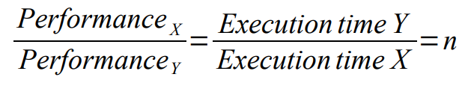
CPU Performance and its Factors…
How to define computer performance…
Relating performance of two computers
  X is n-times faster than Y
  If X is n-times faster than Y, then execution time on Y is n-times as long as on X (Relative performance)

Slide 12
CPU Performance and its Factors…
How to define computer performance…
Example-1: If computer A runs a program in 10 seconds and computer B runs the same program in 15 seconds, how much faster is A than B?
Solution:
The performance ratio is: 15 / 10 = 1.5
Therefore, A is 1.5 times faster than B.
Also, we could also say that B is 1.5 times slower that A

Slide 13
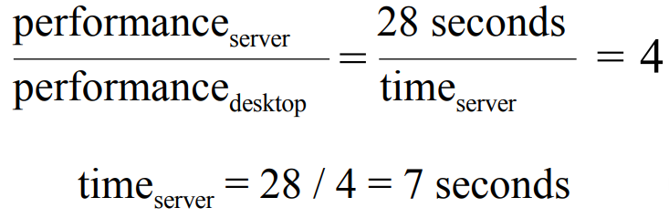
CPU Performance and its Factors…
How to define computer performance…
Example-2: A particular multiprocessor server machine’s performance is 4 times better than a given uniprocessor desktop system. If the desktop system runs an application in 28 seconds, how long will it take on the server??
Solution:
Example-3: If a particular desktop runs a program in 60 seconds and a laptop runs the same program in 75 seconds, how much faster is the desktop than the laptop?
Solution:

Slide 14
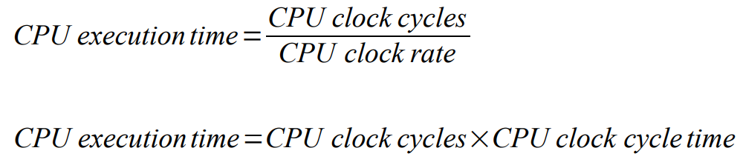
CPU Performance and its Factors…
CPU Performance and Its Factors:
To determine the CPU execution time for a program, you can find out the total number of clock cycles that the program takes and multiply it by the clock cycle time.
Each program is made up of a number of instructions and each instruction takes a number of clock cycles to execute.
A simple formula relates the most basic metrics (clock cycles and clock cycle time) to CPU time:

Slide 15
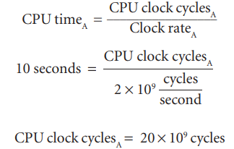
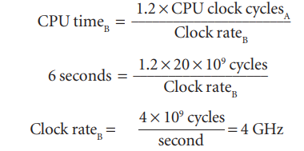
CPU Performance and its Factors…
How to define computer performance…
Example-4: A program runs in 10s on computer A, which has a 2 GHz clock. We are trying to build a computer, B, which will run same program in 6 seconds. For this, CPU design, causing computer B to require 1.2 times as many clock cycles as computer A. What clock rate should we tell the designer to target?
Solution: To run the program in 6 seconds, B must have twice the clock rate of A.

Slide 16

CPU Performance and its Factors…
Instruction Performance: compiler perspective
Since the compiler clearly generated instructions to execute, and the computer had to execute the instructions to run the program, the execution time must depend on the number of instructions in a program.
One way to think about execution time is that it equals the number of instructions executed multiplied by the average time per instruction. Therefore, the number of clock cycles required for a program can be written as:
The term clock cycles per instruction, which is the average number of clock cycles each instruction takes to execute, is often abbreviated as CPI.

Slide 17
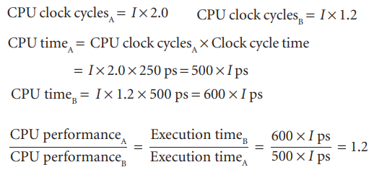
CPU Performance and its Factors…
Instruction Performance: compiler perspective…
Example-5: Suppose we have two implementations of the same instruction set architecture. Computer A has a clock cycle time of 250 ps and a CPI of 2.0 for some program, and computer B has a clock cycle time of 500 ps and a CPI of 1.2 for the same program. Which computer is faster for this program and by how much?
Solution: Let I indicates number of instructions; We can conclude that computer A is 1.2 times as fast as computer B for this program.

Slide 18
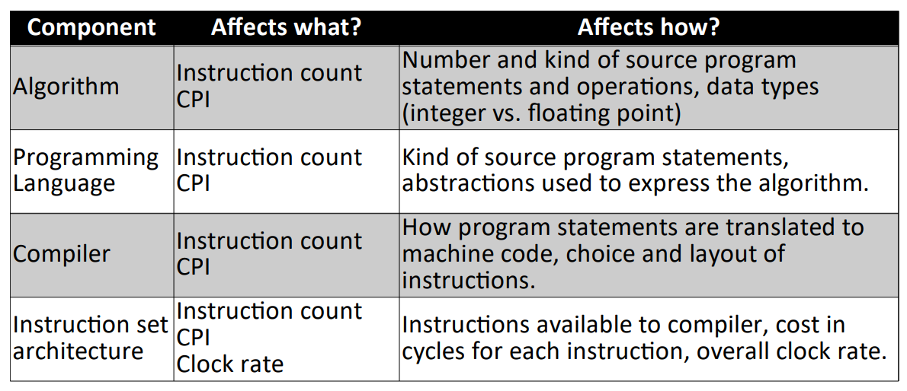
CPU Performance and its Factors…
Program performance:

Slide 19
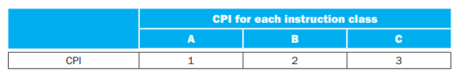
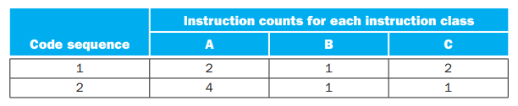
CPU Performance and its Factors…
Program performance: Example-6
A compiler designer is trying to decide between two code sequences for a particular computer. The hardware designers have supplied the following facts:
Which code sequence executes the most instructions? Which will be faster? What is the CPI for each sequence?

Slide 20


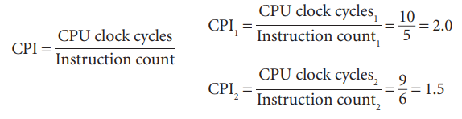
CPU Performance and its Factors…
Program performance: Example-6
Solution: Sequence 1 executes 2 + 1 + 2 = 5 instructions. Sequence 2 executes 4 + 1 + 1 = 6 instructions. Therefore, sequence 1 executes fewer instructions.
We can use the equation for CPU clock cycles based on instruction count and CPI to find the total number of clock cycles for each sequence:
So, code sequence 2 is faster, even though it executes one extra instruction. Since code sequence 2 takes fewer overall clock cycles but has more instructions, it must have a lower CPI. The CPI values can be computed by

Slide 21
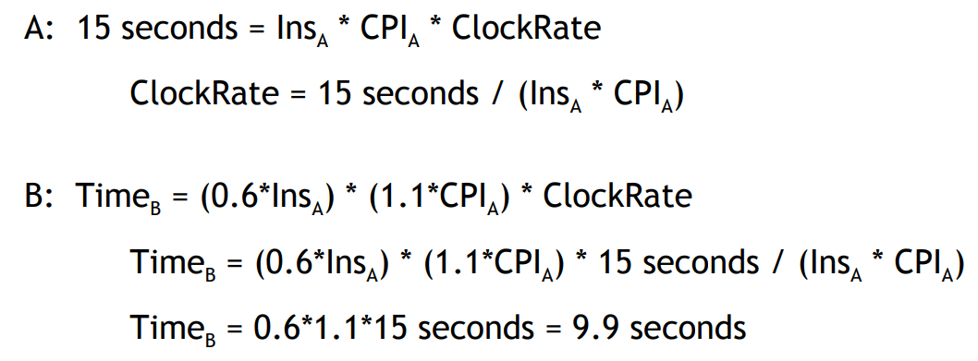
CPU Performance and its Factors…
Program performance: Example-7
A given application written in Java runs 15 seconds on a desktop processor. A new Java compiler is released that requires only 0.6 times as many instructions as the old compiler. Unfortunately, it increases the CPI by 1.1. How fast can we expect the application to run using this new compiler?
Solution:

Slide 22
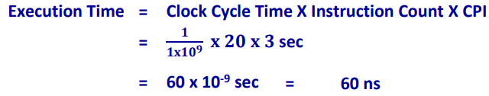
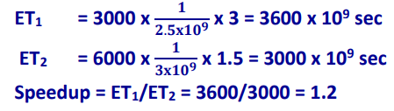
CPU Performance and its Factors…
Example-8: A machine has a CPI of 3, and a single program requires 20 instructions to execute. What will be the execution time if the clock frequency of the machine is 1GHz??
Example-9: Consider a machine with a clock frequency of 2.5 GHz executing 3000 instructions with an average CPI of 3. Suppose we use a new compiler on the same program for which the new instruction count is 6000, and a new CPI is 1.5, running on a faster machine with a clock rate of 3 GHz. What will be the speedup achieved?

Slide 23
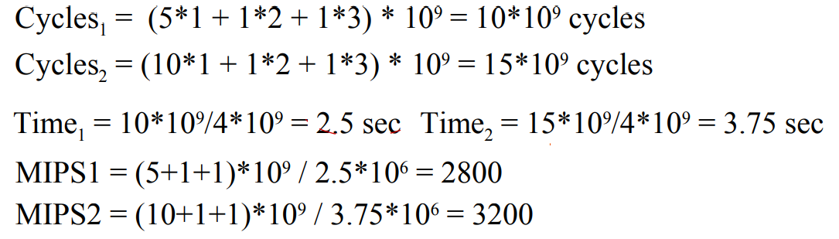
CPU Performance and its Factors…
MIPS performance: Million instructions per second is an alternative metric for performance.
MIPS = Instructions / (Time * 10⁶) = Clock Rate / CPI
Example-10: Given the following tables of instruction counts (in billions) and CPI for each instruction class, find the MIPS and execution times on a 4GHz machine?
Solution:
Class | A | B | C
CPI | 1 | 2 | 3
Sequence | A | B | C
1 | 5 | 1 | 1
2 | 10 | 1 | 1

Slide 24
2. Evaluating Performance
Comparing performance of different computers
  Easy for one specific program (processor execution time)
  Comparing isolated components (clock rate, CPI, number of instructions) not indicative for other programs
  How to approximate performance with respect to a set of programs?
Workload
  A set of programs and tasks capturing a user’s workload
  Compare execution time of the workload on different computers
  Difficult to define (domain specific)
  Difficult to automate (repeated execution)

Slide 25
Evaluating Performance…
Benchmark
  Program specifically made to measure performance
  Set of benchmarks
    Statistically relevant representative of a typical workload
    Hoping that benchmark results will reflect how well a computer will perform with the user’s workload
Which program shall be used to evaluate performance
  Best one: real workload in your daily life
    It is not easy for everyone
  Alternative: benchmark
    To predict the performance of the real workload

Slide 26
Evaluating Performance…
Application-oriented Benchmarks
  CPU performance
    SPEC, for scientific applications
  Server performance
    Focus on throughput, response time to individual events
    SPECweb99
  Graphics performance
    3D Mark
  Embedded computing
    EEMBC
    Automatic, consumer, networking, office automation, telecommunication
  Other research oriented
    MediaBench
    CommBench

Slide 27
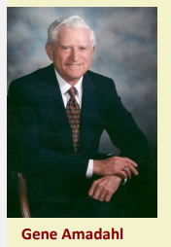
Evaluating Performance…
Amdahl's Law
It is named after computer scientist Gene Amdahl (a computer architect from IBM and Amdahl corporation). It is also known as Amdahl’s argument.
It is a formula that gives the theoretical speedup in latency of the execution of a task at a fixed workload that can be expected of a system whose resources are improved.
In other words, it can be used to find the maximum expected improvement of an overall system when only part of the system is improved.
It is often used in parallel computing to predict the theoretical speedup when using multiple processors.

Slide 28
Evaluating Performance…
Amdahl's Law…If Pe - is the performance for the entire task using the enhancement, when possible, Pw - is the performance for the entire task without using the enhancement, Ew - is the execution time for the entire task without using the enhancement and Ee - is the execution time for the entire task using the enhancement, when possible, then,
Speedup = Pe/Pw = Ew/Ee .
This law uses 2 factors to find speedup from some enhancement:
Fraction enhanced – The fraction of the computation time in the original computer that can be converted to take advantage of the enhancement.
Speedup enhanced – The improvement gained by the enhanced execution mode; that is, how much faster the task would run if the enhanced mode were used for the entire program

Slide 29
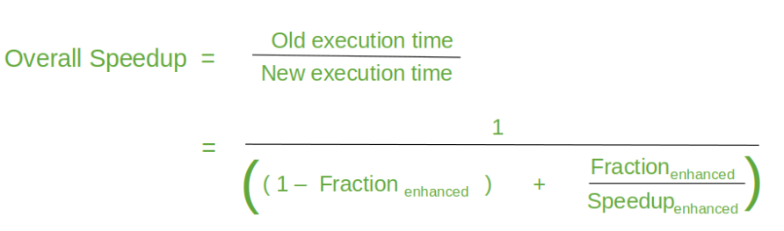
Evaluating Performance…
Amdahl's Law…The overall Speedup is the ratio of the execution time:
Amdahl’s law is a principle that states that the maximum potential improvement to the performance of a system is limited by the portion of the system that cannot be improved. In other words, the performance improvement of a system as a whole is limited by its bottlenecks.
The formula for Amdahl’s law: S = 1 / ((1 – P) + (P / N))
Where: S is the speedup of the system, P is the proportion of the system that can be improved, N is the number of processors in the system

Slide 30
Evaluating Performance…
Example-1: If a system has a single bottleneck that occupies 20% of the total execution time, and we add 4 more processors to the system, find the speedup?
Solution: The formula for Amdahl’s law: S = 1 / ((1 – P) + (P / N))
S = 1 / ((1 – 0.2) + (0.2 / 5))
S = 1 / (0.8 + 0.04)
S = 1 / 0.84
S = 1.19
This means that the overall performance of the system would improve by about 19% with the addition of the 4 processors.

Slide 31
Evaluating Performance…
Example-2: The execution time of a program on a machine is found to be 50 seconds, out of which 42 seconds is consumed by multiply operations. It is required to make the program run 5 times faster. By how much must the speed of the multiplier be improved?
Solution: The formula for Amdahl’s law: S = 1 / ((1 – P) + (P / N))
Here, P = 42 / 50 = 0.84, S = 5
5 = 1 / ((1 – 0.84) + (0.84 / N)) N =21
Example-3: The execution time of a program on a machine is found to be 50 seconds, out of which 42 seconds is consumed by multiply operations. It is required to make the program run 8 times faster. By how much must the speed of the multiplier be improved?
Solution: Here, P = 42 / 50 = 0.84, S = 8
8 = 1 / ((1-0.84) + (0.84 / N)) N = -24
No amount to speed improvement in the multiplier can achieve this. Maximum speedup achievable: 1 / (1-P) = 1 / 1-0.84 = 6.25

Slide 32
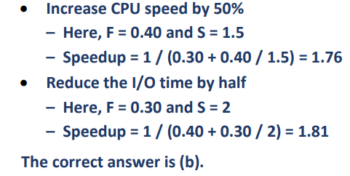
Evaluating Performance…
Example-3: The total execution time of a typical program is made up of 40% CPU time and 30% I/O time. Which of the following alternatives is better? Assume that there is no overlap between CPU and I/O operations.
a. Increase the CPU speed by 50%.
b. Reduce the I/O time by half.
c. Both alternatives give the same speedup.
Solution: Amdahl’s law: S = 1 / ((1 – P) + (P / N))

Slide 33
END OF
UNIT-5
PART-2

