Slide 1
4-2 Functions in C
In C, the idea of top–down design is done using functions. A C program is made of one or more functions, one and only one of which must be named
main.
In general, the purpose of a function is to receive zero or more pieces of data, operate on them, and return at most one piece of data. At the same time, a function can have a side effect. A function side effect is an action that results in a change in the state of the program.
Computer Science: A Structured Programming Approach Using C

Slide 2
Note
In C, a program is made of one or more functions, one and only one of which must be called main.
The execution of the program always starts
with main, but it can call other functions
to do some part of the job.
Computer Science: A Structured Programming Approach Using C

Slide 3
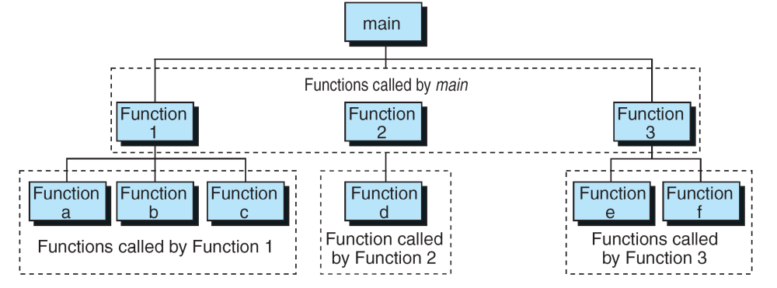
FIGURE 4-3 Structure Chart for a C Program
Computer Science: A Structured Programming Approach Using C

Slide 4
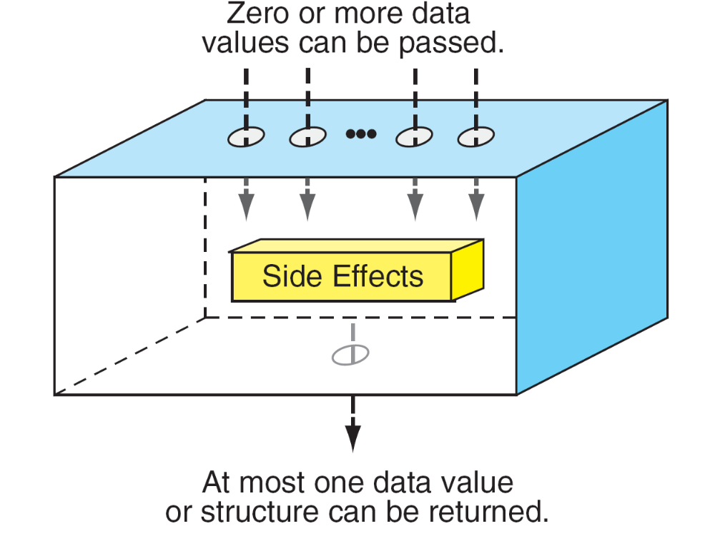
FIGURE 4-4 Function Concept
Computer Science: A Structured Programming Approach Using C

Slide 5
Note
A function in C can have a return value,
a side effect, or both.
The side effect occurs before the value is returned. The function’s value is the value in the expression of
the return statement. A function can be called
for its value, its side effect, or both.
Computer Science: A Structured Programming Approach Using C

Slide 6
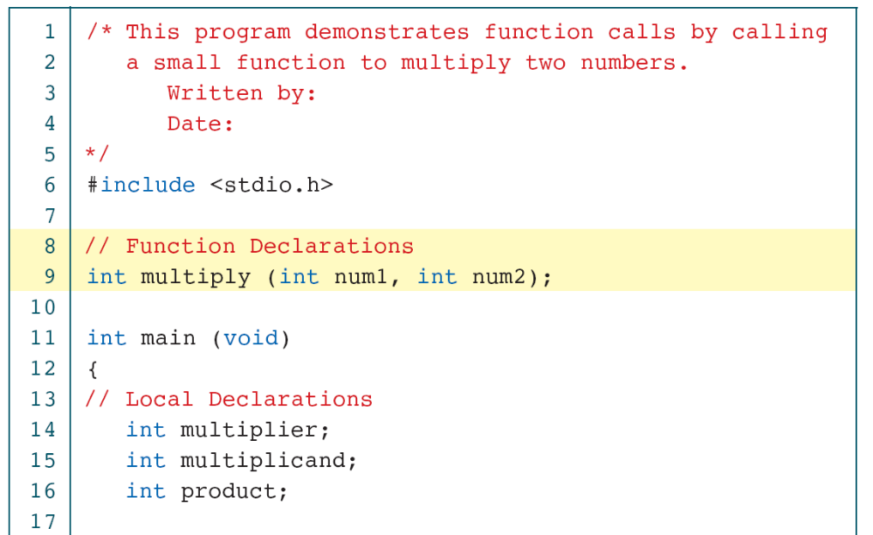
PROGRAM 4-1
Sample Program with Subfunction
Computer Science: A Structured Programming Approach Using C

Slide 7
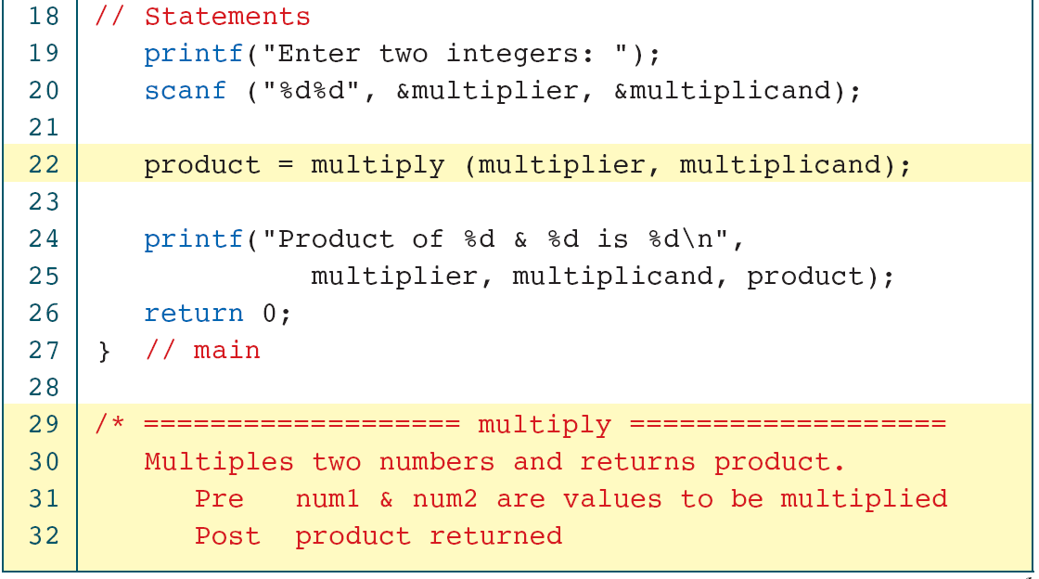
PROGRAM 4-1
Sample Program with Subfunction
Computer Science: A Structured Programming Approach Using C

Slide 8
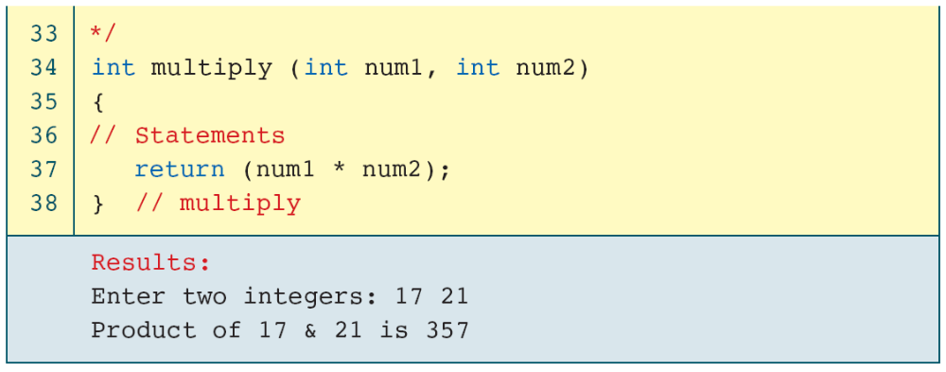
PROGRAM 4-1
Sample Program with Subfunction
Computer Science: A Structured Programming Approach Using C

Slide 9
4-3 User-Defined Functions
Like every other object in C, functions must be both declared and defined. The function declaration gives the whole picture of the function that needs to be defined later. The function definition contains the code for a function.
Topics discussed in this section:
Basic Function Designs
Function Definition
Function Declaration
The Function Call
Computer Science: A Structured Programming Approach Using C

Slide 10
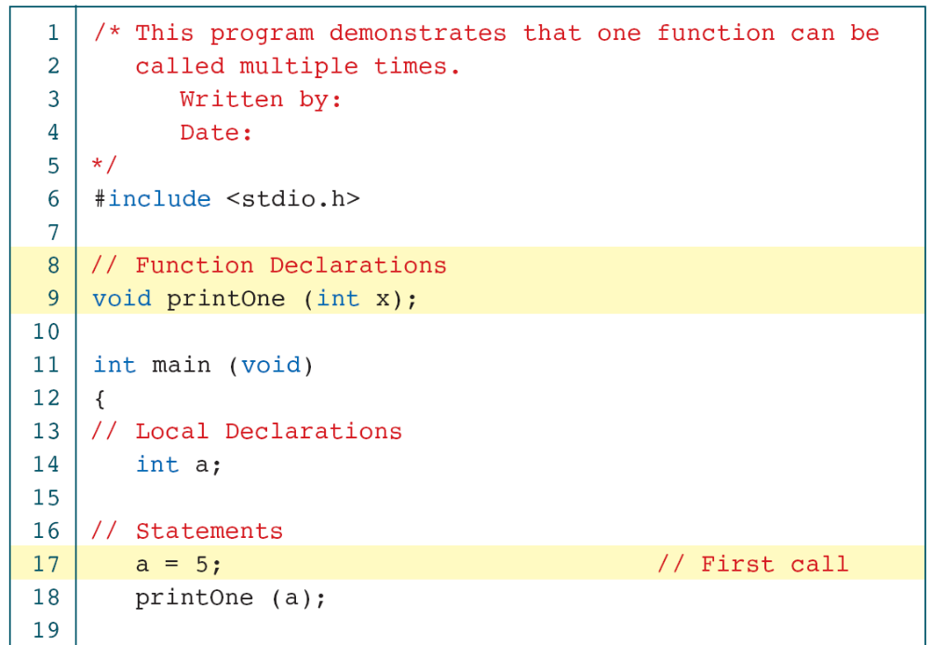
PROGRAM 4-2
void Function with a Parameter
Computer Science: A Structured Programming Approach Using C

Slide 11
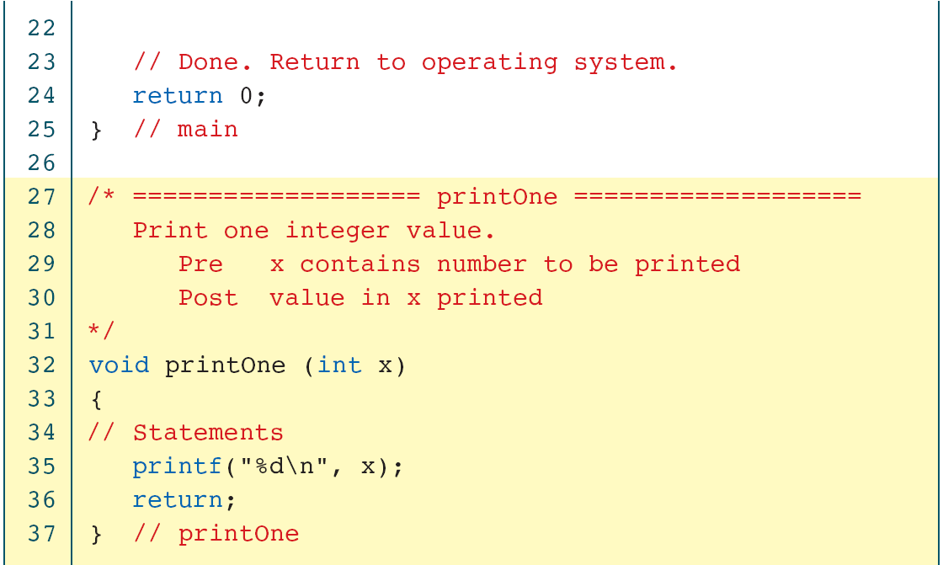
PROGRAM 4-2
void Function with a Parameter
Computer Science: A Structured Programming Approach Using C

Slide 12
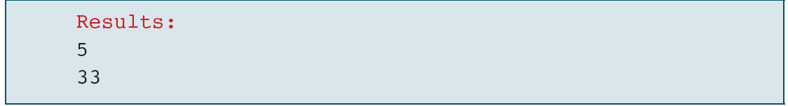
PROGRAM 4-2
void Function with a Parameter
Computer Science: A Structured Programming Approach Using C

Slide 13
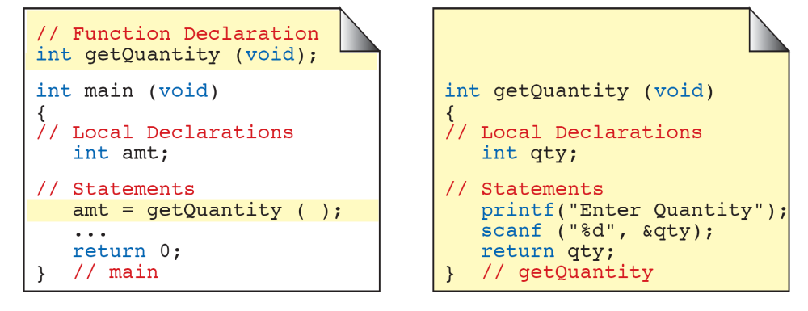
FIGURE 4-7 Non-void Function without Parameters
Computer Science: A Structured Programming Approach Using C

Slide 14
FIGURE 4-8 Calling a Function That Returns a Value
Computer Science: A Structured Programming Approach Using C

Slide 15
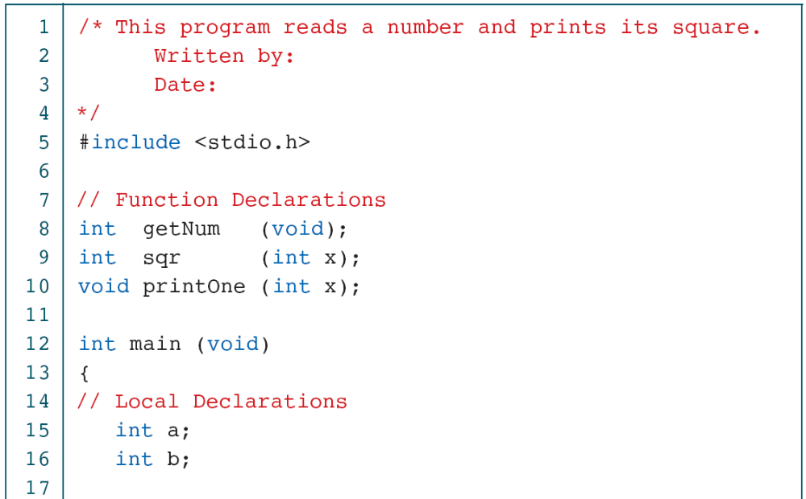
PROGRAM 4-3
Read a Number and Square It
Computer Science: A Structured Programming Approach Using C

Slide 16
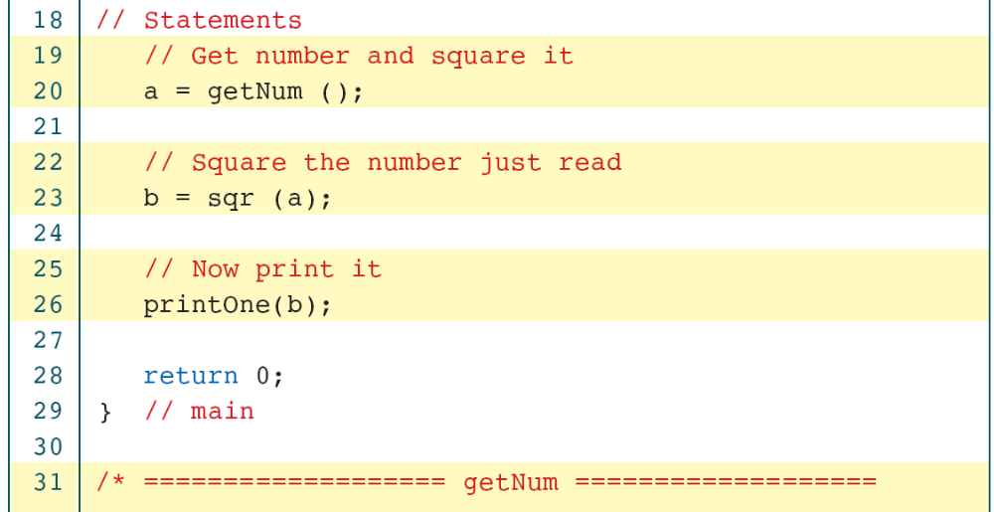
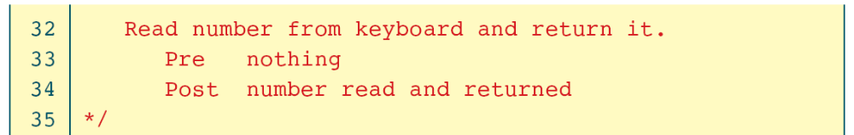
PROGRAM 4-3
Read a Number and Square It
Computer Science: A Structured Programming Approach Using C

Slide 17
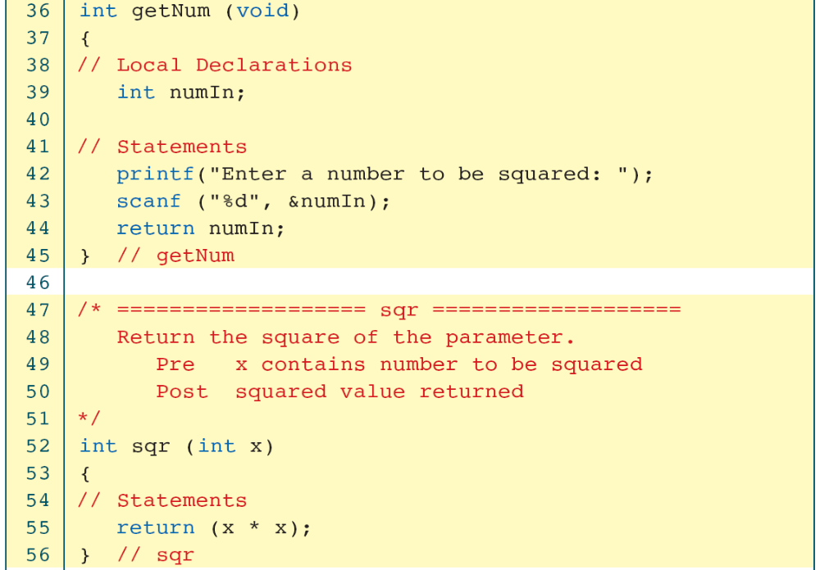
PROGRAM 4-3
Read a Number and Square It
Computer Science: A Structured Programming Approach Using C

Slide 18
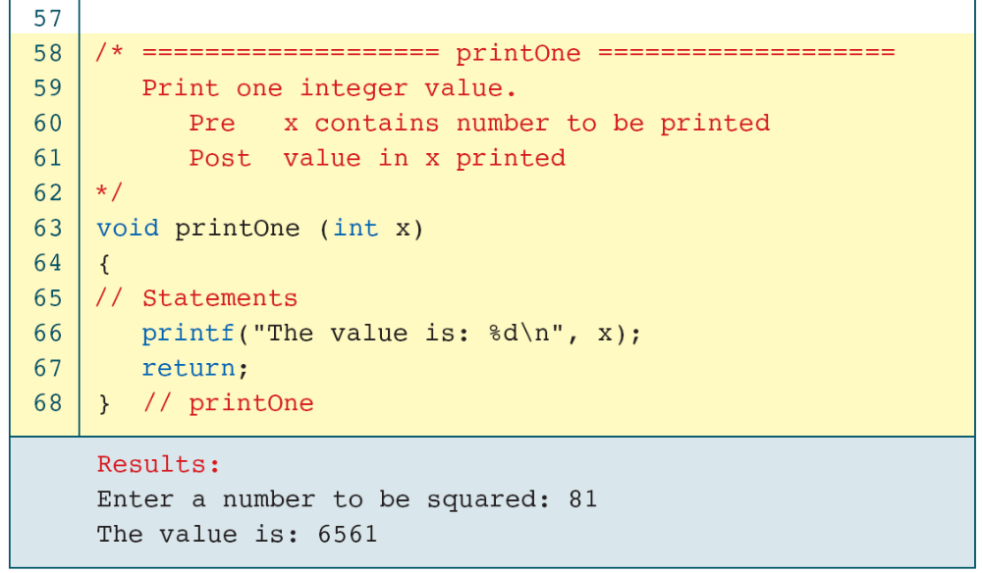
PROGRAM 4-3
Read a Number and Square It
Computer Science: A Structured Programming Approach Using C

Slide 19
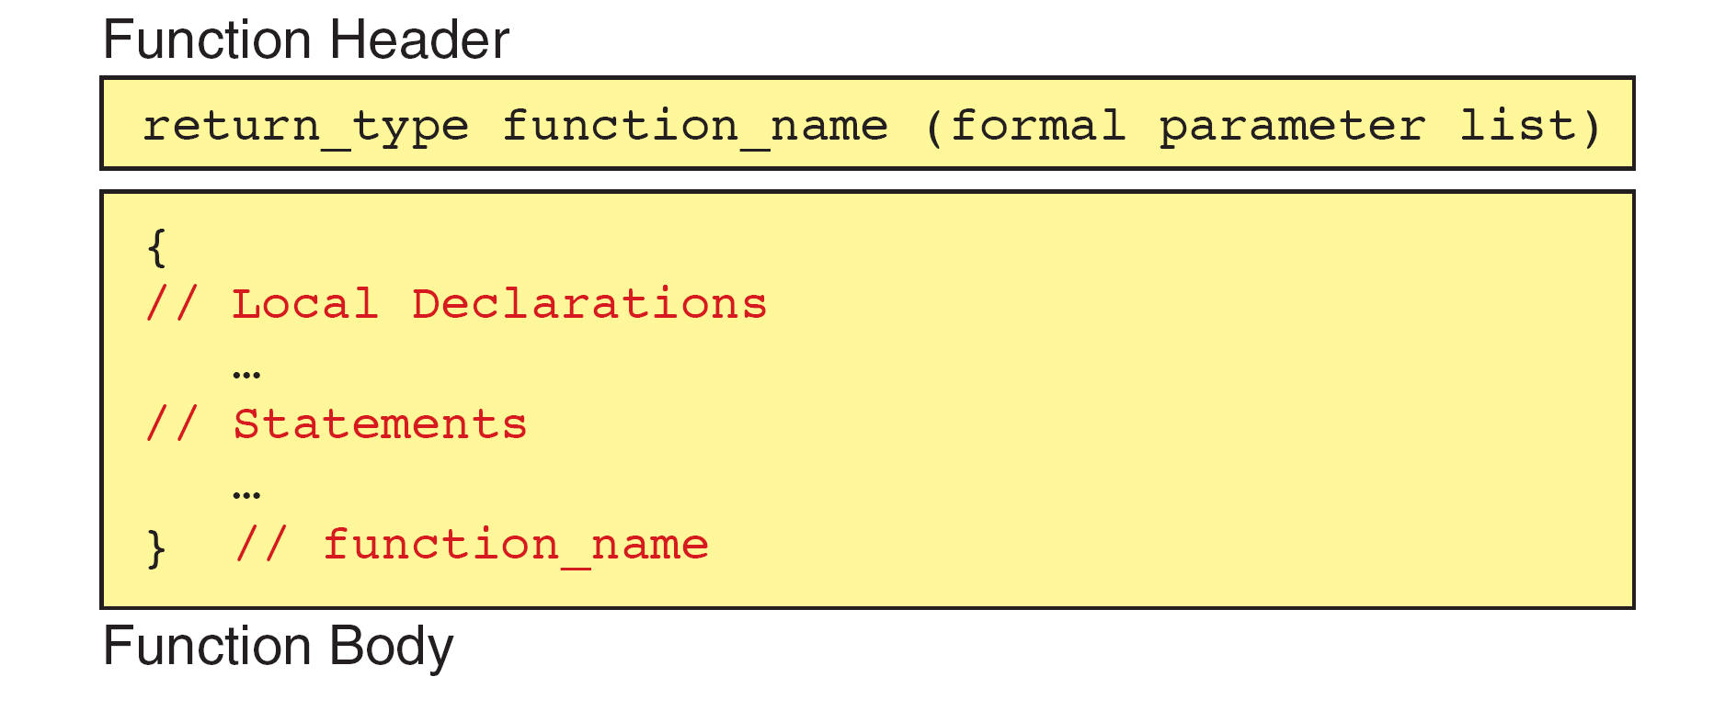
FIGURE 4-9 Function Definition
Computer Science: A Structured Programming Approach Using C

