Slide 1
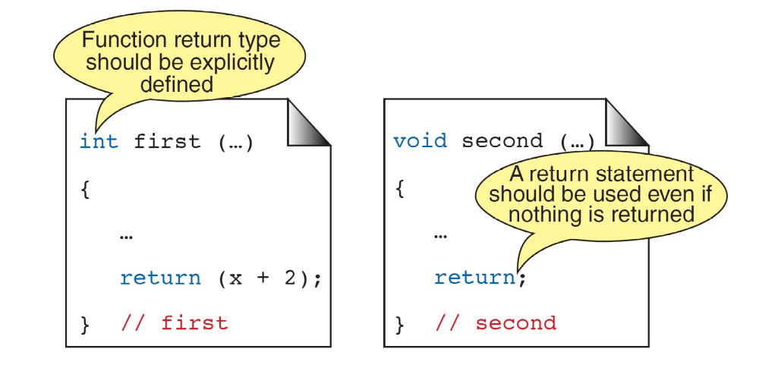
FIGURE 4-10 Function Return Statements

Slide 2
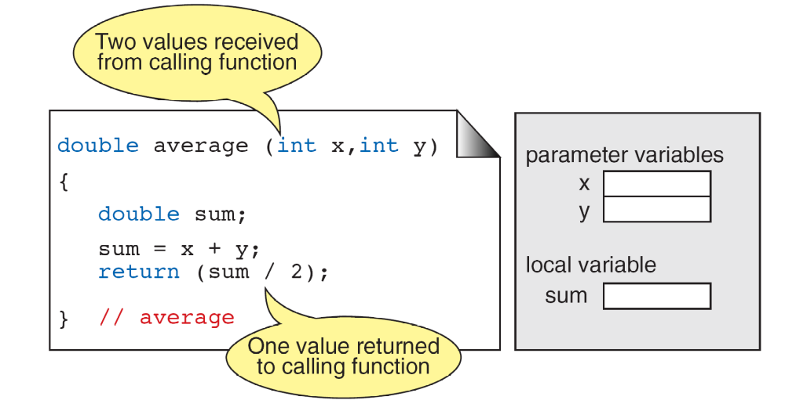
FIGURE 4-11 Function Local Variables

Slide 3
Note
Formal and Actual Parameters
Formal parameters are variables that are declared in the header of the function definition.
Actual parameters are the expressions in the calling statement.
Formal and actual parameters must match exactly in type, order, and number.
Their names, however, do not need to match.

Slide 4
FIGURE 4-12 Parts of a Function Call

Slide 5
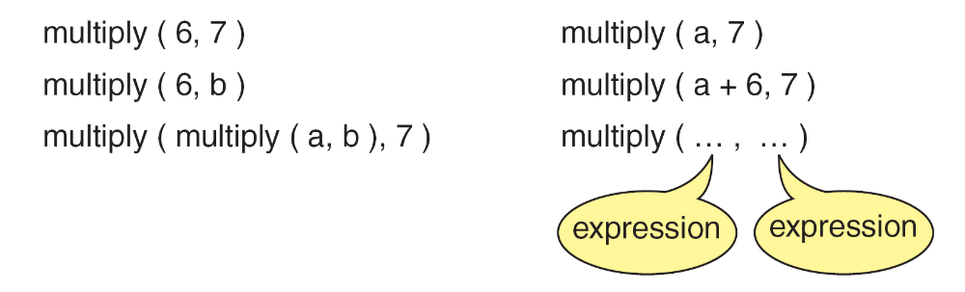
FIGURE 4-13 Examples of Function Calls

Slide 6
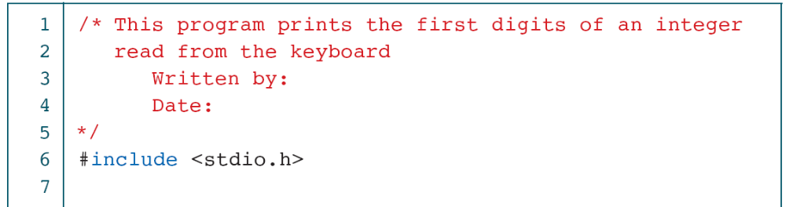
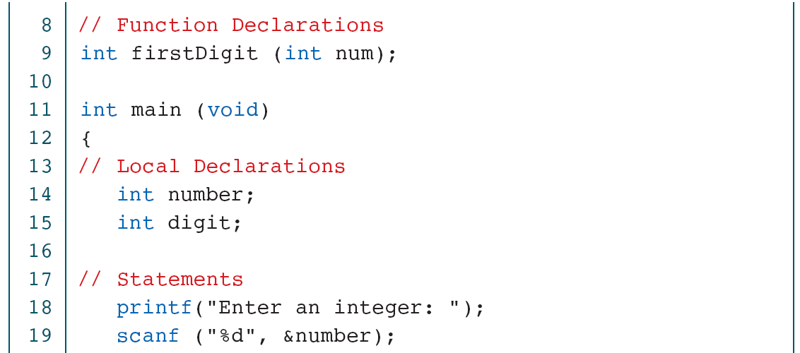
PROGRAM 4-4
Print Least Significant Digit

Slide 7
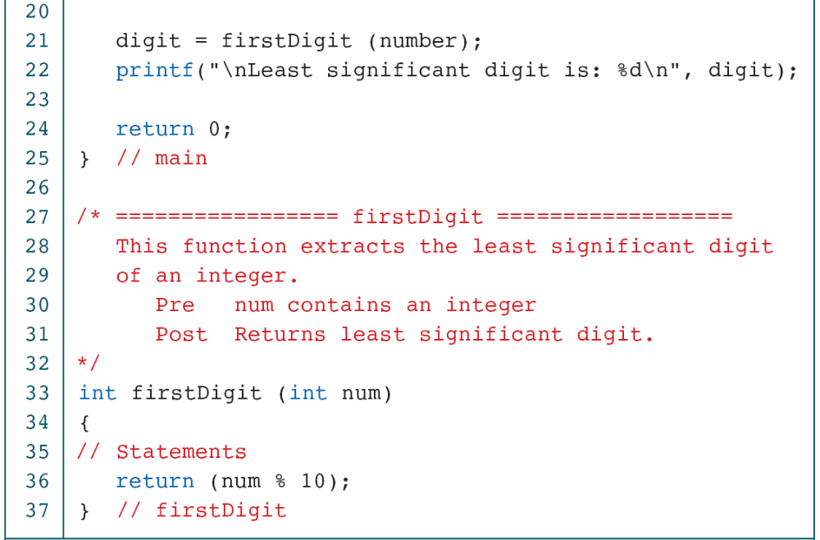
PROGRAM 4-4
Print Least Significant Digit

Slide 8
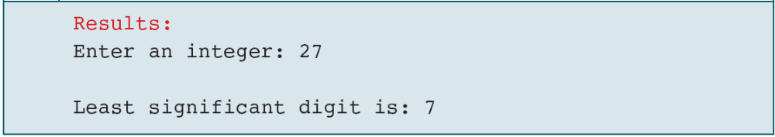
PROGRAM 4-4
Print Least Significant Digit

Slide 9
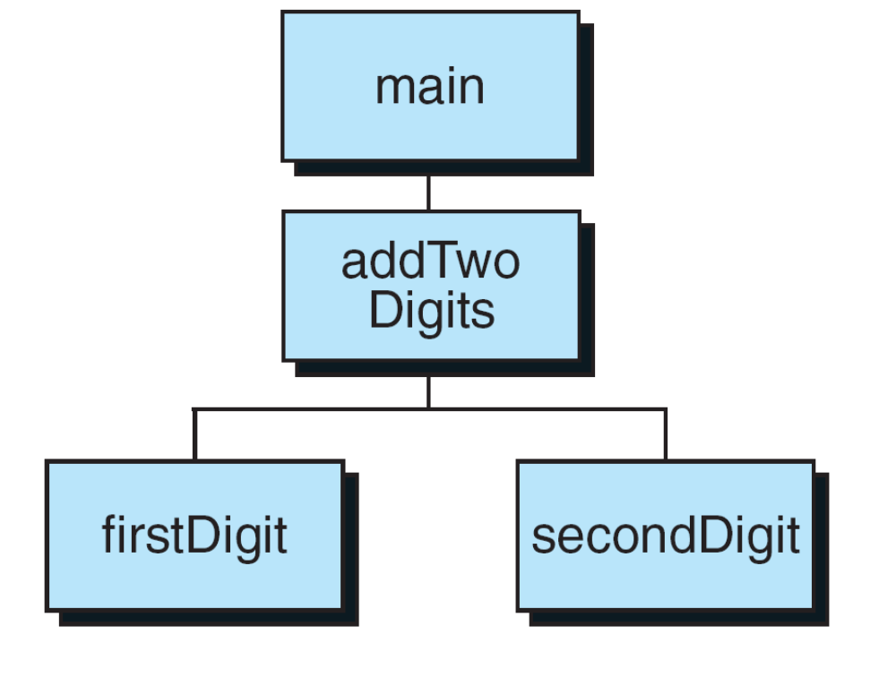
FIGURE 4-14 Design for Add Two Digits

Slide 10
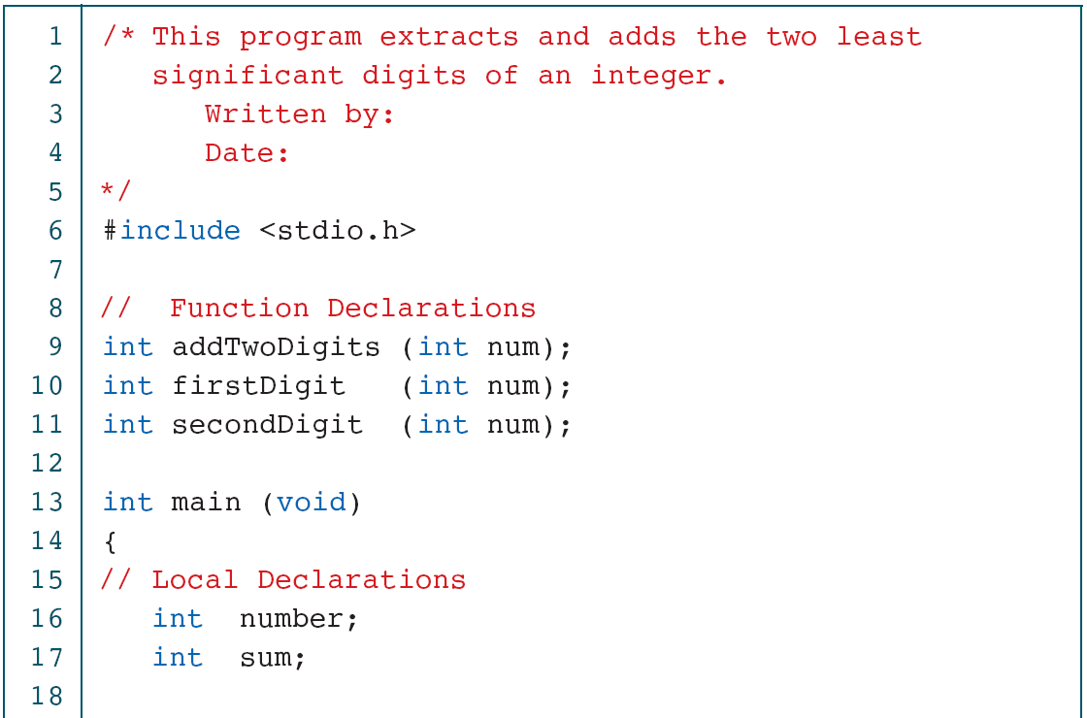
PROGRAM 4-5
Add Two Digits

Slide 11
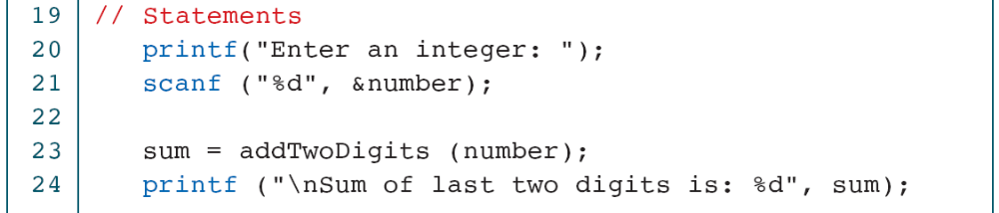
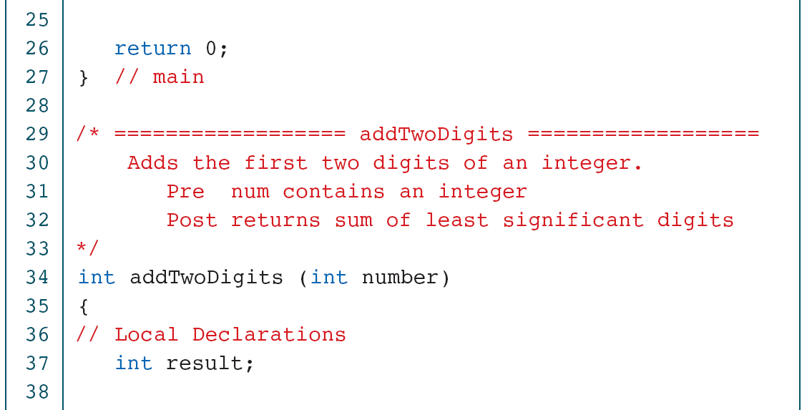
PROGRAM 4-5
Add Two Digits

Slide 12
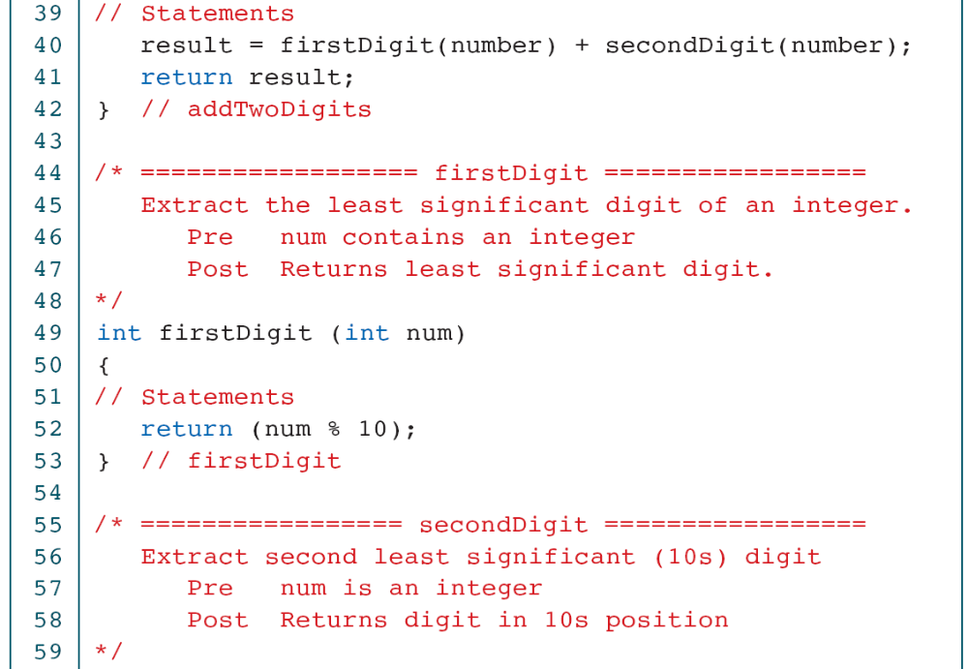
PROGRAM 4-5
Add Two Digits

Slide 13
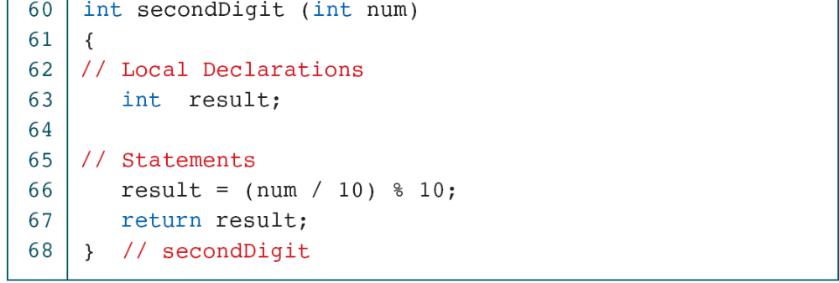
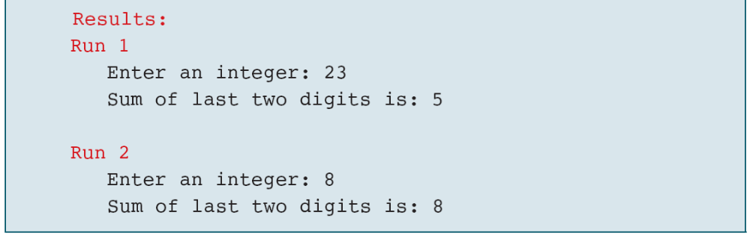
PROGRAM 4-5
Add Two Digits

Slide 14
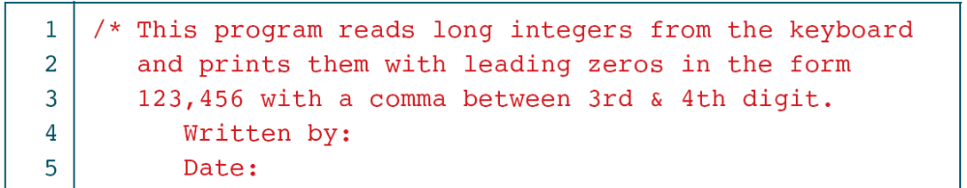
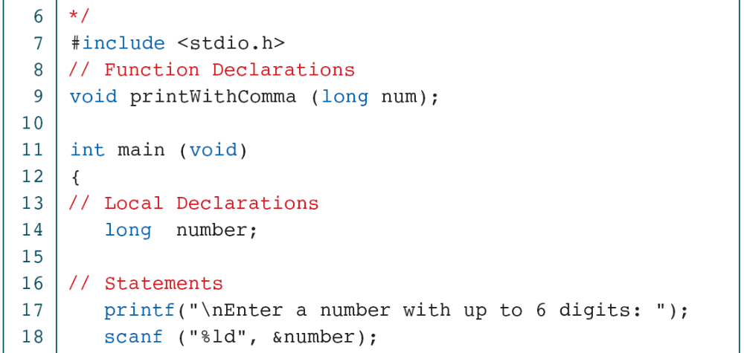
PROGRAM 4-6
Print Six Digits with Comma

Slide 15
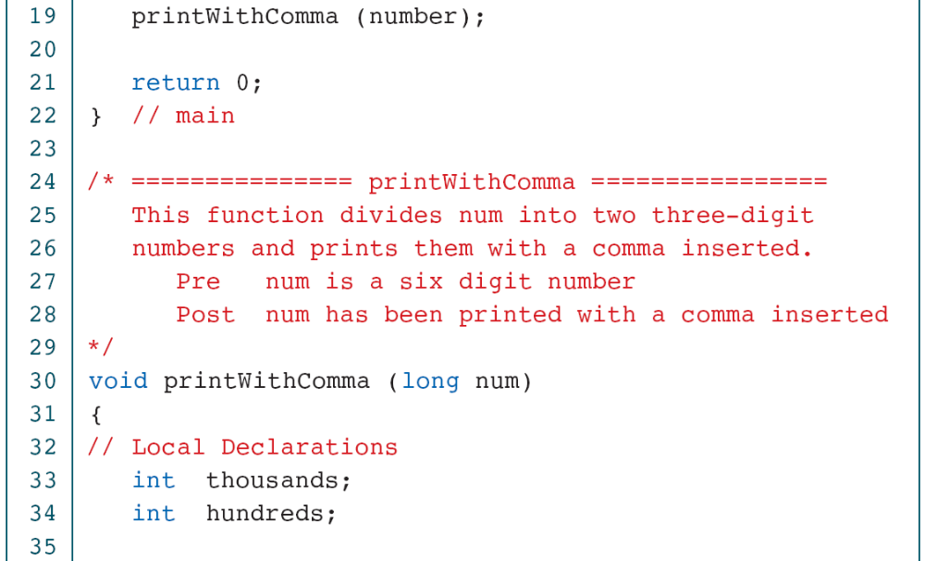
PROGRAM 4-6
Print Six Digits with Comma

Slide 16
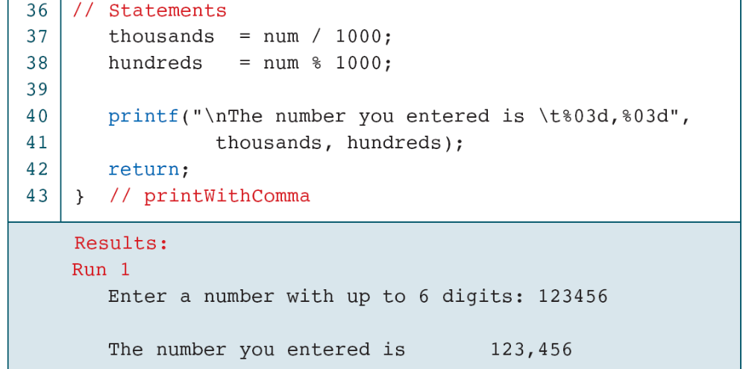
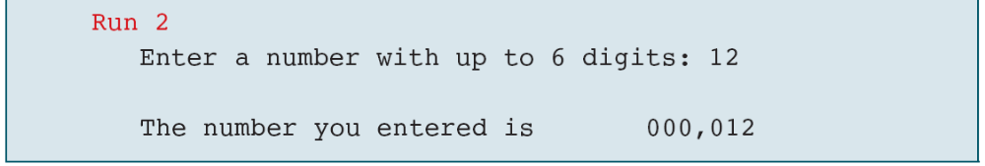
PROGRAM 4-6
Print Six Digits with Comma

Slide 17
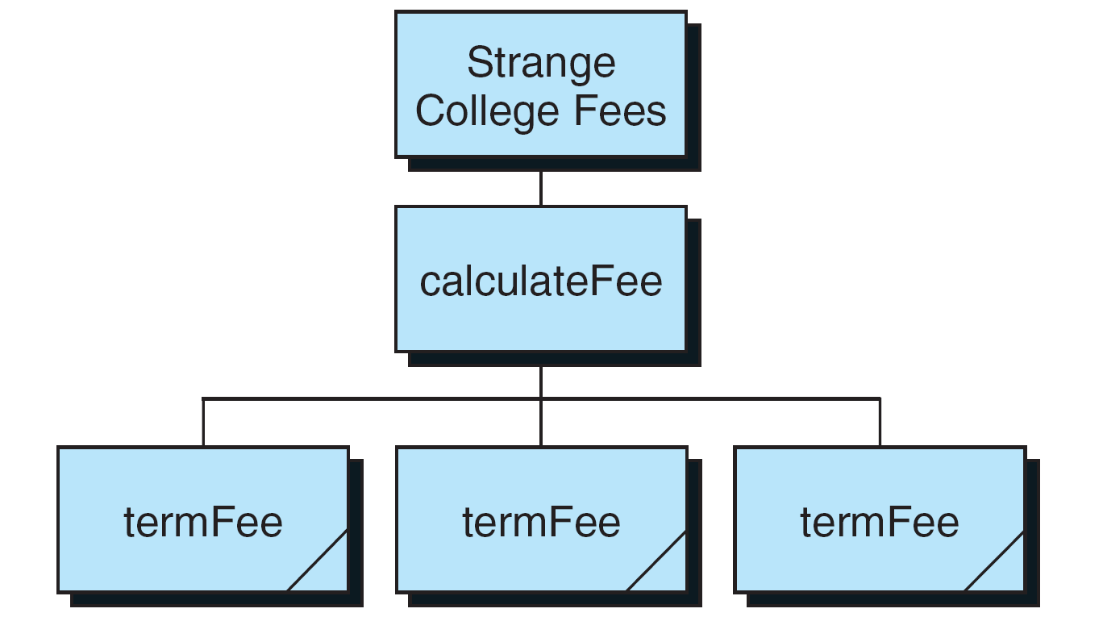
FIGURE 4-15 Design for Strange College fees

Slide 18
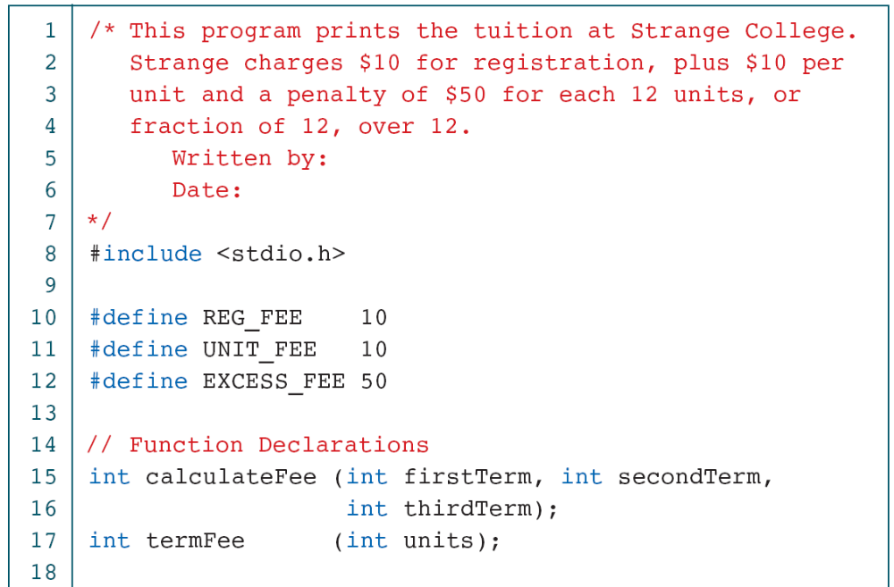
PROGRAM 4-7
Strange College Fees

Slide 19
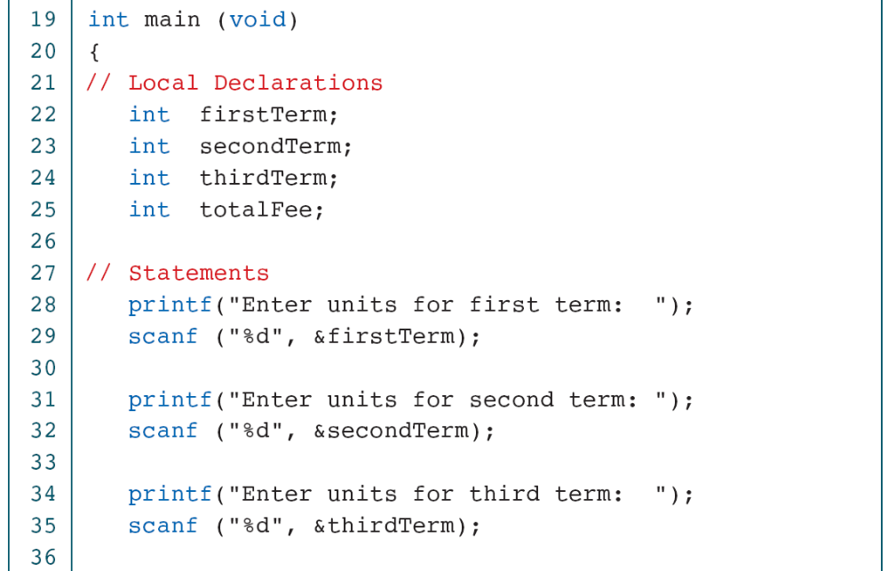
PROGRAM 4-7
Strange College Fees

Slide 20
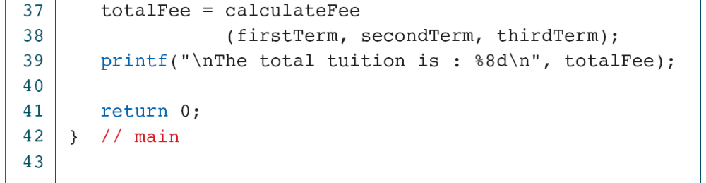
PROGRAM 4-7
Strange College Fees

Slide 21
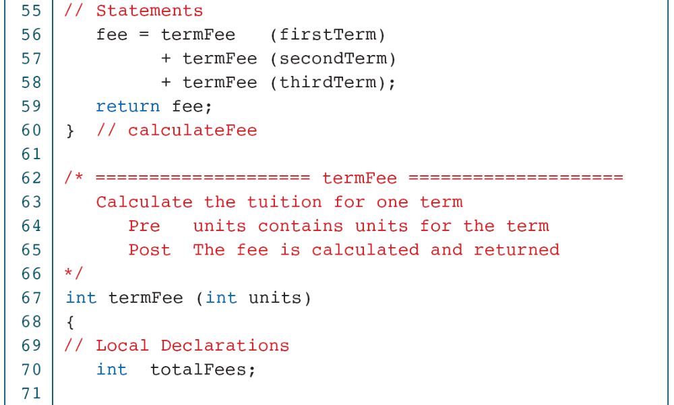
PROGRAM 4-7
Strange College Fees

Slide 22
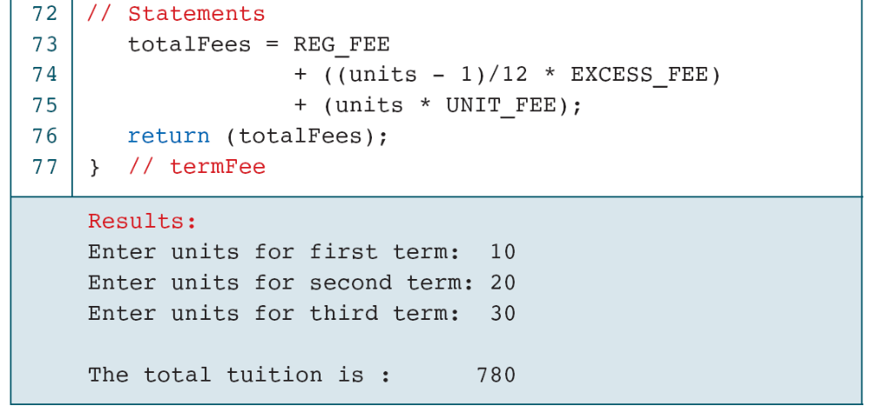
PROGRAM 4-7
Strange College Fees

