Slide 1
4-4 Inter-Function Communication
Although the calling and called functions are two separate entities, they need to communicate to exchange data. The data flow between the calling and called functions can be divided into three strategies: a downward flow, an upward flow, and a bi-directional flow.
Topics discussed in this section:
Basic Concept
C Implementation
Computer Science: A Structured Programming Approach Using C

Slide 2
Note
The C language uses only call by value and return to achieve different types of communications between
a calling and a called function.
Call by value: value of parameter is passed,
so changes made to parameter in function are
not reflected in the calling function.
Computer Science: A Structured Programming Approach Using C

Slide 3
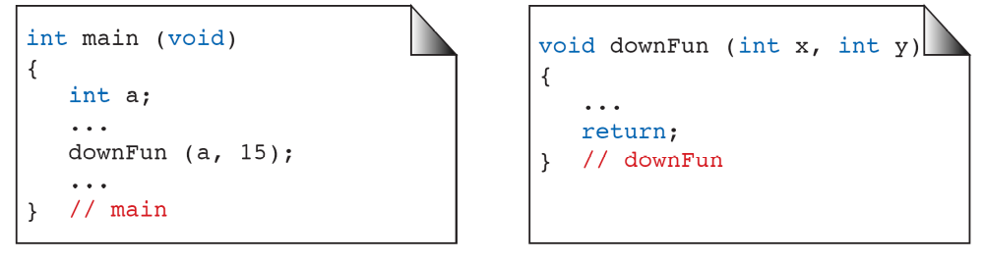
FIGURE 4-17 Downward Communication in C
Computer Science: A Structured Programming Approach Using C

Slide 4
FIGURE 4-18 Downward Communication
Computer Science: A Structured Programming Approach Using C

Slide 5
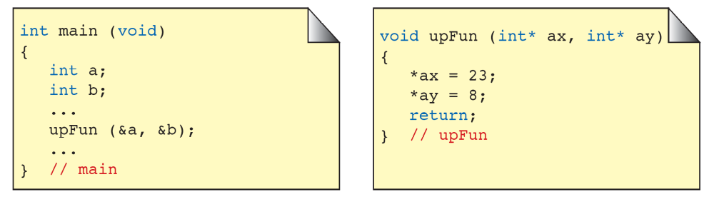
FIGURE 4-19 Upward Communication in C
Computer Science: A Structured Programming Approach Using C

Slide 6
FIGURE 4-20 Upward Communication
Computer Science: A Structured Programming Approach Using C

Slide 7
Note
To send data from the called function to the calling function:
1. We need to use the & symbol in front of the data variable
when we call the function.
2. We need to use the * symbol after the data type when we
declare the address variable
3. We need to use the * in front of the variable when we
store data indirectly
Computer Science: A Structured Programming Approach Using C

Slide 8
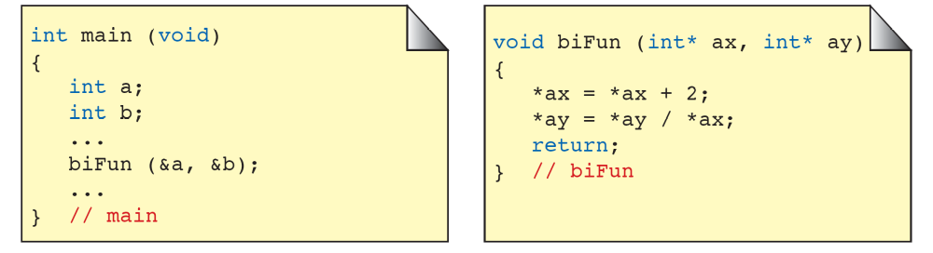
FIGURE 4-21 Bi-directional Communication in C
Computer Science: A Structured Programming Approach Using C

Slide 9
1
FIGURE 4-22 Bi-directional Communication
Computer Science: A Structured Programming Approach Using C

Slide 10
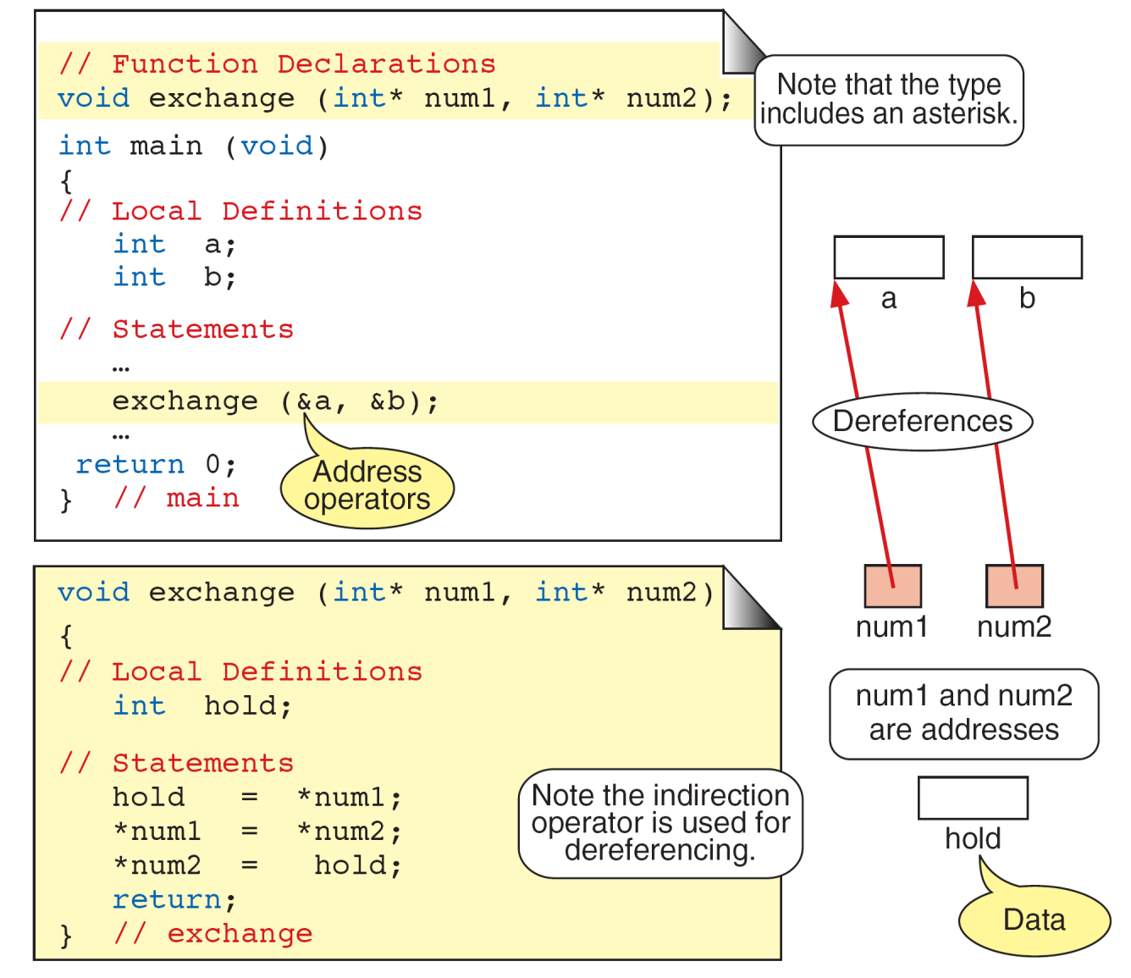
FIGURE 4-23 Exchange Function
Computer Science: A Structured Programming Approach Using C

Slide 11
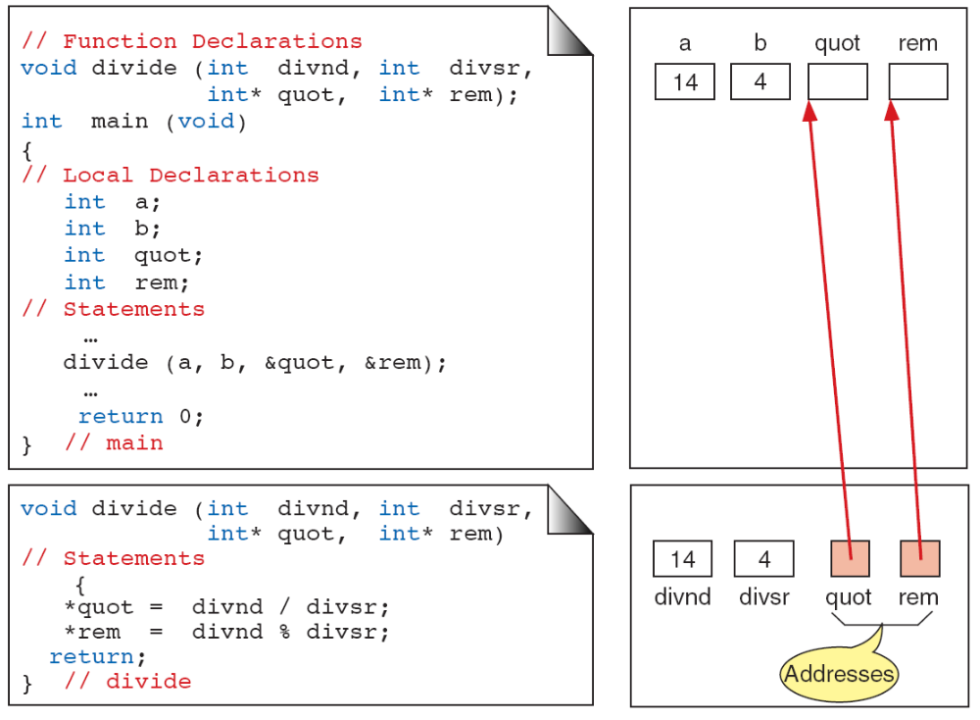
FIGURE 4-24 Calculate Quotient and Remainder
Computer Science: A Structured Programming Approach Using C

Slide 12
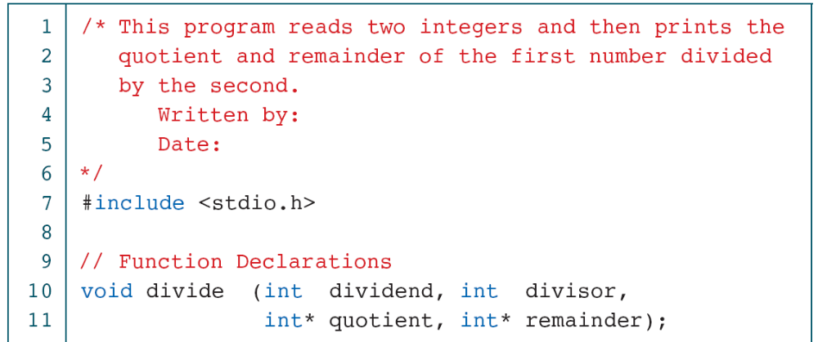
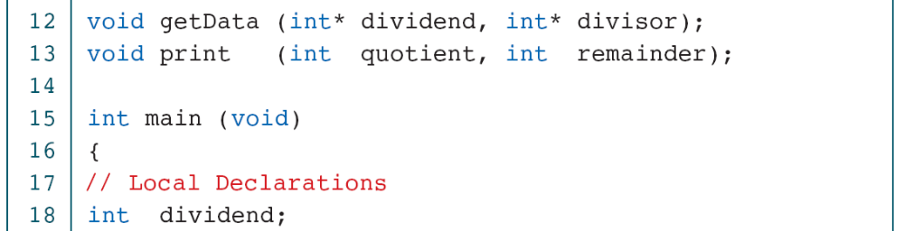
PROGRAM 4-8
Quotient and Remainder
Computer Science: A Structured Programming Approach Using C

Slide 13
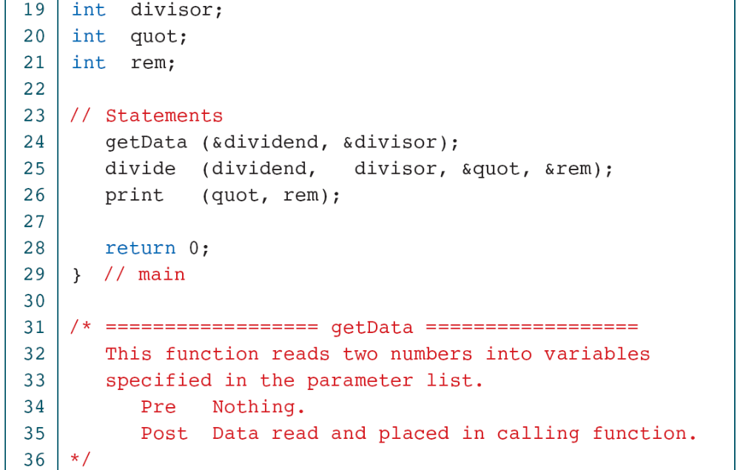
PROGRAM 4-8
Quotient and Remainder
Computer Science: A Structured Programming Approach Using C

Slide 14
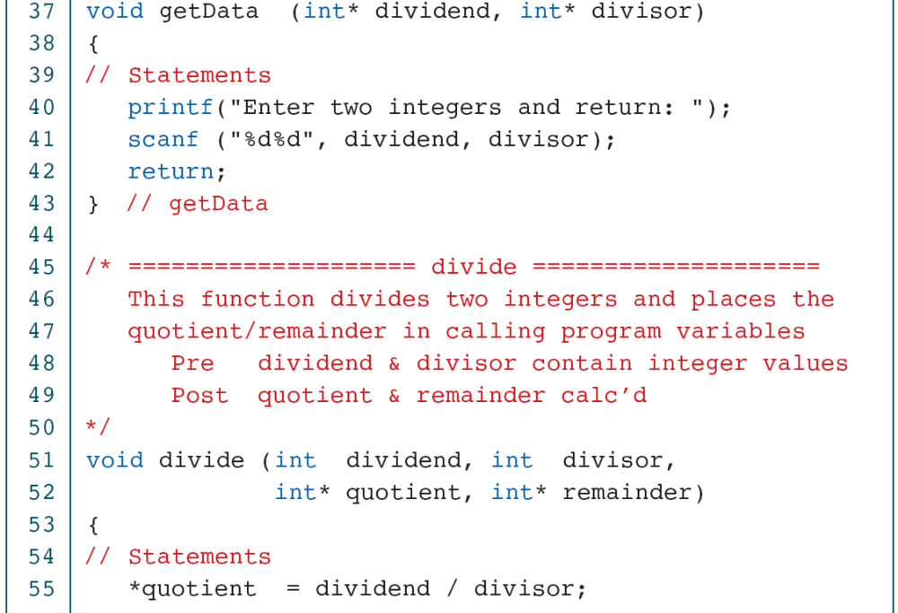
PROGRAM 4-8
Quotient and Remainder
Computer Science: A Structured Programming Approach Using C

Slide 15
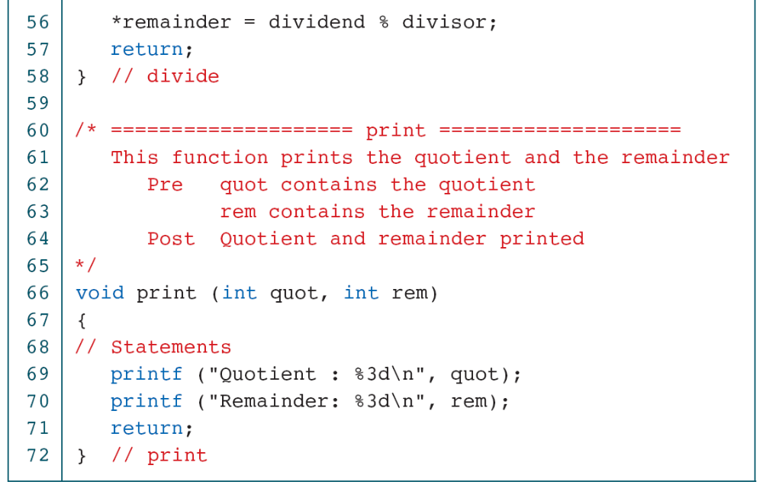
PROGRAM 4-8
Quotient and Remainder
Computer Science: A Structured Programming Approach Using C

