Slide 1
4-5 Standard Functions
C provides a rich collection of standard functions whose definitions have been written and are ready to be used in our programs. To use these functions, we must include their function declarations.
Topics discussed in this section:
Math Functions
Random Numbers
Computer Science: A Structured Programming Approach Using C

Slide 2
FIGURE 4-26 Library Functions and the Linker
Computer Science: A Structured Programming Approach Using C

Slide 3
Some functions
#include<stdlib.h> abs() int = abs(int) rand() srand()
Others: malloc, qsort, etc.
Computer Science: A Structured Programming Approach Using C

Slide 4
Math functions
#include <math.h> trig: cos(), etc. pow(base, exp); log, exp, etc. sqrt() ceil(), floor(), trunc(), round(), etc.
Computer Science: A Structured Programming Approach Using C

Slide 5
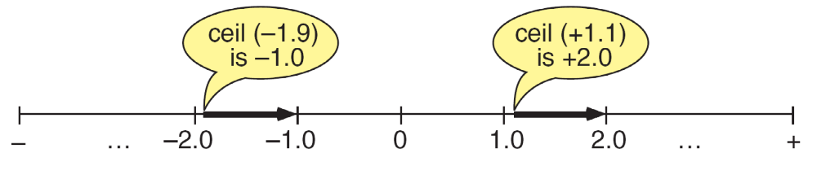
FIGURE 4-27 Ceiling Function
Computer Science: A Structured Programming Approach Using C

Slide 6
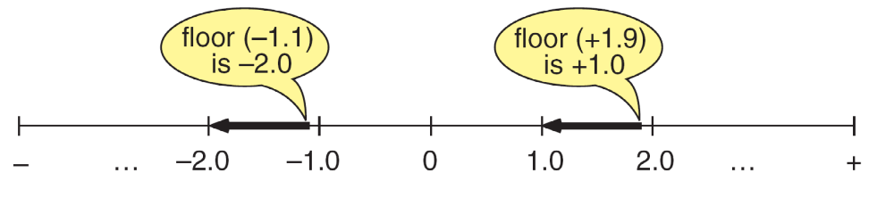
FIGURE 4-28 Floor Function
Computer Science: A Structured Programming Approach Using C

Slide 7

FIGURE 4-29 Random Number Generation
Computer Science: A Structured Programming Approach Using C

Slide 8
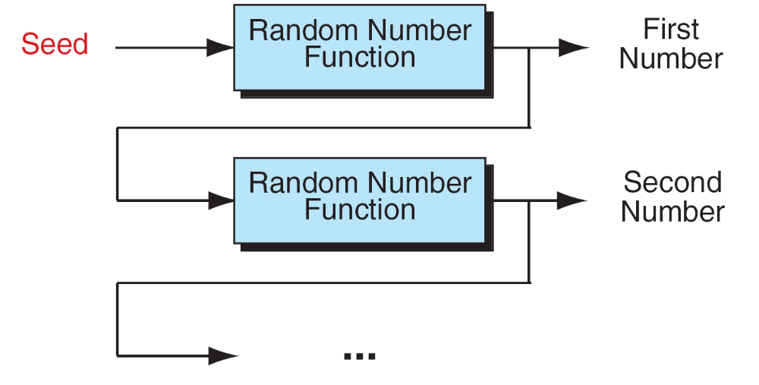
FIGURE 4-30 Generating a Random Number Series
Computer Science: A Structured Programming Approach Using C

Slide 9
Note
srand must be called only once for each random
number series.
Computer Science: A Structured Programming Approach Using C

Slide 10
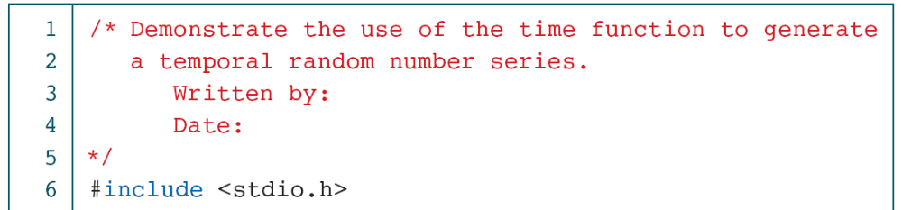
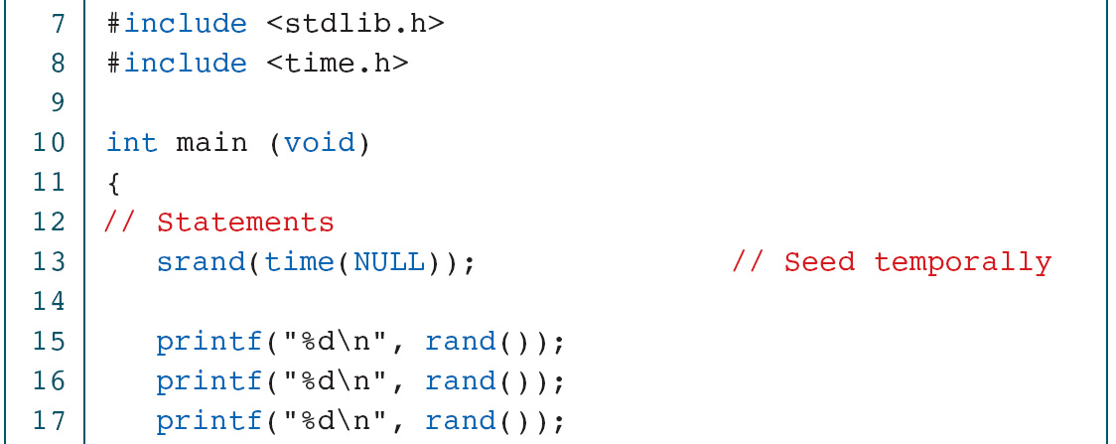
PROGRAM 4-9
Creating Temporal Random Numbers
Computer Science: A Structured Programming Approach Using C

Slide 11
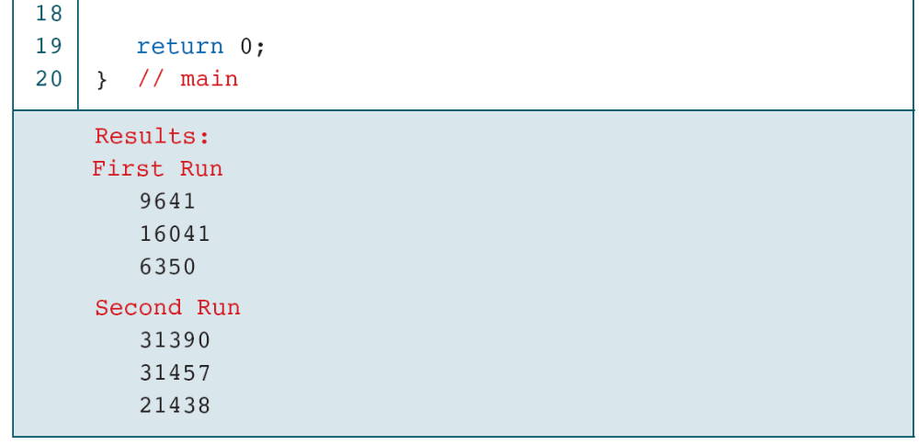
PROGRAM 4-9
Creating Temporal Random Numbers
Computer Science: A Structured Programming Approach Using C

Slide 12
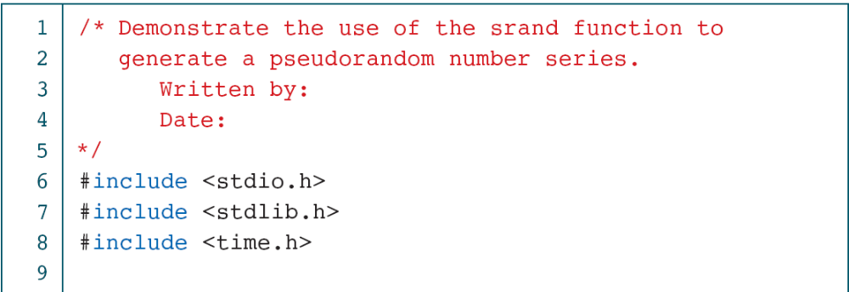
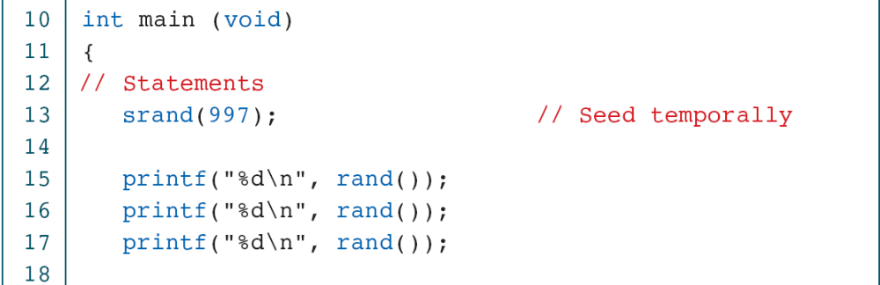
PROGRAM 4-10
Creating Pseudorandom Numbers
Computer Science: A Structured Programming Approach Using C

Slide 13
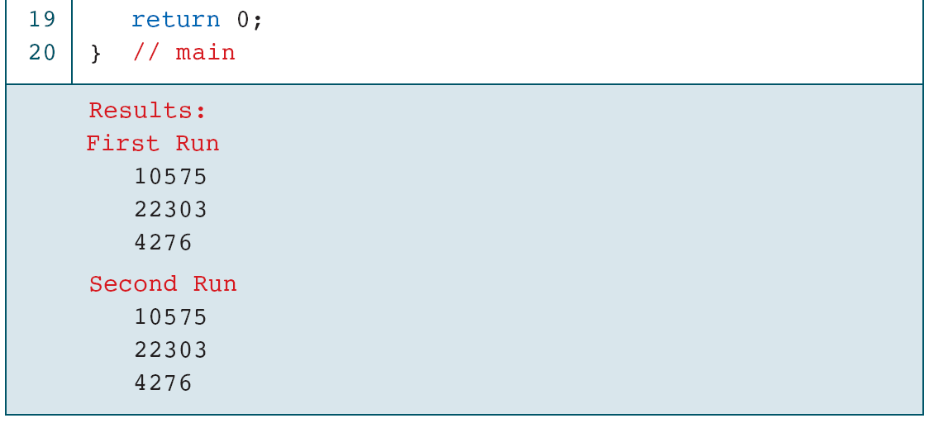
PROGRAM 4-10
Creating Pseudorandom Numbers
Computer Science: A Structured Programming Approach Using C

Slide 14
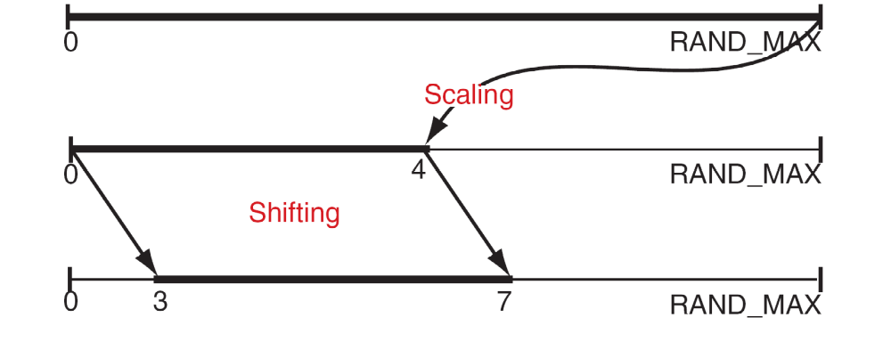
FIGURE 4-31 Random Number Scaling for 3–7
Computer Science: A Structured Programming Approach Using C

Slide 15
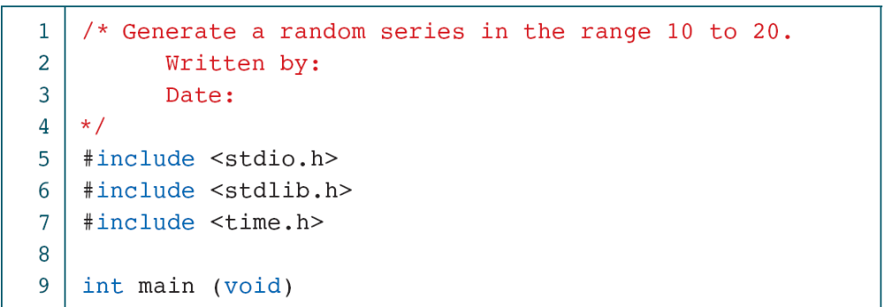
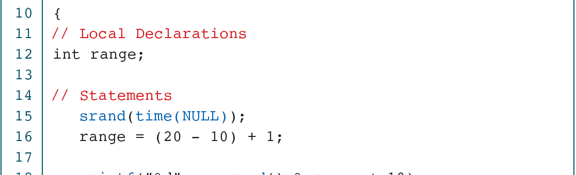
PROGRAM 4-11
Generating Random Numbers in the Range 10 to 20
Computer Science: A Structured Programming Approach Using C

Slide 16
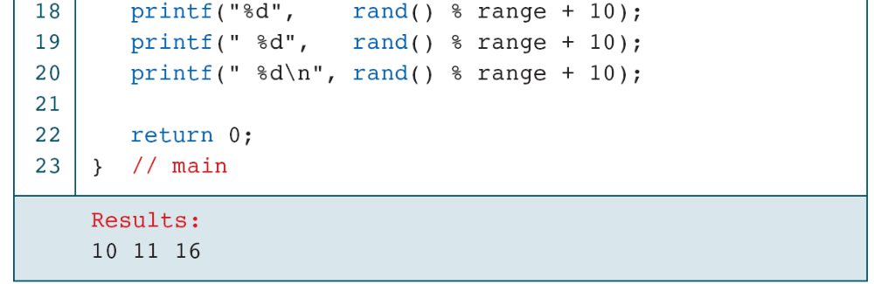
PROGRAM 4-11
Generating Random Numbers in the Range 10 to 20
Computer Science: A Structured Programming Approach Using C

Slide 17
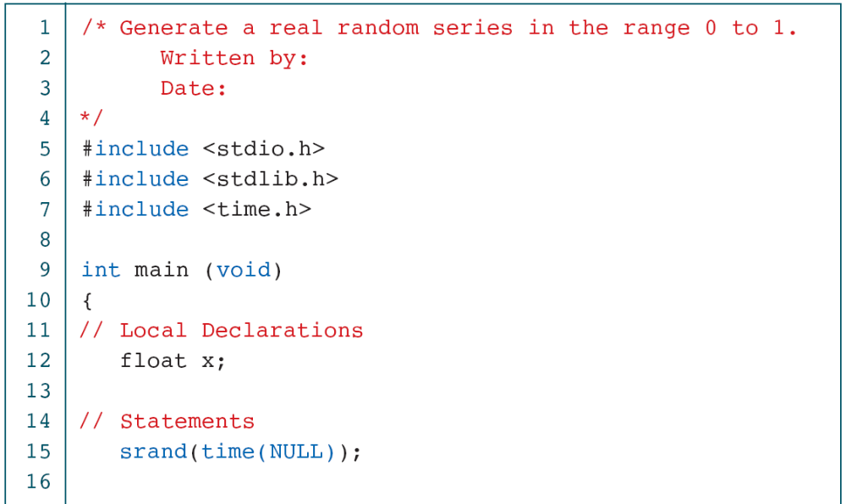
PROGRAM 4-12
Generating Random Real Numbers
Computer Science: A Structured Programming Approach Using C

Slide 18
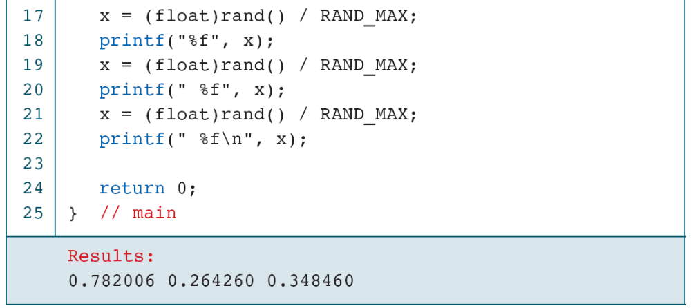
PROGRAM 4-12
Generating Random Real Numbers
Computer Science: A Structured Programming Approach Using C

