Slide 1
8-7 Two-Dimensional Arrays
The arrays we have discussed so far are known as one-dimensional arrays because the data are organized linearly in only one direction. Many applications require that data be stored in more than one dimension. One common example is a table, which is an array that consists of rows and columns.
Topics discussed in this section:
Declaration
Passing A Two-Dimensional Array
Computer Science: A Structured Programming Approach Using C

Slide 2
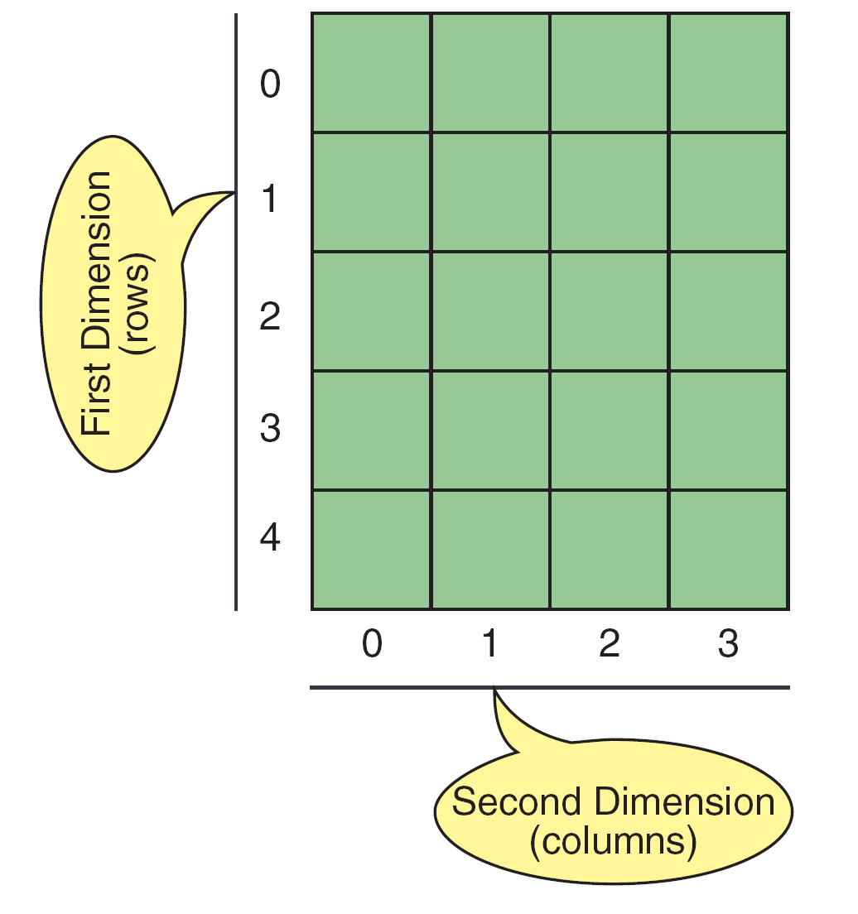
FIGURE 8-34 Two-dimensional Array
Computer Science: A Structured Programming Approach Using C

Slide 3
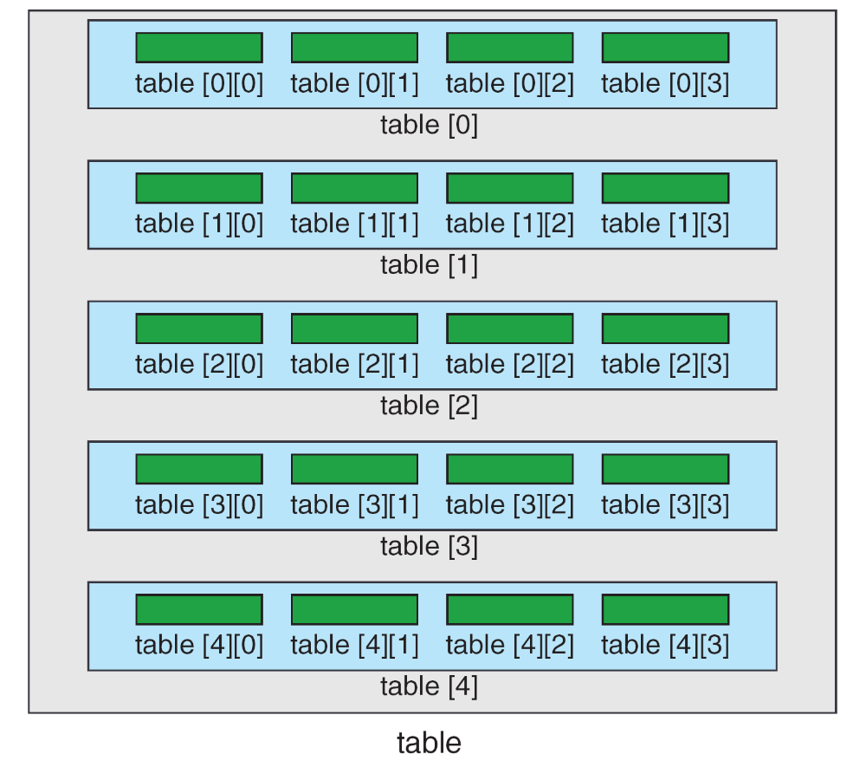
FIGURE 8-35 Array Of Arrays
Computer Science: A Structured Programming Approach Using C

Slide 4
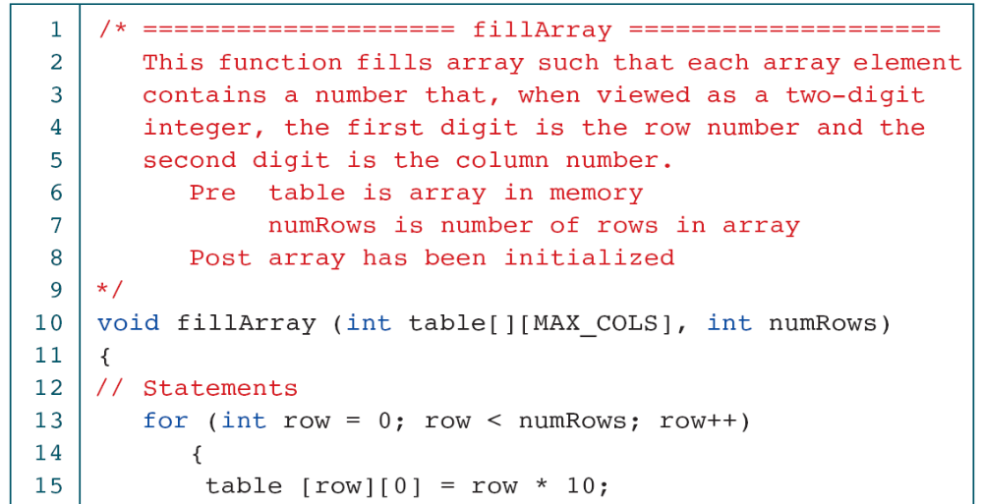
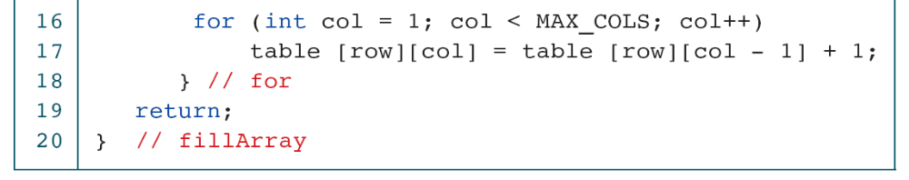
PROGRAM 8-15
Fill Two-dimensional Array
Computer Science: A Structured Programming Approach Using C

Slide 5
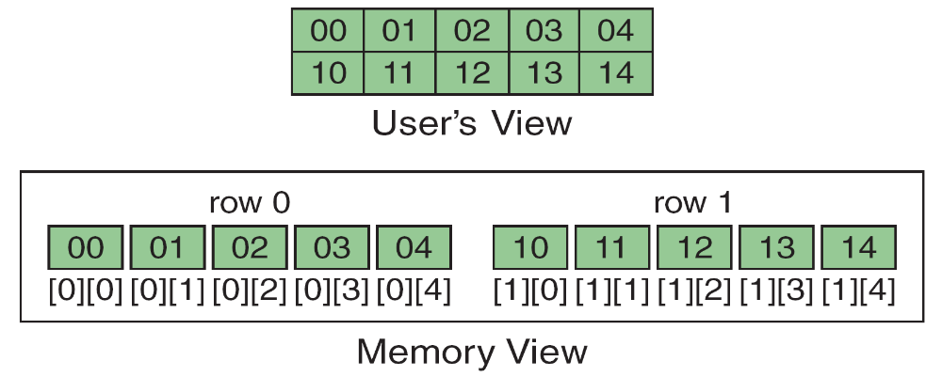
FIGURE 8-36 Memory Layout
Computer Science: A Structured Programming Approach Using C

Slide 6
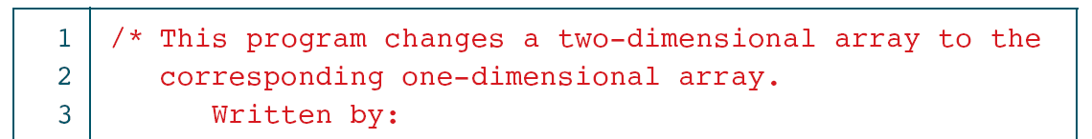
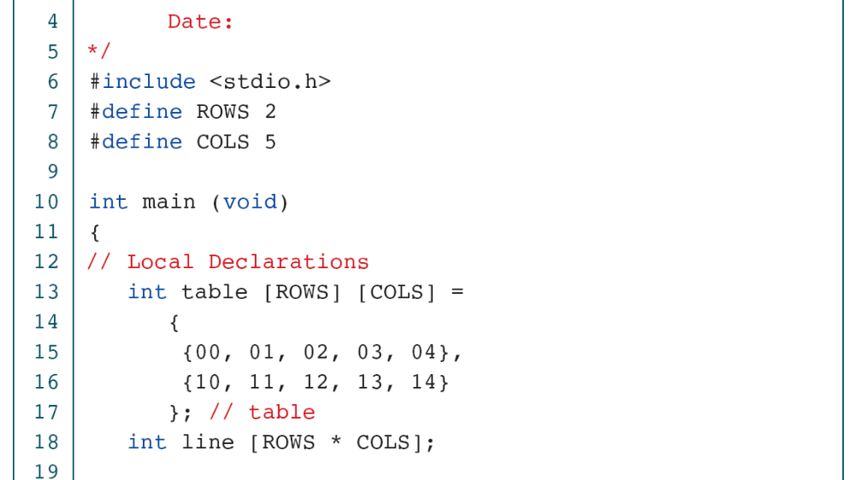
PROGRAM 8-16
Convert Table to One-dimensional Array
Computer Science: A Structured Programming Approach Using C

Slide 7
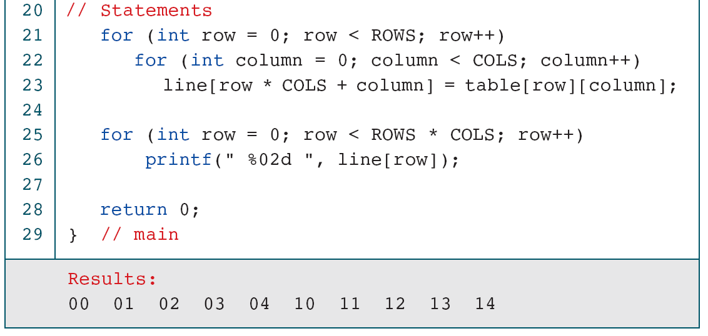
PROGRAM 8-16
Convert Table to One-dimensional Array
Computer Science: A Structured Programming Approach Using C

Slide 8
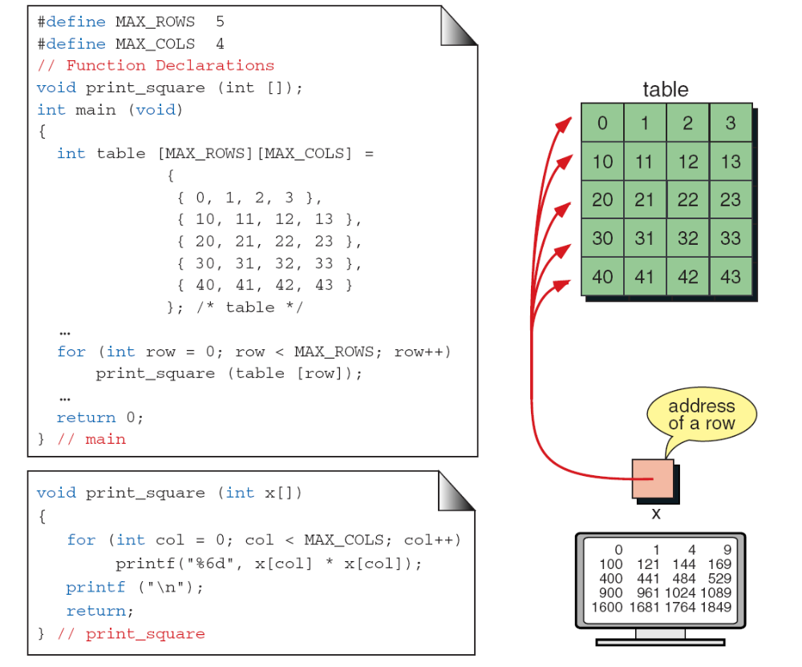
FIGURE 8-37 Passing a Row
Computer Science: A Structured Programming Approach Using C

Slide 9
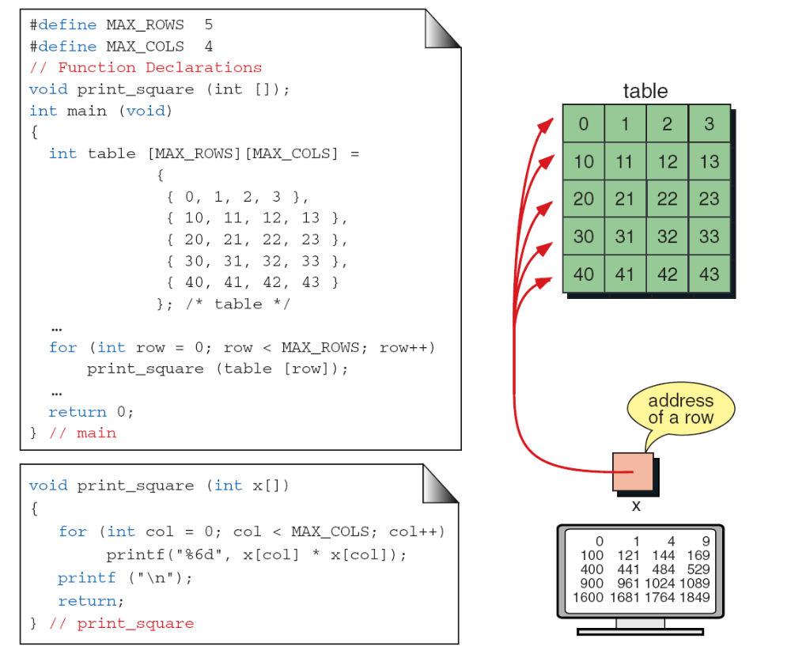
FIGURE 8-38 Calculate Average of Integers in Array
Computer Science: A Structured Programming Approach Using C

Slide 10
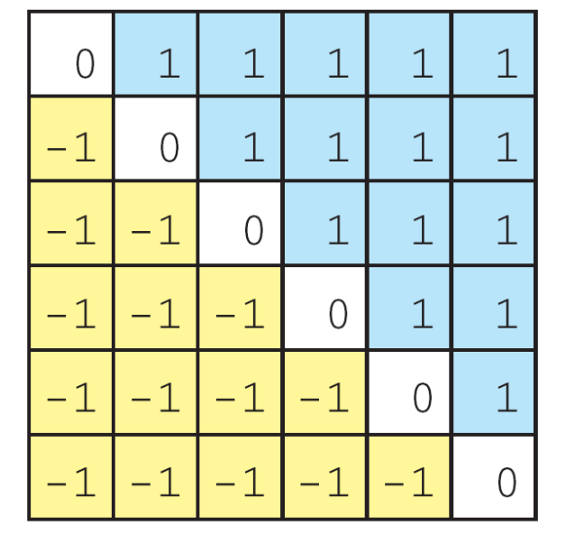
FIGURE 8-39 Example of Filled Matrix
Computer Science: A Structured Programming Approach Using C

Slide 11
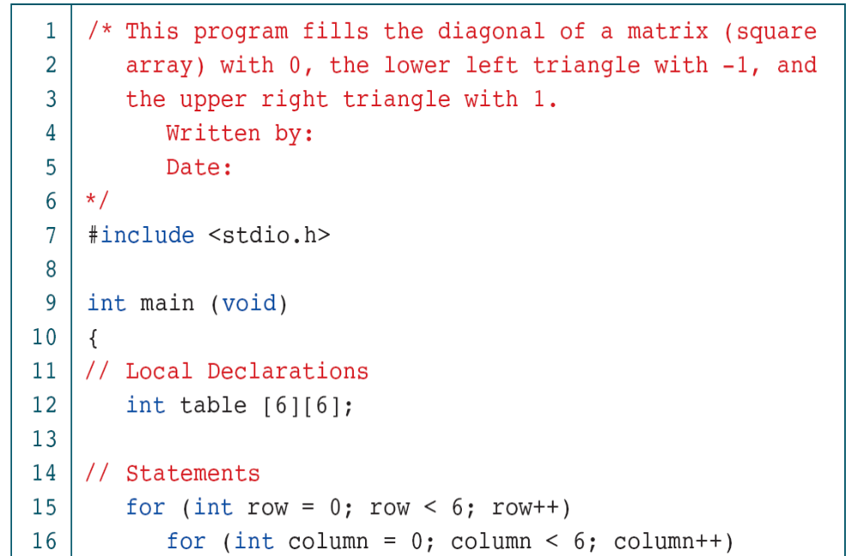
PROGRAM 8-17
Fill Matrix
Computer Science: A Structured Programming Approach Using C

Slide 12
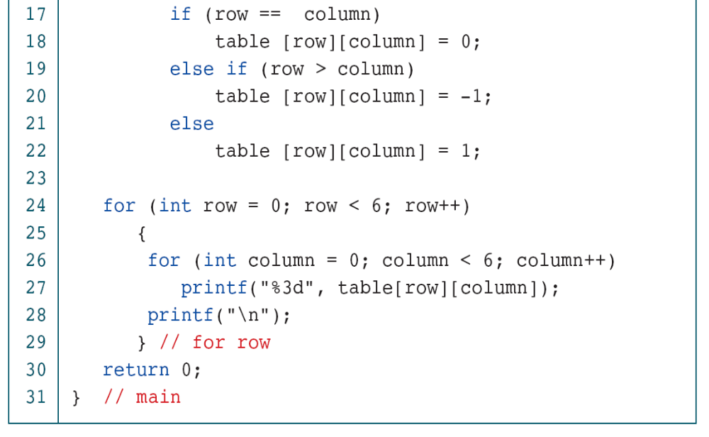
PROGRAM 8-17
Fill Matrix
Computer Science: A Structured Programming Approach Using C

Slide 13
8-8 Multidimensional Arrays
Multidimensional arrays can have three, four, or more dimensions. The first dimension is called a plane, which consists of rows and columns. The C language considers the three-dimensional array to be an array of two-dimensional arrays.
Topics discussed in this section:
Declaring Multidimensional Arrays
Computer Science: A Structured Programming Approach Using C

Slide 14
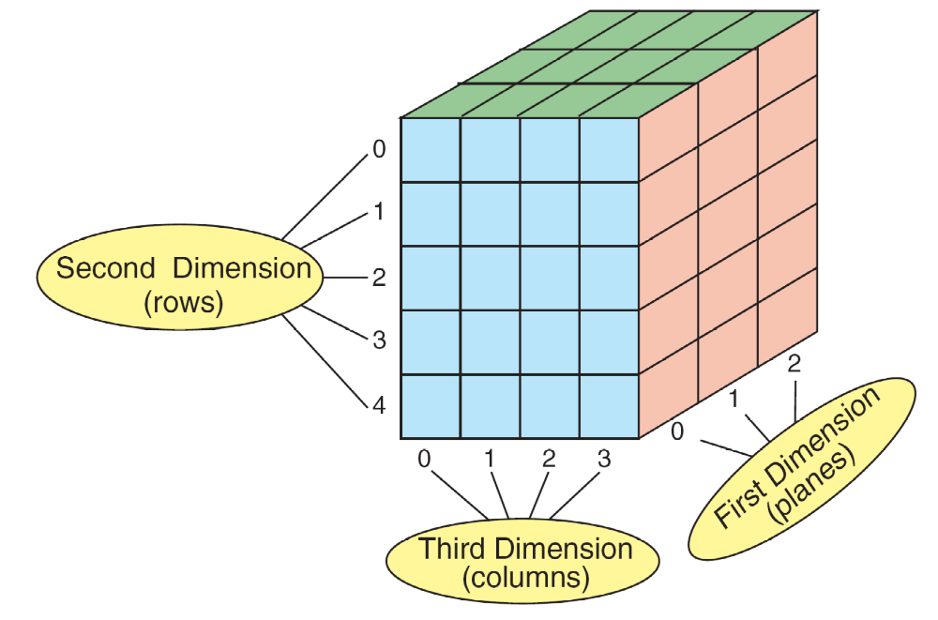
FIGURE 8-40 A Three-dimensional Array (3 x 5 x 4)
Computer Science: A Structured Programming Approach Using C

Slide 15
FIGURE 8-41 C View of Three-dimensional Array
Computer Science: A Structured Programming Approach Using C

Slide 16
8-9 Programming Example—
Calculate Averages
We previously introduced the programming concept known as incremental development. In this chapter we develop an example—calculate average—that contains many of the programming techniques.
Topics discussed in this section:
First Increment: mainYour First C
Second Increment: Get Data
Third Increment: Calculate Row Averages
Fourth Increment: Calculate Column Averages
Fifth Increment: Print Tables
Computer Science: A Structured Programming Approach Using C

Slide 17
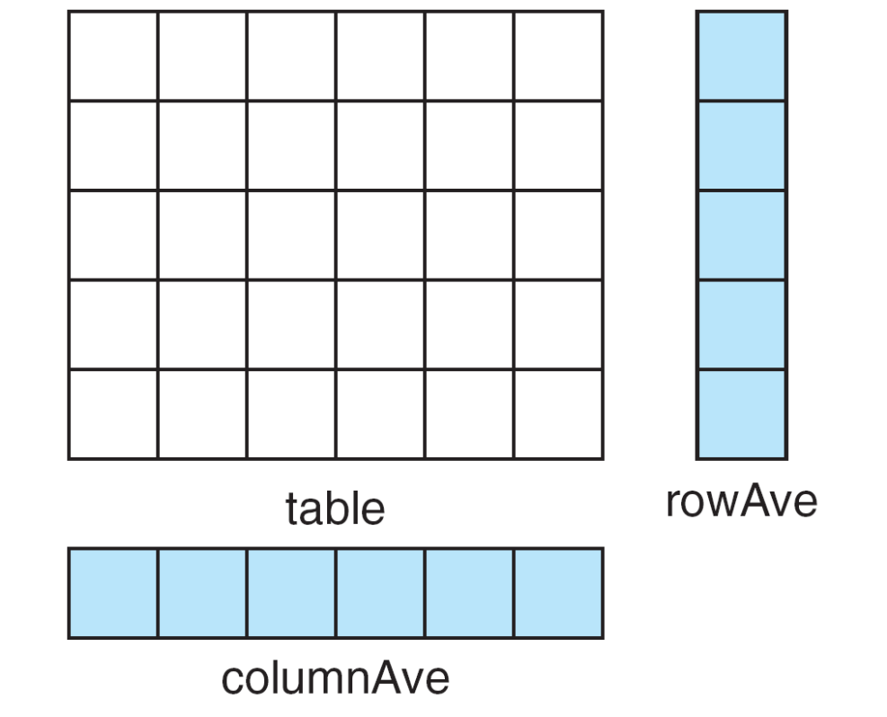
FIGURE 8-42 Data Structures For Calculate Row–Column Averages
Computer Science: A Structured Programming Approach Using C

Slide 18
PROGRAM 8-18
Calculate Row and Column Averages: main
Computer Science: A Structured Programming Approach Using C

Slide 19
PROGRAM 8-19
Calculate Row and Column Averages: Get Data
Computer Science: A Structured Programming Approach Using C

Slide 20
PROGRAM 8-19
Calculate Row and Column Averages: Get Data
Computer Science: A Structured Programming Approach Using C

Slide 21
PROGRAM 8-19
Calculate Row and Column Averages: Get Data
Computer Science: A Structured Programming Approach Using C

Slide 22
PROGRAM 8-19
Calculate Row and Column Averages: Get Data
Computer Science: A Structured Programming Approach Using C

Slide 23
PROGRAM 8-20
Calculate Row and Column Averages: Row Averages
Computer Science: A Structured Programming Approach Using C

Slide 24
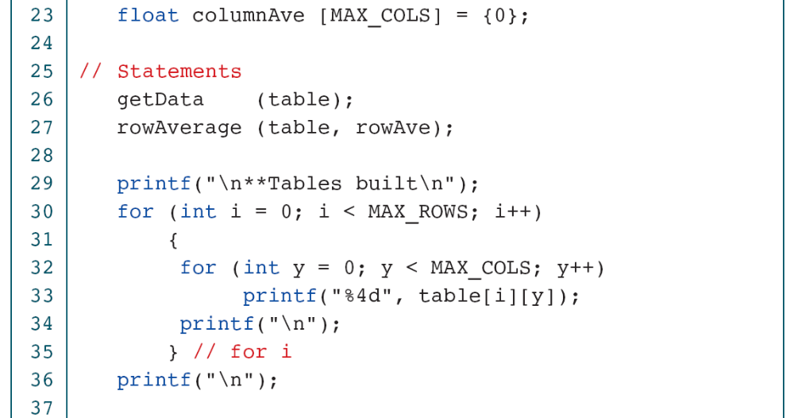
PROGRAM 8-20
Calculate Row and Column Averages: Row Averages
Computer Science: A Structured Programming Approach Using C

Slide 25
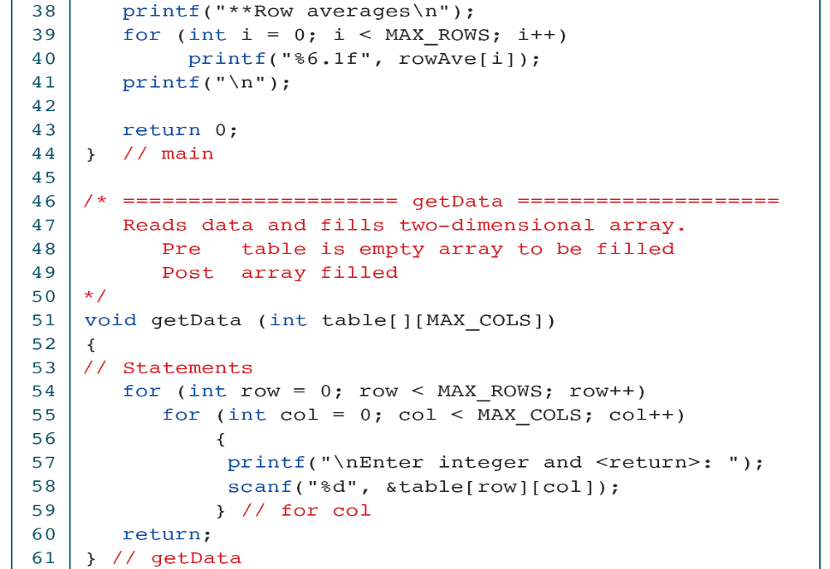
PROGRAM 8-20
Calculate Row and Column Averages: Row Averages
Computer Science: A Structured Programming Approach Using C

Slide 26
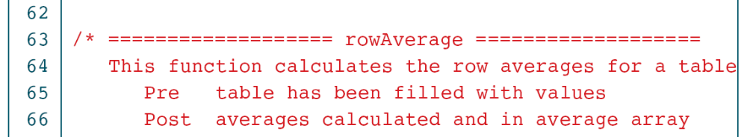
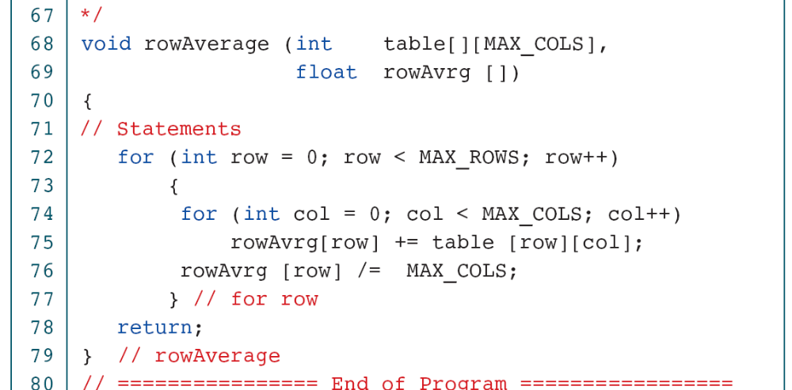
PROGRAM 8-20
Calculate Row and Column Averages: Row Averages
Computer Science: A Structured Programming Approach Using C

Slide 27
PROGRAM 8-20
Calculate Row and Column Averages: Row Averages
Computer Science: A Structured Programming Approach Using C

Slide 28
Note
The efficiency of the bubble sort is O(n²).
Computer Science: A Structured Programming Approach Using C

Slide 29
Note
The efficiency of the selection sort is O(n²).
Computer Science: A Structured Programming Approach Using C

Slide 30
Note
The efficiency of the insertion sort is O(n²).
Computer Science: A Structured Programming Approach Using C

Slide 31
Note
The efficiency of the sequential search is O(n).
Computer Science: A Structured Programming Approach Using C

Slide 32
Note
The efficiency of the binary search is O(logn).
Computer Science: A Structured Programming Approach Using C

Slide 33
Table 8-4
Comparison of binary and sequential searches
Computer Science: A Structured Programming Approach Using C

